Slide 1
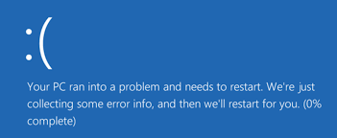
Investigate Data Leakage Case
Find deleted file information in $LogFile
Keywords: Burning CD-R, NTFS file system metadata log ($LogFile)
Notes:
all metadata changes to a file system are logged to ensure the consistent recovery of critical file system structures after a system crash.
https://dfir.ru/2019/02/16/how-the-logfile-works/

Slide 2


MFT is a tree
0
The Master File Table (MFT) in the NTFS file system is a tree structure
  uses a B*-tree structure to store indexes for directories and files.
  A B*-tree is a tree structure based on the B+ tree data structure
A tree structure for Efficient searching
  Nodes are metadata of files and directories
  Edges are relationships between nodes
    a folder contains files/a file is stored inside of a folder
  Edge is a pair of nodes
    (file -- folder) or (inode of a file – inode of a folder)
1
4

Slide 3
Edges in MFT is important
0
NTFS keeps track of edge (relationships) for reasons
  File system integrity (prevent improper referencing of files and directories)
  Security and access control
  File system utilities (disk space analysis)
  Efficient file operations
  File recovery (add recovered files to the correct folder)
Also important for digital forensics
  when relationships are missing because of deletion
1
4

Slide 4
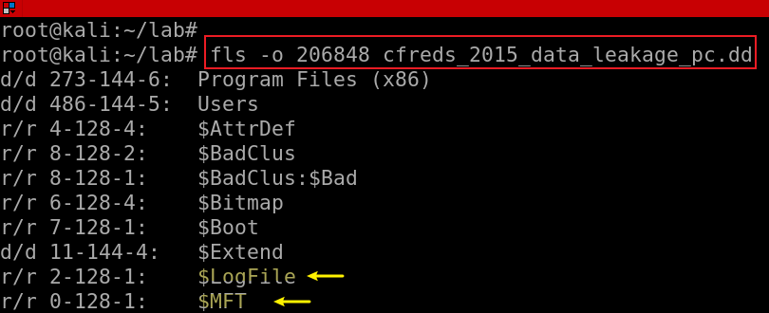
Who tracks edge relationships
Master File Table (MFT): primary data structure
  File System Metadata
Change Journal (Update Sequence Number Journaling)
NTFS log ($LogFile): NTFS integrity
  records transactions and changes made to the file system.
Security Descriptor
  information about its security settings, ownership, and permissions.

Slide 5
Goal
Keep tracking of deleted files under a given folder
Key idea
  find the inode of the folder
  find the inode of a file
  check if the relationship exists for various logs (MTFT, USN Journal, $LogFile)

Slide 6
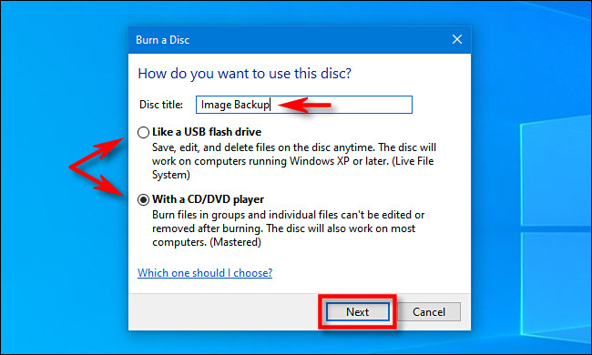
32. What a method (or software) was used for burning CD-R?
33. When did the suspect burn CD-R?
Windows 7+ comes with built in support for burning CD’s and DVD’s.
When insert a blank recordable CD or DVD into your optical drive
  Window titled “Burn a Disc” will appear.
  This dialog asks you how you want Windows to handle writing the disc.
Notes:
https://secureartisan.wordpress.com/2012/06/04/windows-7-cddvd-burning/#:~:text=Event%20ID%20133.&text=While%20there%20is%20no%20supporting,does%20not%20trigger%20this%20event.

Slide 7
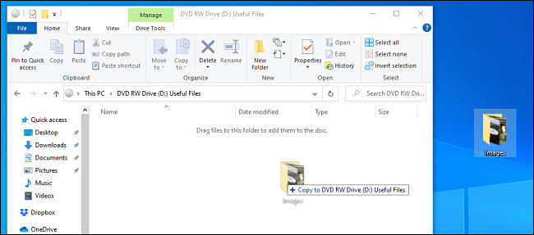
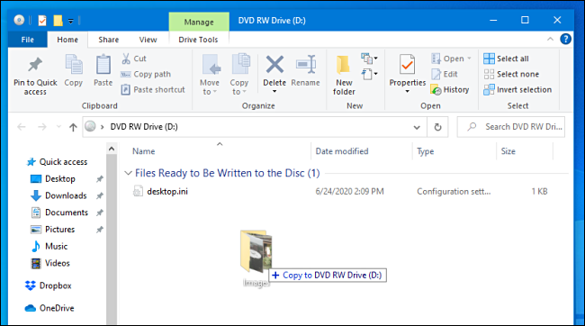
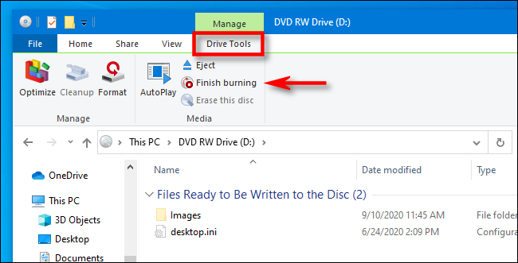
Two options for burning CD-R?
(Type 1) Like a USB flash drive: allows to write and erase files to the disc on-the-fly using a live file system. (can edit)
(Type 2) With a CD/DVD player: files are temporarily copied to a staging area on your hard disk first, then they are written to the disc all at once when you select “Burn” in File Explorer.
  Need to finalize or “master” the disc (read-only)
Both methods need to copy files to the burning directory => staging path
Notes:
https://www.howtogeek.com/689705/how-to-burn-a-cd-or-dvd-on-windows-10/#:~:text=Log%20into%20your%20Windows%20machine,to%20handle%20writing%20the%20disc.

Slide 8
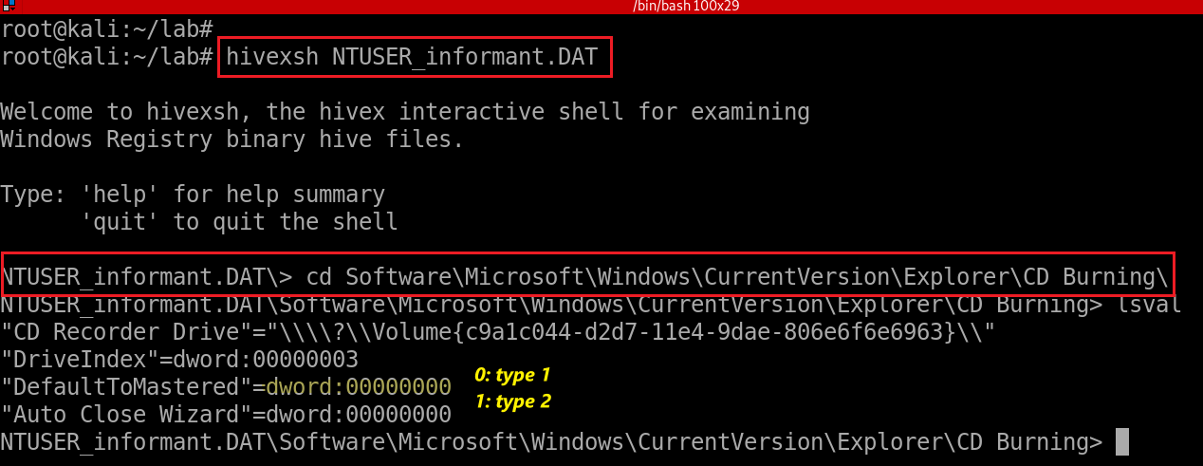

Find Last burning type from registry (type 1)
Check for last burning type from HKU\informant\Software\Microsoft\Windows\CurrentVersion\Explorer\CD Burning\
(False)
(True)
Read-only =False
Notes:
hivexsh NTUSER_informant.DAT
cd Software\Microsoft\Windows\CurrentVersion\Explorer\CD Burning\

Slide 9
Evidence locations
System event logs for burning CD
  Event IDs for Windows Vista or higher
  Event ID 133. Source/Provider Name "cdrom“
Default burning directory
  \User\informant\AppData\Local\Microsoft\Windows\Burn\Burn
NTFS journal file analysis
  \$LogFile
  \$Extend\$UsnJrnl·$J (+ $MFT for identifying full paths of files)
  DAT#####.tmp, DAT#####.tmp, FIL#####.tmp, POST#####.tmp

Slide 10
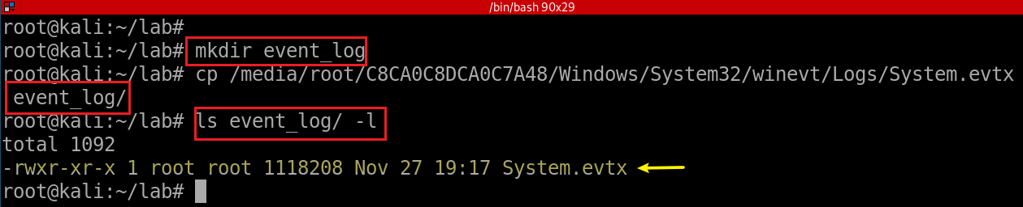
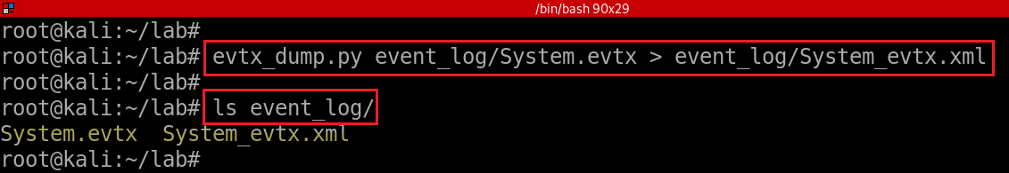
System event logs for burning CD
Copy system event to event_log folder
Extract system event
Notes:
cp /media/root/C8CA0C8DCA0C7A48/Windows/System32/winevt/Logs/System.evtx event_log/
evtx_dump.py event_log/System.evtx > event_log/System_evtx.xml
-rw-r--r-- 1 root root 1576272 Nov 23 18:24 event_log/System_evtx.xml

Slide 11
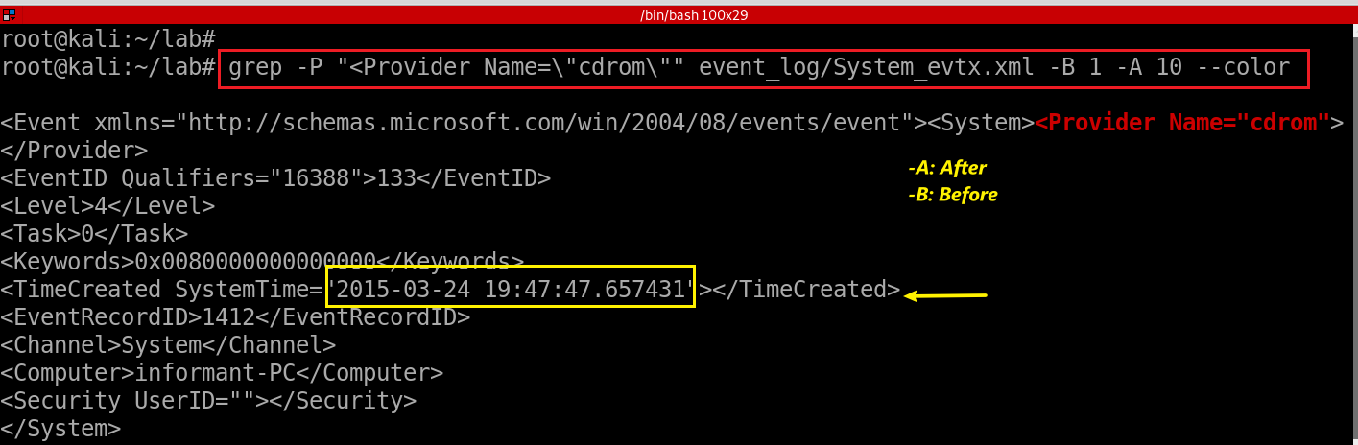
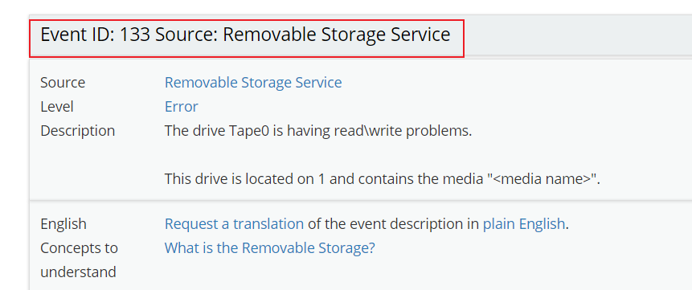
Search for event provider’s name “cdrom”
http://eventid.net/display-eventid-133-source-Removable+Storage+Service-eventno-3918-phase-1.htm
Notes:
grep -P "<Provider Name=\"cdrom\"" event_log/System_evtx.xml -B 1 -A 10 --color

Slide 12

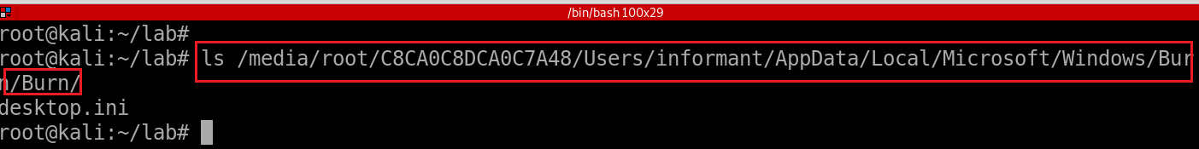
34. What files were copied from PC to CD-R?
Equivalent to tracing what files have been deleted from the burning directory
Show staging area but nothing there because all files will be deleted after burn
Notes:
fls -o 206848 cfreds_2015_data_leakage_pc.dd
http://az4n6.blogspot.com/2015/09/whos-your-master-mft-parsers-reviewed.html

Slide 13

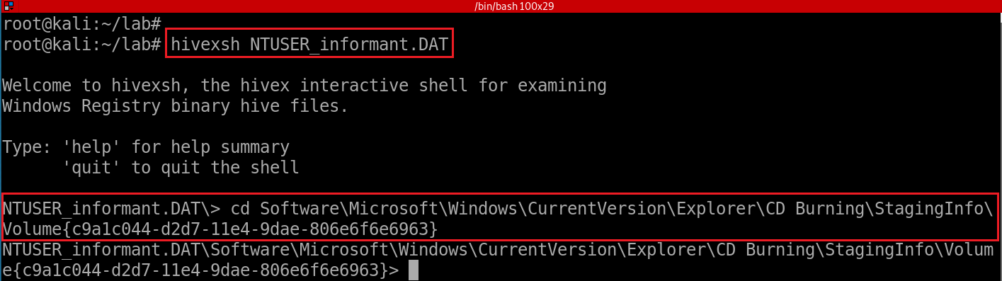
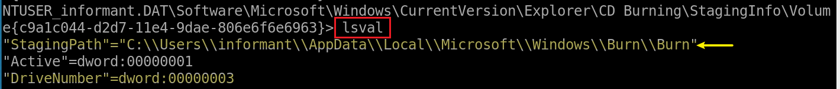
How to find staging area /burn/burn in registry
HKEY_CURRENT_USER\Software\Microsoft\Windows\CurrentVersion\Explorer\CD Burning\
Show StagingPath
The value "StagingPath" is significant. It shows the folder on the volume that is used to ‘stage’ files prior to committing them to the disc.
Notes:
hivexsh NTUSER_informant.DAT
cd Software\Microsoft\Windows\CurrentVersion\Explorer\CD Burning\StagingInfo\Volume{c9a1c044-d2d7-11e4-9dae-806e6f6e6963}

Slide 14








1
search for files which parent is the inode of staging area!
2
from
3
$UsnJrnl
$LogFile
Change log of volumes for backup
write-ahead log for recovering NTFS from crash (ensure file system integrity)
Notes:
fls -o 206848 cfreds_2015_data_leakage_pc.dd
http://az4n6.blogspot.com/2015/09/whos-your-master-mft-parsers-reviewed.html

Slide 15
Why can’t find inode of the staging area using fls? (1)

Slide 16

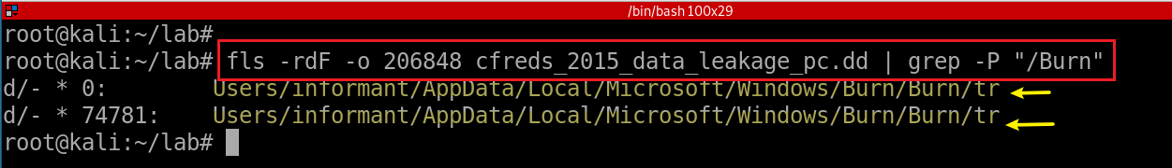
We can’t find the inode of the staging area using fls
The staging folder has been deleted
Notes:
ls /media/root/C8CA0C8DCA0C7A48/Users/informant/AppData/Local/Microsoft/Windows/Burn/Burn/
fls -rdF -o 206848 cfreds_2015_data_leakage_pc.dd | grep -P "/Burn"

Slide 17
$MFT, $UsnJrl, $LogFile
$MFT (a different method to find staging area information)
  provides only last modified/access time of a file
  Each $MFT entry = a file with attributes
$Extend$UsnJrnl·$J
  using bit flags
$LogFile: transaction log of NTFS for data integrity
  Save a few hours of activity recorded in a $LogFile.
  $LogFile associate with $MFT and $UsnJrnl
$LogFile : journal that records the metadata transactions
  The creation of file/directory
  The deletion of file/directory
  Moving File/Directory
  The modification of $data
  The modification of MFT entry
Notes:
fls -o 206848 cfreds_2015_data_leakage_pc.dd
http://az4n6.blogspot.com/2015/09/whos-your-master-mft-parsers-reviewed.html

Slide 18
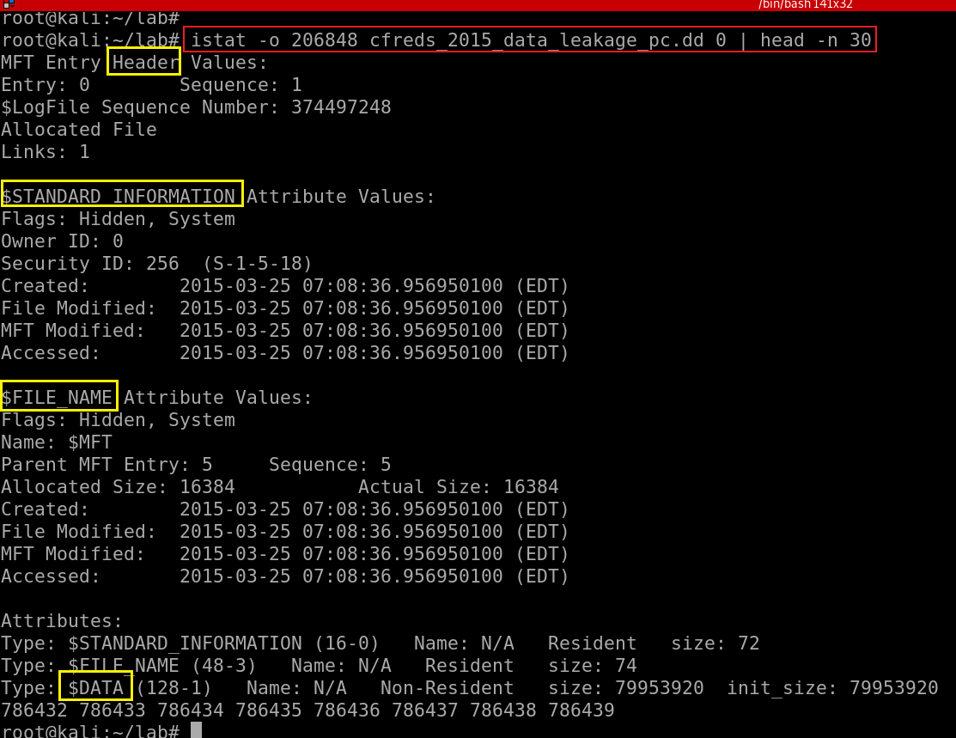
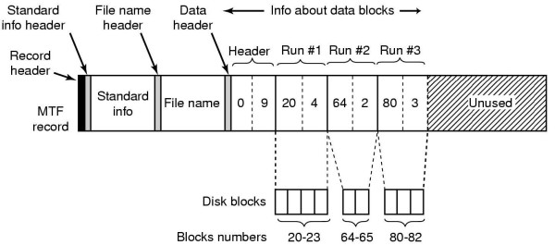
34.1 $MFT (Master File Table) Entry
0: Entry number (the $MFT itself)
One MFT entry = one file (Except file content)
Each entry size = 1K
first 16 MFT entries for special metadata files
M – Modified : When the contents of a file were last changed.
A – Accessed : When the contents of a file were accessed/read.
C – Created : When the file was created.
E – Entry Modified : When the MFT record associated with the file changed.
Notes:
https://countuponsecurity.com/2015/11/10/digital-forensics-ntfs-metadata-timeline-creation/
https://flatcap.org/linux-ntfs/ntfs/attributes/standard_information.html

Slide 19
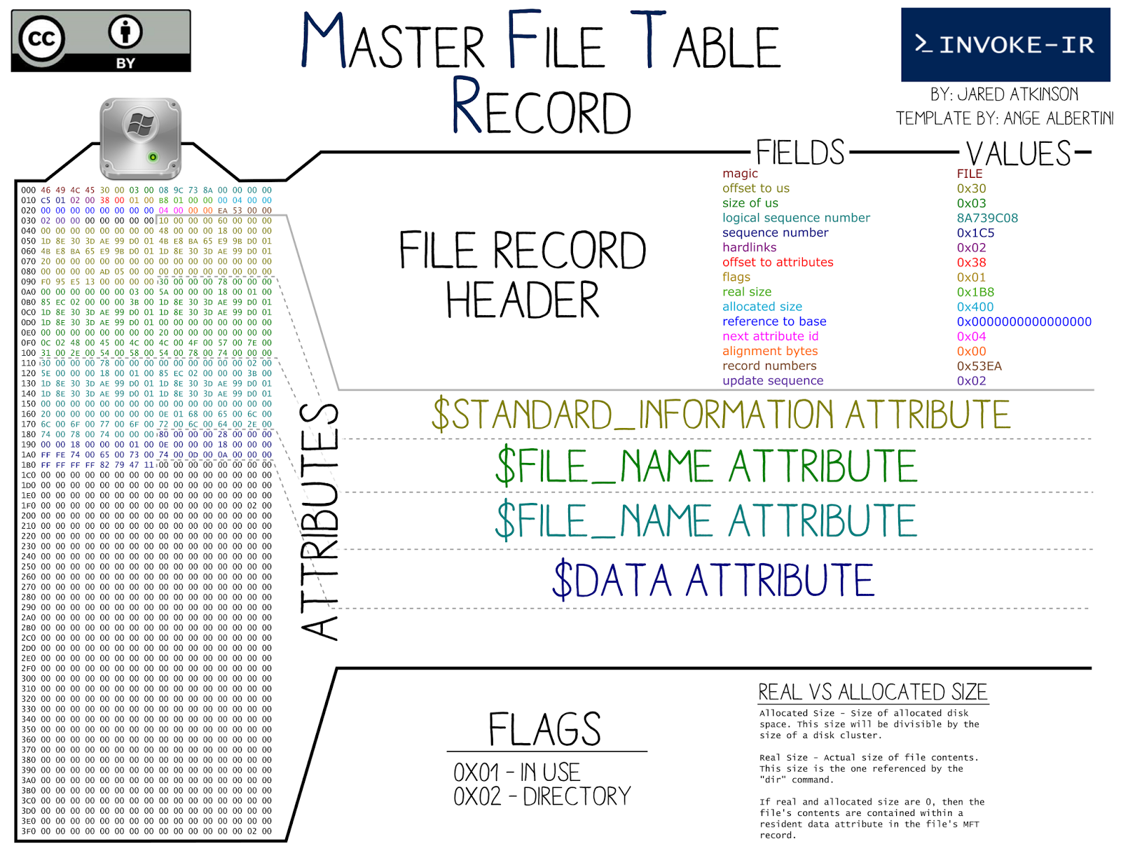

Slide 20
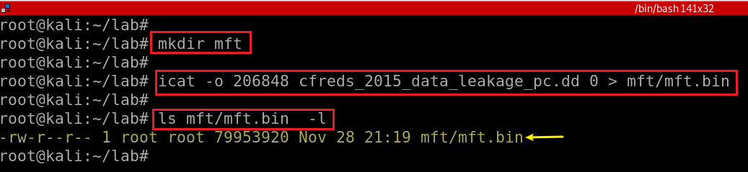
Find Burn/Burn MFT entry ID using analyzeMFT
analyzeMFT is designed to fully parse the MFT file from an NTFS filesystem
  present the results in multiple formats.
Extract $MFT (entry 0) from DD image
Notes:
icat -o 206848 cfreds_2015_data_leakage_pc.dd 0 > mft/mft.bin

Slide 21

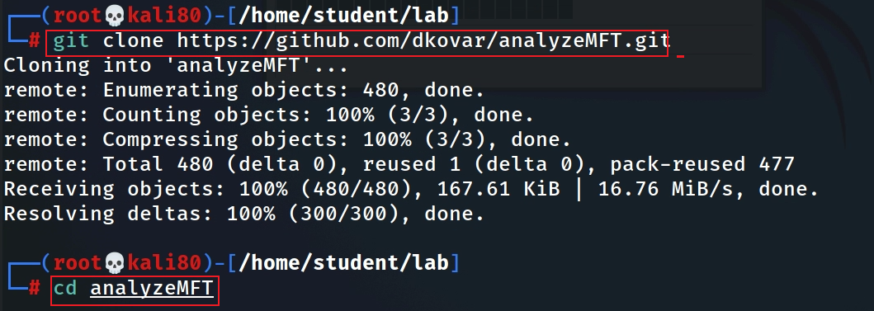
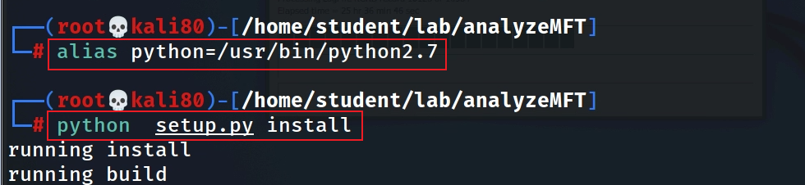
Install $MFT analyze tool
Download from github
install analyzeMFT
analyzeMFT only supports python2.x. So, we have to point the current Python environment to python2.7
use unalias to remove the alias
Notes:
git clone https://github.com/dkovar/analyzeMFT.git
cd analyzeMFT

Slide 22
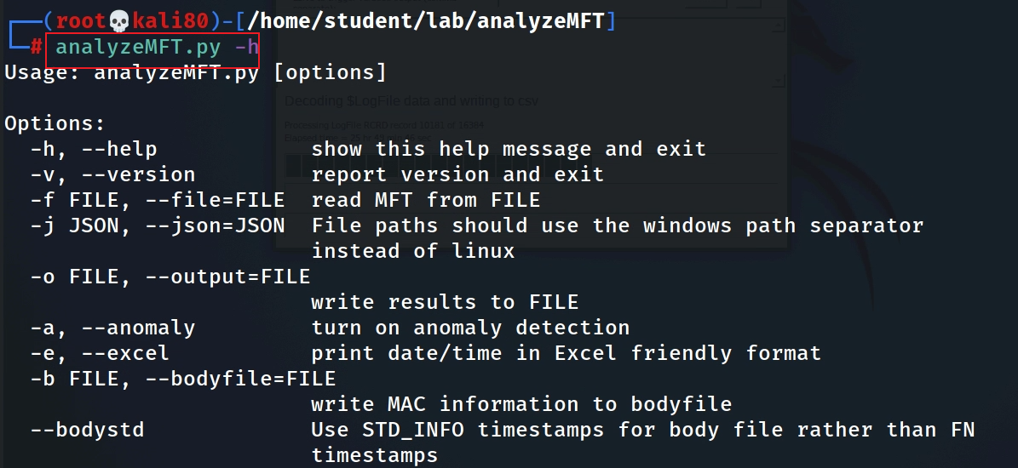
Test MFT analyze tool
Notes:
pip install analyzeMFT

Slide 23

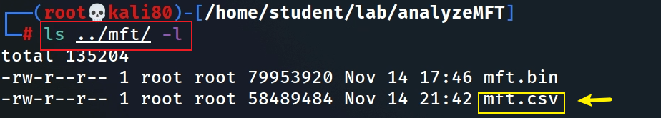
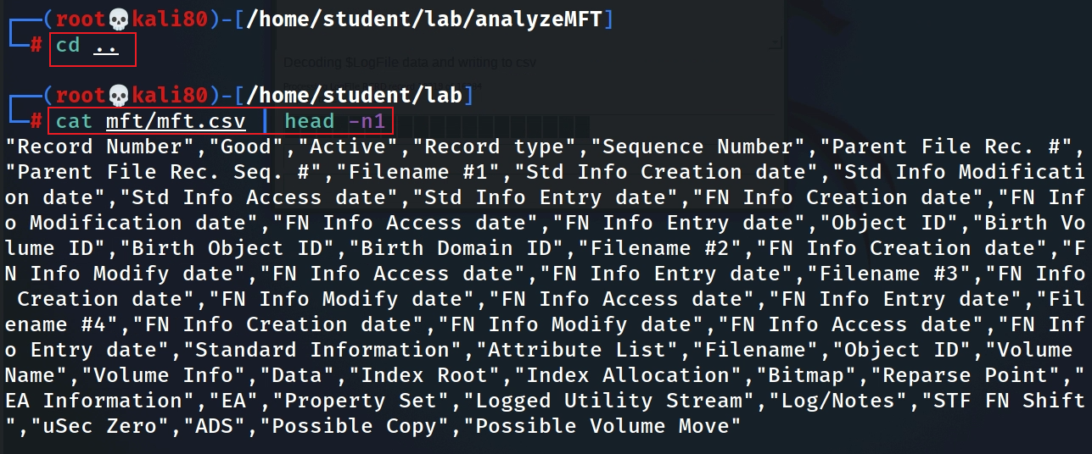
Convert $MFT to .csv
https://www.dropbox.com/s/6sjdecon9c1f7rl/mft.csv
https://raw.githubusercontent.com/frankwxu/digital-forensics-lab/main/NIST_Data_Leakage_Case/NIST_Answers/lab_generated_file/mft.zip
Show $MFT column names
1,4,6,8,11
Notes:
awk -e '$1 ~/informant.*\/Burn/ {print $1}' mft/mft.csv
"Record Number","Good","Active","Record type","Sequence Number","Parent File Rec. #","Parent File Rec. Seq. #","Filename #1","Std Info Creation date","Std Info Modification date","Std Info Access date","Std Info Entry date","FN Info Creation date","FN Info Modification date","FN Info Access date","FN Info Entry date","Object ID","Birth Volume ID","Birth Object ID","Birth Domain ID","Filename #2","FN Info Creation date","FN Info Modify date","FN Info Access date","FN Info Entry date","Filename #3","FN Info Creation date","FN Info Modify date","FN Info Access date","FN Info Entry date","Filename #4","FN Info Creation date","FN Info Modify date","FN Info Access date","FN Info Entry date","Standard Information","Attribute List","Filename","Object ID","Volume Name","Volume Info","Data","Index Root","Index Allocation","Bitmap","Reparse Point","EA Information","EA","Property Set","Logged Utility Stream","Log/Notes","STF FN Shift","uSec Zero","ADS"

Slide 24
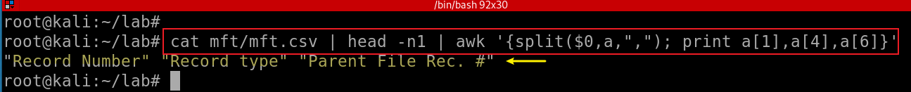
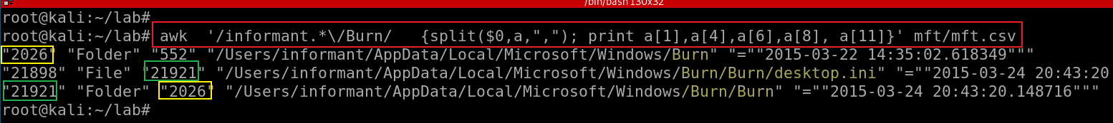

awk '{split($0, a, “,“ ) }’
^^ ^ ^
| | |
string | fieldsep
|
array to store results
Show fields 1: Record # (Entry #), 4: record type, 6: Parent File #
Search for Burn folder
$MFT entry 21921, which indicates the folder …/Burn/Burn
8: Filename #1",“
11:Std Info Access date
Notes: we can’t find any deleted files here, however, we can find entry ID (21921).
We will search for ID in $UsnJrnl·$J . Any files with the ID as the parent entry ID are deleted files (copied to CD).
Notes:
cat mft/mft.csv | head -n1 | awk '{split($0,a,","); print a[1],a[4],a[6]}‘
awk '/informant.*\/Burn/ {split($0,a,","); print a[1],a[4],a[6],a[8], a[11]}' mft/mft.csv

Slide 25
Search for files from $UsnJsl whose parent is the inode of the staging area! (2)

Slide 26
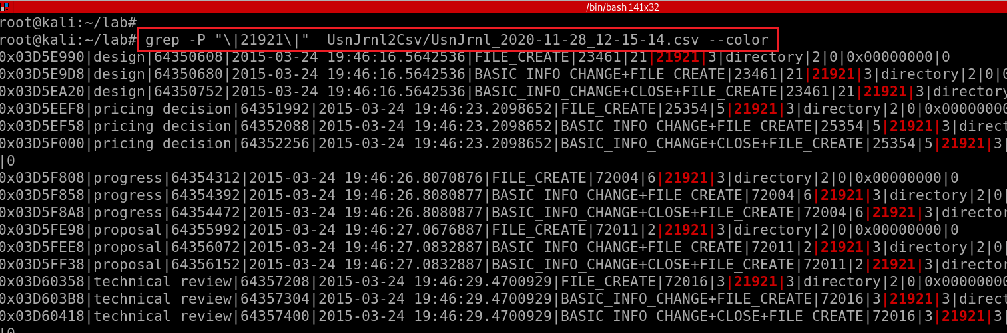
34.2 $Extend$UsnJrnl·$J (2)
the name is confusing: it is MFT entry ID
Offset|FileName|USN|Timestamp|Reason|MFTReference|MFTReferenceSeqNo|MFTParentReference|MFTParentReferenceSeqNo|FileAttributes|MajorVersion|MinorVersion|SourceInfo|SecurityId
https://www.dropbox.com/s/cbxcx1276udxrnn/UsnJrnl_2020-11-28_12-15-14.csv
Search for directories/files associated with entry ID /Burn/Burn 21921 in $UsnJrnl·$J
Your file name is different
the rest of screenshot is omitted. See next slide for summarized info
Notes:
grep -P "\|21921\|" UsnJrnl2Csv/UsnJrnl_2020-11-28_12-15-14.csv –color
https://docs.microsoft.com/en-us/windows/win32/api/winioctl/ns-winioctl-usn_record_v2?redirectedfrom=MSDN

Slide 27
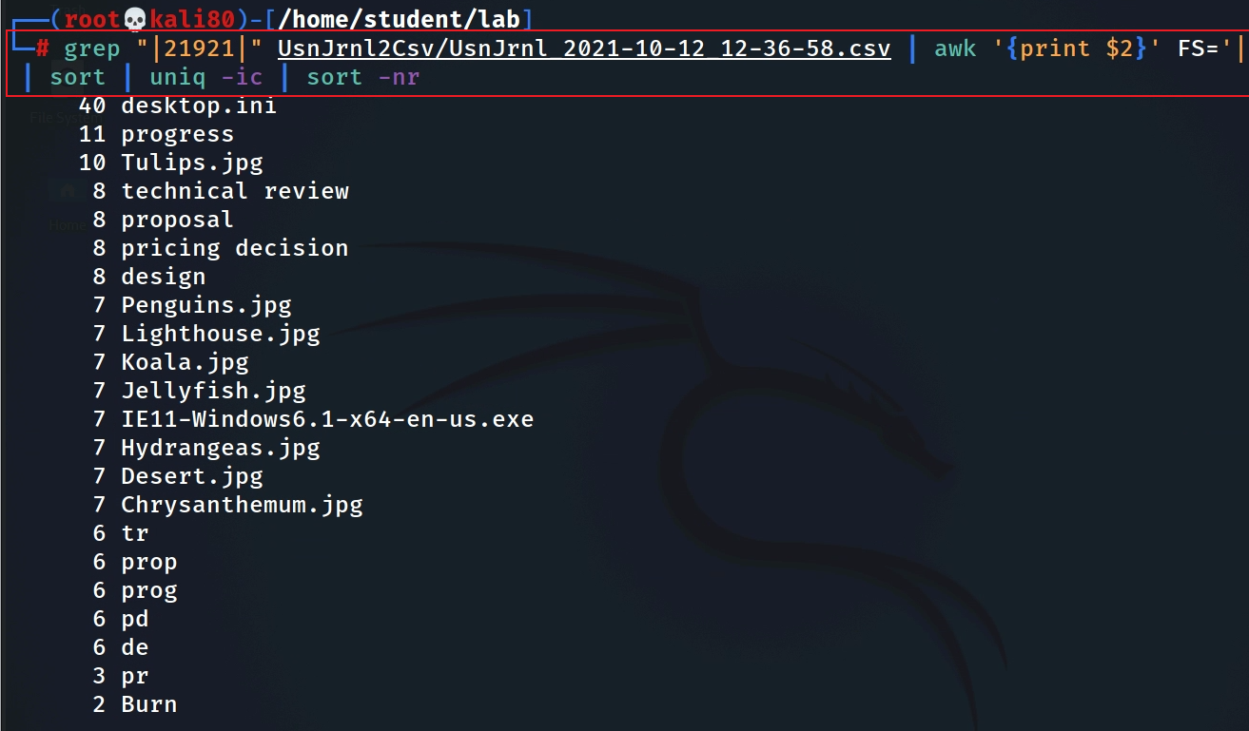
Find all directories/files under the folder …/Burn/Burn, those files are copied to CD
Your file name is different
directory/file name
$MFT entry 21921, which indicate the folder …/Burn/Burn
sort: -n , --numeric-sort
-r, --reverse
Notes:
grep "|21921|" UsnJrnl2Csv/UsnJrnl_2021-10-12_12-36-58.csv | awk '{print $2}' FS='|' | sort | uniq -ic | sort -nr

Slide 28
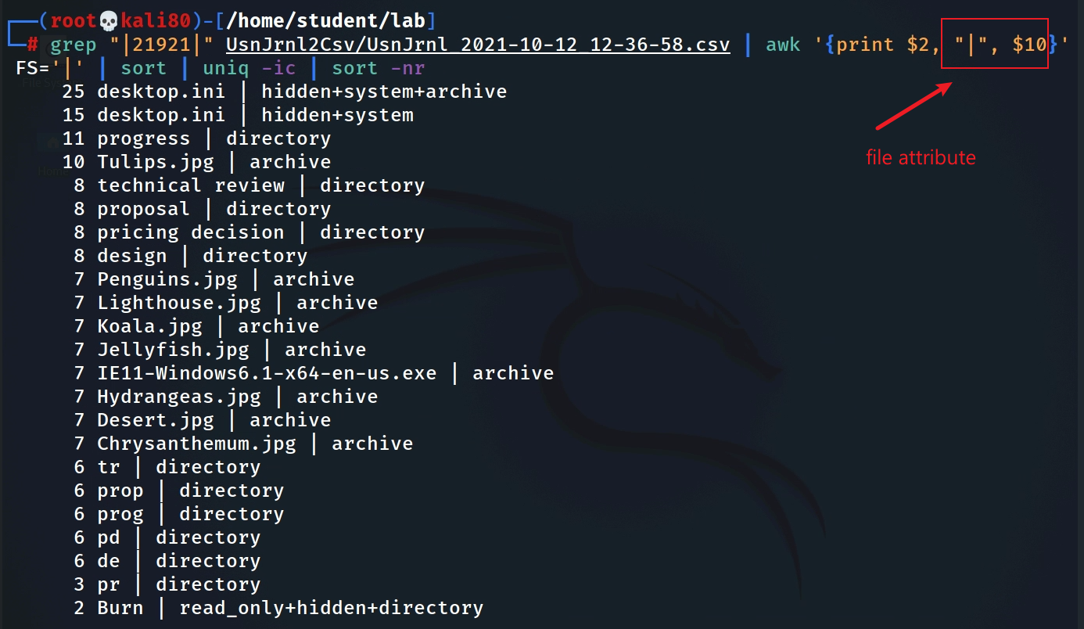
Identify directory or file and file activities
conclusion:
../Burn/Burn contains folder (tr, prop, prog, pd, de, pr, technical review…) and files (*.jpg)
These files are copied to CD
Notes:
grep "|21921|" UsnJrnl2Csv/UsnJrnl_2021-10-12_12-36-58.csv | awk '{print $2, "|", $10}' FS='|' | sort | uniq -ic | sort -nr

Slide 29
Assignment
There is a subfolder under the ../Burn/Burn
Find these deleted files

Slide 30
Search for files from $LogFile whose parent is the inode of the staging area! (3)

Slide 31

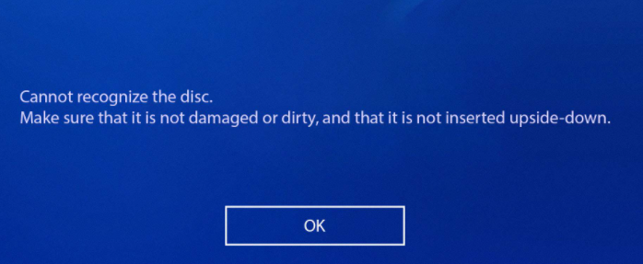

34.3 $LogFile: transaction log file of NTFS
Microsoft wanted to improve the reliability of NTFS
  recover the status of file system in case of unexpected system shutdown due to power error or critical system failure
  avoid corruption / keep a clean state during NTFS transactions
What is clean state?
  one transaction has multiple operations
  either complete all scheduled operations of a transaction or abandon all in-completed operations of a transaction
  Atomicity property of transaction (all occurs, or nothing occurs)
Keep the following transactions in a clean state
  The creation of file/directory
  The deletion of file/directory
  The modification of $data (write data)
  Modification of MFT entry
operation 1
operation 2
operation 3
Notes:
http://forensicinsight.org/wp-content/uploads/2013/06/F-INSIGHT-NTFS-Log-TrackerEnglish.pdf

Slide 32


A transaction = N operations
A transaction (create, del, ren) is consisted of multiple operations sequentially
  Create a resident file (Redo/Undo)
    SetBitsInNonresidentBitMap/ClearBitsInNonresidentBitMap
    Noop/DeallocateFileRecordSegment
    AddIndexEntryAllocaton/DeleteIndexEntryAllocaton
    InitializeFileRecordSegment/Nood
  Delete a file
    …
    DeleteIndexEntryAllocation: delete the index of files. In NTFS file system, an index of all files & directories is stored in $I30 attribute of an $MFT entry.
    DeallocateFileRecordSegment: free up metadata
    …
  Rename
    …
    DeleteAttribute
    CreateAttribute
    …
Operation contains MFT file name
Operation contains MFT entry ID before the delete operation
Notes:
https://alexsta-cybersecurity.com/what-happens-when-a-file-is-deleted-on-a-windows-system/

Slide 33
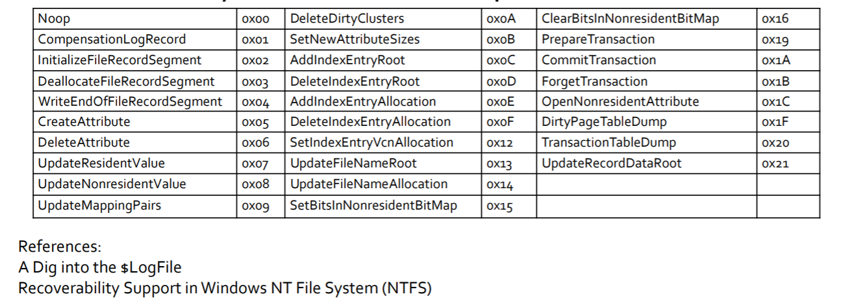
Redo/Undo Operation Code
Notes:
https://digital-forensics.sans.org/summit-archives/DFIR_Summit/File-System-Journaling-Forensics-Theory-Procedures-and-Analysis-Impacts-David-Cowen-with-Matthew-Seyer.pdf

Slide 34
How are transaction operations recorded?
NTFS records all NTFS operations-> journaling of NTFS
Multiple transaction operations are recorded sequentially
  each transaction operation recorded is called a transaction (operation) record
Three types of transaction records needed for maintain a clean state
  Check Point Record : the start record of transaction
    after previous commit
  Update (operation) Record (updates have not performed yet): the middle records of transaction
    information about any metadata updates before/about they happen
    e.g., scheduled operations we mentioned earlier
  Commit Record : the last record of transaction
    when updates have been performed

Slide 35

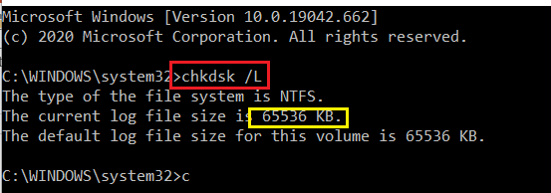
$LogFile overview
delete a file
Each record has LSN($LogFile Sequence Number).
  This LSN information increase sequentially.
LFS restart area
Logging Area
NTFS restart (metadata of Logging Area)
Log File Records (64 MB, 2 ~ 3 hours of activities)
…
LSN
100
LSN
101
LSN
102
LSN
103
LSN
104
…
LSN
117
Can be resized

Slide 36
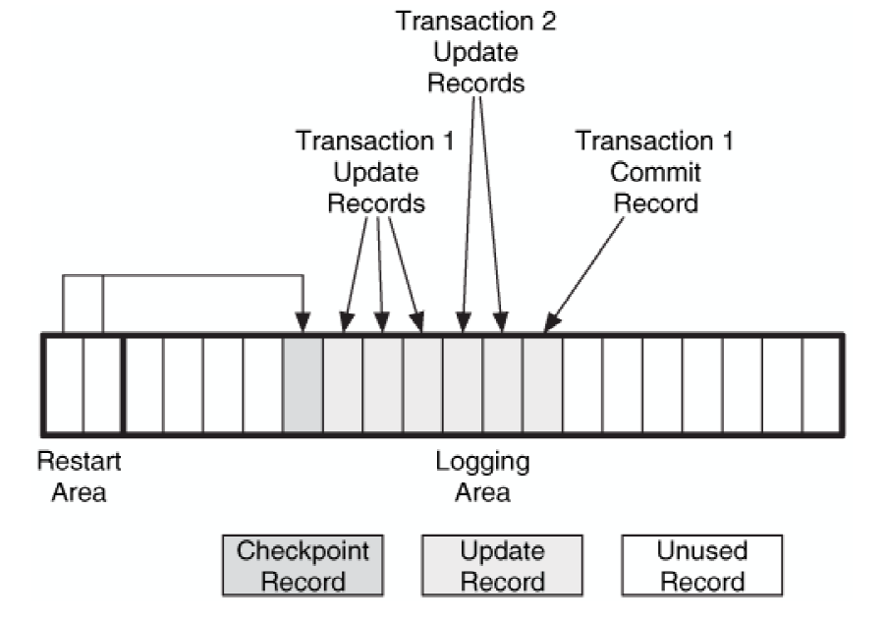
An example $LogFile with two transactions after the last checkpoint record. One
of the transactions did not commit.
In case of any unexpected system shutdown, OS checks $LogFile
Transaction 1 has a commit record
  we use the 'redo' to ensure that the disk is correct.
Transaction 2 does not have a commit record
  we use the 'undo' to ensure that none of the proposed changes exist.
  void a corrupted state
File System Forensic Analysis 1st Edition

Slide 37
The workflow when error recovery is executed
Check Point Record
Update Record
Update Record
Update Record
Commit Record
LSN (102)
LSN(103)
LSN (104)
…
LSN (117)
Transaction 1 : if a commit record presents
Previous LSN
Previous LSN
Previous LSN
…
Previous LSN
Redo Data
Redo Data
Redo Data
…
Redo Data
Undo Data
Undo Data
Undo Data
…
Undo Data
Transaction 2: if a commit record is missing

Slide 38


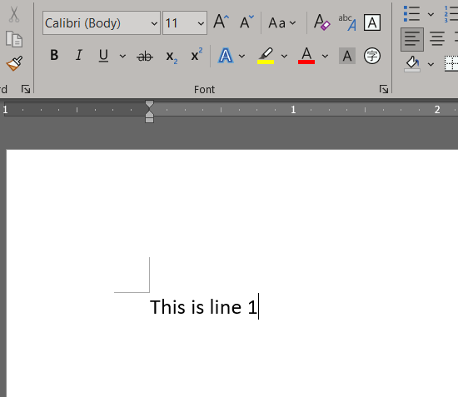





4. undo (This is line2)
3. undo (This is line 3)
1
2
Update Resident Value”
5. redo (This is line2)
6. redo (This is line 3)
Undo Data : the data before modification
Redo Data : the data after modification

Slide 39
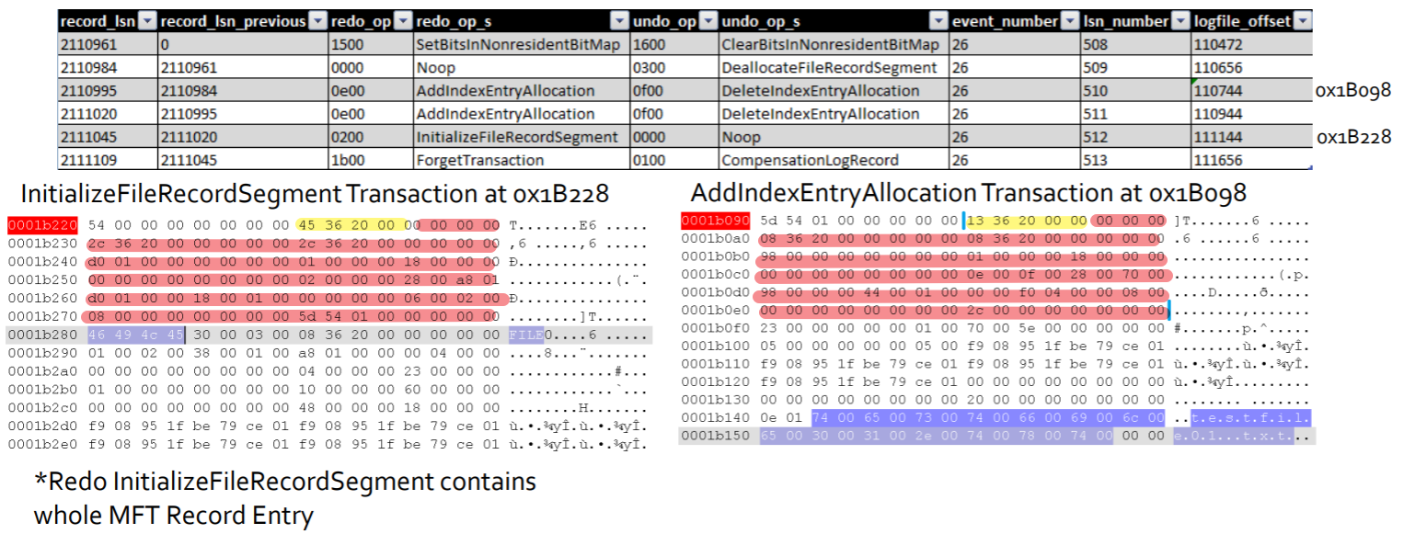



Creation testfile01.txt records
Credits: David Cowen, Matthew Seyer, G-C Partners, LLC /

Slide 40
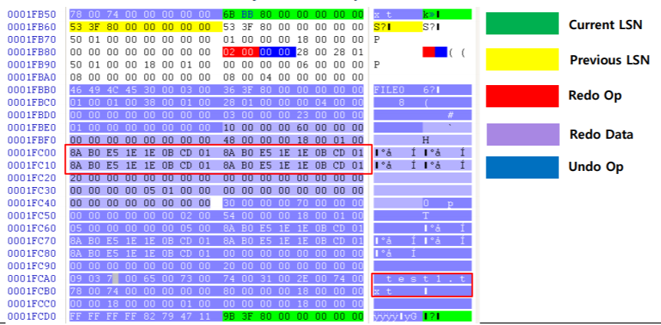
Initialize File (test1.txt) Record Segment
Notes:
http://forensicinsight.org/wp-content/uploads/2013/06/F-INSIGHT-NTFS-Log-TrackerEnglish.pdf

Slide 41
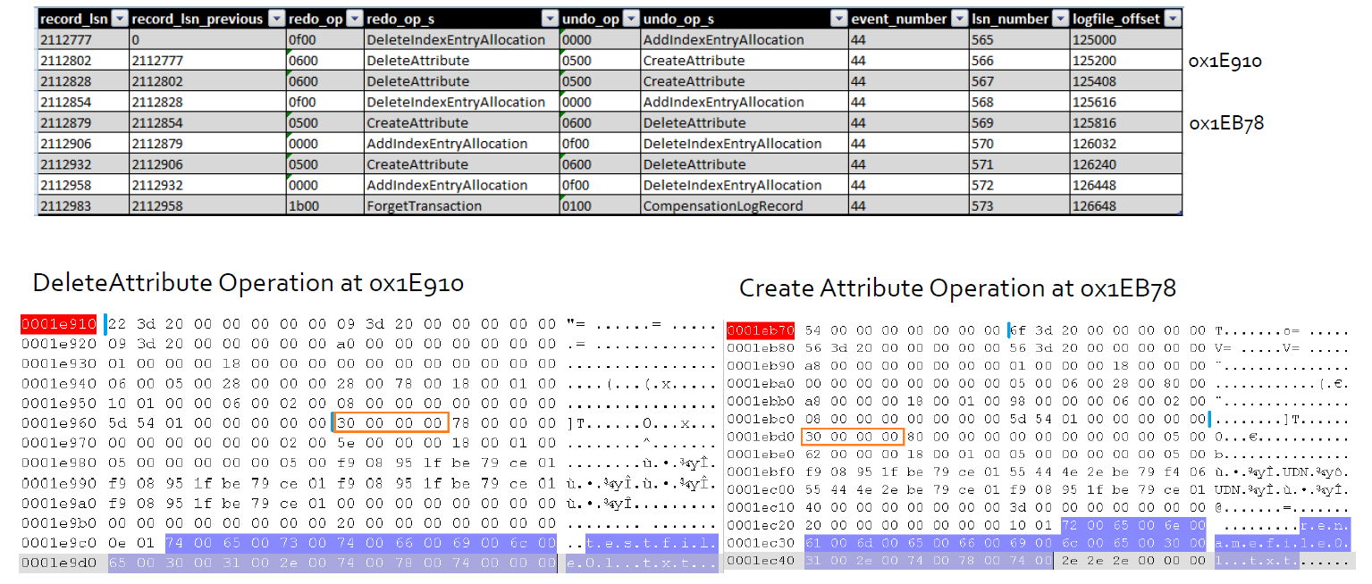




Rename testfile01.txt records

Slide 42
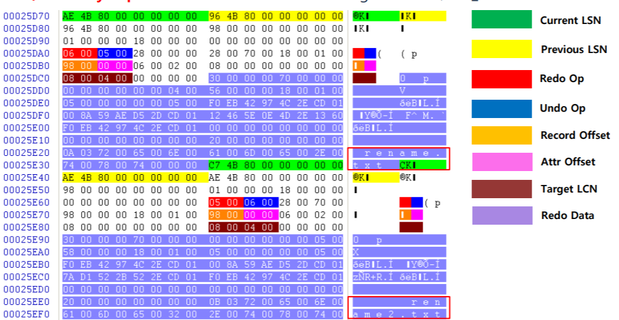
Delete Attribute(0x06) / Create Attribute(0x05)

Slide 43
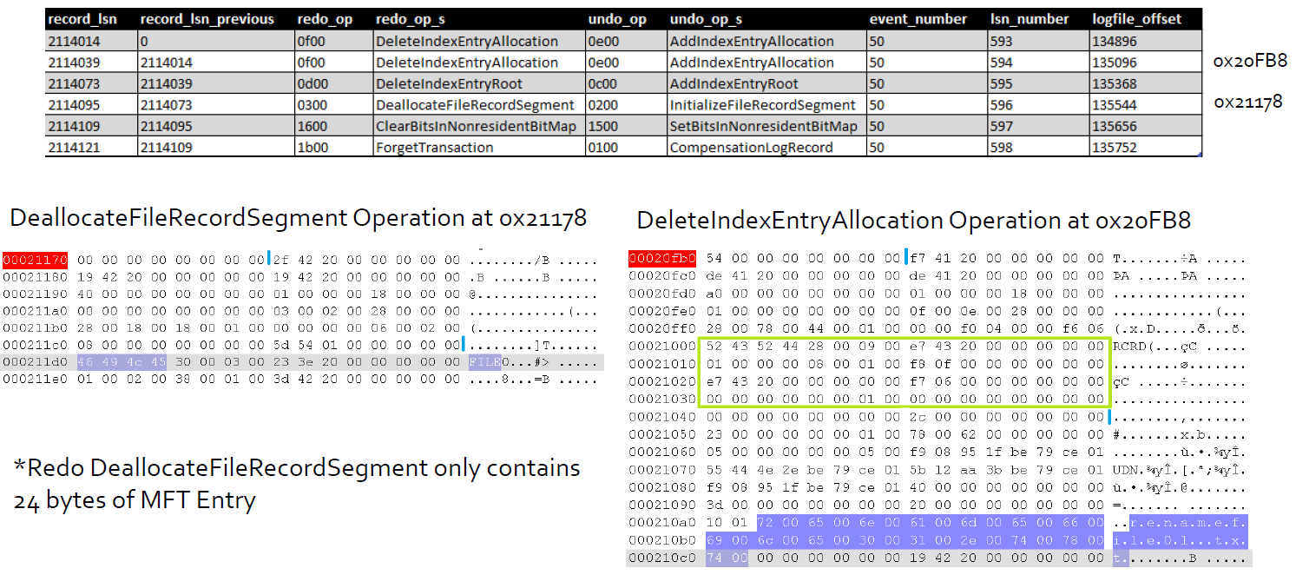




Delete renamefile01.txt records

Slide 44
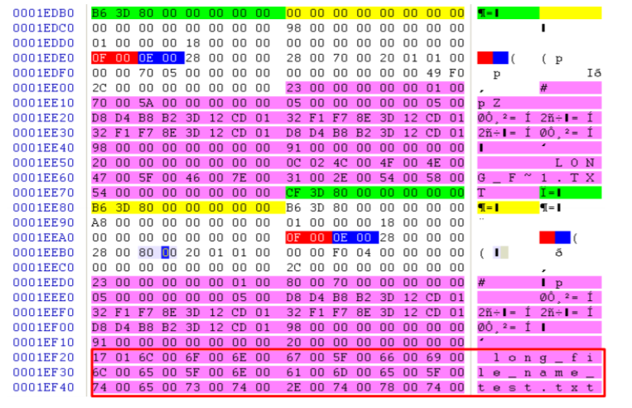
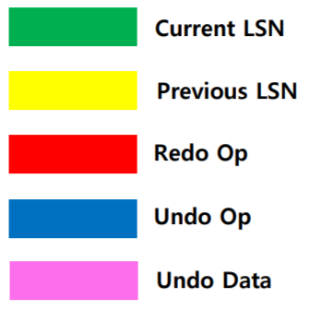
Delete Index Entry Allocation/Add Index Entry Allocation/

Slide 45
Analysis deleted file evidence in $LogFile
The most important Operations
  DeleteIndexEntryAllocation: contains MFT file name and the MFT entry ID before the delete operation
Approach
  Find the file name in DeleteIndexEntryAllocation
  Find MFT entry ID
  Find the parent MFT entry ID (folder) of the entry ID
    from $UsnJrnl
  If the parent folder contains the entry ID file, the file has been deleted

Slide 46
Lab: Analyze $LogFile
Install using LogFileParser
logfile.bin <= Extract $LogFile
.csv <= Run LogFileParser to parse logfile.bin
Analyze extracted .csv

Slide 47
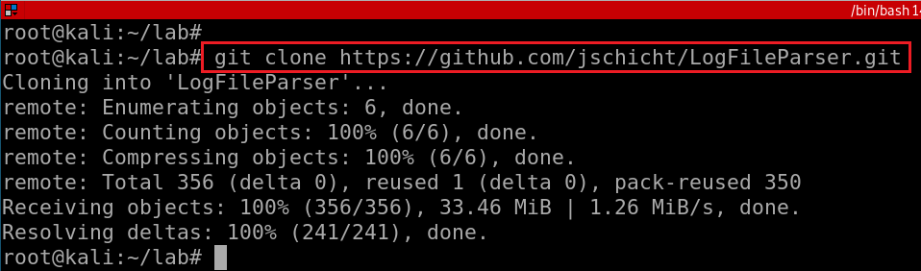
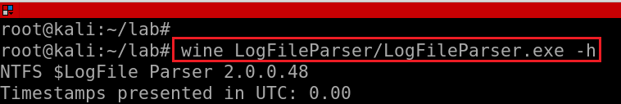
a) Install LogFileParser
Notes:
git clone https://github.com/jschicht/LogFileParser.git
wine LogFileParser/LogFileParser.exe -h

Slide 48
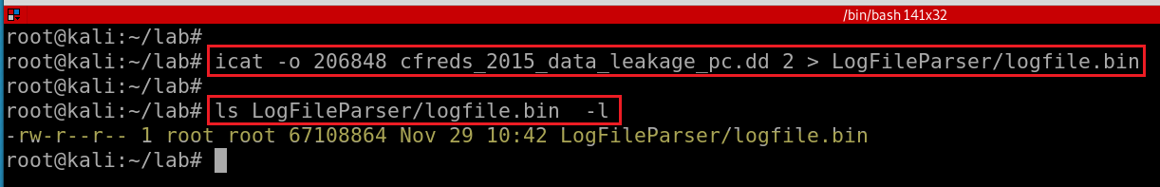
b) Extract $LogFile

Slide 49

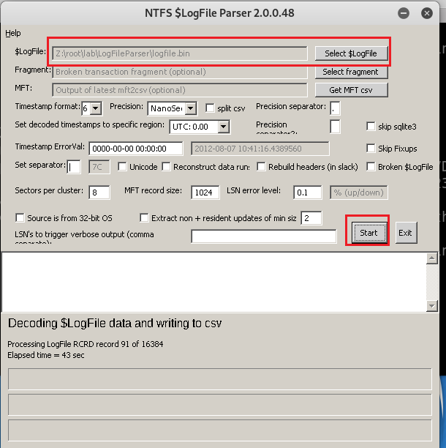
c) Parse logfile.bin extracted from $Logfile
MUST select the logfile.bin extracted from last slide
Any improvements? Have to run it in Windows.
Take over 10 hour

Slide 50
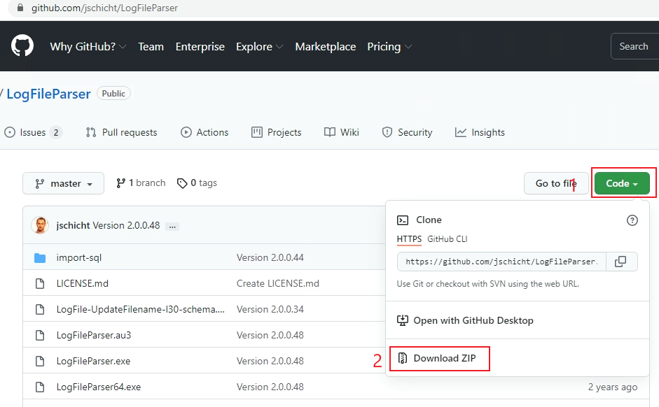
Run LogFileParser in Windows (better performance)
Notes:
https://github.com/jschicht/LogFileParser

Slide 51
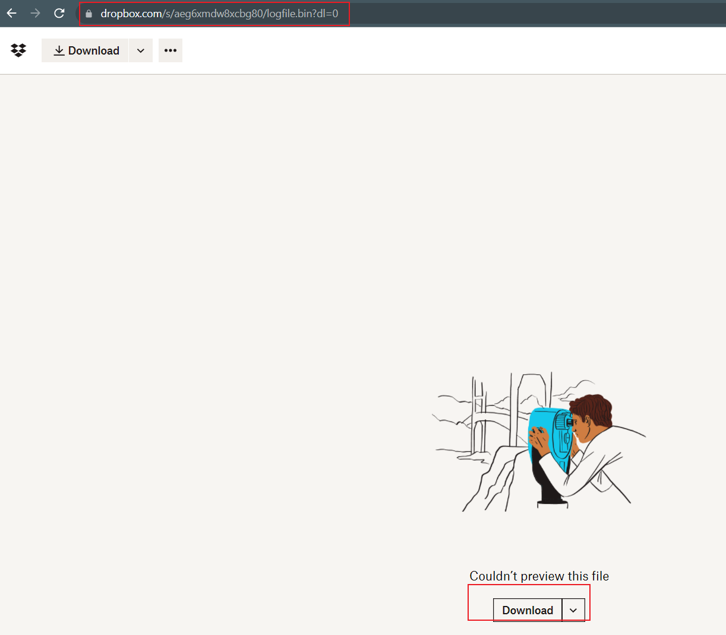
Download $logFile
remember the downloading folder
Notes:
https://www.dropbox.com/s/aeg6xmdw8xcbg80/logfile.bin?dl=0
https://www.dropbox.com/s/6sjdecon9c1f7rl/mft.csv?dl=0

Slide 52
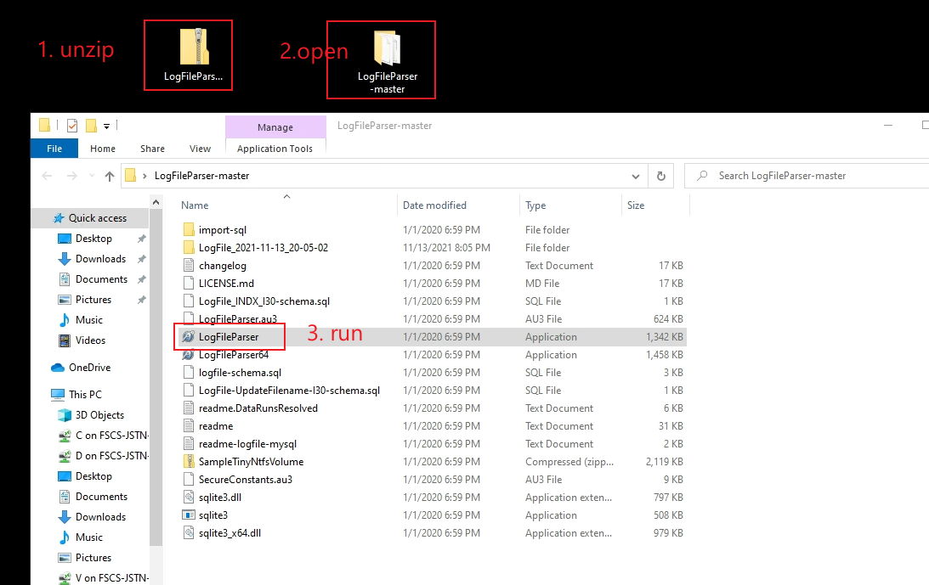
Download $logfile parser and execute it

Slide 53
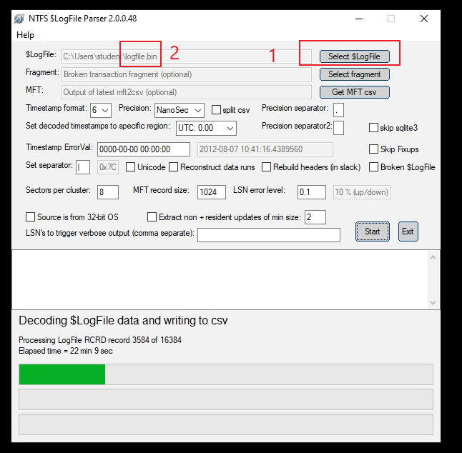
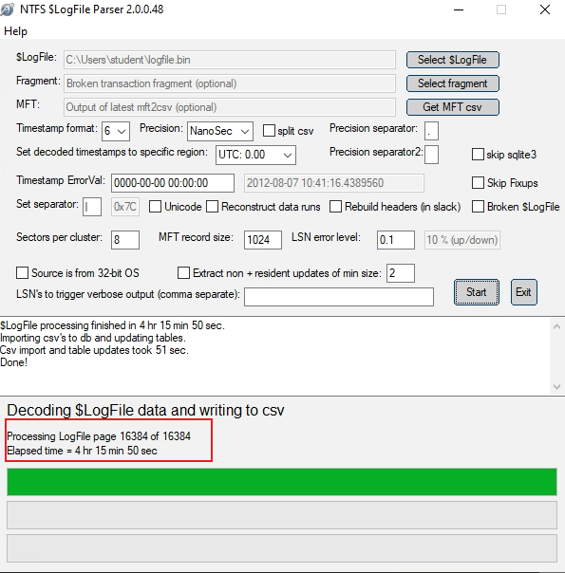
Parsing may take 4+ hours
3

Slide 54


Slide 55


Since the parsing process may take more than 4 hours, we can download the results directly from our dropbox.
https://www.dropbox.com/s/660rsdj2rp8zfrh/%24logfile.7z
Notes:
https://www.dropbox.com/s/660rsdj2rp8zfrh/%24logfile.7z
https://github.com/frankwxu/digital-forensics-lab/blob/main/NIST_Data_Leakage_Case/NIST_Answers/lab_generated_file/LogFile.zip

Slide 56


Slide 57

d) Analyze extracted .csv
$2:lf_MFTReference (?)
$7: lf_RedoOperation
$10:lf_FileName
$12:lf_TextInformation(MFT entry ID (ref),MFT Seq #) (matches MFT entry id in mft.csv)
$13:lf_UsnJrnlFileName
$14: lf_UsnJrnlMFTReference
$15: lf_UsnJrnlMFTParentReference
Notes:
lf_Offset|lf_MFTReference|lf_RealMFTReference|lf_MFTBaseRecRef|lf_LSN|lf_LSNPrevious|lf_RedoOperation|lf_UndoOperation|lf_OffsetInMft|lf_FileName|lf_CurrentAttribute|lf_TextInformation|lf_UsnJrnlFileName|lf_UsnJrnlMFTReference|lf_UsnJrnlMFTParentReference|lf_UsnJrnlTimestamp|lf_UsnJrnlReason|lf_UsnJrnlUsn|lf_SI_CTime|lf_SI_ATime|lf_SI_MTime|lf_SI_RTime|lf_SI_FilePermission|lf_SI_MaxVersions|lf_SI_VersionNumber|lf_SI_ClassID|lf_SI_SecurityID|lf_SI_QuotaCharged|lf_SI_USN|lf_SI_PartialValue|lf_FN_CTime|lf_FN_ATime|lf_FN_MTime|lf_FN_RTime|lf_FN_AllocSize|lf_FN_RealSize|lf_FN_Flags|lf_FN_Namespace|lf_DT_StartVCN|lf_DT_LastVCN|lf_DT_ComprUnitSize|lf_DT_AllocSize|lf_DT_RealSize|lf_DT_InitStreamSize|lf_DT_DataRuns|lf_DT_Name|lf_FileNameModified|lf_RedoChunkSize|lf_UndoChunkSize|lf_client_index|lf_record_type|lf_transaction_id|lf_flags|lf_target_attribute|lf_lcns_to_follow|lf_attribute_offset|lf_MftClusterIndex|lf_target_vcn|lf_target_lcn|InOpenAttributeTable|FromRcrdSlack|IncompleteTransaction

Slide 58
Goal
Determine if a deleted file belongs to /Burn/Burn
  only use jpg as an example
Approach
  Find MFT entry IDs which jpg file names from DeleteIndexEntryAllocaton
  Repeat for each jpg file
    Pick one file
    Find the parent MFT entry ID (folder) of the file entry ID/name
    Check if the parent MFT entry ID is 21921 (/Burn/Burn)
    if Yes: the jpg is deleted from /Burn/Burn

Slide 59

is one transaction of delete operation
Search “DeleteIndexEntryAllocation” transaction record
Notes:
awk '{print NR,"|", $2,"|", $7, "|",$10, "|", $12, "|", $13, "|", $14, "|", $15}' FS='|' LogFile.csv | grep -Ei "DeleteIndexEntryAllocation" | grep "jpg"

Slide 60

Find the parent MFT entry ID (folder) of the file name based on mft entry ID 74620 and the file name. We only demonstrate one example here, e.g., Chrysanthemum.jpg
The jpg file appears in two different folders, 74402 and 21921
$MFT entry 21921, which indicates the folder …/Burn/Burn
Conclusion: Chrysanthemum.jpg is the one file deleted from the folder
Notes:
grep "|74620|" ../UsnJrnl2Csv/UsnJrnl_2021-10-12_12-36-58.csv | grep "Chrysanthemum.jpg"

Slide 61



Slide 62
Remark 1: $LogFile can’t be used for file recovery
The log does not contain user data that is non-resident and stored in a cluster
It does store the content of resident attributes, so it can be used to recover recent changes
  e.g., when modify a file content , if changes are small and can fit in resident $DATA

Slide 63
Remark 2: Only $UsnJrnl contains parents' folder information
$Logfile has deleted file names and $MFT entry IDs
We rely on $UsnJrnl to determine if a deleted file was resided in a specific folder

Slide 64
35. What files were opened from CD-R?
The mounted CD device is D:\
  rip.pl –r SYSTEM –o mountdev
Recently opened file accessed using .lnk
  \User\informant\AppData\Roaming\Microsoft\Windows\Recent\*.lnk
Jumplist
  \User\informant\AppData\Roaming\Microsoft\Windows\Recent\AutomaticDestinations

Slide 65

Recently accessed .lnk1
List all recently accessed .lnk

Slide 66

Check one of .lnk

Slide 67

Search for changed files with D:\
Need to repeat for each .lnk in the folder

Slide 68

Jumplist
Notes:
grep -P "D\:" AutomaticDestinations/20201126160358_AutomaticDestinations.csv --color

