Slide 1
Investigate Data Leakage Case
Keywords: Thumbcache (Vinetto), sticky notes, Windows Search, csv to SQL
Notes:
http://xmlstar.sourceforge.net/doc/UG/

Slide 2
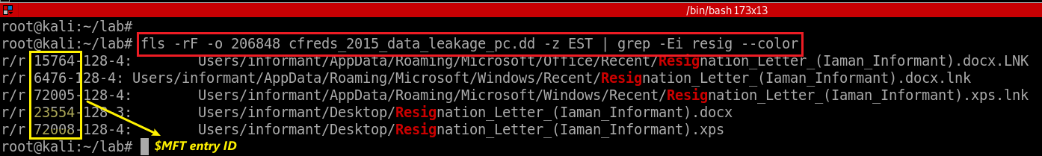
36. Identify all timestamps related to a resignation file in Windows Desktop
Search a resignation file using regular expression
-F: Display only files
-r: Recursive on directory entries
-z: Time zone of original machine (i.e., EST5EDT or GMT) (only useful with -l)
Notes:
fls -rF -o 206848 cfreds_2015_data_leakage_pc.dd -z EST | grep -Ei resig --color

Slide 3
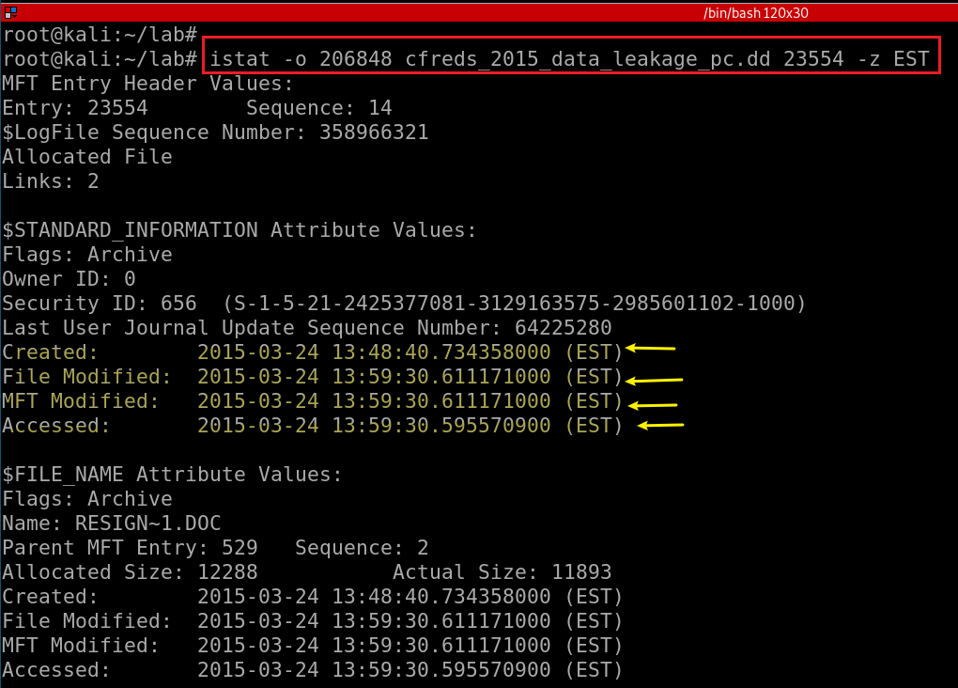
Exam the details of a MFT entry
Notes:
istat -o 206848 cfreds_2015_data_leakage_pc.dd 23554 -z EST

Slide 4
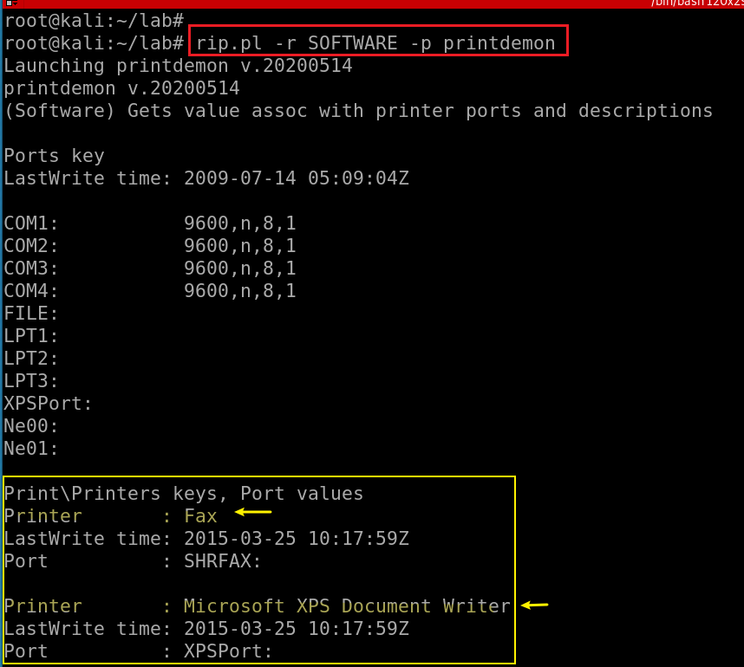
37. How and when did the suspect print a resignation file?
There are no real printer devices.
A XPS file can be found in Windows Desktop.
HKLM\SOFTWARE\Microsoft\Windows NT\CurrentVersion\Print\Printers
Registry entry write time, not document write time
Notes:
rip.pl -r SOFTWARE -p printdemon

Slide 5
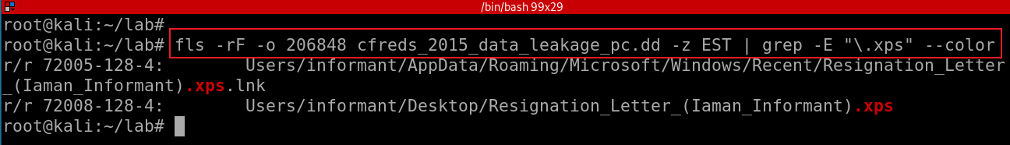
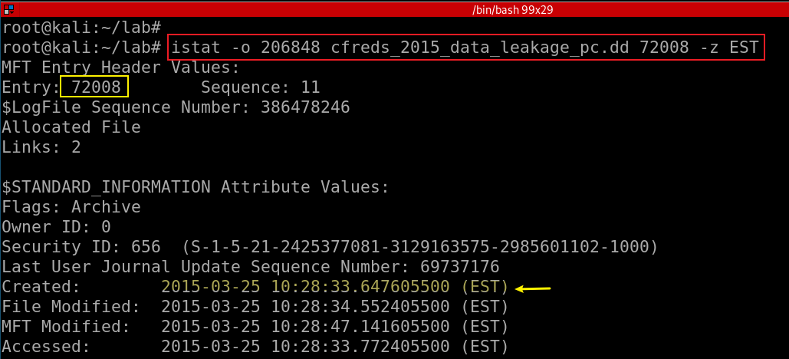
Search all .xps files
Find .xps generated time

Slide 6
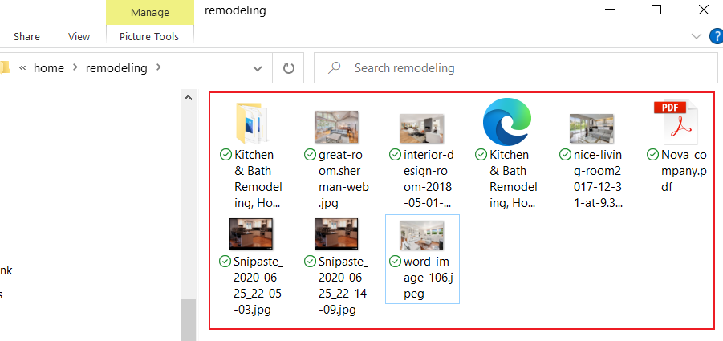
38. Where are ‘Thumbcache’ files located?
Thumbnails
  are reduced-size versions of pictures or videos
  used to help in recognizing and organizing them
A thumbnail cache
  is used to store thumbnail images for Windows Explorer's thumbnail view.
  it speeds up the display of images as these smaller images do not need to be recalculated every time the user views the folder
ThumbsXX.db files are stored in each directory
  that contains thumbnails on Windows systems.
  %userprofile%\AppData\Local\Microsoft\Windows\Explorer
Notes:
fls -rF -o 206848 cfreds_2015_data_leakage_pc.dd | grep thumbcache.*\.db --color

Slide 7
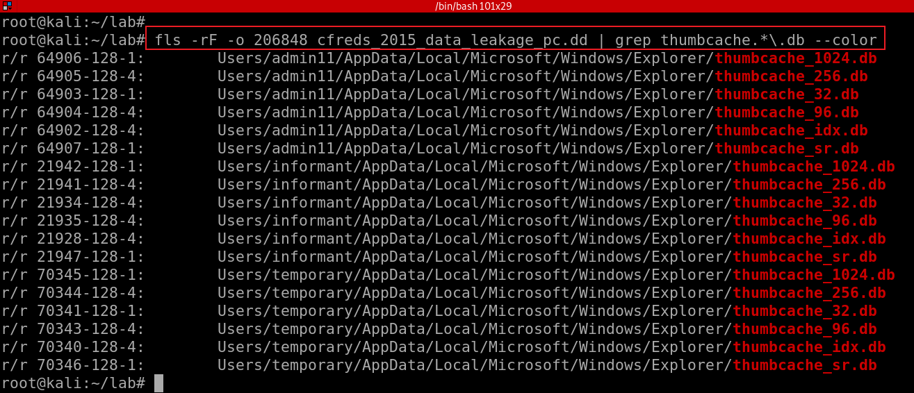
Notes:
fls -rF -o 206848 cfreds_2015_data_leakage_pc.dd | grep thumbcache.*\.db --color

Slide 8
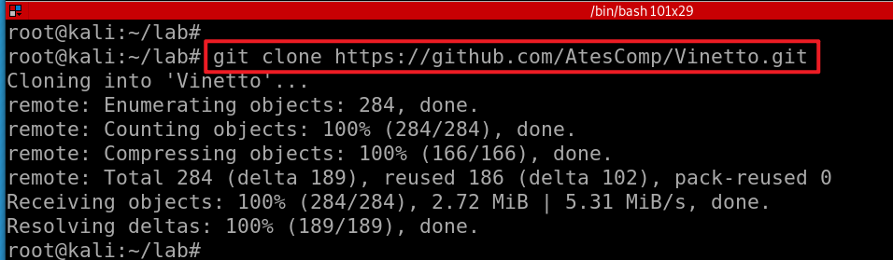
39. Identify traces related to confidential files stored in Thumbcache. (Include ‘256’ only)
Download vinetto to extract thumbnail images from thumbcache
Notes:
https://github.com/AtesComp/Vinetto.git
https://github.com/AtesComp/Vinetto

Slide 9
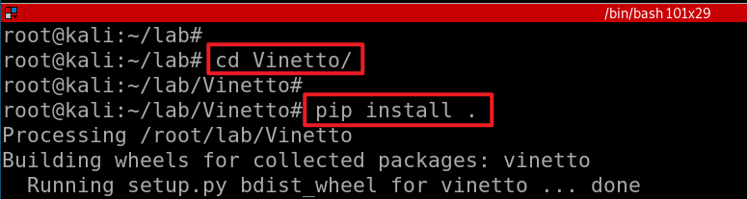
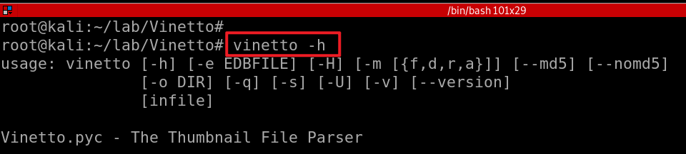
Install Vinetto to extract thumb.db
Install vinetto
Verify the installation
Notes:
git clone https://github.com/AtesComp/Vinetto.git
pip install .
vinetto -h

Slide 10
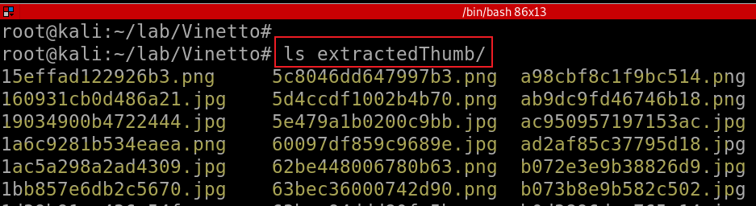
Extract .db to the folder extractedThumb
-o DIR, --outdir DIR write thumbnails to DIR
Verify the extracted thumbnail images
Notes:
vinetto -o extractedThumb /media/root/C8CA0C8DCA0C7A48/Users/informant/AppData/Local/Microsoft/Windows/Explorer/thumbcache_256.db

Slide 11
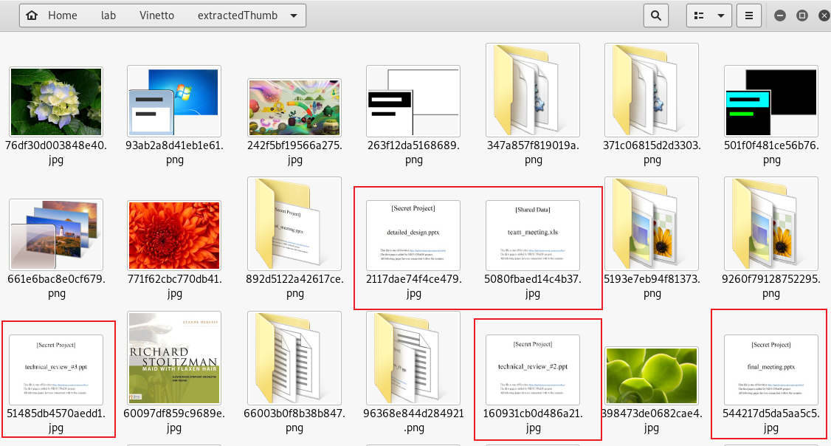
Thumbnail images of some MS PowerPoint files

Slide 12
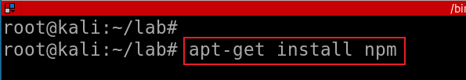
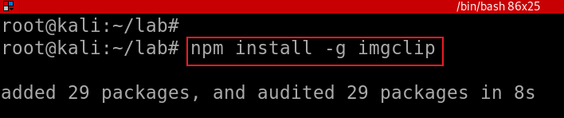
Extract word from thumbnail images automatically
Install npm (Node Package Manager for the JavaScript programming language.)
Install imgclip (extract word from images)
Notes:
apt-get install npm
npm install -g imgclip

Slide 13
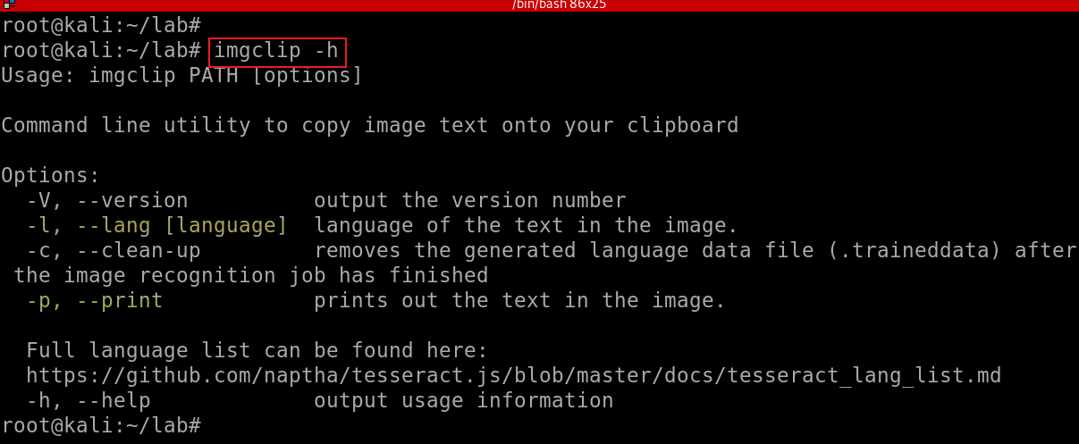

Slide 14
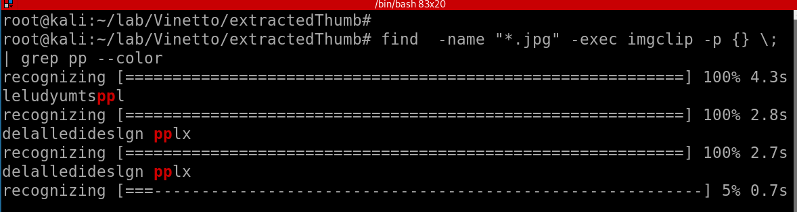
Under the extractedThumb folder, find all .jpg and extract the word “pp” from each .jpg
The issue is I don’t know which file is processing and image to words conversion is not accurate.
Notes:
find -name "*.jpg" -exec imgclip -p {} \; | grep pp --color

Slide 15
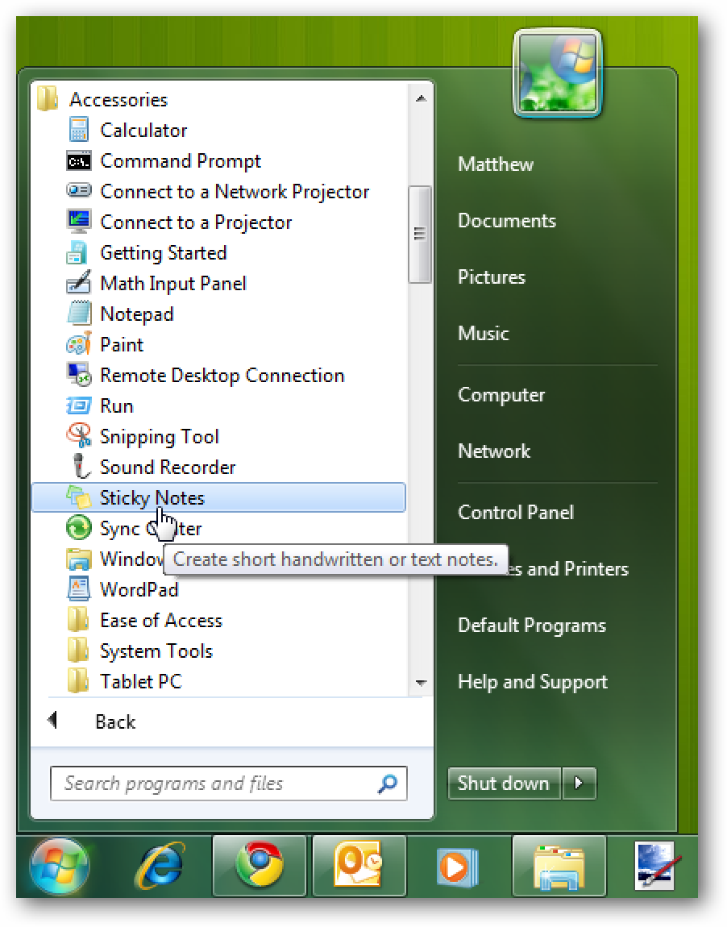
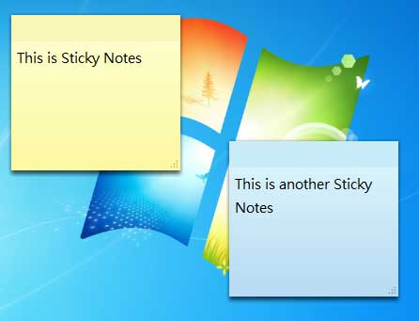
40. Where are Sticky Note files located?

Slide 16
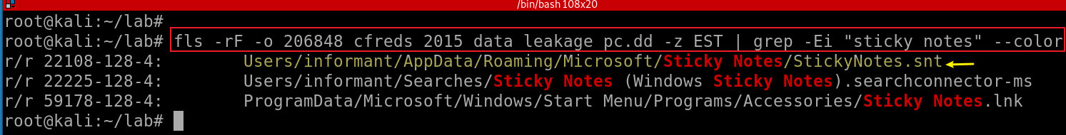
Search for the locations of sticky notes
Notes:
fls -rF -o 206848 cfreds_2015_data_leakage_pc.dd -z EST | grep -Ei "sticky notes" --color

Slide 17
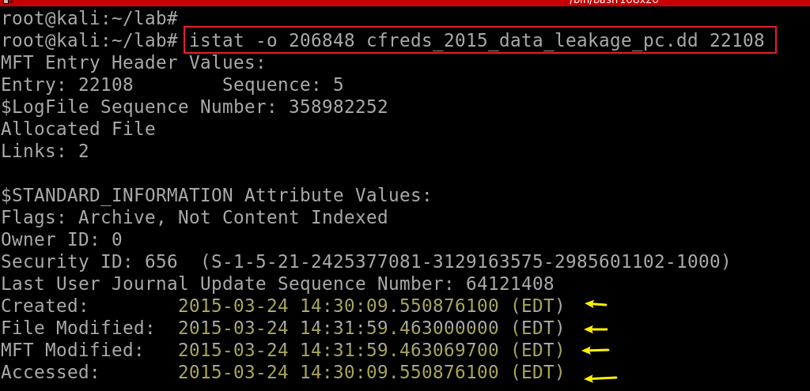
41. Identify notes stored in the Sticky Note file.
Exam the MAC of sticky notes
Notes:
istat -o 206848 cfreds_2015_data_leakage_pc.dd 22108

Slide 18
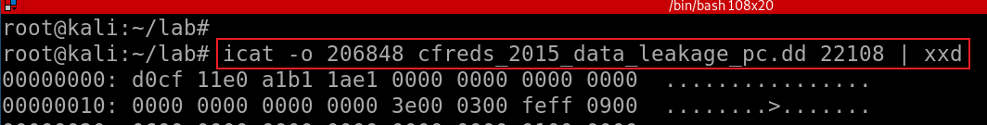
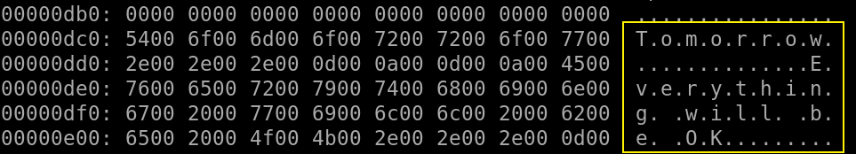
Exam the content of sticky notes
Notes:
icat -o 206848 cfreds_2015_data_leakage_pc.dd 22108 | xxd

Slide 19
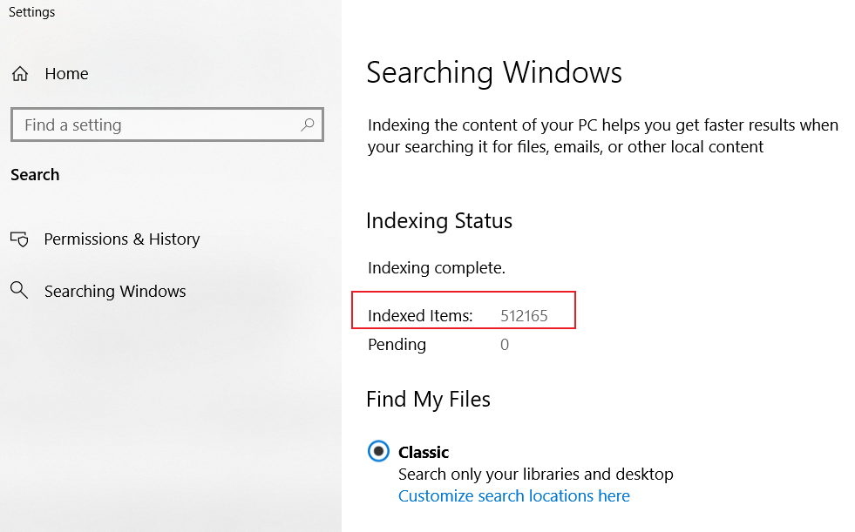
42. Was the ‘Windows Search and Indexing’ function enabled? How can you identify it?
Windows Search builds a full-text index of all the files on a computer.
Index improve search speed
  Once a file’s contents have been added to this index, the search function uses the index to find the results of a search rather than searching through all the files on the computer.
Path
  HKEY_LOCAL_MACHINE\SOFTWARE\Microsoft\Windows Search
  C:\ProgramData\Microsoft\Search\Data\Applications\Windows\Windows.edb

Slide 20
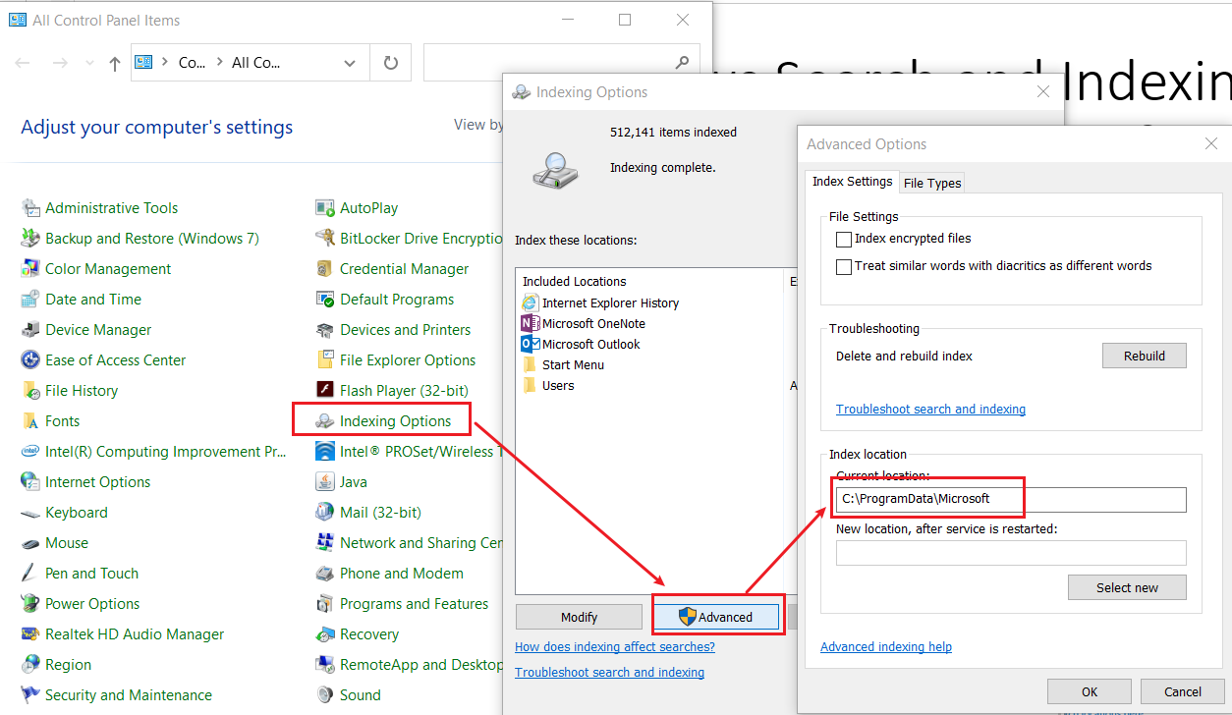
Find the location of the Windows index

Slide 21
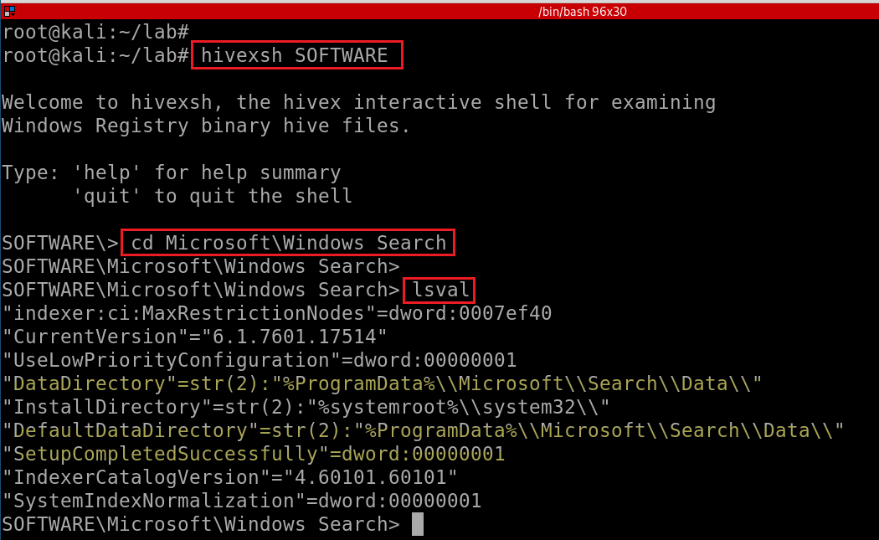
Find the location of the Windows index in registry
Notes:
hivexsh SOFTWARE
cd Microsoft\Windows Search
lsval

Slide 22
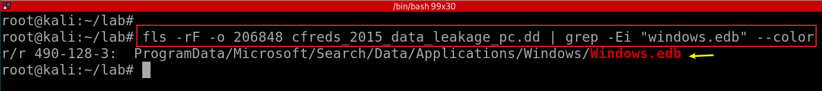
Find the find name of the Windows index
Database File (EDB) format is used by many Microsoft application to store data such as Windows Mail, Windows Search, Active Directory and Exchange
Notes:
fls -rF -o 206848 cfreds_2015_data_leakage_pc.dd | grep -Ei "windows.edb" --color

Slide 23
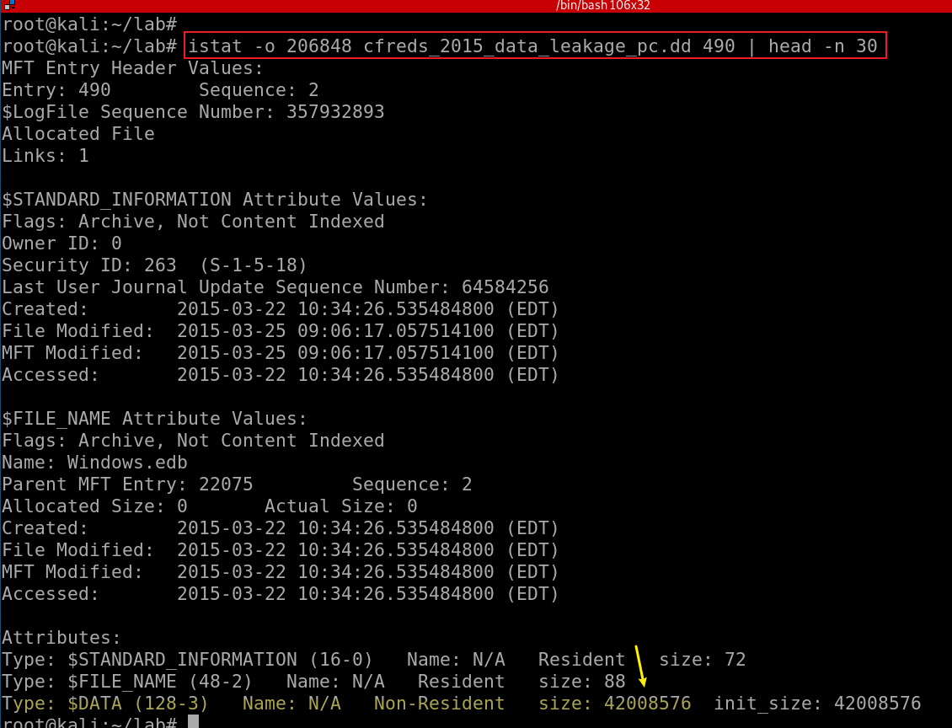

Slide 24
43. What kinds of data were stored in Windows Search database?
ESE is used to store data for various Microsoft applications like:
Active Directory (NTDS)
File Replication service (FRS)
Windows Internet Name service (WINS)
DHCP
Security Configuration Engine (SCE)
Certificate Server
Terminal Services Session folder
Terminal Services Licensing service
Catalog database
Help and Support Services
Directory Synchronization service (MSDSS)
Remote Storage (RSS)
Phone Book service
Single Instance Store (SIS) Groveler
Windows NT Backup/Restore
Exchange store
Microsoft Exchange folder (SRS and DXA)
Key Management service (KMS)
Instant Messaging
Content Indexing
Notes:
https://github.com/libyal/libesedb/blob/main/documentation/Extensible%20Storage%20Engine%20(ESE)%20Database%20File%20(EDB)%20format.asciidoc#:~:text=Overview-,The%20Extensible%20Storage%20Engine%20(ESE)%20Database%20File%20(EDB),also%20known%20as%20JET%20Blue.

Slide 25
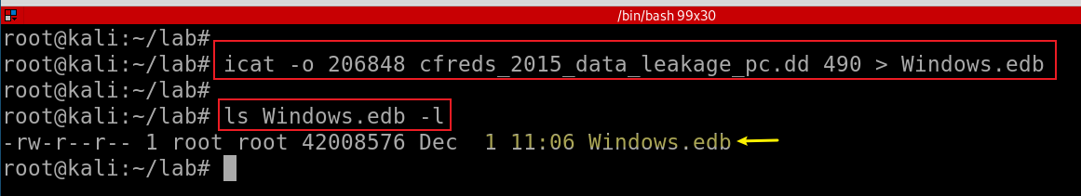
Investigate Windows.edb
Extract the db
Export the db to readable files
Exam each file
Extract Windows.edb
Notes:
icat -o 206848 cfreds_2015_data_leakage_pc.dd 490 > Windows.edb

Slide 26
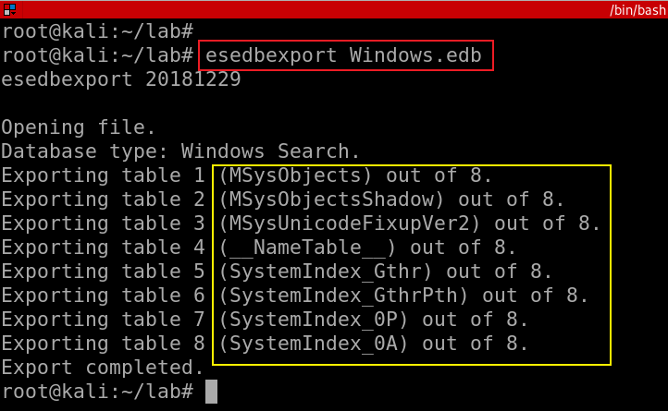
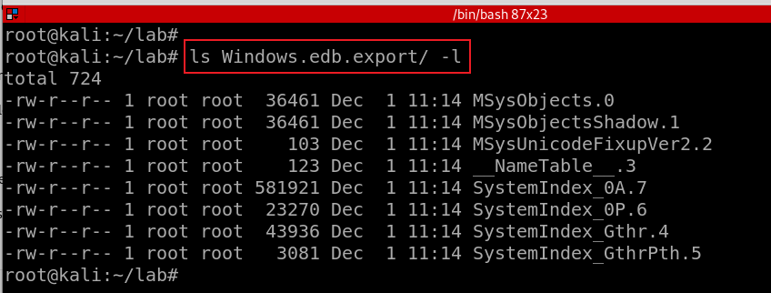
Export Windows.edb
Verify the exported data under the folder Windows.edb.export

Slide 27
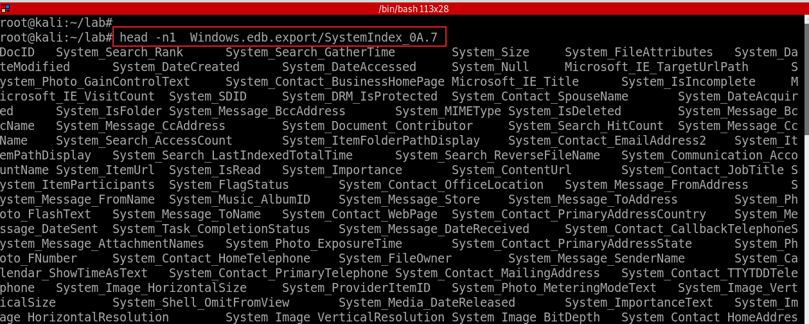
Show field names of a file
‘System_ItemFolderPathDisplay’ column
‘System_ItemPathDisplay’ column
‘System_Search_Store’ column (file, iehistory, mapi15, stickyNotes…)
‘System_ItemNameDisplay’ column
‘System_ItemName’ column
Notes:
head -n1 Windows.edb.export/SystemIndex_0A.7

Slide 28
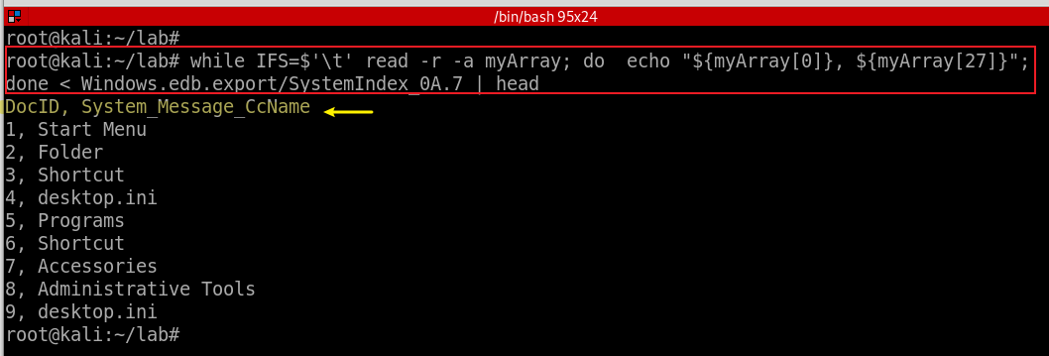
Show two fields of if SystemIndex_A/7
Note you can open it in excel. Note the fields and value doesn’t match. We will use sqlites to review the data later
Notes:
while IFS=$'\t' read -r -a myArray; do echo "${myArray[0]}, ${myArray[27]}"; done < Windows.edb.export/SystemIndex_0A.7 | head

Slide 29
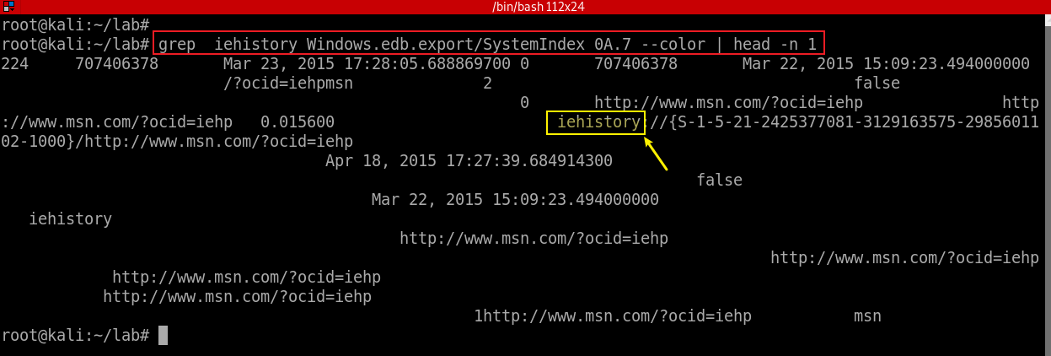
Search iehistory
Notes:
grep iehistory Windows.edb.export/SystemIndex_0A.7 --color | head -n 1

Slide 30
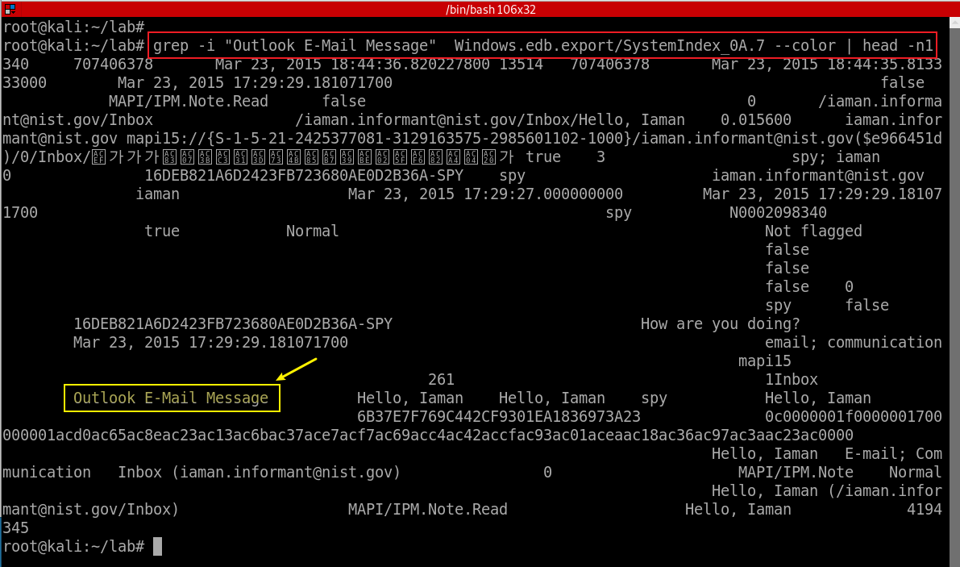
Search outlook email
Notes:
grep -i "Outlook E-Mail Message" Windows.edb.export/SystemIndex_0A.7 --color | head -n1

Slide 31
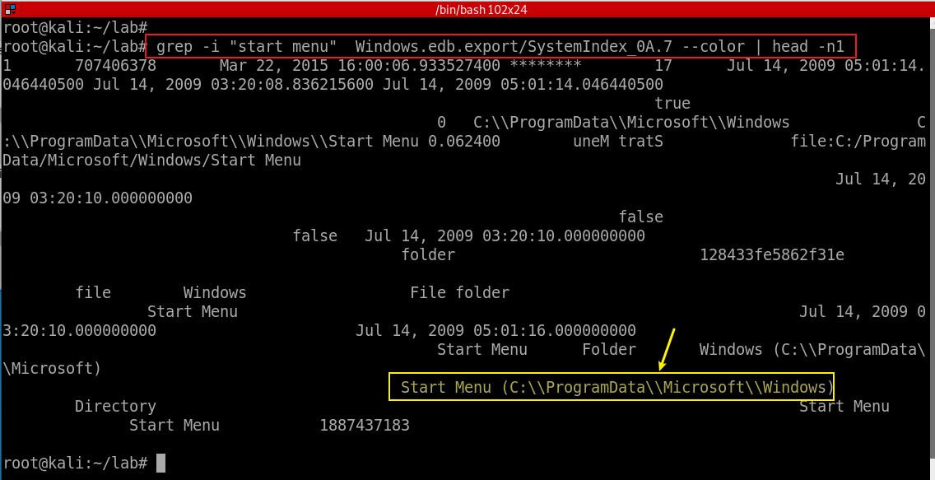
Search start menu
Notes:
grep -i "start menu" Windows.edb.export/SystemIndex_0A.7 --color | head -n1

Slide 32
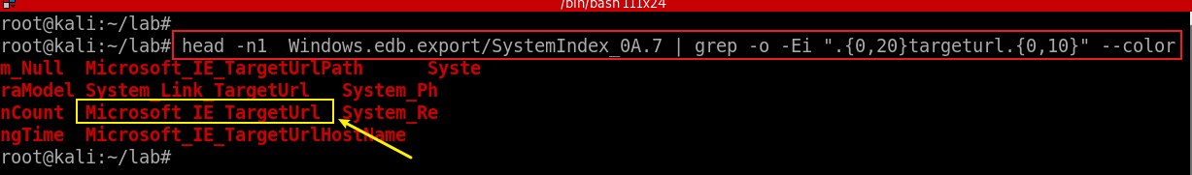
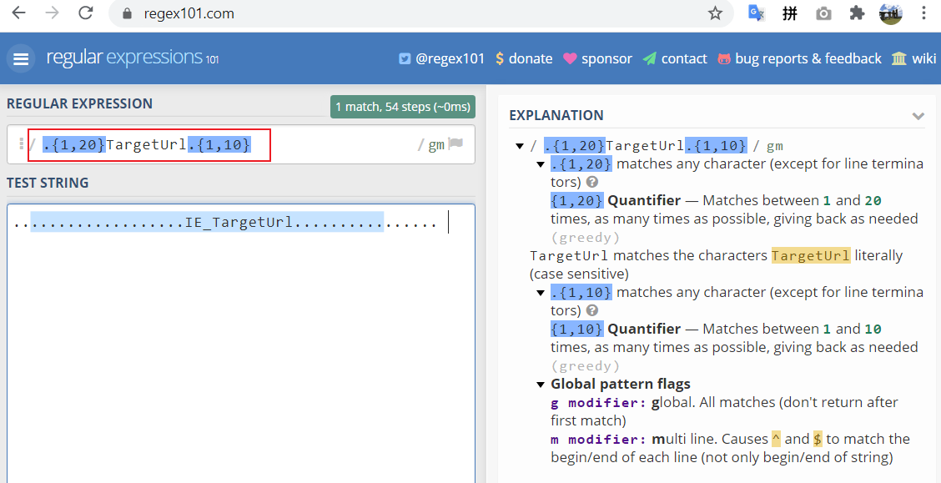
44. Find traces of Internet Explorer usage stored in Windows Search database
Search for field name with targeturl and show string before (0, 20) and after (0, 10) the key word
-o, --only-matching show only nonempty parts of lines that match
Notes:
head -n1 Windows.edb.export/SystemIndex_0A.7 | grep -o -Ei ".{1,20}targeturl.{1,10}" –color
.{1,20}TargetUrl.{1,10}

Slide 33
Too many fields, we have to use SQLite3
Create database
Set the mode & table name
Set the separator
Import the csv file data to sqlite3
Find tables
Check table schema
Find table data (answer the question)
Count the number of rows in the table
Notes:
head -n1 Windows.edb.export/SystemIndex_0A.7 | grep -Ei "\bMicrosoft_IE_TargetUrl\b" --color| while IFS=$'\t' read -r -a myArray; do echo "${myArray[0]}, ${myArray[375]}"; done

Slide 34
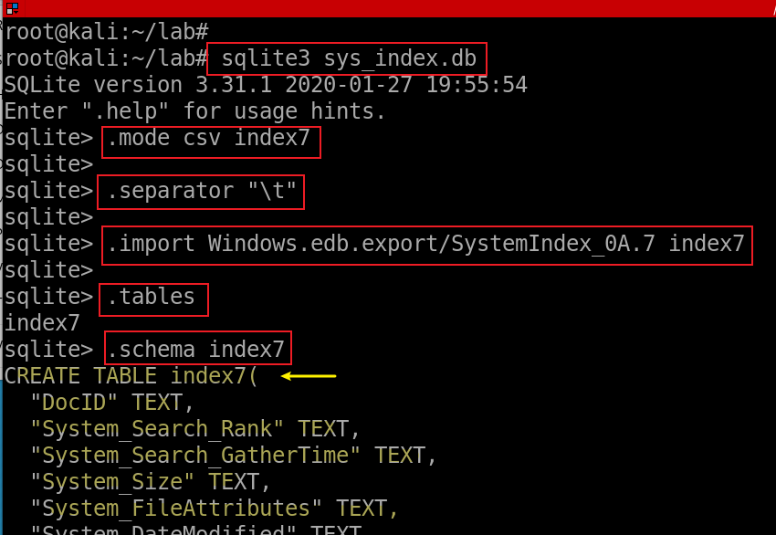
Create database sys_index.db
Set the mode & tablename
Set the separator as tab (“\t”)
Import the csv file data to sqlite3
Find tables
Check table schema
Notes:
sqlite3 sys_index.db
.mode csv index7
.separator "\t“
.import Windows.edb.export/SystemIndex_0A.7 index7
.tables
.schema index7

Slide 35
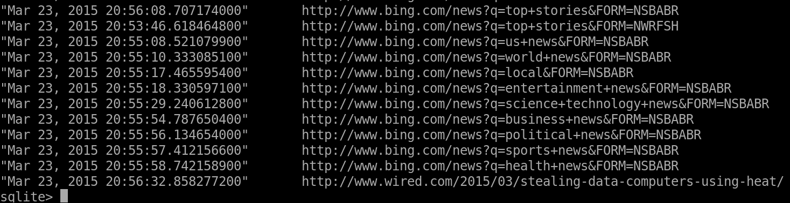
Find traces of Internet Explorer usage stored in Windows Search database
Notes:
select System_DateModified, Microsoft_IE_TargetUrl from index7 where Microsoft_IE_TargetUrl<>"";

Slide 36
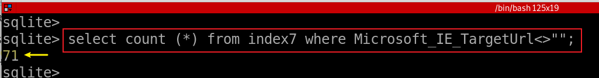

Count the number of rows in the table
Notes:
select count (*) from index7 where Microsoft_IE_TargetUrl<>"";

Slide 37
45. List the e-mail communication stored in Windows Search database.
Microsoft ESE (Extensible Storage Engine) database format
Windows.edb
  ‘System_ItemPathDisplay’ column
  ‘System_Message_FromName’ column
  ‘System_Message_ToAddress’ column
  ‘System_Message_ToName’ column
  ‘System_Message_DateSent’ column
  ‘System_Message_DateReceived’ column
  ‘System_Message_AttachmentNames’ column
  ‘System_Search_AutoSummary’ column
  …
Some e-mail items can be found only in Windows Search database.

Slide 38
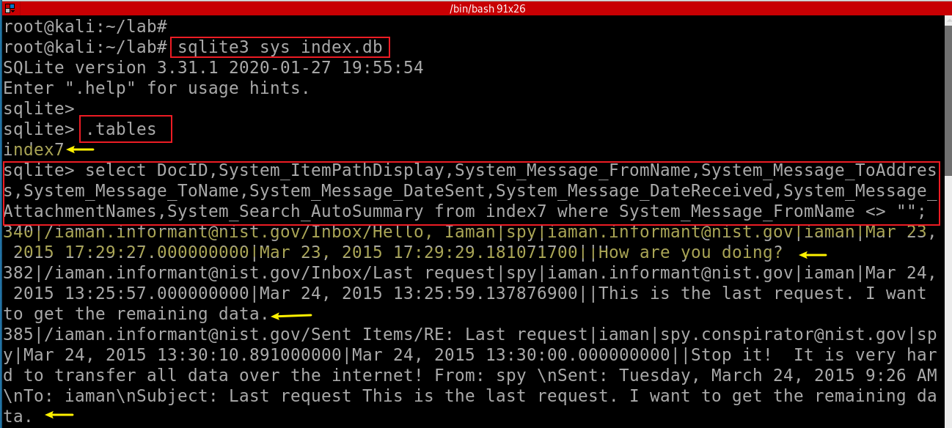
Notes:
sqlite3 sys_index.db
select DocID,System_ItemPathDisplay,System_Message_FromName,System_Message_ToAddress,System_Message_ToName,System_Message_DateSent,System_Message_DateReceived,System_Message_AttachmentNames,System_Search_AutoSummary from index7 where System_Message_FromName <> "";

Slide 39
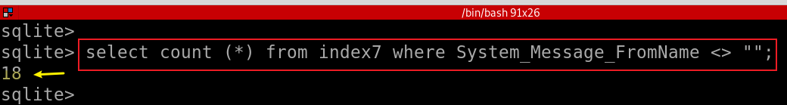
Count the number of rows in the table if the from field is not empty
Notes:
select count (*) from index7 where System_Message_FromName <> "";

Slide 40
46. List files and directories related to Windows Desktop stored in Windows Search database
Windows Desktop directory:
  \Users\informant\Desktop\
Microsoft ESE (Extensible Storage Engine) database format
  Windows.edb
  ‘System_DateCreated’ column
  ‘System_ItemDate’ column
  ‘System_ItemPathDisplay’ column
  ‘System_Search_AutoSummary’ column

Slide 41
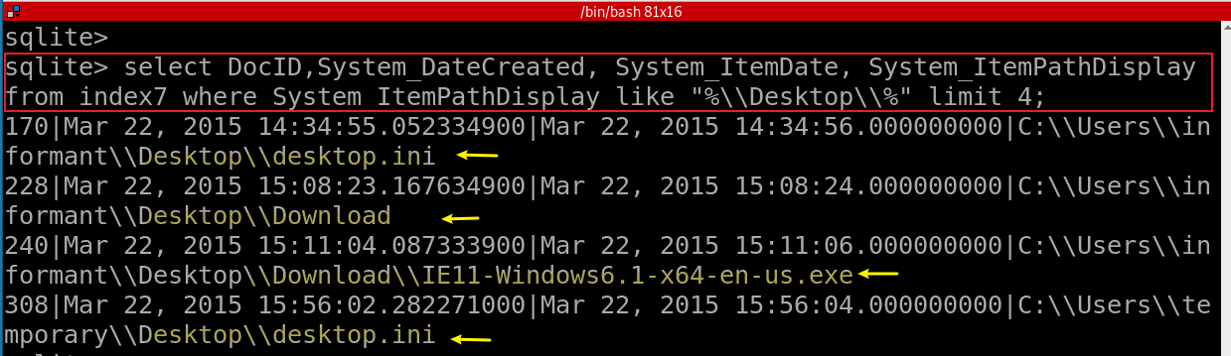
files and directories related to Windows Desktop
Count the number of file and directories in Windows Desktop
Notes:
sqlite3 sys_index.db
elect DocID,System_DateCreated, System_ItemDate, System_ItemPathDisplay from index7 where System_ItemPathDisplay like "%\\Desktop\\%" limit 4;
select count(*) from index7 where System_ItemPathDisplay like "%\\Desktop\\%" ;

Slide 42
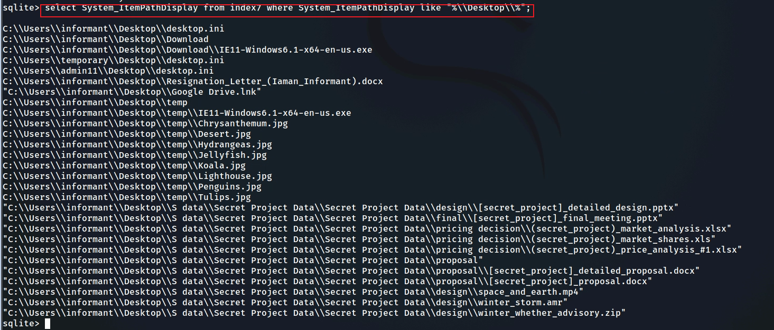
Show all files and directories in Windows Desktop
Notes:
select System_ItemPathDisplay from index7 where System_ItemPathDisplay like "%\\Desktop\\%";

