Slide 1
Investigate Data Leakage Case
Keywords: Volume Shadow Copy
Notes:
http://xmlstar.sourceforge.net/doc/UG/

Slide 2
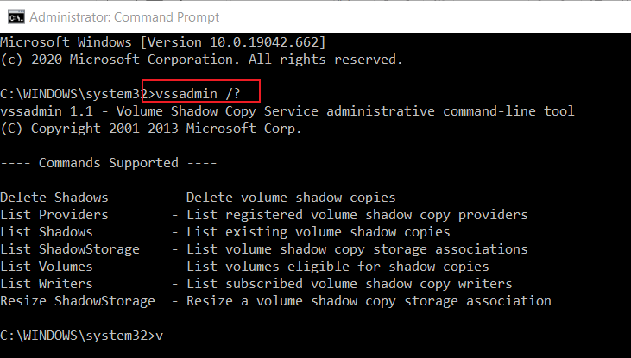
47. Where are Volume Shadow Copies stored? When were they created?
Volume Snapshots Service (VSS)
  A feature of Windows
  Allows the OS or applications to periodically take "point-in-time snapshots" of an entire disk
  Work without locking the filesystem
Introduced with Windows XP/2003
Notes:
https://docs.microsoft.com/en-us/windows/win32/vss/volume-shadow-copy-service-overview

Slide 3

Volume Shadow Copy (VSC)
Volume Shadow Copy Service
Are "differential, block-level backups“
  Whenever a change is made to live data, the block of data being modified is copied to a “differences area” associated with the shadow copy before the change is written to the live data block.
  Fast and easy to recover directly from Windows.
Shadow Copy has different IDs
  VSC ID, shadow snapshot ID, shadow Copy setID, and shadow Copy ID
VSC is useful feature of forensic analysis
C:
D:
E:
Snapshot 1
C’:
D’:
E’:
shadow Copy setID
Snapshot 2
C’’:
D’’:
E’’:
  shadow Copy ID
Notes:
https://helpcenter.itopia.com/en/articles/724296-configuring-volume-shadow-copies-vss-on-windows-server
https://leahycenterblog.champlain.edu/2014/02/05/volume-shadow-copy-part-2/

Slide 4
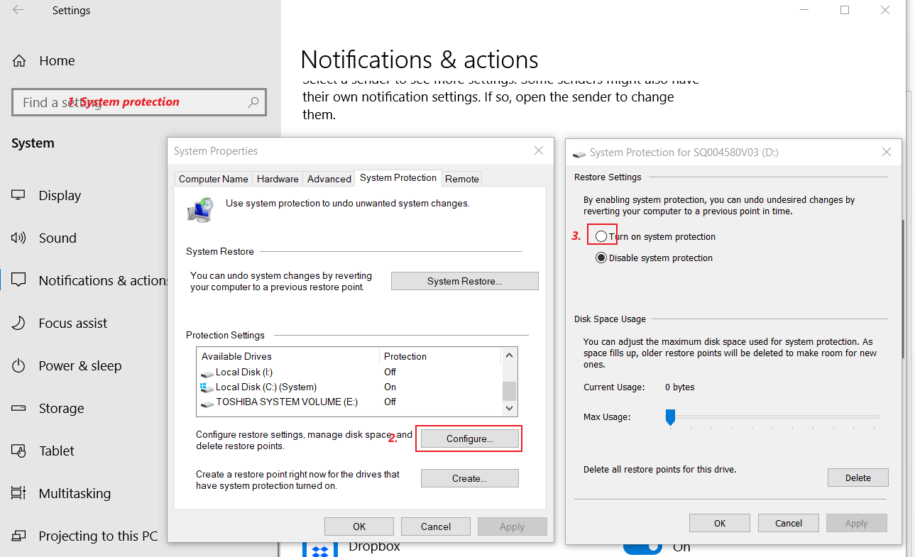
enable the shadow copy option

Slide 5
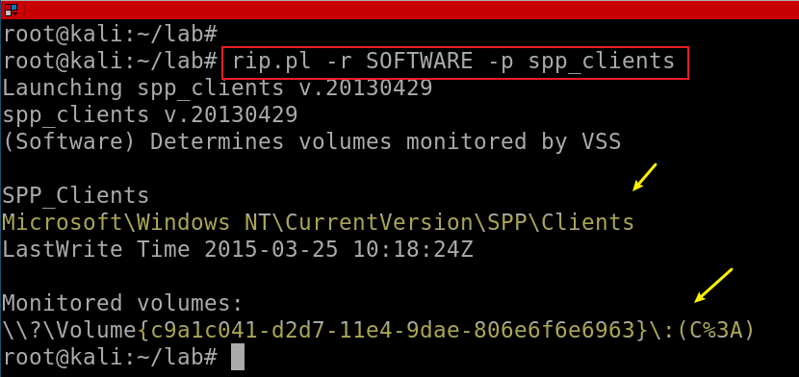
Find the monitored Volumes
Find monitored Volumes in registry
Shared protection point
%3A: ASCII Encoding of :
C:
Notes:
rip.pl -r SOFTWARE -p spp_clients

Slide 6
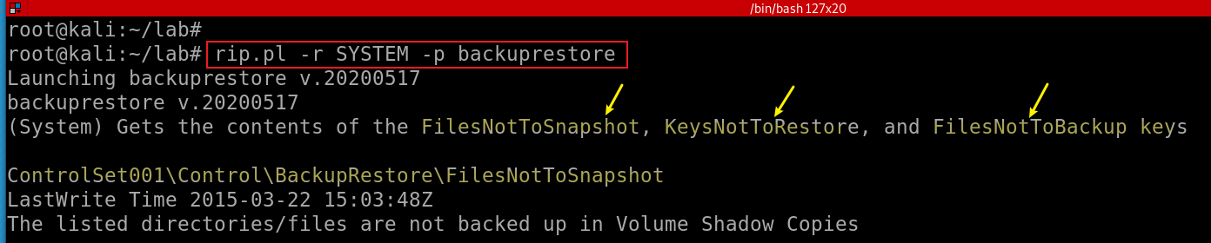
Excluding Files from Shadow Copies
Find Excluding Files from Shadow Copies in registry
Doesn’t snapshot: Unallocated space, Slack space , Page file, Hibernation file
Exclude: FilesNotToSnapshot, KeysNotToRestore, and FilesNotToBackup
Notes:
rip.pl -r SYSTEM -p backuprestore

Slide 7
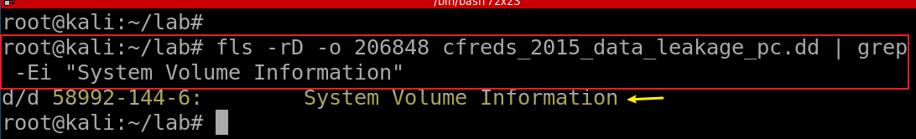
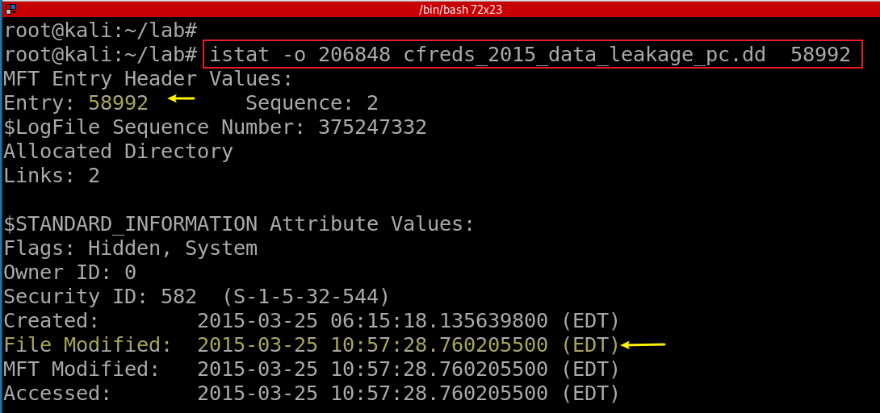
Find VSS location
Find $MFT entry ID
Find MAC timestamp of the folder
Notes:
fls -rD -o 206848 cfreds_2015_data_leakage_pc.dd | grep -Ei "System Volume Information"
istat -o 206848 cfreds_2015_data_leakage_pc.dd 58992

Slide 8
Volume Shadow Snapshots (VSS) on-disk
 | Header (VSS ID) 3808 |  | Catalog Contains store info Radom Store GUID Timestamp Location of store |  | Stores Contains one snapshot Shadow copy set ID Shadow copy ID

Slide 9
Shadow Copy location
\System Volume Information\{Store GUID}{VSS ID}
  VSS ID stored at file offset 0 for 16 bytes
    {3808876b-c176-4e48-b7ae-04046e6cc752}
  VSC ID stored at file offset 144 for 16 bytes
    {8f1a2a2d-ce6b-42a5-b92b-f13e65d9c2cb}
  VSC set ID stored at file offset 160 for 16 bytes
    {56e43eb5-ac18-4f06-a521-1e17712b7ced}
Old shadow copies are overwritten
Shared protection point (SPP)
  The location of monitored volume

Slide 10
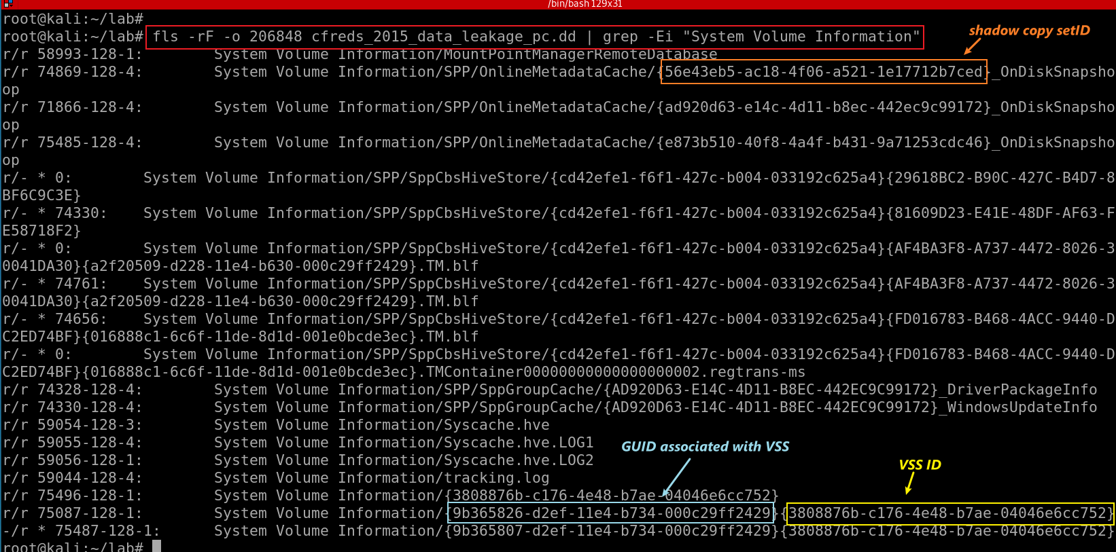
Find all files contains the path “System Volume Information”
Notes:
losetup -r --partscan --find --show cfreds_2015_data_leakage_pc.dd
fls -rF -o 206848 cfreds_2015_data_leakage_pc.dd | grep -Ei "System Volume Information"

Slide 11
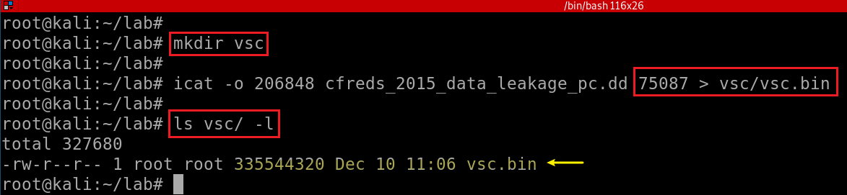
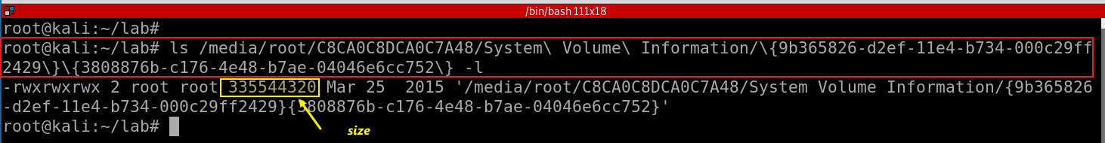
Find the size of VSC method 1 using icat
Find the size of VSC method 2 after mounting
Notes:
mkdir vsc
icat -o 206848 cfreds_2015_data_leakage_pc.dd 75087 > vsc/vsc.bin
ls vsc/ -l

Slide 12
Using libvshadow tool to retrieve Snapshot from a DD image
libvshadow is a library to access the Volume Shadow Snapshot format.
The snapshot format is used by Windows, as of Vista, to maintain copies of data on a storage media volume.
Notes:
https://www.youtube.com/watch?v=OtIk2ldtWno&ab_channel=0xN00B

Slide 13
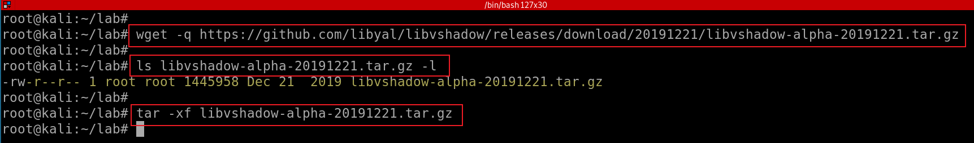
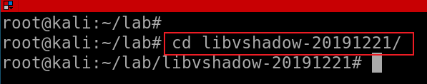
Install libvshadow
retrieve the source distribution package
extract the source distribution package
This will create the source directory: libvshadow-<version>
Change to source directory
Notes:
wget -q wget https://github.com/libyal/libvshadow/releases/download/20210425/libvshadow-alpha-20210425.tar.gz
ls libvshadow-alpha-20191221.tar.gz –l
tar -xf libvshadow-alpha-20191221.tar.gz
python setup.py build
sudo python setup.py install

Slide 14
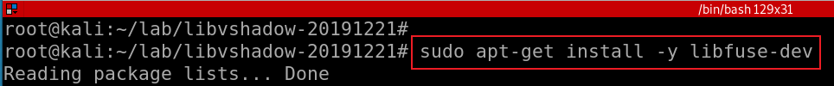

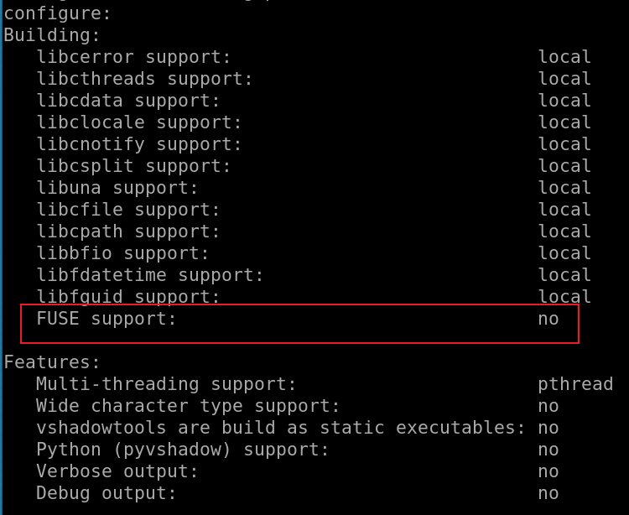


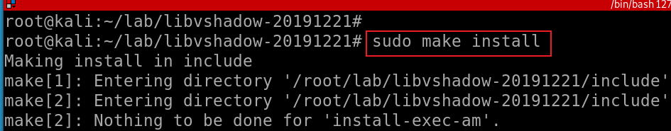
FUSE (Filesystem in Userspace) is an interface for userspace programs to export a filesystem to the Linux kernel. Without it, you will see error message ”No sub system to mount VSS format”
Install FUSE
Build the libvshadow source code change into the source directory
Install the binaries that were build by running:
Notes:
sudo apt-get install -y libfuse-dev
sudo apt install -y git autoconf automake autopoint libtool pkg-config

Slide 15
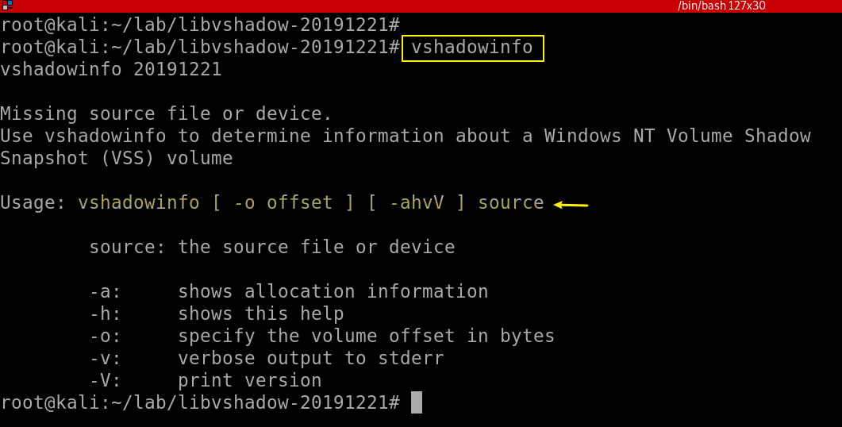
Verify tool installation
In bytes not sectors

Slide 16
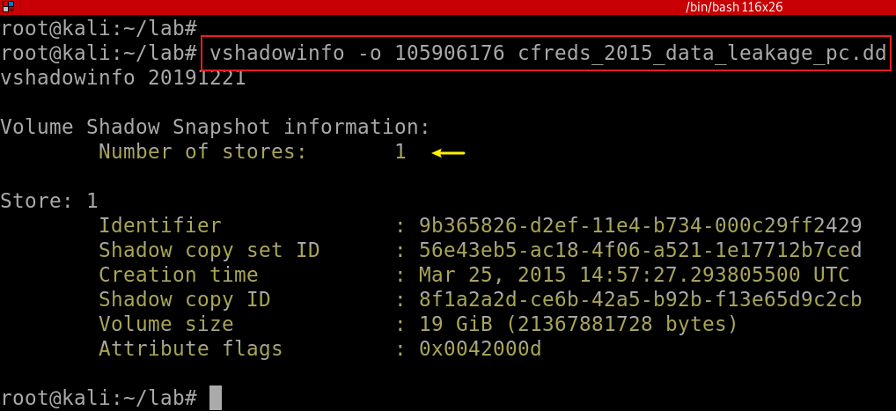
Find VSS information using vshadowinfo
206848*512(bytes per sector)=105906176 bytes
Identifier: A random GUID for storing a snapshot
Creation time: the timestamps shows that the VSC is created before the logout activity. Next slide shows all user logout activities
Notes:
vshadowinfo -o 105906176 cfreds_2015_data_leakage_pc.dd

Slide 17
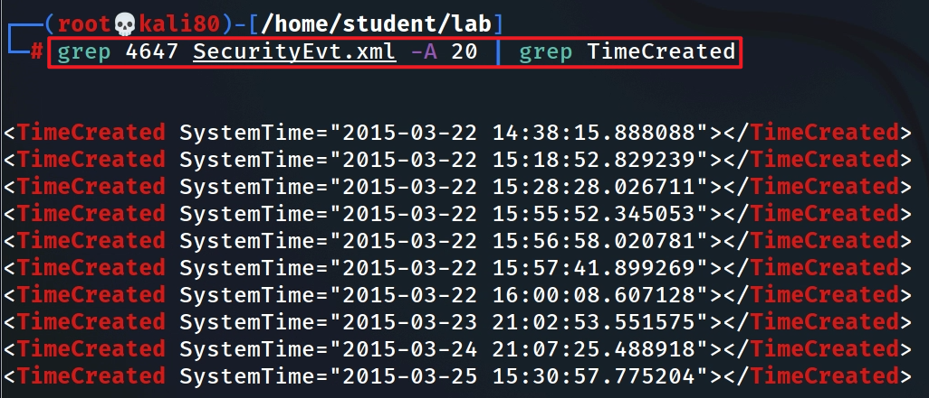
4608 (Windows is starting up)
1100 (service shutdown)
4624 (successful logon)
4634 (logoff)
4625 (logon failure)
4647 (a user initiated the logoff process)...
Find user (informant) initiated logout activities
The timestamps shows the user last time logoff activity.
The VSC is token before the logoff activity
Notes:
grep 4647 SecurityEvt.xml -A 20 | grep TimeCreated

Slide 18
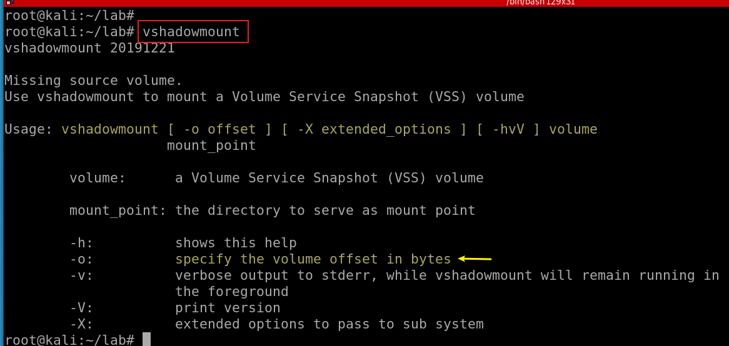
The name of the command is confusing. It extract vss image, not real mounting
Verify tool installation

Slide 19
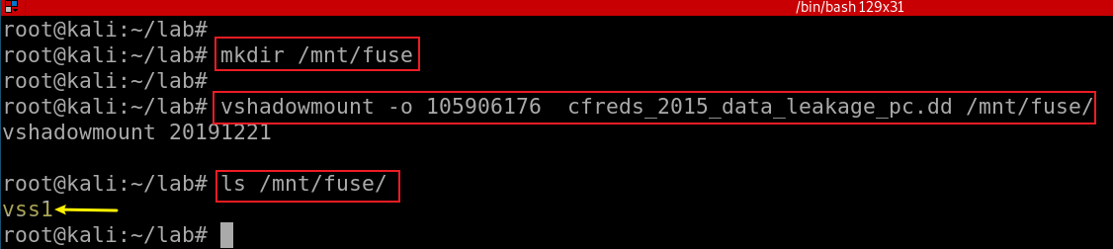
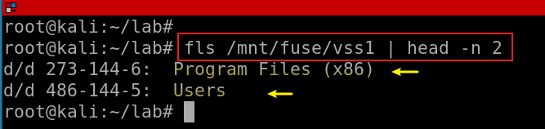
Create a mounting point to VSS
Mount dd image to the mounting point
Verify we have VSS1 image
VSS volume: /mnt/fuse/vss1
Show vss1 image
Notes:
mkdir /mnt/fuse
vshadowmount -o 105906176 cfreds_2015_data_leakage_pc.dd /mnt/fuse/
ls /mnt/fuse/
fls /mnt/fuse/vss1 | head -n 2
https://www.youtube.com/watch?v=OtIk2ldtWno&ab_channel=0xN00B

Slide 20
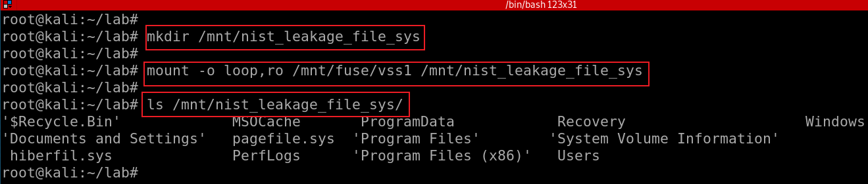
mount the VSS1 file as a loop device
Notes:
mkdir /mnt/nist_leakage_file_sys
mount -o loop,ro /mnt/fuse/vss1 /mnt/nist_leakage_file_sys
ls /mnt/nist_leakage_file_sys/
https://www.youtube.com/watch?v=OtIk2ldtWno&ab_channel=0xN00B

Slide 21
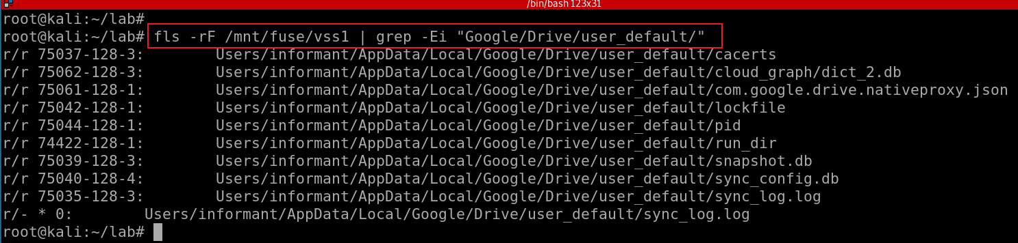
48. Find traces related to Google Drive service in Volume Shadow Copy.
What are the differences between the current system image (of Question 29 ~ 31) and its VSC?
google drive information on VSS
Notes:
fls -rF /mnt/fuse/vss1 | grep -Ei "Google/Drive/user_default/"

Slide 22
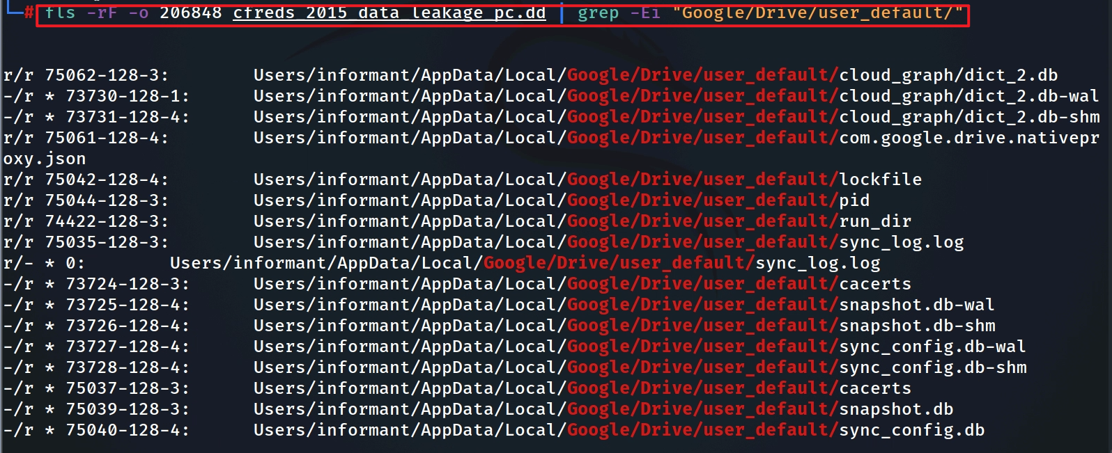
google drive information on current image
these files are deleted due to logoff activities

Slide 23
Files associated with Google Driver
snapshot.db: contains information about local and cloud entries
  Cloud_entry table: files in a cloud
  local_entry table: files at a local device
sync_config.db: contains profile configuration
  has only one table with containing several records including
    the Google Drive version used,
    the local sync root path and
    the user email address.
these files are deleted due to logoff activities

Slide 24
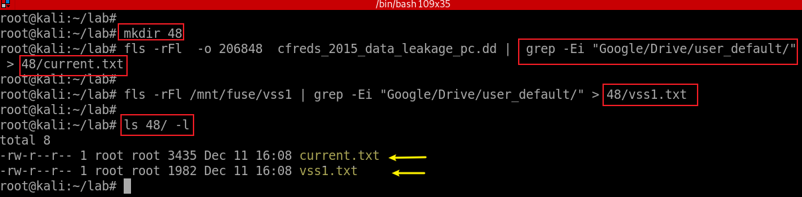
How to compare files at current DD file system and VSC?
Extract Google drive service files from both DD and VSS images
Notes:
mkdir 48
fls -rFl -o 206848 cfreds_2015_data_leakage_pc.dd | grep -Ei "Google/Drive/user_default/" > 48/current.txt
fls -rFl /mnt/fuse/vss1 | grep -Ei "Google/Drive/user_default/" > 48/vss1.txt
ls 48/ -l

Slide 25
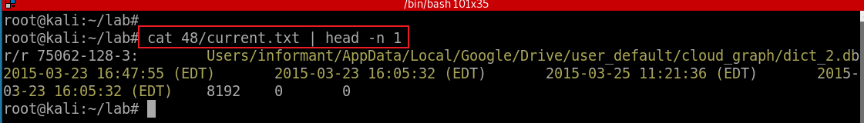
Show first record to understand the file information
file type as reported in file name and metadata structure (see above)
Metadata Address
name
mtime (last modified time)
atime (last accessed time)
ctime (last metadata changed time, e.g., permission)
crtime (created time)
size (in bytes)
uid (User ID)
gid (Group ID)
Notes:
https://wiki.sleuthkit.org/index.php?title=Fls

Slide 26
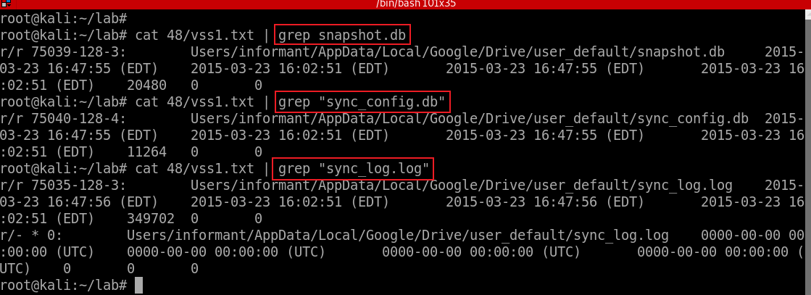
Search Google Driver service files (databases) related files in VSS1
Notes:
cat 48/vss1.txt | grep snapshot.db
cat 48/vss1.txt | grep "sync_config.db“
cat 48/vss1.txt | grep "sync_log.log"

Slide 27
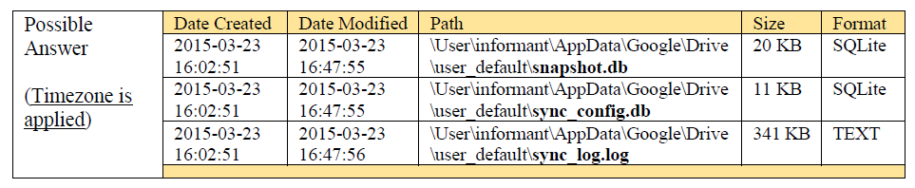
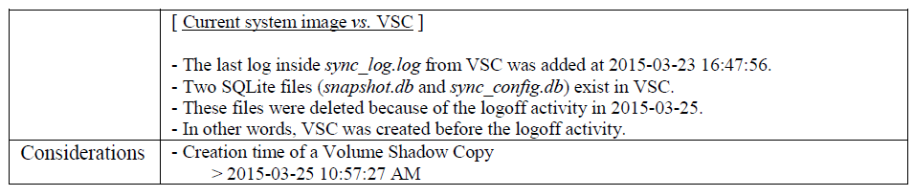
You should compare your result against NIST’s solution below
in VSS1

Slide 28
49. What files were deleted from Google Drive?
When files are deleted
  Entries of cloud_entry table are deleted
  Approach: To find deleted records of cloud_entry table inside snapshot.db from VSC
Who did delete files?
  sync_config.db contains the account information
Just examine the SQLite database only
  Let us suppose that a text-based log file was wiped.

Slide 29
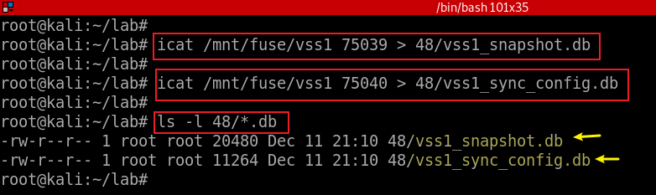
Extract Google Driver service .db files from VSC
Notes:
icat /mnt/fuse/vss1 75039 > 48/vss1_snapshot.db
icat /mnt/fuse/vss1 75040 > 48/vss1_sync_config.db

Slide 30
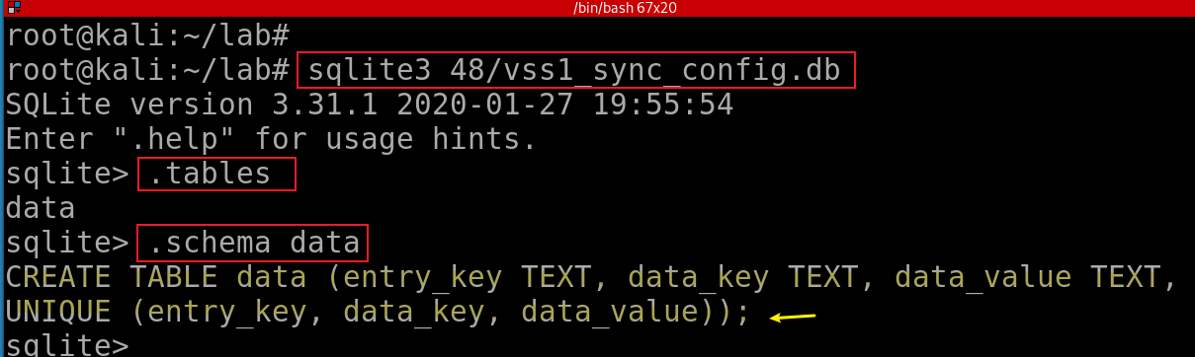
vss1_sync_config.db
It has only one table, including Google Drive configuration information
  the Google Drive version used,
  the local sync root path and
  the user email address.
Show schema vss1_sync_config.db

Slide 31
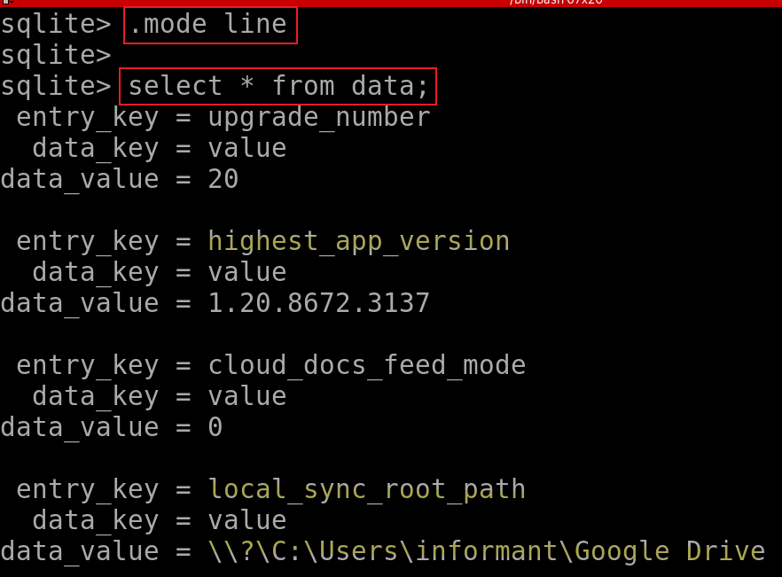
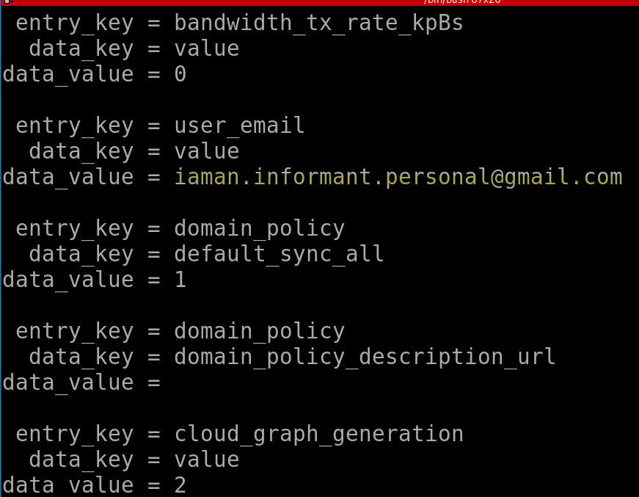
Check records of vss1_sync_config.db
Notes:
.mode line
select * from data;

Slide 32
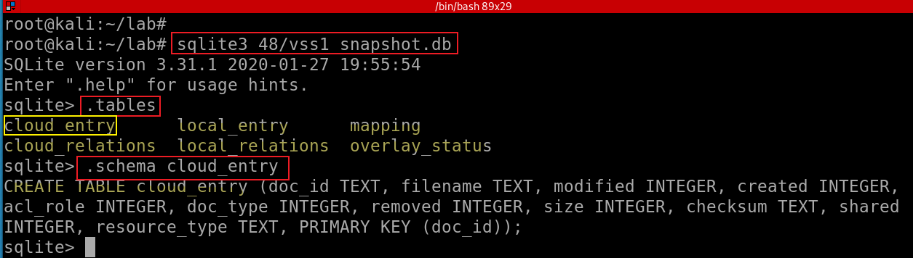
snapshot.db
Show records of snapshot.db
entries in the table have been deleted, however, you still can view deleted entries
INTEGER. The value is a signed integer, stored in 1, 2, 3, 4, 6, or 8 bytes depending on the magnitude of the value.
TEXT. The value is a text string, stored using the database encoding (UTF-8, UTF-16BE or UTF-16LE).
Notes:
sqlite3 48/vss1_snapshot.db
.tables
.schema cloud_entry

Slide 33
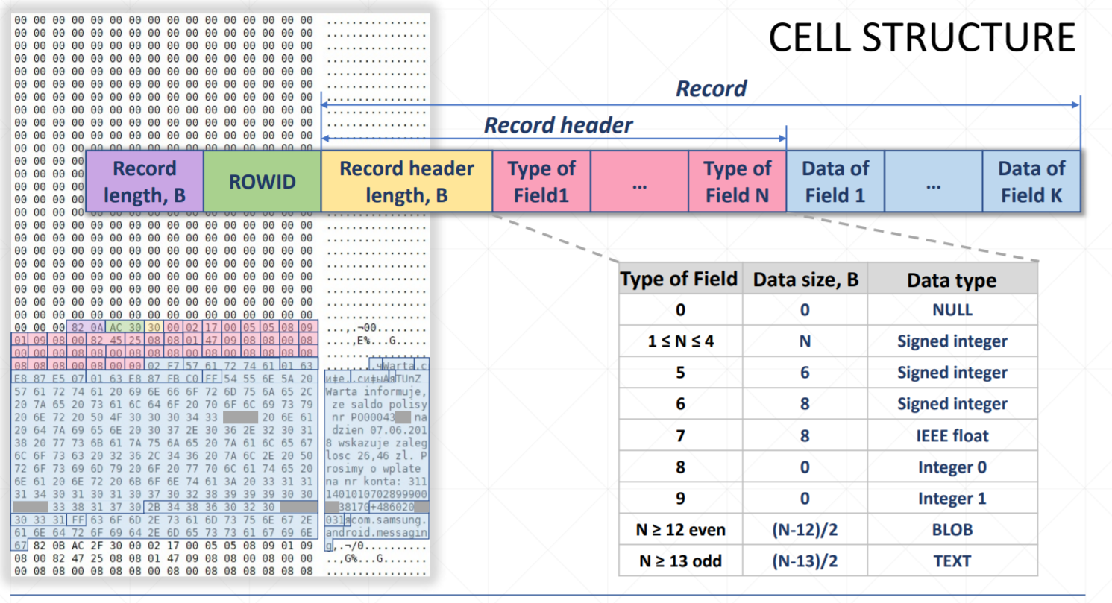

Compare entries before/after deleted
Notes:
https://rusolut.com/wp-content/uploads/2019/05/5_VNR-SQLite-carver.pdf

Slide 34
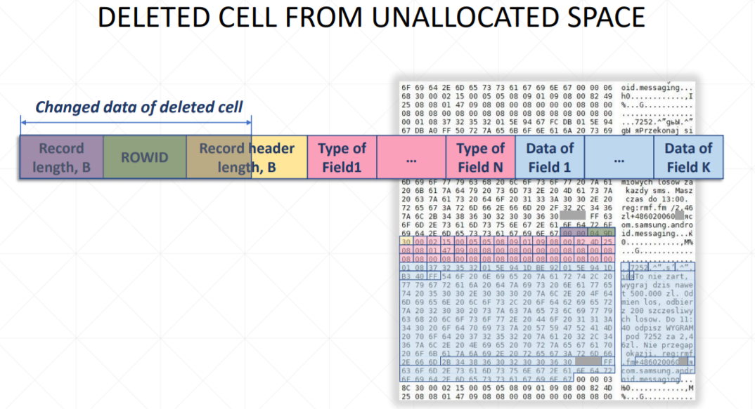
Fields of deleted entries remain

Slide 35
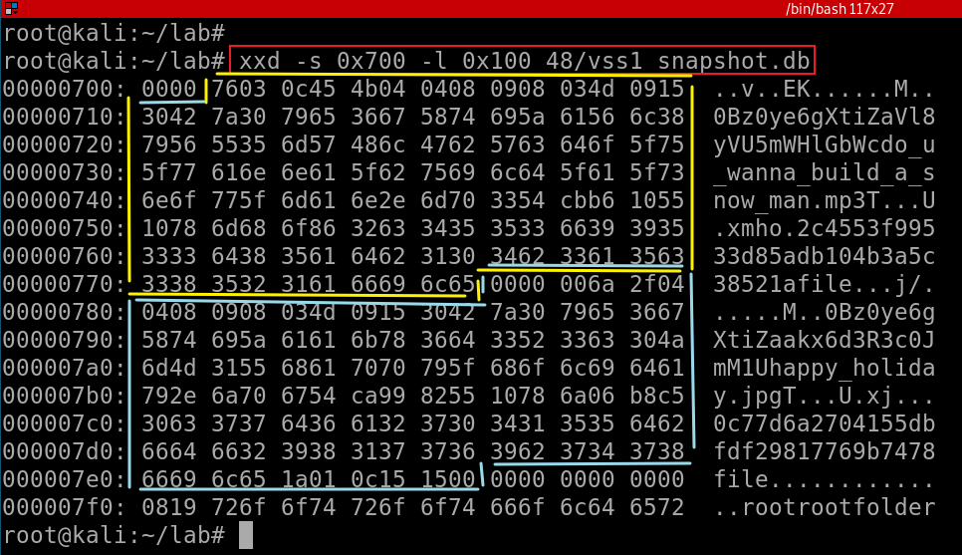
Show two deleted file entries
The first deleted file
do_u_wanna_build_a_snow_man.mp3
The second deleted file
happy_holiday.jpg
Notes:
xxd -s 0x700 -l 0x100 48/vss1_snapshot.db

Slide 36
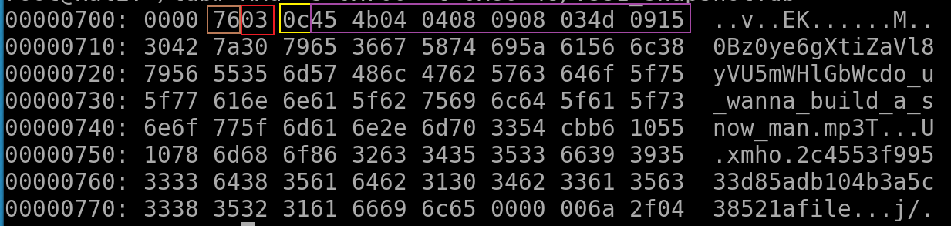
Analyze the first deleted file do_u_wanna_build_a_snow_man.mp3
Record length (0x76) | Row ID (0x03) | Record header length (0x0c) | Type of Fields

Slide 37
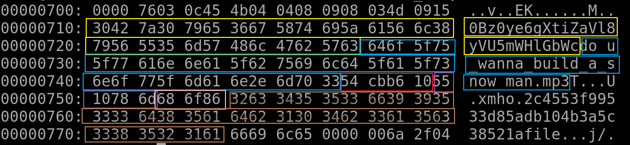
Record Info | Column | Size (bytes) | Data
[File offset 0x702] RecordSize: 0x76 RowID: 0x03 HeaderSize: 0x0C | doc_id | (69-13)/2 = 28 | 0Bz0ye6gXtiZaVl8yVU5mWHlGbWc
 | Filename | (75-13)/2 = 31 | do_u_wanna_build_a_snow_man.mp3
 | modified | 4 | 0x54CBB610 (1422636560) → 2015-01-30 11:49:20 (UTC-05)
 | created | 4 | 0x5510786D (1427142765) → 2015-03-23 16:32:45 (UTC-04)
 | acl_role | 0 | 0
 | doc_type | 0 | 1
 | removed | 0 | 0
 | size | 3 | 0x686F86 (6844294) → 6,844,294 bytes
 | checksum | (77-13)/2 = 32 | 2c4553f99533d85adb104b3a5c38521a
 | shared | 0 | 1
 | resource_type | (21-13)/2 = 4 | file
Notes:
Can we use strings? strings 48/vss1_snapshot.db
More reading https://digitalforensicforest.com/2015/07/27/sqlite-data-carving-a-way-to-trace/
http://forensicsfromthesausagefactory.blogspot.com/2011/04/carving-sqlite-databases-from.html

Slide 38
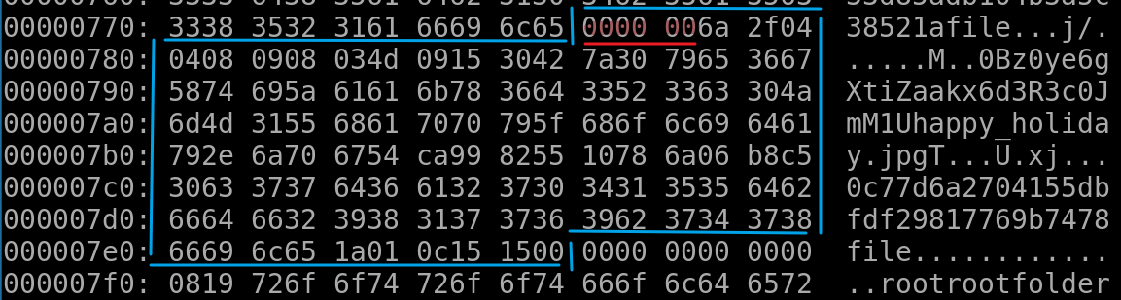
Analyze the second deleted file happy_holiday.jpg
[File offset 0x77A] First 4 bytes are overwritten RecordSize: N/A RowID: N/A HeaderSize: N/A | doc_id | fixed size (28) | 0Bz0ye6gXtiZaakx6d3R3c0JmM1U
 | Filename | (47-13)/2 = 17 | happy_holiday.jpg
 | modified | 4 | 0x54CA9982 (1422563714) → 2015-01-29 15:35:14 (UTC-05)
 | created | 4 | 0x5510786A (1427142762) → 2015-03-23 16:32:42 (UTC-04)
 | acl_role | 0 | 0
 | doc_type | 0 | 1
 | removed | 0 | 0
 | size | 3 | 0x6B8C5 (440517), → 440,517 bytes
 | checksum | (77-13)/2 = 32 | 0c77d6a2704155dbfdf29817769b7478
 | shared | 0 | 1
 | resource_type | (21-13)/2 = 4 | file

Slide 39
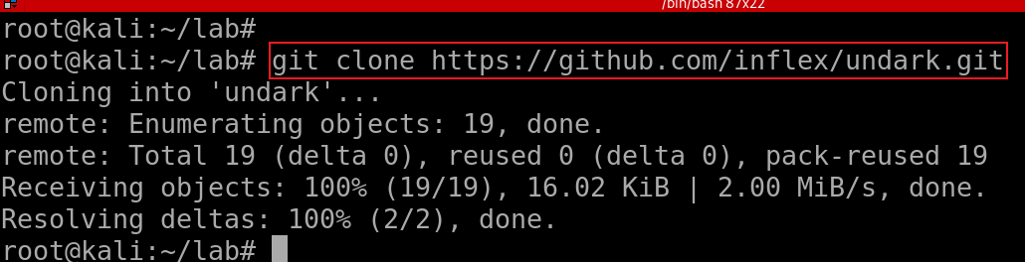
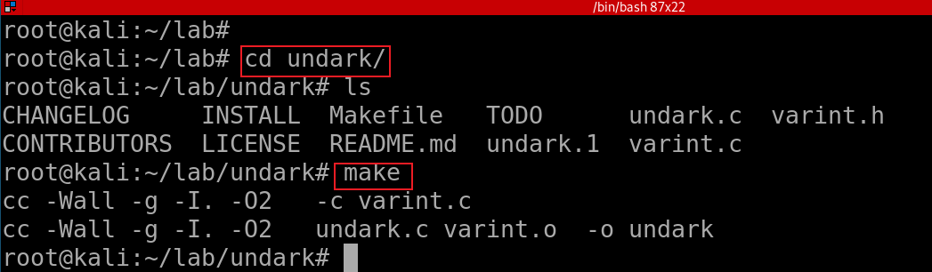
Carving sqlite .db with tools
Clone the project
Build it!

Slide 40
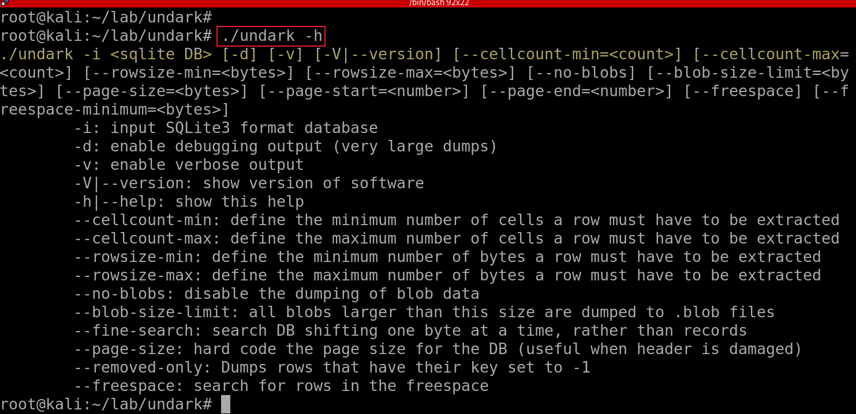
Show Help

Slide 41
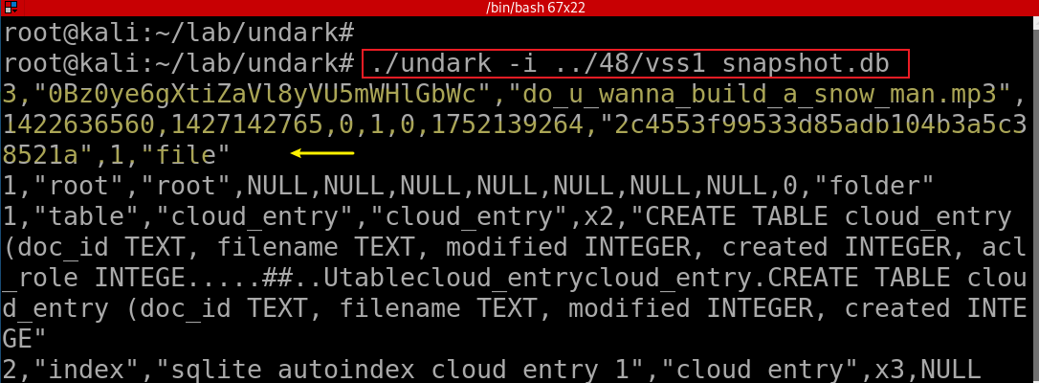
Show Help
Note: the second record can be not carved due to missing information

Slide 42
50. Why can’t we find Outlook’s e-mail data in Volume Shadow Copy?
Find Excluding Files from Shadow Copies in registry
Doesn’t snapshot: Unallocated space, Slack space , Page file, Hibernation file
Exclude: FilesNotToSnapshot, KeysNotToRestore, and FilesNotToBackup
Notes:
https://msdn.microsoft.com/en-us/library/windows/desktop/aa819132(v=vs.85).aspx

Slide 43
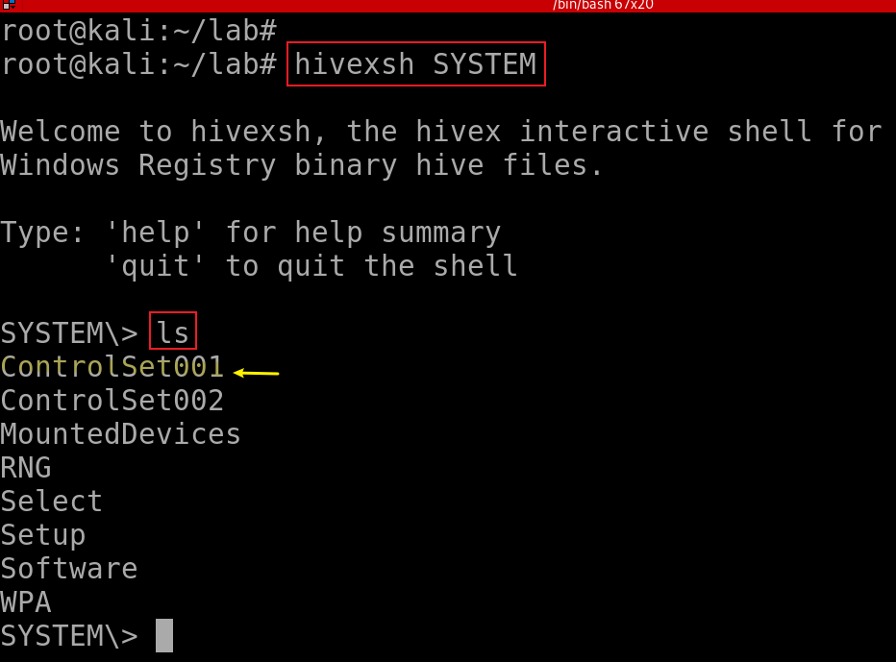
Find System hive
Notes:
hivexsh SYSTEM

Slide 44
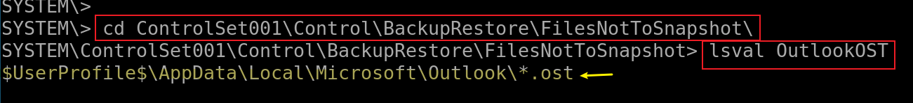
Find HKLM\System\CurrentControlSet\Control\BackupRestore\FilesNotToSnapshot\
lsval [key]: List the (key, value) pairs of the current hive Registry key.
Notes:
cd ControlSet001\Control\BackupRestore\FilesNotToSnapshot\
lsval OutlookOST

