Slide 1

Investigating Health Application
iOS 13

Slide 2
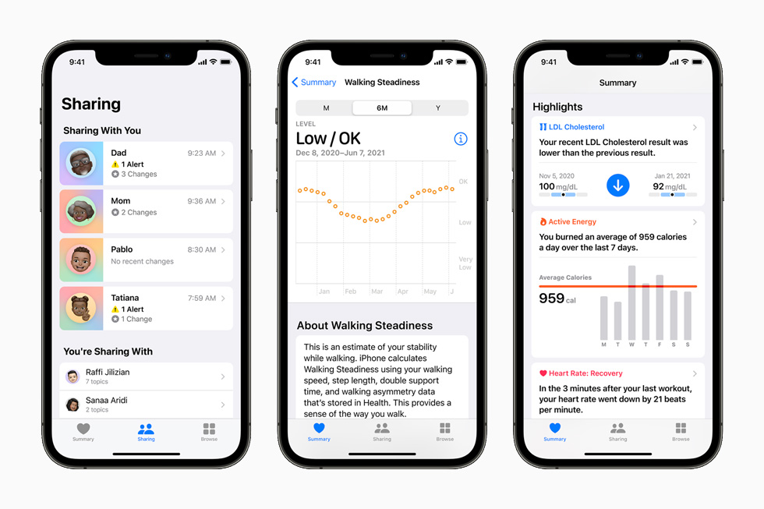
Introduction to Health App
The iPhone Health App automatically collects data on daily activities for health purposes. Detailed information on the number of steps taken and distances travelled is stored in a database together with timestamps with a time granularity of a couple of minutes. While such information can potentially be very valuable in a forensic investigation.

Slide 3
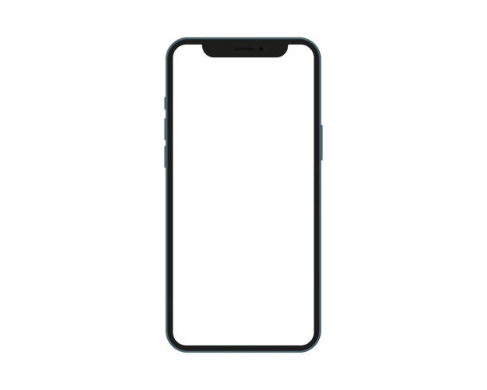
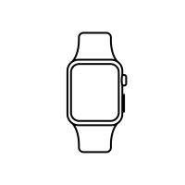
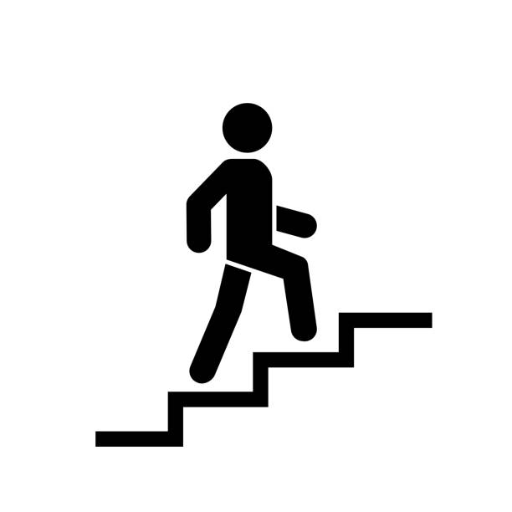

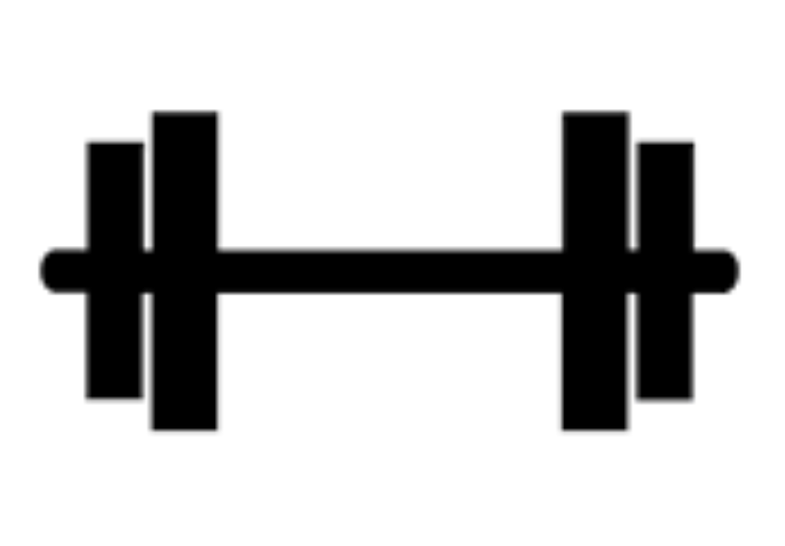
About Apple Health App
The Health app was created to help organize your important health information and make it easy to access in a central and secure place.

Slide 4
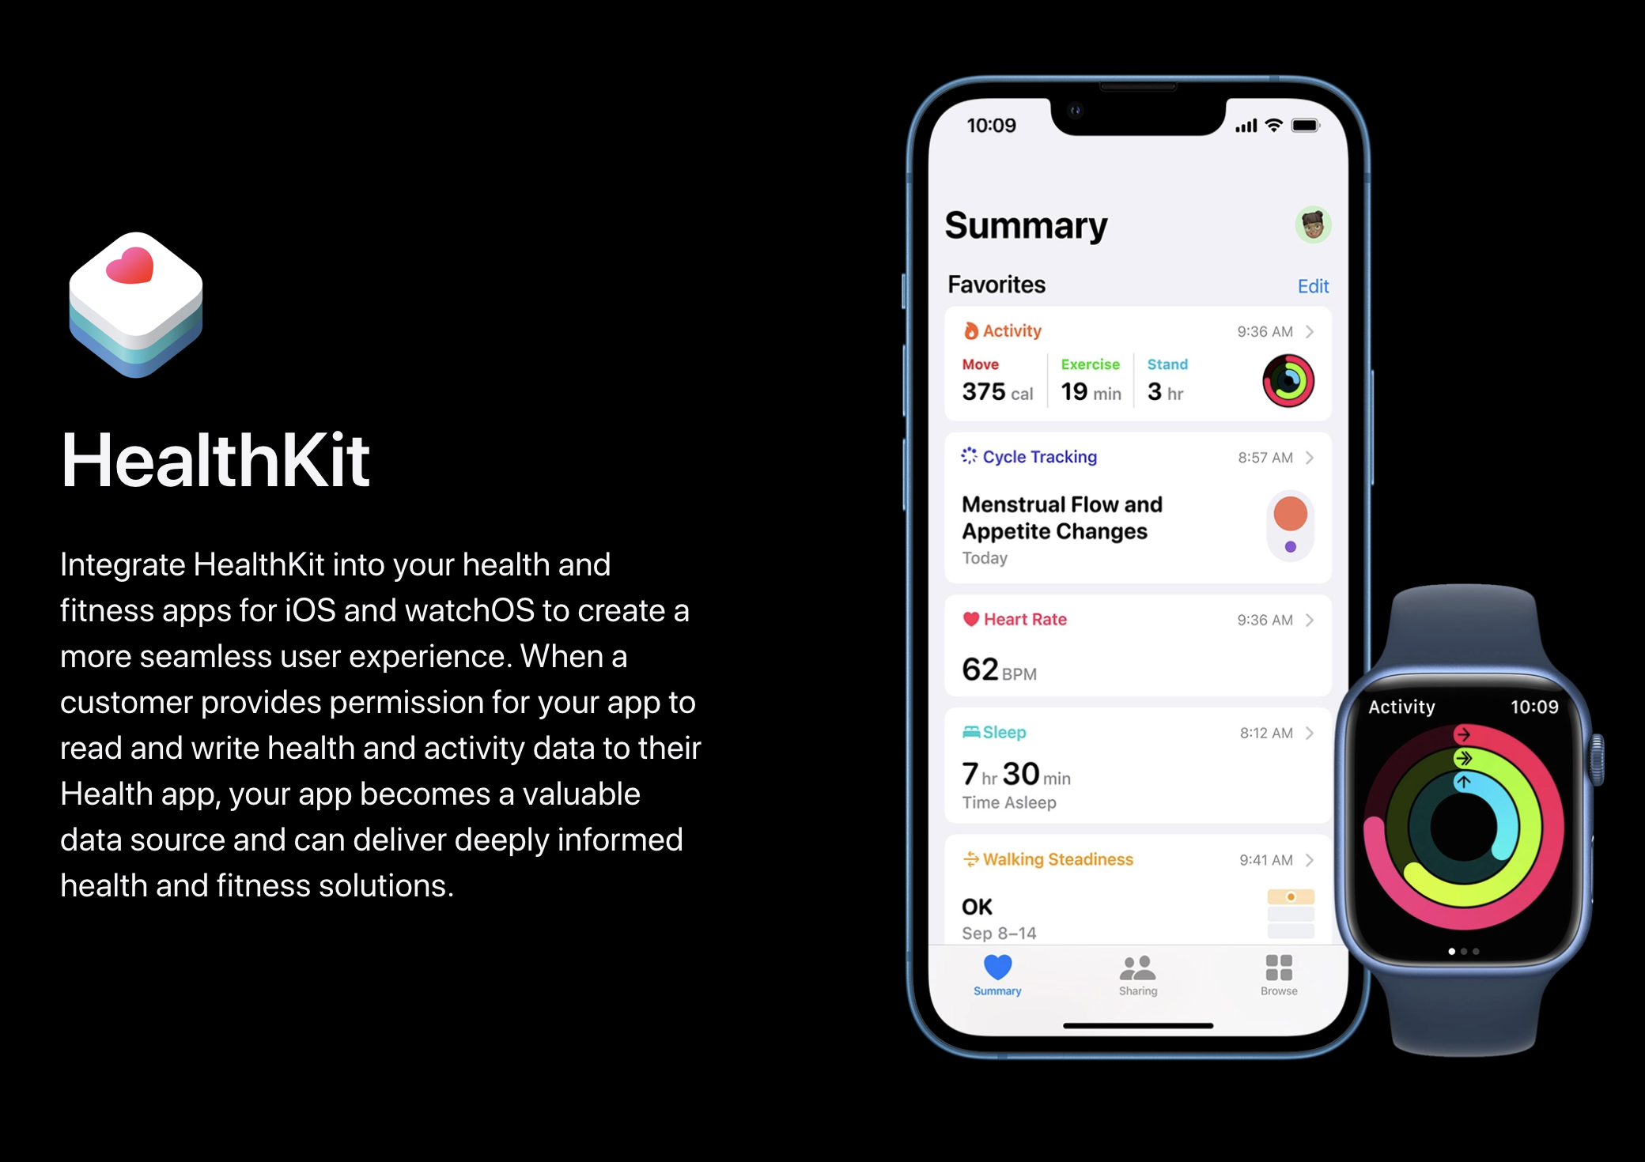
How Devices and Applications Sync to Health
HealthKit is a set of Developer tools which allow third party products and applications to be able to sync to Apple’s Health app
Notes:
https://developer.apple.com/health-fitness/

Slide 5
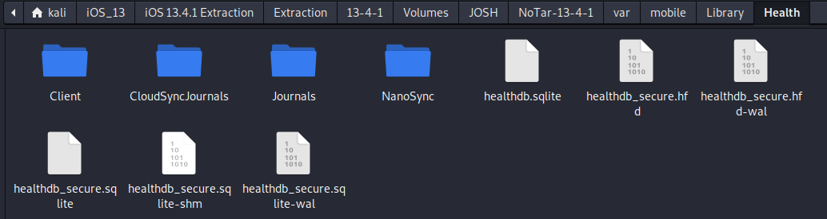
Location of Health Folder & Databases
Located at ~/var/mobile/Library/Health

Slide 6
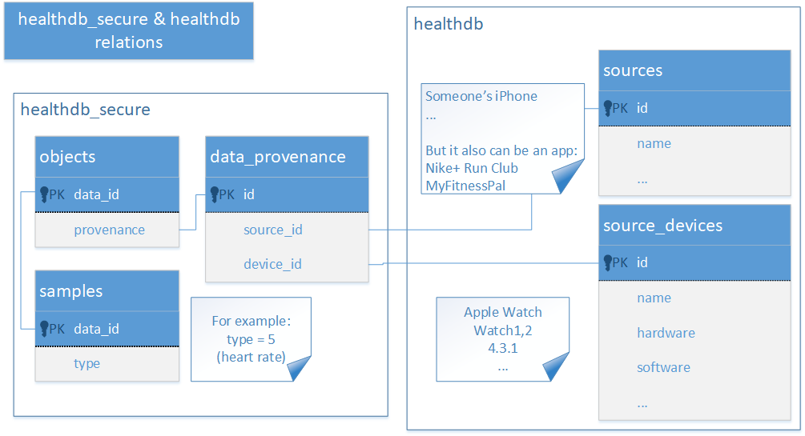
What's the difference between HealthDB and HealthDB_Secure?
The two databases contain all information collected or received by the Health app with one exception. There is also a separate encrypted database healthdb_secure.sql. It stores the user’s GPS coordinates collected during workouts.

Slide 7
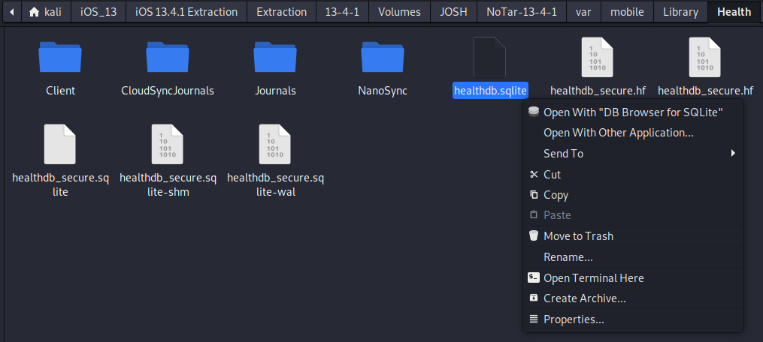
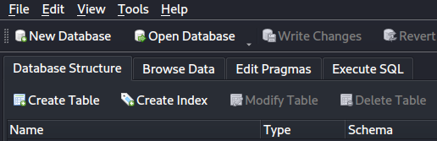
Querying within Healthdb.sqlite
Open healthdb.sqlite with DB Browser for SQLite.
Head to execute SQL tab.

Slide 8
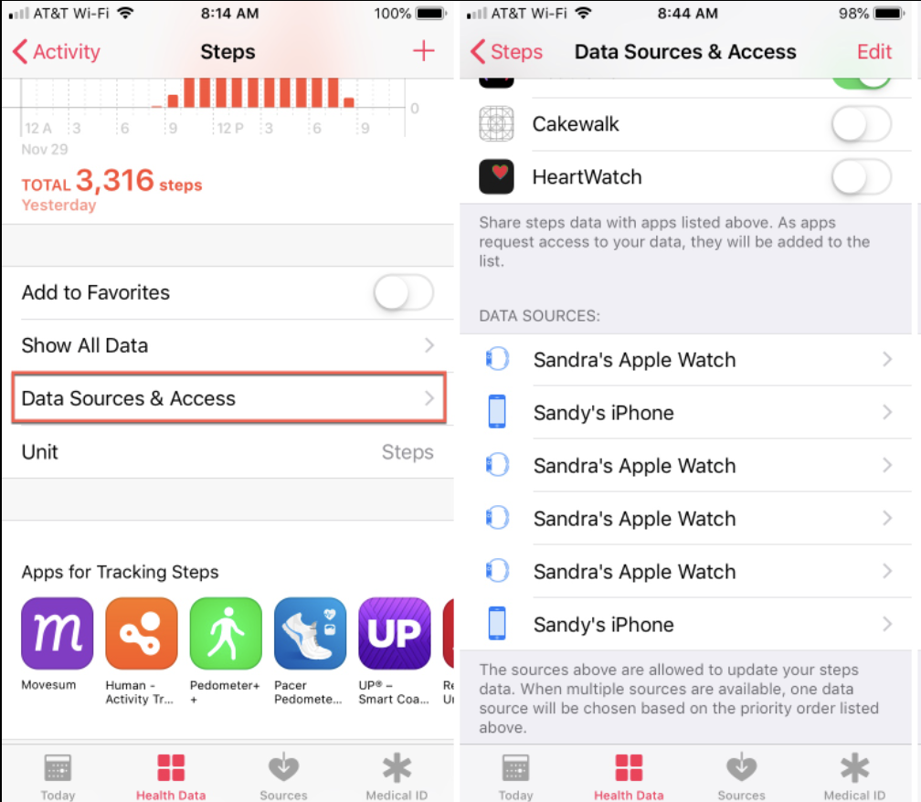
Health Sources - Devices
Data Sources in the Health app can be Apple Devices or third-party products (i.E Fitbits) that are synced to the Health app to log steps and exercise, etc.
We can set up a simple statement to extract the synced devices from healthdb.sqlite

Slide 9
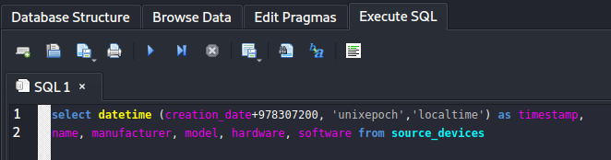
Health Sources – Devices - Statement
Copy and paste the statement below into the Execute SQL tab and press the play button to execute.
select datetime (creation_date+978307200, 'unixepoch','localtime') as timestamp,
name, manufacturer, model, hardware, software from source_devices

Slide 10
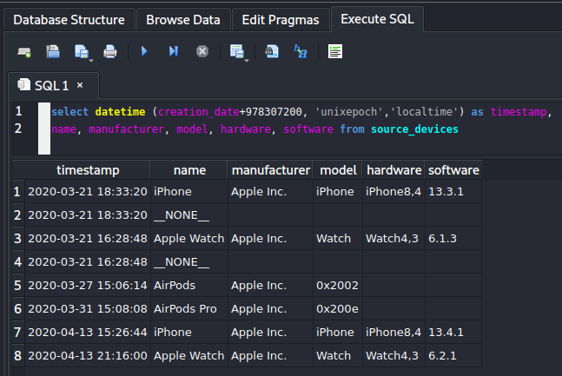
Health Sources – Devices - Results
Upon successful execution the SQL will return a list of devices. Many of the devices are duplicates but registered as different devices due to software version.

Slide 11
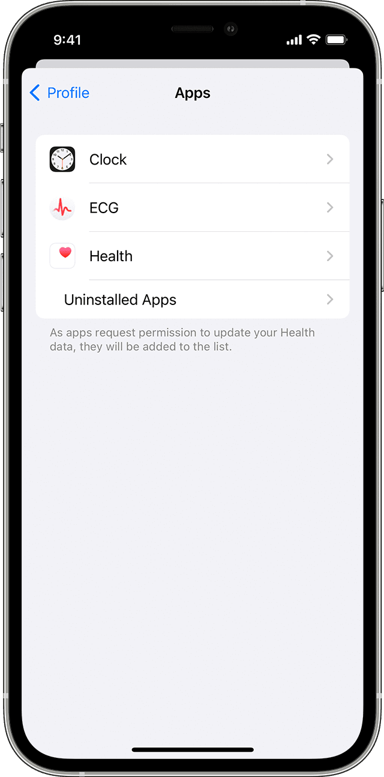
Health Sources - Applications
Health Applications can also be synced to the health app on iOS. Which stores all gathered health data in one place for the user.
Apple supports native applications as well as most third-party exercise apps to be synced to the Health app for the user.

Slide 12
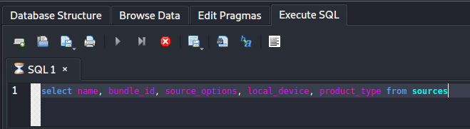
Health Sources – Applications - Statement
Copy and paste the statement below into the Execute SQL tab and press the play button to execute.
select name, bundle_id, source_options, local_device, product_type from sources

Slide 13
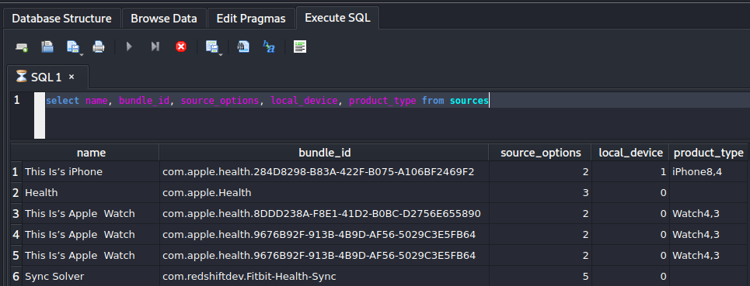
Health Sources – Devices - Results
Here we can see the results of the applications synced to the iPhone. Appears mostly to be native apple apps and the Fitbit app are synced.

Slide 14
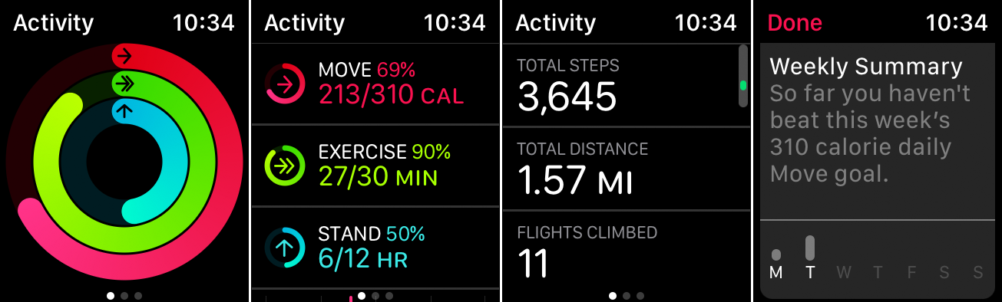
Healthdb_Secure – Activity Cache
Located within healthdb_secure.sqlite

Slide 15
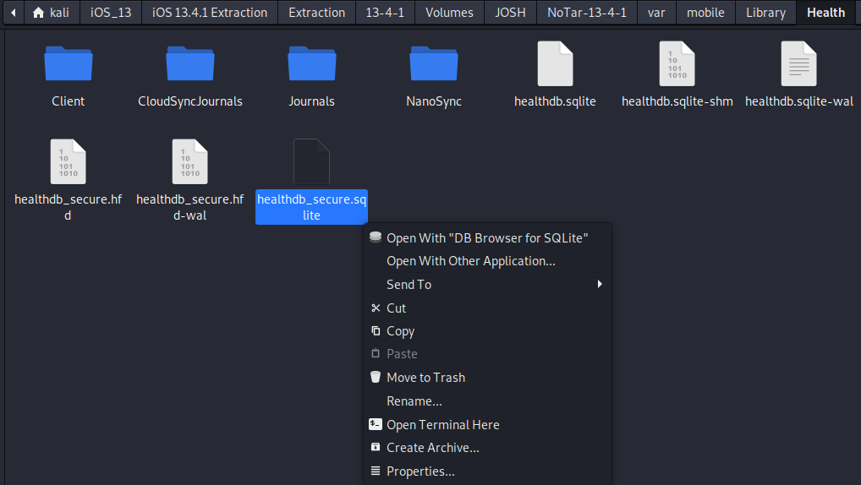
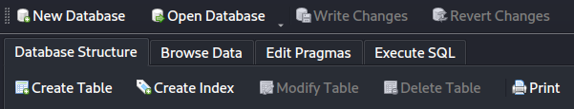
Healthdb_secure.sqlite
Open healthdb_secure.sqlite with DB Browser for SQLite
Head to Execute SQL tab

Slide 16
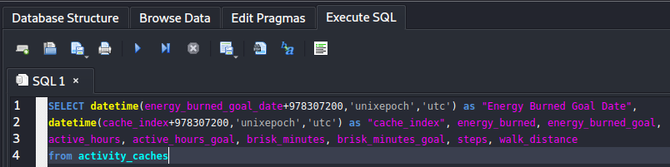
Activity Cache - Statement
Copy and paste the statement below into the Execute SQL tab and press the play button to execute.
SELECT datetime(energy_burned_goal_date+978307200,'unixepoch','utc') as "Energy Burned Goal Date",
datetime(cache_index+978307200,'unixepoch','utc') as "cache_index", energy_burned, energy_burned_goal,
active_hours, active_hours_goal, brisk_minutes, brisk_minutes_goal, steps, walk_distance
from activity_caches

Slide 17
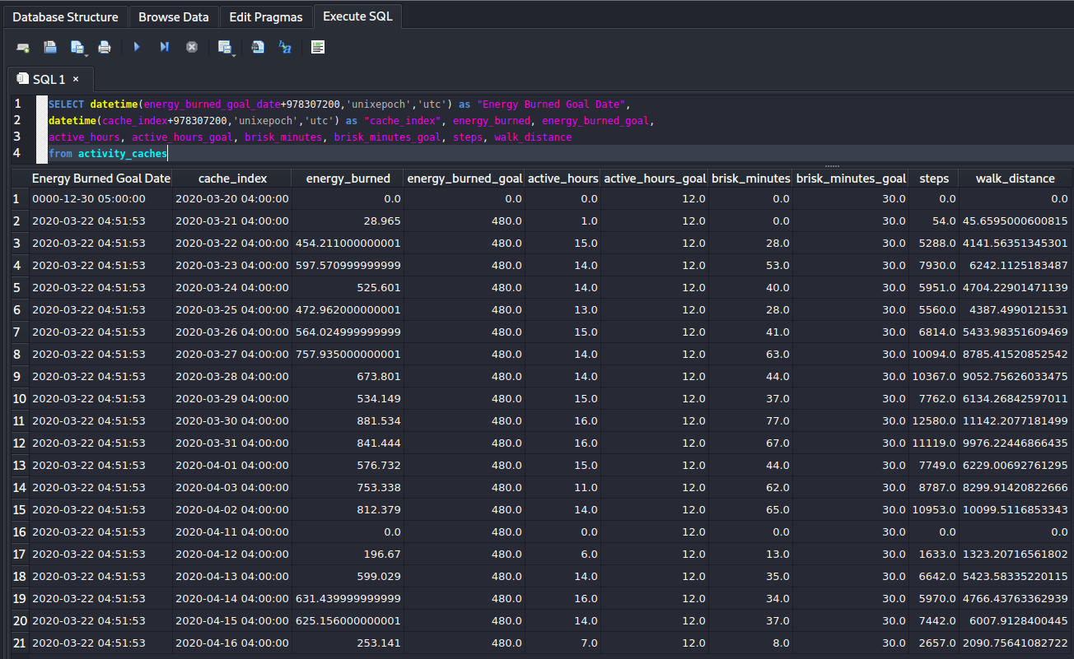
Activity Cache - Results
In meters
Calories
Calorie Goal
The Activity Cache stores a log of activity captured by the Health App

Slide 18
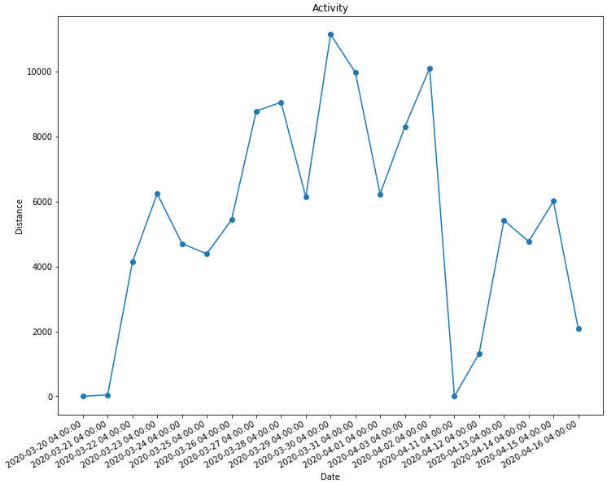
Activity Cache Results – Visualized - Distance

Slide 19
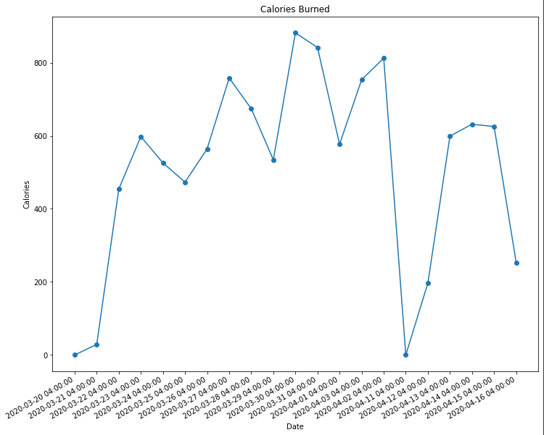
Activity Cache Results – Visualized - Calories

Slide 20
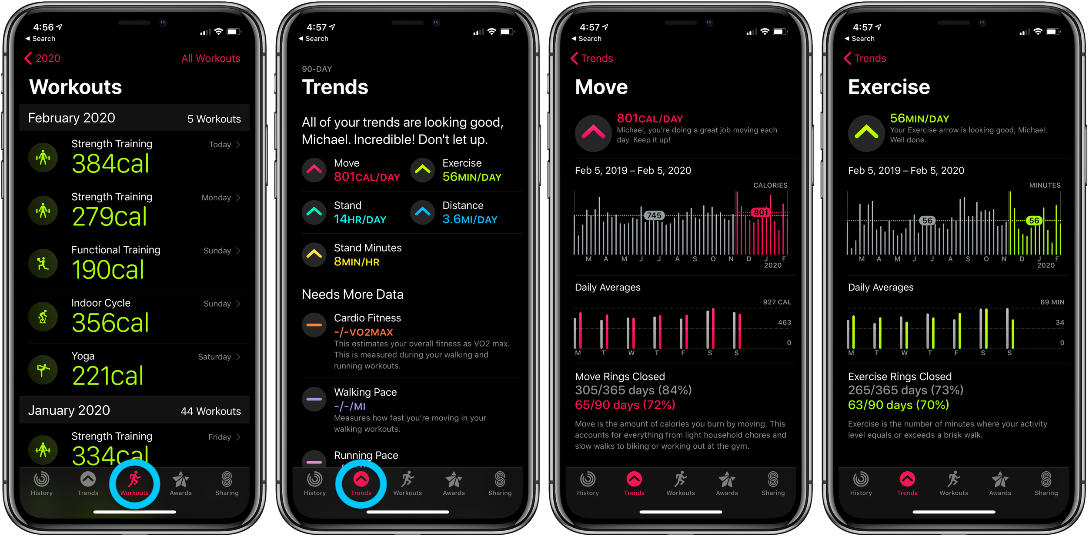
Healthdb_Secure – Workouts

Slide 21
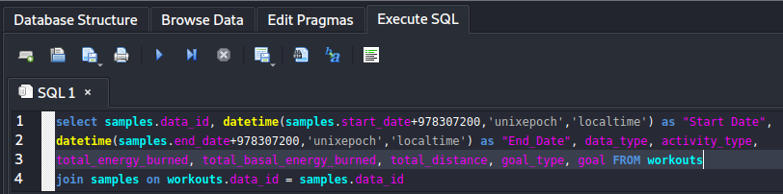
Workouts - Statement
Copy and paste the statement below into the Execute SQL tab and press the play button to execute.
select samples.data_id, datetime(samples.start_date+978307200,'unixepoch','localtime') as "Start Date",
datetime(samples.end_date+978307200,'unixepoch','localtime') as "End_Date", data_type, activity_type,
total_energy_burned, total_basal_energy_burned, total_distance, goal_type, goal FROM workouts
join samples on workouts.data_id = samples.data_id

Slide 22
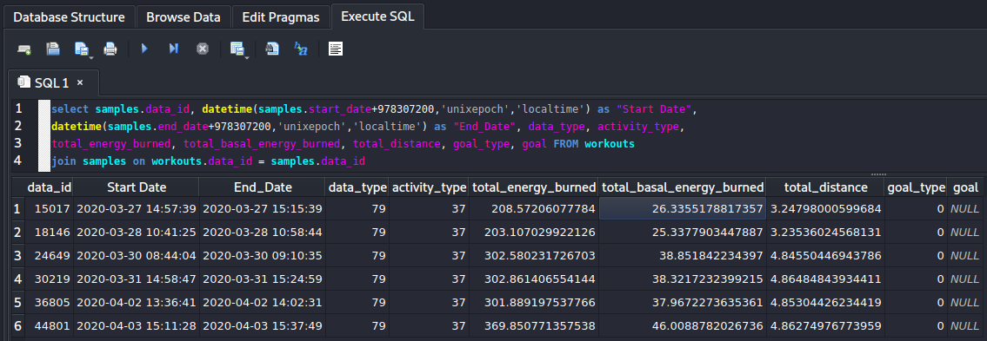
Workouts - Results

Slide 23
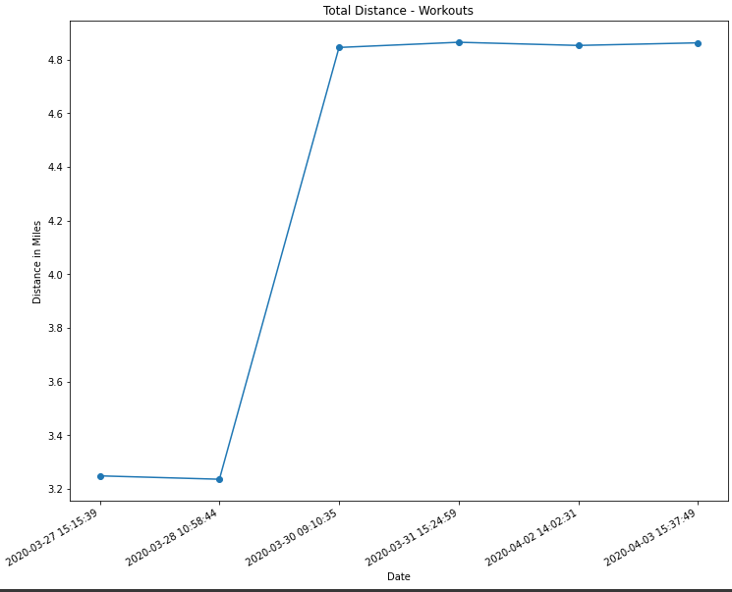
Workouts Results – Visualized - Distance

Slide 24
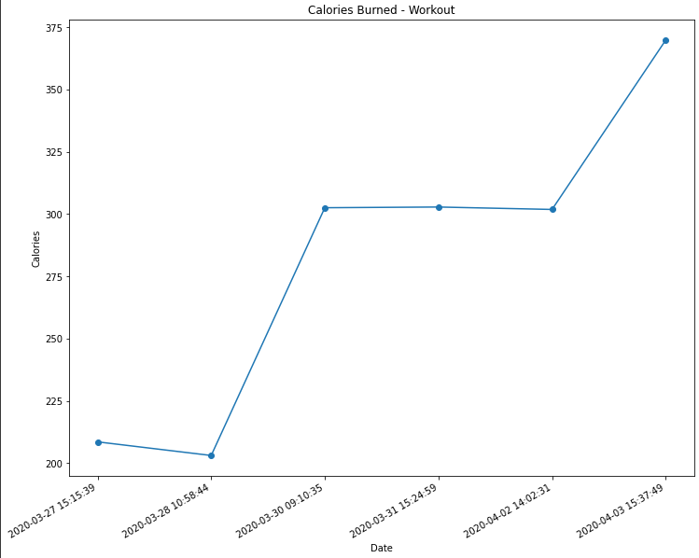
Workouts Results – Visualized – Calories

Slide 25
Creating Simple Graphs with Python

Slide 26
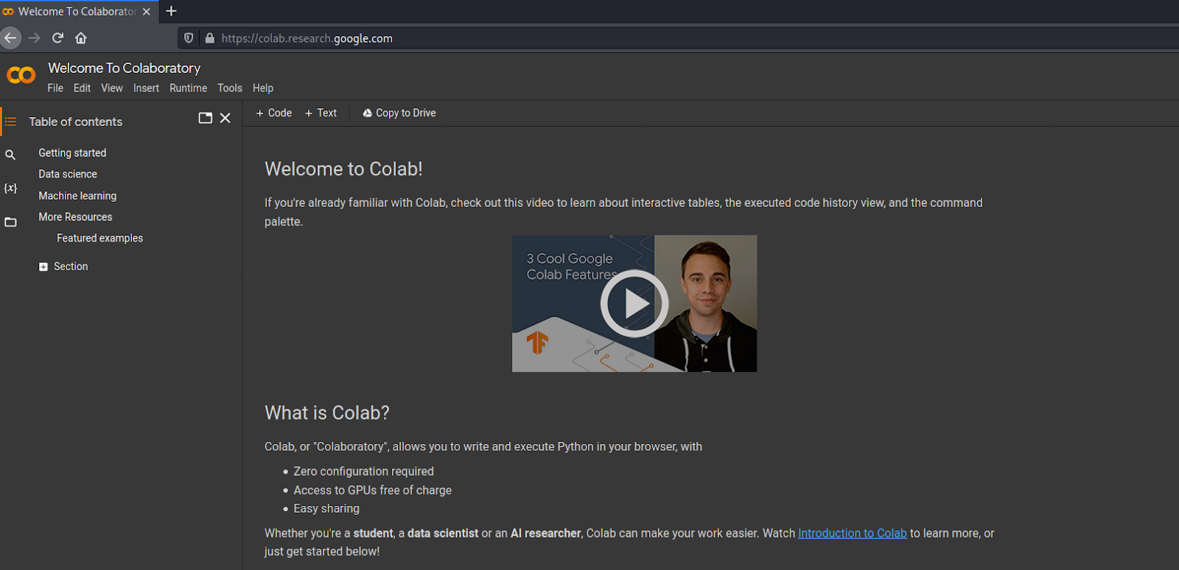
Visit Google Colab
https://colab.research.google.com/

Slide 27
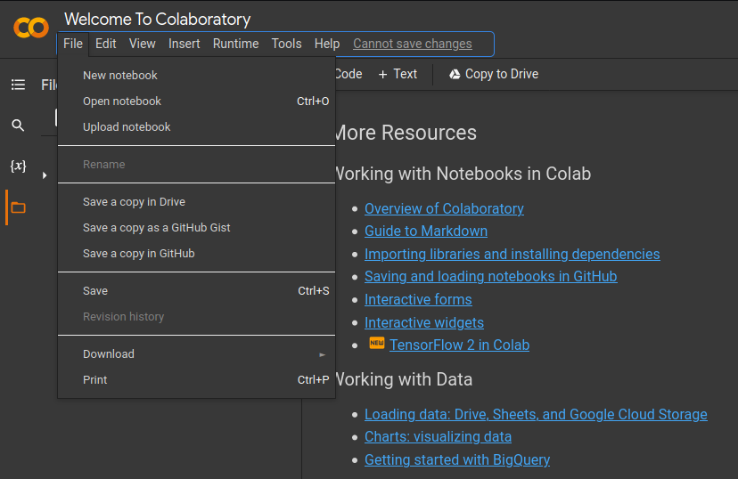
Create a new notebook under File tab

Slide 28
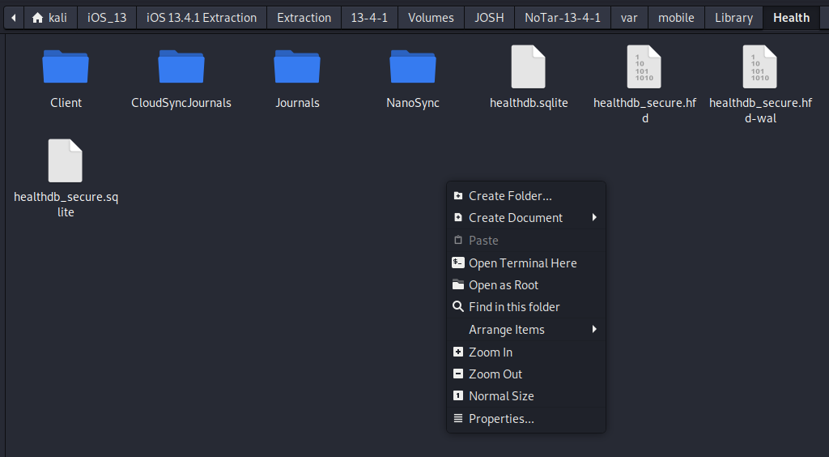
Prepare data by converting to CSV
Open a Terminal instance inside the ~/var/Mobile/Library/Health folder.
Use sqlite3 command to convert to CSV and place in Documents
In this instance we will create a graph that shows date and walking distance from the activity cache
Notes:
sqlite3 -header -csv healthdb_secure.sqlite "select datetime(cache_index+978307200,'unixepoch','utc') as Date, walk_distance as Distance from activity_caches;" > ~/Documents/Activity.csv

Slide 29
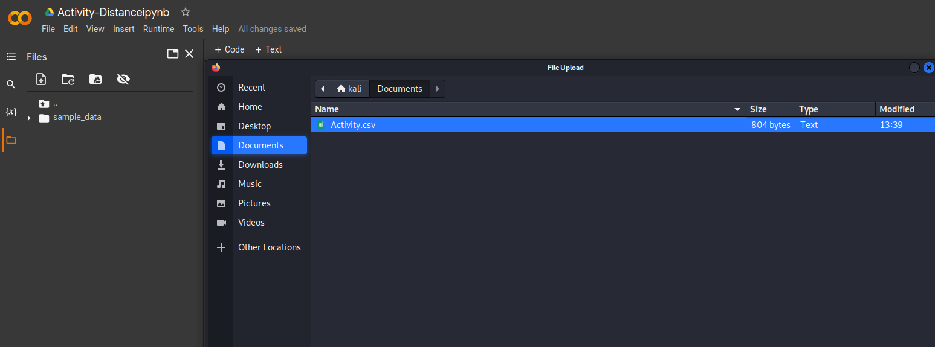
Upload Activity.csv to Google Colab
The code needs to read the data from the source file provided to work

Slide 30
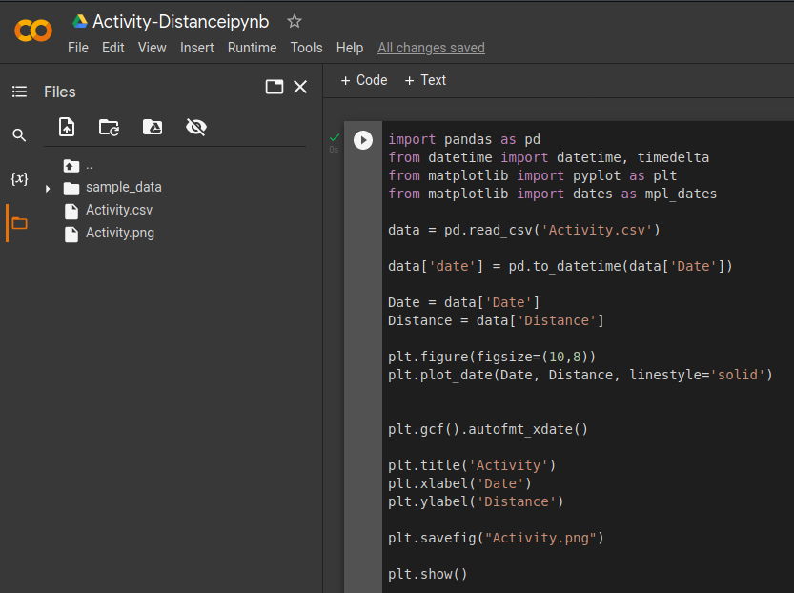
Input Code and Press Play Button to Run

Slide 31
Code
import pandas as pd
from datetime import datetime, timedelta
from matplotlib import pyplot as plt
from matplotlib import dates as mpl_dates
data = pd.read_csv('Activity.csv')
data['date'] = pd.to_datetime(data['Date'])
Date = data['Date']
Distance = data['Distance']
plt.figure(figsize=(12,10))
plt.plot_date(Date, Distance, linestyle='solid')
plt.gcf().autofmt_xdate()
plt.title('Activity')
plt.xlabel('Date')
plt.ylabel('Distance')
plt.savefig("Activity.png")
plt.show()

Slide 32
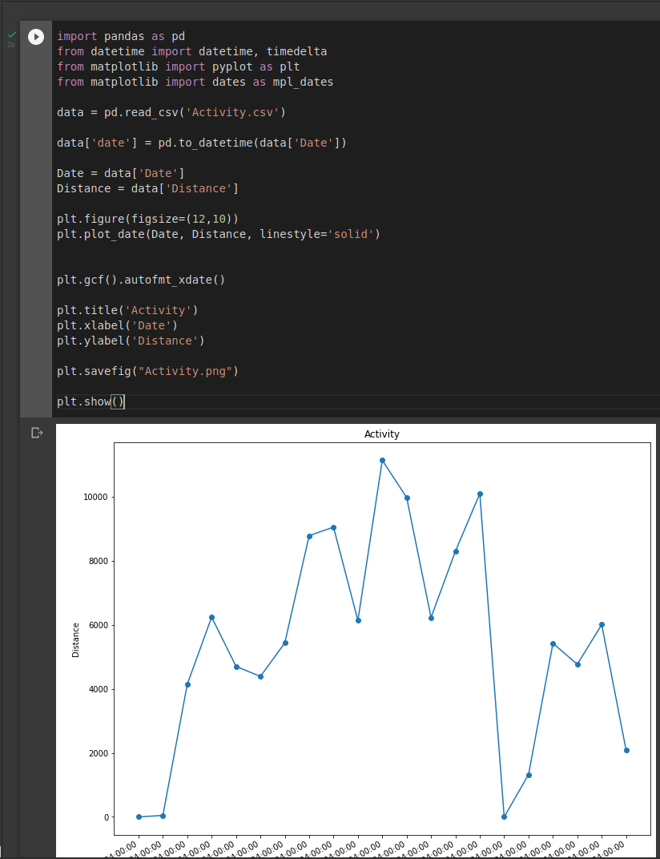
Upon Successful Execution a Graph will Display Below

Slide 33
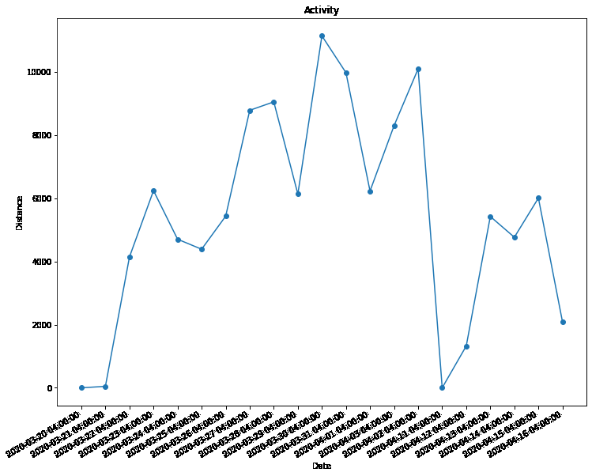
From the activity graph we can see the Phone owner was generally active in his steps daily.
We can see a fall off in activity between 4/3/2020 and 4/11/2020 where no steps were recorded.

Slide 34
Plotting Calories Burned per Day
Create a new Notebook under Files tab

Slide 35
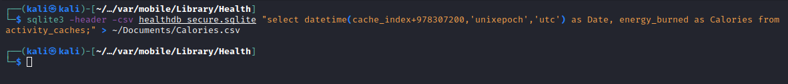
Prepare data by converting to CSV
Open a Terminal instance inside the ~/var/Mobile/Library/Health folder.
Use sqlite3 command to convert to CSV and place in Documents
In this instance we will create a graph that shows date and calories burned from the activity cache
Notes:
sqlite3 -header -csv healthdb_secure.sqlite "select datetime(cache_index+978307200,'unixepoch','utc') as Date, energy_burned as Calories from activity_caches;" > ~/Documents/Calories.csv

Slide 36
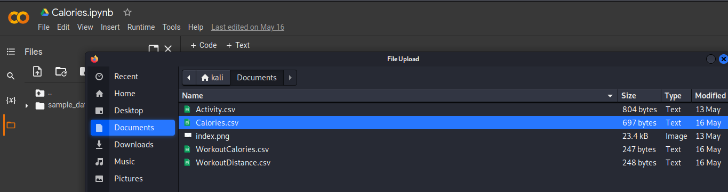
Upload data to Colab
The code needs to read the data from the source file provided to work

Slide 37
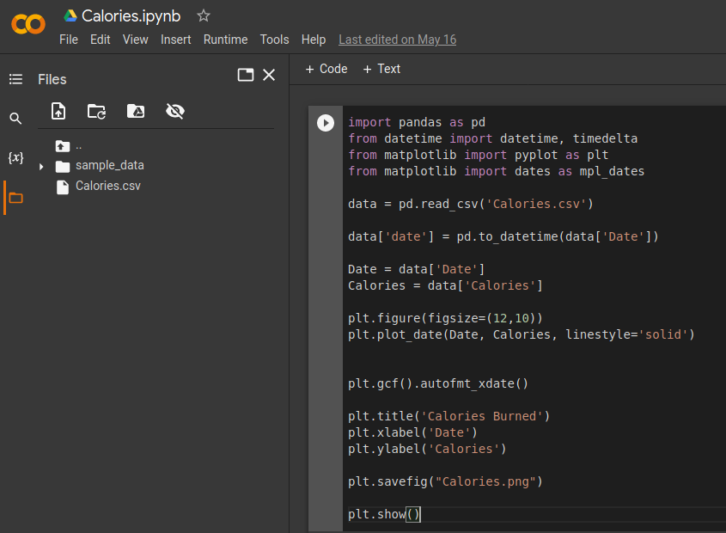
Input Code and Press Play Button to Run

Slide 38
Code
import pandas as pd
from datetime import datetime, timedelta
from matplotlib import pyplot as plt
from matplotlib import dates as mpl_dates
data = pd.read_csv('Calories.csv')
data['date'] = pd.to_datetime(data['Date'])
Date = data['Date']
Calories = data['Calories']
plt.figure(figsize=(12,10))
plt.plot_date(Date, Calories, linestyle='solid')
plt.gcf().autofmt_xdate()
plt.title('Calories Burned')
plt.xlabel('Date')
plt.ylabel('Calories')
plt.savefig("Calories.png")
plt.show()

Slide 39
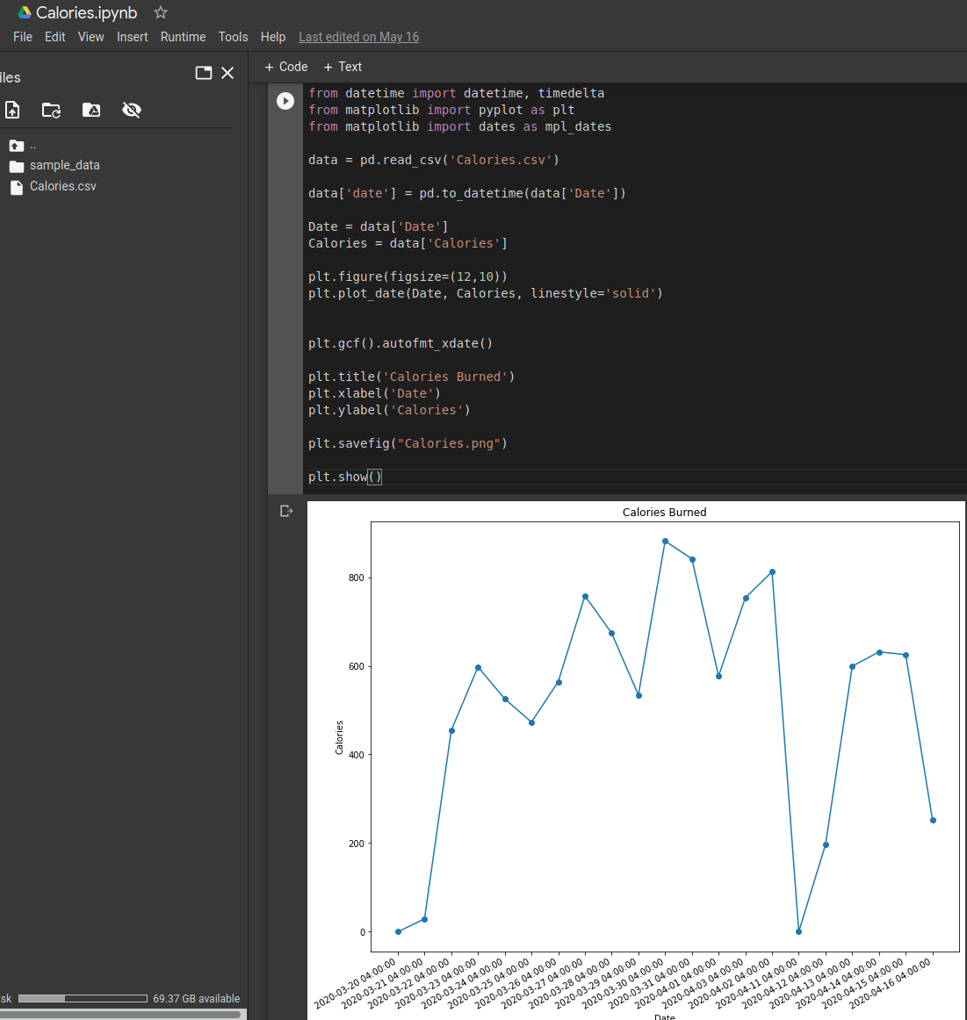
Upon Successful Execution a Graph will Display Below

Slide 40
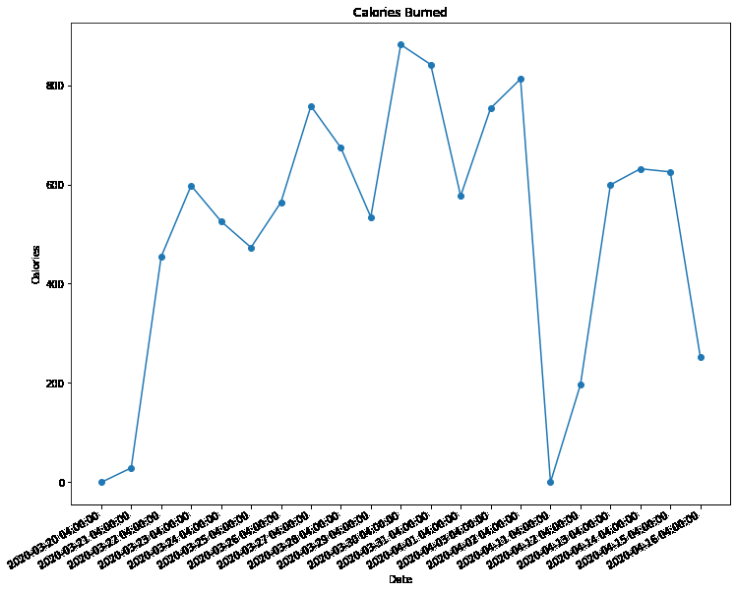
From the activity graph we can see the graph is generally identical to the activity graph. We can see the number of steps directly correlates with how many calories are burned.
We can see a fall off in activity between 4/3/2020 and 4/11/2020 where no calories were recorded.

Slide 41
Summary
Health DB stores useful information that is helpful to forensic investigations.
Synced Devices
Synced Applications
Workout Information
Data Visualization and creating Graphs with Python

