Slide 1
Front End Engineering-I Project
Team Details:
Anamveen Kaur 2210990106
Anand Kaushik 2210990107
Anant Singh 2210990106
Ananya 2210990107
Faculty Coordinator: Dr Amandeep Kaur
:
Chitkara University Institute of Engineering and Technology,
Chitkara University, Punjab

Slide 2
Table of Contents
Introduction
Problem Statement
Technical Details
Key Features
Project Highlights
Conclusion
References/Links used

Slide 3
Problem Statement
Cafes and restaurants need to have an online presence to attract customers and remain competitive in today's digital age. However, many businesses struggle to create a website that is visually appealing, user-friendly, and responsive across different devices. The lack of expertise in HTML and CSS often leads to poorly designed websites that fail to engage manage the business operations effectively.
The problem is further exacerbated by the increasing use of mobile devices, which require websites to be optimized for different screen sizes and resolutions. Businesses that fail to adapt to these changes risk losing potential customers due to sluggish speed of business operations.

Slide 4
Problem Statement
Therefore, the problem statement for the HTML and CSS project of a cafe management site is as follows: How can we create a visually appealing, user-friendly, and responsive website for a cafe that effectively showcases and manages its business operations and optimizes the user experience across different devices?

Slide 5
Introduction
In today's age where the technologies are developing at a breakneck speed, there is a need for ordinary works like accounting , managing employees data etc. to also be done using advanced technologies. An online presence is vital for any business not just to attract customers but also for managing business operations.
For this we have created a HTML and CSS project of a cafe management site which is an essential component of building such a digital presence in managing operations.

Slide 6
Introduction
This project involves designing and developing the front-end of a website that is visually appealing, user-friendly, and responsive across different devices. This project is responsible for creating the overall look and feel of the website and ensuring that the content is well-organized and easy to navigate.

Slide 7
Technical Details
Document type declaration:
In our HTML file, we have included a document type declaration at the beginning. You can mention this in your file as well. For example, <!DOCTYPE html>
Tags: We have used different types of tags. These tags are as follows:-
HTML tags : <html><head><meta><link><title><body><style> <div><img><a><label><input><hr>,etc.
CSS tags:
*: This is a universal selector that targets all elements on the page.
.main-body: This targets the body element of the HTML page.
.header: This targets the header element.
.header-logo: This targets the logo inside the header element.
.menu-header:hover : This targets the menu inside the header element when they are being hovered over.

Slide 8
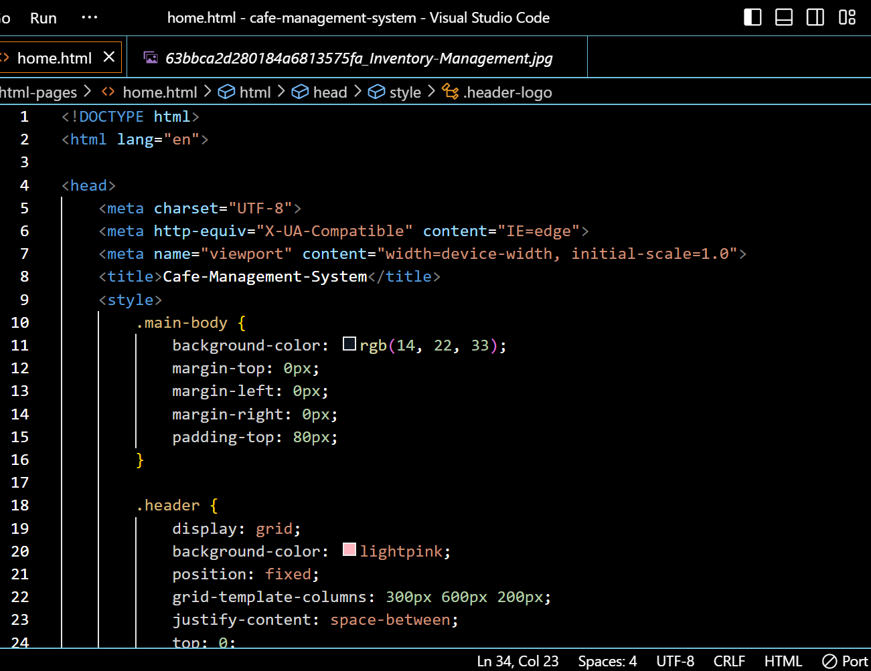
Project Highlights

Slide 9
Project Higlights
The <!DOCTYPE html> declaration at the beginning specifies that this document is an HTML5 document.
The <html> element encloses the entire web page and includes the metadata and content of the page.
The <head> element contains the metadata of the page, such as the title, character encoding, and viewport settings.
The <meta> elements specify the character encoding and the viewport settings, which determine how the page is displayed on different devices.
The <title> element specifies the title of the page, which appears in the browser tab or window.
The <link> element references an external CSS file named main.css, which contains the styling rules for the page.

Slide 10
Project Higlights
The <body> element contains the visible content of the page.
The <section> element defines a section of the page, which is used to group related content.
The class attribute is used to assign a class to the section, which can be used to apply specific styles to the section.
The <header> element defines the header of the page, which typically includes the logo and navigation menu.
The <nav> element defines the navigation menu of the page.
The <div> element contains the logo of the page.
The <span> element is used to create dots around the logo.

Slide 11
Project Higlights:
CODE EXPLANATION:
This is an HTML code that defines the structure and content of a web page. Here is a brief explanation of each section: The first line of code (``) declares the language of the document to be English. The `` section contains meta tags and links to external resources that the page requires. In this code, there are four meta tags: `charset`, `http-equiv`, `viewport`, and `title`. The `charset` tag specifies the character encoding used in the document (UTF-8, in this case). The `http-equiv` tag provides information about how the browser should handle certain features, such as compatibility mode. The `viewport` tag sets the width of the viewport to match the device's screen width, and the `title` tag sets the title of the page that appears in the browser's tab. Additionally, there is one link to external resource: Google fonts API.

Slide 12
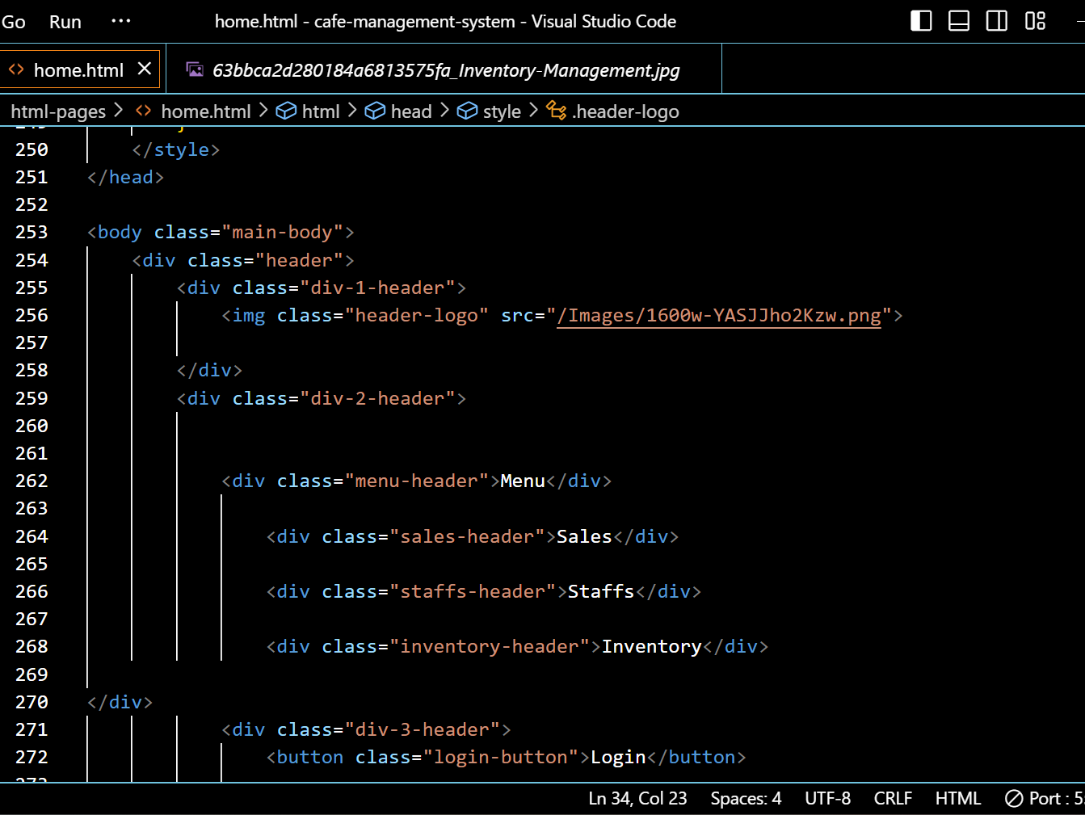
Project Higlights:

Slide 13
Project Higlights:
This code is for an HTML webpage. The webpage has a header with icons and logo with the name of the café. There is also a login button which can be used to get acess to the main features.
The <body> element contains a <section> element with a class of "header". Inside the header section, there is a <div> element with a class of "intro" that contains a heading and a button, and another <div> element with a class of "hero-bg" that contains an image of the logo of the cafe. There is also a <div> element with a class of "scroll" that has an anchor tag with an href attribute pointing to the "brands" section, and an SVG arrow icon indicating that users should scroll down.

Slide 14
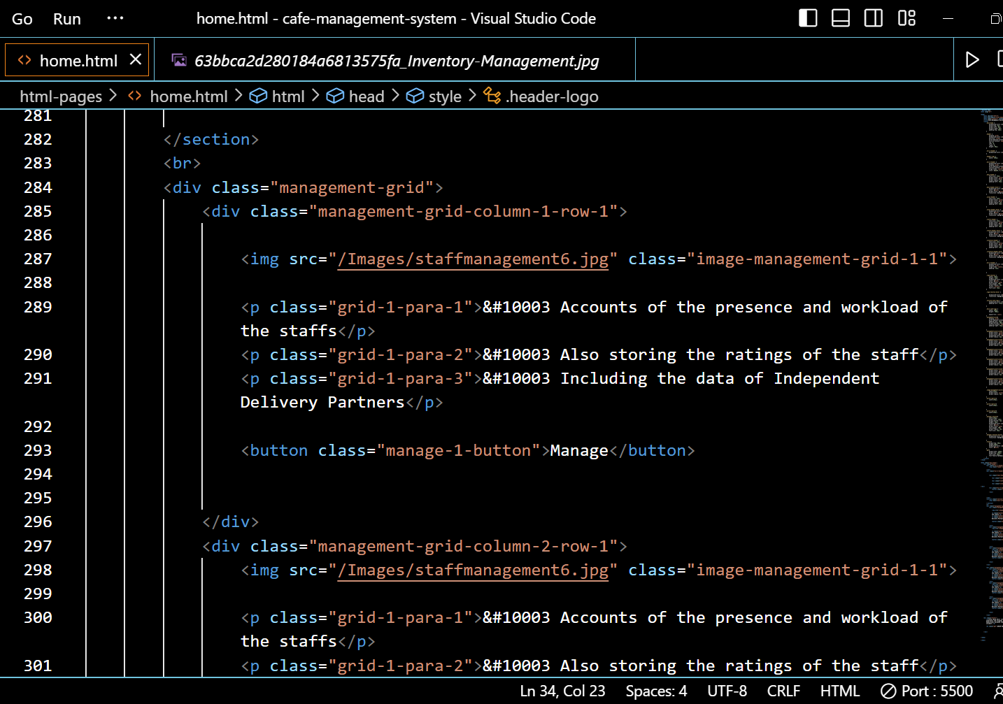
Project Higlights:

Slide 15
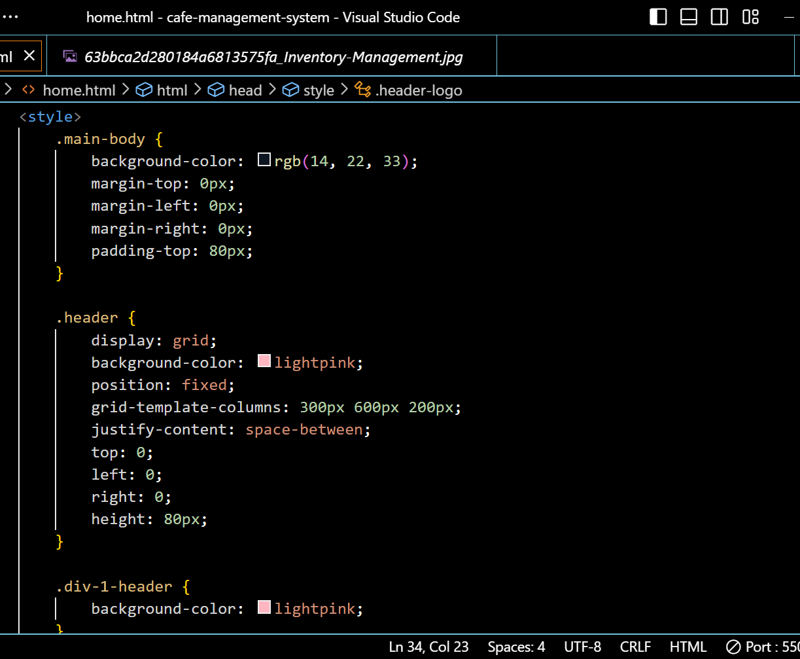
Project Highlights
CSS Code:

Slide 16
Project Higlights:
Code Explanation :
This is a CSS code that styles the HTML elements of a web page. Here's a breakdown of what each section does:
- * { padding-top:80px;}: This sets the content to be shown 80px down so there is enough space for the header and also no content remains hidden from the user’s view.
- *.header { display: grid;background-color: lightpink;position: fixed; grid-template-columns: 300px 600px 200px; justify-content: space-between; top: 0; left: 0; right: 0; height: 80px;}
This styles the `div ` element which is performing as the header, setting it to use a grid layout with a column direction. It also sets the height of the header to 80px of the viewport height and sets the background color to lightpink.
The * selector selects all elements on the page, and sets their padding and margin to 0, their box-sizing property to border-box, their font-family to “Roboto",
The justify-content to space-between, which means the elements inside the container will be spaced out evenly with the first element at the start of the container and the last element at the end.

Slide 17
Project Higlights:
The first block of code sets the background color of the header to be pink and it’s position to be fixed at the top of the page. Also it sets the display to grid and adds space between the elements using justify-content: space-between.
The final block of code styles the header. It sets the grid-template-columns to 300px 600px 200px, which allows the main body section to expand and take up all available space. It also sets the display to grid, aligns the content to the top using top:0px.
The third block of code targets the .header_logo element within the .div-1-header and applies it’s width to be 200px.

Slide 18
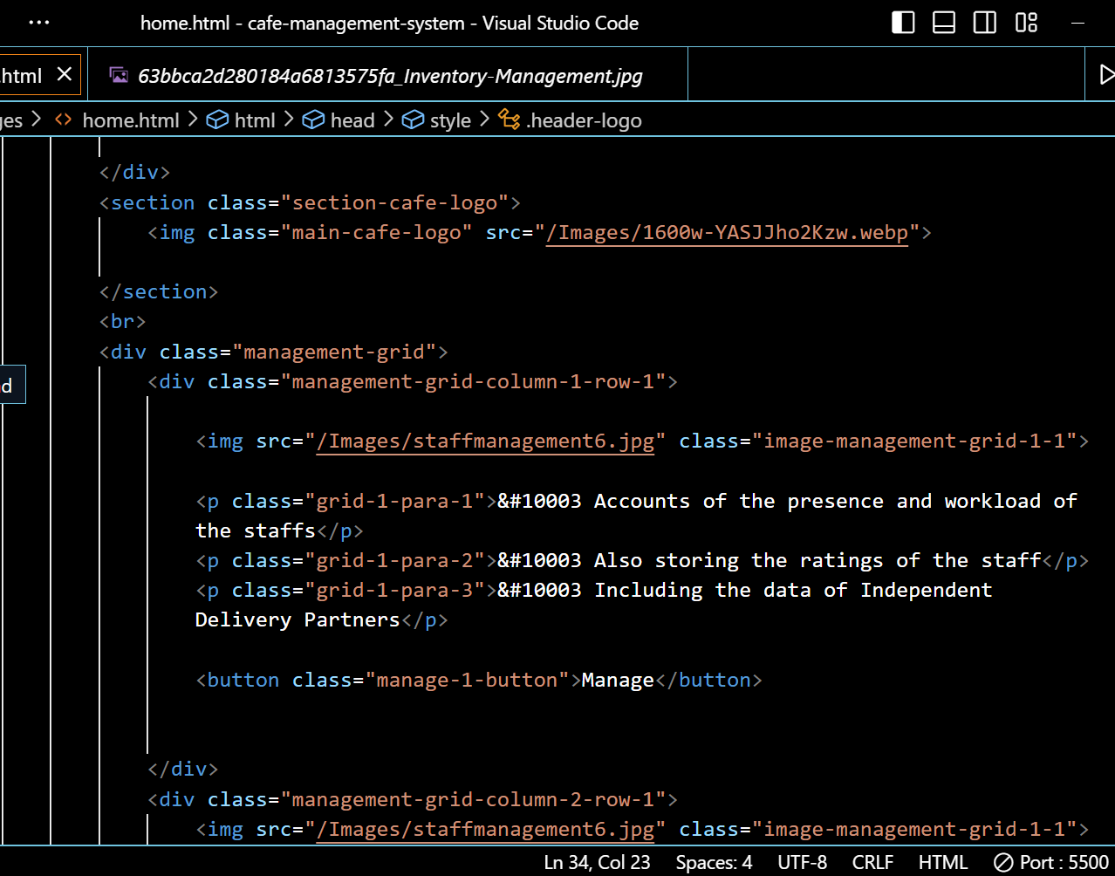
Project Higlights:

Slide 19
Project Highlights
The <section class=”main-café-logo”> contains an image of the café’s logo.
Then we used an img tag, the image in this <imgsrc tag is the inventory management image. In the next step a div class named “management-grid” is created. This container is a set to display:grid so all these div containers under it will form a grid and get properly vertically aligned.
At the end there is a div class=”footer” in which general information is displayed, and if the information is above a certain height property overflow:scroll will let users scroll the footer.

Slide 20
Bonus Feature
Enhanced User Experience: With an attractive and user-friendly website design created through HTML and CSS, staffs can navigate the website easily and post updates about the business operations. This can lead to an increase in the speed of business operations and ultimately higher customer satisfaction levels.
Cost-Effective: Building a website using HTML and CSS is a cost-effective option, especially for small businesses with a limited budget. It eliminates the need for expensive software or tools, making it an affordable option for creating a professional-looking website.
Mobile Responsiveness: With the increasing use of mobile devices, it's essential to have a website that is responsive across different screen sizes. HTML and CSS can be used to create a mobile-responsive website that adapts to different devices screen sizes, ensuring that users can access the site from any device & anywhere.

Slide 21
Conclusion
In conclusion, the HTML and CSS project for a cafe management site has vast potential for future enhancements and expansions to improve the website's functionality and overall business operations. By keeping up with emerging trends and technologies and continuously updating and improving the website, businesses can stay ahead of the competition and provide their customers with the best possible service.

Slide 22
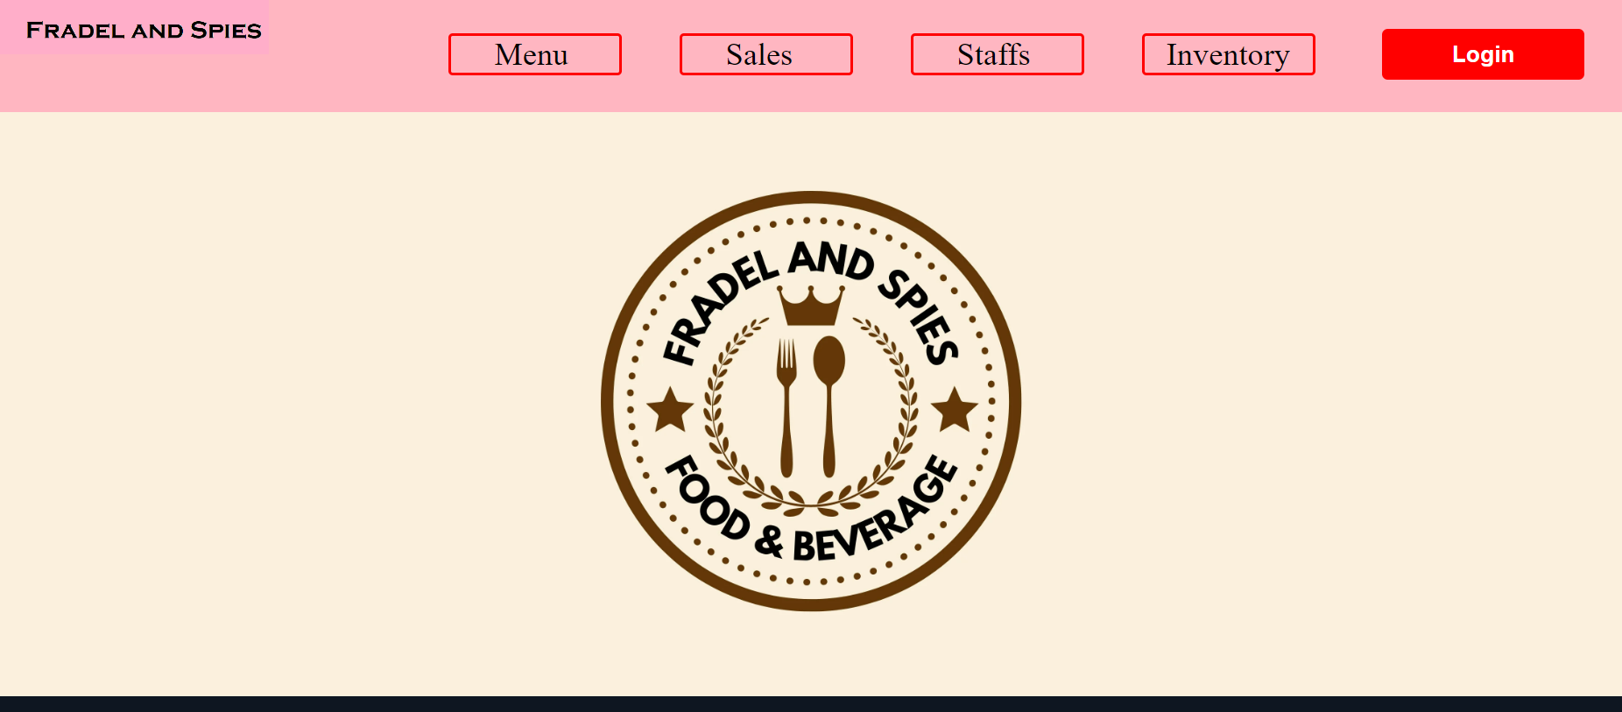
Solution of the project:
Final Outcome:

Slide 23
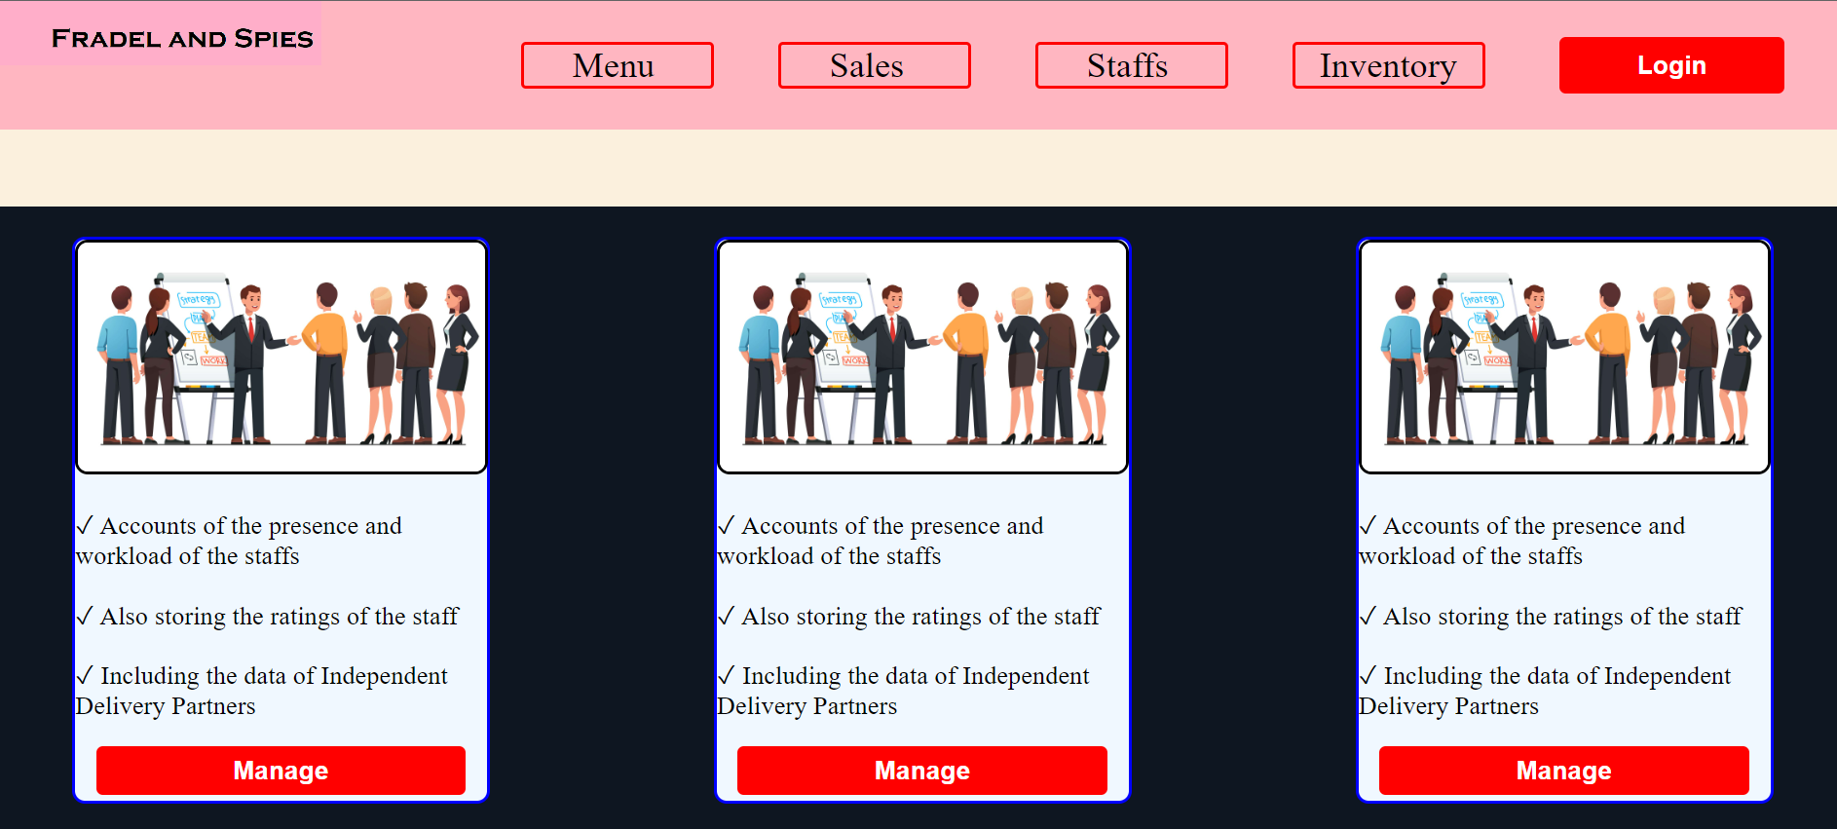
Solution of the project:
Final Outcome:

Slide 24


