Slide 1

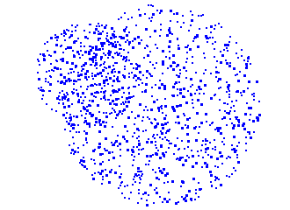

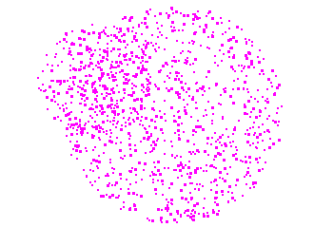
Chartitable
(chart-it-able)
if ur donation does good,
u should be able to CHART IT
graphic design is my passion
Notes:
Hi, we're [team]. This is Chartitable. Not charitable. Chart-it-able. If your donation does something good, you should be able to chart it. Not with an actual chart. It's a pun.

Slide 2



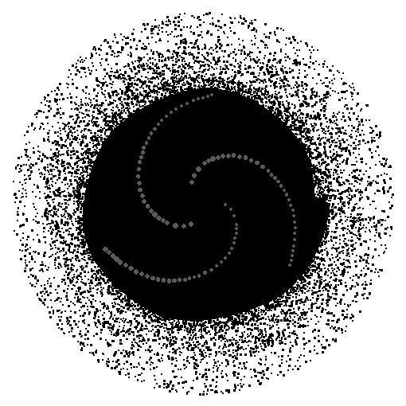

where does my money go??
1 MONTH LATER
CHARITY WEBSITE
CHARITY WEBSITE
*donates*
...hello??
graphic design is my passion
Notes:
I give $[X]. I go back a month later and nothing has changed. Where did my money go? Black hole.

Slide 3
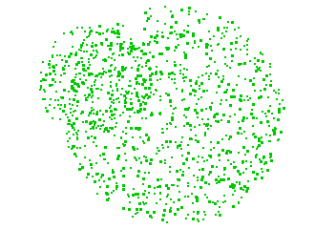
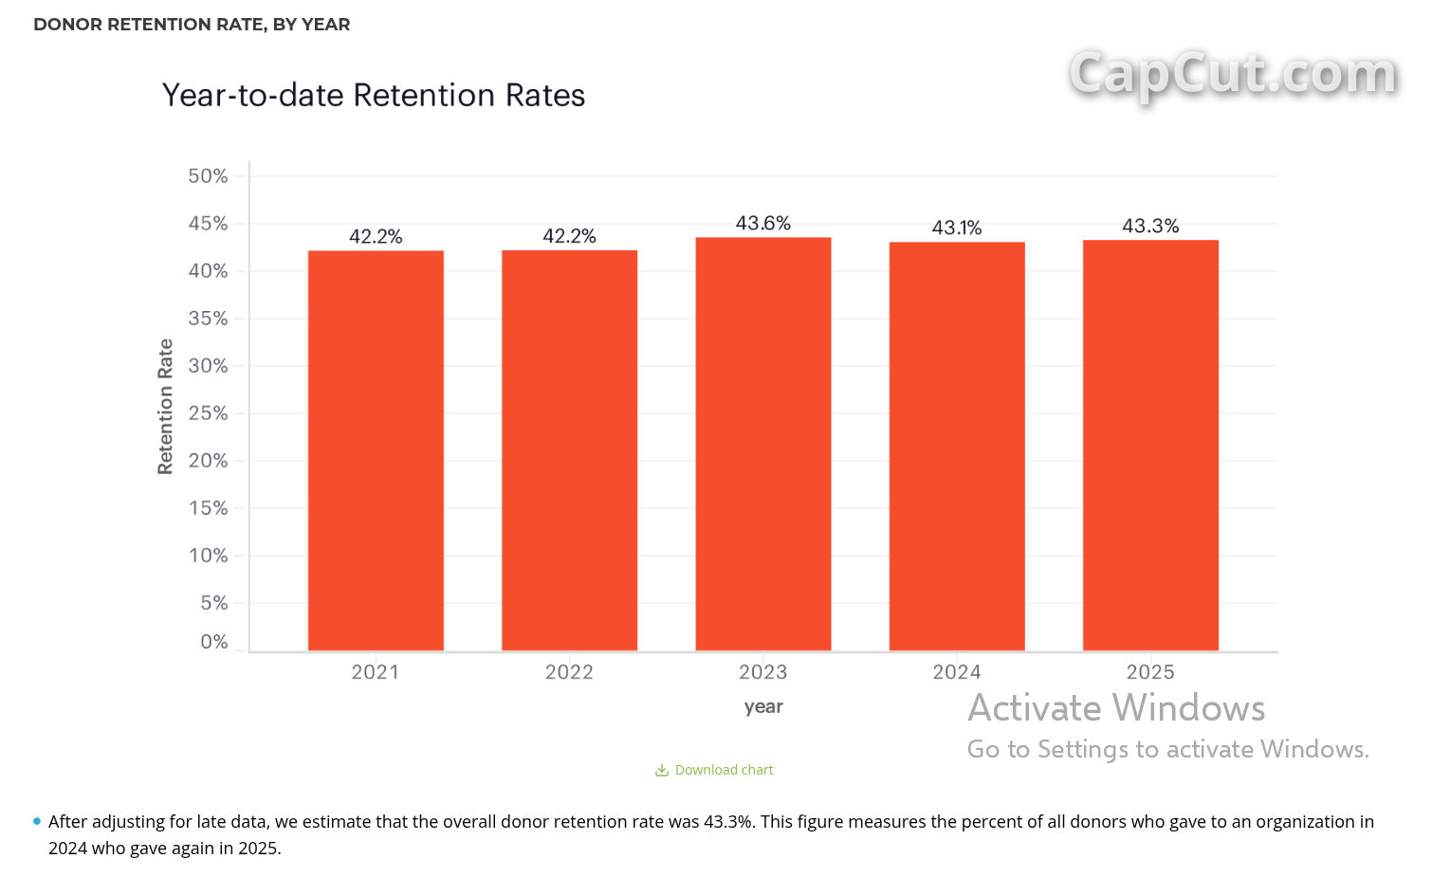
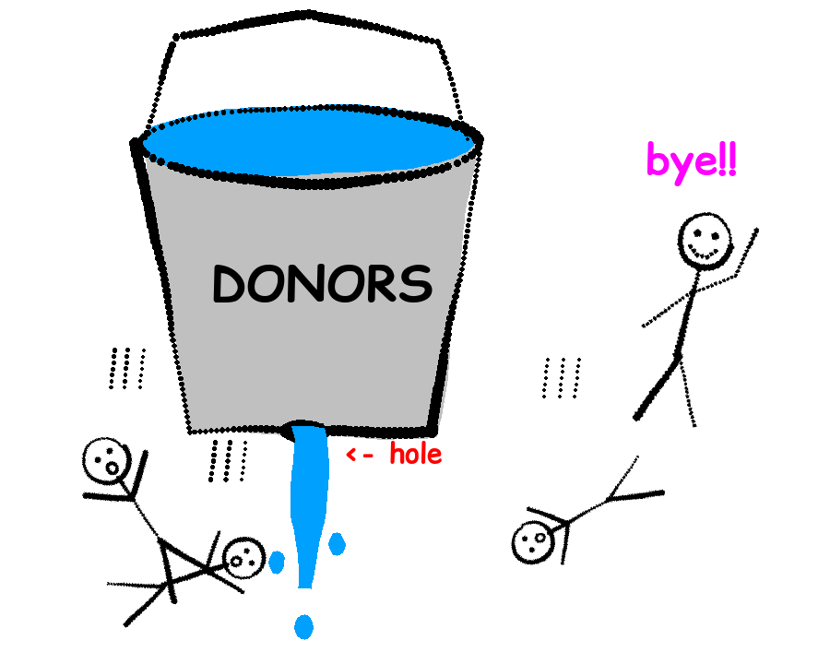
the bucket is LEAKING
source: Fundraising Effectiveness Project, Q4 2025
43.3%
less than half of
donors give again
$4.6 BILLION
lost in 1 yr to donors who left or gave less (just 10,640 charities!!)
source: Fundraising Effectiveness Project 2019 report (2018 data)
~1.6 MILLION
US charities w/ a bucket we could plug
source: IRS Data Book FY2025, 501(c)(3) orgs
graphic design is my passion
Notes:
One of the biggest problems charities have is donor retention. According to the Fundraising Effectiveness Project, only 43.3% of donors gave again the next year, so more than half never come back. And that costs real money: in one year, just the 10,640 charities in FEP's dataset lost $4.6 billion to donors who stopped giving or gave less. There are about 1.6 million 501(c)(3) charities in the US, and every one of them has this same leaky bucket. The bucket leaks because donors never see what happened next. Sources: 43.3% retention - Fundraising Effectiveness Project, Q4 2025, https://publications.fepreports.org/archive/2025-q4/retention-time-series/ . $4.6B - 2019 Fundraising Effectiveness Survey Report (AFP/Urban Institute; 2018 data): gains of $5.009B offset by losses of $4.643B through reduced gifts and lapsed donors across 10,640 US nonprofits, https://afpglobal.org/sites/default/files/attachments/generic/FEP2019AnnualSurveyReport.pdf . 1.6M - IRS Data Book FY2025, Table 2-6: 1,596,231 recognized 501(c)(3) organizations (includes private foundations; excludes churches that never applied), https://www.irs.gov/statistics/soi-tax-stats-tax-exempt-organizations-and-nonexempt-charitable-trusts-irs-data-book-table-2-6 .

Slide 4

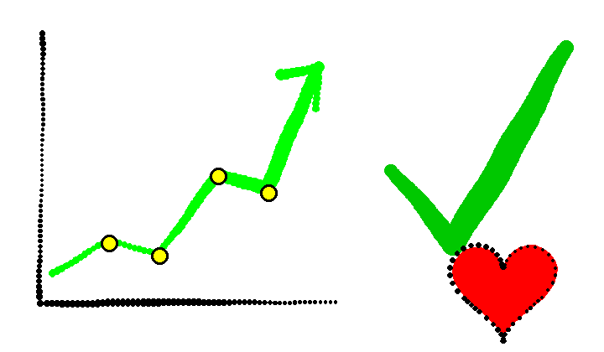

THE FIX
CHARTITABLE
you actually get to see what your money did
graphic design is my passion
Notes:
Chartitable closes that loop. After you give, you see what your money did, and the charity gets an easy way to show you.

Slide 5

DEMO TIME
graphic design is my passion
Notes:
Okay, let me show you.

Slide 6









Thank you.
Please clap.
Please fund us.
built with:
Grok Bot
graphic design is my passion
Notes:
Donors stay when they can see the impact. Chartitable makes your giving chart-it-able. Thank you. Please clap. Please fund us.

