Slide 1
You have a mission-critical application that must be globally available at all times. IF this is the case, which of the below deployment mechanisms would you employ?
Deployment to multiple Availability Zones
Deployment to multiple Data Centers
Deployment to multiple edge locations
Deployment to multiple Regions
Notes:
The correct answer is:Deployment to multiple Regions
Reason:Regions represent different geographic locations and are best to host your application across multiple regions for disaster recovery.

Slide 2
Which of the following can be used to protect against DDos Attacks. Pick two
AWS EC2
AWS ELB
AWS Shield
AWS Shield Advanced
Notes:
The correct answer is:AWS Shield;AWS Shield Advanced
Reason:AWS Shield – All AWS customers benefit from the automatic protections of AWS Shield Standard, at no additional charge. AWS Shield Standard defends against most common, frequently occurring network and transport layer DDOS attacks that target your web site for applications. AWS Sheild Advanced – For higher levels of protection against attacks targeting your web applications running on Amazon EC2, Elastic Load Balancing (ELB), CloudFront, and Route-53 resources, you can subscribe to AWS Shield Advanced. AWS Shield Advanced provides expanded DDoS attack protection for these resources.

Slide 3
Which of the following are the right principles when designing cloud-based systems?
Build Tightly-coupled components
Use as many services as possible
Build loosely-coupled components
Assume everything will fail
Notes:
The correct answer is:Build loosely-coupled components;Assume everything will fail
Reason:Always build components that are loosely coupled. This is so that even if one component does fail, the entire system does not fail. Also. if you build with the assumption that everything will fail, then you will ensure the right measures are taken to build a highly available and fault-tolerant system.

Slide 4
A company does not want to manage their database. Which of the following services is a fully managed NoSQL database provided by AWS.
Oracle RDS
Elastic MapReduce
AWS RDS
DynamoDB
Notes:
The correct answer is:DynamoDB
Reason:DynamoDB is a fully managed NoSQL database provided by AWS. It is now available in most regions for users to consume. Oracle Database is not a NoSQL database solution. Elastic MapReduce is a Hadoop-based processing service not a database solution. AmazonRDS is managing your databases in the cloud, not a database itself. It supports 6 database types Amazon Aurora, PostgreSQL, MySQL, MariaDB, Oracle Database, and SQL Server.

Slide 5
Which AWS service allows for the distribution of incoming application traffic across multiple EC2 instances?
AWS Autoscaling
AWS inspector
AWS Elastic Cloud Compute (EC2)
AWS Elastic Load Balancer (ELB)
Notes:
The correct answer is:AWS Elastic Load Balancer (ELB)
Reason:ELB automatically distributes incoming application traffic across multiple targets, such as Amazon EC2 instances, containers, and IP addresses, helping to ensure the fault tolerance of your applications. AWS autoscaling does not distribute traffic, instead, it automatically adjust the number of EC2 instances in use, scaling the capacity up or down according to defined conditions for optimal performance and cost. Although Autoscaling works in conjunction with load balancing services to maintain performance across instances, it is not responsible for the distribution of traffic. AWS Inspector is a security assessment service that helps improve the security and compliance of applications deployed on AWS. It automatically assesses applications for vulnerabilities or deviations from best practices. It does not deal with traffic distribution but focuses on identifying security issues and vulnerabilities within the application environment. AWS EC2 itself is not a load balancing service. It provides resizable compute capacity in the cloud, allowing users to launch virtual servers and manage the server software. While EC2 instances are the targets for load balancing in many scenarios, the service itself does not distribute traffic across multiple instances.

Slide 6
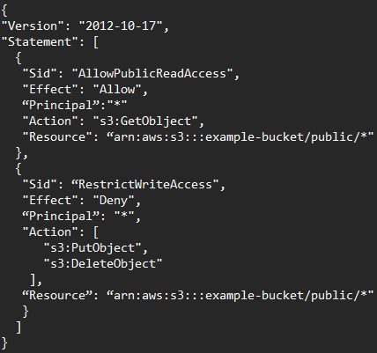
What actions are allowed in the following resource-policy?
No actions are allowed
Anyone can delete or add objects but not see them
Anyone can see objects in the example-bucket, but cannot add or delete objects
Anyone can see, add, and delete objects in the example-bucket
Notes:
The correct answer is:Anyone can see objects in the example-bucket, but cannot add or delete objects
Reason:

