Slide 1





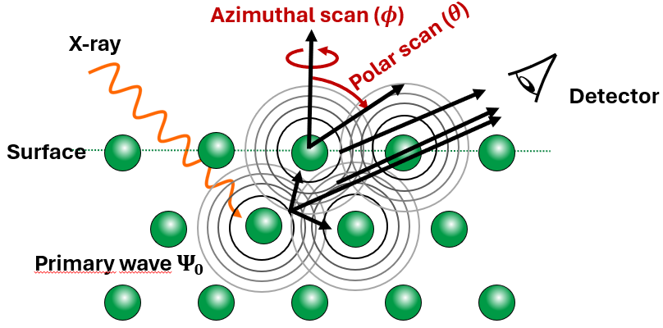
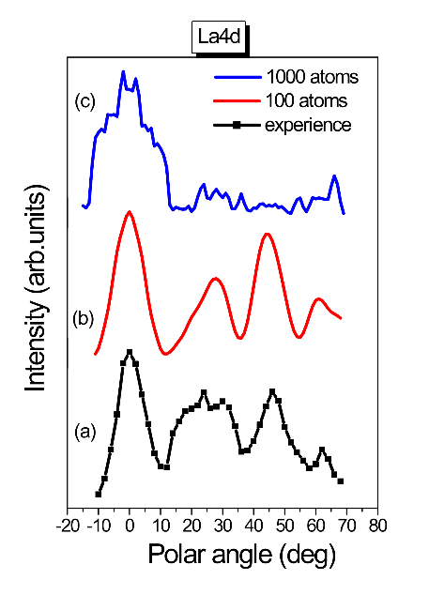
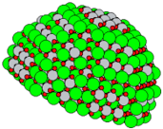
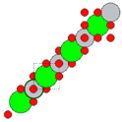
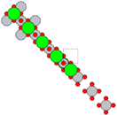
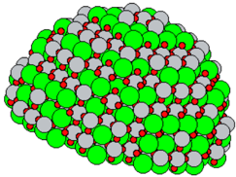

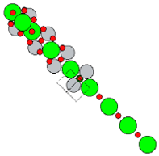

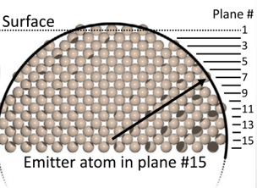
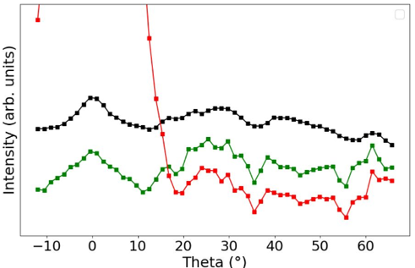
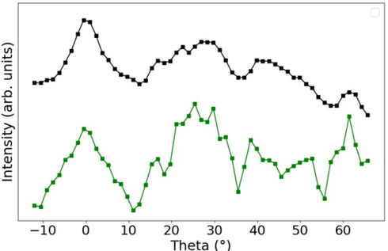
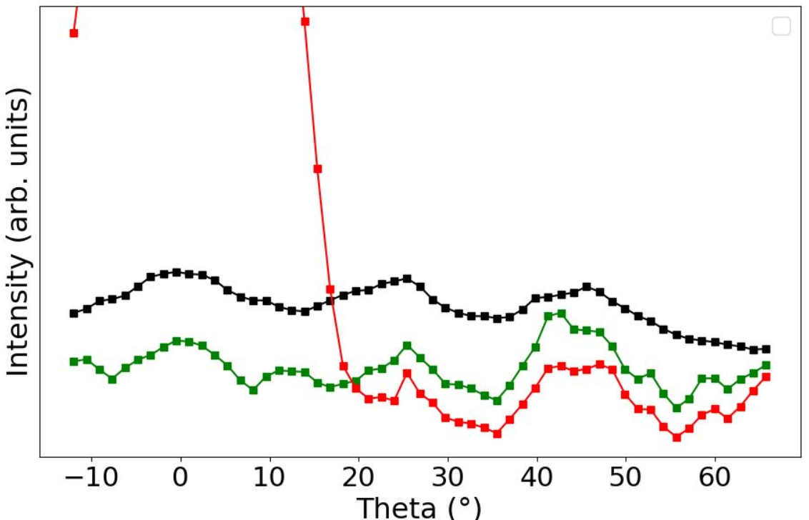
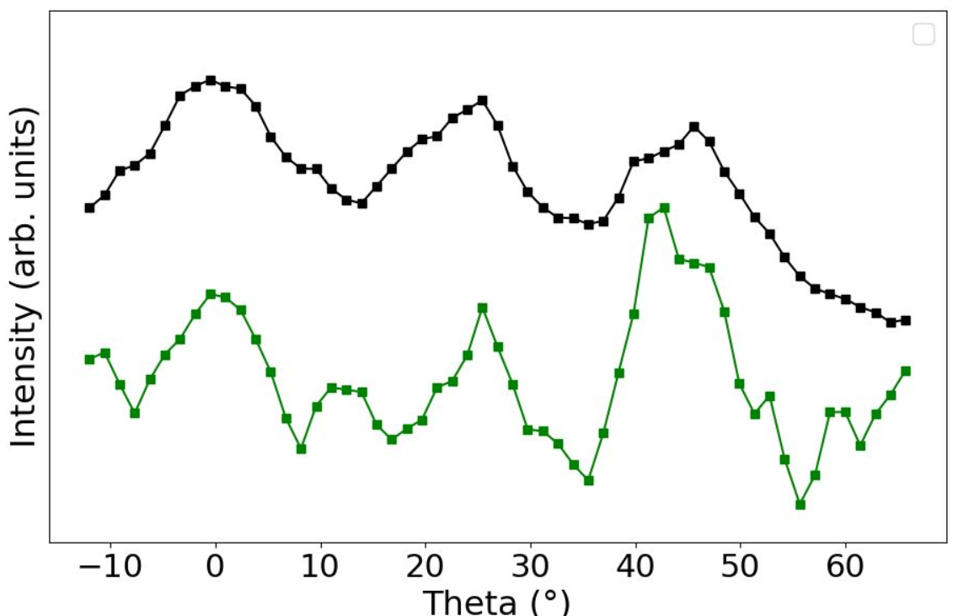



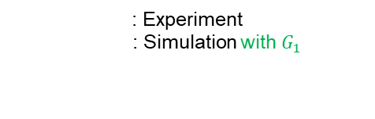




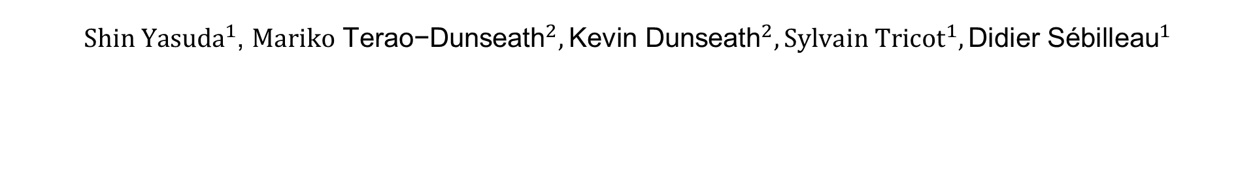
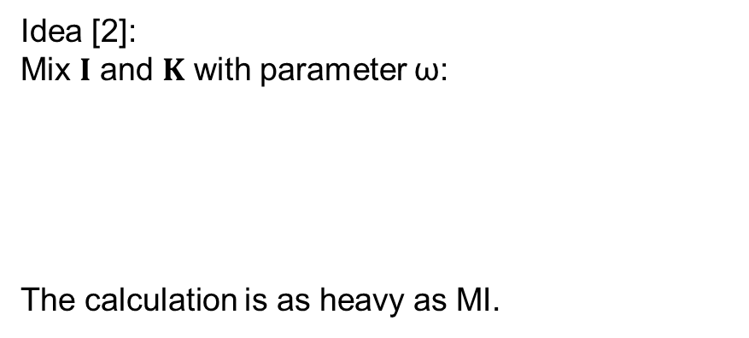

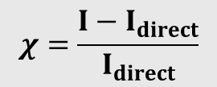





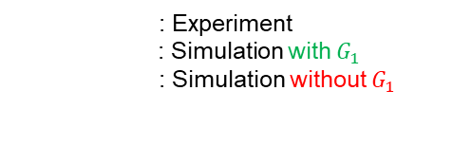

Modeling X-ray photoelectron diffraction forcing/accelerating convergence
${Shin Yasuda}^{1}$, ${{Mariko \text{Terao}\text{−}\text{Dunseath}}^{2},{\text{Kevin} \text{Dunseath}}^{2}, Sylvain Tricot}^{1},{\text{Didier} \text{S}\text{é}\text{billeau}}^{1}$
${}_{}^{1}{Department of Material and nanoscience, Institue of Physics, University of Rennes}$, France
${}_{}^{2}{Department of \text{molecular} \text{physics}, Institue of Physics, University of Rennes}$, France
International symposium on X-ray spectroscopies of synchrotron
1. Introduction
Ⅰ
Perovskite
Ⅱ
PhotoElectron Diffraction
Ⅲ
Simulation and experiment
Sr
Sr
Motivation from this divergence !
Where it comes from ?
How to cure it ?
Ti
O
Ti
O
3,905 Å
[001]
[010]
3,905 Å
[001]
[010]
[100]
[100]
Strontium Titanate is of great importance:
2 Dimensional Electron Gas (2DEG)
PED calculation for LaAlO₃ (Mohamed Zanouni, Faculty of Sciences, Tangiers, Morocco)
2. Theory & Method
Ⅰ
Theory in MsSpec
Ⅱ
Our Method ~ Atomic cone approximation
In MsSpec calculating the intensity:
*$K= G_{0}T$
$G_{0}:$ Free propagator
$T$: T-matrix
X-ray
z
$({I−K)}^{−1}=I+{K+K}^{2}+…$ diverges if $ρ\left(K\right)<1$
: Sr
: Ti
: O
Idea [2]:
Mix $I$ and $K$ with parameter ω:
The calculation is as heavy as MI.
$$G_{0}$$
$$G_{1}= \left(1−ω\right)I+ωK⇒({I−K)}^{−1}=ω({I−G_{1})}^{−1}$$
$$T$$
Ti Emitter
1920 atoms
$$\tilde{ω}=0.757+0.192j$$
We hope for some$ω$parameter:
$$G_{0}$$
: Sr
: Ti
: O
X-ray
$$ρ\left(G_{1}\right)<1$$
$$T$$
For 1000 atoms, around 3 weeks !
$$I$$
$$G_{0}$$
[2] Takatsu, A. et al., Phys. Chem. Chem. 24 5658–5668 (2022)
$$I+ G_{0}T+…$$
O Emitter
1688 atoms
$$\tilde{ω}=0.708+0.274j$$
3. Results & Discussion
Ⅰ
Computation Trick
Ⅲ
STO cluster with Ti emitter
: Experiment
: Simulation with $G_{1}$
: Simulation without $G_{1}$
: Experiment
: Simulation with $G_{1}$
1: Compute *signal for an emitter at each plane
2: Sum all signals
→ reflects interference phenomena between the planes
*modulation function (vibrational behavior)
Ⅳ
STO cluster with Ti emitter
$$χ=\frac{I−I_{direct}}{I_{direct}}$$
: Experiment
: Simulation with $G_{1}$
: Simulation without $G_{1}$
: Experiment
: Simulation with $G_{1}$
Ⅱ
Computation parameters
Photoelectron kinetic energy: 1019 eV (Ti), 948 eV (O)
Exchange and correlation potential: Hedin-Lundqvist complex
Lmax: 29 (Sr), 29 (Ti), 29 (O)
Scattering order = 6
Path filtering: Forward (15°), Backward (1°)
→ to reduce computational time
4. Conclusion & Perspectives
We have found out divergence effect on an atomic chain. The divergence effect seems to happen due to backscattering. We demonstrated our method- ology simulating theta scans for STO based on atomic chains. More perovskites are to be tested (CTO, BTO,…etc, experimental data are available at the IPR).
Notes:
I have to change the logo to new

