Slide 1





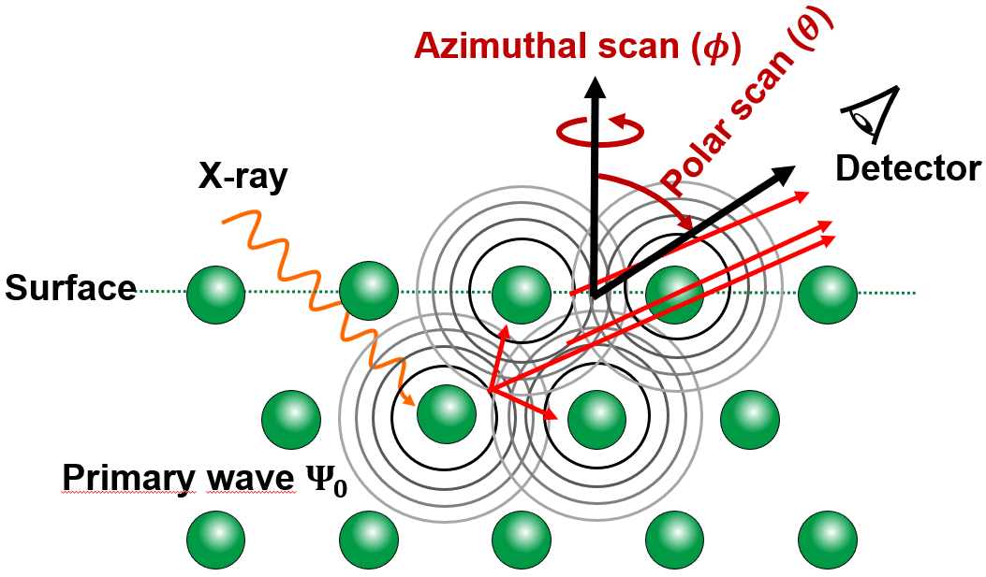
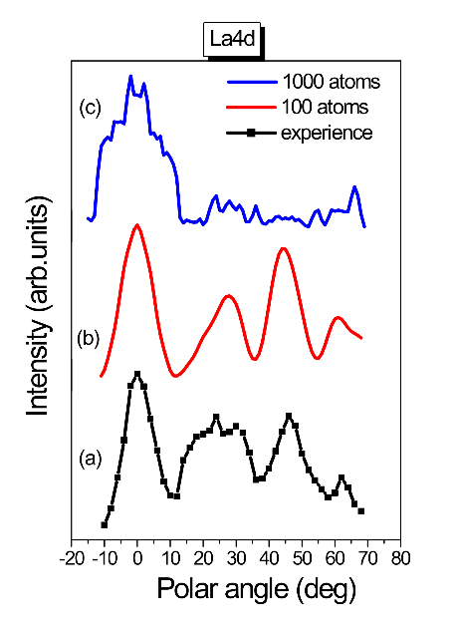
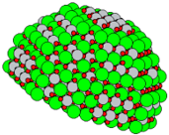
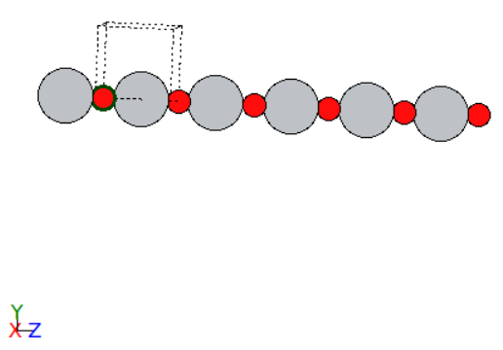
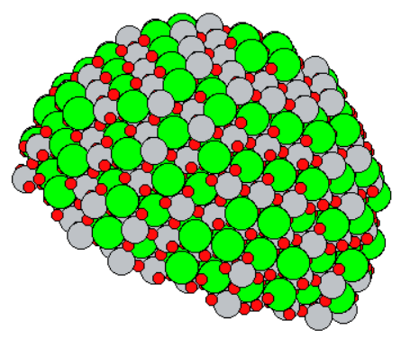
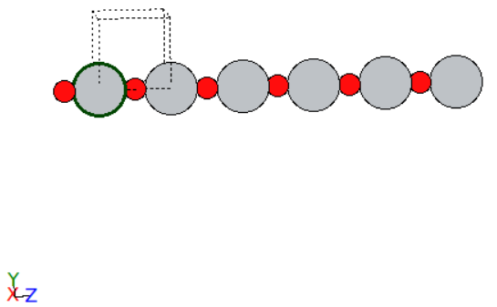
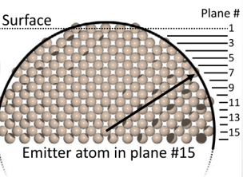
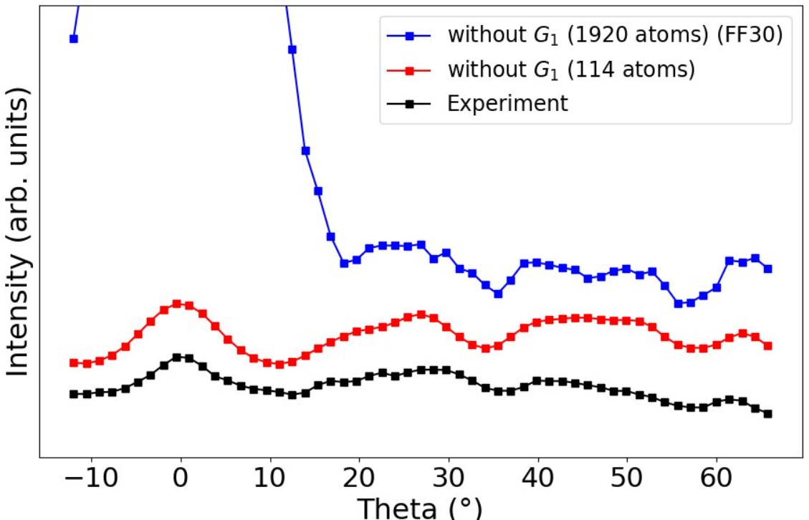
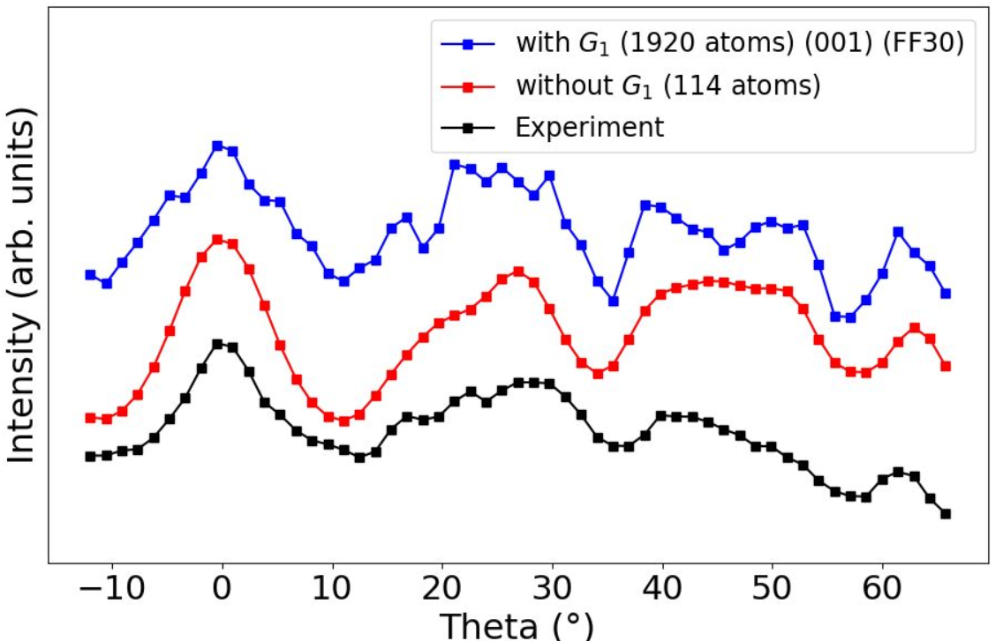
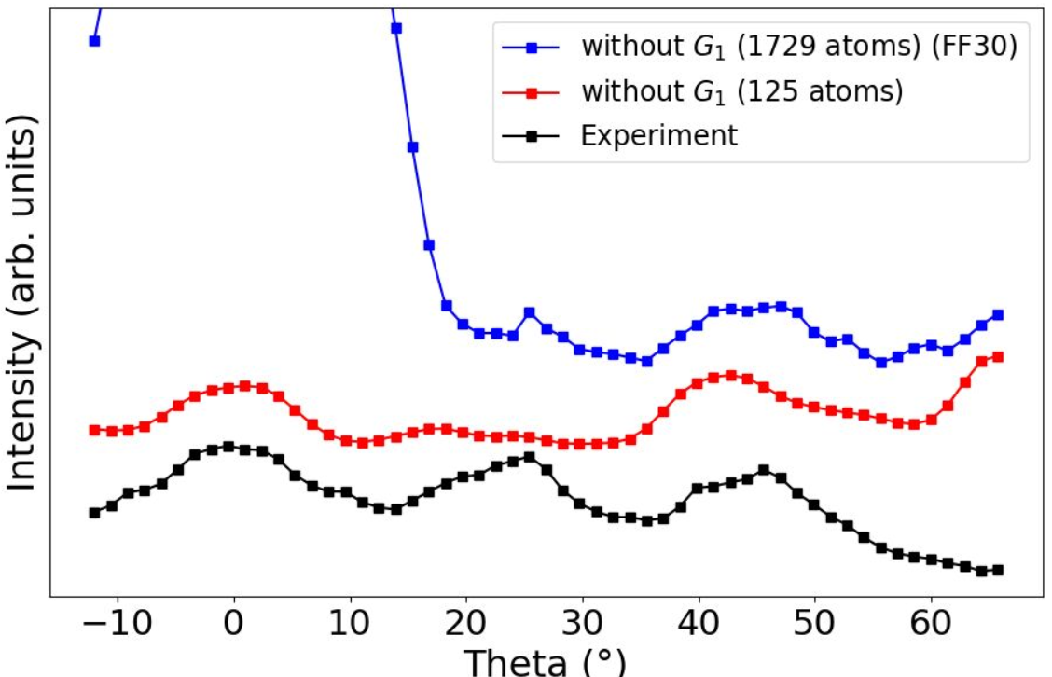
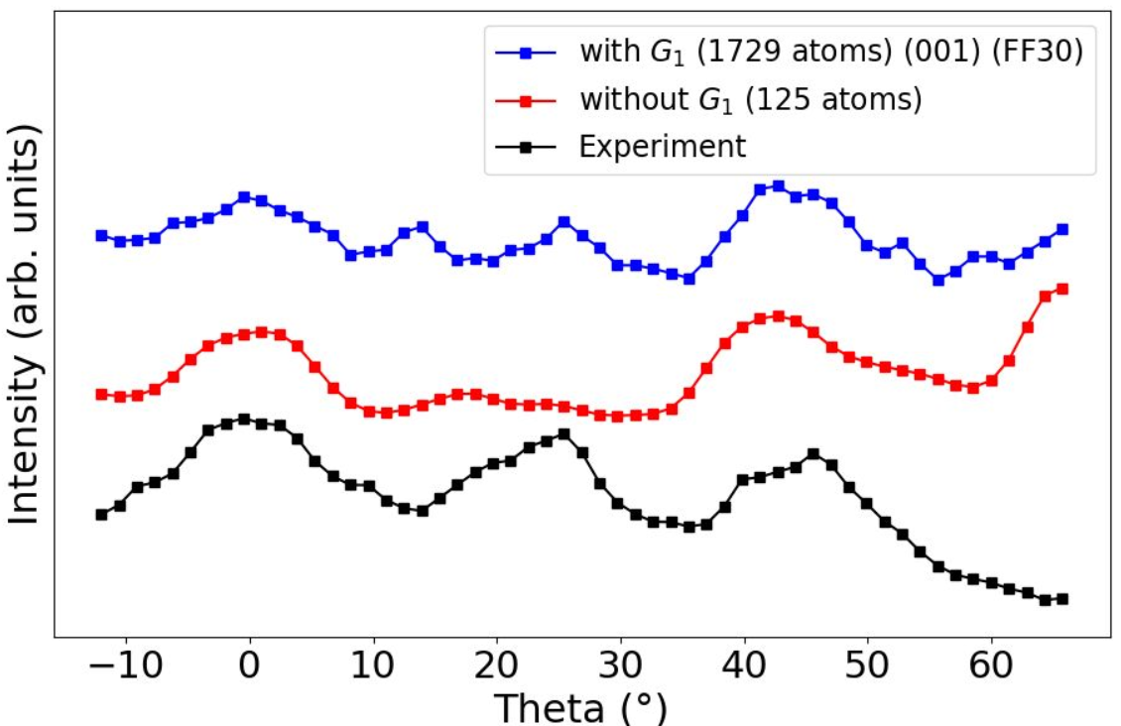
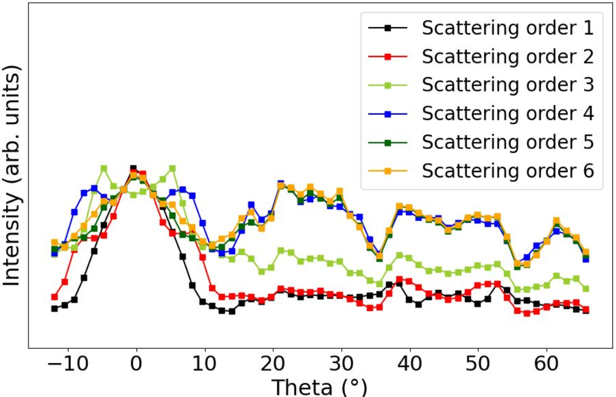
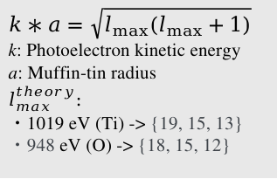







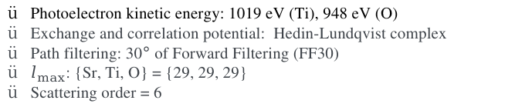






Modeling X-ray photoelectron diffraction forcing/accelerating convergence
Shin Yasuda¹, Mariko Terao−Dunseath², Kevin Dunseath², Sylvain Tricot¹, Didier Sébilleau¹
¹Department of Material and nanoscience, Institute of Physics, University of Rennes, France
²Department of molecular physics, Institute of Physics, University of Rennes, France
1. Introduction
Ⅰ
Perovskite
Ⅱ
Photo Electron Diffraction
Ⅲ
Simulation and experiment
Sr
Sr
Motivation from this divergence !
Where it comes from ?
How to cure it ?
Ti
O
Ti
O
3.905 Å
[001]
[010]
3.905 Å
[001]
[010]
[100]
[100]
Strontium Titanium Oxide (STO) is of great importance:
Ferroelectricity
PED calculation for LaAlO₃ (Mohamed Zanouni, Faculty of Sciences, Tangiers, Morocco)
2. Theory & Method
Ⅰ
Theory in MsSpec
Ⅱ
Our Method ~ Atomic chain approximation ~
In MsSpec [1] calculating the intensity:
: Sr
: Ti
: O
X-ray
z
$({I−K)}^{−1}=I+{K+K}^{2}+…$ diverges if $ρ\left(K\right)>1$
*$K= G_{0}T$
$G_{0}$: Free propagator
$T$ : T-matrix
Idea [2]:
Mix $I$ and $K$ with parameter ω:
The calculation is as heavy as MI (Matrix Inversion).
$$G_{0}$$
$ρ=1.135$
$$ω=0.803+0.243j$$
$ρ_{Re}=0.706$
$$G_{1}= \left(1−ω\right)I+ωK⇒({I−K)}^{−1}=ω({I−G_{1})}^{−1}$$
$$T$$
Ti Emitter
1920 atoms
We hope for some$ω$parameter:
: Sr
: Ti
: O
X-ray
z
$$ρ\left(G_{1}\right)<1$$
$$G_{0}$$
$$T$$
$ρ=1.182$
$$ω=0.813+0.241j$$
$ρ_{Re}=0.714$
For 1000 atoms, around 3 weeks !
$$I$$
$$G_{0}$$
[1] D. Sébilleau et al., Comput. Phys. Commun. 182, 2567-2579 (2001). [2] A. Takatsu, et al., Phys. Chem. Chem. 24, 5658–5668 (2022).
$$I+ G_{0}T+…$$
O Emitter
1729 atoms
3. Computational details 4. Results & Discussion
Ⅰ
Trick
Ⅰ
STO cluster with Ti emitter
[3]
1: Compute the cross section for an emitter at each plane
2: Sum all signals → interference between the planes
Not Renormalized
Renormalized
[3] S. Tricot, et al., J. Electron Spectrosc. Relat. Phenom. 256, 147176 (2022).
Divergence effect never shows up with $G_{1}$
Good agreement with experiment
Fine peaks are reproduced by ~ 1000 atoms
Ⅱ
Parameters
Ⅱ
STO cluster with O emitter
Photoelectron kinetic energy: 1019 eV (Ti), 948 eV (O)
Exchange and correlation potential: Hedin-Lundqvist complex
Path filtering: 30$°$ of Forward Filtering (FF30)
$l_{max}$: {Sr, Ti, O} = {29, 29, 29}
Scattering order = 6
$$k∗a=\sqrt{l_{max}(l_{max}+1)}$$
k: Photoelectron kinetic energy
a: Muffin-tin radius
$$l_{max}^{theory}:$$
・1019 eV (Ti) -> {19, 15, 13}
・948 eV (O) -> {18, 15, 12}
Not Renormalized
Renormalized
Same fruits as Ti emitter !
5. Conclusion & Perspectives
We have found out divergence effect on an atomic chain. We demonstrated our methodology simulating theta scans for STO based on atomic chains. More perovskites are to be tested (CTO, BTO,…etc., experimental data are available at the IPR).
Notes:
I have to change the logo to newSTOの名前、Oがない。
Normal vecotrの色
平均自由行程で1000個ほしい
鎖の前方散乱や香蘭散乱に発散の原因があるとにらんでいる
Clusterの図のreference
Lmax見積もり
Scattering を変えて収束性を確かめる
100個のクラスターの図もやる

