Slide 1
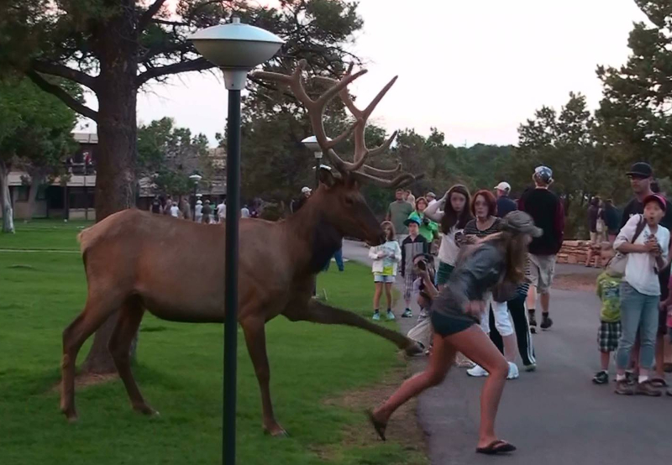
Modelling Conservation Conflict
Brad Duthie

Slide 2
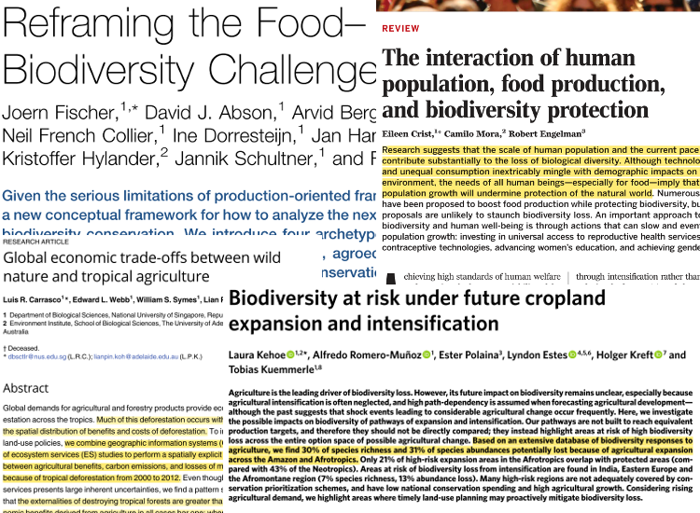

Slide 3
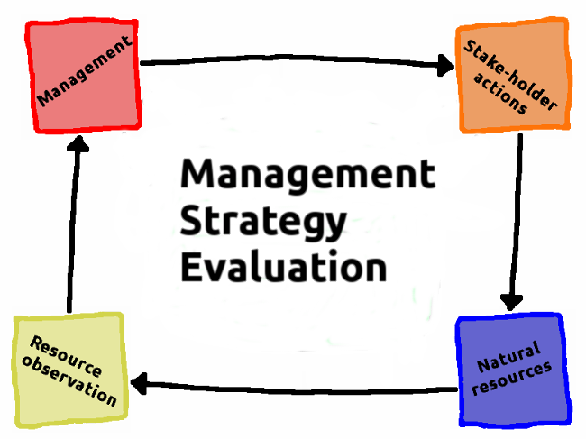

Slide 4
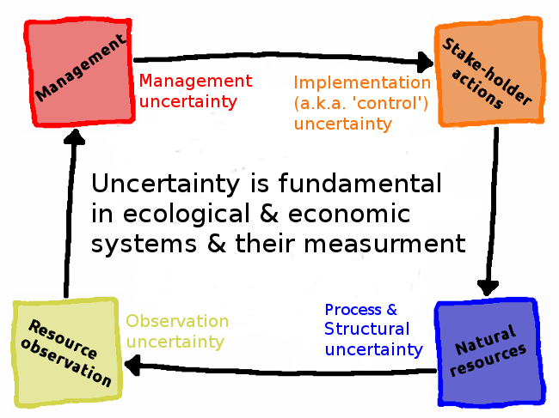

Slide 5
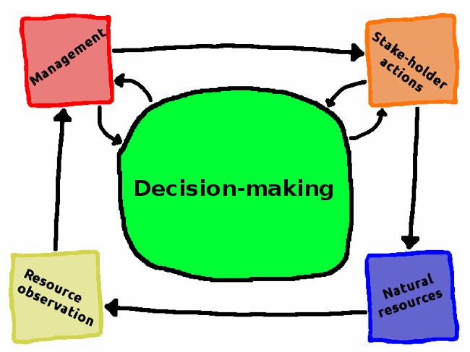

Slide 6

Generalised Management Strategy Evaluation
Open-source R package on CRAN and GitHub
Model biodiversity dynamics & realistic human decision-making
Predict resource & land-use changes in social-ecological systems
Integrate flexibly with existing ecological models
https://confoobio.github.io/gmse/

Slide 7
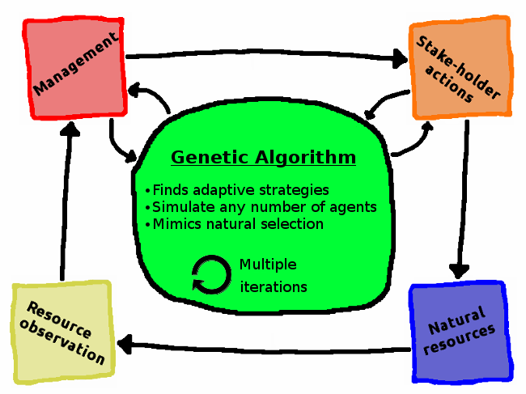

Slide 8
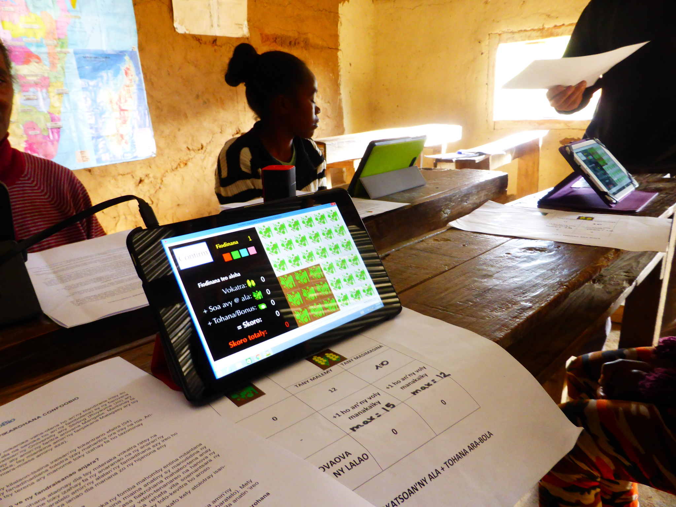

Slide 9
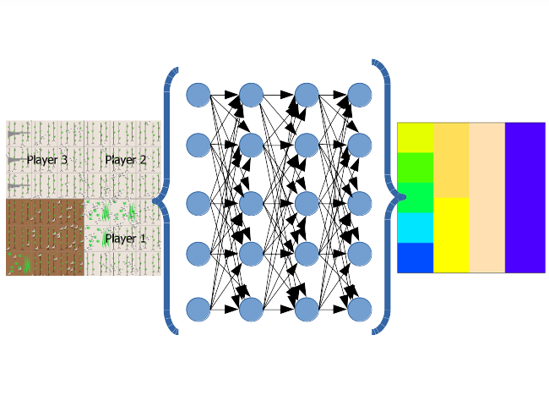

Slide 10
