Slide 1










Kit
Age: 22
Gender: F
Status: Single
Josh
Age: 21
Gender: M
Status: Single
Lucy
Age: 20
Gender: F
Status: Single
Drew
Age: 18
Gender: N
Status: Taken
Ty
Age: 21
Gender: M
Status: Single
Quinn
Age: 22
Gender: N
Status: Single
Viv
Age: 25
Gender: F
Status: Taken
Dee
Age: 26
Gender: F
Status: Taken
Ron
Age: 17
Gender: M
Status: Taken
Chet
Age: 24
Gender: M
Status: Taken

Slide 2
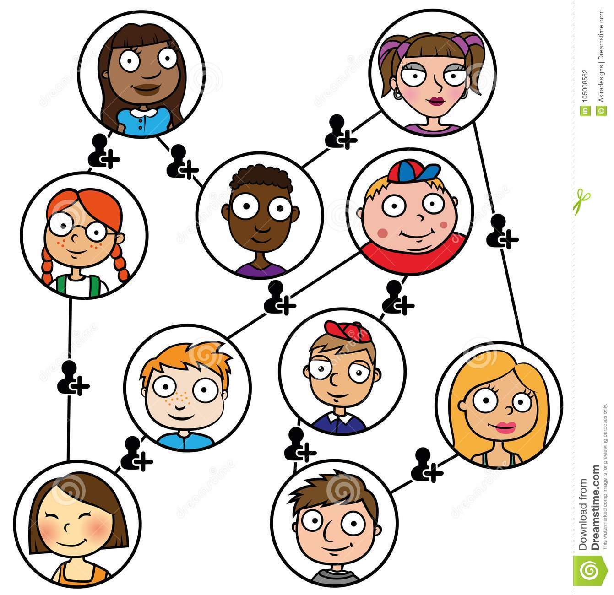

Slide 4
1
2
4
2
1
1
8
2
4
2

Slide 5



Slide 6
A
B
C
D
2
4
1
2
1
1
8
2
4
2

Slide 7
Kit
Age: 22
Gender: F
Status: Single
Josh
Age: 21
Gender: M
Status: Single
Lucy
Age: 20
Gender: F
Status: Single
Drew
Age: 18
Gender: N
Status: Taken
Ty
Age: 21
Gender: M
Status: Single
Quinn
Age: 22
Gender: N
Status: Single
Viv
Age: 25
Gender: F
Status: Taken
Dee
Age: 26
Gender: F
Status: Taken
Ron
Age: 17
Gender: M
Status: Taken
Chet
Age: 24
Gender: M
Status: Taken

Slide 8
Kit
Age: 22
Gender: F
Status: Single
Josh
Age: 21
Gender: M
Status: Single
Lucy
Age: 20
Gender: F
Status: Single
Drew
Age: 18
Gender: N
Status: Taken
Ty
Age: 21
Gender: M
Status: Single
Quinn
Age: 22
Gender: N
Status: Single
Viv
Age: 25
Gender: F
Status: Taken
Dee
Age: 26
Gender: F
Status: Taken
Ron
Age: 17
Gender: M
Status: Taken
Chet
Age: 24
Gender: M
Status: Taken

Slide 9
Kit
Age: 22
Gender: F
Status: Single
Josh
Age: 21
Gender: M
Status: Single
Lucy
Age: 20
Gender: F
Status: Single
Drew
Age: 18
Gender: N
Status: Taken
1
2
4
2
Ty
Age: 21
Gender: M
Status: Single
Quinn
Age: 22
Gender: N
Status: Single
1
1
8
Viv
Age: 25
Gender: F
Status: Taken
Dee
Age: 26
Gender: F
Status: Taken
2
4
2
Ron
Age: 17
Gender: M
Status: Taken
Chet
Age: 24
Gender: M
Status: Taken

Slide 10
Kit
Age: 22
Gender: F
Status: Single
Josh
Age: 21
Gender: M
Status: Single
Lucy
Age: 20
Gender: F
Status: Single
Drew
Age: 18
Gender: N
Status: Taken
Ty
Age: 21
Gender: M
Status: Single
Quinn
Age: 22
Gender: N
Status: Single
Viv
Age: 25
Gender: F
Status: Taken
Dee
Age: 26
Gender: F
Status: Taken
Ron
Age: 17
Gender: M
Status: Taken
Chet
Age: 24
Gender: M
Status: Taken

