Slide 1
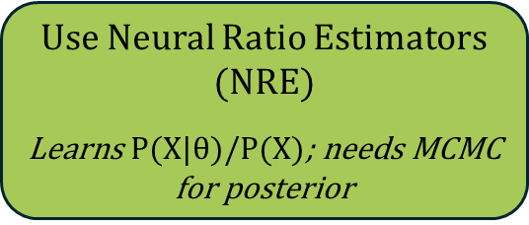

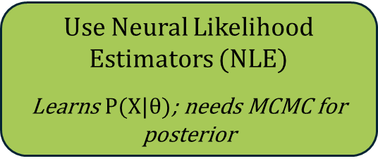
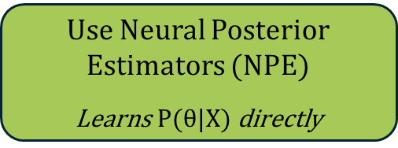

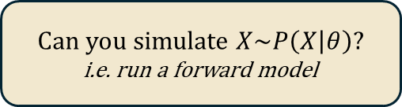

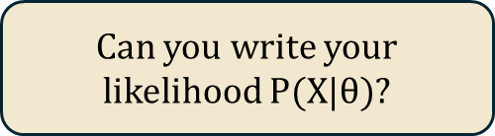
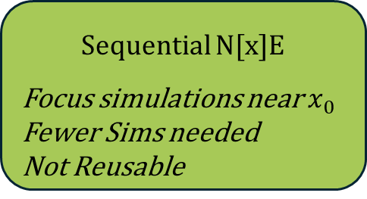
Likelihood-Free Inference
A.K.A
Simulation-Based Inference
Bayes Theorem
$$P(θ|X) = \frac{P(X|θ)P(θ)}{P(X)}$$
0)
Can you write your likelihood $P(X|θ)$?
Yes
No
Use MCMC or Nested Sampling
Can you simulate $X\sim P\left(X | θ\right)?$
i.e. run a forward model
Yes
No
Entirely different problem
Use Simulation-Based Inference
1)
Want to swap priors without retraining?
Yes
No (Fastest)
Expect a multi-modal posterior?
Use Neural Posterior Estimators (NPE)
Learns $P(θ|X)$directly
Yes
No
Use Neural Ratio Estimators (NRE)
Learns $P(X|θ)/P(X)$; needs MCMC for posterior
Use Neural Likelihood Estimators (NLE)
Learns $P(X|θ)$; needs MCMC for posterior
2)
Many observations to analyse?
Yes / Real Time
No
Amortised
Many more simulations
Train once for all data
Reusable
Sequential N[x]E
Focus simulations near $x_{0}$
Fewer Sims needed
Not Reusable
3)
Is dimensionality of your data high?
No (less than ~50 data points)
Learn a low dimensionality representation of the data
Or
Hand craft summary statistics (period, etc)
Use raw data
4)
Choose a network architecture
If using NPE or NLE
Simple $θ?$
Default
Max. Flexibility
High dim $θ?$
MDN
Mixture Density Network
Normalising Flows
e.g. Masked Autoregressive flow, Neural Spline Flow
Flow Match
Score-Based Diffusion
5)
MODEL VALIDATION
E.g. SBC Ranks, Coverage Tests, etc
0) Is Simulation-based Inference the right tool?
1) What type of estimator should you choose?
2) Choose either sequential or non-sequential models
3) Should you compress your data?
4) What architecture should you choose?
5) Validate your model!

