Slide 1

BENV0091 Lecture 5: Dates and Times
Hector Camm and Cato Davies

Slide 2
Lecture Overview
Intro to dates, times and the lubridate package
Time series forecasting (Renewables Ninja)
Upcoming competition!

Slide 3
Challenges of Dates and Times
Handling dates and times (AKA date-times) in R (and other languages) can be challenging
There is no single format for dates and times:
9am 25th Dec 2021
2021-12-25 09:00
9:00:00 25/12/2021
Furthermore, local time zones (including daylight savings) mean that the time isn’t the same everywhere in the world
Coordinated Universal Time (UTC) is the standard time zone that is most widely used as a reference point, but often the local time is more informative
Plus leap years (and even leap seconds) can pose problems!

Slide 4
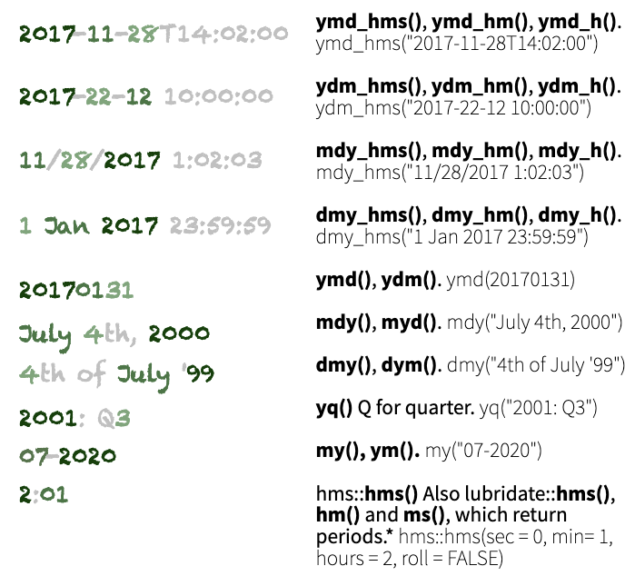
Parsing Dates and Times
From the lubridate cheat sheet
Dates and times should be treated as their own data types: not as strings!
There are 3 types of date/time object:
date
time
date-time (AKA POSIXct)
When you read in data with a timestamp or date column, it will often not be automatically converted to date/time data
The lubridate package has intelligent functions like `ymd()` or `dmy_hms()` for converting to date/time objects
Identify the order of years, months, days, hours, minutes and seconds, then apply the relevant function on the right

Slide 5
Converting Time Zones
When you create a date-time object, the time zone will be UTC unless you specify otherwise with the `tz` argument
E.g. ymd_hms(d, tz = …)
The time zone codes (which should be passed as strings) and UTC offsets are taken from the tz database and generally have the form “region/place”
OlsonNames() function gives a list of valid tzs
The tz database takes into consideration daylight savings time when necessary
Convert between timezones using `with_tz()`
TZ Name | UTC Offset
Africa/Cairo | +02:00
Pacific/Honolulu | -10:00
Europe/Brussels | +01:00
America/Chicago | -06:00

Slide 6
Date-Time Arithmetic
There are some subtleties when adding or subtracting date/times: you must consider whether you want to consider discontinuities in the time line.
Suppose you want to know the time 3 hours after Saturday 30th October 2021 at 11pm (the night the clocks go back): 2am or 1am?
Date/time data can be added or subtracted
Using `seconds()`, `months()`, `years()` etc. creates a duration
Using `second()`, `month()`, `year()` etc. gets the specific value from the datetime
Adding/subtracting a period from a date-time returns a new date-time
Subtracting two date-times returns a difftime
now() gives the current time as a date-time object

Slide 7
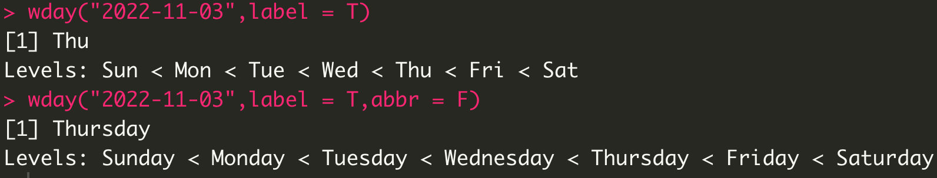
Other useful functions
now(), today(), Sys.Date(), as.Date()
difftime(), leap_year()
wday() - day of week, yday() - day of year, mday() - day of month

Slide 8
Failures to parse with lubridate
"\" back slashes cannot be parsed by lubridate
hms_dym / ms_dmy / ….
dmy or myd or ymd or mdy has to come first when parsing with time
hms_dmy("16:00:00 14.11.2030") - will not work
Roll up your sleaves and use as.POSIXct()
as.POSIXct("16:00:00 14.11.2030", format= "%H:%M:%S %d.%m.%y")
You have to specify where R should look for each date time element

Slide 9
Exercise 1
Task 1: convert the following dates/times to date or date-time variables:
March 3rd 2003
16:00:00 14.11.2030
Tuesday 2nd August 1966 7:30pm
Task 2: create a date-time variable for 1st April 1980 5am with the UTC time zone, then convert to:
Europe/London (06:00 BST)
Asia/Tokyo (14:00 JST)
America/Los_Angeles (21:00 PST)
Task 3:
Calculate the time in 123456789 seconds from now
Calculate your age in seconds by taking the difference between the time now and your DOB

Slide 10
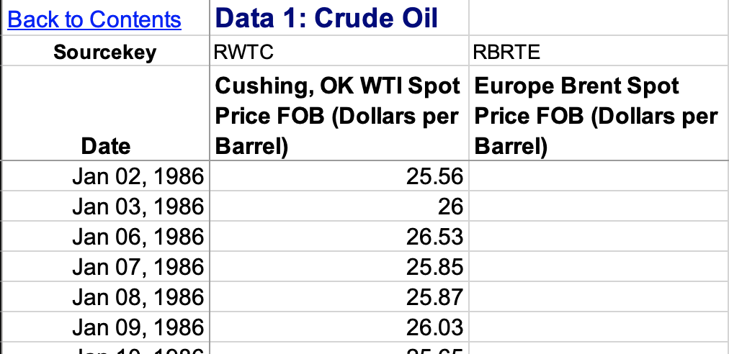
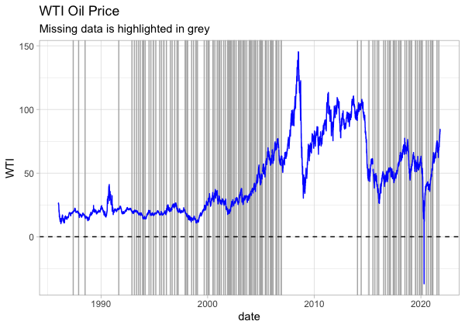
Filling NAs
This daily crude oil price (WTI) data has a few missing values
We can get rid of these values with `drop_na()` but we will lose valuable data!
Alternatively, we can attempt to fill in (impute) the missing data points
Data is not CSV

Slide 11
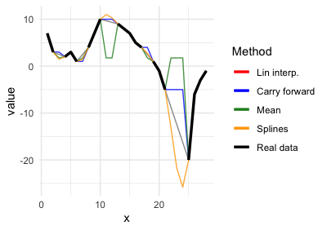
Imputation
Methods which impute missing values of column X using information from column X alone are univariate. Methods include:
Taking the mean, max or other statistic
Interpolation (linear, splines…)
Carry forward/backward
Multivariate imputation uses other variables to predict the missing values
Univariate methods are particularly appropriate for time series, because often adjacent values are similar to each other
zoo functions for univariate imputation:
na.approx()
na.locf()
na.aggregate()
na.spline()
R packages for multivariate imputation:
missForest
mice
Amelia
mi

Slide 12
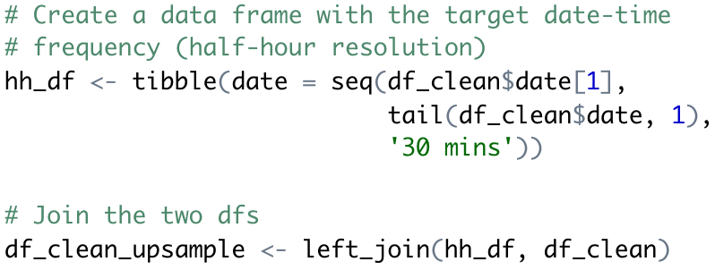
Resampling Time Series
Often, we want to change the resolution of a time series to match another data set
Electricity metered at 30 minute resolution, gas metered at 1 hour resolution
Daily oil prices, half-hourly electricity prices
The methods for resampling depend on whether we want to increase or decrease the resolution:
Reduce resolution 🡪 aggregate
Increase resolution 🡪 impute or aggregate
One upsampling method: join the data frame to a separate data frame with the desired date-time resolution

Slide 13
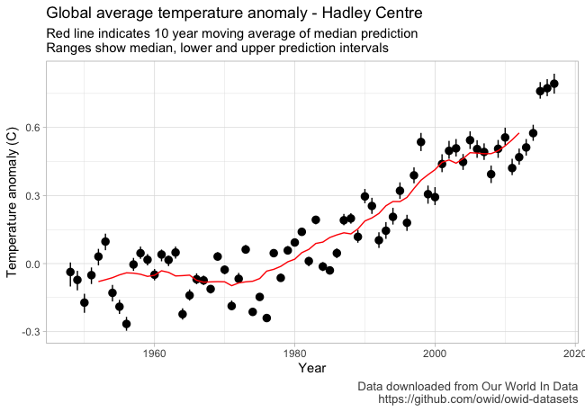
Moving Averages
A useful and interpretable way to indicate a trend over time is a moving average
Moving (or rolling) average typically calculates the mean over a rolling window
The `rollmean()` function from zoo is a good option for calculating rolling averages (or you can write your own function!)
Code available from the Github repo

Slide 14
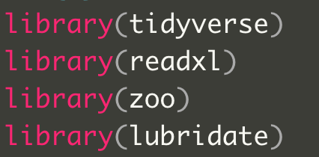
Exercise 2
Task 1: read the crude oil price data using `read_excel()` from the readxl package:
Skip the first two rows
Choose the sheet named “Data 1”
Rename the columns (see right)
Task 2: count the number of NAs in the WTI column
Task 3: use na.approx() from the zoo package to fill the NA values in the WTI oil price time series
Task 4: upsample the oil price data to 30 minute resolution
Task 5: impute the missing WTI data with a method of your choice

Slide 15
Introduction to Forecasting

Slide 16
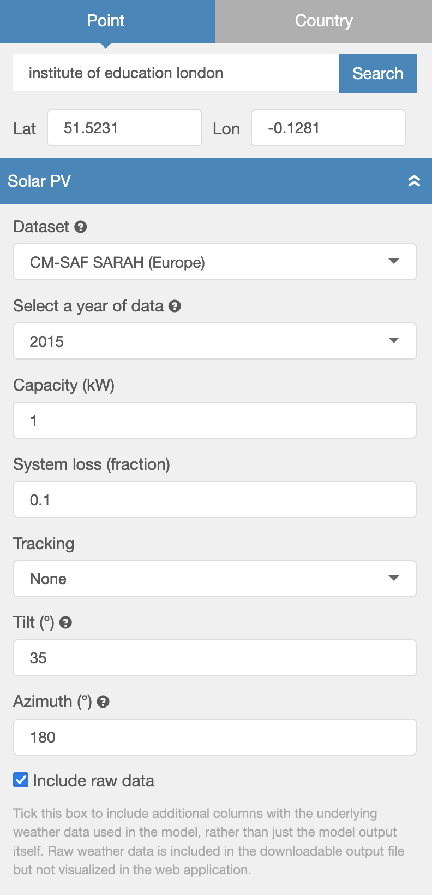
Data: Renewables Ninja
Renewables Ninja runs simulations of hypothetical solar PV or wind turbines for a specified location, based on weather data
We will use hourly simulated solar PV production for a 1 kW solar panel on the Institute of Education building (51.5231, -0.1281)
Note there are two time columns:
time (UTC)
local_time (considers local time zones, including daylight savings)

Slide 17
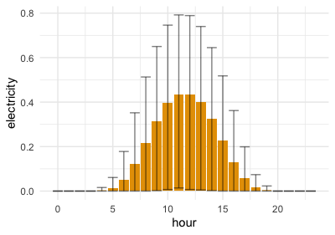
Retrieving Date-Time Components
Once you have a correctly formatted a date-time, you can easily retrieve components such as week, hour, year etc.
Use week() to retrieve week number from a date-time, year() to retrieve year etc.

Slide 18
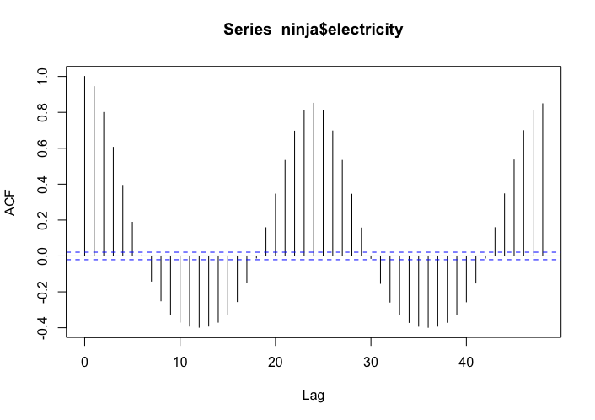
Autocorrelation
Use acf(vector, lag.max = N) to plot the autocorrelation function for vector with a maximum lag of N
Autocorrelation measures the correlation between a series and a delayed version of itself
It is useful for determining patterns and periodicity of time series, which can be useful for feature generation

Slide 19
Solar PV Forecasting
Our task will be to forecast the (simulated) solar PV output 24 hours ahead
In this lecture we will adopt a machine learning approach, using supervised learning methods that are equally applicable in non-time series contexts
However, there is a rich literature of traditional time series forecasting methods, including:
Exponential smoothing
Autoregressive and moving average models, e.g. ARMA, ARIMA

Slide 20
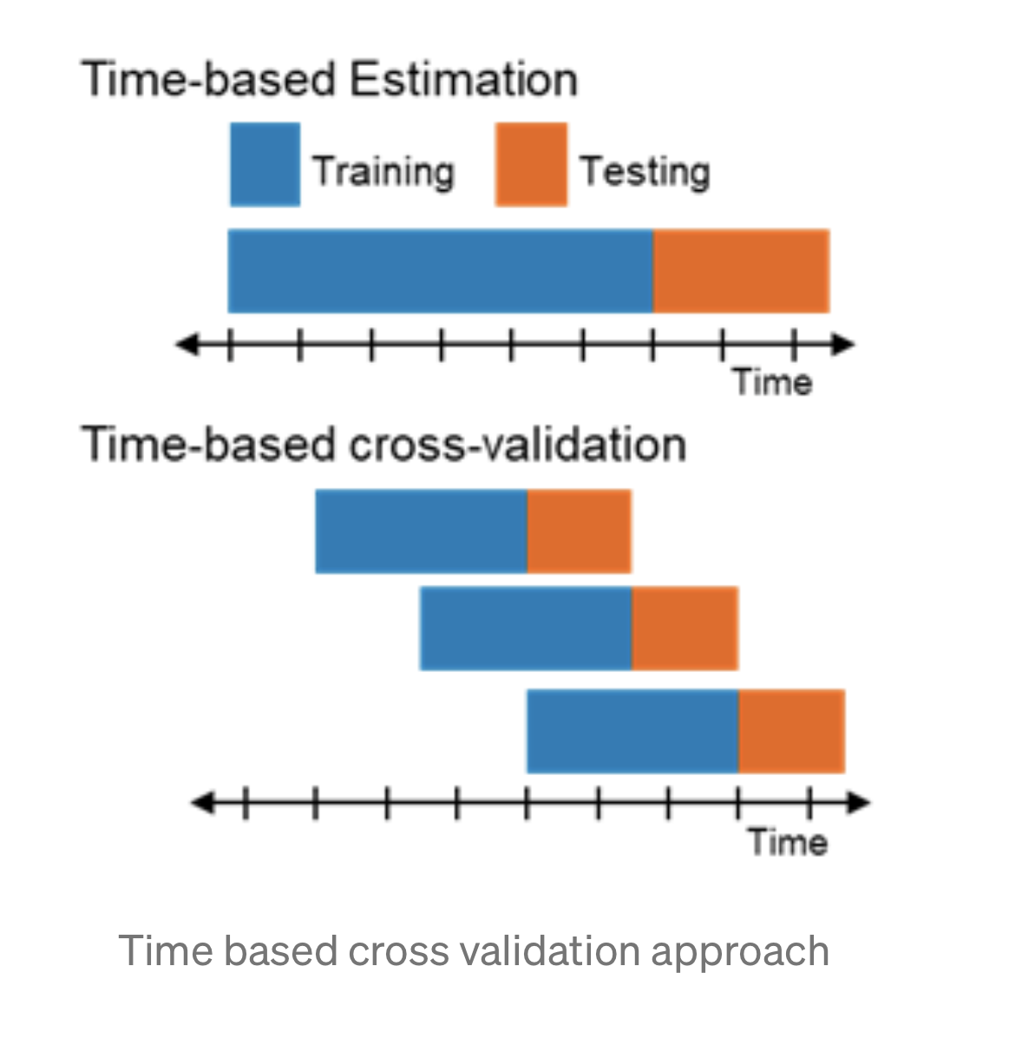
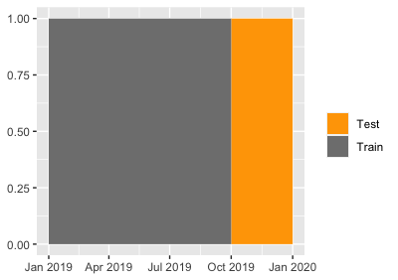
Data Pre-Processing and Train/Test Splitting
It is important to get the data pre-processing and train/test split steps right for forecasting tasks as there are serious risks of data leakage:
Including measurements from the target time as features in the model
Including adjacent observations in test and train data
To avoid (1), observations from the target period shouldn’t be used to train the model!
To avoid (2), the test set is often set to be the last segment

Slide 21
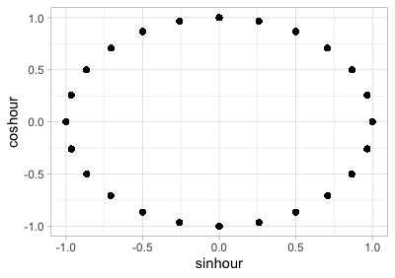
Cyclical Date/Time Features
Dates and times are cyclical: hour 24 is adjacent to hour 1, December is adjacent to January
If we encode dates/times as numeric variables, then we cannot immediately capture the cyclical nature
A categorical encoding could also work, but this loses the continuous nature of dates and times and increases the dimensionality of the data significantly
One option to create a numeric (continuous) encoding that captures the cyclical nature of dates/times is to use the sine and cosine functions
For variable with period T:
cos_var = 2π cos(var / T)
sin_var = 2π sin(var / T)

Slide 22
Exercise 3
Use week() to retrieve week number from a date-time, year() to retrieve year etc.
Task 1: read the data into an object called `ninja`
Task 2: use mutate() to add hour, week and date columns to `ninja`
Task 3: produce the above plot on the right hand side!
geom_col() shows the mean production by hour
geom_errorbar() shows the range
Task 4: produce the below plot on the right with the `acf()` function
Task 5: split the data such that all pre-October data is for training; the remainder is for testing hint: use filter()
Task 6: on the training set use mutate() to create new variables for hour and weeks:
sin_week, cos_week
sin_hour, cos_hour
Use acf(vector, lag.max = N) to plot the autocorrelation function for vector with a maximum lag of N

Slide 23
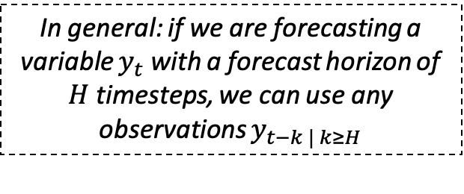
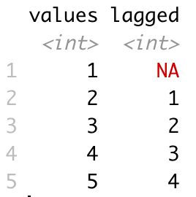
Lagged Predictors
Lagged explanatory variables are among the most important inputs for forecasting models
We can include observations of the target variable and other explanatory variables from any time before the forecast horizon, but not after
Depending on the context, you may want to include 24hr, 1wk, 1yr lagged variables: you can use autocorrelation to inform your decision
1 year might be useful for solar PV, but we don’t have enough data ☹
Use lag(vector, N) to create a new vector that is lagged by N steps, with the initial values padded with NA
Lagged values with N=1

Slide 24
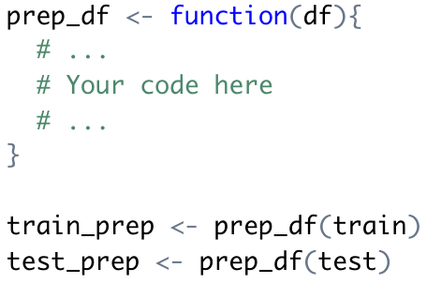
Pre-Processing - Exercise 4
Task 1: create a function for pre-processing your data
Add 24 hour lagged variables for:
Electricity
Direct irradiance
Diffuse irradiance
Temperature
Add the sine and cosine transforms of week and hour variables
Task 2: pre-process your training and testing data separately with the cleaning function
Task 3: drop the NA values from your training data

Slide 25
Random Forests and Ensemble Learning
Decision trees built on many subsets of the data (n times)
Make predictions and take the average value across all trees
Improves accuracy
More stable – 1 change in the data set could impact 1 tree but will not affect many trees
Similar to the game of asking everyone in a room to guess how many jelly beans are in a jar
The average of all guesses will have a good chance of being close to the real number

Slide 26
Not quite as easy as jelly beans
Our formula for these models is:
electricity ~ . - time
Random forests fit many different decision trees using different features (sampled randomly) and with different data – ensures each tree is different
The forest of trees are used to calculate an average prediction
Lists variable importance
Not likely to overfit
Regression and classification
Balance out uneven number of classes
Efficient at handling many variables
The simplest forecast assumes that the forecast is the same as the last observation: called a naïve forecast or persistence forecast
Use lm(formula, train) to fit a linear regression model
Use rpart(formula, train) to fit a decision tree model
Use randomForest(formula, data, arguments…) to fit a random forest model

Slide 27
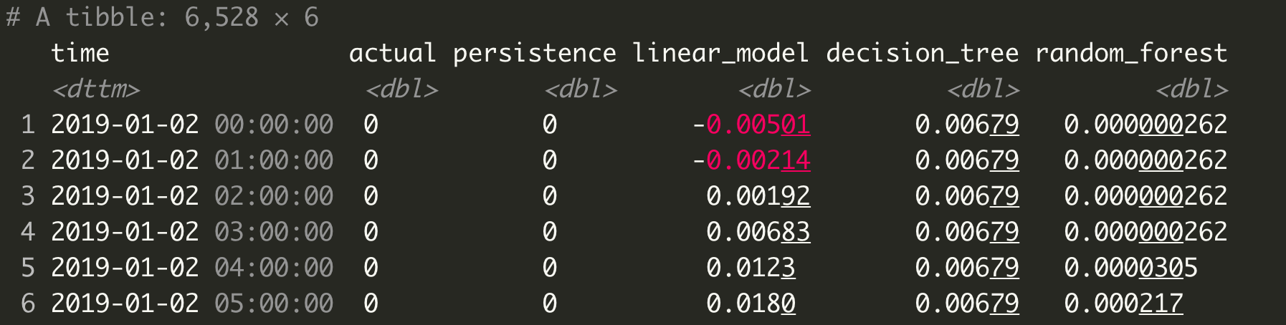
Exercise 5
Our formula for these models is:
electricity ~ . - time
Task: fit the following models to the training data
Linear Regression
Decision Tree (minsplit = 10)
Random Forest (ntree = 200)
Task: calculate the predictions based on the training data, storing them in a data frame with the following columns:
C(Timestamp, Actual value, Linear model prediction, Decision tree prediction, Random forest prediction)
Task: add a naïve (persistence) forecast to your predictions data frame
Task: calculate the RMSE of each of the models
Hint the "Metrics" package contains many functions evaluate model performance
rmse(actual,predicted)
Use lm(formula, train) to fit a linear regression model
Use rpart(formula, train, arguments...) to fit a decision tree model
Use randomForest(formula, data, arguments…) to fit a random forest model

Slide 28
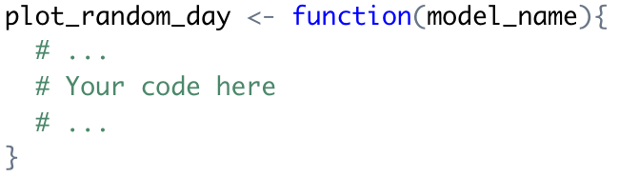
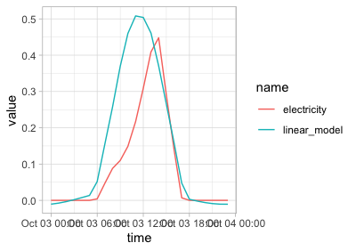
Model Evaluation on Test Data
We will now employ our models to predict the solar PV output on the out-of-sample data (October onwards)
Task: make your predictions on the (pre-processed) test data
Task: calculate the RMSE of each model on the test data
Bonus task: write a function that plots the predicted and actual time series for a specified model and random day (see right)
Which model performed best? What are the limitations of the random forest model?
Less interpretable
Computationally costly

Slide 29

Further Reading
Forecasting: Principles and Practice by Rob J Hyndman and George Athanasopoulos
Excellent (free) book with R examples and more focus on traditional time series methods

Slide 30
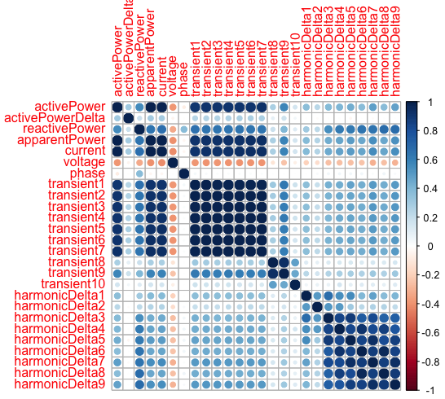
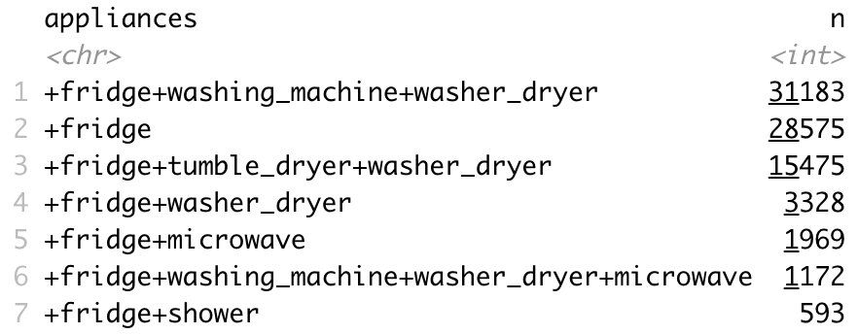
Kaggle Competition
Correlation of training features
Today we are launching a Kaggle competition looking at non-intrusive load monitoring (NILM)
Your task is to predict appliances being used based on recorded samples of voltage and current
75% of the data is available in a training data set, 25% is held back in a test set
You will be marked on classification accuracy
£100 for winner; £50 for 2nd and 3rd places!
Deadline is Wednesday 16th November @ 11:59pm
Class labels (28 in total)

Slide 31
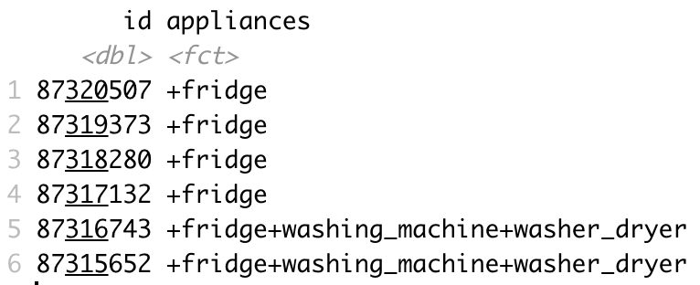
Minimum Viable Submission
Make a submission is as simple as uploading a CSV file with 2 columns:
id (corresponding to the ids in the test set)
appliances (your prediction)
We have made available a minimum viable submission: fitting a model, making predictions and saving the submission to a .CSV file
If nothing else, try submitting an improved decision tree with some hyper-parameter tuning!
More details are available on the Kaggle webpage ☺ Good luck!
Submission format
https://www.kaggle.com/competitions/esda-nilm-2022/overview

