Slide 1

BENV0091 Lecture 1: Introduction
Hector Camm & Cato Davies

Slide 2
Lecture Part 1: Course Overview

Slide 3
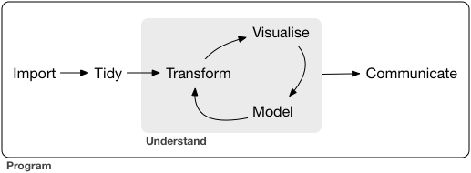
Course Aims
Build a toolbox for energy data science!
Learn to use data effectively:
Handle data confidently and carefully
Draw insights from data
Solve problems with data
R for Data Science by Hadley Wickham and Garrett Grolemund

Slide 4
Course Overview
Programming in R
Data wrangling
Data visualisation
Tools and best practices for data science
Time series
Data retrieval (APIs and web scraping)
Supervised learning
Unsupervised learning
R Shiny
Guest lecturer!

Slide 5
Assessment
Group project 😬
One report of 5000 words
Collaborative effort: one report, one grade
Groups to be assigned before reading week!
Deadline is Wednesday 14th December 2022

Slide 6
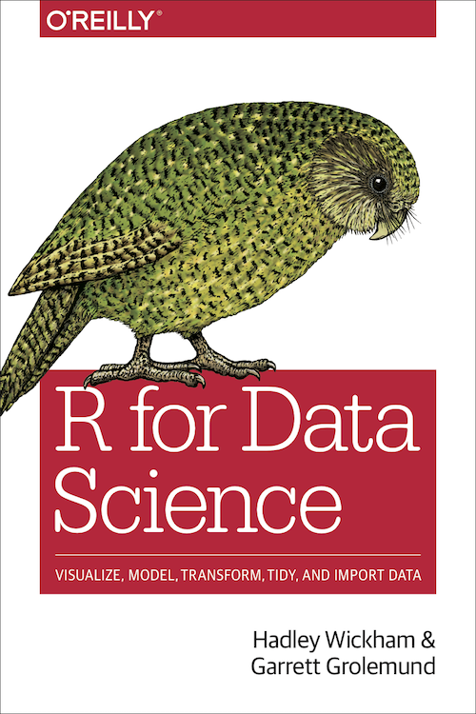
Textbook
R for Data Science by Hadley Wickham and Garrett Grolemund
It is free! https://r4ds.had.co.nz/
But it won’t teach you everything… get familiar with Stack Overflow

Slide 7
Lecture Part 2: Introduction to R

Slide 8

Task: Install R
Go to: https://cran.r-project.org
Choose option for your operating system
a) Windows - Install for first time b) Mac - select right version for you computer
Open the downloaded file and follow steps

Slide 9
Task: Download an IDE (R-Studio)
Go to: https://www.rstudio.com
Click on RStudio
Download RStudio for desktop
Select free version and appropriate version for
your operating system
IDE: Integrated Development Environment

Slide 10


Why R?
Designed for data science
Quick to pick up
Powerful when you need it to be
Encourages statistical rigour
Widely used by academics and professionals
Enables you to work efficiently
Recommended reading: How R Helps Airbnb Make the Most of Its Data
Notes:
Rio Ferdinand
Pursuing an end-to-end machine learning project can often be costly and time consuming. This means that validating the ideas before fully investing in engineering and implementation is a high leverage activity. One of the ways in which data scientists would validate whether a modeling based solution would work is to build a prototype. R turns out to be an extremely powerful tool for this purpose because we can easily perform data wrangling and feature engineering once training data is loaded into an R session. Furthermore, with the training data prepared, data scientists can try out a wide variety of models to understand how much gain we would get versus a naive, non-modeling solution.

Slide 11
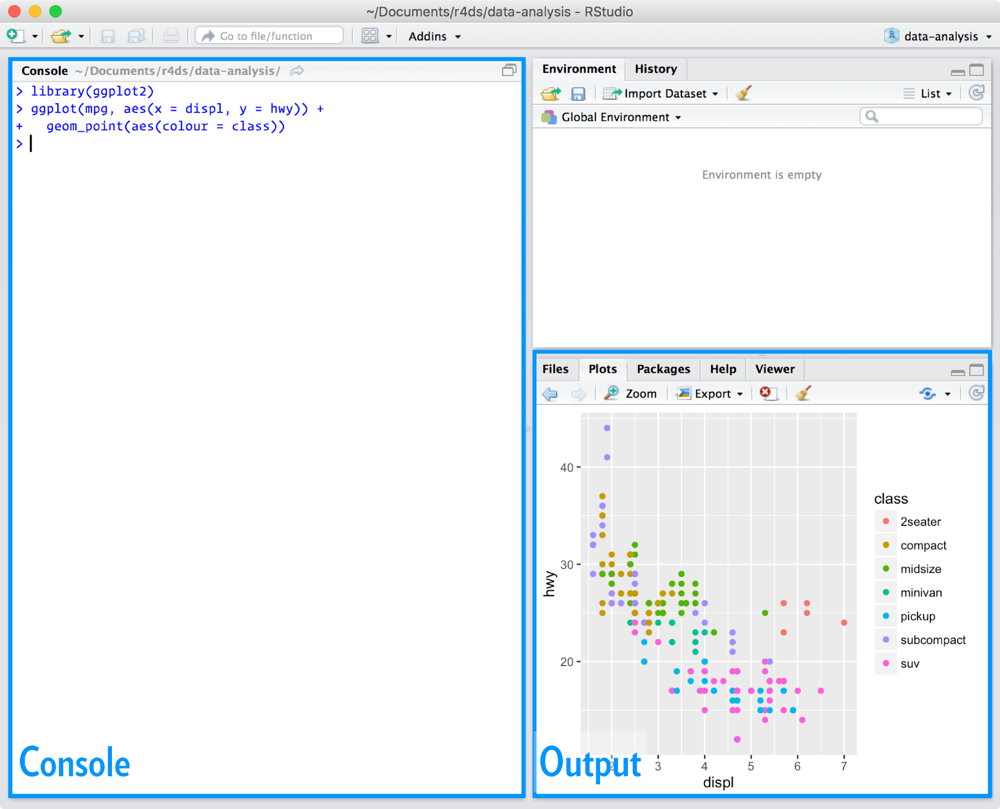
RStudio: Integrated Development Environment (IDE)
Lets you view/write code, files, plots, notebooks (more on this later) all in one place
Task: do some calculations in the console
`print(x)` is a function that displays `x` on your screen
Inputs to a function are called arguments
Task: print hello world!
Function: a reusable piece of code to perform a particular task
Type `?print` to read the documentation for print()
Notes:
Demonstrate print. What is a function? What is a string (Sequence of characters)? What is an argument? Documentation for print: look at `digits` argument

Slide 12
Variables
Type | Examples
numeric | 3, 12.9, 5e-7
character | “hello world”, “3.3”
logical | TRUE, FALSE
A name we give to some value
R uses <- to assign variables
We can manipulate and update variables
Variables have types – these determine how we can operate on them
We can convert between types using `as.character()`, `as.numeric()` etc.
Logical variables can take two values: TRUE or FALSE which are not characters!
Task: get familiar with creating variables; changing type; using mode(x)
x <- 2 assigns variable x to value 2
Use mode(x) to get type of x
Convert between types using as.character(), as.numeric()…
== think “is exactly equal to"
Notes:
Variables appear in your environment. Demonstrate as.character(x). x doesn’t update until I assign it! Can’t add strings. Demonstrate as.logical()

Slide 13
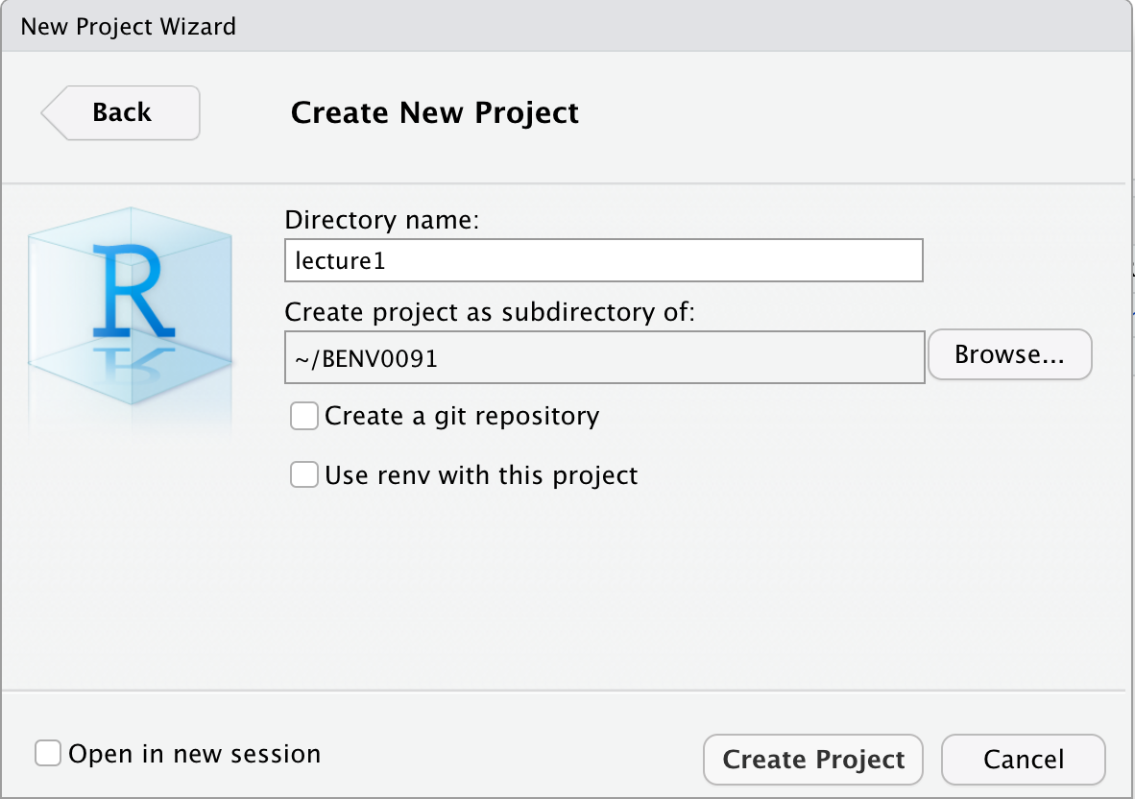
Create an R Project
Create a new directory called BENV0091 somewhere sensible on your machine
Go to File > New Project > New Directory and call it lecture1, and make it a subdirectory of BENV0091
Projects load your settings including working directory when you open it
Working directory determines where R will look for files: it is often the cause of bugs!
Task: make sure your working directory is set to ‘…/BENV0091/lecture1’
Use getwd() to print your working directory
Use setwd(x) to manually change your working directory to x
Notes:
Don’t use spaces in filenames or folders!

Slide 14
Scripts
So far we have only worked in the console
Once we have run those commands, they are lost forever :(
Scripts are simply text (.R) files for storing code
A script should be standalone – performing a task from start to finish with no errors on a fresh startup!
Open a new script and save it as variables.R in your lecture1 directory
Add comments by beginning a line with #
Task: write some variable assignments in variables.R and click Source. Check there are no errors!
To be 100% sure that a script runs standalone, restart R (clears all saved variables) and then Source

Slide 15
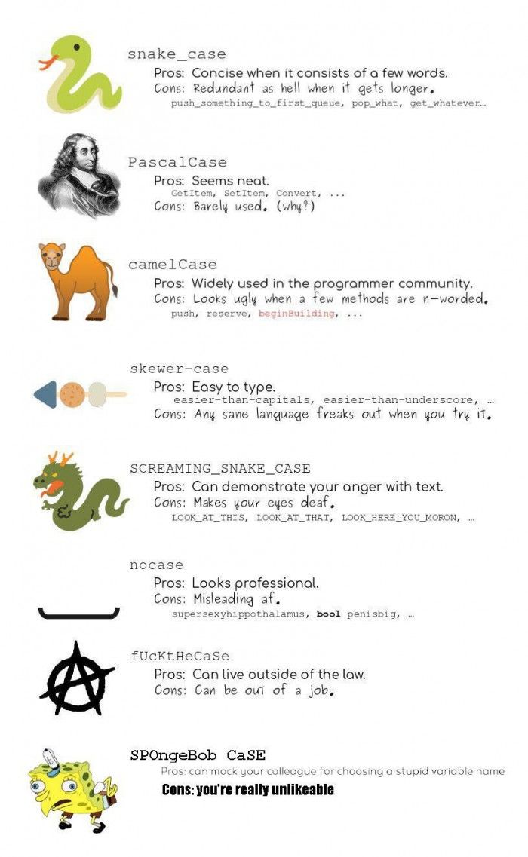
Cases
I recommend using snake_case for naming files and variables.
You may want to use a different case like PascalCase for directory names
Whatever you do: AVOID SPACES!

Slide 16

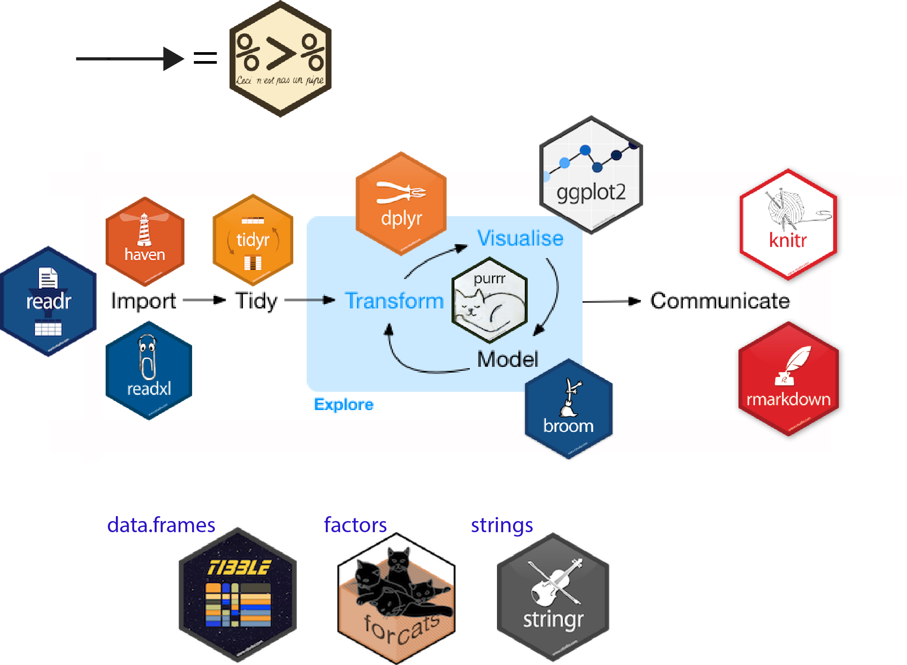
The Tidyverse
Package: a collection of functions
Tidyverse: a collection of packages
Most (but not all) of what you need for data wrangling and visualisation is provided by tidyverse
Install tidyverse
Load up tidyverse
Cheat sheets: https://www.rstudio.com/resources/cheatsheets/
Use install.packages(x) to install package x (remember x is a string!)
Use library(x) to load package x (this time x is NOT a string!)
Notes:
Install with dependencies=TRUE

Slide 17
Part 3: A Simple Data Science Project

Slide 18
Our World In Data, Data
We will now begin a simple data science project that will teach you the basics of reading and wrangling data
Create new folder ‘data’ inside BENV0091/lecture1
Download owid_co2.csv from Moodle and put it in BENV0091/lecture1/data
Create a new script analysis.R and save it in BENV0091/lecture1
Load the tidyverse at the beginning of your script
Use library(tidyverse) to load tidyverse

Slide 19
Reading CSV Data
Use read_csv(x) to load CSV with name x into a data frame
Type head(df) or glimpse(df) to get a concise look at the data
We can import data into a data frame (aka tibble), a special type of object used in R to store data
Read the OWID CO2 data CSV file and store it in an object called `co2` using <- (write in your script!)
Show the first few rows of the data frame
Each column is a variable
Each row is an observation
skim(df) is also a very useful function from the skimr package
Reading Files: Common Fixes!
Make sure your working directory is set correctly
Make sure the filename is a string (has quotes)

Slide 20
Indexing a Data Frame
We can retrieve a value at row i and column j and even change it
Try changing the value of position [3,2] to 0. Try changing it to “hello”. Now change it back!
Can also index by column name: e.g. co2[10, ‘country’]
However avoid numeric indexing wherever possible!
You can also retrieve an entire column by name with the $ sign (returns a 1D vector)
Return value at row i, column j with df[i,j]
Use df[i,] to return all of row i; use df[,j] to return all of column j
Use df$var to get the entire column with name var
Notes:
Cant change values to different types.

Slide 21
Manipulating data: some dplyr functions
Too many to mention! But here are a few:
rename(df, new_name = old_name)
select(df, column1, column2,…)
mutate(df, new_variable = …)
transmute(df, new_variable = …)
filter(df, condition)
arrange(df, var)
count(df, var)
sample_n(df, n)
All these functions return a dataframe - you must assign it to something with <- if you want to keep it
Try the exercises on the right
Reminder: https://www.rstudio.com/resources/cheatsheets/
EXERCISES 01
Rename co2 to Mtco2 (megatonnes of CO2)
Create a new column: Gtco2 (gigatonnes of CO2)
Arrange the df in descending order by Gtco2
Remove the “World” data
Filter to 2019 only and only countries with > 1 GtCO2
How many observations are left?

Slide 22
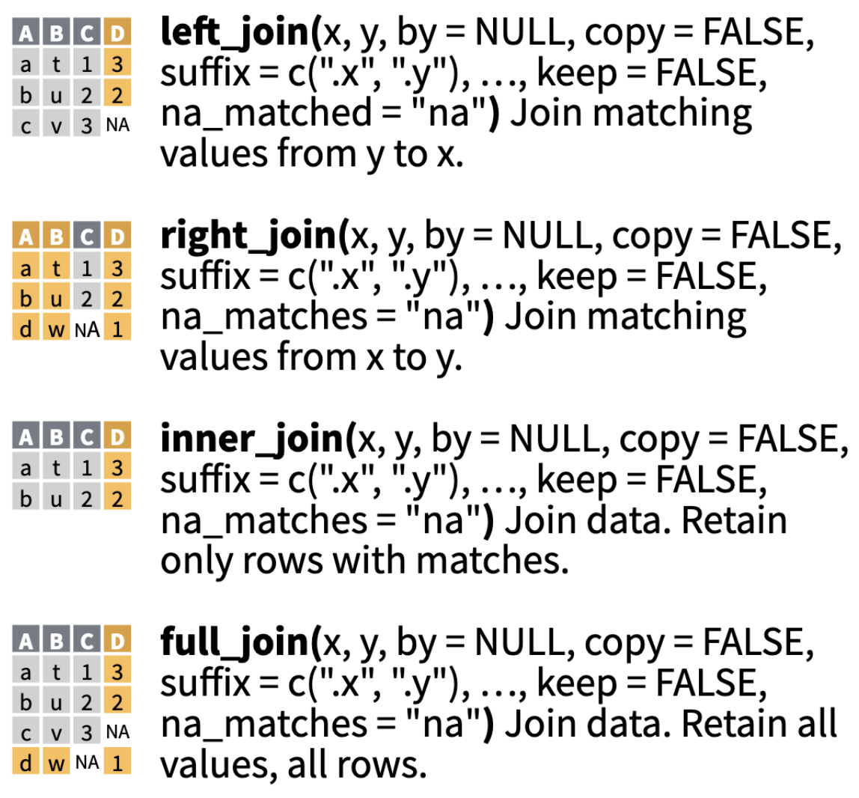
Joining Data
We often need to combine multiple datasets
To do this, we need at least one variable to match across the two datasets
In general you should specify what variable(s) you want to join on with `by = `

Slide 23
Joining CO2 and Energy data
Open a fresh script and save it as join.R
Download the owid_energy.csv file and put it in your data directory
Writing in your script: load the energy data to a new data frame called `energy`
Writing in your script: load the CO2 data as before, in a data frame called `co2`
Try combining energy and co2 with:
left_join()
right_join()
inner_join()
full_join()
Try varying the order of co2 and energy
Notice how many rows your joined dataframe has in each case
Writing in your script: combine co2 and energy with left_join(co2, energy) and assign it to `df`
We can specify a list by using:
c(1, TRUE, 2, ‘hello)
left_join(df1, df2, by = c(var1, var2)) joins together df1 and df2 by matching columns var1 and var2

Slide 24
NAs
is.na(x) checks whether x (or the values in x) are NA
is.na(df) can be combined with colSums(df) to count NAs
NAs represent missing data points
How you deal with NAs is often a very important decision (more later in the course)
For now, it’s good to know how to identify where NAs are and how to remove them
Count how many NAs there are in each column of your combined data frame
Now remove all rows with NAs
Use drop_na(df) to remove all rows with NA
Use drop_na(df, var) to remove all rows with NA in column var
The skimr package has skim() for counting NAs (and some other useful functions)

Slide 25

Pipes
You can string together multiple functions with the pipe operator
The output of the first function is passed as the first argument to the second function (and so on)
Can make code much more concise and readable
Try piping df into a sequence of any two functions, e.g.:
left_join() and count()
filter() and sample_n()
drop_na() and mutate()
f(x) %>% g() passes the output of f(x) as the first argument to g()
x <- f(x) %>% g(y)
is the same as:
x <- g(f(x), y)
Notes:
Demonstrate

Slide 26
Exercises 02
Use tolower(x) to change x to lower case
Use write_csv(df, f) to save df to location f
Drop World from the data and remove NAs
Create new variables for CO2/E, E/GDP, CO2/capita and GDP/capita
Set all country names to lower case
Save your combined data frame to a new file in the data directory
Which country had the highest GDP/capita in 2000?
Which country had the largest per capita CO2 emissions in 1965?
What proportion of countries had a GDP per capita of under $1000 in 1990?
What was the percentage change in global CO2 emissions between 1965 and 2016?

Slide 27
R Markdown
R Markdown files combine text and code
You can knit (render) them in a number of neat formats including pdf and html
Task: try opening a new RMarkdown file and make some changes
A worksheet will be posted on Moodle as a .Rmd file for you to work through

Slide 28

Tips for Improving your coding
Read R for Data Science!
Ask your pals and read their code
R4DS also posts data every Tuesday as part of the Tidy Tuesday project
Practise!

