Slide 1

BENV0091 Lecture 7: Publishing Data Science Online
Hector Camm and Cato Davies

Slide 2
Lecture Overview
Shiny Overview
Building Shiny Apps
Customization
Frameworks
Deploying Apps
Requirements:
Go to https://github.com/hectorcamm/BENV0091
And clone the repository

Slide 3
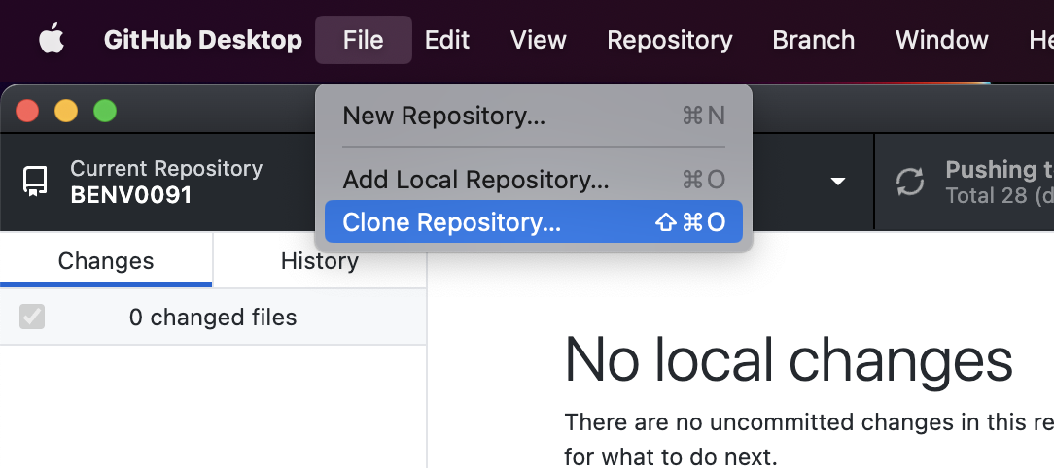
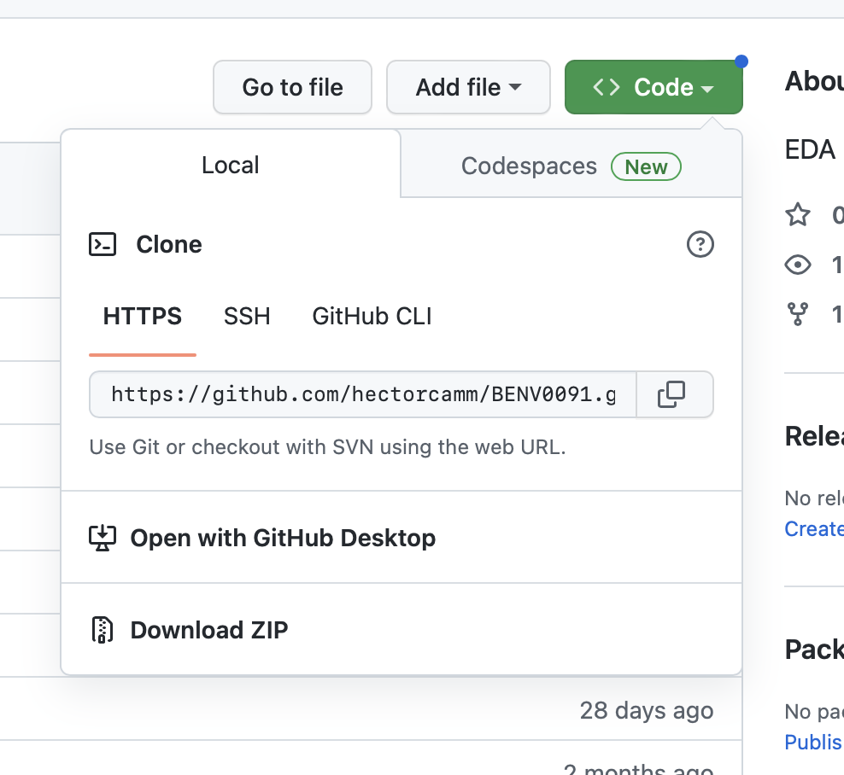
Cloning repository refresher
Open GitHub Desktop
Click File > Clone Repository > Select URL tab
Enter the URL to the online repo (https://github.com/hectorcamm/BENV0091)
Select your path
Click clone
Alternatively, you can download the repository as a zip folder

Slide 4
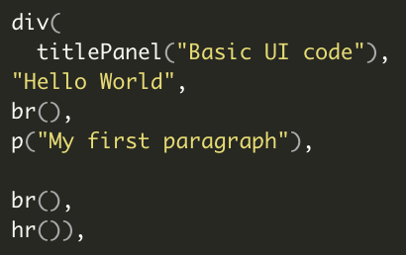
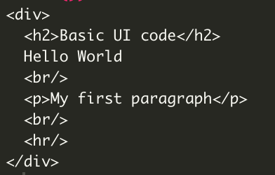
What is Shiny?
Shiny is an R package that lets you build interactive web apps
The user can change variables using dropdown menus, sliders, buttons etc. in a user interface (UI) and view the results
A Shiny app is maintained by a server running an R session
The code running on the server responds reactively to user inputs to produce outputs such as plots, tables, text etc.
Plots and tables are updated and rendered as HTML

Slide 5

Why Shiny?
Free
Tailored plotting functionality
Shiny can connect with any data source using APIs
Incorporate and interact with ML models
Data driven micro - sites (NY Times)
Quick to test and build MVP and even functioning products (if built robustly using the likes of Golem)
Image: https://analyticsindiamag.com/tableau-vs-shiny-which-one-should-you-pick-for-data-visualisation/

Slide 6
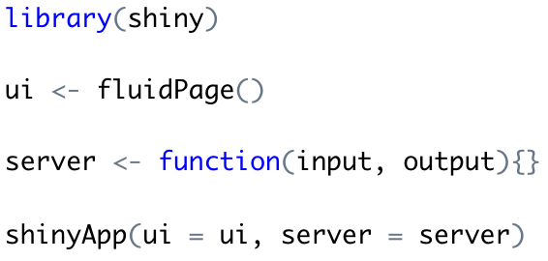
App Template
You can build a Shiny app with only a few lines of code:
The ’front end’
The ‘back end’: your R code goes here!
Knitting the UI and server together to run the app
All of this code should be saved in a file called app.R
Alternatively, you can split your code over 2 files: ui.R and server.R

Slide 7
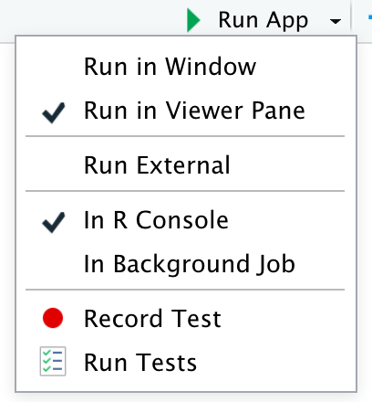
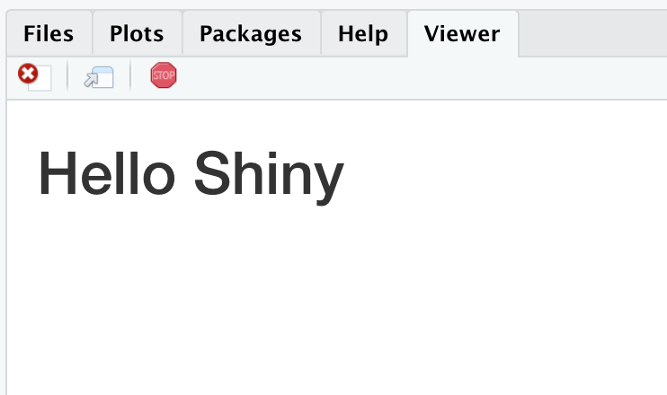
Setting up an App
Task: make sure you have the shiny package installed
We will now manually set up a simple app:
Create a new folder/directory called `my_app`
Inside `my_app`, create a file called `app.R`
Copy the code from the previous slide and save
Add `titlePanel(“My App”)` as an argument to `fluidPage()`
Run your app (top right)!
RStudio can help you build an app
Task: >File> New File > Shiny Web App create a server.R and ui.R app named test_app
Have a play around with the old faithful app
Viewing your app in the Viewer pane

Slide 8
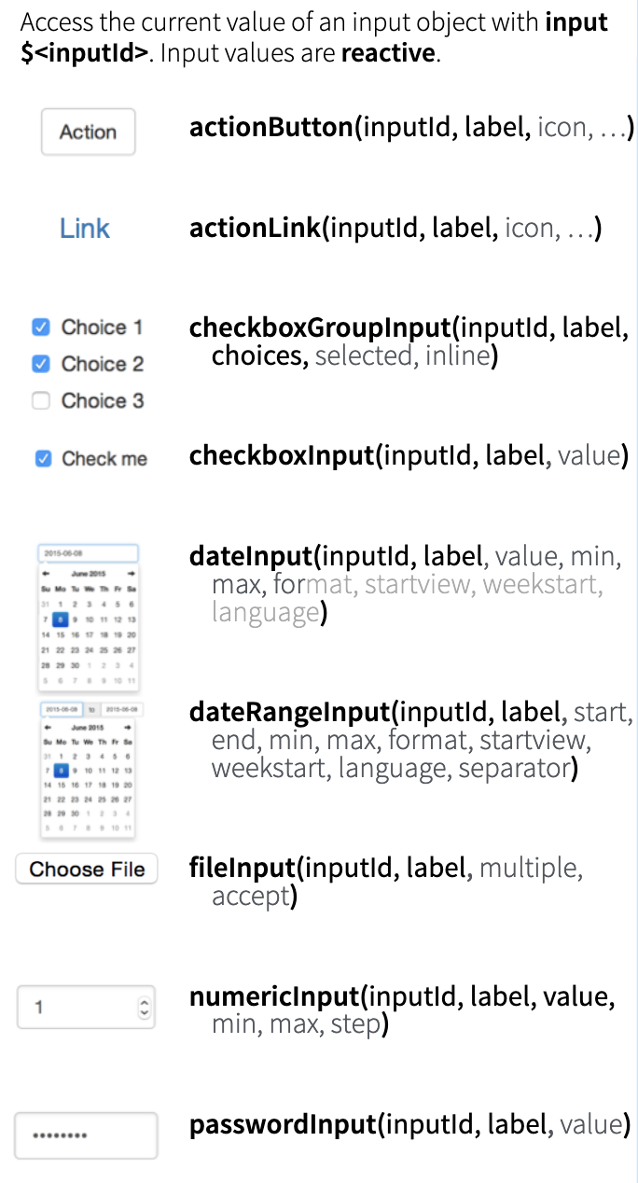
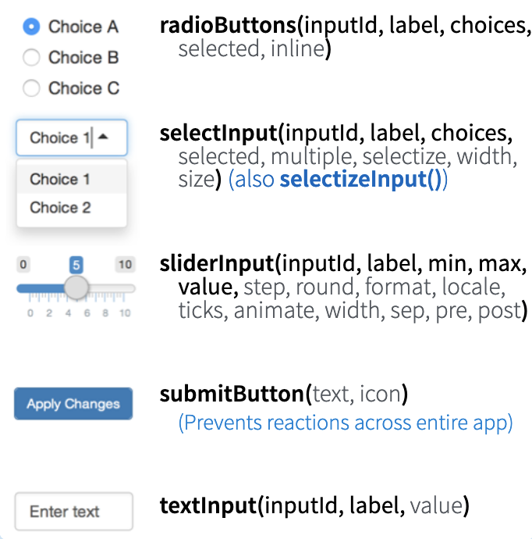
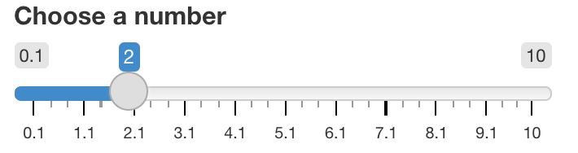
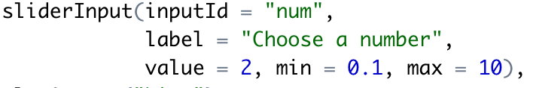

Input
Input Functions
Shiny widgets
Adding input functions to the UI (`fluidPage`) component of your code creates variables which respond to user inputs
These reactive values can be referenced in your server code using `input$inputId`, where inputId is a specified variable name

Slide 9
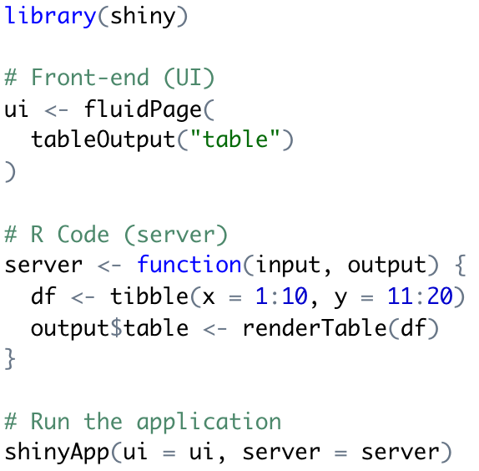
Output
Similarly, we can create outputs in the server code, which can be referenced in the UI code
You must use a render function to create an object which can be referenced in the UI:
renderTable
renderPlot
Then, in the UI, you must use the corresponding output function to render the object in the web app
tableOutput
plotOutput
The code on the right creates a simple table (there are no reactive values (inputs in this case)
Task: in app.R reproduce the web app on the right
Task: change the code to output a scatter plot of y vs. x

Slide 10
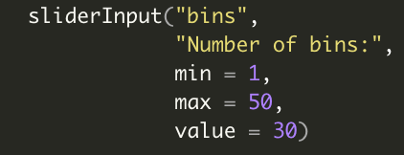
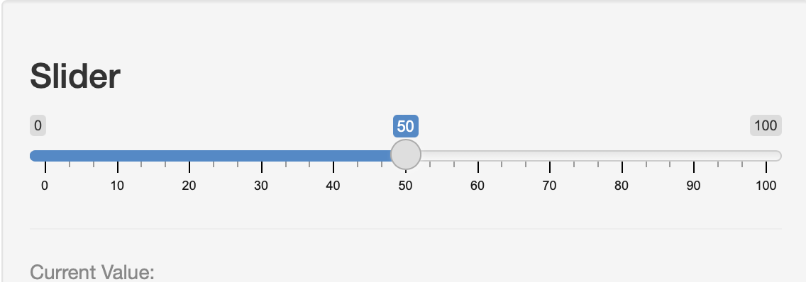
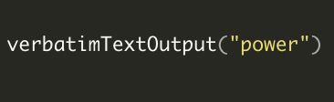

UI
Server
1. Everything the user sees
2. Elements separated by comma
3. Input elements are created
1. Hidden from the user
2. Elements don’t have to be separated by a comma
User can make actions by editing inputs
Receives and projects server output (reaction)
Inputs are used to manipulate code/plots/functions
Outputs are rendered (the reactions sent back to the UI for the user to view)
25

Slide 11
Summary reactivity
input$var1; input$var2…
UI
Server
Render HTML using output
Run R code: using input
output$plot; output$table…

Slide 12
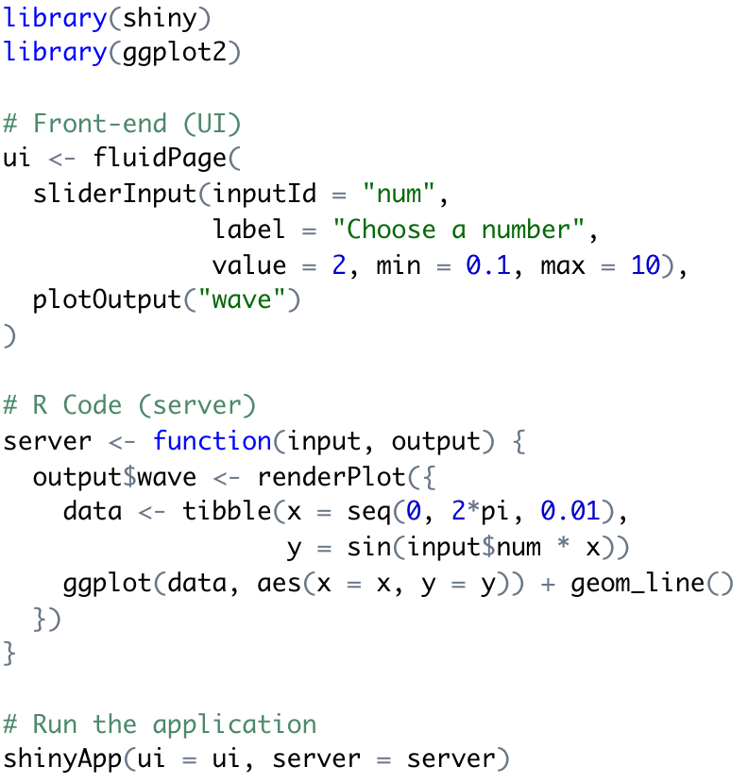
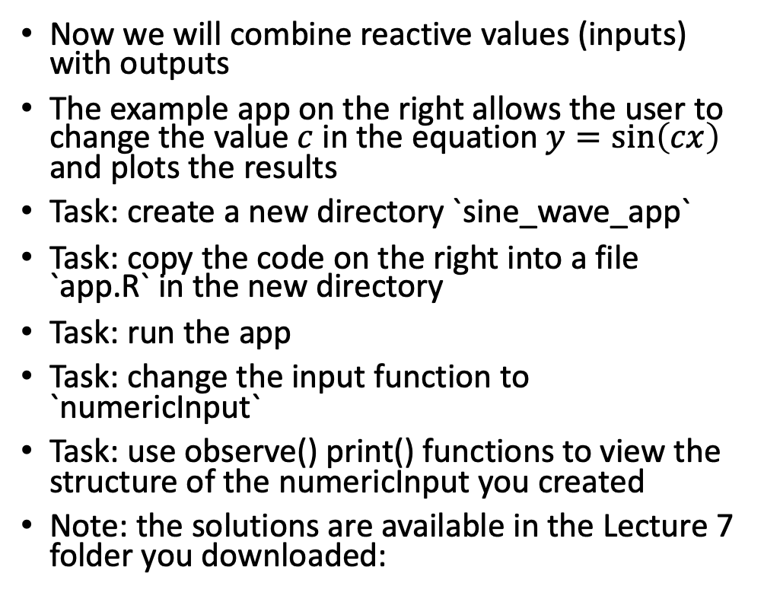
Example App: Sine Wave
Now we will combine reactive values (inputs) with outputs
The example app on the right allows the user to change the value $c$ in the equation $y=\sin\left(cx\right)$ and plots the results
Task: create a new directory `sine_wave_app`
Task: copy the code on the right into a file `app.R` in the new directory
Task: run the app
Task: change the input function to `numericInput`
Task: use observe() print() functions to view the structure of the numericInput you created
Note: the solutions are available in the Lecture 7 folder you downloaded:

Slide 13
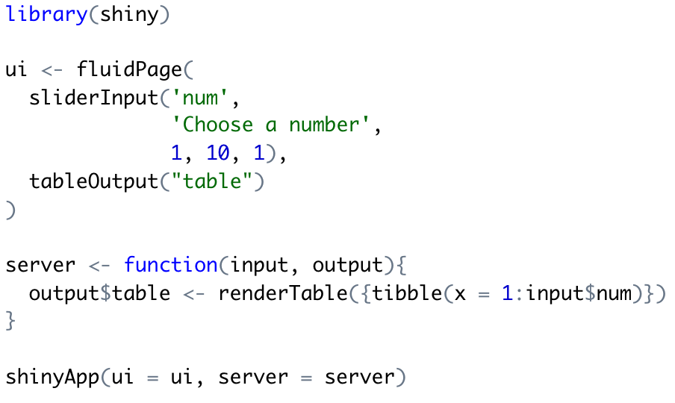
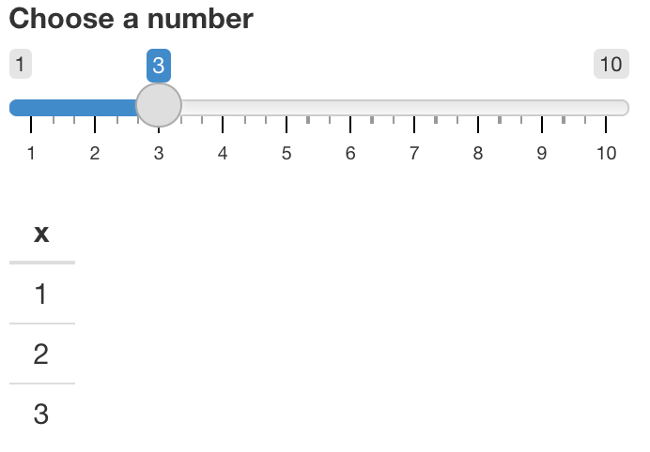

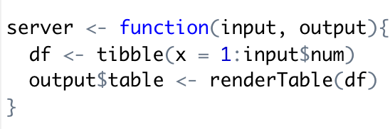
Reactive Functions
Not all code on the server side will respond to a change in `input`
Functions which respond to reactive values are called reactive functions or rective consumers, and include the `render*()` functions
If you try to reference `input` outside of a reactive function, R will throw an error!
Inside reactive function
Outside reactive function

Slide 14
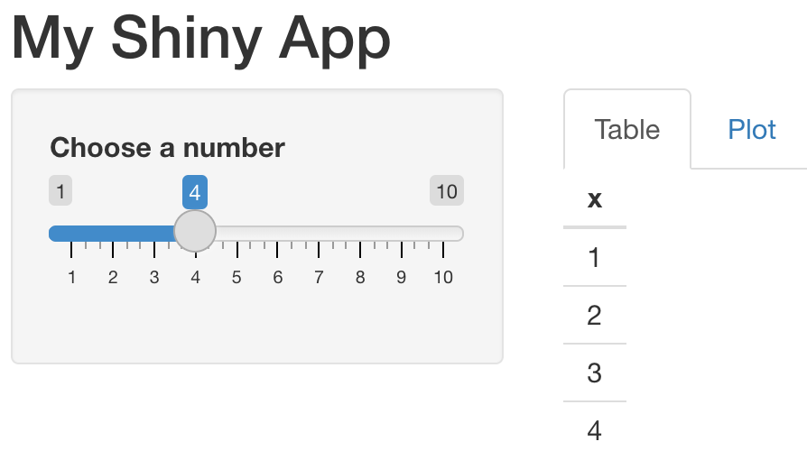
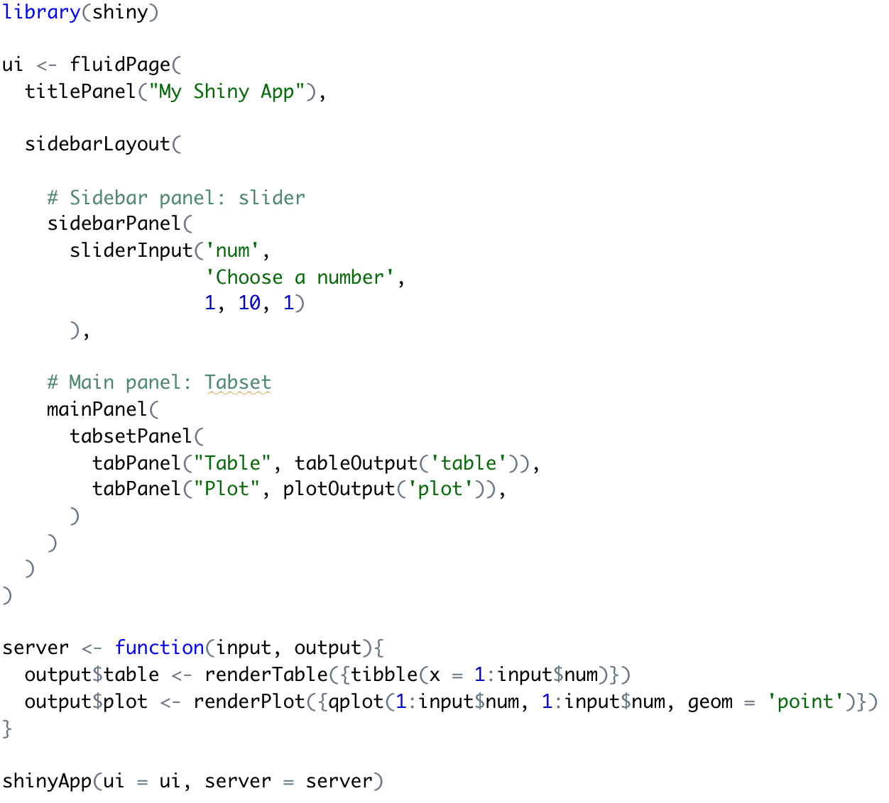
Customisation: Layouts
The `sidebarLayout()` enables you to add a sidebar panel next to a main panel
Tabsets can be created with `tabsetPanel()`
You can also create more complex arrangements with `fluidRow()`, as well as apps with multiple pages using `navbarPage()`
For a guide to layouts: https://shiny.rstudio.com/articles/layout-guide.html
Sidebar layout with tabs

Slide 15
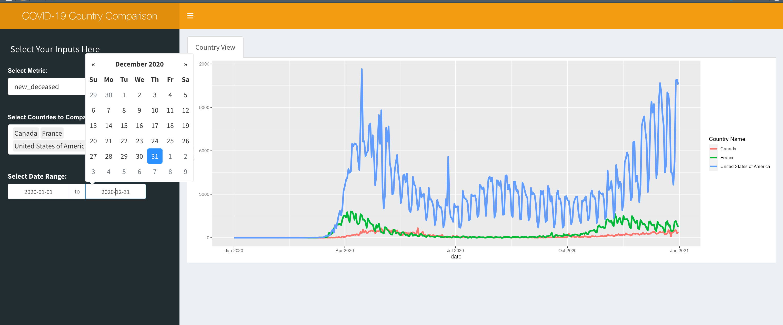
Frameworks: Shiny Dashboard
library(shinydashboard)
Split into Header, Sidebar, and MainPanel
Changeable skins
Next Shinydashboardplus
BS4Dash:
https://rinterface.github.io/bs4Dash/reference/index.html

Slide 16
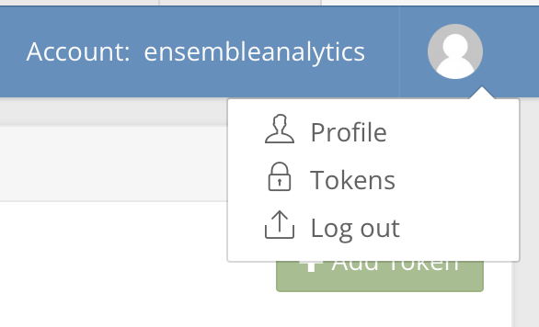
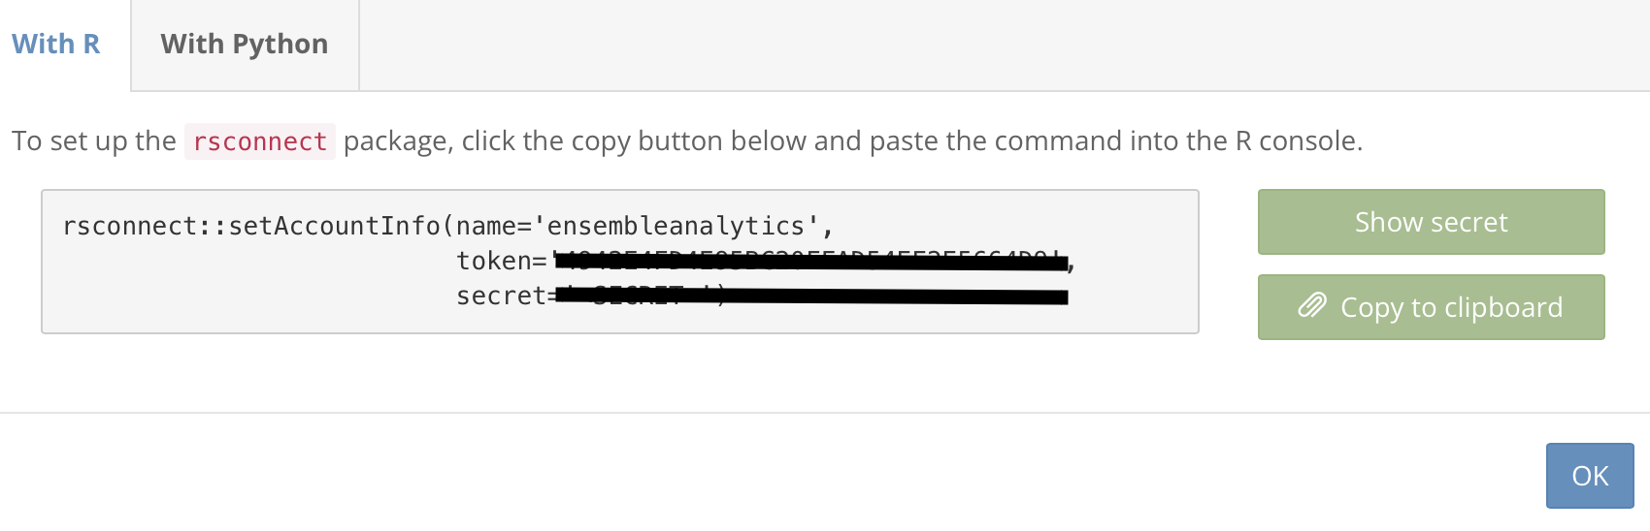
shinyapps.io
shinyapps.io is a (mostly free) platform for hosting Shiny web apps
Task: sign up for an account at shinyapps.io
Shiny uses the rsconnect package to securely enable you to make changes and deploy/redeploy your app
Task: install rsconnect with `install.packages()`
Once you have signed up to shinyapps.io, you can generate a token and a secret which enables you will need to configure your account with rsconnect
Task: generate a token and secret and copy the code to run in the R Studio console

Slide 17
Deploying your App
You are now all set up to deploy your app!
Running `rsconnect::deployApp()` will deploy your app, which will be found at: https://{username}.shinyapps.io/{app_name}
Note that the `app_name` is the name of your directory by default, but can be changed with the argument `appName`
See the documentation `?deployApp` for more deployment options
Task: deploy your app
Task: check your app runs by visiting the URL in a web browser
Note: App needs to contain atleast either a singular App.R script or both a ui.R and server.R scripts

Slide 18
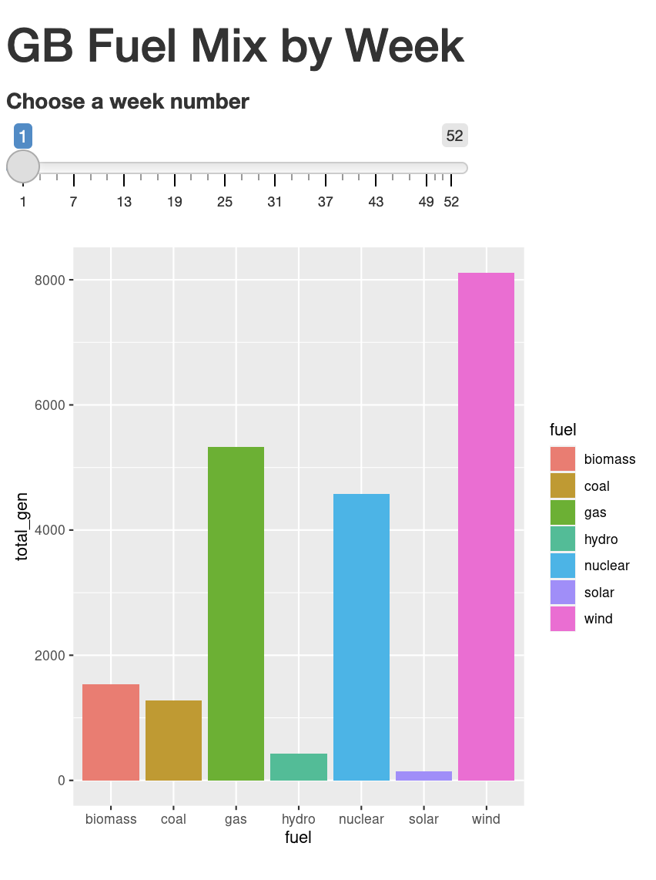
Including Data and Additional Files
So long as your app is packaged in a single directory with app.R at the root, you can include additional files (e.g. data or code)
Go to: lecture7/electric_insights_app in the course repo (see right for URL)
The app.R file uses `source()` to load the plotting function in electric_insights_plot.R
You can source multiple server files using the expression local = TRUE
The data is stored in a sub-directory `data`
App URL
https://ensembleanalytics.shinyapps.io/electric_insights_app/

Slide 19
Hosting Shiny Elsewhere?
shinyapps.io is unique in offering free hosting of Shiny apps
AWS EC2 and ECS
RStudio Connect

Slide 20
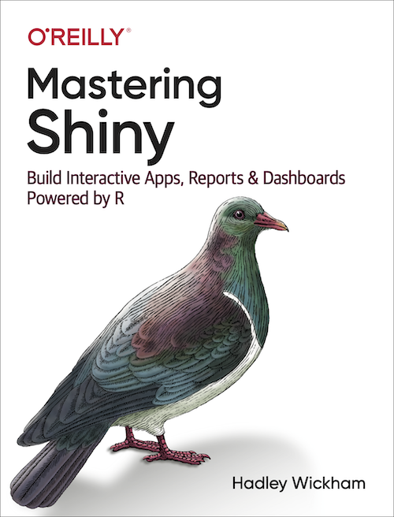
Further Reading
Shiny apps are highly customisable and can be powerful tools for disseminating your data science work
Some resources:
https://engineering-shiny.org/index.html Excellent overview to build robust production ready shiny apps
Learn Shiny: https://shiny.rstudio.com/tutorial/
shinyapps.io user guide: https://docs.rstudio.com/shinyapps.io/
Mastering Shiny – Hadley Wickham

