Slide 1

TRAFFIC ACCIDENTS PREVENTION (CHRISTMAS EDITION)

Slide 2

OUR TEAM
DIMOSTHENIS GKITZENAS
KONSTANTINOS XENOKTISTAKIS
GEORGIA SAMARA

Slide 3
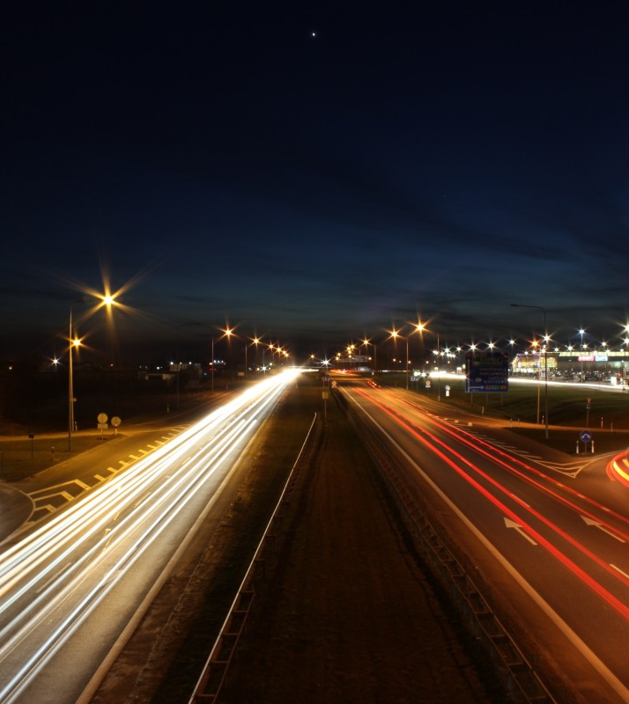
AGENDA
THE DATASET
OUR SELECTION
THE ANALYSIS
CONCLUSION

Slide 4

THE DATASET

Slide 5

THE DATASET
The source: https://www.kaggle.com/datasets/oktayrdeki/traffic-accidents
Description: This dataset contains detailed information on traffic accidents across various regions and time periods. It includes various metrics and spans multiple locations and accident types
Our Dataset in Numbers:
209.306 Rows
24 columns

Slide 6

OUR SELECTION
Description: According to the purpose of our analysis, we used only the data that reported a death or injury, and we excluded the cases where no physical harm occurred.
Our Dataset in Numbers:
54.517 Rows
24 columns
The main elements of the table, on which our analysis is based:
Crash date and time
The number of injuries
The severity of injuries
The weather conditions
The road conditions

Slide 7
THE ANALYSIS

Slide 8
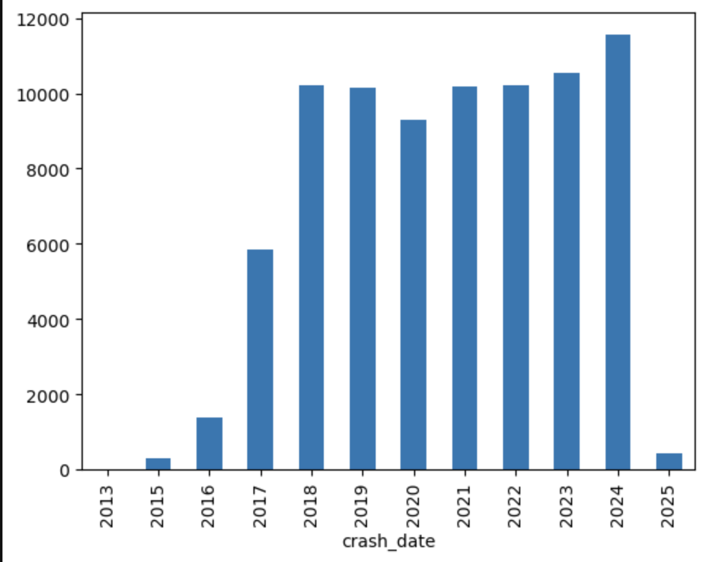
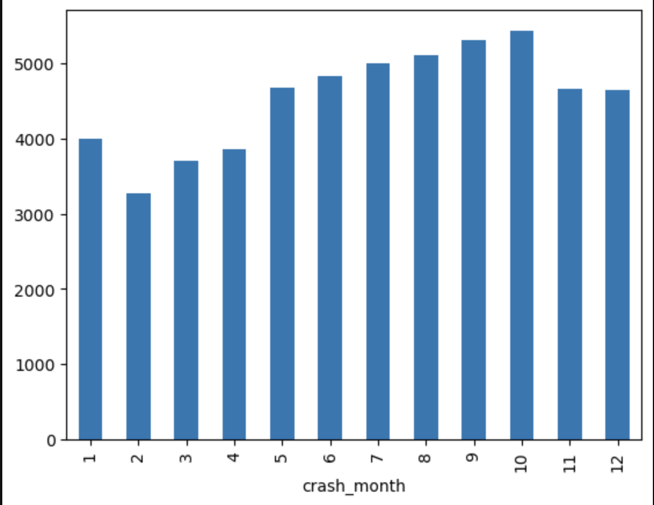
Analyzing Period:
3 March 2013 – 17 January 2025
Total number of Injuries: 80.105
Number of Fatal Injuries: 389
Year with less Injuries: 2013
Year with most Injuries: 2024
Month with less Injuries: February
Month with most Injuries: October

Slide 9
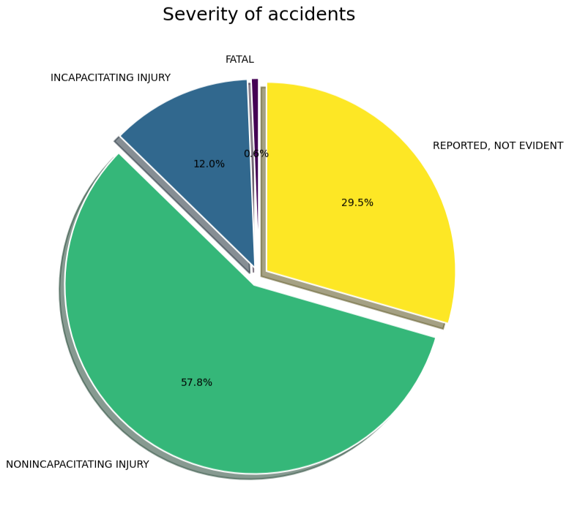
Accidents analysis per Injury Severity

Slide 10
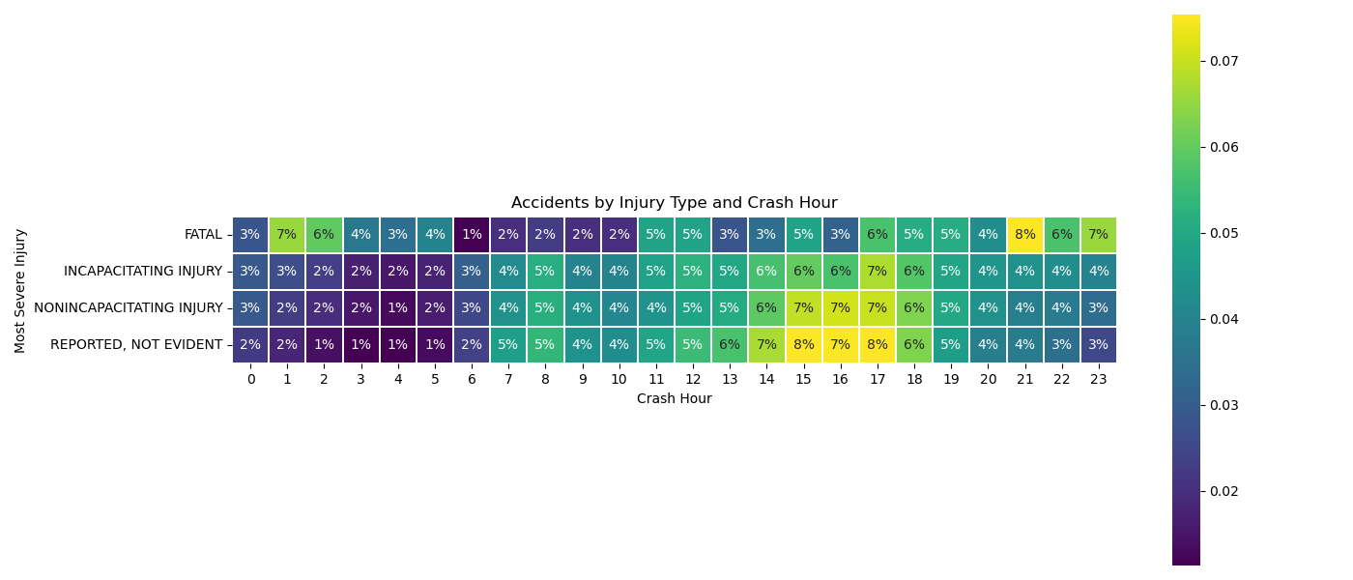
Accidents Αnalysis per Hour and Injury Type
4 of 10 Fatal Injures occur between 21.00 and 02.00
Highest frequency of accidents occur between 14.00 and 18.00
Lowest frequency of injuries occur between 06.00 and 10.00

Slide 11
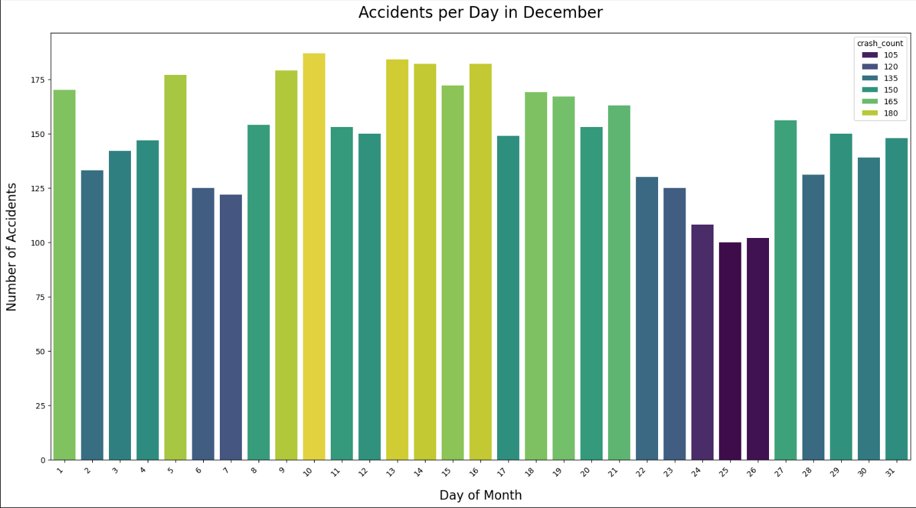
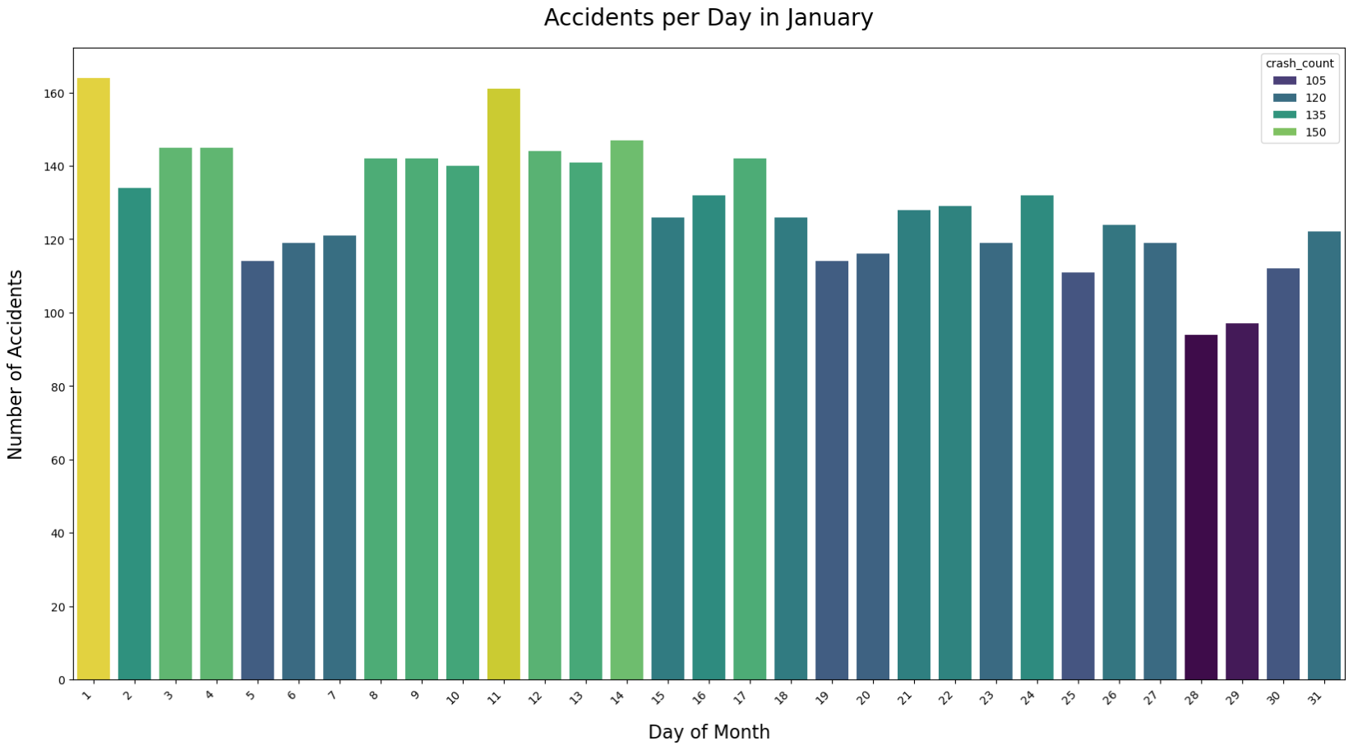
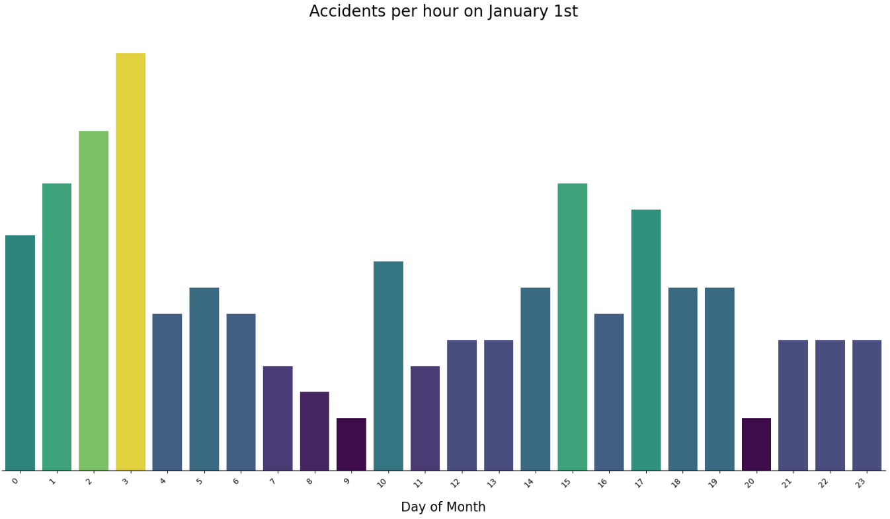
Analyzing Christmas Holiday Season
Increasing number of accidents in the middle of December
High number of accidents on January 1st and January 11th
Lower number of accidents around Christmas

Slide 12
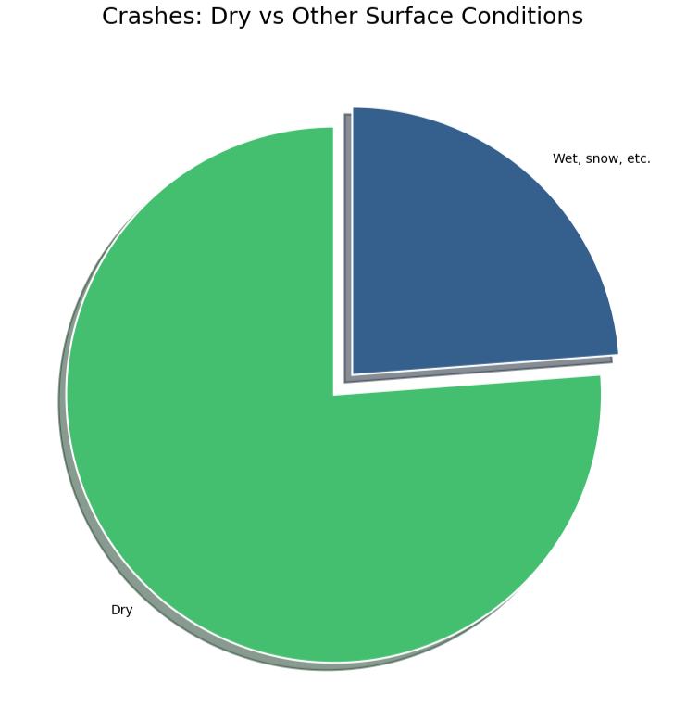
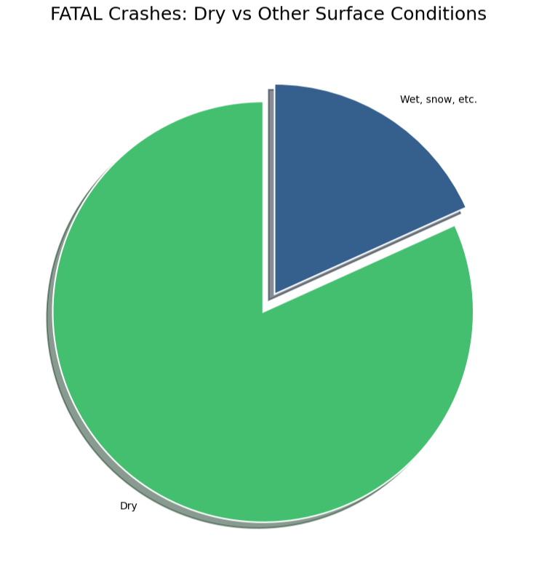
Analysis per conditions

Slide 13
CONCLUSION

Slide 14
SUGGESTIONS
Increase traffic officer presence during peak hours
Add more traffic cameras
Targeted road-safety campaign on high-risk days

Slide 15

THANK YOU

