Slide 1

Exercises for Chapter 1:
Characterization of Distributed Systems
From Coulouris, Dollimore, Kindberg and Blair
Distributed Systems:
Concepts and Design
Edition 5, © Addison-Wesley 2012

Slide 2
Exercise 1.1
Give five types of hardware resource and five types of data or software resource that can usefully be shared. Give examples of their sharing as it occurs in practice in distributed systems.
pages 2, 14
Instructor’s Guide for Coulouris, Dollimore, Kindberg and Blair, Distributed Systems: Concepts and Design Edn. 5
© Pearson Education 2012
Notes:
Hardware: CPU, memory, disk, screen, printer, network capacity…
Data/Software: Web page, file, object, database, newsgroup content, vedio/audio stream, exclusive lock, …

Slide 3
Exercise 1.2
How might the clocks in two computers that are linked by a local network be synchronized without reference to an external time source? What factors limit the accuracy of the procedure you have described? How could the clocks in a large number of computers connected by the Internet be synchronized? Discuss the accuracy of that procedure.
page 2
Instructor’s Guide for Coulouris, Dollimore, Kindberg and Blair, Distributed Systems: Concepts and Design Edn. 5
© Pearson Education 2012
Notes:
Problem: no global clock
Cristian’s protocol:
Measure RTT by repeated tests
Computer A send its clock setting T to computer B
B sets its clock to T + t/2
How about accuracy? The setting can be refined by repetition
---------
Several time synchronization protocols are described in Section 10.3. One of these is Cristian’s protocol.
Briefly, the round trip time t to send a message and a reply between computer A and computer B is measured
by repeated tests; then computer A sends its clock setting T to computer B. B sets its clock to T+t/2. The setting
can be refined by repetition. The procedure is subject to inaccuracy because of contention for the use of the
local network from other computers and delays in the processing the messages in the operating systems of A
and B. For a local network, the accuracy is probably within 1 ms.
For a large number of computers, one computer should be nominated to act as the time server and it
should carry out Cristian’s protocol with all of them. The protocol can be initiated by each in turn. Additional
inaccuracies arise in the Internet because messages are delayed as they pass through switches in wider area
networks. For a wide area network the accuracy is probably within 5-10 ms. These answers do not take into
account the need for fault-tolerance. See Chapter 10 for further details.

Slide 4
Exercise 1.3
Consider the implementation strategies for massively multiplayer online games as discussed in Section 1.2.2. In particular, what advantages do you see in adopting a single server approach for representing the state of the multiplayer game? What problems can you identify and how might they be resolved? page5
Instructor’s Guide for Coulouris, Dollimore, Kindberg and Blair, Distributed Systems: Concepts and Design Edn. 5
© Pearson Education 2012
Notes:
Advantage:
There is a single copy and hence no need to maintain consistency of multiple copies
Clients have a single place to go to discover this state
Potential problems:
Failure of the single server
Become the bottleneck
------------
The advantages of having a single server maintain a representation of the game are that: (1) there is a single
copy and hence no need to maintain consistency of multiple copies; and (2) clients have a single place to go
to discover this state. There may also be advantages to having a global view of the entire systems state.
The potential problems are that this single server may fail and may also become a bottleneck affecting
the performance and scalability of the approach. To handle failure, it would be necessary to introduce
replication, which in turn would require a solution to maintaining consistency across replicas. There are a
number of solutions to improving performance and scalability including running the server on a cluster
architecture as described in Section 1.2.2, or again using replication and load balancing within the distributed
environment. Alternatively, a peer-to-peer solution can be adopted. These techniques are covered throughout
the book.

Slide 5
Exercise 1.4
A user arrives at a railway station that she has never visited before, carrying a PDA that is capable of wireless networking. Suggest how the user could be provided with information about the local services and amenities at that station, without entering the station’s name or attributes. What technical challenges must be overcome?
page 13
Instructor’s Guide for Coulouris, Dollimore, Kindberg and Blair, Distributed Systems: Concepts and Design Edn. 5
© Pearson Education 2012
Notes:
User must be able to acquire the address of locally relevant information – preferably as automatically as possible
Local wireless network provide the URL of web pages about the locality
User must run a program on her devices
Listens for the URLs
Gives the user sufficient control for security
The URL should correspond to the physical spread of the place itself
-----------
The user must be able to acquire the address of locally relevant information as automatically as possible. One
method is for the local wireless network to provide the URL of web pages about the locality over a local
wireless network.
For this to work: (1) the user must run a program on her device that listens for these URLs, and which gives
the user sufficient control that she is not swamped by unwanted URLs of the places she passes through; and
(2) the means of propagating the URL (e.g. infrared or an 802.11 wireless LAN) should have a reach that
corresponds to the physical spread of the place itself.

Slide 6
Exercise 1.5
Compare and contrast cloud computing with more traditional client-server computing? What is novel about cloud computing as a concept? Pages 13,14
Instructor’s Guide for Coulouris, Dollimore, Kindberg and Blair, Distributed Systems: Concepts and Design Edn. 5
© Pearson Education 2012
Notes:
Supporting Internet-based services, everything is a service
Dispensing with local data storage or application software
Cloud computing is partially a technical innovation in terms of the level of ambition, but largely a business innovation in terms of viewing (distributed) computing services as a utility

Slide 7
Exercise 1.6
Use the World Wide Web as an example to illustrate the concept of resource sharing, client and server. What are the advantages and disadvantages of HTML, URLs and HTTP as core technologies for information browsing? Are any of these technologies suitable as a basis for client-server computing in general? Pages 14,16
Instructor’s Guide for Coulouris, Dollimore, Kindberg and Blair, Distributed Systems: Concepts and Design Edn. 5
© Pearson Education 2012
Notes:
Web pages: resource share
Web browser and server: client-server architecture
HTML: straightforward language to parse and render
URL: efficient resource locators
HTTP: simple protocol that can be put to use in many types of content
HTTP and URLs are acceptable as a basis for client-server computing
No type checking
Inefficiency as resource links

Slide 8
Exercise 1.7
A server program written in one language (for example C++) provides the implementation of a BLOB object that is intended to be accessed by clients that may be written in a different language (for example Java). The client and server computers may have different hardware, but all of them are attached to an internet. Describe the problems due to each of the five aspects of heterogeneity that need to be solved to make it possible for a client object to invoke a method on the server object.
page 16
Instructor’s Guide for Coulouris, Dollimore, Kindberg and Blair, Distributed Systems: Concepts and Design Edn. 5
© Pearson Education 2012
Notes:
Differences in network
Differences in hardware
Differences in OS
Differences in programming languages
Differences in implementors
-----------
As the computers are attached to an internet, we can assume that Internet protocols deal with differences in
networks.
But the computers may have different hardware - therefore we have to deal with differences of
representation of data items in request and reply messages from clients to objects. A common standard will be
defined for each type of data item that must be transmitted between the object and its clients.
The computers may run different operating systems, therefore we need to deal with different operations
to send and receive messages or to express invocations. Thus at the Java/C++ level a common operation would
be used which will be translated to the particular operation according to the operating system it runs on.
We have two different programming languages C++ and Java, they use different representations for data
structures such as strings, arrays, records. A common standard will be defined for each type of data structure
that must be transmitted between the object and its clients and a way of translating between that data structure
and each of the languages.
We may have different implementors, e.g. one for C++ and the other for Java. They will need to agree
on the common standards mentioned above and to document them.

Slide 9
Exercise 1.8
An open distributed system allows new resource sharing services such as the BLOB object in Exercise 1.7 to be added and accessed by a variety of client programs. Discuss in the context of this example, to what extent the needs of openness differ from those of heterogeneity.
page 17
Instructor’s Guide for Coulouris, Dollimore, Kindberg and Blair, Distributed Systems: Concepts and Design Edn. 5
© Pearson Education 2012
Notes:
The implementers must conform to those standards/agreements as answered in Q7

Slide 10
Exercise 1.9
Suppose that the operations of the BLOB object are separated into two categories – public operations that are available to all users and protected operations that are available only to certain named users. State all of the problems involved in ensuring that only the named users can use a protected operation. Supposing that access to a protected operation provides information that should not be revealed to all users, what further problems arise?
page 18
Instructor’s Guide for Coulouris, Dollimore, Kindberg and Blair, Distributed Systems: Concepts and Design Edn. 5
© Pearson Education 2012
Notes:
Each request access a protected operation much include the identity of the user making the request:
Defining user identifies of users
Ensuring identifies’ sources
Preventing replaying or tampering
Further problems:
Returned information of a protected operation must be hidden from unauthorized users
------------
Each request to access a protected operation must include the identity of the user making the request. The
problems are:
• defining the identities of the users. Using these identities in the list of users who are allowed to access
the protected operations at the implementation of the BLOB object. And in the request messages.
• ensuring that the identity supplied comes from the user it purports to be and not some other user
pretending to be that user.
• preventing other users from replaying or tampering with the request messages of legitimate users.
Further problems.
• the information returned as the result of a protected operation must be hidden from unauthorised users.
This means that the messages containing the information must be encrypted in case they are intercepted
by unauthorised users.

Slide 11
Exercise 1.10
The INFO service manages a potentially very large set of resources, each of which can be accessed by users throughout the Internet by means of a key (a string name). Discuss an approach to the design of the names of the resources that achieves the minimum loss of performance as the number of resources in the service increases. Suggest how the INFO service can be implemented so as to avoid performance bottlenecks when the number of users becomes very large.
page 19
Instructor’s Guide for Coulouris, Dollimore, Kindberg and Blair, Distributed Systems: Concepts and Design Edn. 5
© Pearson Education 2012
Notes:
Hierarchic structures for naming:
“A.B.C” -> O (log n)
Resource partition for avoiding performance bottleneck
Could be more than one level as in DNS
Name look up must be decentralized
The same server must not be involved in looking up every name
--------------
Algorithms that use hierarchic structures scale better than those that use linear structures. Therefore the
solution should suggest a hierarchic naming scheme. e.g. that each resource has an name of the form ’A.B.C’
etc. where the time taken is O(log n) where there are n resources in the system.
To allow for large numbers of users, the resources are partitioned amongst several servers, e.g. names
starting with A at server 1, with B at server 2 and so forth. There could be more than one level of partitioning
as in DNS. To avoid performance bottlenecks the algorithm for looking up a name must be decentralised. That
is, the same server must not be involved in looking up every name. (A centralised solution would use a single
root server that holds a location database that maps parts of the information onto particular servers). Some
replication is required to avoid such centralisation. For example: i) the location database might be replicated
at multiple root servers or ii) the location database might be replicated in every server. In both cases, different
clients must access different servers (e.g. local ones or randomly).

Slide 12
Exercise 1.11
List the three main software components that may fail when a client process invokes a method in a server object, giving an example of a failure in each case. Suggest how the components can be made to tolerate one another’s failures.
page 21
Instructor’s Guide for Coulouris, Dollimore, Kindberg and Blair, Distributed Systems: Concepts and Design Edn. 5
© Pearson Education 2012
Notes:
Think about the three main software components (Can they fail? What are the causes? What should they do to handle failures?)
Client process
Server process
Communication software

Slide 13
Exercise 1.12
A server process maintains a shared information object such as the BLOB object of Exercise 1.7. Give arguments for and against allowing the client requests to be executed concurrently by the server. In the case that they are executed concurrently, give an example of possible ‘interference’ that can occur between the operations of different clients. Suggest how such interference may be prevented.
page 22
Instructor’s Guide for Coulouris, Dollimore, Kindberg and Blair, Distributed Systems: Concepts and Design Edn. 5
© Pearson Education 2012
Notes:
Problems of interferences between concurrent operations
Example:
Client A’s thread reads value of variable X
Client B’s thread reads value of variable X
Client A’s thread adds 1 to its value and stores the result of X
Client B’s thread subtracts 1 from its value and stores the result in X
-------------
For concurrent executions - more throughput in the server (particularly if the server has to access a disk or
another service)
Against - problems of interference between concurrent operations
Example:
Client A’s thread reads value of variable X
Client B’s thread reads value of variable X
Client A’s thread adds 1 to its value and stores the result in X
Client B’s thread subtracts 1 from its value and stores the result in X
Result: X := X-1; imagine that X is the balance of a bank account, and clients A and B are implementing credit
and debit transactions, and you can see immediately that the result is incorrect.
To overcome interference use some form of concurrency control. For example, for a Java server use
synchronized operations such as credit and debit.

Slide 14
Exercise 1.13
A service is implemented by several servers. Explain why resources might be transferred between them. Would it be satisfactory for clients to multicast all requests to the group of servers as a way of achieving mobility transparency for clients?
page 23
Instructor’s Guide for Coulouris, Dollimore, Kindberg and Blair, Distributed Systems: Concepts and Design Edn. 5
© Pearson Education 2012
Notes:
Resource migration is performed:
To reduce communication delays
To balance the load of processing and or storage utilization between different servers
If all servers receive all requests, the communication load on the network is much increased and servers must do unnecessary work filtering out requests for objects that they do not hold.

Slide 15
Exercise 1.14
Resources in the World Wide Web and other services are named by URLs. What do the initials URL denote? Give examples of three different sorts of web resources that can be named by URLs. Page 26
Instructor’s Guide for Coulouris, Dollimore, Kindberg and Blair, Distributed Systems: Concepts and Design Edn. 5
© Pearson Education 2012
Notes:
URL: Uniform Resource Locator
Three different sorts of web resources:
A file or an image
Moves, sound, anything that can be rendered
A query to a database or a search engine
E.g., https://www.google.com/search?q=harrisburg

Slide 16
Exercise 1.15
Give an example of an HTTP URL. List the main components of an HTTP URL, stating how their boundaries are denoted and illustrating each one from your example. To what extent is an HTTP URL location-transparent? page 26
Instructor’s Guide for Coulouris, Dollimore, Kindberg and Blair, Distributed Systems: Concepts and Design Edn. 5
© Pearson Education 2012
Notes:
http://www.doc.qmw.ac.uk/research/distrib/index.html
The protocol to use, i.e., the part before the colon
The part between // and / is the domain name of the Web server host
The reminder refers to information on that host – named within the top level directory used by that web server
Hostname www is location independent

Slide 17
Exercises for Chapter 2:
System models
From Coulouris, Dollimore, Kindberg and Blair
Distributed Systems:
Concepts and Design
Edition 5, © Addison-Wesley 2012

Slide 18
Exercise 2.1
Provide three specific and contrasting examples of the increasing levels of heterogeneity experienced in contemporary distributed systems as defined in Section 2.2. page 39
Instructor’s Guide for Coulouris, Dollimore, Kindberg and Blair, Distributed Systems: Concepts and Design Edn. 5
© Pearson Education 2012
Notes:
In terms of:
Hardware
…
OS
…
Networks
…

Slide 19
Exercise 2.1
What problems do you foresee in the direct coupling between communicating entities that is implicit in remote invocation approaches? Consequently, what advantages do you anticipate from a level of decoupling as offered by space and time uncoupling? Note: you might want to revisit this answer after reading Chapters 5 and 6. page 43
Instructor’s Guide for Coulouris, Dollimore, Kindberg and Blair, Distributed Systems: Concepts and Design Edn. 5
© Pearson Education 2012
Notes:
The coupling makes it hard to deal with change
The client is intrinsically bound to the server and vice versa and this is inflexible in terms of dealing with failure
Not possible to operate in more volatile environments when either party may be unavailable
The uncoupling is in providing more degrees of freedom in dealing with change
----------
The client is intrinsically bound to the server and vice versa and this is inflexible in terms of dealing with
failure, for example if the server fails and a backup server takes over managing requests. More generally, this
level of coupling makes it hard to deal with change.
Clients and servers must exist at the same time and hence it is not possible to operate in more volatile
environments when either party may be unavailable, for example disconnected in the case of a mobile node.
The benefits of space uncoupling is in providing more degrees of freedom in dealing with change, for
example if a new server starts dealing with requests.
The benefit of time uncoupling is in allowing entities to communicate when entities may come and go.

Slide 20
Exercise 2.3
Describe and illustrate the client-server architecture of one or more major Internet applications (for example the Web, email or netnews).
page 46
Instructor’s Guide for Coulouris, Dollimore, Kindberg and Blair, Distributed Systems: Concepts and Design Edn. 5
© Pearson Education 2012
Notes:
See picture on next page

Slide 21
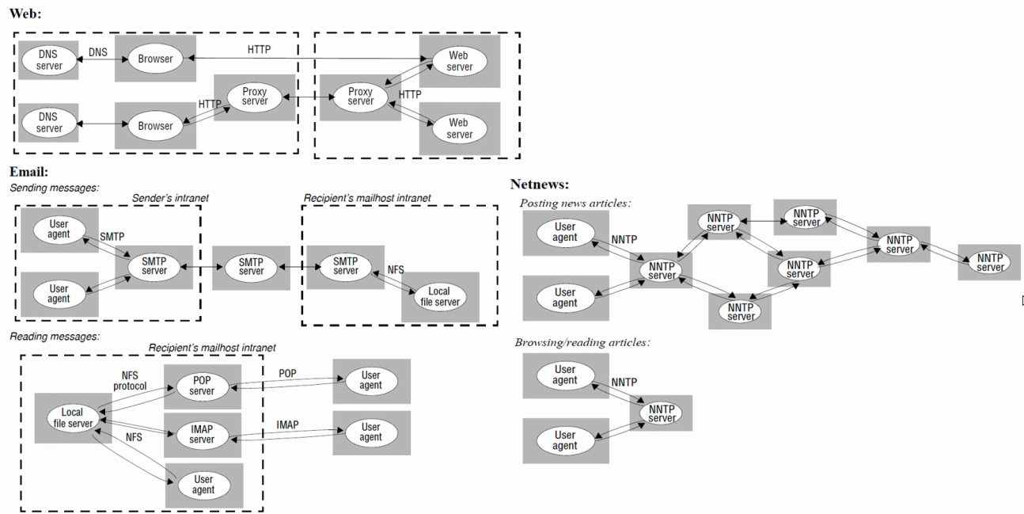
Exercise 2.3 Answer
Instructor’s Guide for Coulouris, Dollimore, Kindberg and Blair, Distributed Systems: Concepts and Design Edn. 5
© Pearson Education 2012
Notes:
Keywords:
Web: DNS Server, HTTP, Browser, Proxy Server, Web Server
Email: Sending messages, sender’s intranet, User agent, SMTP Server, NFS, Local file server, Recipient’s mailhost intranet, Reading messages: NFS protocol, POP Server, Recipient’s mailhost intranet, IMAP Server, POP, IMAP
Netnews: Posting news articles: User agent, NNTP Server, Browsing/reading articles

Slide 22
Exercise 2.4
For the applications discussed in Exercise 2.1 state how the servers cooperate in providing a service.
page 48
Instructor’s Guide for Coulouris, Dollimore, Kindberg and Blair, Distributed Systems: Concepts and Design Edn. 5
© Pearson Education 2012
Notes:
Consider the mapping to multiple machines (partitioning and replication)
Web
…
Mail
…
Newnet
…

Slide 23
Exercise 2.5
A search engine is a web server that responds to client requests to search in its stored indexes and (concurrently) runs several web crawler tasks to build and update the indexes. What are the requirements for synchronization between these concurrent activities?
page 46
Instructor’s Guide for Coulouris, Dollimore, Kindberg and Blair, Distributed Systems: Concepts and Design Edn. 5
© Pearson Education 2012
Notes:
Crawler tasks build partial indexes to new page incrementally and then merge them with active index (and deleting invalid references)
Can be done on an off-line copy
The environment for processing client requests is changed to access the new index
Just a change to one reference to the index which should be atomic
-------
The crawler tasks could build partial indexes to new pages incrementally, then merge them with the active
index (including deleting invalid references). This merging operation could be done on an off-line copy.
Finally, the environment for processing client requests is changed to access the new index. The latter might
need some concurrency control, but in principle it is just a change to one reference to the index which should
be atomic.

Slide 24
Exercise 2.6
The host computers used in peer-to-peer systems are often simply desktop computers in users’ offices or homes. What are the implications of this for the availability and security of any shared data objects that they hold and to what extent can any weaknesses be overcome through the use of replication? pages 47, 48
Instructor’s Guide for Coulouris, Dollimore, Kindberg and Blair, Distributed Systems: Concepts and Design Edn. 5
© Pearson Education 2012
Notes:
Problems:
Desktop computers are often turned off
Trustworthiness is unknown
Network connections are exposed to attack
Solutions:
Replication
…
Secure hash identifiers
…
------------
Problems:
– people often turn their desktop computers off when not using them. Even if on most of the time, they
will be off when user is away for an extended time or the computer is being moved.
– the owners of participating computers are unlikely to be known to other participants, so their
trustworthiness is unknown. With current hardware and operating systems the owner of a computer
has total control over the data on it and may change it or delete it at will.
– network connections to the peer computers are exposed to attack (including denial of service).
The importance of these problems depends on the application. For the music downloading that was the original
driving force for peer-to-peer it isn’t very important. Users can wait until the relevant host is running to access
a particular piece of music. There is little motivation for users to tamper with the music. But for more
conventional applications such as file storage availability and integrity are all-important.
Solutions:
Replication:
– if data replicas are sufficiently widespread and numerous, the probability that all are unavailable
simultaneously can be reduced the a negligible level.
– one method for ensuring the integrity of data objects stored at multiple hosts (against tampering or
accidental error) is to perform an algorithm to establish a consensus about the value of the data (e.g.
by exchanging hashes of the object’s value and comparing them). This is discussed in Chapter 15.
But there is a simpler solution for objects whose value doesn’t change (e.g. media files such as music,
photographs, radio broadcasts or films).
Secure hash identifiers:
– The object’s identifier is derived from its hash code. The identifier is used to address the object. When
the object is received by a client, the hash code can be checked for correspondence with the identifier.
The hash algorithms used must obey the properties required of a secure hash algorithm as described
in Chapter 7.

Slide 25
Exercise 2.7
List the types of local resource that are vulnerable to an attack by an untrusted program that is downloaded from a remote site and run in a local computer.
page 50
Instructor’s Guide for Coulouris, Dollimore, Kindberg and Blair, Distributed Systems: Concepts and Design Edn. 5
© Pearson Education 2012
Notes:
Objects in the file system
E.g. files, directories can be read/written/created/deleted using the rights of the local user who runs the program.
Network communication
The program might attempt to create sockets, connect to them, send message etc.
Access to printers
It may also impersonate the user in various ways
E.g. sending/receiving messages

Slide 26
Exercise 2.8
Give examples of applications where the use of mobile code is beneficial.
page 50
Instructor’s Guide for Coulouris, Dollimore, Kindberg and Blair, Distributed Systems: Concepts and Design Edn. 5
© Pearson Education 2012
Notes:
Doing computation close to the user
Applets example
Enhancing browser to allow server initiated communication
See page 70 of our textbook
Cases where objects are sent to a process and the code is required to make them usable
E.g. as in RMI

Slide 27
Exercise 2.9
Consider a hypothetical car hire company and sketch out a three-tier solution to the provision of their underlying distributed car hire service. Use this to illustrate the benefits and drawbacks of a three-tier solution considering issues such as performance, scalability, dealing with failure and also maintaining the software over time. page 52
Instructor’s Guide for Coulouris, Dollimore, Kindberg and Blair, Distributed Systems: Concepts and Design Edn. 5
© Pearson Education 2012
Notes:
The presentation logic
A web-based front-end offering a user interface for the car hire service
The application logic
A middle tier supporting the core operations associated with the car hire business including locating a particular make and model, checking availability and pricing, getting a quote and purchasing a particular car
The data logic
A database which stores all the persistent data associated with the stock
--------------
A three-tier solution might consist of:
• a web-based front-end offering a user interface for the car hire service (the presentation logic);
• a middle tier supporting the core operations associated with the car hire business including locating a
particular make and model, checking availability and pricing, getting a quote and purchasing a particular
car (the application logic);
• a database which stores all the persistent data associated with the stock (the data logic).
In terms of performance, this approach introduces extra latency in that requests must go from the web-based
interface to the middle tier and then to the database (and back). However, processing load is also spread over
three machines (especially over the middle tier and the database) and this may help with performance. For this
latter reason, the three-tier solution may scale better. This may be enhanced though by other, complementary
placement strategies including replication.
In terms of failure, there is an extra element involved and this increases the probability of a failure
occurring in the system. Equally, failures are more difficult to deal with, for example if the middle tier is
available and the database fails.
The three-tier approach is much better for evolution because of the intrinsic separation of concerns. For
example, the middle tier only contains application logic and this should therefore be easier to update and
maintain.

Slide 28
Exercise 2.10
Provide a concrete example of the dilemma offered by Saltzer’s end-to-end argument in the context of the provision of middleware support for distributed applications (you may want to focus on one aspect of providing dependable distributed systems, for example related to fault tolerance or security). page 60
Instructor’s Guide for Coulouris, Dollimore, Kindberg and Blair, Distributed Systems: Concepts and Design Edn. 5
© Pearson Education 2012
Notes:
Please read the classic paper: J. H. Saltzer, D. P. Reed, and D. D. Clark. 1984. End-to-end arguments in system design. ACM Trans. Comput. Syst. 2, 4 (November 1984), 277-288. DOI: https://doi.org/10.1145/357401.357402
A pdf is downloadable in moodle
----------------
Saltzer’s end-to-end argument states that communication-related functions can only be completely and
reliably implemented with the knowledge and help of the application and therefore providing that function as
a feature of the communication system itself (or middleware) is not always sensible. One concrete example is
in secure communication. Assume that in a given system, the communication subsystem provides encrypted
communication. This is helpful but insufficient. For example, the pathway from the network to the application
software may be compromised and this is unprotected. This solution also does not deal with malicious
participants in the exchange of data.
Consider also the reliable exchange of data implemented by introducing checksum protection on
individual hops in the network. Again, this is insufficient as data may be corrupted by intermediary nodes, for
example, gateways, or indeed in the end systems.

Slide 29
Exercise 2.11
Consider a simple server that carries out client requests without accessing other servers. Explain why it is generally not possible to set a limit on the time taken by such a server to respond to a client request. What would need to be done to make the server able to execute requests within a bounded time? Is this a practical option?
page 49
Instructor’s Guide for Coulouris, Dollimore, Kindberg and Blair, Distributed Systems: Concepts and Design Edn. 5
© Pearson Education 2012
Notes:
The rate of arrival of client requests is unpredictable
If the server uses threads to execute the requests,…
If the server queues the requests and carries them out on at a time, …
How to execute requests within bounded time?
Capacity-dependent limit?
How about performance?
-------------
The rate of arrival of client requests is unpredictable.
If the server uses threads to execute the requests concurrently, it may not be able to allocate sufficient
time to a particular request within any given time limit.
If the server queues the request and carries them out one at a time, they may wait in the queue for an
unlimited amount of time.
To execute requests within bounded time, limit the number of clients to suit its capacity. To deal with more
clients, use a server with more processors. After that, (or instead) replicate the service....
The solution may be costly and in some cases keeping the replicas consistent may take up useful processing
cycles, reducing those available for executing requests.

Slide 30
Exercise 2.12
For each of the factors that contribute to the time taken to transmit a message between two processes over a communication channel, state what measures would be needed to set a bound on its contribution to the total time. Why are these measures not provided in current general-purpose distributed systems?
page 63
Instructor’s Guide for Coulouris, Dollimore, Kindberg and Blair, Distributed Systems: Concepts and Design Edn. 5
© Pearson Education 2012
Notes:
Main contributing factors:
Time taken by OS communication services in sending and receiving processes
Time taken to access network
Time taken to transit the data
To provide such guarantees
Need more resources and associated costs
Limited number of clients
------------
Time taken by OS communication services in the sending and receiving processes - these tasks would need to
be guaranteed sufficient processor cycles.
Time taken to access network. The pair of communicating processes would need to be given guaranteed
network capacity.
The time to transmit the data is a constant once the network has been accessed.
To provide the above guarantees we would need more resources and associated costs. The guarantees
associated with accessing the network can for example be provided with ATM networks, but they are
expensive for use as LANs.
To give guarantees for the processes is more complex. For example, for a server to guarantee to receive
and send messages within a time limit would mean limiting the number of clients.

Slide 31
Exercise 2.13
The Network Time Protocol service can be used to synchronize computer clocks. Explain why, even with this service, no guaranteed bound is given for the difference between two clocks.
page 64
Instructor’s Guide for Coulouris, Dollimore, Kindberg and Blair, Distributed Systems: Concepts and Design Edn. 5
© Pearson Education 2012
Notes:
Any client using the NTP service must communicate with it by means of messages passed over a communication channel
Can a bound be set on the time transmit a message over a communication channel?
If with unbounded message transmission time, clock differences are necessarily unbounded.

Slide 32
Exercise 2.14
Consider two communication services for use in asynchronous distributed systems. In service A, messages may be lost, duplicated or delayed and checksums apply only to headers. In service B, messages may be lost, delayed or delivered too fast for the recipient to handle them, but those that are delivered arrive with the correct contents.
Describe the classes of failure exhibited by each service. Classify their failures according to their effect on the properties of validity and integrity. Can service B be described as a reliable communication service?
page 67 and page 71
Instructor’s Guide for Coulouris, Dollimore, Kindberg and Blair, Distributed Systems: Concepts and Design Edn. 5
© Pearson Education 2012
Notes:
Service A can have:
Arbitrary failures, e.g., checksums do not apply to message bodies
Omission failures, e.g., lost messages, since it is asynchronous
Service B can have:
Omission failures, e.g., lost messages, dropped messages
---------------
Service A can have:
arbitrary failures:
– as checksums do not apply to message bodies, message bodies can corrupted.
– duplicated messages,
omission failures (lost messages).
Because the distributed system in which it is used is asynchronous, it cannot suffer from timing failures.
Validity - is denied by lost messages
Integrity - is denied by corrupted messages and duplicated messages.
Service B can have:
omission failures (lost messages, dropped messages).
Because the distributed system in which it is used is asynchronous, it cannot suffer from timing failures.
It passes the integrity test, but not the validity test, therefore it cannot be called reliable.

Slide 33
Exercise 2.15
Consider a pair of processes X and Y that use the communication service B from Exercise 2.14 to communicate with one another. Suppose that X is a client and Y a server and that an invocation consists of a request message from X to Y, followed by Y carrying out the request, followed by a reply message from Y to X. Describe the classes of failure that may be exhibited by an invocation.
page 67
Instructor’s Guide for Coulouris, Dollimore, Kindberg and Blair, Distributed Systems: Concepts and Design Edn. 5
© Pearson Education 2012
Notes:
Crash failures:
X or Y may crash, an invocation may suffer from crash failures
Omission failures:
As service B suffers from omission failures the request or reply message may be lost
------------
An invocation may suffer from the following failures:
• crash failures: X or Y may crash. Therefore an invocation may suffer from crash failures.
• omission failures: as SB suffers from omission failures the request or reply message may be lost.

Slide 34
Exercise 2.16
Suppose that a basic disk read can sometimes read values that are different from those written. State the type of failure exhibited by a basic disk read. Suggest how this failure may be masked in order to produce a different benign form of failure. Now suggest how to mask the benign failure.
page 70
Instructor’s Guide for Coulouris, Dollimore, Kindberg and Blair, Distributed Systems: Concepts and Design Edn. 5
© Pearson Education 2012
Notes:
The basic disk read exhibit arbitrary failures
Could be masked using a checksum on each disk block
Making it unlikely that wrong values will go undetected
When an incorrect value is detected, the read returns no value – an omission failure
The omission failures can be masked using replications
--------------
The basic disk read exhibit arbitrary failures.
This can be masked by using a checksum on each disk block (making it unlikely that wrong values will
go undetected) - when an incorrect value is detected, the read returns no value instead of a wrong value - an
omission failure.
The omission failures can be masked by replicating each disk block on two independent disks. (Making
omission failures unlikely).

Slide 35
Exercise 2.17
Define the integrity property of reliable communication and list all the possible threats to integrity from users and from system components. What measures can be taken to ensure the integrity property in the face of each of these sources of threats.
pages 71, 74
Instructor’s Guide for Coulouris, Dollimore, Kindberg and Blair, Distributed Systems: Concepts and Design Edn. 5
© Pearson Education 2012
Notes:
Integrity – the message received is identical to the one sent and no messages are delivered twice
Threats from users:
Injecting spurious messages, replaying old messages, altering messages during transmission
Threats from system components:
Messages may get corrupted during transmission
Messages may be duplicated by communication protocols.

Slide 36
Exercise 2.18
Describe possible occurrences of each of the main types of security threat (threats to processes, threats to communication channels, denial of service) that might occur in the Internet.
page 74,75
Instructor’s Guide for Coulouris, Dollimore, Kindberg and Blair, Distributed Systems: Concepts and Design Edn. 5
© Pearson Education 2012
Notes:
Threats to processes:
…
Threats to communication channels:
… IP spoofing, man-in-the-middle-attacks
Denial of service:
…

Slide 37
Exercises for Chapter 3:
Networking and Internetworking
From Coulouris, Dollimore, Kindberg and Blair
Distributed Systems:
Concepts and Design
Edition 5, © Addison-Wesley 2012

Slide 38
Exercise 3.1
A client sends a 200 byte request message to a service, which produces a response containing 5000 bytes. Estimate the total time to complete the request in each of the following cases, with the performance assumptions listed below:
i) Using connectionless (datagram) communication (for example, UDP);
ii) Using connection-oriented communication (for example, TCP);
iii) The server process is in the same machine as the client.
[Latency per packet
(local or remote, incurred on both send and receive): 5 ms
Connection setup time (TCP only): 5 ms
Data transfer rate: 10 Mbps
MTU: 1000 bytes
Server request processing time: 2 ms
Assume that the network is lightly loaded.]
pages 82, 122
Instructor’s Guide for Coulouris, Dollimore, Kindberg and Blair, Distributed Systems: Concepts and Design Edn. 5
© Pearson Education 2012
Notes:
Send and re eive latencies include (OS) software overheads and network delays
UDP: 5 + 2000/10000 + 2 + 5(5 + 10000/10000) = 37.2 ms
TCP: 5 + 5 + 2000/10000 + 2 + 5(5 + 10000/10000) = 42.2 ms
Same machine: the message can be sent by a single in memory copy; estimate inter-process data transfer rate 40 Mbps. Latency/message is about 5 millisecond. Time for server call: 5 + 2000/40000 + 5 + 50000/40000 = 11.3 ms
---------------
The send and receive latencies include (operating system) software overheads as well as network delays.
Assuming that the former dominate, then the estimates are as below. If network overheads dominate,
then the times may be reduced because the multiple response packets can be transmitted and received
right after each other.
i) UDP: 5 + 2000/10000 + 2 + 5(5 + 10000/10000) = 37.2 milliseconds
ii) TCP: 5 + 5 + 2000/10000 + 2 + 5(5 + 10000/10000) = 42.2 milliseconds
iii)same machine: the messages can be sent by a single in memory copy; estimate interprocess data transfer
rate at 40 megabits/second. Latency/message ~5 milliseconds. Time for server call:
5 + 2000/40000 + 5 + 50000/40000 = 11.3 milliseconds

Slide 39
Exercise 3.2
The Internet is far too large for any router to hold routing information for all destinations. How does the Internet routing scheme deal with this issue?
pages 98, 114
Instructor’s Guide for Coulouris, Dollimore, Kindberg and Blair, Distributed Systems: Concepts and Design Edn. 5
© Pearson Education 2012
Notes:
If a router does not find the network id portion of a destination address in its routing table, it dispatches the packet to a default address, an adjacent gateway or router that is designated as responsible for routing the packets for which there is no routing information available.
Each router’s default address carries such packets towards a router that has more complete routing information, until one is encountered that has a specific entry for the relevant network id.

Slide 40
Exercise 3.3
What is the task of an Ethernet switch? What tables does it maintain?
pages 105, 130
Instructor’s Guide for Coulouris, Dollimore, Kindberg and Blair, Distributed Systems: Concepts and Design Edn. 5
© Pearson Education 2012
Notes:
Routing tables giving the Ethernet addresses and network id for all hosts on the local network
It does this by “learning” …
If the detonation is not found …
If the destination is on the same Ethernet as the source …
In all other cases …

Slide 41
Exercise 3.4
Make a table similar to Figure 3.5 describing the work done by the software in each protocol layer when Internet applications and the TCP/IP suite are implemented over an Ethernet.
pages 94, 122, 130
Instructor’s Guide for Coulouris, Dollimore, Kindberg and Blair, Distributed Systems: Concepts and Design Edn. 5
© Pearson Education 2012
Notes:
See next page
-----------------
Layer Description Examples
Application Protocols that are designed to meet the communication requirements of
specific applications, often defining the interface to a service. network
representation that is independent of the representations used in individual
computers. Encryption is performed in this layer.
HTTP, FTP,
SMTP,
CORBA IIOP,
Secure Sockets
Layer, CORBA
Data Rep
Transport UDP: checksum validation, delivery to process ports. TCP: segmentation, flow
control, acknowledgement and reliable delivery.
TCP, UDP
Network IP addresses translated to Ethernet addresses (using ARP). IP packets
segmented into Ether packets.
IP
Data link Ethernet CSMA CD mechanism. Ethernet MAC
Layer
Physical Various Ethernet transmission standards. Ethernet baseband
signalling

Slide 42
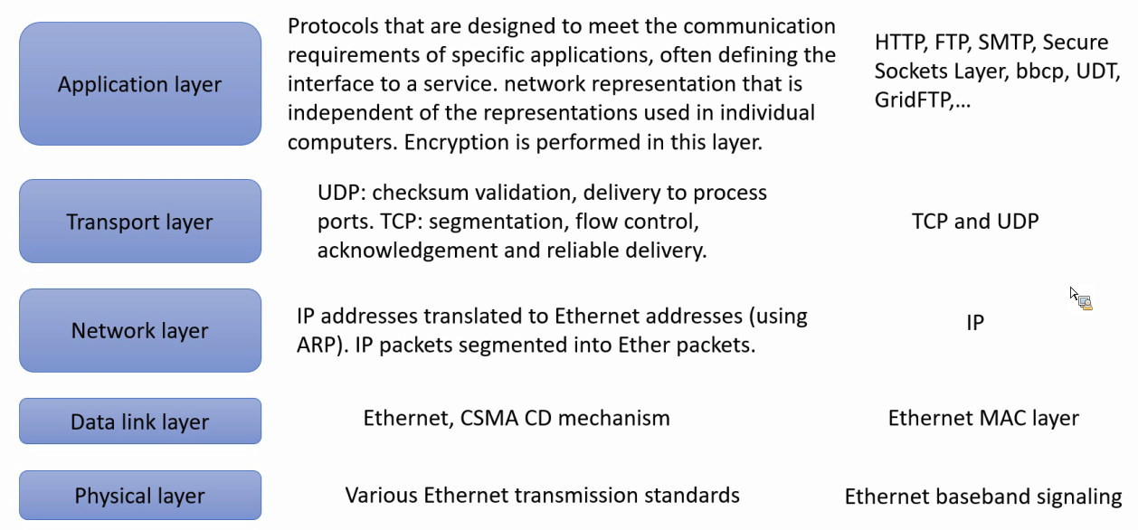
Exercise 3.4
Make a table similar to Figure 3.5 describing the work done by the software in each protocol layer when Internet applications and the TCP/IP suite are implemented over an Ethernet.
pages 94, 122, 130
Instructor’s Guide for Coulouris, Dollimore, Kindberg and Blair, Distributed Systems: Concepts and Design Edn. 5
© Pearson Education 2012
Notes:
See picture
-----------------
Layer Description Examples
Application Protocols that are designed to meet the communication requirements of
specific applications, often defining the interface to a service. network
representation that is independent of the representations used in individual
computers. Encryption is performed in this layer.
HTTP, FTP,
SMTP,
CORBA IIOP,
Secure Sockets
Layer, CORBA
Data Rep
Transport UDP: checksum validation, delivery to process ports. TCP: segmentation, flow
control, acknowledgement and reliable delivery.
TCP, UDP
Network IP addresses translated to Ethernet addresses (using ARP). IP packets
segmented into Ether packets.
IP
Data link Ethernet CSMA CD mechanism. Ethernet MAC
Layer
Physical Various Ethernet transmission standards. Ethernet baseband
signalling

Slide 43
Exercise 3.5
How has the end-to-end argument [Saltzer et al. 1984] been applied to the design of the Internet? Consider how the use of a virtual circuit network protocol in place of IP would impact the feasibility of the World Wide Web.
pages 61, 96, 106, [www.reed.com]
Instructor’s Guide for Coulouris, Dollimore, Kindberg and Blair, Distributed Systems: Concepts and Design Edn. 5
© Pearson Education 2012
Notes:
See the paper posted on moodle

Slide 44
Exercise 3.6
Can we be sure that no two computers in the Internet have the same IP addresses?
page 108
Instructor’s Guide for Coulouris, Dollimore, Kindberg and Blair, Distributed Systems: Concepts and Design Edn. 5
© Pearson Education 2012
Notes:
This depends on the allocation of network ids to user organizations by the Network Information Center
Networks with unauthorized network ids may become connected, in which case the requirement for unique ID address is broken

Slide 45
Exercise 3.7
Compare connectionless (UDP) and connection-oriented (TCP) communication for the implementation of each of the following application-level or presentation-level protocols:
i) virtual terminal access (for example, Telnet);
ii) file transfer (for example, FTP);
iii) user location (for example, rwho, finger);
iv) information browsing (for example, HTTP);
v) remote procedure call.
page 122
Instructor’s Guide for Coulouris, Dollimore, Kindberg and Blair, Distributed Systems: Concepts and Design Edn. 5
© Pearson Education 2012
Notes:
Long duration of sessions. TCP
Transmission of large volumes of data. TCP
Messages are short. UDP
The volume of data could be large or small. both
RPC achieves reliability by means of timeouts and re-trys. UDP
--------------
i) The long duration of sessions, the need for reliability and the unstructured sequences of characters
transmitted make connection-oriented communication most suitable for this application. Performance is
not critical in this application, so the overheads are of little consequence.
ii) File calls for the transmission of large volumes of data. Connectionless would be ok if error rates are low
and the messages can be large, but in the Internet, these requirements aren’t met, so TCP is used.
iii)Connectionless is preferable, since messages are short, and a single message is sufficient for each
transaction.
iv)Either mode could be used. The volume of data transferred on each transaction can be quite large, so
TCP is used in practice.
v) RPC achieves reliability by means of timeouts and re-trys. so connectionless (UDP) communication is
often preferred.

Slide 46
Exercise 3.8
Explain how it is possible for a sequence of packets transmitted through a wide area network to arrive at their destination in an order that differs from that in which they were sent. Why can’t this happen in a local network? Can it happen in an ATM network?
pages 97, 131
Instructor’s Guide for Coulouris, Dollimore, Kindberg and Blair, Distributed Systems: Concepts and Design Edn. 5
© Pearson Education 2012
Notes:
Routing is determined dynamically for each packet
TCP
Adding sequence numbers to the packets and re-ordering them at the receiving host
LAN
It can’t happen because the medium provides only a single channel connecting all of the hosts on the network
Packets are therefore transmitted and received in strict sequence

Slide 47
Exercise 3.9
A specific problem that must be solved in remote terminal access protocols such as Telnet is the need to transmit exceptional events such as ‘kill signals’ from the ‘terminal’ to the host in advance of previously-transmitted data. Kill signals should reach their destination ahead of any other ongoing transmissions. Discuss the solution of this problem with connection-oriented and connectionless protocols.
page 122
Instructor’s Guide for Coulouris, Dollimore, Kindberg and Blair, Distributed Systems: Concepts and Design Edn. 5
© Pearson Education 2012
Notes:
Example: the kill signal
Should reach the receiving process quickly even when there is buffer overflow or other exceptional conditions at receiving host
Out-of-band signaling
Connection-oriented case
Connectionless case
-------------
The problem is that a kill signal should reach the receiving process quickly even when there is buffer overflow
(e.g. caused by an infinite loop in the sender) or other exceptional conditions at the receiving host.
With a connection-oriented, reliable protocol such as TCP, all packets must be received and
acknowledged by the sender, in the order in which they are transmitted. Thus a kill signal cannot overtake other
data already in the stream. To overcome this, an out-of-band signalling mechanism must be provided. In TCP
this is called the URGENT mechanism. Packets containing data that is flagged as URGENT bypass the flowcontrol
mechanisms at the receiver and are read immediately.
With connectionless protocols, the process at the sender simply recognizes the event and sends a
message containing a kill signal in the next outgoing packet. The message must be resent until the receiving
process acknowledges it.

Slide 48
Exercise 3.10
What are the disadvantages of using network-level broadcasting to locate resources:
i) in a single Ethernet?
ii) in an intranet?
To what extent is Ethernet multicast an improvement on broadcasting?
page 130
Instructor’s Guide for Coulouris, Dollimore, Kindberg and Blair, Distributed Systems: Concepts and Design Edn. 5
© Pearson Education 2012
Notes:
Ethernet broadcasting does not happen very often
Just once for each host to locate other hosts on the local net that it needs to communicate with
It is hardly feasible in a large-scale network such as the Internet
Ethernet multicast address are matched in the Ethernet controller and are passed up to the OS only for addresses that match multicast groups the local host is subscribing to

Slide 49
Exercise 3.11
Suggest a scheme that improves on MobileIP for providing access to a web server on a mobile device which is sometimes connected to the Internet by mobile phone and at other times has a wired connection to the Internet at one of several locations.
page 120
Instructor’s Guide for Coulouris, Dollimore, Kindberg and Blair, Distributed Systems: Concepts and Design Edn. 5
© Pearson Education 2012
Notes:
The idea is to exploit the cellular phone system to locate the mobile device and to give the IP address of its current location to the client.

Slide 50
Exercise 3.12
Show the sequence of changes to the routing tables in Figure 3.8 that would occur (according to the RIP algorithm given in Figure 3.9) after the link labelled 3 in Figure 3.7 is broken.
pages 98–101
Instructor’s Guide for Coulouris, Dollimore, Kindberg and Blair, Distributed Systems: Concepts and Design Edn. 5
© Pearson Education 2012
Notes:
See next page
-------
See following 4 pages

Slide 51
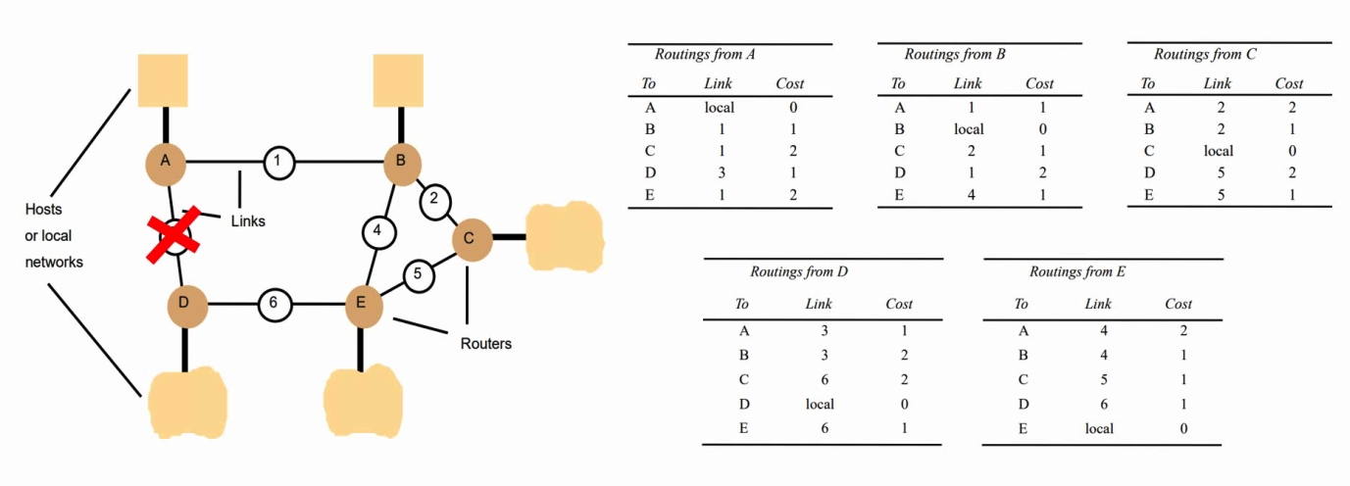
Exercise 3.12
Show the sequence of changes to the routing tables in Figure 3.8 that would occur (according to the RIP algorithm given in Figure 3.9) after the link labelled 3 in Figure 3.7 is broken.
pages 98–101
Instructor’s Guide for Coulouris, Dollimore, Kindberg and Blair, Distributed Systems: Concepts and Design Edn. 5
© Pearson Education 2012
Notes:
Problem is here, the steps are the same as the solution.
-------
See following 4 pages

Slide 52
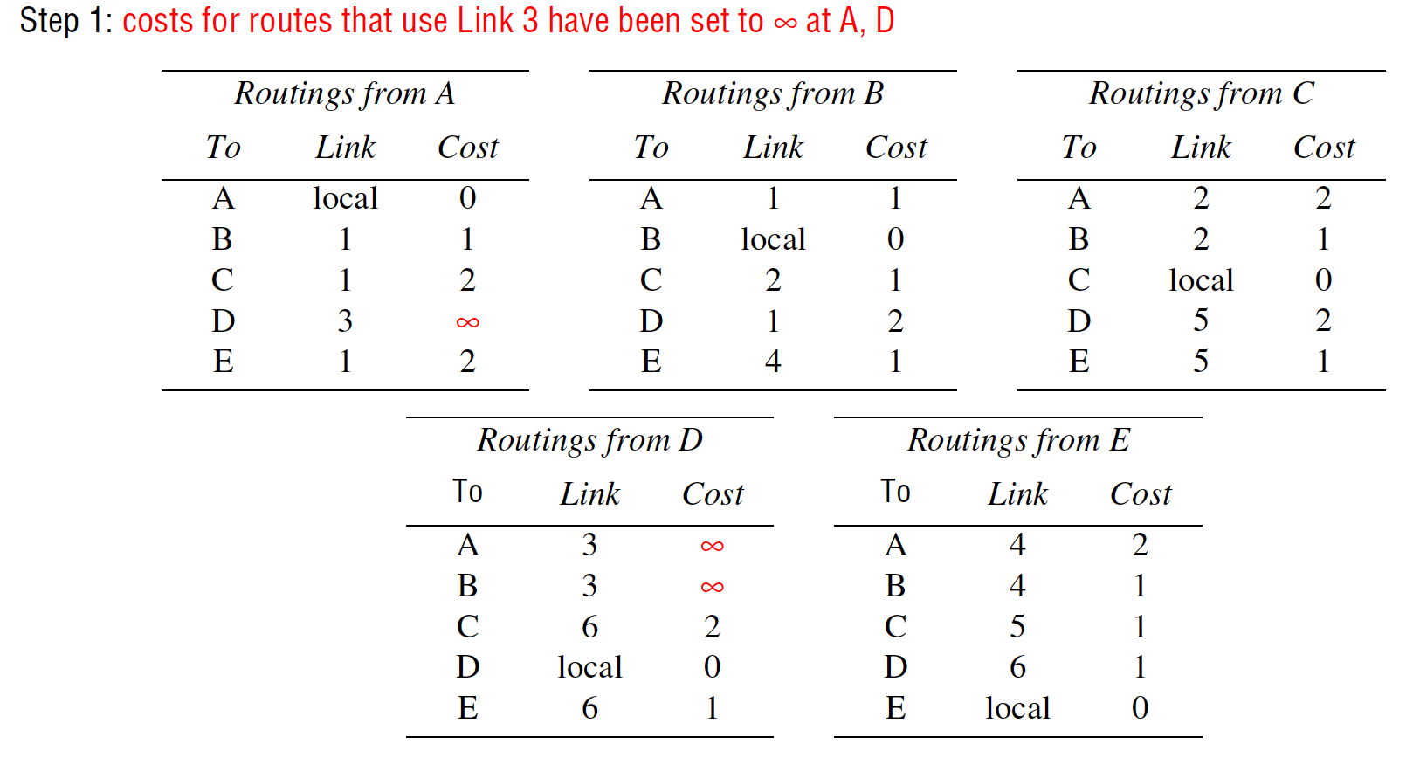
Exercise 3.13
Instructor’s Guide for Coulouris, Dollimore, Kindberg and Blair, Distributed Systems: Concepts and Design Edn. 5
© Pearson Education 2012
Notes:
-----
Routing tables with changes shown in red (grey in monochrome printouts):
Step 1: costs for routes that use Link 3 have been set to ∞ at A, D
Step 2: after first exchange of routing tables
Step 3: after second exchange of routing tables
Step 4: after third exchange of routing tables.

Slide 53
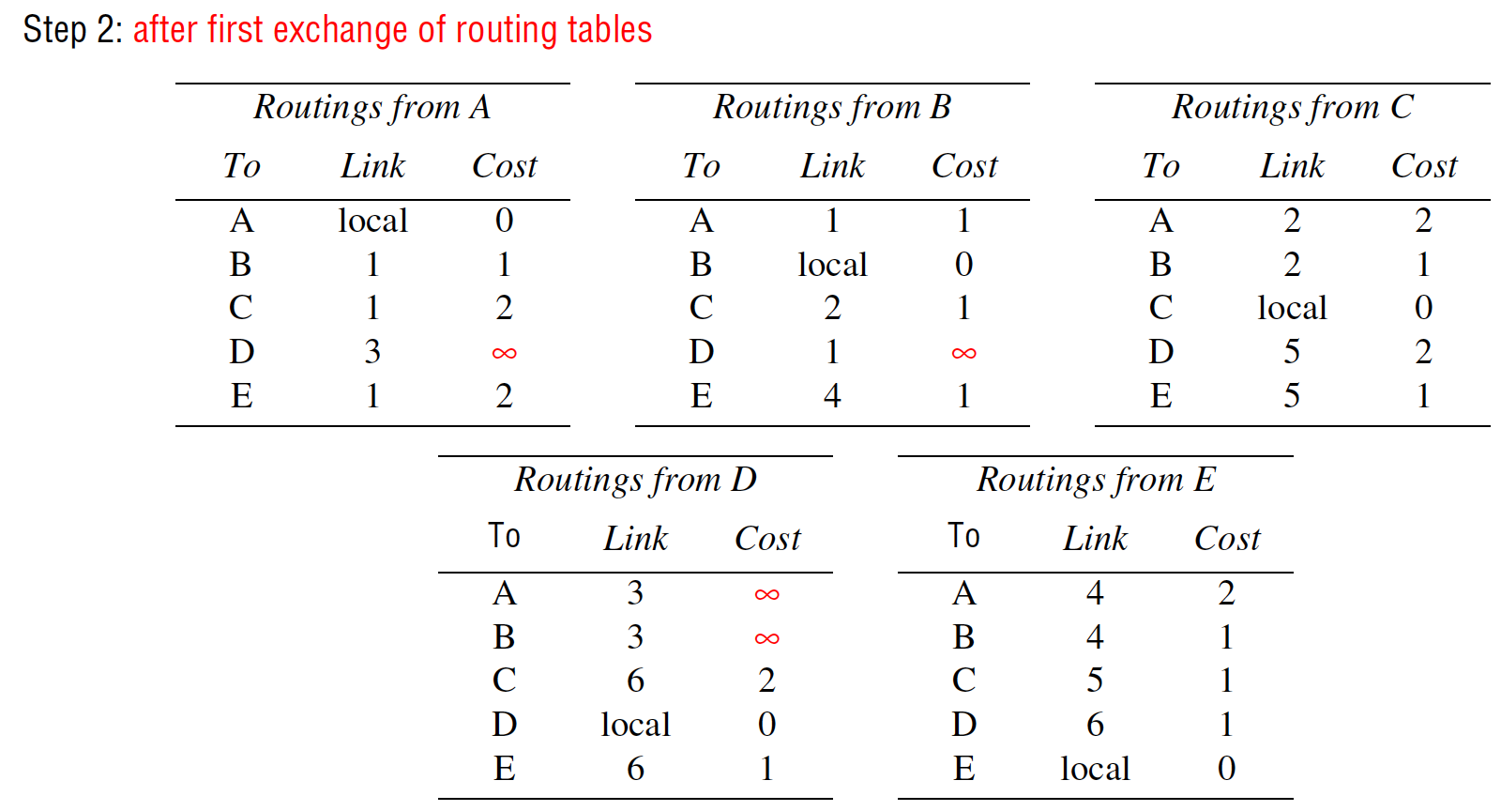
Exercise 3.13
Instructor’s Guide for Coulouris, Dollimore, Kindberg and Blair, Distributed Systems: Concepts and Design Edn. 5
© Pearson Education 2012
Notes:
-----
Routing tables with changes shown in red (grey in monochrome printouts):
Step 1: costs for routes that use Link 3 have been set to ∞ at A, D
Step 2: after first exchange of routing tables
Step 3: after second exchange of routing tables
Step 4: after third exchange of routing tables.

Slide 54
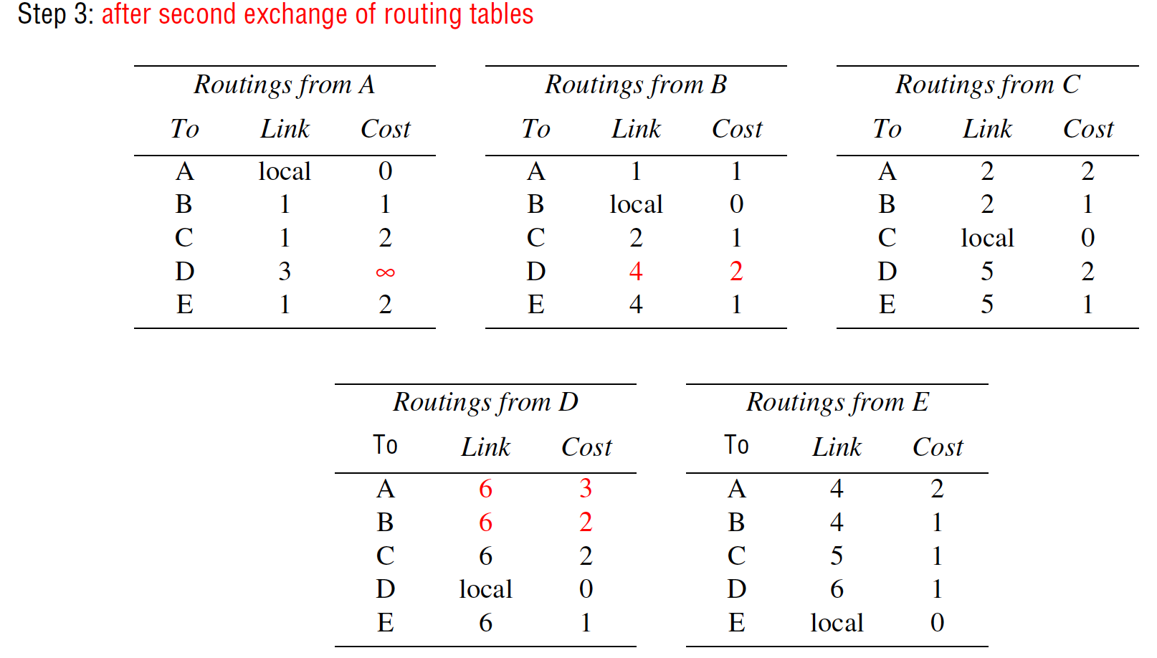
Exercise 3.13
Instructor’s Guide for Coulouris, Dollimore, Kindberg and Blair, Distributed Systems: Concepts and Design Edn. 5
© Pearson Education 2012
Notes:
-----
Routing tables with changes shown in red (grey in monochrome printouts):
Step 1: costs for routes that use Link 3 have been set to ∞ at A, D
Step 2: after first exchange of routing tables
Step 3: after second exchange of routing tables
Step 4: after third exchange of routing tables.

Slide 55
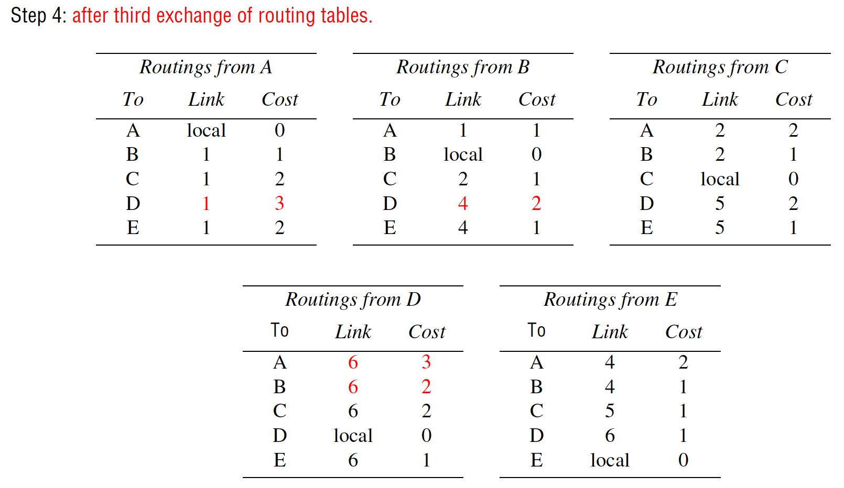
Exercise 3.13
Instructor’s Guide for Coulouris, Dollimore, Kindberg and Blair, Distributed Systems: Concepts and Design Edn. 5
© Pearson Education 2012
Notes:
-----
Routing tables with changes shown in red (grey in monochrome printouts):
Step 1: costs for routes that use Link 3 have been set to ∞ at A, D
Step 2: after first exchange of routing tables
Step 3: after second exchange of routing tables
Step 4: after third exchange of routing tables.

Slide 56
Exercise 3.13
Use the diagram in Figure 3.13 as a basis for an illustration showing the segmentation and encapsulation of an HTTP request to a server and the resulting reply. Assume that the request is a short HTTP message, but the reply includes at least 2000 bytes of HTML.
pages 93, 107
Instructor’s Guide for Coulouris, Dollimore, Kindberg and Blair, Distributed Systems: Concepts and Design Edn. 5
© Pearson Education 2012
Notes:
See next page.
Application message
TCP header
Ethernet header
Ethernet frame
port
TCP
IP
IP header
------
Left to the reader.

Slide 57
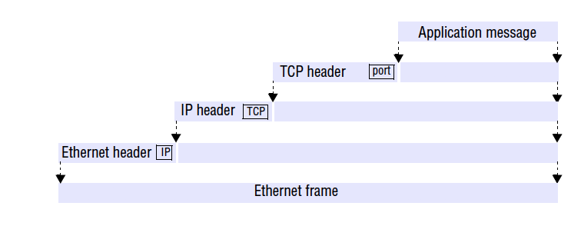
Exercise 3.13
Use the diagram in Figure 3.13 as a basis for an illustration showing the segmentation and encapsulation of an HTTP request to a server and the resulting reply. Assume that the request is a short HTTP message, but the reply includes at least 2000 bytes of HTML.
pages 93, 107
Instructor’s Guide for Coulouris, Dollimore, Kindberg and Blair, Distributed Systems: Concepts and Design Edn. 5
© Pearson Education 2012
Notes:
Application message
TCP header
Ethernet header
Ethernet frame
port
TCP
IP
IP header
------
Left to the reader.

Slide 58
Exercise 3.14
Consider the use of TCP in a Telnet remote terminal client. How should the keyboard input be buffered at the client? Investigate Nagle’s and Clark’s algorithms [Nagle 1984, Clark 1982] for flow control and compare them with the simple algorithm described on page 124 when TCP is used by
(a) a web server,
(b) a Telnet application,
(c) a remote graphical application with continuous mouse input.
pages 102, 124
Instructor’s Guide for Coulouris, Dollimore, Kindberg and Blair, Distributed Systems: Concepts and Design Edn. 5
© Pearson Education 2012
Notes:
Basic TCP buffer algorithm is not very efficient for interactive input
Nagle’s algorithm is designed for this:
Requires the sending machine to send any bytes found in the output buffer, then wait for an acknowledgement. Whenever an ACK is received, any additional characters in the buffer are sent
For a web server: …
For a remote shell: …
For a continuous mouse input: …
-------
The basic TCP buffering algorithm described on p. 105 is not very efficient for interactive input. Nagle’s
algorithm is designed to address this. It requires the sending machine to send any bytes found in the output
buffer, then wait for an acknowledgement. Whenever an acknowledgement is received, any additional
characters in the buffer are sent. The effects of this are:
a) For a web server: the server will normally write a whole page of HTML into the buffer in a single write.
When the write is completed, Nagle’s algorithm will send the data immediately, whereas the basic
algorithm would wait 0.5 seconds. While the Nagle’s algorithm is waiting for an acknowledgement, the
server process can write additional data (e.g. image files) into the buffer. They will be sent as soon as
the acknowledgement is received.
b) For a remote shell (Telnet) application: the application will write individual key strokes into the buffer
(and in the normal case of full duplex terminal interaction they are echoed by the remote host to the
Telnet client for display). With the basic algorithm, full duplex operation would result in a delay of 0.5
seconds before any of the characters typed are displayed on the screen. With Nagle’s algorithm, the first
character typed is sent immediately and the remote host echoes it with an acknowledgement piggybacked
in the same packet. The acknowledgement triggers the sending of any further characters that have
been typed in the intervening period. So if the remote host responds sufficiently rapidly, the display of
typed characters appears to be instantaneous. But note that a badly-written remote application that reads
data from the TCP buffer one character at a time can still cause problems - each read will result in an
acknowledgement indicating that one further character should be sent - resulting in the transmission of
an entire IP frame for each character. Clarke [1982] called this the silly window syndrome. His solution
is to defer the sending of acknowledgements until there is a substantial amount of free space available.
c) For a continuous mouse input (e.g. sending mouse positions to an X-Windows application running on a
compute server): this is a difficult form of input to handle remotely. The problem is that the user should
see a smooth feedbvack of the path traced by the mouse, with minimal lag. Neither the basic TCP
algorithm nor Nagle’s nor Clarke’s algorithm achieves this very well. A version of the basic algorithm
with a short timeout (0.1 seconds) is the best that can be done, and this is effective when the network is
lightly loaded and has low end-to-end latency - conditions that can be guaranteed only on local networks
with controlled loads.
See Tanenbaum [1996] pp. 534-5 for further discussion of this.

Slide 59
Exercise 3.15
Construct a network diagram similar to Figure 3.10 for the local network at your institution or company.
page 104.
Instructor’s Guide for Coulouris, Dollimore, Kindberg and Blair, Distributed Systems: Concepts and Design Edn. 5
© Pearson Education 2012
Notes:
See next page.
138.37.88.230
138.37.88.162
bruno
138.37.88.249
router/
sickle
138.37.95.240/29 138.37.95.241
138.37.95.249
138.37.94.247
copper
138.37.88.248
firewall
web
138.37.95.248/29
server
desktop computers 138.37.88.xx
subnet
subnet
Eswitch
138.37.88
server
server
server
138.37.88.251
custard
138.37.94.246
desktop computers 138.37.94.xx
Eswitch
138.37.94
hub hub
Staff subnet Student subnet
other
servers
router/
firewall
138.37.94.251
138.37.88.247
file server/
gateway
printers
138.37.95.232/29
subnet
Campus
router
Campus
router Subnet boundary
100 Mbps Ethernet
1000 Mbps Ethernet

Slide 60
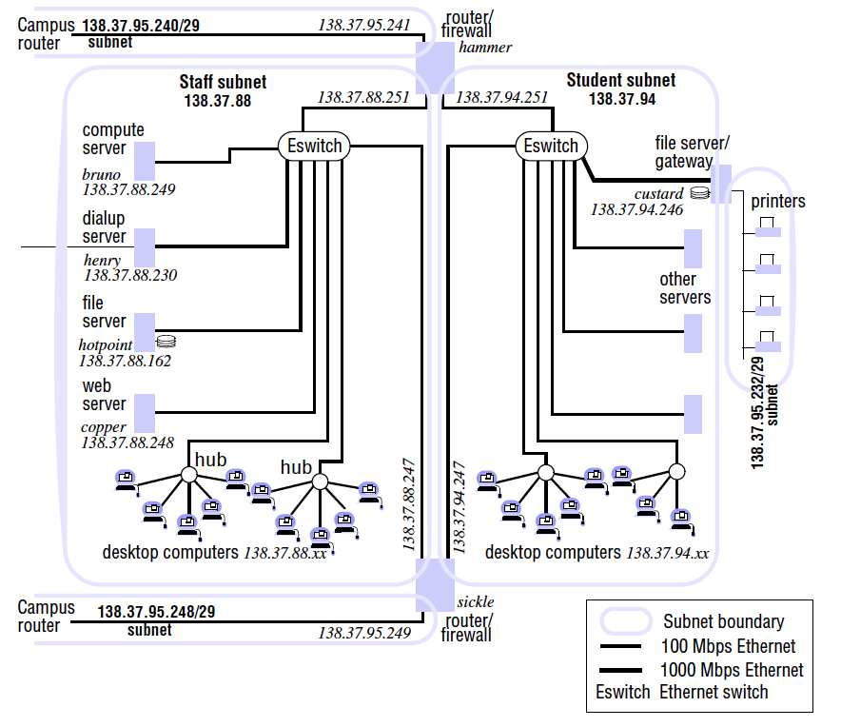
Exercise 3.15
Construct a network diagram similar to Figure 3.10 for the local network at your institution or company.
page 104.
Instructor’s Guide for Coulouris, Dollimore, Kindberg and Blair, Distributed Systems: Concepts and Design Edn. 5
© Pearson Education 2012
Notes:
See next page.
138.37.88.230
138.37.88.162
bruno
138.37.88.249
router/
sickle
138.37.95.240/29 138.37.95.241
138.37.95.249
138.37.94.247
copper
138.37.88.248
firewall
web
138.37.95.248/29
server
desktop computers 138.37.88.xx
subnet
subnet
Eswitch
138.37.88
server
server
server
138.37.88.251
custard
138.37.94.246
desktop computers 138.37.94.xx
Eswitch
138.37.94
hub hub
Staff subnet Student subnet
other
servers
router/
firewall
138.37.94.251
138.37.88.247
file server/
gateway
printers
138.37.95.232/29
subnet
Campus
router
Campus
router Subnet boundary
100 Mbps Ethernet
1000 Mbps Ethernet

Slide 61
Exercise 3.16
Describe how you would configure a firewall to protect the local network at your institution or company. What incoming and outgoing requests should it intercept?
page 125
Instructor’s Guide for Coulouris, Dollimore, Kindberg and Blair, Distributed Systems: Concepts and Design Edn. 5
© Pearson Education 2012
Notes:
Left to you.
Block everything first, then add the only required ones back.
Log every step …
---------
Left to the reader.

Slide 62
Exercise 3.17
How does a newly-installed personal computer connected to an Ethernet discover the IP addresses of local servers? How does it translate them to Ethernet addresses?
page 111
Instructor’s Guide for Coulouris, Dollimore, Kindberg and Blair, Distributed Systems: Concepts and Design Edn. 5
© Pearson Education 2012
Notes:
Neither Ethernet nor the Internet support ‘discovery’ services as such.
A newly-installed computer must be configured with the domain names of any servers that it needs to access.
DHCP.
nslookup.
ARP: Address Resolution Protocol. Each network type mush implement ARP on its own way.

Slide 63
Exercise 3.18
Can firewalls prevent denial of service attacks such as the one described on page 96? What other methods are available to deal with such attacks?
page 112, 125
Instructor’s Guide for Coulouris, Dollimore, Kindberg and Blair, Distributed Systems: Concepts and Design Edn. 5
© Pearson Education 2012
Notes:
Firewall is simply another computer program
Attacking traffic is likely to closely resemble real service requests and responses
Produce malicious messages in large quantities that firewall is likely to be overwhelmed and become bottleneck
Solve:
Big data, AI, anomaly detection

Slide 64
Exercises for Chapter 4:
Interprocess Communication
From Coulouris, Dollimore, Kindberg and Blair
Distributed Systems:
Concepts and Design
Edition 5, © Addison-Wesley 2012

Slide 65
Exercise 4.1
Is it conceivably useful for a port to have several receivers? page 148
Instructor’s Guide for Coulouris, Dollimore, Kindberg and Blair, Distributed Systems: Concepts and Design Edn. 5
© Pearson Education 2012
Notes:
If several processes share a port, then it must be possible for all of the messages that arrive on that port to be received and processed independently by those processes.
Processes do not usually share data, but if they do share
It would requires access to common data representing the messages in the queue at the port -> the queue structure would be complicated by the fact that each process has its own idea of the front of the queue and when the queue is empty.
A port group may be used to allow several processes to receive the same message.

Slide 66
Exercise 4.2
A server creates a port which it uses to receive requests from clients. Discuss the design issues concerning the relationship between the name of this port and the names used by clients. page 148
Instructor’s Guide for Coulouris, Dollimore, Kindberg and Blair, Distributed Systems: Concepts and Design Edn. 5
© Pearson Education 2012
Notes:
How does a client know what port and IP address to use to reach a service?
How can different servers offer the service at different times?
Efficiency of access to ports and local identifiers.

Slide 67
Exercise 4.3
The programs in Figure 4.3 and Figure 4.4 are available at cdk5.net/ipc. Use them to make a test kit to determine the conditions in which datagrams are sometimes dropped. Hint: the client program should be able to vary the number of messages sent and their size; the server should detect when a message from a particular client is missed. page 156
Instructor’s Guide for Coulouris, Dollimore, Kindberg and Blair, Distributed Systems: Concepts and Design Edn. 5
© Pearson Education 2012
Notes:
HW2
Socket programming practice
----------
For a test of this type, one process sends and another receives. Modify the program in Figure 4.3 so that the
program arguments specify i) the server’s hostname ii) the server port, iii) the number, n of messages to be
sent and iv) the length, l of the messages. If the arguments are not suitable, the program should exit
immediately. The program should open a datagram socket and then send n UDP datagram messages to the
server. Message i should contain the integer i in the first four bytes and the character ‘*’ in the remaining l-4
bytes. It does not attempt to receive any messages.
Take a copy of the program in Figure 4.4 and modify it so that the program argument specifies the server port.
The program should open a socket on the given port and then repeatedly receive a datagram message. It should
check the number in each message and report whenever there is a gap in the sequence of numbers in the
messages received from a particular client.
Run these two programs on a pair of computers and try to find out the conditions in which datagrams are
dropped, e.g. size of message, number of clients.

Slide 68
Exercise 4.4
Use the program in Figure 4.3 to make a client program that repeatedly reads a line of input from the user, sends it to the server in a UDP datagram message, then receives a message from the server. The client sets a timeout on its socket so that it can inform the user when the server does not reply. Test this client program with the server in Figure 4.4.
page 150
Instructor’s Guide for Coulouris, Dollimore, Kindberg and Blair, Distributed Systems: Concepts and Design Edn. 5
© Pearson Education 2012
Notes:
HW2
Socket programming practice
------------
The program is as Figure 4.4 with the following amendments:
DatagramSocket aSocket = new DatagramSocket();
aSocket.setSoTimeout(3000);// in milliseconds
while (// not eof) {
try{
// get user’s input and put in request
.....
aSocket.send(request);
........
aSocket.receive(reply);
}catch (InterruptedIOException e){System.out.println("server not responding”);}

Slide 69
Exercise 4.5
The programs in Figure 4.5 and Figure 4.6 are available at cdk5.net/ipc. Modify them so that the client repeatedly takes a line of user’s input and writes it to the stream and the server reads repeatedly from the stream, printing out the result of each read. Make a comparison between sending data in UDP datagram messages and over a stream.
page 153
Instructor’s Guide for Coulouris, Dollimore, Kindberg and Blair, Distributed Systems: Concepts and Design Edn. 5
© Pearson Education 2012
Notes:
HW2
Socket programming practice
----------
The changes to the two programs are straightforward. But students should notice that not all sends go
immediately and that receives must match the data sent.
For the comparison. In both cases, a sequence of bytes is transmitted from a sender to a receiver. In the
case of a message the sender first constructs the sequence of bytes and then transmits it to the receiver which
receives it as a whole. In the case of a stream, the sender transmits the bytes whenever they are ready and the
receiver collects the bytes from the stream as they arrive.

Slide 70
Exercise 4.6
Use the programs developed in Exercise 4.5 to test the effect on the sender when the receiver crashes and vice-versa. page 153
Instructor’s Guide for Coulouris, Dollimore, Kindberg and Blair, Distributed Systems: Concepts and Design Edn. 5
© Pearson Education 2012
Notes:
HW2
Socket programming practice

Slide 71
Exercise 4.7
Sun XDR marshals data by converting it into a standard big-endian form before transmission. Discuss the advantages and disadvantages of this method when compared with CORBA’s CDR.
page 160
Instructor’s Guide for Coulouris, Dollimore, Kindberg and Blair, Distributed Systems: Concepts and Design Edn. 5
© Pearson Education 2012
Notes:
XDR (Extended Data Representation) uses a standard form which is inefficient when communication takes place between pairs of similar computers whose byte orderings differ from the standard.
COBRA (Common Object Request Broker Architecture) CDR (Common Data Representation) senders include an identifier in each message indicating recipients to convert the bytes to their own ordering if necessary.

Slide 72
Exercise 4.8
Sun XDR aligns each primitive value on a four byte boundary, whereas CORBA CDR aligns a primitive value of size n on an n-byte boundary. Discuss the trade-offs in choosing the sizes occupied by primitive values. page 160
Instructor’s Guide for Coulouris, Dollimore, Kindberg and Blair, Distributed Systems: Concepts and Design Edn. 5
© Pearson Education 2012
Notes:
Marshalling is simpler when the data matches the alignment boundaries of the computers involved.
Four bytes is large enough to support most architectures efficiently, but some space is wasted by smaller primitive values.
The hybrid method of CDR is more complex to implement, but saves some space in the marshalled form.
------------
Marshalling is simpler when the data matches the alignment boundaries of the computers involved. Four
bytes is large enough to support most architectures efficiently, but some space is wasted by smaller primitive
values. The hybrid method of CDR is more complex to implement, but saves some space in the marshalled
form. Although the example in Figure 4.8 shows that space is wasted at the end of each string because the
following long is aligned on a 4- byte boundary.

Slide 73
Exercise 4.9
Why is there no explicit data-typing in CORBA CDR? page 160
Instructor’s Guide for Coulouris, Dollimore, Kindberg and Blair, Distributed Systems: Concepts and Design Edn. 5
© Pearson Education 2012
Notes:
The use of data-typing produces costs in space and time -> performance
The RMI protocol for which CDR is designed is used in a situation in which the target and the invoker know what type to expect in the messages carrying its arguments and results. -> necessity

Slide 74
Exercise 4.10
Write an algorithm in pseudocode to describe the serialization procedure described in Section 4.3.2. The algorithm should show when handles are defined or substituted for classes and instances. Describe the serialized form that your algorithm would produce when serializing an instance of the following class Couple.
class Couple implements Serializable{
private Person one;
private Person two;
public Couple(Person a, Person b) {
one = a;
two = b;
}
} page 162
Instructor’s Guide for Coulouris, Dollimore, Kindberg and Blair, Distributed Systems: Concepts and Design Edn. 5
© Pearson Education 2012
Notes:
Describe serialization of an object as writing its class information followed by the names and types of the instance variables, and then serialize each instance variable recursively.
serialize(Object o) {
c = class(o);
class_handle = get_handle(c);
if (class_handle==null) // write class information and define class_handle;
write class_handle
write number (n), name and class of each instance variable
object_handle = get_handle(o);
if (object_handle==null) {
define object_handle;
for (iv = 0 to n-1)
if (primitive(iv) ) write iv
else serialize( iv)
}
write object_handle
}
To describe the serialized form that your algorithm would produce when serializing an instance of the class Couple.
For example declare an instance of Couple as
Couple t1 – new Couple (new Person(“Smith”, “London”, 1934), new Person(“Jones”, “Paris”, 1945));
The output will be: (next page)
----------
The algorithm must describe serialization of an object as writing its class information followed by the names
and types of the instance variables.Then serialize each instance variable recursively.
serialize(Object o) {
c = class(o);
class_handle = get_handle(c);
if (class_handle==null) // write class information and define class_handle;
write class_handle
write number (n), name and class of each instance variable
object_handle = get_handle(o);
if (object_handle==null) {
define object_handle;
for (iv = 0 to n-1)
if (primitive(iv) ) write iv
else serialize( iv)
}
write object_handle
}
To describe the serialized form that your algorithm would produce when serializing an instance of
the class Couple.
An example is shown on the next page.

Slide 75
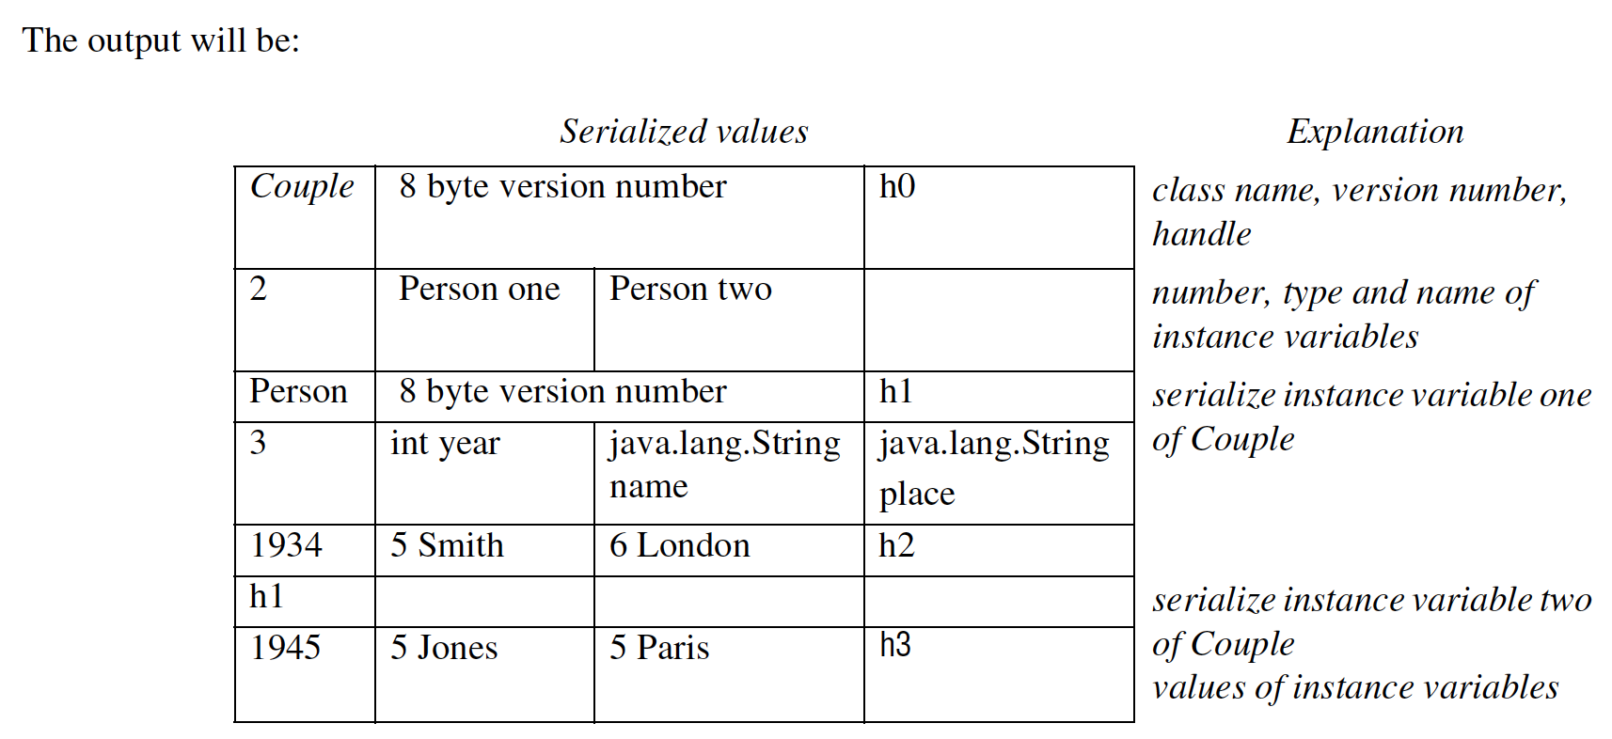
Exercise 4.10
Instructor’s Guide for Coulouris, Dollimore, Kindberg and Blair, Distributed Systems: Concepts and Design Edn. 5
© Pearson Education 2012
Notes:
-----------
For example declare an instance of Couple as
Couple t1 = new Couple(new Person("Smith", "London", 1934),
new Person("Jones", "Paris", 1945));
The output will be:
Serialized values Explanation
Couple 8 byte version number h0 class name, version number,
handle
2 Person one Person two number, type and name of
instance variables
Person 8 byte version number h1 serialize instance variable one
3 int year java.lang.String of Couple
name
java.lang.String
place
1934 5 Smith 6 London h2
h1 serialize instance variable two
of Couple
values of instance variables
1945 5 Jones 5 Paris h3

Slide 76
Exercise 4.11
Write an algorithm in pseudocode to describe deserialization of the serialized form produced by the algorithm defined in Exercise 4.10. Hint: use reflection to create a class from its name, to create a constructor from its parameter types and to create a new instance of an object from the constructor and the argument values. page 162
Instructor’s Guide for Coulouris, Dollimore, Kindberg and Blair, Distributed Systems: Concepts and Design Edn. 5
© Pearson Education 2012
Notes:
Object deserialize(byte [] stream) {
Constructor aConstructor;
read class_name and class_handle;
if (class_information == null) aConstructor = lookup(class_handle);
else {
Class cl = Class.forName(class_name);
read number (n) of instance variables
Class parameterTypes[]= new Class[n];
for (int i=0 to n-1) {
read name and class_name of instance variable i
parameterTypes[i] = Class.forName(class_name);
}
aConstructor = cl.getConstructor(parameterTypes);
map(aConstructor, class_handle);
}
if (next item in stream is object_handle) o = lookup(object_handle);
else {
Object args[] = new Object[n];
for (int i=0 to n-1) {
if (next item in stream is primitive) args[i] = read value
else args[i] = deserialize(//rest of stream)
}
Object o = cnew.newInstance(args);
read object_handle from stream
map(object, object_handle)
return o;
}
}
-------------
Whenever a handle definition is read, i.e. a class_info, handle correspondence or an object, handle
correspondence, store the pair by method map. When a handle is read look it up to find the corresponding class
or object.
Object deserialize(byte [] stream) {
Constructor aConstructor;
read class_name and class_handle;
if (class_information == null) aConstructor = lookup(class_handle);
else {
Class cl = Class.forName(class_name);
read number (n) of instance variables
Class parameterTypes[]= new Class[n];
for (int i=0 to n-1) {
read name and class_name of instance variable i
parameterTypes[i] = Class.forName(class_name);
}
aConstructor = cl.getConstructor(parameterTypes);
map(aConstructor, class_handle);
}
if (next item in stream is object_handle) o = lookup(object_handle);
else {
Object args[] = new Object[n];
for (int i=0 to n-1) {
if (next item in stream is primitive) args[i] = read value
else args[i] = deserialize(//rest of stream)
}
Object o = cnew.newInstance(args);
read object_handle from stream
map(object, object_handle)
return o;
}
}

Slide 77
Exercise 4.12
Why can’t binary data be represented directly in XML, for example, by representing it as Unicode byte values? XML elements can carry strings represented as base64. Discuss the advantages or disadvantages of using this method to represent binary data. page 164
Instructor’s Guide for Coulouris, Dollimore, Kindberg and Blair, Distributed Systems: Concepts and Design Edn. 5
© Pearson Education 2012
Notes:
Special character such as ‘<‘ or ‘>’.
The terminator for CDATA ‘]]’.
Binary data can be encoded in base64 and represented in XML as a string.
Base64 encoding takes three bytes, each consisting of eight bits, and represents them as four printable characters in the ASCII standard (padding when necessary).
A disadvantage in using base64 is that the quantity of data is increased by a factor of 4/3 and the translation process at both ends can take time.
The only advantage of base64 is that it can be used when necessary. It is in fact used in XML Security to represent digital signatures and encrypted data.
----------
Binary data can’t be represented directly in XML, because somewhere the embedded binary data will include
the representation of a special character such as '<' or '>'.
Even if binary is represented as CDATA, it might include the terminator for CDATA: ']]'.
Binary data can be encoded in base64 and represented in XML as a string.
Base64 encoding takes three bytes, each consisting of eight bits, and represents them as four printable
characters in the ASCII standard (padding when necessary).
Thus a disadvantage in using base64 is that the quantity of data is increased by a factor of 4/3 and the
translation process at both ends can take time. In addition, the encoded value isn’t really a string and in some
cases may be passed on to an application as a string.
The only advantage of base64 is that it can be used when necessary. It is in fact used in XML Security to
represent digital signatures and encrypted data. In both cases, the data is enclosed in elements that specify, for
example, signature or encrypted data.

Slide 78
Exercise 4.13
Define a class whose instances represent remote object references. It should contain information similar to that shown in Figure 4.13 and should provide access methods needed by the request-reply protocol. Explain how each of the access methods will be used by that protocol. Give a justification for the type chosen for the instance variable containing information about the interface of the remote object. page 168
Instructor’s Guide for Coulouris, Dollimore, Kindberg and Blair, Distributed Systems: Concepts and Design Edn. 5
© Pearson Education 2012
Notes:
class RemoteObjectReference{
private InetAddress ipAddress;
private int port;
private int time;
private int objectNumber;
private Class interface;
public InetAddress getIPaddress() ( return ipAddress;}
public int getPort() { return port;);
}
-----------
class RemoteObjectReference{
private InetAddress ipAddress;
private int port;
private int time;
private int objectNumber;
private Class interface;
public InetAddress getIPaddress() ( return ipAddress;}
public int getPort() { return port;);
}
The server looks up the client port and IP address before sending a reply.
The variable interface is used to recognize the class of a remote object when the reference is passed as an
argument or result. Chapter 5 explains that proxies are created for communication with remote objects. A
proxy needs to implement the remote interface. If the proxy name is constructed by adding a standard suffix
to the interface name and all we need to do is to construct a proxy from a class already available, then its string
name is sufficient. However, if we want to use reflection to construct a proxy, an instance of Class would be
needed. CORBA uses a third alternative described in Chapter 17.

Slide 79
Exercise 4.14
IP multicast provides a service that suffers from omission failures. Make a test kit, possibly based on the program in Figure 4.17, to discover the conditions under which a multicast message is sometimes dropped by one of the members of the multicast group. The test kit should be designed to allow for multiple sending processes.
page 170
Instructor’s Guide for Coulouris, Dollimore, Kindberg and Blair, Distributed Systems: Concepts and Design Edn. 5
© Pearson Education 2012
Notes:
The program should be modified so that it can run as a sender or just a receiver. A program argument could specify its role.
The number of messages and their size should be variable and a sequence number should be sent with each one.
Each recipient records the last sequence number from each sender (sender IP address can be retrieved from data grams) and prints out any missing sequence numbers.
Test with several senders and receivers and message sizes to discover the load required to cause dropped messages. The test kit should be designed to allow for multiple sending processes.
----------
The program in Figure 4.17 should be altered so that it can run as a sender or just a receiver. A program
argument could specify its role. As in Exercise 4.3 the number of messages and their size should be variable
and a sequence number should be sent with each one. Each recipient records the last sequence number from
each sender (sender IP address can be retrieved from datagrams) and prints out any missing sequence numbers.
Test with several senders and receivers and message sizes to discover the load required to cause dropped
messages.The test kit should be designed to allow for multiple sending processes.

Slide 80
Exercise 4.15
Outline the design of a scheme that uses message retransmissions with IP multicast to overcome the problem of dropped messages. Your scheme should take the following points into account:
i) there may be multiple senders;
ii) generally only a small proportion of messages are dropped;
iii) unlike the request-reply protocol, recipients may not necessarily send a message within any particular time limit.
Assume that messages that are not dropped arrive in sender ordering. page 173
Instructor’s Guide for Coulouris, Dollimore, Kindberg and Blair, Distributed Systems: Concepts and Design Edn. 5
© Pearson Education 2012
Notes:
Senders must attach a sequence number to each message …
A negative acknowledgement scheme is preferred …
Possible solutions:
senders discards stored messages after a time limit
Occasional acknowledgements from recipients which may be piggy backed on messages that are sent.
-----------
To allow for point (i) senders must attach a sequence number to each message. Recipients record last sequence
number from each sender and check sequence numbers on each message received.
For point (ii) a negative acknowledgement scheme is preferred (recipient requests missing messages,
rather than acknowledging all messages). When they notice a missing message, they send a message to the
sender to ask for it. To make this work, the sender must store all recently sent messages for retransmission.
The sender re-transmits the messages as a unicast datagram.
Point (iii) - refers to the fact that we can’t rely on a reply as an acknowledgement. Without
acknowledgements, the sender will be left holding all sent messages in its store indefinitely. Possible solutions:
a) senders discards stored messages after a time limit b) occasional acknowledgements from recipients which
may be piggy backed on messages that are sent.
Note requests for missing messages and acknowledgments are simple - they just contain the sequence
numbers of a range of lost messages.

Slide 81
Exercise 4.16
Your solution to Exercise 4.15 should have overcome the problem of dropped messages in IP multicast. In what sense does your solution differ from the definition of reliable multicast? page 173
Instructor’s Guide for Coulouris, Dollimore, Kindberg and Blair, Distributed Systems: Concepts and Design Edn. 5
© Pearson Education 2012
Notes:
Reliable multicast requires that any message transmitted is received by all members of a group or none of them.
If the sender fails before it has sent a messasge to all of the members (e.g. if it has to retransmit a message) or if a gateway fails, then some members will receive the message when others do not.

Slide 82
Exercise 17
Devise a scenario in which multicasts sent by different clients are delivered in different orders at two group members. Assume that some form of message retransmissions are in use, but that messages that are not dropped arrive in sender ordering. Suggest how recipients might remedy this situation. page 173
Instructor’s Guide for Coulouris, Dollimore, Kindberg and Blair, Distributed Systems: Concepts and Design Edn. 5
© Pearson Education 2012
Notes:
Sender1 sends request r1 to members m1 and m2 but the message to m2 is dropped
Sender2 sends request r2 to members m1 and m2 (both arrive safely)
Sender1 re-transmits request r1 to member m2 (it arrives safely).
Member m1 receives the messages in the order r1;r2. However m2 receives them in the order r2;r1.
How to remedy this?
--------------
Sender1 sends request r1 to members m1 and m2 but the message to m2 is dropped
Sender2 sends request r2 to members m1 and m2 (both arrive safely)
Sender1 re-transmits request r1 to member m2 (it arrives safely).
Member m1 receives the messages in the order r1;r2. However m2 receives them in the order r2;r1.
To remedy the situation. Each recipient delivers messages to its application in sender order. When it receives
a message that is ahead of the next one expected, it hold it back until it has received and delivered the earlier
re-transmitted messages.

Slide 83
Exercise 4.18
Revisit the Internet architecture as introduced in Chapter 3 (see Figures 3.12 and 3.14). What impact does the introduction of overlay networks have on this architecture, and in particular on the programmer’s conceptual view of the Internet? page 175
Instructor’s Guide for Coulouris, Dollimore, Kindberg and Blair, Distributed Systems: Concepts and Design Edn. 5
© Pearson Education 2012
Notes:
What is an overlay network?
The introduction of overlay networks introduces an element of extra complexity into the Internet architecture but also an increasing degree of sophistication to meet these two requirements.
The key elements in terms of the conceptual view offered by the Internet is that programmers now see the architecture as extensible and also see the potential to have more application-specific network servies.
-----------
The initial Internet architecture was devised for a relatively small number of applications (such as electronic
mail and file transfer) to run over relatively homogeneous styles of network. The definition and standardization
of the (relatively simple) Internet architecture has been very successful in supporting these applications and
other emerging applications. As the Internet grows though in terms of scale and diversity, there is a need to
support richer application styles and also to operate more effectively over an increasing variety of network
types. The introduction of overlay networks introduces an element of extra complexity into the Internet
architecture but also an increasing degree of sophistication to meet these two requirements. For example,
overlay networks can be introduced to support new styles of Internet applications, for example related to
streaming of continuous media content. The Internet can also be extended to operate more optimally over new
network types, for example ad hoc networks.
The key elements in terms of the conceptual view offered by the Internet is that programmers now see
the architecture as extensible and also see the potential to have more application-specific network services.
They also see a move from rigid standardization to a more experimental environment.

Slide 84
Exercise 4.19
What are the main arguments for adopting a super node approach in Skype? page 177
Instructor’s Guide for Coulouris, Dollimore, Kindberg and Blair, Distributed Systems: Concepts and Design Edn. 5
© Pearson Education 2012
Notes:
Efficient and reliable search, a key enabling function in Skype.
Search is supported only nodes that have the required capabilities in terms of bandwidth, reachability and availability.
The alternative is to adopt a pure peer-to-peer approach where all nodes cooperate to provide this function
The down side of this pure approach is that certain nodes involved in the implementation of search may be disconnected, or have weak connectivity in terms of bandwidth, leading to a more erratic service.
The trade-off is that super nodes will encounter more traffic due to search, but they are selected on the basis they can absorb this.

Slide 85
Exercise 4.20
As discussed in Section 4.6, MPI offers a number of variants of send including the MPI_Rsend operation, which assumes the receiver is ready to receive at the time of sending. What optimizations in implementation are possible if this assumption is correct and what are the repercussions of this assumption being false? page 180
Instructor’s Guide for Coulouris, Dollimore, Kindberg and Blair, Distributed Systems: Concepts and Design Edn. 5
© Pearson Education 2012
Notes:
The key optimization is that the sender does not have to check that the receiver is ready to receive a message and this therefore avoids a handshake between sender and receiver, increasing the performance of the implementation.
If the receiver is not ready, the outcome of the send operation is unpredictable in terms of the buffer being ready and the MPI documentation deems the outcome undefined. It may be for example that values will be over-written before being consumed.
------------
The key optimization is that the sender does not have to check that the receiver is ready to receive a message
and this therefore avoids a handshake between sender and receiver, increasing the performance of the
implementation. If the receiver is not ready, the outcome of the send operation is unpredictable in terms of the
buffer being ready and the MPI documentation deems the outcome undefined. It may be for example that
values will be over-written before being consumed.

Slide 86
Exercises for Chapter 7
Operating Systems Support
Operating System Support
From Coulouris, Dollimore, Kindberg and Blair
Distributed Systems:
Concepts and Design
Edition 5, © Addison-Wesley 2012

Slide 87
Exercise 7.1
Discuss each of the tasks of encapsulation, concurrent processing, protection, name resolution, communication of parameters and results, and scheduling in the case of the UNIX file service (or that of another kernel that is familiar to you)
page 282
Instructor’s Guide for Coulouris, Dollimore, Kindberg and Blair, Distributed Systems: Concepts and Design Edn. 5
© Pearson Education 2012
Notes:
Encapsulation
Concurrent processing
Protection
Name resolution
Parameter and result communication
Scheduling
------------
The core OS components are the following:
Process manager: Handles the creation of and operations upon processes. A process is a unit of resource
management, including an address space and one or more threads.
Thread manager: Thread creation, synchronization and scheduling. Threads are schedulable activities attached
to processes.
Communication manager: Communication between threads attached to different processes on the same
computer. Some kernels also support communication between threads in remote processes. Other kernels have
no notion of other computers built into them, and an additional service is required for external communication.
Memory manager: Management of physical and virtual memory. It is the utilization of memory management
techniques for efficient data copying and sharing.
Supervisor: Dispatching of interrupts, system call traps and other exceptions; control of memory management
unit and hardware caches; processor and floating point unit register manipulations. This is known as the
Hardware Abstraction Layer in Windows.

Slide 88
Exercise 7.2
Why are some system interfaces implemented by dedicated system calls (to the kernel), and others on top of message-based system calls?
page 282
Instructor’s Guide for Coulouris, Dollimore, Kindberg and Blair, Distributed Systems: Concepts and Design Edn. 5
© Pearson Education 2012
Notes:
Dedicated system calls are more efficient for simple calls than message-based calls.
The advantage of implementing a system call as a RPC is that then a process can perform operations transparently on either remote or local resources.

Slide 89
Exercise 7.3
Smith decides that every thread in his processes ought to have its own protected stack – all other regions in a process would be fully shared. Does this make sense? page 282
Instructor’s Guide for Coulouris, Dollimore, Kindberg and Blair, Distributed Systems: Concepts and Design Edn. 5
© Pearson Education 2012
Notes:
If every thread has its own protected stack, then each must have its own address space.
Better described as a set of single-threaded processes, most of whose regions are shared
The advantage of sharing an address space has thus been lost
----------
If every thread has its own protected stack, then each must have its own address space. Smith’s idea is better
described as a set of single-threaded processes, most of whose regions are shared. The advantage of sharing
an address space has thus been lost.

Slide 90
Exercise 7.4
Should signal (software interrupt) handlers belong to a process or to a thread? page 286
Instructor’s Guide for Coulouris, Dollimore, Kindberg and Blair, Distributed Systems: Concepts and Design Edn. 5
© Pearson Education 2012
Notes:
There is not “correct” answer to these questions.
It might be convenient for threads within a process to use their own SIGALARM signal handlers.
On the other hand, a process only needs one SIGINT handler.

Slide 91
Exercise 7.5
Discuss the issue of naming applied to shared memory regions. page 288
Instructor’s Guide for Coulouris, Dollimore, Kindberg and Blair, Distributed Systems: Concepts and Design Edn. 5
© Pearson Education 2012
Notes:
Memory regions may be given textual names.
The second naming issue is that of the addresses used to access a shared region …
In the absence of global address space management, some addresses belonging to a particular region might already be occupied in some processes.

Slide 92
Exercise 7.6
Suggest a scheme for balancing the load on a set of computers. You should discuss:
  i) what user or system requirements are met by such a scheme;
  ii) to what categories of applications it is suited;
  iii) how to measure load and with what accuracy; and
  iv) how to monitor load and choose the location for a new process. Assume that processes may not be migrated.
How would your design be affected if processes could be migrated between computers? Would you expect process migration to have a significant cost? page 289
Instructor’s Guide for Coulouris, Dollimore, Kindberg and Blair, Distributed Systems: Concepts and Design Edn. 5
© Pearson Education 2012
Notes:
Example requirements: good interactive response times despite load level.
A load-balancing scheme should be designed according to a job profile.
A simple and effective way to measure a computer’s load is to find the length of its run queue.
A useful approach is for computers whose load is LIGHT to advertise this fact to others, so that new jobs are started on these computers.
---------------
The following brief comments are given by way of suggestion, and are not intended to be comprehensive:
i) Examples of requirements, which an implementation might or might not be designed to meet: good
interactive response times despite load level; rapid turnaround of individual compute-intensive jobs;
simultaneous scheduling of a set of jobs belonging to a parallel application; limit on load difference between
least- and most-loaded computers; jobs may be run on otherwise idle or under-utilized workstations; high
throughput, in terms of number of jobs run per second; prioritization of jobs.
ii) A load-balancing scheme should be designed according to a job profile. For example, job behaviour (total
execution time, resource requirements) might be known or unknown in advance; jobs might be typically
interactive or typically compute-intensive or a mixture of the two; jobs may be parts of single parallel
programs. Their total run-time may on average be one second or ten minutes. The efficacy of load balancing
is doubtful for very light jobs; for short jobs, the system overheads for a complex algorithm may outweigh the
advantages.
iii) A simple and effective way to measure a computer’s load is to find the length of its run queue. Measuring
load using a crude set of categories such as LIGHT and HEAVY is often sufficient, given the overheads of
collecting finer-grained information, and the tendency for loads to change over short periods.
iv) A useful approach is for computers whose load is LIGHT to advertise this fact to others, so that new jobs
are started on these computers.
Because of unpredictable job run times, any algorithm might lead to unbalanced computers, with a temporary
dearth of new jobs to place on the LIGHT computers. If process migration is available, however, then jobs can
be relocated from HEAVY computers to LIGHT computers at such times. The main cost of process migration
is address space transfer, although techniques exist to minimise this [Kindberg 1990]. It can take in the order
of seconds to migrate a process, and this time must be short in relation to the remaining run times of the
processes concerned.

Slide 93
Exercise 7.7
Explain the advantage of copy-on-write region copying for UNIX, where a call to fork is typically followed by a call to exec. What should happen if a region that has been copied using copy-on-write is itself copied?
page 291
Instructor’s Guide for Coulouris, Dollimore, Kindberg and Blair, Distributed Systems: Concepts and Design Edn. 5
© Pearson Education 2012
Notes:
It would be wasteful to copy the forked process’s address space contents, since they are immediately replaced. With copy-on-write, only those few pages that are actually needed before calling exec will be copied.
Issues about managing chains of page dependencies…

Slide 94
Exercise 7.8
A file server uses caching, and achieves a hit rate of 80%. File operations in the server cost 5 ms of CPU time when the server finds the requested block in the cache, and take an additional 15 ms of disk I/O time otherwise. Explaining any assumptions you make, estimate the server’s throughput capacity (average requests/sec) if it is:
i) single-threaded;
ii) two-threaded, running on a single processor;
iii) two-threaded, running on a two-processor computer.
page 292
Instructor’s Guide for Coulouris, Dollimore, Kindberg and Blair, Distributed Systems: Concepts and Design Edn. 5
© Pearson Education 2012
Notes:
80% of accesses cost 5 ms; 20% of accesses cost 20 ms.
average request time is 0.8*5+.2*20 = 4+4=8ms.
i) single-threaded: rate is 1000/8 = 125 reqs/sec
ii) two-threaded: serving 4 cached and 1 uncached requests takes 25 ms. (overlap I/O with computation).
Therefore throughput becomes 1 request in 5 ms. on average, = 200 reqs/sec
iii) two-threaded, 2 CPUs: Processors can serve 2 rqsts in 5 ms => 400 reqs/sec. But disk can serve the 20%
of requests at only 1000/15 reqs/sec (assume disk rqsts serialised). This implies a total rate of 5*1000/15 = 333
requests/sec (which the two CPUs can service).
-------------------
80% of accesses cost 5 ms; 20% of accesses cost 20 ms.
average request time is 0.8*5+.2*20 = 4+4=8ms.
i) single-threaded: rate is 1000/8 = 125 reqs/sec
ii) two-threaded: serving 4 cached and 1 uncached requests takes 25 ms. (overlap I/O with computation).
Therefore throughput becomes 1 request in 5 ms. on average, = 200 reqs/sec
iii) two-threaded, 2 CPUs: Processors can serve 2 rqsts in 5 ms => 400 reqs/sec. But disk can serve the 20%
of requests at only 1000/15 reqs/sec (assume disk rqsts serialised). This implies a total rate of 5*1000/15 = 333
requests/sec (which the two CPUs can service).

Slide 95
Exercise 7.9
Compare the worker pool multi-threading architecture with the thread-per-request architecture. page 293
Instructor’s Guide for Coulouris, Dollimore, Kindberg and Blair, Distributed Systems: Concepts and Design Edn. 5
© Pearson Education 2012
Notes:
The worker pool architecture saves on thread creation and destruction costs compared to the thread-per-request architecture
But
The pool may contain too few threads to maximize performance under high workloads or too many threads for practical purposes and
Threads contend for the shared work queue.

Slide 96
Exercise 7.10
What thread operations are the most significant in cost? page 295
Instructor’s Guide for Coulouris, Dollimore, Kindberg and Blair, Distributed Systems: Concepts and Design Edn. 5
© Pearson Education 2012
Notes:
Thread switching tends to occur many times in the lifetime of threads and is therefore the most significant cost.
Next come thread creation/destruction operations, which occur often in dynamic threading architectures (such as the thread-per-request architecture).

Slide 97
Exercise 7.11
A spin lock (see Bacon [1998]) is a boolean variable accessed via an atomic test-and-set instruction, which is used to obtain mutual exclusion. Would you use a spin lock to obtain mutual exclusion between threads on a single-processor computer? page 298
Instructor’s Guide for Coulouris, Dollimore, Kindberg and Blair, Distributed Systems: Concepts and Design Edn. 5
© Pearson Education 2012
Notes:
The problem that might arise is the situation in which a thread spinning on a lock uses up its time slice, when meanwhile the thread that is about to free the lock lies idle on the READY queue.
We can try to avoid this problem by integrating lock management with the scheduling mechanism, but it is doubtful whether this would have any advantages over a mutual exclusion mechanism without busy-waiting.
-------------
The problem that might arise is the situation in which a thread spinning on a lock uses up its time slice, when
meanwhile the thread that is about to free the lock lies idle on the READY queue. We can try to avoid this
problem by integrating lock management with the scheduling mechanism, but it is doubtful whether this would
have any advantages over a mutual exclusion mechanism without busy-waiting.

Slide 98
Exercise 7.12
Explain what the kernel must provide for a user-level implementation of threads, such as Java on UNIX.
page 300
Instructor’s Guide for Coulouris, Dollimore, Kindberg and Blair, Distributed Systems: Concepts and Design Edn. 5
© Pearson Education 2012
Notes:
A user-level implementation requires
Non-blocking (asynchronous) I/O operations provided by the kernel, that only initiate I/O;
A way of determining when the I/O has completed – for example, the UNIX select system call.
The threads programmer should not use native blocking system calls but calls in the threading APIs which make an asynchronous call and then invoke the scheduler.

Slide 99
Exercise 7.13
Do page faults present a problem for user-level threads implementations?
page 300
Instructor’s Guide for Coulouris, Dollimore, Kindberg and Blair, Distributed Systems: Concepts and Design Edn. 5
© Pearson Education 2012
Notes:
If a process with a user-level threads implementation takes a page fault, then by default the kernel will de-schedule the entire process.
In principle, the kernel could instead generate a software interrupt in the process, notifying it of the page fault and allowing it to schedule another thread while the page is fetched.

Slide 100
Exercise 7.14
Explain the factors that motivate the hybrid scheduling approach of the ‘scheduler activations’ design (instead of pure user-level or kernel-level scheduling).
page 301
Instructor’s Guide for Coulouris, Dollimore, Kindberg and Blair, Distributed Systems: Concepts and Design Edn. 5
© Pearson Education 2012
Notes:
A hybrid scheduling scheme combines the advantages of
User-level scheduling with the degree of control of allocation of processors that comes from kernel-level implementations.
Efficient, custom scheduling takes place inside processes, but the allocation of a multiprocessor’s processors to processes can be globally controlled.

Slide 101
Exercise 7.15
Why should a threads package be interested in the events of a thread’s becoming blocked or unblocked? Why should it be interested in the event of a virtual processor’s impending preemption? (Hint: other virtual processors may continue to be allocated.)
page 302
Instructor’s Guide for Coulouris, Dollimore, Kindberg and Blair, Distributed Systems: Concepts and Design Edn. 5
© Pearson Education 2012
Notes:
If a thread becomes blocked …
The user-level scheduler may have a READY thread to schedule.
If a thread becomes unblocked …
It may become the highest-priority thread and so should be run.
If a virtual processor is to be preempted ..
The user-level scheduler may re-assign user-level threads to virtual processors, so that the highest-priority threads will continue to run.
--------
If a thread becomes blocked, the user-level scheduler may have a READY thread to schedule. If a thread
becomes unblocked, it may become the highest-priority thread and so should be run.
If a virtual processor is to be preempted, then the user-level scheduler may re-assign user-level threads to
virtual processors, so that the highest-priority threads will continue to run.

Slide 102
Exercise 7.16
Network transmission time accounts for 20% of a null RPC and 80% of an RPC that transmits 1024 user bytes (less than the size of a network packet). By what percentage will the times for these two operations improve if the network is upgraded from 10 megabits/second to 100 megabits/second? page 305
Instructor’s Guide for Coulouris, Dollimore, Kindberg and Blair, Distributed Systems: Concepts and Design Edn. 5
© Pearson Education 2012
Notes:
Null RPC time = fixed OS costs + time on wire at 10 Mbps
See. Next page
-----------
Tnull = null RPC time = f + wnull, where f = fixed OS costs, wnull = time on wire at 10 megabits-per-second.
Similarly, T1024 = time for RPC transferring 1024 bytes = f + w1024.
Let T'null and T'1024 be the corresponding figures at 100 megabits per second. Then
T'null = f + 0.1wnull, and T'1024 = f + 0.1w1024.
Percentage change for the null RPC = 100(Tnull - T'null)/Tnull = 100*0.9wnull /Tnull = 90*0.2 = 18%.
Similarly, percentage change for 1024-byte RPC = 100*0.9*0.8 = 72%.

Slide 103
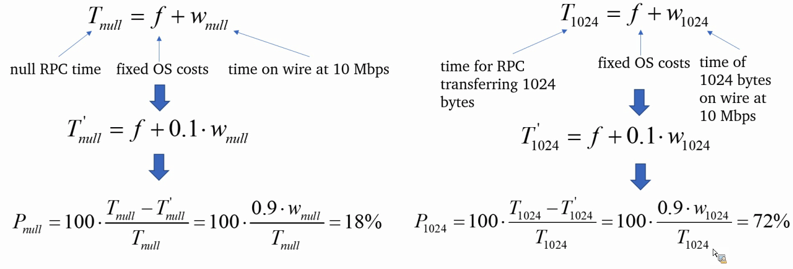
Exercise 7.16
Network transmission time accounts for 20% of a null RPC and 80% of an RPC that transmits 1024 user bytes (less than the size of a network packet). By what percentage will the times for these two operations improve if the network is upgraded from 10 megabits/second to 100 megabits/second? page 305
Instructor’s Guide for Coulouris, Dollimore, Kindberg and Blair, Distributed Systems: Concepts and Design Edn. 5
© Pearson Education 2012
Notes:
Null RPC time = fixed OS costs + time on wire at 10 Mbps
-----------
Tnull = null RPC time = f + wnull, where f = fixed OS costs, wnull = time on wire at 10 megabits-per-second.
Similarly, T1024 = time for RPC transferring 1024 bytes = f + w1024.
Let T'null and T'1024 be the corresponding figures at 100 megabits per second. Then
T'null = f + 0.1wnull, and T'1024 = f + 0.1w1024.
Percentage change for the null RPC = 100(Tnull - T'null)/Tnull = 100*0.9wnull /Tnull = 90*0.2 = 18%.
Similarly, percentage change for 1024-byte RPC = 100*0.9*0.8 = 72%.

Slide 104
Exercise 7.17
A ‘null’ RMI that takes no parameters, calls an empty procedure and returns no values delays the caller for 2.0 milliseconds. Explain what contributes to this time.
In the same RMI system, each 1K of user data adds an extra 1.5 milliseconds. A client wishes to fetch 32K of data from a file server. Should it use one 32K RMI or 32 1K RMIs? page 305
Instructor’s Guide for Coulouris, Dollimore, Kindberg and Blair, Distributed Systems: Concepts and Design Edn. 5
© Pearson Education 2012
Notes:
Null RMI’s execution involves an exchange of messages carrying some system data but no user data.
One 32K RMI: total delay is 2 + 32*1.5 = 50 ms.
32 1K RMIs: total delay is 32*(2 + 1.5) = 112 ms – one RMI is much cheaper.
-------------
Page 236 details the costs that make up the delay of a null RMI.
one 32K RMI: total delay is 2 + 32*1.5 = 50 ms.
32 1K RMIs: total delay is 32(2+1.5) = 112 ms -- one RMI is much cheaper.

Slide 105
Exercise 7.18
Which factors identified in the cost of a remote invocation also feature in message passing?
page 308
Instructor’s Guide for Coulouris, Dollimore, Kindberg and Blair, Distributed Systems: Concepts and Design Edn. 5
© Pearson Education 2012
Notes:
Most remote invocation costs also feature in message passing.
If a sender uses asynchronous message passing then it is not delayed by scheduling, data copying at the receiver, or waiting for acknowledgements.

Slide 106
Exercise 7.19
Explain how a shared region could be used for a process to read data written by the kernel. Include in your explanation what would be necessary for synchronization.
page 308
Instructor’s Guide for Coulouris, Dollimore, Kindberg and Blair, Distributed Systems: Concepts and Design Edn. 5
© Pearson Education 2012
Notes:
The shared region is mapped read-only into the process’s address space, but is writable by the kernel.
The process reads data from the region using standard LOAD instructions (avoiding a TRAP). The process may poll the data in the region from time to time to see if it has changed.
Let the kernel to notify the process when it has written new data – a software interrupt can be used for this purpose.

Slide 107
Exercise 7.20
i) Can a server invoked by lightweight procedure calls control the degree of concurrency within it?
ii) Explain why and how a client is prevented from calling arbitrary code within a server under lightweight RPC.
iii) Does LRPC expose clients and servers to greater risks of mutual interference than conventional RPC (given the sharing of memory)?
page 309
Instructor’s Guide for Coulouris, Dollimore, Kindberg and Blair, Distributed Systems: Concepts and Design Edn. 5
© Pearson Education 2012
Notes:
A server using LRPC does not explicitly create and manage threads, but it can control the degree of concurrency within it by using semaphores within the operations that it exports.
The kernel ensures that only valid procedures are called when it mediates the thread’s upcall into the server.
Threads within servers should therefore copy all arguments into a private region before attempting to validate and use them. Otherwise, a server’s data is entirely protected by the LRPC invocation mechanism.
---------
i) Although a server using LRPC does not explicitly create and manage threads, it can control the degree of
concurrency within it by using semaphores within the operations that it exports.
ii) A client must not be allowed to call arbitrary code within the server, since it could corrupt the server’s data.
The kernel ensures that only valid procedures are called when it mediates the thread’s upcall into the server,
as explained in Section 6.5.
iii) In principle, a client thread could modify a call’s arguments on the A-stack, while another of the client’s
threads, executing within the server, reads these arguments. Threads within servers should therefore copy all
arguments into a private region before attempting to validate and use them. Otherwise, a server’s data is
entirely protected by the LRPC invocation mechanism.

Slide 108
Exercise 7.21
A client makes RMIs to a server. The client takes 5 ms to compute the arguments for each request, and the server takes 10ms to process each request. The local OS processing time for each send or receive operation is 0.5 ms, and the network time to transmit each request or reply message is 3 ms. Marshalling or unmarshalling takes 0.5 ms per message.
Estimate the time taken by the client to generate and return from 2 requests (i) if it is single-threaded, and (ii) if it has two threads which can make requests concurrently on a single processor. Is there a need for asynchronous RMI if processes are multi-threaded?
page 311
Instructor’s Guide for Coulouris, Dollimore, Kindberg and Blair, Distributed Systems: Concepts and Design Edn. 5
© Pearson Education 2012
Notes:
------------
(i) Single-threaded time: 2(5 (prepare) + 4(0.5 (marsh/unmarsh) + 0.5 (local OS)) + 2*3 (net)) + 10 (serv))
= 50 ms.
(ii) Two-threaded time: (see figure 6.14) because of the overlap, the total is that of the time for the first
operation’s request message to reach the server, for the server to perform all processing of both request and
reply messages without interruption, and for the second operation’s reply message to reach the client.
This is: 5 + (0.5+0.5+3) + (0.5+0.5+10+0.5+0.5) + (0.5+0.5+10+0.5+0.5) + (3 + 0.5+0.5)
= 37ms.

Slide 109
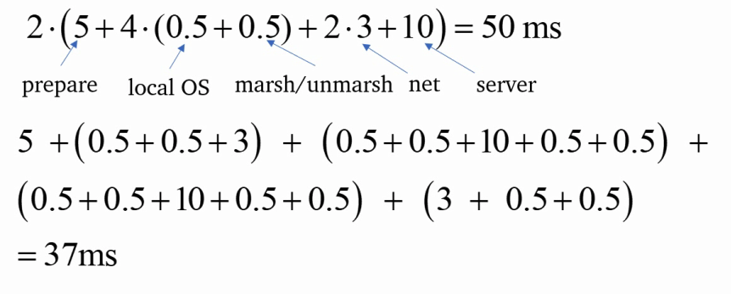
Exercise 7.21
A client makes RMIs to a server. The client takes 5 ms to compute the arguments for each request, and the server takes 10ms to process each request. The local OS processing time for each send or receive operation is 0.5 ms, and the network time to transmit each request or reply message is 3 ms. Marshalling or unmarshalling takes 0.5 ms per message.
Estimate the time taken by the client to generate and return from 2 requests (i) if it is single-threaded, and (ii) if it has two threads which can make requests concurrently on a single processor. Is there a need for asynchronous RMI if processes are multi-threaded?
page 311
Instructor’s Guide for Coulouris, Dollimore, Kindberg and Blair, Distributed Systems: Concepts and Design Edn. 5
© Pearson Education 2012
Notes:
See next page
------------
(i) Single-threaded time: 2(5 (prepare) + 4(0.5 (marsh/unmarsh) + 0.5 (local OS)) + 2*3 (net)) + 10 (serv))
= 50 ms.
(ii) Two-threaded time: (see figure 6.14) because of the overlap, the total is that of the time for the first
operation’s request message to reach the server, for the server to perform all processing of both request and
reply messages without interruption, and for the second operation’s reply message to reach the client.
This is: 5 + (0.5+0.5+3) + (0.5+0.5+10+0.5+0.5) + (0.5+0.5+10+0.5+0.5) + (3 + 0.5+0.5)
= 37ms.

Slide 110
Exercise 7.22
Explain what is security policy and what are the corresponding mechanisms in the case of a multi-user operating system such as UNIX.
page 314
Instructor’s Guide for Coulouris, Dollimore, Kindberg and Blair, Distributed Systems: Concepts and Design Edn. 5
© Pearson Education 2012
Notes:
Policy concerns the application of these mechanisms by a particular user or in a particular working environment.
For example, the default access permissions on new files might be “rw------” in the case of an environment in which security is a high priority, and “rw-r—r—” where sharing is encouraged.

Slide 111
Exercise 7.23
Explain the program linkage requirements that must be met if a server is to be dynamically loaded into the kernel’s address space, and how these differ from the case of executing a server at user level. page 315
Instructor’s Guide for Coulouris, Dollimore, Kindberg and Blair, Distributed Systems: Concepts and Design Edn. 5
© Pearson Education 2012
Notes:
Portions of the kernel’s address space must be allocated for the new code and data. Symbols within the new code and data must be resolved to items in the kernel’s address space. For example, it could use the kernel’s message-handling functions.
By contrast, if the server was to execute as a separate process then it would run from a standard address in its own address space and, apart from references to shared libraries, its linked image would be self-contained.
Libstdc++-static and glibc-static: two libraries need to be installed to statically link C/C++ code

Slide 112
Exercise 7.24
How could an interrupt be communicated to a user-level server?
page 317
Instructor’s Guide for Coulouris, Dollimore, Kindberg and Blair, Distributed Systems: Concepts and Design Edn. 5
© Pearson Education 2012
Notes:
The interrupt handler creates a message and sends it, using a special non-blocking primitive, to a pre-determined port which the user-level server owns.

Slide 113
Exercise 7.25
On a certain computer we estimate that, regardless of the OS it runs, thread scheduling costs about 50 microsec, a null procedure call 1 millisec, a context switch to the kernel 20 microsec and a domain transition 40 microsec. For each of Mach and SPIN, estimate the cost to a client of calling a dynamically loaded null procedure. page 317
Instructor’s Guide for Coulouris, Dollimore, Kindberg and Blair, Distributed Systems: Concepts and Design Edn. 5
© Pearson Education 2012
Notes:
By default, Mach runs dynamically loaded in a separate address space.
Invoking the code involves control transfer to a thread in a separate address space. – involves four (context switch + domain transitions) to and from the kernel and two scheduling's (client to server thread and server thread to client thread) – in addition to the null procedure itself.
Estimated cost 4(20+40) + 2*50 + 1 = 341 μs
In SPIN, the call involve two (context switch + domain transitions) and no thread scheduling.
Estimated cost: 2(20 + 40) + 1 = 121 μs.
-----------
Mach, by default, runs dynamically loaded code in a separate address space. So invoking the code involves
control transfer to a thread in a separate address space. This involves four (context switch + domain transitions)
to and from the kernel as well as two schedulings (client to server thread and server thread to client thread) --
in addition to the null procedure itself.
Estimated cost: 4(20 + 40) + 2*50 + 1 = 341 μs
In SPIN, the call involve two (context switch + domain transitions) and no thread scheduling.
Estimated cost: 2(20 + 40) + 1 = 121 μs.

Slide 114
Exercise 7.26
What is the distinction between the virtualization approach advocated by Xen and the style of microkernel advocated by the Exokernel project? In your answer, highlight two things they have in common and two distinguishing characteristics between the approaches. pages 317, 320
Instructor’s Guide for Coulouris, Dollimore, Kindberg and Blair, Distributed Systems: Concepts and Design Edn. 5
© Pearson Education 2012
Notes:
Both are examples of virtualization – offering abstraction over the underlying hardware
Both support the coexistence of a number of virtual machines on one physical architecture
They operate at different levels though
System virtualization is concerned with providing virtualization over the hardware, preserving the interface as provided by the hardware.
Microkernels provide a much higher level of abstraction based on offering (typically policy neutral) operating system services (for example address spaces, threads and interprocesses communication on a single machine).
System virtualization focuses on extremely lightweight implementation.
The use cases are also quite different
For example managing the mapping of services to virtual machines in server farms (exploiting the ability of migrate virtual images).
--------------
Both approaches are examples of virtualization in the general sense of the word, offering abstraction over the
underlying hardware.
They also both support the coexistence of a number of virtual machines on one physical architecture (and
also the necessary isolation between instances), through domains in the case of virtualization and operating
system emulations in the case of microkernels.
They do operate at different levels though. System virtualization is concerned with providing
virtualization over the hardware, preserving the interface as provided by the hardware. In contrast,
microkernels provide a much higher level of abstraction based on offering (typically policy neutral) operating
system services (for example address spaces, threads and interprocess communication on a single machine).
The emphasis in system virtualization is on extremely lightweight implementation, hence the interest in
techniques such as paravirtualization, and hence system virtualization can support potentially very large
numbers of virtual machines compared to the microkernel approach.
The use cases of system virtualization are also quite different, for example managing the mapping of
services to virtual machines in server farms (exploiting the ability to migrate virtual images).

Slide 115
Exercise 7.27
Sketch out in pseudo-code how you would add a simple round robin scheduler to the Xen hypervisor using the framework discussed in Section 7.7.2. page 323
Instructor’s Guide for Coulouris, Dollimore, Kindberg and Blair, Distributed Systems: Concepts and Design Edn. 5
© Pearson Education 2012
Notes:
Define an abstract interface including operations to
Initialize the scheduler,
Initialize and destroy a domain,
Initialize and destroy a VCPU
Sleep, wake and a call to determine the next VCPU to be scheduled (do_schedule);
Create a data structure (struct Scheduler) that contains the full name, short name and ID for this scheduler together with pointers to the above functions;
Add this to a static array of schedulers with the user able to specify the scheduler to be used at boot time.
struct scheduler sched_simpleRR_def = {
.name = "Simple Round Robin Scheduler",
.opt_name = "simpleRR",
.sched_id = 7,
.init_vcpu = simple_vcpu_init,
.destroy_vcpu = simple_vcpu_destroy,
.do_schedule = simple_schedule,
};
simple_vcpu_init (struct vcpu *v)
{
<insert the new VCPU, v, into the linked list>
}
simple_vcpu_destroy (struct vcpu *v)
{
<remove the VCPU, v, from the linked list>
}
simple_do_schedule ()
{
<traverse the linked list and select the first runnable VCPU>
<move the head to the tail>
};
---------
In order to answer this question, it is first necessary to appreciate the steps required to implement a new
scheduler (as discussed in Chisnall [2007]).
To introduce anew scheduler, the following steps must be carried out:
• Provide an implementation of various functions defined in an abstract interface, with these functions
including operations to initialise the scheduler, initialise and destroy a domain, initialise and destroy a
VCPU, sleep, wake and a call to determine the next VCPU to be scheduled (do_schedule);
Distributed Systems, Edition 5: Chapter 7 Solutions (OSS).fm 8
Last updated: 12 October 2011 ©George Coulouris, Jean Dollimore, Tim Kindberg and Gordon Blair 2012
• Create a data structure (struct Scheduler) that contains the full name, short name and ID for this
scheduler together with pointers to the above functions (for some schedulers certain functions can be
NULL);
• Add this to a static array of schedulers with the user able to specify the scheduler to be used at boot time.
As an example, the following is a minimal specification of a simple scheduler, where simple_vcpu_init,
simple_vcpu_destroy and simple_schedule are implementations of the respective functions:
struct scheduler sched_simpleRR_def = {
.name = "Simple Round Robin Scheduler",
.opt_name = "simpleRR",
.sched_id = 7,
.init_vcpu = simple_vcpu_init,
.destroy_vcpu = simple_vcpu_destroy,
.do_schedule = simple_schedule,
};
It is then necessary to implement the three functions above. Let us first assume the existence of a singly linked
list of VCPUs. The pseudo code for the three functions is then as follows
simple_vcpu_init (struct vcpu *v)
{
<insert the new VCPU, v, into the linked list>
}
simple_vcpu_destroy (struct vcpu *v)
{
<remove the VCPU, v, from the linked list>
}
simple_do_schedule ()
{
<traverse the linked list and select the first runnable VCPU>
<move the head to the tail>
};

Slide 116
Exercise 7.28
From your understanding of the Xen approach to virtualization, discuss specific features of Xen that can support the XenoServer architecture, thus illustrating the synergy between virtualization and cloud computing. pages 320, 330
Instructor’s Guide for Coulouris, Dollimore, Kindberg and Blair, Distributed Systems: Concepts and Design Edn. 5
© Pearson Education 2012
Notes:
The XenoServer architecture supports the discovery and use of XenoServers or indeed more sophisticated servers or cluster of servers with a given level of connectivity. The architecture therefore promotes a view of everything as a service as in cloud computing.
Using Xen, the mapping of XenoServers to physical hardware can be managed. More generally, the use of virtualization in could computing supports the provision of infrastructure as a service by providing access to virtual rather than physical machines.
Paper on moodle: “Xen and the Art of Virtualization”, In Proc. Of SOSP ‘03.
--------------
As explained in Section 7.7.2, the XenoServer architecture supports the discovery and use of XenoServers or
indeed more sophisticated servers or cluster of servers with a given level of connectivity. The architecture
therefore promotes a view of everything as a service as in cloud computing. Through using Xen, the mapping
of XenoServers to physical hardware can be managed. More generally, the use of virtualization in cloud
computing supports the provision of infrastructure as a service by providing access to virtual rather than
physical machines.

Slide 117
Exercises for Chapter 8:
Distributed Objects and Components
From Coulouris, Dollimore, Kindberg and Blair
Distributed Systems:
Concepts and Design
Edition 5, © Addison-Wesley 2012

Slide 118
Exercise 8.1
The Task Bag is an object that stores (key, value) pairs . A key is a string and a value is a sequence of bytes. Its interface provides the following remote methods:
pairOut, with two parameters through which the client specifies a key and a value to be stored.
pairIn, whose first parameter allows the client to specify the key of a pair to be removed from the Task Bag. The value in the pair is supplied to the client via a second parameter. If no matching pair is available, an exception is thrown.
readPair, which is the same as pairIn except that the pair remains in the Task Bag.
Use CORBA IDL to define the interface of the Task Bag. Define an exception that can
be thrown whenever any one of the operations cannot be carried out. Your exception
should return an integer indicating the problem number and a string describing the
problem. The Task Bag interface should define a single attribute giving the number of
tasks in the bag.
page 341
Instructor’s Guide for Coulouris, Dollimore, Kindberg and Blair, Distributed Systems: Concepts and Design Edn. 5
© Pearson Education 2012
Notes:
Typedef string Key;
Typedef sequence<octet> Value;
Interface TaskBag {
readonly attribute long numberOfTasks;
exception TaskBagException {long id; string reason};
void pairOut (in Key key, in Value value) raises (TaskBagException);
void pairIn (in Key key, out Value value) raises (TaskBagException);
void readPair (in Key key, out Value value) raises (TaskBagException);
};

Slide 119
Exercise 8.2
Define an alternative signature for the methods pairIn and readPair, whose return value indicates when no matching pair is available. The return value should be defined as an enumerated type whose values can be ok and wait. Discuss the relative merits of the two alternative approaches. Which approach would you use to indicate an error such as a key that contains illegal characters?
page 342
Instructor’s Guide for Coulouris, Dollimore, Kindberg and Blair, Distributed Systems: Concepts and Design Edn. 5
© Pearson Education 2012
Notes:
Enum status {ok, wait};
Status pairIn (in Key key, out value value);
Status readPair (in Key key, out Value value);
Which is generally more complex for a programmer to deal with? An exception or an ordinary return? – Exceptions break the normal flow of control
It is better to use an exception for the key containing illegal characters
It is an error ( and presumably an unusual occurrence)
Exception can supply additional information about the error

Slide 120
Exercise 8.3
Which of the methods in the Task Bag interface could have been defined as a oneway operation? Give a general rule regarding the parameters and exceptions of oneway methods. In what way does the meaning of the oneway keyword differ from the remainder of IDL?
page 342
Instructor’s Guide for Coulouris, Dollimore, Kindberg and Blair, Distributed Systems: Concepts and Design Edn. 5
© Pearson Education 2012
Notes:
A oneway operation cannot have out or inout parameters
It must raise an exception because there is no reply message
No information can be sent back to the client
The pairOut method might be made one way
If its exception was not needed, e.g., if the server guarantees to store every pair sent to it.
General rule
Return value is void
No out or inout parameters
No user-defined exceptions
Oneway is used to specify the required quality of delivery

Slide 121
Exercise 8.4
The IDL union type can be used for a parameter that will need to pass one of a small number of types. Use it to define the type of a parameter that is sometimes empty and sometimes has the type Value.
page 345
Instructor’s Guide for Coulouris, Dollimore, Kindberg and Blair, Distributed Systems: Concepts and Design Edn. 5
© Pearson Education 2012
Notes:
Union ValueIOption switch (Boolean) {
Case TRUE: Value value;
};
When the value of the tag is TRUE, a Value is passed. When it is FALSE, only the tag is passed.

Slide 122
Exercise 8.5
In Figure 8.2 the type All was defined as a sequence of fixed length. Redefine this as an array of the same length. Give some recommendations as to the choice between arrays and sequences in an IDL interface.
page 345
Instructor’s Guide for Coulouris, Dollimore, Kindberg and Blair, Distributed Systems: Concepts and Design Edn. 5
© Pearson Education 2012
Notes:
Figure 8.2:
IDL interfaces Shape and ShapeList
struct Rectangle{ 1
long width;
long height;
long x;
long y;
};
struct GraphicalObject { 2
string type;
Rectangle enclosing;
boolean isFilled;
};
interface Shape { 3
long getVersion();
GraphicalObject getAllState(); // returns state of the GraphicalObject
};
typedef sequence <Shape, 100> All; 4
interface ShapeList { 5
exception FullException{ }; 6
Shape newShape(in GraphicalObject g) raises (FullException); 7
All allShapes(); // returns sequence of remote object references 8
long getVersion();
};
See next page.
Typedef shape ALL[100];
Recommendations
If a fixed length structure then use an array
If variable length structure then use a sequence
If you need to embed data within data, then use a sequence because one may be embedded in another
If your data is sparse over its index, it may be better to use a sequence of <index, value> pairs

Slide 123
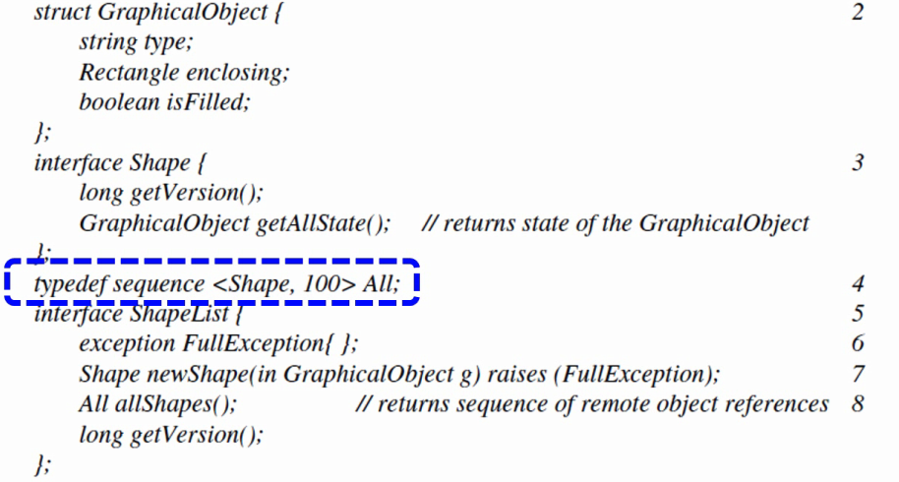
Exercise 8.5
In Figure 8.2 the type All was defined as a sequence of fixed length. Redefine this as an array of the same length. Give some recommendations as to the choice between arrays and sequences in an IDL interface.
page 345
Instructor’s Guide for Coulouris, Dollimore, Kindberg and Blair, Distributed Systems: Concepts and Design Edn. 5
© Pearson Education 2012

Slide 124
Exercise 8.6
The Task Bag is intended to be used by cooperating clients, some of which add pairs (describing tasks) and others of which remove them (and carry out the tasks described). When a client is informed that no matching pair is available, it cannot continue with its work until a pair becomes available. Define an appropriate callback interface for use in this situation.
page 357
Instructor’s Guide for Coulouris, Dollimore, Kindberg and Blair, Distributed Systems: Concepts and Design Edn. 5
© Pearson Education 2012
Notes:
This callback can send the value required by a readPair or pairIn operation. Its method should not be a oneway as the client depends on receiving it to continue its work.
Interface TaskBagCallback {
void data (in Value value);
}

Slide 125
Exercise 8.7
Describe the necessary modifications to the Task Bag interface to allow callbacks to be used.
page 357
Instructor’s Guide for Coulouris, Dollimore, Kindberg and Blair, Distributed Systems: Concepts and Design Edn. 5
© Pearson Education 2012
Notes:
The server must allow each client to register its interest in receiving callbacks and possibly also deregister.
These operations may be added to the TaskBag interface or to a separate interface implemented by the server.
Int register (in TaskBagCallback callback);
Void deregister (in int callbackId);

Slide 126
Exercise 8.8
Which of the parameters of the methods in the Task Bag interface are passed by value and which are passed by reference?
page 343
Instructor’s Guide for Coulouris, Dollimore, Kindberg and Blair, Distributed Systems: Concepts and Design Edn. 5
© Pearson Education 2012
Notes:
In the original interface, all of the parameters are passed by value.
The parameter of register is passed by reference. (and that of deregister by value)

Slide 127
Exercise 8.9
Use the Java IDL compiler to process the interface you defined in Exercise 8.1. Inspect the definition of the signatures for the methods pairIn and readPair in the generated Java equivalent of the IDL interface. Look also at the generated definition of the holder method for the value argument for the methods pairIn and readPair. Now give an example showing how the client will invoke the pairIn method, explaining how it will acquire the value returned via the second argument.
page 346
Instructor’s Guide for Coulouris, Dollimore, Kindberg and Blair, Distributed Systems: Concepts and Design Edn. 5
© Pearson Education 2012
Notes:
The java interface is
Public interface TaskBag extends org.omg.CORBA.Object {
void pairOut (in Key p, in Value value);
void pairIn (in Key p, out ValueHolder value);
void readPair (in Key p, out ValueHolder value);
int numberOfTasks();
}
The class ValueHolder has an instance variable
public Value value;
and a constructor
public ValueHolder (Value __arg) {
value = __arg;
}
The client must first get a remote object reference to the TaskBag, probably via the naming service.
…
TaskBag taskBagRef = TaskBagHelper.narrow(taskBagRef.resolve(path));
Value aValue;
taskbagRef.pairIn(“Some key”, new ValueHolder(aValue));
The required value will be in the variable aValue.

Slide 128
Exercise 8.10
Give an example to show how a Java client will access the attribute giving the number of tasks in the Task Bag object. In what respects does an attribute differ from an instance variable of an object?
page 345
Instructor’s Guide for Coulouris, Dollimore, Kindberg and Blair, Distributed Systems: Concepts and Design Edn. 5
© Pearson Education 2012
Notes:
Assume the IDL attribute is called numberOfTasks. Then the client uses the method numberOfTasks to access this attribute. E.g.,
taskbagRef.numberOfTasks();
Attributes indicate methods that a client can invoke in a COREBA object.
Client cannot make any assumption about the storage used in the CORBA object;
An attribute may be implemented as a variable or a method calculates the result;
The client invokes a method and the server implements it.

Slide 129
Exercise 8.11
Explain why the interfaces to remote objects in general and CORBA objects in particular do not provide constructors. Explain how CORBA objects can be created in the absence of constructors.
Chapter 5 and page 355
Instructor’s Guide for Coulouris, Dollimore, Kindberg and Blair, Distributed Systems: Concepts and Design Edn. 5
© Pearson Education 2012
Notes:
A server provides an implementation and then offers its interface
More efficient
If clients were allowed to request a server to create instances of a given interface, the server would need to provide its implementation
CORBA objects can be created within the server:
The server creates an instance of the implementation class and then exports a remote object reference for accessing its methods.
A factory method crates an instance of the implementation class and then exports a remote object reference for accessing its methods.

Slide 130
Exercise 8.12
Redefine the Task Bag interface from Exercise 8.1 in IDL so that it makes use of a struct to represent a Pair, which consists of a Key and a Value. Note that there is no need to use a typedef to define a struct.
page 345
Instructor’s Guide for Coulouris, Dollimore, Kindberg and Blair, Distributed Systems: Concepts and Design Edn. 5
© Pearson Education 2012
Notes:
Typedef string Key;
Typedef sequence<octet> Value;
Struct Pair {
Key key;
Value value;
};
Interface TaskBag {
readonly attribute int numberOfTasks;
exception TaskBagException { int no; string reason; };
void pairOut (in Pair) raises (TaskBagException);
// pairIn and readPair might use the pair, or could be left unchanged
};

Slide 131
Exercise 8.13
Discuss the functions of the implementation repository from the point of view of scalability and fault tolerance.
page 350, page 351
Instructor’s Guide for Coulouris, Dollimore, Kindberg and Blair, Distributed Systems: Concepts and Design Edn. 5
© Pearson Education 2012
Notes:
An IR is used by clients to locate objects and active implementations
A remote object reference contains the address of the IR that manages its implementation
An IR is shared by clients and server within some location domain.
To improve scalability (commonly used tricks)
Several IRS can be deployed ..
Avoid unnecessary requests… (caching-like)
From the fault tolerance point of view (commonly used tricks)
An IR is a single point of failure
Replication…

Slide 132
Exercise 8.14
To what extent may CORBA objects be migrated from one server to another?
page 350, page 351
Instructor’s Guide for Coulouris, Dollimore, Kindberg and Blair, Distributed Systems: Concepts and Design Edn. 5
© Pearson Education 2012
Notes:
IR can locate and activate CORBA objects within any one of those servers – it will still be able deal with CORBA objects that migrate from one server in the group to another
The object adapter name is the key for the implementation int eh IR.
All of the objects in one server must move together to another server
This could be modified by using separate adapters…

Slide 133
Exercise 8.15
Explain carefully how component-based middleware in general and EJB in particular can overcome the key limitations of distributed object middleware. Provide examples to illustrate your answer.
page 358-364
Instructor’s Guide for Coulouris, Dollimore, Kindberg and Blair, Distributed Systems: Concepts and Design Edn. 5
© Pearson Education 2012
Notes:
Implicit dependencies
Component-based middleware get round this issue by having a complete contract with the environment (and other components) through both required and provided interfaces
EJB achieves this through the mechanism of dependency injection
Programming complexity
Components hide low level calls by management within the container abstraction
EJB does not have to deal with these complexities but still significantly simplifies lifecycle management
Lack of separation of distribution concerns
This is hidden from the programmer through the container abstraction
EJB handles this through a combination of configuration by exception and the use of annotations to declare requirements more declaratively
No support for deployment
Component technologies provide support for deployment through the packaging of components with associated architectural descriptions and deployment descriptors
In EJB, jar files fulfil this purpose

Slide 134
Exercise 8.16
Discuss whether the EJB architecture would be suitable to implement a massively multiplayer online game (an application domain initially introduced in Section 1.2.2). What would be the strengths and weaknesses of using EJB in this domain?
page 364
Instructor’s Guide for Coulouris, Dollimore, Kindberg and Blair, Distributed Systems: Concepts and Design Edn. 5
© Pearson Education 2012
Notes:
Think about what MMOGs require.. What their main features are…
The EJB architecture makes it easier to develop distributed applications by hiding much of the complexity from the programmer
MMOGs are quite a different class of application

Slide 135
Exercise 8.17
Would Fractal be a more suitable implementation choice for the MMOG domain? Justify your answer.
page 372
Instructor’s Guide for Coulouris, Dollimore, Kindberg and Blair, Distributed Systems: Concepts and Design Edn. 5
© Pearson Education 2012
Notes:
It is much more likely that a successful implementation could be achieved using Fractal than EJB.
Fractal is more lightweight and hence would lend itself to achieving good performance
It is much less prescriptive in what this offers
Allow more tailored policies to be developed, e.g., supporting weaker forms of consistency

Slide 136
Exercise 8.18
Explain how the container-based philosophy could be adopted to provide migration transparency for distributed components.
page 362, 362
Instructor’s Guide for Coulouris, Dollimore, Kindberg and Blair, Distributed Systems: Concepts and Design Edn. 5
© Pearson Education 2012
Notes:
Migration (or mobility) transparency is concerned with hiding the movement of distributed system entities from users or programmers
Containers operate by intercepting incoming invocations and making series of calls to implement the desired level of transparency before optionally passing on the invocation to the component
To implement migration transparency, a container can use a location service to map objects (or in this case components) on to physical locations (and keep track of them if they move)

Slide 137
Exercise 8.19
How would you achieve the same effect in Fractal?
page 375
Instructor’s Guide for Coulouris, Dollimore, Kindberg and Blair, Distributed Systems: Concepts and Design Edn. 5
© Pearson Education 2012
Notes:
Exactly the same effect can be achieved by using the interception mechanism as provided in controllers.
Fractal, with its open and configurable approach, also lends itself to the introduction or new levels of transparency.

Slide 138
Exercise 8.20
Consider the implementation of Java RMI as a composite binding in Fractal. Discuss the extent to which such a binding can be both configurable and reconfigurable.
Chapter 5, page 373
Instructor’s Guide for Coulouris, Dollimore, Kindberg and Blair, Distributed Systems: Concepts and Design Edn. 5
© Pearson Education 2012
Notes:
A composite binding has an associated software architecture in terms of components and bindings
Granularity of the composition can be varied
The communication module could further be broken down into different aspects
Underlying transport protocol
Leads to a more configurable and reconfigurable approach

Slide 139
Exercises for Chapter 9:
Web Services
From Coulouris, Dollimore, Kindberg and Blair
Distributed Systems:
Concepts and Design
Edition 5, © Addison-Wesley 2012

Slide 140
Exercise 9.1
Compare the request reply protocol as described in Section 5.2 with the implementation of client-server communication in SOAP. State two reasons why the use of asynchronous messages by SOAP is more appropriate for use over the Internet. To what extent does the use of HTTP by SOAP reduce the difference between the two approaches? page 388
Instructor’s Guide for Coulouris, Dollimore, Kindberg and Blair, Distributed Systems: Concepts and Design Edn. 5
© Pearson Education 2012
Notes:
SOAP = Simple Object Access Protocol
Request reply communication
Uses a synchronous request-reply exchange; passes the remote object reference of an object to be invoked
SOAP
Specifies the use of a pair of asynchronous messages; does not support remote objects
Over the internet:
SOAP uses asynchronous messages in order to reduce the closer coupling between client and server which occurs with a synchronous protocol
SOAP allows the transport of single documents
The use of HTTP enables the request and reply messages to be related to one another – the HTTP response carries the reply to a SOAP request. The method name may be specified as an action header in HTTP

Slide 141
Exercise 9.2
Compare the structure of URLs as used for web services with that of remote object references as specified in Section 4.3.4. State in each case how they are used to get a client request executed. page 393
Instructor’s Guide for Coulouris, Dollimore, Kindberg and Blair, Distributed Systems: Concepts and Design Edn. 5
© Pearson Education 2012
Notes:
A URL specifies the name of a server as a DNS name (and an optional port) and the path name of a resource managed by that server.
For a web service, the resource in the URL refers to an action to be performed by a web service.
A remote object reference contains the internet address and port of a server, time, object number and type information about the interface of a remote object.
DNS is used to convert the domain name into the internet address of a server. The client request is sent to that location where the server dispatcher selects an operation to be performed.

Slide 142
Exercise 9.3
Illustrate the contents of a SOAP Request message and corresponding Reply message in the Election service example of Exercise 5.11, using the pictorial version of XML as shown in Figure 9.4 and Figure 9.5.
Page 389.
Instructor’s Guide for Coulouris, Dollimore, Kindberg and Blair, Distributed Systems: Concepts and Design Edn. 5
© Pearson Education 2012
Notes:
An Election interface provides two remote methods:
Vote: This method has two parameters through which the client supplies the name of a candidate (a string) and the ‘voter’s number’ (an integer used to ensure each user votes once only). The voter’s numbers are allocated sparsely from the range of integers to make them hard to guess.
Result: This method has two parameters through which the server supplies the client with the name of a candidate and the number of votes for that candidate.
Which of the parameters of these two procedures are input and which are output parameters?
Env:envelope xmlns: env = namespace URI for SOAP envelopes
env:body
m:vote
xmlns:m = namespace URI of the service description
m:arg1 m:arg2
Jame Tory 928374521
Env:envelope xmlns:env = namespace URI for SOAP envelop
env:body
m:exchangeResponse
xmlns:m = namespace URI for the service description
m:res1 m:res2
Jack Lab 15,900
See next page

Slide 143
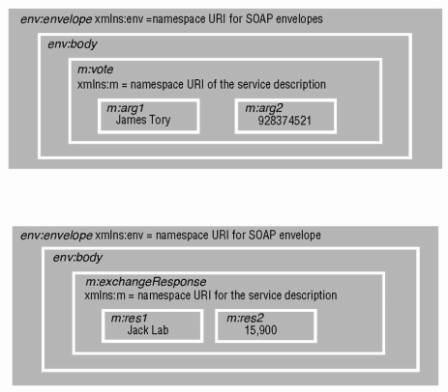
Exercise 9.3
Illustrate the contents of a SOAP Request message and corresponding Reply message in the Election service example of Exercise 5.11, using the pictorial version of XML as shown in Figure 9.4 and Figure 9.5.
Page 389.
Instructor’s Guide for Coulouris, Dollimore, Kindberg and Blair, Distributed Systems: Concepts and Design Edn. 5
© Pearson Education 2012

Slide 144
Exercise 9.4
Outline the five main elements of a WSDL service description. In the case of the Election service defined in Question 5.1, state the type of information to be used by the request and reply messages – does any of this need to be included in the target namespace? For the vote operation, draw diagrams similar to Figure 9.11 and Figure 9.13.
page 402
Instructor’s Guide for Coulouris, Dollimore, Kindberg and Blair, Distributed Systems: Concepts and Design Edn. 5
© Pearson Education 2012
Notes:
Five main elements of a WSDL service: type, message, interface, bindings, and services.
Message name = “votemsg”
part name = “candname”
type = “string”
part name = “number”
type = “int”
Operation name = “vote”
pattern = In-Only
input message = “tns: votemsg”
See next page

Slide 145
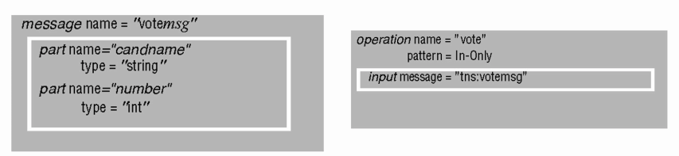
Exercise 9.4
Outline the five main elements of a WSDL service description. In the case of the Election service defined in Question 5.1, state the type of information to be used by the request and reply messages – does any of this need to be included in the target namespace? For the vote operation, draw diagrams similar to Figure 9.11 and Figure 9.13.
page 402
Instructor’s Guide for Coulouris, Dollimore, Kindberg and Blair, Distributed Systems: Concepts and Design Edn. 5
© Pearson Education 2012

Slide 146
Exercise 9.5
Continuing with the example of the Election service, explain why the part of the WSDL defined in Question 9.4 is referred to as ‘abstract’. What would need to be added to the service description to make it completely concrete? page 400
Instructor’s Guide for Coulouris, Dollimore, Kindberg and Blair, Distributed Systems: Concepts and Design Edn. 5
© Pearson Education 2012
Notes:
The part defined so far is abstract – no details have been given
i) as to what particular communication or transport protocols are to be used
II) as to the location of the server
To make it concrete
WSDL has to specify the protocols in use, for example SOAP with HTTP
This can be done in a WSDL binding element
Also has to specify the address of the server, for example, in a WSDL service element.

Slide 147
Exercise 9.6
Define a Java interface for the Election service suitable for use as a web service. State why you think the interface you defined is suitable. Explain how a WSDL document for the service is generated and how it is made available to clients.
page 396
Instructor’s Guide for Coulouris, Dollimore, Kindberg and Blair, Distributed Systems: Concepts and Design Edn. 5
© Pearson Education 2012
Notes:
The interface to the service is defined as a Java class.
We need to define a class for the result e.g.
Class Result {
String name;
Int votes;
}
The interface is:
Import java.rmi.*;
public interface Election extends Remote {
void vote (String name, int number) throws RemoteException;
Result result () throws RemoteException;
};
This is suitable because it does not pass values of Remote as arguments or results;
The tool wscompile is used to generate a WSDL document describing the service from the above interface. When the service is deployed, this document is installed in the servlet container from whence clients may get it.

Slide 148
Exercise 9.7
Describe the contents of a Java client proxy for the Election service. Explain how the appropriate marshalling and unmarshalling methods can be obtained for a static proxy. page 396
Instructor’s Guide for Coulouris, Dollimore, Kindberg and Blair, Distributed Systems: Concepts and Design Edn. 5
© Pearson Education 2012
Notes:
The proxy must contain the URL of the server for the Election service.
It contains one method for vote and another for result.
Each of these methods marshalls its own method name and its arguments into a SOAP request envelope. When the reply arrives it is unmarshalled by extracting the results from the XML envelope.
The client obtains the WSDL document containing the service description and uses wscompile to generate the methods sin the proxy.

Slide 149
Exercise 9.8
Explain the role of a servlet container in the deploying of a web service and the execution of a client request. page 396
Instructor’s Guide for Coulouris, Dollimore, Kindberg and Blair, Distributed Systems: Concepts and Design Edn. 5
© Pearson Education 2012
Notes:
When the service is created
Wsdeploye creates the skeleton (or tie) classes from the service implementation
When the service is deployed in a servlet container
It is suppplied with the servlet name and WSDL description, its class and skeleton classes
The WSDL contains the URL of the end point.
Client SOAP request…
Addressed to the URL of the service
A dispatcher uses the name of the method in the Action header to locate the appropriate skeleton.
When the result is returned
It translates theses back into a SOAP reply message.

Slide 150
Exercise 9.9
In the Java example illustrated in Figure 9.8 and Figure 9.9, both client and server are dealing with objects, although web services do not support distributed objects. How can this be the case? What are the limitations imposed on the interfaces of Java web services? page 395
Instructor’s Guide for Coulouris, Dollimore, Kindberg and Blair, Distributed Systems: Concepts and Design Edn. 5
© Pearson Education 2012
Notes:
In this example, the objects exchanged by client and server are of class GraphicalObject.
The SOAP requests and replies deal with an XML representation of a structure with the same fields, but no methods.
Limitations – no passing of remote references and no factory methods.

Slide 151
Exercise 9.10
Outline the replication scheme used in UDDI. Supposing that vector timestamps are used to support this scheme, define a pair of operations for use by registries needing to exchange data.
page 406
Instructor’s Guide for Coulouris, Dollimore, Kindberg and Blair, Distributed Systems: Concepts and Design Edn. 5
© Pearson Education 2012
Notes:
Universal Description Discovery Integration
The members of a registry propagate copies of data structures to one another as follows:
a server that has made changes notifies the other servers in the registry, which then request the changes.
1. all changes to a particular data structure are made at the same server;
2. updates from a particular server are received in sequential order by the other members, but no particular ordering is imposed between update operations made by different servers.
Call the vector timestamp V, then the operations are
notify(Id of registry, V)
a UDDI server uses this operation to inform another that it has new updates to data structures. The recipient compares the vector V with its own vector timestamp.
get(V)-> sequences of updates
a UDDI server uses this operation to requests another server to send it updates it needs. The argument is that server's vector timestamp. The recipient uses V to determine which updates the requester requires before returning them.

Slide 152
Exercise 9.11
Explain why UDDI can be described as being both a name service and a directory service, mentioning the types of enquiries that can be made. The second ‘D’ in the name UDDI refers to ‘discovery’ – is UDDI really a discovery service? Chapter 13 and page 404
Instructor’s Guide for Coulouris, Dollimore, Kindberg and Blair, Distributed Systems: Concepts and Design Edn. 5
© Pearson Education 2012
Notes:
A white pages (name) service – it holds lists of organizations enabling clients to look up a service against an organization;
A yellow pages (directory) service – it allows clients to look up services by category or by interface;
Information can also be looked up by a key which is a sort of URI.
A discovery service is a directory service that is designed to register the services provided in a spontaneous networking environment. It allows the set of clients and services to change dynamically without user intervention. UDDI does not do those things.

Slide 153
Exercise 9.12
Outline the main difference between TLS and XML security. Explain why XML is particularly suitable for the role it plays, in terms of these differences.
Chapter 11 and page 406
Instructor’s Guide for Coulouris, Dollimore, Kindberg and Blair, Distributed Systems: Concepts and Design Edn. 5
© Pearson Education 2012
Notes:
The main difference between TLS and XML security:
TLS provides a means for the secure transmission of information
XML security applies the security measures to documents
XML is a self-defining format
Enabling security to be applied within a document
Extensible, allowing security measures to be added as requirements evolve

Slide 154
Exercise 9.13
Documents protected by XML security may be signed or encrypted long before anyone can predict who will be the ultimate recipients. What measures are taken to ensure that the latter have access to the algorithms used by the former? page 406
Instructor’s Guide for Coulouris, Dollimore, Kindberg and Blair, Distributed Systems: Concepts and Design Edn. 5
© Pearson Education 2012
Notes:
The algorithms used are specified within the XML document itself, so that recipients know which one was
used for a particular task,
e.g encryption or digital signing.
In addition, the standard states the algorithms that must be available to any implementation of XML encryption and XML digital signature.
The creator of such documents should be sure to use one of the standard algorithms.

Slide 155
Exercise 9.14
Explain the relevance of canonical XML to digital signatures. What contextual information can be included in the canonical form? Give an example of a breach of security where the context is omitted from canonical form. page 409
Instructor’s Guide for Coulouris, Dollimore, Kindberg and Blair, Distributed Systems: Concepts and Design Edn. 5
© Pearson Education 2012
Notes:
Digital signatures are used to ensure that the information content has not changed since the document was digitally signed.
The signature is initially generated using a digest calculation based on the canonical form of the document, which eliminates insignificant differences. After its transmission, the receiving application applies the same algorithm to the document, producing another digest of the canonical form, and the two digests are compared. If they differ, it means the canonical forms differ, so the document must have been altered since it was signed.
The contextual information consists of all of the namespaces declared and the values of attributes that surround a particular XML element. The inclusion of context in canonical XML ensures that the particular element cannot be used out of context - or in a different context.
If the context is omitted, the canonicalized element can be placed in a different context.
For example, the value of an attribute in the context may be crucial to the document being signed. It might for example, be an exchange rate.

Slide 156
Exercise 9.15
A coordination protocol could be carried out in order to coordinate the actions of web services. Outline an architecture for (i) a centralized and (ii) a distributed coordination protocol. In each case, describe the interactions needed to establish coordination between a pair of web services. page 411
Instructor’s Guide for Coulouris, Dollimore, Kindberg and Blair, Distributed Systems: Concepts and Design Edn. 5
© Pearson Education 2012
Notes:
Centralized coordination. -- A particular server would play the role of coordinator and the web services that require coordination would send their coordination messages to the coordinator, rather like the protocol used.
In distributed coordination, -- each participating web service would have a local coordinator that it communicates with and the set of local coordinators would communicate amongst them selves.

Slide 157
Exercise 9.16
Compare RPC call semantics with the semantics of WS-ReliableMessaging:
i) State the entities to which each refers.
ii) Compare the differing meanings of the available semantics (for example, at-least-once, at-most-once, exactly-once).
Chapter 5 and page 39.
Instructor’s Guide for Coulouris, Dollimore, Kindberg and Blair, Distributed Systems: Concepts and Design Edn. 5
© Pearson Education 2012
Notes:
In WS-ReliableMessaging, there is a message exchange between and application source and an application destination and the goal is to provide a given semantics over this message delivery. The semantics are as follows:
At-least-once: The message is delivered at least once (with possible duplicate messages), but an error is reported if it cannot be delivered.
At-most-once: The message is delivered at most once (with no duplicate messages, but without any error report if it cannot be delivered.
Exactly-once: The message is delivered exactly once, but an error is reported if it cannot be delivered.
In RPC call semantics, there is a two way interaction between the client and the server with the client sending a request, the server executing the (remote) procedure and the server sending a reply
back to the client. The semantics are defined over this complete path and not just the delivery of the initial message (the request):
At-least-once: The client receives a result, in which case the requested procedure is executed at least once (with possible duplicate executions), or receives an error, with no result obtained.
At-most-once: The client receives a result, in which case the requested procedure is executed at most once (no duplicates, but possible failure in executing the procedure), or receives an error, with no result obtained.
Exactly-once: The client receives a result, in which case the requested procedure is executed exactly once (no duplicates, and no failure part way through), or receives an error, with no result obtained.

Slide 158
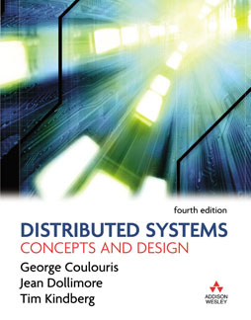
Exercises for Chapter 19:
Mobile and Ubiquitous Computing
From Coulouris, Dollimore and Kindberg
Distributed Systems:
Concepts and Design
Edition 4, © Pearson Education 2005

Slide 159
Exercise 16.1
What is a volatile system? List the main types of changes that occur in a ubiquitous system.
Instructor’s Guide for Coulouris, Dollimore and Kindberg Distributed Systems: Concepts and Design Edn. 4
© Pearson Education 2005
Notes:
A volatile system is one in which certain types of change are the rule (i.e., they commonly happen) rather than the exception
Devices may fail, e.g., due to battery failure
Users may bring devices in and take them out again
Connectivity between devices may also change
Due to the way ubiquitous systems are integrated with physical objects that may affect wireless transmission.

Slide 160
Exercise 16.2
Discuss whether it is possible to improve upon the ‘pull’ model of service discovery by multicasting (or broadcasting) and caching replies to queries.
Instructor’s Guide for Coulouris, Dollimore and Kindberg Distributed Systems: Concepts and Design Edn. 4
© Pearson Education 2005
Notes:
What is a pull model? And what is a push model?
With multicasting (or broadcasting)
All potential client devices can then hear and cache the service advertisements…
Other potential clients may now learn about those services’ existence
Only services not in the query need reply
The hybrid scheme needs validation through simulation or experimentation
The extra multicasts incur a cost.

Slide 161
Exercise 16.3
Explain the use of leases in a discovery service to cope with the problem of service volatility.
Instructor’s Guide for Coulouris, Dollimore and Kindberg Distributed Systems: Concepts and Design Edn. 4
© Pearson Education 2005
Notes:
The problem – services may fail or become disconnected at any time – leaving stale entries in the service directory
Assume a lease expiry time of T seconds
The list of services in a directory is fresh to within T seconds
Any server that is still alive will renew its lease before its expiry time
If a server leaves, crashes, or becomes disconnected from a lookup service
Its entry will be deleted as soon as the lease expires
An unavailable server is registered only for a maximum of T seconds after it becomes unavailable.
A client that obtains a stable server entry, will discover this when it tries to connect

Slide 162
Exercise 16.4
The Jini lookup service matches service offers to client requests based on attributes or on Java typing. Explain with examples the difference between these two methods of matching. What is the advantage of allowing both sorts of matching?
Instructor’s Guide for Coulouris, Dollimore and Kindberg Distributed Systems: Concepts and Design Edn. 4
© Pearson Education 2005
Notes:
Attributes
Attributes describe properties of a service
For example, a printer might specify its speed, resolution, whether it prints on one of two sides of the paper, its location in the building
Types
Specify the Java data types implemented by the service, e.g. Printer, ColourPrinter
If match only by type (e.g., for ColourPrinter)
There may be several such services and the client can specify its selection by means of attributes e.g. to get the nearest one.
If match only by attributes, the type may not be exactly correct

Slide 163
Exercise 16.5
Describe the use of IP multicast and group names in the Jini ‘discovery’ service which allows clients and servers to locate lookup servers.
Instructor’s Guide for Coulouris, Dollimore and Kindberg Distributed Systems: Concepts and Design Edn. 4
© Pearson Education 2005
Notes:
Each lookup service has a set of groups associated with it. A client or server needs to locate a lookup server specifies the names of a set of groups (they are interested in) in a multicast request
Lookup servers belonging to those groups reply by sending a proxy
Lookup servers also advertise the groups they are associated with when they send their “I am here” messages.

Slide 164
Exercise 16.6
What is data-oriented programming and how does it differ from object-oriented programming?
Instructor’s Guide for Coulouris, Dollimore and Kindberg Distributed Systems: Concepts and Design Edn. 4
© Pearson Education 2005
Notes:
In a data-oriented programming system such as the web
The methods in the interface between components are always the same
What is allowed to vary is the data that is passed through those methods and the semantics of the processing that is applied to that data
In object-oriented programming, by contrast,
Each object can have an interface with arbitrary methods
Client are usually (although not necessarily) programmed on the assumption of specific processing semantics associated with those methods, complicating interoperation with independently written objects

Slide 165
Exercise 16.7
Discuss the issue of how the scope of an event system can and should be related to the physical extent of a smart space in which it is used.
Instructor’s Guide for Coulouris, Dollimore and Kindberg Distributed Systems: Concepts and Design Edn. 4
© Pearson Education 2005
Notes:
This is a “boundary principle” question
E.g., components in a hotel guest room…
One approach would be for events to be propagated by default only to components within the smart space.
If necessary, those events could also be replayed to components outside the smart space by a proxy component in the smart space.
How to ensure that propagation is physically limited in scope?
The techniques introduced for physically scoping association can all be applied to this case

Slide 166
Exercise 16.8
Compare and contrast the persistence requirements associated with event systems and tuple spaces in the infrastructure of smart spaces.
Instructor’s Guide for Coulouris, Dollimore and Kindberg Distributed Systems: Concepts and Design Edn. 4
© Pearson Education 2005
Notes:
Events are intended to be delivered immediately to consumers
By default, they do not persist
A smart space implementation could choose to record all the events that occur for debugging or replaying applications
A separate event store would be required to subscribe to and consume
Tuples in tuple spaces have lifetimes that are independent of the lifetimes of the components that place them there
That is a benefit, given changes in the set of participating components
It could turn out to be a problem, since some tuples might never be taken from the tuple space even though they have no further value. For that reason, a tuple space implementation might delete tuples after a suitable period of the time.

Slide 167
Exercise 16.9
Describe three ways of sensing the presence of a user beside a display and thus motivate some features required in an architecture for context-aware systems.
Instructor’s Guide for Coulouris, Dollimore and Kindberg Distributed Systems: Concepts and Design Edn. 4
© Pearson Education 2005
Notes:
E.g., active badge sensor, face recognition by camera, voice detection
An architecture for context-aware computing should:
Be able to accommodate should heterogeneous sensors
Abstract values such as “user present” or “user X is present” from the data they provide
Deal with the uncertainties and errors in the technologies, e.g. by fusing the results from several types of sensor
Detect changes e.g. from absence to presence

Slide 168
Exercise 16.10
Explain and motivate in-network processing for wireless sensor networks.
Instructor’s Guide for Coulouris, Dollimore and Kindberg Distributed Systems: Concepts and Design Edn. 4
© Pearson Education 2005
Notes:
In-network processing refers to processing performed at the nodes of the network, as opposed to processing performed outside the network on data gathered from the network.
The nodes of a sensor network combine sensing, processing and communication. By processing data sensed from the node or routed through it, we can prevent unnecessary communication – which is a significant drain on power. For example, duplicated data can be suppressed; sensed values of no interest do not need to be forwarded.

Slide 169
Exercise 16.11
In the Active Bat location system, only three ultrasound receivers are used by default to obtain a 3D position whereas four satellites are required to obtain a 3D position in satellite navigation. Why is there a difference?
Instructor’s Guide for Coulouris, Dollimore and Kindberg Distributed Systems: Concepts and Design Edn. 4
© Pearson Education 2005
Notes:
As a matter of geometry, only three non-colinear reference points are required. But that presupposes that all distances are known.
In the BAT system, all times are computed by the difference between electronic and ultrasound signals and distances are measured using an estimate of the speed of sound
In GPS, the receiving unit does not have an accurate way of measuring the signal propagation times from satellite to receiver directly
If an object is at a known altitude (e.g., sea level) then only three satellites are needed.

Slide 170
Exercise 16.12
In some location systems, tracked objects give up their identifiers to the infrastructure. Explain how this may give rise to concerns about privacy, even if the identifiers are anonymous.
Instructor’s Guide for Coulouris, Dollimore and Kindberg Distributed Systems: Concepts and Design Edn. 4
© Pearson Education 2005
Notes:
Consider that a user carries a tracked object (for example, a wearable or handheld device)…
If the identifier is directly correlated with the identity of the individual, then the user’s movements become known
Even if the identifier is anonymous, the more places that identifier is observed, the greater is the chance that it can be correlated with identifying information
For example, if the user pays or signs for something and they are the only visitor in that place at that time, then their identity becomes known and thus their movements.
Moreover, in principle, movements such as regular journeys 9as between home and work) might also be used to make inferences
How many employees of Acme Widgets Ltd live near enough to the Zenith Coffee bar to visit it every working morning?

Slide 171
Exercise 16.13
Many sensor nodes are to be scattered throughout a region. The nodes are to communicate securely. Explain the problem of key distribution and outline a probabilistic strategy for distributing keys.
Instructor’s Guide for Coulouris, Dollimore and Kindberg Distributed Systems: Concepts and Design Edn. 4
© Pearson Education 2005
Notes:
If the nodes all share the same key, then an attacker could compromise the whole collection by tampering with one node
If the number of nodes is large, there may be insufficient memory to store a pairwise key for each other node
A compromise position is for nodes to share keys only with their nearest neighbors
Rely on chains of mutually trusting nodes that encrypt messages hop-by-hop, rather than using end-to-end encryption./
But which keys should each node possess, if it is not known in advance which will be node’s neighbors?
Distribute keys probabilistically:
Each node gets a random set of keys drawn from a distribution
The distribution is selected to ensure the probability of it sharing a key with sufficiently many neighbors high enough so that a fully connected
Nodes can test for keys in common by exchanging messages with encrypted intelligible text as a challenge.

Slide 172
Exercise 16.14
We described several technologies that provide receive-constrained channels for use in secure spontaneous device association. Which of those technologies also provide send-constrained channels?
Instructor’s Guide for Coulouris, Dollimore and Kindberg Distributed Systems: Concepts and Design Edn. 4
© Pearson Education 2005
Notes:
Physical contact …
Receive-constrained channels are the channels that can decide which device can recive
Infrared ..
Audio …
Laser …
Barcode and camera…
Physical contact. Clearly this also provides send-constrained channels.
Infrared. By default, this provides us with a channel that is send-constrained only up to the boundary of a room,
say, since an infrared receiver on, say, a PDA or mobile phone could receive data from many possible sources.
However, it is possible to mount a receiver behind a lens to prevent signals from sources outside a required
direction.
Audio. This provides us with a channel that is send-constrained only up to the boundary of an insulated room,
say, since received audio could emanate from many possible sources.
Laser. By default, this provides us with a channel that is send-constrained only up to the nearest optical barrier.
However, by mounting a receiver at the end of a narrow, opaque, non-reflective tube one could limit sources
to lie in a given direction.
Barcode and camera. This combination can provide useful send-constrained channels. A camera can be
focused and positioned so as to read data only from symbols presented from a given orientation and distance.
For example, a user can place her camera phone so as to be sure of reading just the symbol presented by a given
device.

Slide 173
Exercise 16.15
Show how to construct a send-constrained channel from a receive-constrained channel, and vice versa. Hint: use a trusted node connected to the given channel.
Instructor’s Guide for Coulouris, Dollimore and Kindberg Distributed Systems: Concepts and Design Edn. 4
© Pearson Education 2005
Notes:
Hint: use a trusted node connected to the given channel.
Let rc be a receive-constrained channel. We shall show how to construct a channel s(rc), which is sendconstrained.
We use a trusted node N. When it receives a message m, it uses the receive-constrained channel to return to
the sender a signed hash sig{h(m, t)}, where t is the time by N's clock.
Let c be any (possibly unconstrained) channel connecting the parties that we wish to be able to communicate.
We construct s(rc) from c and N. The rules for sending and receiving on s(rc) are as follows:
To send m on s(rc):
send m to N
receive < t, sig{h(m, t)}> from N over rc
send <m, t, sig{h(m, t)}> on c.
To receive m on s(rc):
receive <m, t, h> on c
verify h = sig{h(m, t)}
verify currency of t and freshness of h
Discard m if verification fails, else receive m.
We assume that the receivers' clocks are synchronised to N's clock. The timestamp (and hence state of the
sender) is deemed current if it is within a given bound of the time on the receiver's clock. To prevent replay
attacks, the receiver need remember the hashes for only a limited time: older messages will have a non-current
timestamp.
In a similar fashion, we can implement a receive-constrained channel from a send-constrained channel. All
messages are sent (over any channel) to a trusted node, which stores them. Receivers must use a particular
send-constrained channel to reach that node, which responds with the next message for them.

Slide 174
Exercise 16.16
A group of smart spaces are connected only by a space between them such as a hallway or square. Discuss the factors that determine whether that intervening space can act as a mix zone.
Instructor’s Guide for Coulouris, Dollimore and Kindberg Distributed Systems: Concepts and Design Edn. 4
© Pearson Education 2005
Notes:
A mix zone is an area in which users do not access location-aware services (i.e., do not give up an identifier correlated to a location). The idea is that users change their (pseudonymous) identifiers in the mix zone, and the mix zone acts to prevent correlations between the identifiers used by a particular individual.
To server as a mix zone, there needs to be sufficiently many travelling through it at any give time. Moreover, it should be impossible to make an inference based on distances and likely speeds of travel. If, for example, two spaces are known to be close to one another, then an absence of an identifier in one correlated with a new presence in another shortly after may provide evidence that those two identifiers belong to the same person.

Slide 175
Exercise 16.17
Explain the contextual factors to be taken into account when adapting multimedia content.
Instructor’s Guide for Coulouris, Dollimore and Kindberg Distributed Systems: Concepts and Design Edn. 4
© Pearson Education 2005
Notes:
The bandwidth to the device (the content may need to be compressed)
The preferences of the user (e.g. do they prefer audio to visual data?)
The capabilities of the user’s device (e.g. do they have audio output? What is the screen size?)
The needs implied by the user’s current task (e.g. what type of map do the need?)

Slide 176
Exercise 16.18
Assume that a device can execute 3 million instructions for the same amount of energy (3J) used to transmit or receive 1 Kbit of data a distance of 100m by radio. The device has the option of sending a 100 Kbyte binary program to a compute server 100m away, which when run will execute 60 billion instructions and exchange 10,000 1Kbit messages with the device. If energy is the only consideration, should the device offload the computation or execute it itself? Assume computation on the device is negligible in the offloaded case
Instructor’s Guide for Coulouris, Dollimore and Kindberg Distributed Systems: Concepts and Design Edn. 4
© Pearson Education 2005
Notes:
Cost of executing the program on the device = 3J * (60 billion / 3 million) = 60,000 J
Cost of executing the program remotely = 3J *(800 + 10000) = 32,400J
Devices should offload the computation.
See next page

Slide 177
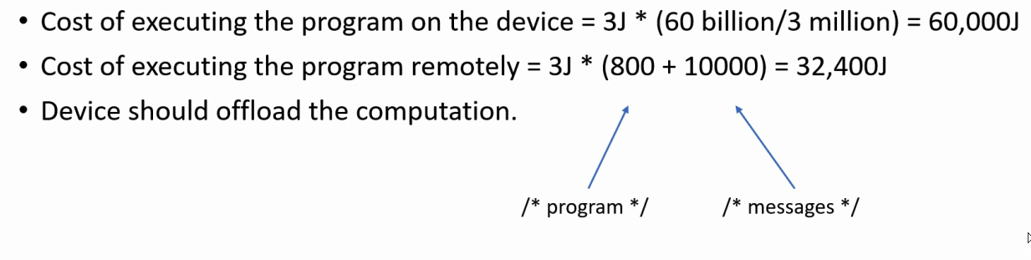
Exercise 16.18
Assume that a device can execute 3 million instructions for the same amount of energy (3J) used to transmit or receive 1 Kbit of data a distance of 100m by radio. The device has the option of sending a 100 Kbyte binary program to a compute server 100m away, which when run will execute 60 billion instructions and exchange 10,000 1Kbit messages with the device. If energy is the only consideration, should the device offload the computation or execute it itself? Assume computation on the device is negligible in the offloaded case
Instructor’s Guide for Coulouris, Dollimore and Kindberg Distributed Systems: Concepts and Design Edn. 4
© Pearson Education 2005

Slide 178
Exercise 16.19
A Cooltown user squirts the URL of a sound file or a streaming radio station to an Internet radio. Suggest a modification to the eSquirt protocol that would enable the user to control the volume from their portable device. Hint: consider what extra data the squirting device should provide.
Instructor’s Guide for Coulouris, Dollimore and Kindberg Distributed Systems: Concepts and Design Edn. 4
© Pearson Education 2005
Notes:
One approach would be to provide a transport address along with the URL of the content to be rendered
The recipient device could then make a callback to the sending device, supplying a URL for obtaining the recipient device’s control web page

Slide 179
Exercise 16.20
Discuss the applicability to mobile and ubiquitous systems of techniques drawn from the areas of (a) peer-to-peer systems (Chapter 10); (b) coordination and agreement protocols (Chapter 12); and (c) replication (Chapter 15).
Instructor’s Guide for Coulouris, Dollimore and Kindberg Distributed Systems: Concepts and Design Edn. 4
© Pearson Education 2005
Notes:
P2p systems are volatile but they are not necessarily physically integrated. Some of the P2P algorithms assume there is a connected infrastructure.
The coordination and agreement protocols are in general designed on the assumption that failure is the exception (e.g. election algorithms) whereas in volatile systems it is the rule. Many of these techniques are too expensive in communication or too slow to converge to be run frequently.
Chapter 15 deals with disconnected operation. However, in general the techniques considered in Ch. 15 tend to assume a redundancy of resources, but in ubiquitous and mobile systems the opposite is generally true.

Slide 180
Exercises for Chapter 20:
Distributed Multimedia Systems
From Coulouris, Dollimore, Kindberg and Blair
Distributed Systems:
Concepts and Design
Edition 5, © Addison-Wesley 2012

Slide 181
Exercise 20.1
Outline a system to support a distributed music rehearsal facility. Suggest suitable QoS requirements and a hardware and software configuration that might be used.
pages 884, 889
Instructor’s Guide for Coulouris, Dollimore, Kindberg and Blair, Distributed Systems: Concepts and Design Edn. 5
© Pearson Education 2012
Notes:
This is an interactive distributed multimedia application – a typical round-trip delay (RTT) of less than 50 ms is required
Video and sound should be tightly synchronized so that the musicians can use visual cues as well as audio ones
Bandwidths should be suitable for the cameras and audio inputs used, e.g., 1.5 Mbps for video streams and 44 kbps for audio streams. Loss rates should be low, but not necessarily zero.
A software environment that includes QoS management with resource contracts is required

Slide 182
Exercise 20.2
The Internet does not currently offer any resource reservation or quality of service management facilities. How do the existing Internet-based audio and video streaming applications achieve acceptable quality? What limitations do the solutions they adopt place on multimedia applications?
pages 884, 893, 899
Instructor’s Guide for Coulouris, Dollimore, Kindberg and Blair, Distributed Systems: Concepts and Design Edn. 5
© Pearson Education 2012
Notes:
Media delivery systems
Traffic shaping
Usually work reasonably well for audio and low-resolution video, but getting better and better…
Interactive applications
Stream adaption
Usually unsatisfactory
There are two types of Internet-based applications:
a) Media delivery systems such as music streaming, Internet radio and TV applications.
b) Interactive applications such as Internet phone and video conferencing (NetMeeting, CuSeemMe).
For type (a), the main technique used is traffic shaping, and more specifically, buffering at the
destination.Typically, the data is played out some 5–10 seconds after its delivery at the destination. This masks
the uneven latency and delivery rate (jitter) of Internet protocols and masks the delays incurred in the network
and transport layers of the Internet due to store-and-forward transmission and TCP’s reliability mechanisms.
For type (b), the round trip delay must be kept below 100 ms so the above technique is ruled out. Instead,
stream adaptation is used. Specifically, video is transmitted with high levels of compression and reduced
frame rates. Audio requires less adaptation. UDP is generally used.
Overall, type (a) systems work reasonably well for audio and low-resolution video only. For type (b) the
results are usually unsatisfactory unless the network routes and operating system priorities are explicitly
managed.

Slide 183
Exercise 20.3
Explain the distinctions between the three forms of synchronization (synchronous distributed state, media synchronization and external synchronization) that may be required in distributed multimedia applications. Suggest mechanisms by which each of them could be achieved, for example in a video conferencing application.
page 885
Instructor’s Guide for Coulouris, Dollimore, Kindberg and Blair, Distributed Systems: Concepts and Design Edn. 5
© Pearson Education 2012
Notes:
Synchronous distributed state
All users should see the same application state
Media synchronization
Certain streams are closely coupled
External synchronization
This is really an instance of synchronous distributed state
synchronous distributed state: All users should see the same application state. For example, the results of
operation on controls for a video, such as start and pause should be synchronized, so that all users see the same
frame. This can be done by associating the current state (sample number) of the active multimedia streams with
each state-change message. This constitutes a form of logical vector timestamp.
media synchronization: Certain streams are closely coupled. E.g. the audio that accompanies a video
stream. They should be synchronised using timestamps embedded in the media data.
external synchronization: This is really an instance of synchronous distributed state. The messages that
update shared whiteboards and other shared objects should carry vector timestamps giving the states of media
streams.

Slide 184
Exercise 20.4
Outline the design of a QoS manager to enable desktop computers connected by an ATM network to support several concurrent multimedia applications. Define an API for your QoS manager, giving the main operations with their parameters and results.
pages 889–891
Instructor’s Guide for Coulouris, Dollimore, Kindberg and Blair, Distributed Systems: Concepts and Design Edn. 5
© Pearson Education 2012
Notes:
Resource Contract
Whenever a new stream is to be started, a request is made to the QoS manager specifying CPU resources, memory and network connections with their /flow Specs. A negotiation takes place to reduce the resources of existing streams.
API:
QoSmanager.QoSRequest(FlowID, FlowSpec) -> ResourceContract
Application.ScaleDownCallback(FlowID, FlowSpec) -> AcceptReject
Each multimedia application requires a resource contract for each of its multimedia streams. Whenever a new
stream is to be started, a request is made to the QoS manager specifying CPU resources, memory and network
connections with their Flow Specs. The QoS manager performs an analysis similar to Figure 17.6 for each endto-
end stream. If several streams are required for a single application, there is a danger of deadlock – resources
are allocated for some of the streams, but the needs of the remaining streams cannot be satisfied. When this
happens, the QoS negotiation should abort and restart, but if the application is already running, this is
impractical, so a negotiation takes place to reduce the resources of existing streams.
API:
QoSManager.QoSRequest(FlowID, FlowSpec) –> ResourceContract
The above is the basic interface to the QoS Manager. It reserves resources as specified in the FlowSpec and
returns a corresponding ResourceContract.
A FlowSpec is a multi-valued object, similar to Figure 17.8.
A ResourceContract is a token that can be submitted to each of the resource handlers (CPU scheduler,
memory manager, network driver, etc.).
Application.ScaleDownCallback(FlowID, FlowSpec) -> AcceptReject
The above is a callback from the QoS Manager to an application, requesting a change in the FlowSpec for
a stream. The application can return a value indicating acceptance or rejection.

Slide 185
Exercise 20.5
In order to specify the resource requirements of software components that process multimedia data, we need estimates of their processing loads. How can this information be obtained without undue effort?
pages 889–891
Instructor’s Guide for Coulouris, Dollimore, Kindberg and Blair, Distributed Systems: Concepts and Design Edn. 5
© Pearson Education 2012
Notes:
The main issue is how to measure or otherwise evaluate the resource requirements (CPU, memory, network bandwidth, disk bandwidth) of the components that handle multimedia streams without a lot of manual testing.
A test framework is required that will evaluate the resource utilization of a running component.
Resource requirement models of the components are also needed – for assess requirements for different application contexts and stream characteristics and different hardware performance parameters
The main issue is how to measure or otherwise evaluate the resource requirements (CPU, memory, network
bandwidth, disk bandwidth) of the components that handle multimedia streams without a lot of manual testing.
A test framework is required that will evaluate the resource utilization of a running component. But there is
also a need for resource requirement models of the components – so that the requirements can be extrapolated
to different application contexts and stream characteristics and different hardware environments (hardware
performance parameters).

Slide 186
Exercise 20.6
How does the Tiger system cope with a large number of clients all requesting the same movie at random times?
pages 901–906
Instructor’s Guide for Coulouris, Dollimore, Kindberg and Blair, Distributed Systems: Concepts and Design Edn. 5
© Pearson Education 2012
Notes:
If they arrive within a few seconds of each other ..
If they are more widely spaced …
A single disk access can server multiple client requests

Slide 187
Exercise 20.7
The Tiger schedule is potentially a large data structure that changes frequently, but each cub needs an up-to-date representation of the portions it is currently handling. Suggest a mechanism for the distribution of the schedule to the cubs.
pages 901–906
Instructor’s Guide for Coulouris, Dollimore, Kindberg and Blair, Distributed Systems: Concepts and Design Edn. 5
© Pearson Education 2012
Notes:
In the first implementation – the controller computer was responsible for maintaining an up-to-date version of the schedule and replicating it to all of the cubs – centralized design – does not scale well
In a later implementation – the cubs were made collectively responsible for maintaining the schedule – distributed/decentralized design
When the controller needs to modify the schedule – to delete or suspend an existing entry to insert a viewer into an empty slot – it sends a request to the cub that is currently responsible for the relevant fragment of the schedule to make the update. The cub then uses the updated schedule fragment to fulfil its responsibilities and passes it to the next downstream cub.
In the first implementation of Tiger the controller computer was responsible for maintaining an up-to-date
version of the schedule and replicating it to all of the cubs. This does not scale well – the processing and
communication loads at the controller grow linearly with the number of clients – and is likely to limit the scale
of the service that Tiger can support. In a later implementation, the cubs were made collectively responsible
for maintaining the schedule. Each cub holds a fragment of the schedule – just those slots that it will be playing
processing in the near future. When slots have been processed they are updated to show the current viewer
state and then they are passed to the next ‘downstream’ cub. Cubs retain some extra fragments for faulttolerance
purposes.
When the controller needs to modify the schedule – to delete or suspend an existing entry or to insert a
viewer into an empty slot – it sends a request to the cub that is currently responsible for the relevant fragment
of the schedule to make the update. The cub then uses the updated schedule fragment to fulfil its
responsibilities and passes it to the next downstream cub.

Slide 188
Exercise 20.8
When Tiger is operating with a failed disk or cub, secondary data blocks are used in place of missing primaries. Secondary blocks are n times smaller than primaries (where n is the decluster factor). How does the system accommodate this variability in block size?
page 905
Instructor’s Guide for Coulouris, Dollimore, Kindberg and Blair, Distributed Systems: Concepts and Design Edn. 5
© Pearson Education 2012
Notes:
Whether they are large primary or smaller secondary blocks, they are always identified by a play sequence number
The cubs simply deliver the blocks to the clients in order via the ATM network.
It is the clients’ responsibility to assemble them in the correct sequence and then to extract the frames from the incoming sequence of blocks and play the frames according to the play schedule.

Slide 189
Exercise 20.9
Discuss the relative merits of the rarest-first download policy in BitTorrent in comparison to the more traditional sequential download approach.
pages 906–908
Instructor’s Guide for Coulouris, Dollimore, Kindberg and Blair, Distributed Systems: Concepts and Design Edn. 5
© Pearson Education 2012
Notes:
BitTorrent schedules downloads according to a rarest first policy
Each peer maintains a record of the number of copies of each piece in its peer set (the set of connected peers) and, based on this data structure, schedules downloads by randomly selecting a piece from its rarest piece set.
This ensures that rare items (including new items) spread quickly and hence this significantly increases the availability of pieces of data.
The sequential download policy has no knowledge of availability of data and hence is not tailored towards this particular outcome.

Slide 190
Exercise 20.10
In addition to Tiger (see Exercise 20.6), both ESM and CoolStreaming also support streaming access to the same movie by potentially large numbers of users. Discuss the strategies adopted by both ESM and CoolStreaming for managing such simultaneous access and compare the approaches to those advocated by Tiger.
pages 901–906, 908–912
Instructor’s Guide for Coulouris, Dollimore, Kindberg and Blair, Distributed Systems: Concepts and Design Edn. 5
© Pearson Education 2012
Notes:
ESM
i) P2P approach that adopts a structured approach to streaming a movie to potentially large numbers of clients;
ii) it builds and maintains a tree structure to disseminate the movie to recipients
CoolStreaming
i) also a P2P approach but, in comparison to ESM, is unstructured;
ii) less deterministic than a tree-based approach but more resilient to change
Tiger:
i) a more classical video server design ( in comparison to the P2P strategies outlined above);
ii) the emphasis is on effective scheduling strategies for the server; and
Iii) the strategies are therefore more centralized and less cooperative than in ESM or CoolStreaming

