Slide 1

Data for python analysis
HADDAD Samy
HUIN Mathieu
JEMAI Salim

Slide 2
LOADING FILE
In a first place we have loaded the data set in dfMain and created a label called ranks_labels to disociate the diferents ranks of players to have a better vision on the plots
And we have added to the dataset, the column rankColor associated to the rank

Slide 3
DATA REPRESENTATION

Slide 4
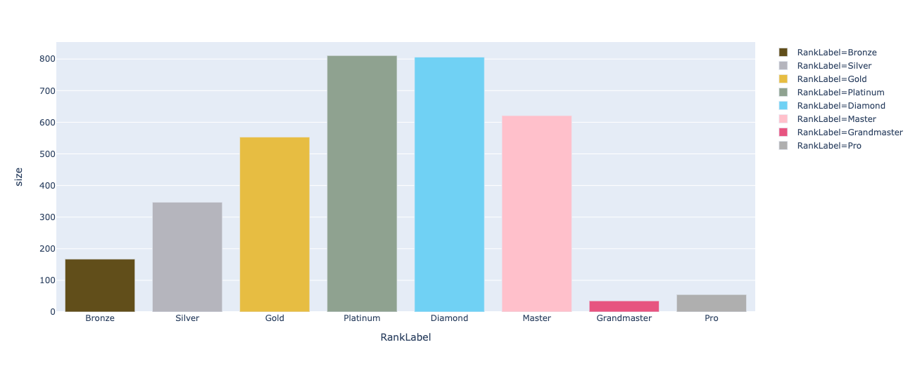
For this plot we can realize that most of the players are rated in platinum and Diamond

Slide 5
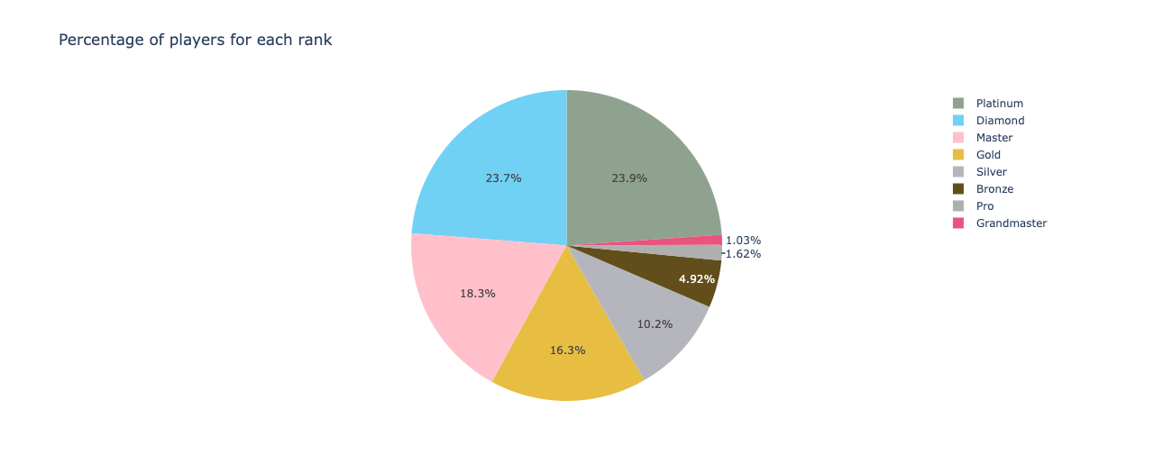
To have a better understating in number of the volume of players, we created a pie that shown the percentage of players for each rank

Slide 6
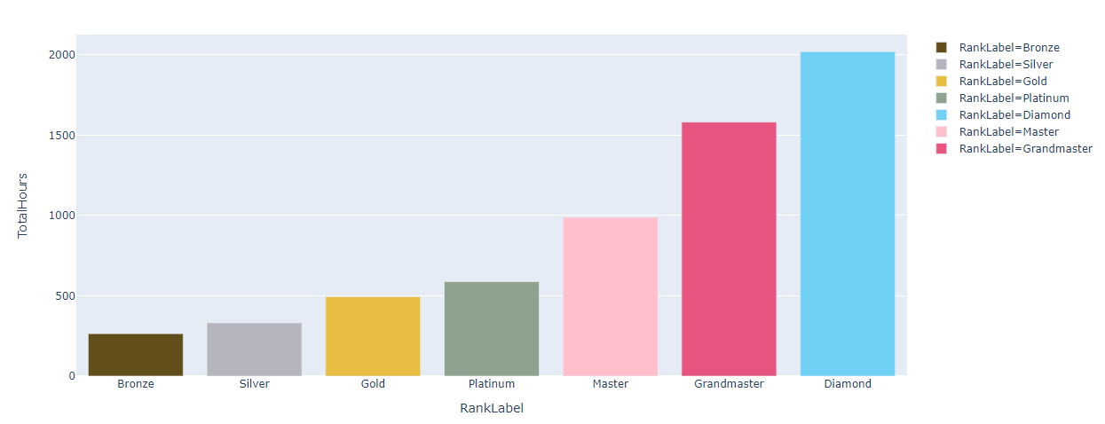
Amount of time per rank in average
This graph enable us to see clearly that the most the player have a strong level the most he spends time on the game.
As you can see, there is no value for pro player, because no datas where given for them but we can imagine that it is more than Diamond rank player time spending.

Slide 7
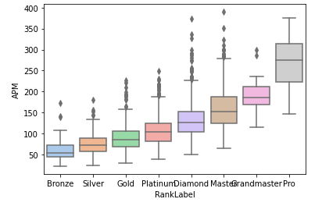
APM : Action Per Minute.
Here we can see that on average, GrandMaster player does not necessary do more actions than Diamond or master players whereas they’re lower level.

Slide 8
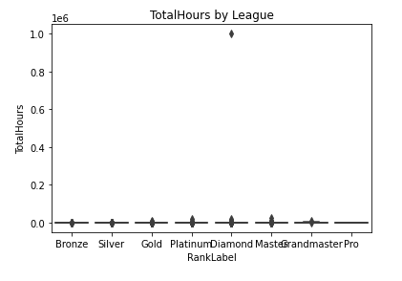
Répartition of game time
Here we interpret that the most past of the time spend on the game is from the diamond elo players.
The rest is not significative according to this graph

Slide 9
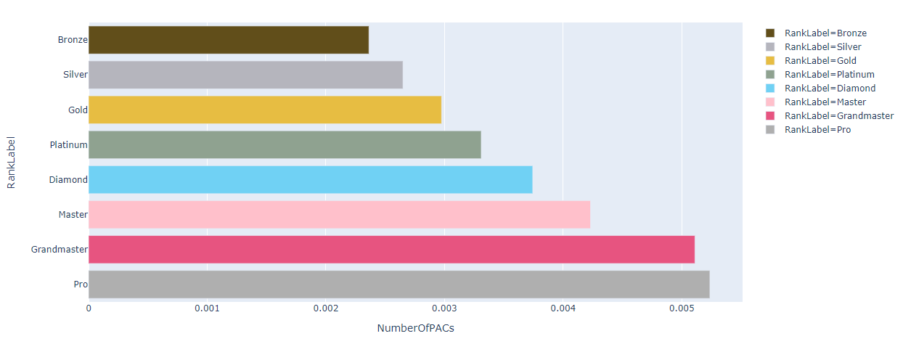
NumberOfPACs per rank
The PCA enable to quantify the number and the precision of the moves. As we can see on the graph the PCA indice is more important for high elo.

Slide 10
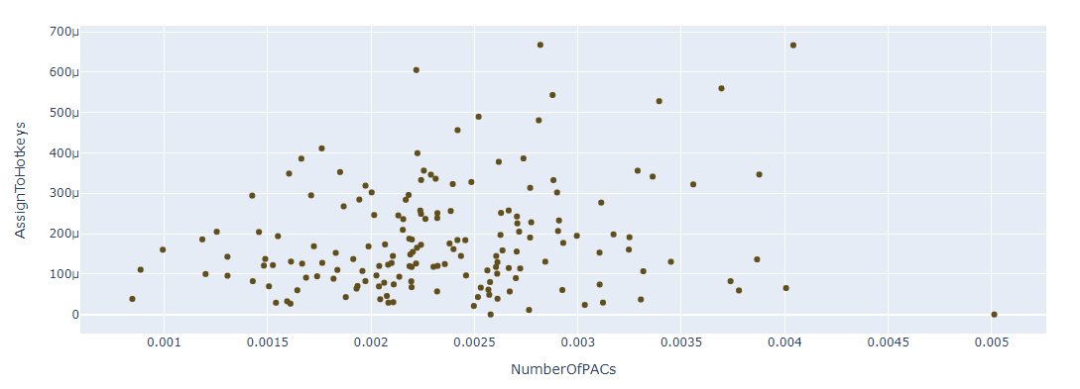
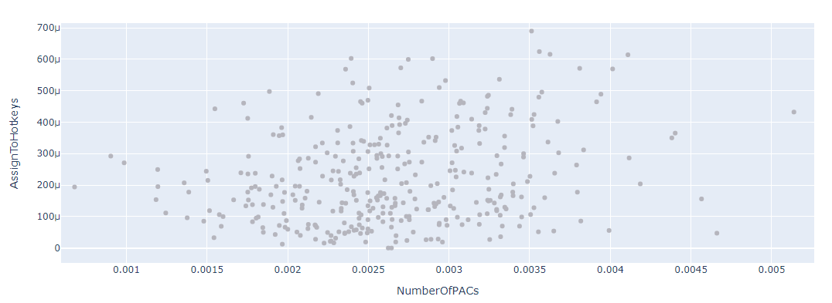
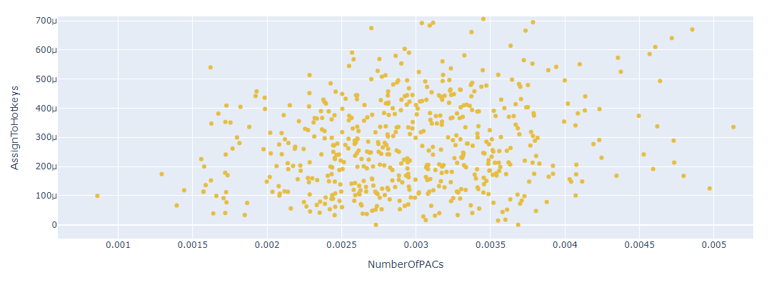
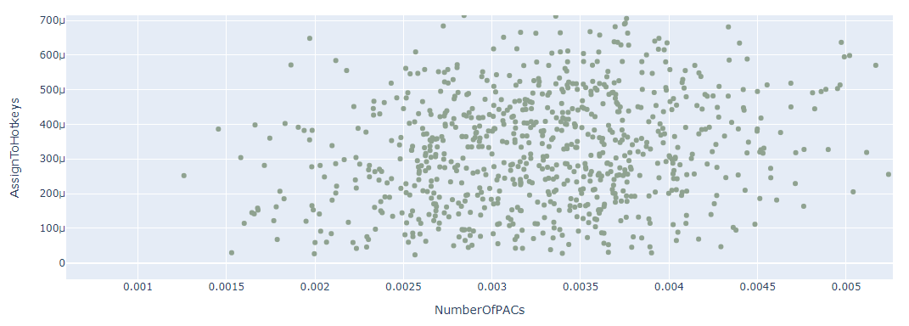
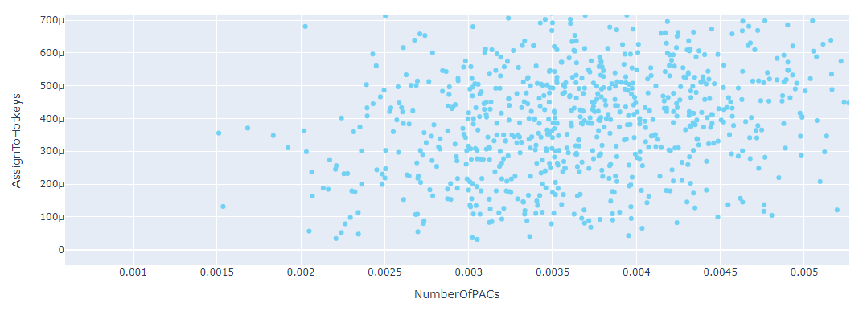
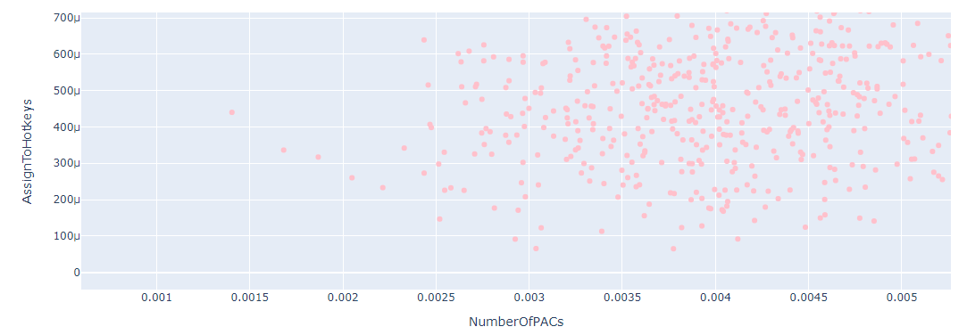
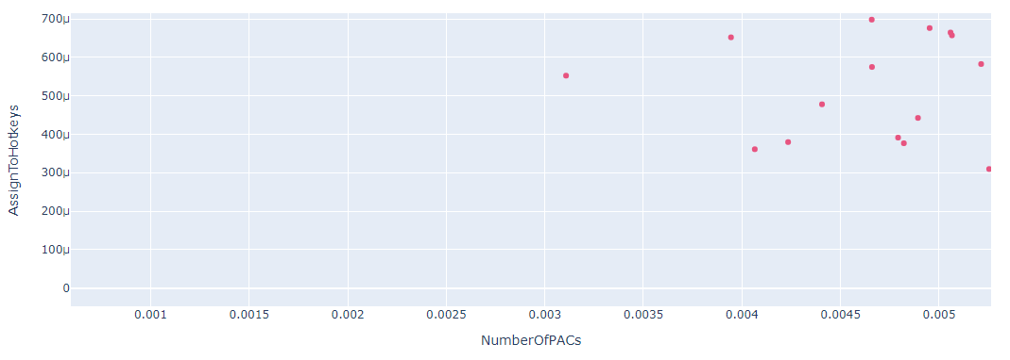
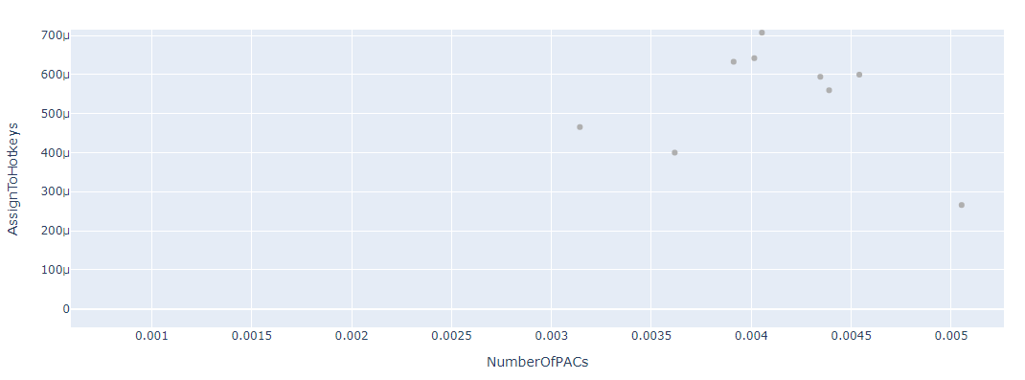
NumberOfPACs per AssignToHotkeys for each rank
Bronze Silver Gold
Platinium Diamond Master
GrandMaster Pro

