Slide 1
Page Object Model
Agenda:-
What is Python
Possible Implementations using python
Python for Web Automation
Python Environment configuration for Automation
Implementation of Page object in Python
Implementation of Allure Reporting dashboard
Type of Listeners
Way to implement Listeners
Annotation in TestNG
Implementation of Extent Report

Slide 2
Page Object Model
What is POM
Page Object model is just a design pattern in automation project and not a framework.
Based on application behavior we will be creating separate pages and will store all locators and methods of that page.
In POM each object can have corresponding method .
Method name has been given based on action of the object.
Way to implement POM
Using normal approach
Using Page Factory approach
What is Page factory:-
The Page Factory Class is an extension to the Page Object design pattern.
It is used to initialize the elements of the Page Object or instantiate the Page Objects itself.
It is used to initialize elements of a Page class without having to use 'FindElement' or 'FindElements’

Slide 3
Page Object Model
Login
Homepage
TC1
Pyment
Logout

Slide 4
Page Object Model
Advantages of POM
Script will be more readable format.
Easy to maintain and reusable script.
We can make use of cache feature.

Slide 5
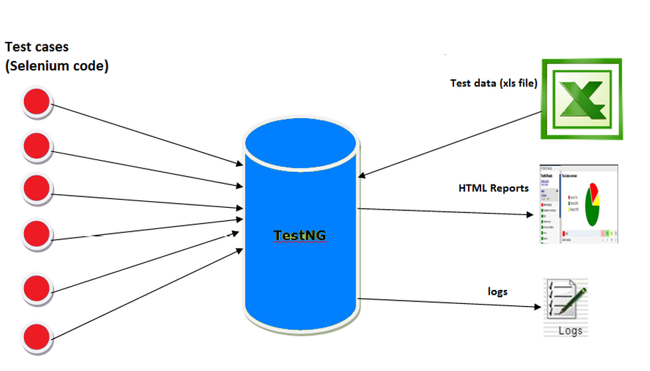
Test ng
What is TestNG
TestNG is open source test automation framework which in inspired from JUnit
TestNG has multiple classes, interface and methods.

Slide 6
Test NG
Advantages of TestNG
Default Reporting
Supports of Listeners
Supports of Advanced Annotations
Easy and flexible test Configurations
Supports for data driven testing(with @data provider)
Supports of parameter
Easy way to execute Test Suite
Supports Parallel execution
Grouping and Dependencies feature and many more.

Slide 7
Test Ng
TestNG Annotations
@BeforeSuite: The annotated method will be run before all tests in this suite have run.
@AfterSuite: The annotated method will be run after all tests in this suite have run.
@BeforeTest: The annotated method will be run before any test method belonging to the classes inside the tag is run.
@AfterTest: The annotated method will be run after all the test methods belonging to the classes inside the tag have run.
@BeforeGroups: The list of groups that this configuration method will run before. This method is guaranteed to run shortly before the first test method that belongs to any of these groups is invoked.
@AfterGroups: The list of groups that this configuration method will run after. This method is guaranteed to run shortly after the last test method that belongs to any of these groups is invoked.
@BeforeClass: The annotated method will be run before the first test method in the current class is invoked.
@AfterClass: The annotated method will be run after all the test methods in the current class have been run.
@BeforeMethod: The annotated method will be run before each test method.
@AfterMethod: The annotated method will be run after each test method.
@Test: The annotated method is a part of a test case
Source:-http://testng.org

Slide 8
Test ng
What is Listener
Listener is important feature in TestNG which used to customize logs. And report of TestNG
As the name says it listen to certain event and act accordingly
Type of Listeners
IAnnotation Transformer
IHookable
IInvokedMethod Listner
IMethodInterceptor
IReporter
ITestListener
Way To Implement Listner
Class Level
Suite Level
Source:-http://testng.org

Slide 9
Extent Report
What is Extent Report
Extent Report is a HTML reporting library for Selenium.
We can use this tool within our TestNG and BDD automation framework.
Download Extent report library from http://extentreports.com

Slide 10
Git Hub Repository:-https://github.com/ConceptByAmbadas
Web Block:-http://conceptbyambadas.blogspot.com/2017/05/selenium-extent-report.html
YouTube Channel :-https://www.youtube.com/channel/UC2UV6Nwn_rfIk1YjFxOsglg

