Slide 1
Page Object Model Framework
Maven + TestNG configuration.
Framework Configuration from Base Class
Driver Class Configuration
Implementation of Log 4j
Test Data Configuration using Apache POI and TestNG Data provider.
Property File reading
Reusable Function
Page Factory Approach
TestNG Listener Implementation
Integration of third party script (AutoIT,Sikuli)
Extent Report
TestNG Report
Custom HTML Report
Running Test Eclipse independent
parallel Test Execution
Implementation Of CI using Jenkins And GIT
Schedule Jenkins Job
Jenkins Email Notification
Configured Jenkins Execution Report

Slide 2
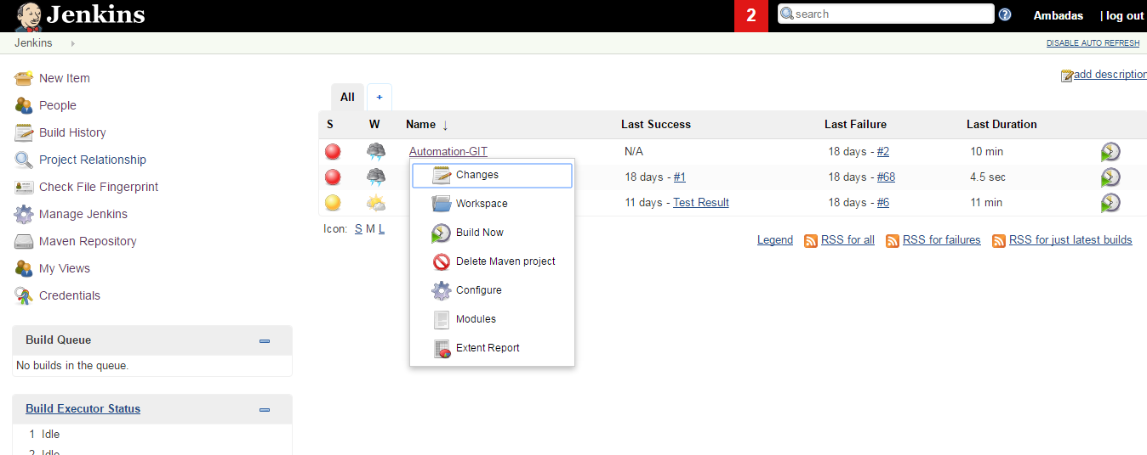
Jenkins Configuration

Slide 3
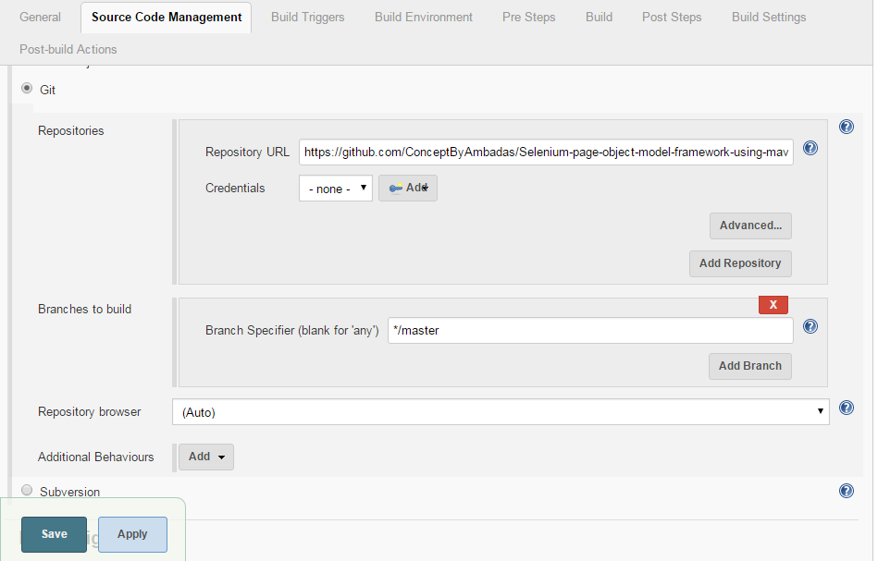
Git Configuration in Jenkins

Slide 4
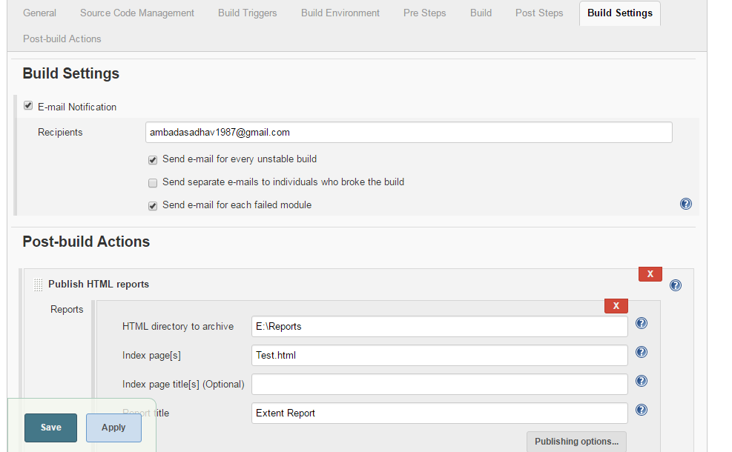
Email & Report Configuration in Jenkins

Slide 5
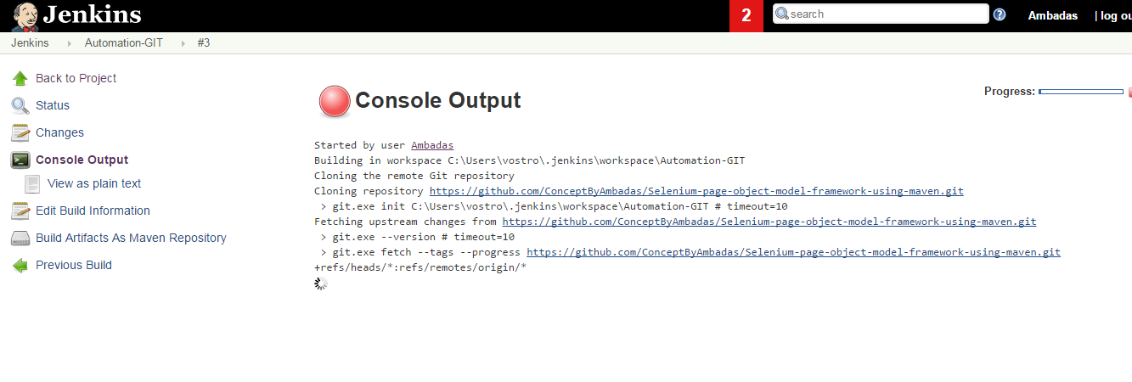
Build Jenkins Job

Slide 6
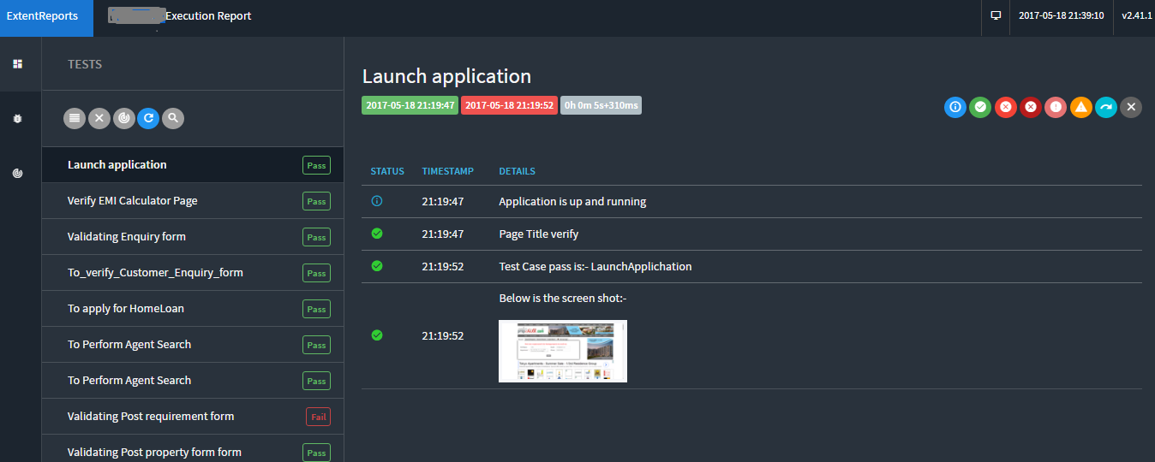
Execution Report

Slide 7
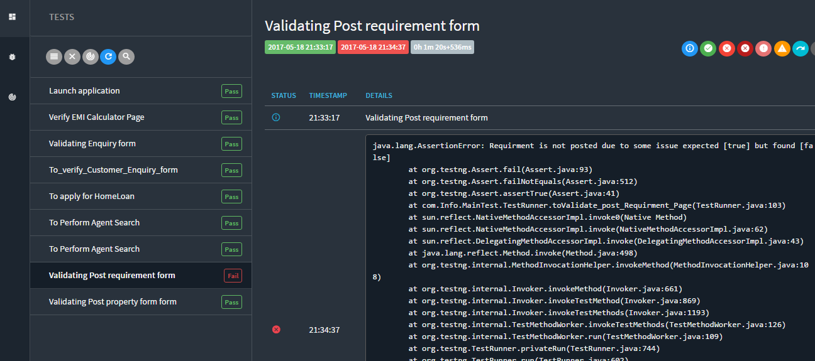
Summary of fail Scenario

Slide 8
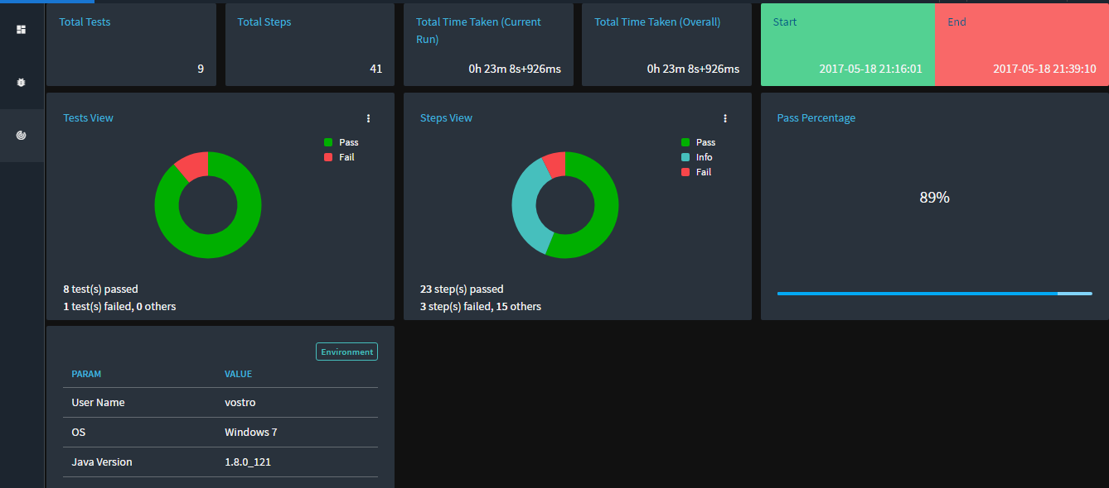
System Report

Slide 9
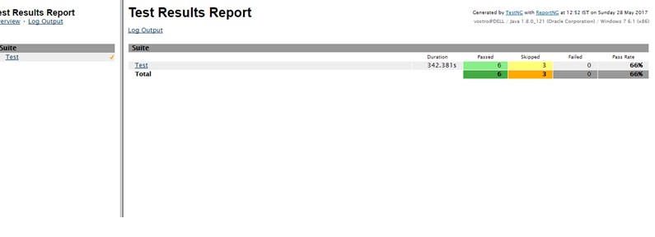
TestNG Report

