Slide 1
Is PDF your best option?
TechExeter 2018
Craig Buckler
@craigbuckler
github.com/craigbuckler/html5-export
Notes:
Hello!
My name's Craig Buckler
And I'm a freelance full-stack web developer

Slide 2
HIRE ME!
HIRE ME!
Notes:
but you won't see any self-promotion or subliminal advertising in this presentation

Slide 3

Notes:
So let’s talk about PDFs.
Yeah - fresh tech!
PDFs have only been around 25 years.
Is anyone not familiar with the document format?
For everyone else, I’ll keep you excited by mentioning Blockchain and serverless every few minutes.

Slide 4
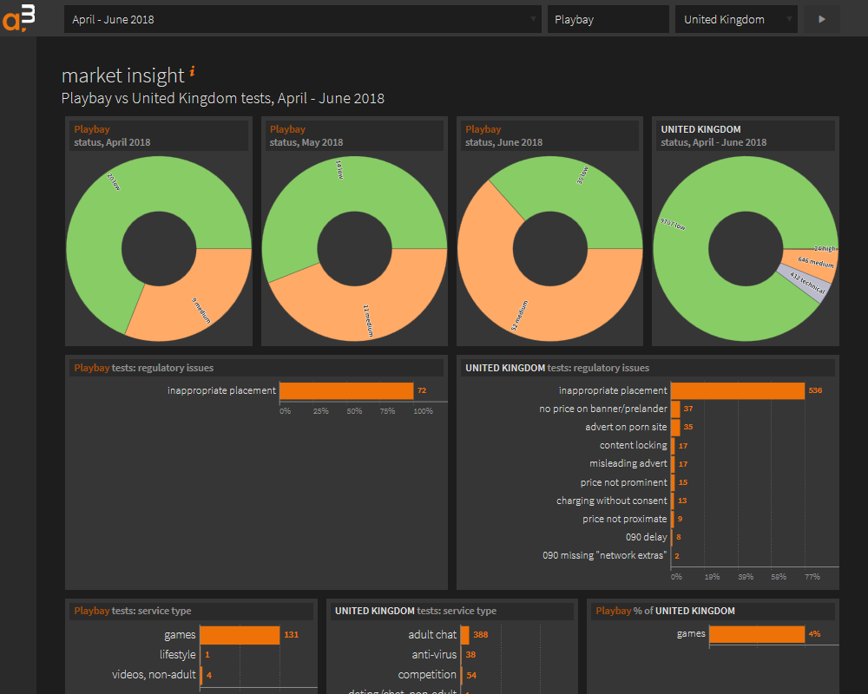
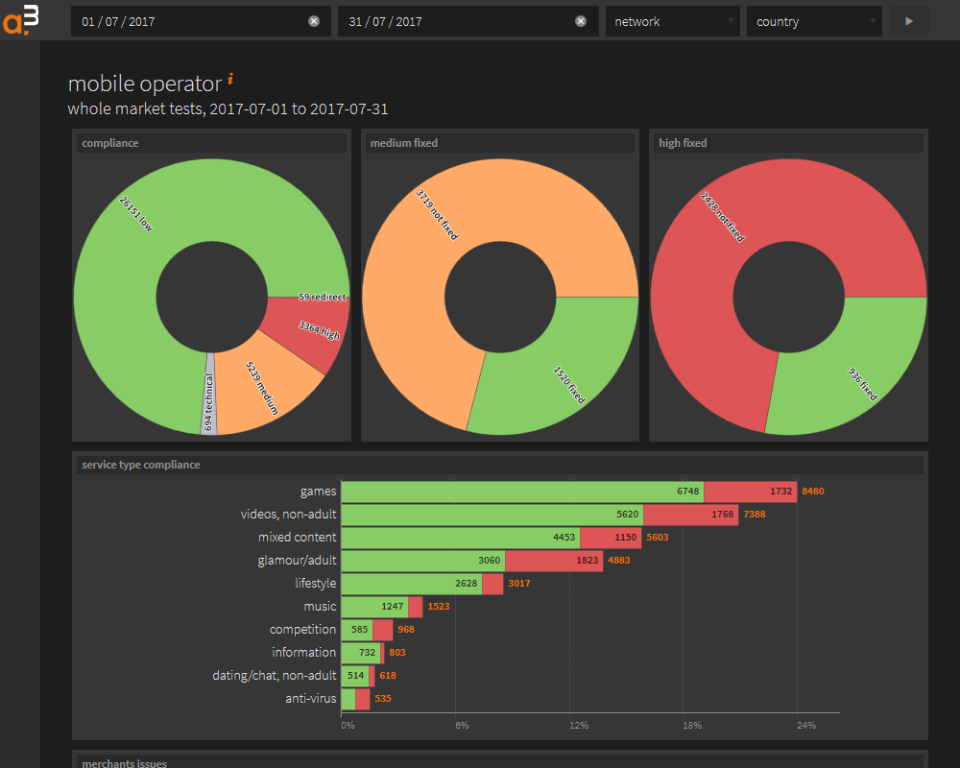
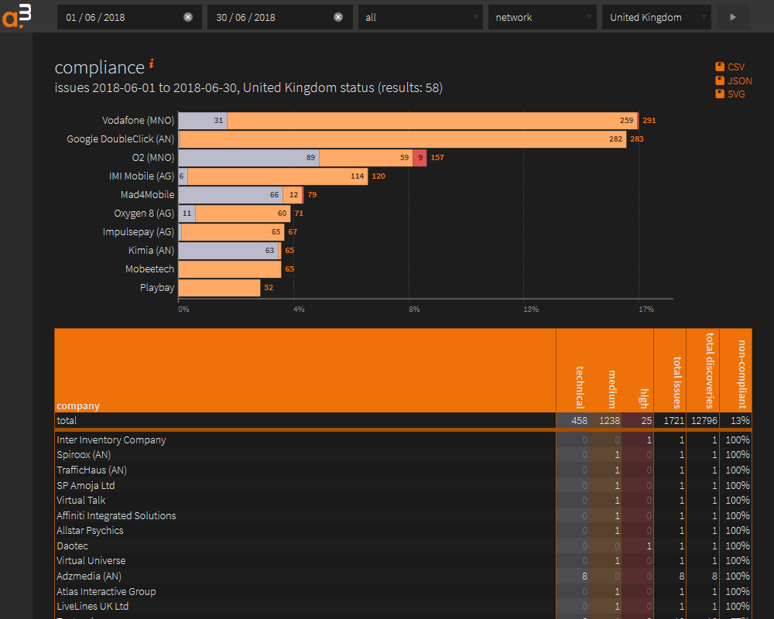
Back story
Notes:
I’ve built on web application for one of my clients
It's nothing revolutionary: usual stuff
They add data and their customers can interact with it
Those customers can run reports and get all sorts of amazing business insights
I was smuggly satisfied with the system

Slide 5
Emailed reports

