Slide 1
Is PDF your best option?
TechExeter 2018
Craig Buckler
@craigbuckler
github.com/craigbuckler/html5-export
Notes:
Hello!
My name's Craig Buckler
And I'm a freelance full-stack web developer

Slide 2
HIRE ME!
HIRE ME!
Notes:
but you won't see any self-promotion or subliminal advertising in this presentation

Slide 3

Notes:
So let’s talk about Portable Document Format – or PDF.
Yeah - fresh tech!
It’s only been around 25 years.
But I’ll keep you excited by mentioning Blockchain and serverless every few minutes.
Is anyone not familiar with PDFs?
They’re essentially postscript instructions sent to a file rather than to a printer

Slide 4
What has PDF ever done for us?
any application can create a PDF
preview before saving
read-only
distribution is easy
free reader software for all OSes
works offline
prints perfectly
users expect it
Notes:
That makes very practical.
If an application can print, it can export a PDF
If you have print preview, you can see what the PDF will look like before saving it
The file is effectively read-only (or near enough)
So it can be sent to others without any security implications
And they can open it on any system which has a PDF reader.
You don’t need the software which created the PDF file.
You can usually read PDFs offline
and print them as well as the original application could
And finally, PDFs are the will of the people. It’s what they want.
So get over it Craig. What don’t you understand.

Slide 5
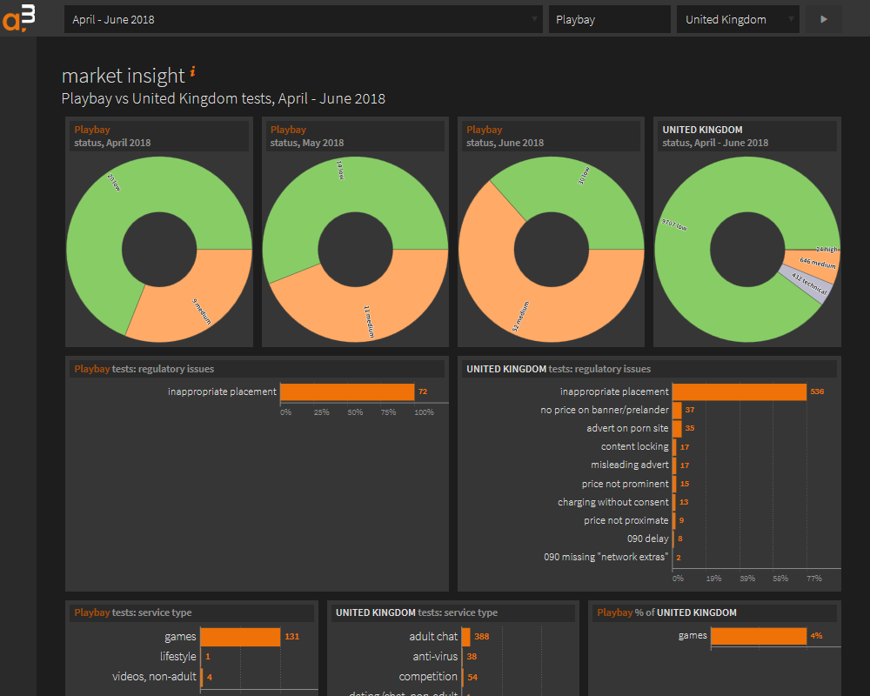
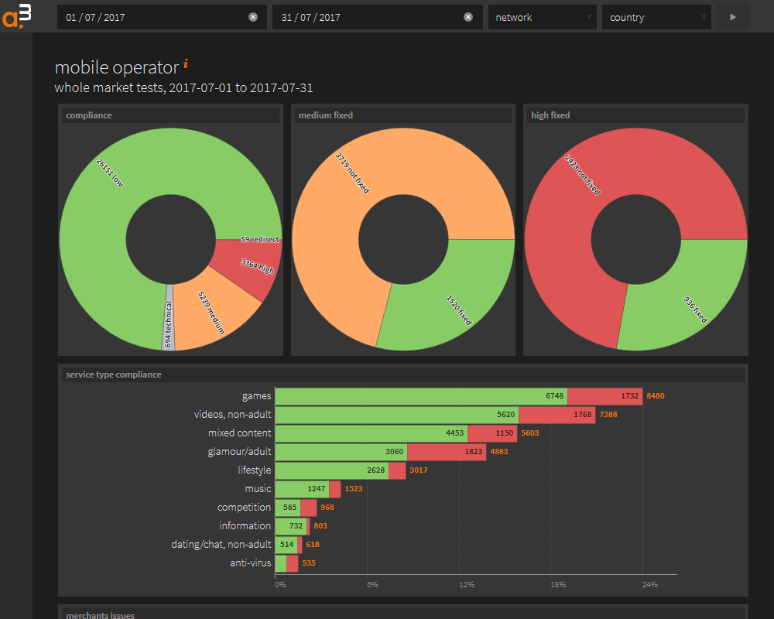
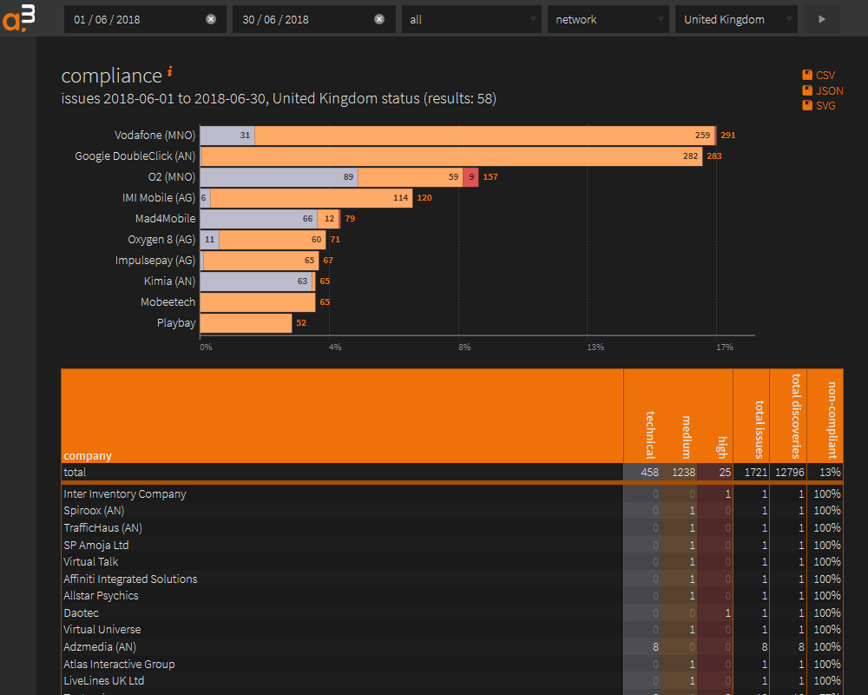
Back story
Notes:
So a little back story to this presentation
I’ve been building a web application for one of my clients
It's nothing revolutionary: usual stuff
They add data and their customers can interact with it
Those customers can run reports and get all sorts of amazing business insights with just a few clicks
I was smuggly satisfied with this system

Slide 6


Emailed reports
Notes:
How wrong I was
My client contacted me last year to say they were spending several days every month creating PDF reports which they emailed to customers.
[CLICK]
Why?
Why do that when those customers can access the same information with a few clicks.

Slide 7
The reason…
I KNOW NOTHING ABOUT MARKETING
Notes:
The reason was simple.
I don’t understand marketing.
But I’m not a typical user. And nor are any of you.
We’re all curious about technology. And data. And serverless. And blockchain.
So if we want to find something out, we go looking for it.
We ask others. We search the web. We go to conferences.
Normal people are not like us.
They like to be told what’s good for them.
They don’t want the effort of doing research.
They’ve got important jobs and they’re far too busy to analyse facts.
This report gave them a summary of information which they could read at their convenience
And it reminded them they were getting a useful service even if they weren’t logging in every day.
So this monthly PDF report worked well.
I had to accept I was wrong and most users like to be spoon fed facts.

Slide 8
What process was used?
For every client…
Access their web reports.
Take a screenshot.
Paste into PowerPoint.
Edit.
Save as PDF.
Email to client.
Notes:
So my next question: how are you producing these PDFs?
Well, Craig, we access various reports for each customer in the web application.
Then we grab screenshots.
{ What? You don’t download the CSV or SVGs I sweated over? }
No.
We paste screenshots into PowerPoint.
{ PowerPoint? Not Excel or anything practical for further analysis? }
No. We like PowerPoint. Our staff understand it.
And it means we can edit the information easily.
Then we export a PDF.
{ Whatever. But isn’t the quality really bad? }
Yes it’s terrible. The screenshots go all blocky. We often have to go back, zoom the page, then stitch screens together.
Then we email the files.
{ OK. Aren’t those files fairly big? }
Yes. They are. They’re several megabytes in size. That causes problems for some clients.
So the question was:
could I make this process easier?

Slide 9
Create a PDF from a web app…
METHOD 1
print to PDF
easy
very limited
METHOD 2
PDF creation
flexible
very difficult
Notes:
So there are two main ways of creating a PDF from a browser-based application
The first is what most developers use … because you don’t need to really do anything.
You just get a browser to print to a PDF which effectively converts HTML to Postscript.
It works, but control is limited.
There are some CSS printing properties but…
you couldn't, for example, make some pages portrait and some landscape.
And you’re often relying on the user to tweak the settings. And they never get it right.
The second option is to output a PDF directly by drawing onto the paper canvas.
The masochists amongst you could write raw Postscript code but it’s easier to use a library.
This has more flexibly because you're positioning text and lines on paper.
But it’s difficult do to anything complex.
I tried several libraries to convert tables and SVGs but it was a lot of work and results were variable.
Little choice between these two extremes.
And neither is ideal for web applications
I started to question my life choices and the futility of everything

Slide 10

The eureka moment…
Notes:
But I came though that darkness and experienced a rare moment of clarity.
Why was I trying to convert one document format to another?
Am I using PDF because that’s what’s expected?
Is it really the best solution?
These reports are HTML.
Why can’t I send people an HTML document instead?
That would be a lot easier to develop.

Slide 11
What has HTML ever done for us?
all OSes have a browser
responsive layout
small file size
text copy/paste
accessibility
open standard
Notes:
And it would also benefit users.
First, all Operating Systems have a browser so there’s nothing to install
That’s not necessarily the case for PDF readers
HTML documents can be responsive.
They can work on any device whether it’s a smartphone, a PC or TV
PDFs are always a fixed size and you end up zooming and panning on mobiles
HTML file sizes should be much smaller.
There’s no need to rasterize fonts and images
Copy and paste normally works on HTML documents
That’s not always the case for PDFs or the readers people use
It's accessible
HTML content can be read by screen readers
And we can create HTML for free.
PDF is also an open standard but the software often isn’t

Slide 12
Bring PDF benefits to HTML?
preview before saving
easy distribution
work offline
prints well
read-only(-ish)
users expect it
Notes:
I’d only win this argument is if I could bring the benefits of PDF to HTML.
It couldn’t be more difficult to create or distribute
But this last point caused most concern for my client.
Users expect PDFs? Don’t they?
Let's face it: most users don’t know or care what you’re sending them.
But I had to prove they could cope
Now there are some options from history.
Does anyone remember MHTML?
You’re all too young. Ask your grandparents about 56K modems and surfing the web in the 1990s.
MHTML is:
MIME Encapsulation of Aggregate HTML Documents.
When you loaded a page after 20 minutes, you could save it as a single MHTML file for offline reading later
You didn’t need to hog the telephone line or pay BT a fortune
Yes, exactly.
You kids with your fibre wifi and instant instagramming don’t know you’re born!
MHTML effectively encodes HTML as it’s done in email. Which is horrible.
And it’s only directly supported in IE so it wasn’t an option.

Slide 13
Objectives
preview page and download itself
looks like a paged document
printer-friendly
no external assets
no JavaScript in the output
Notes:
This was my plan:
I’d create a web report preview which allowed some simple editing
You could then download a static representation of that page as a single HTML file
It would look documenty.
And have PDF-like pages even though that was more for show than practicalities
It would print well.
HTML pages will never print better than PDFs but the results should be reasonable.
The exported HTML file could be viewed offline
That meant I couldn’t use external assets such as fonts
CSS and images would also have to be embedded into the document
Finally, that document could not contain JavaScript.
Some systems would flag a security alert so it wasn’t worth the hassle.
But Craig: we use React. Or Vue. Or Angular. We need JavaScript.
That’s not a problem. All client-side libraries ultimately put HTML on the page.
We could extract that HTML.
We wouldn’t need to include the JavaScript which created it.

Slide 14
Let’s get coding!

Slide 15
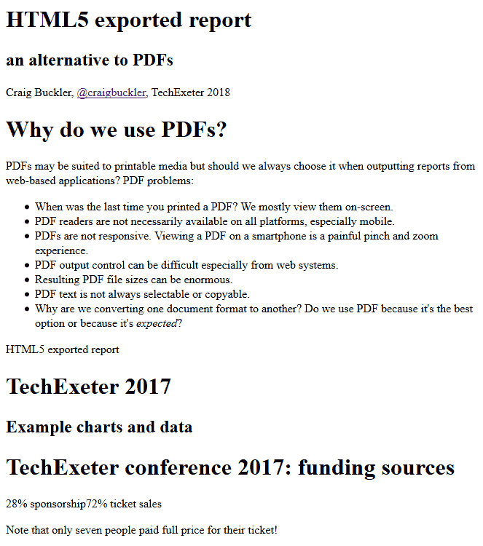
Gmail evil
Notes:
So our resulting HTML file can now be sent to people by email or whatever.
But there’s a slight hitch.
What do you think Gmail users see when they click the attachment and see a preview?
I’ll give you a clue: Gmail opens the file in a new tab.
[CLICK]
Yep, Google thinks it’s best to treat this document as an HTML email.
It strips the styles and all the images.
Ironically, this renders quite well if you use semantic tags.
You can still read the information.
But some users could think this is the report.
You could fix this using HTML email-like inline style attributes on all your tags.
But life’s too short for that sort of nonsense.

Slide 16
Gmail preview fix
<head>
<style>
#exportview {
display: none;
}
</style>
</head>
<main>
<!-- damn you Gmail! -->
<p id="exportview" style="font-size:2em;text-align:center;color:#f00;background-color:#ff0;">THIS DOCUMENT IS NOT DISPLAYING CORRECTLY.<br />PLEASE DOWNLOAD THE FILE THEN OPEN IT IN A WEB BROWSER.</p>
<!-- slide 1 -->
<article></article>
Notes:
To fix it for Gmail and similar systems:
I added a styled paragraph at the top of the page which gave the viewer further instructions.
That paragraph was then removed with display: none if the CSS was parsed correctly.

Slide 17
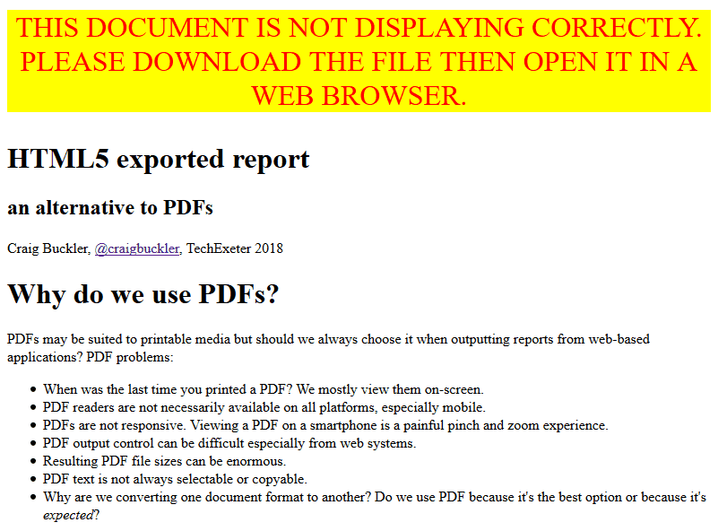
Gmail new preview
Notes:
The result isn’t perfect
But it gives users a helping hand
Which is more than Google offers.

Slide 18
Fin
TechExeter 2018
Craig Buckler
@craigbuckler
github.com/craigbuckler/html5-export
Notes:
We have a web report we can preview then download a static HTML document which can be sent to anyone.
It has all the benefits of HTML plus those of PDFs.
It works in all browsers.
I have used some CSS properties which aren't great in IE but the document is readable and prints perfectly.
It's not quite read-only but nor are PDFs when it comes to it.
But the HTML is minified and difficult to edit.
If you’re worried, generate a hash in the content or on the filename so you can prove it’s been tampered with.
Finally, user expectations.
This was the biggest unknown but, so far, everyone seems to love it.
HTML documents have been sent to hundreds of people over the past year.
They had different email systems and browsers but I don’t know of anyone who had a technical problem.
In fact, some have even being demanding monthly reports before the month ends.
That’s clearly bonkers, but that’s users for you.
All the example code is on GitHub.
Feel free to adapt it for your own purposes.
Or please hire me if you’d like someone else to do the work!
So, the next time someone demands a PDF, tell them you have a better option.

