Slide 1
Is PDF your best option?
TechExeter 2018
Craig Buckler
@craigbuckler
github.com/craigbuckler/html5-export
Notes:
Hello!
My name's Craig Buckler
And I'm a freelance full-stack web developer

Slide 2
HIRE ME!
HIRE ME!
Notes:
but you won't see any self-promotion or subliminal advertising in this presentation

Slide 3

Notes:
So let’s talk about Portable Document Format – or PDF.
Yeah - fresh tech!
OK, so PDFs have been around for 25 years.
But I’ll keep you excited by mentioning Blockchain and serverless every few minutes.
Is anyone not familiar with the document format?
PDFs is essentially the printer-based postscript standard stored in a file rather than output onto paper

Slide 4
What has PDF ever done for us?
any application can create a PDF
preview before saving
read-only
distribution is easy
free reader software for all OSes
works offline
prints perfectly
users expect it
Notes:
That makes it very practical.
If an application can print, it can output a PDF
That means you know what it’s going to look like before saving just by using a print preview
The file is effectively read-only
So it can be sent to others without any security implications
And they can open it on any system without having the software which created it
Normally, they can read it offline
Or print it as if they had the original application
And finally, PDFs are the will of the people. It’s what they want.
So get over it Craig. You’ve already lost.

Slide 5
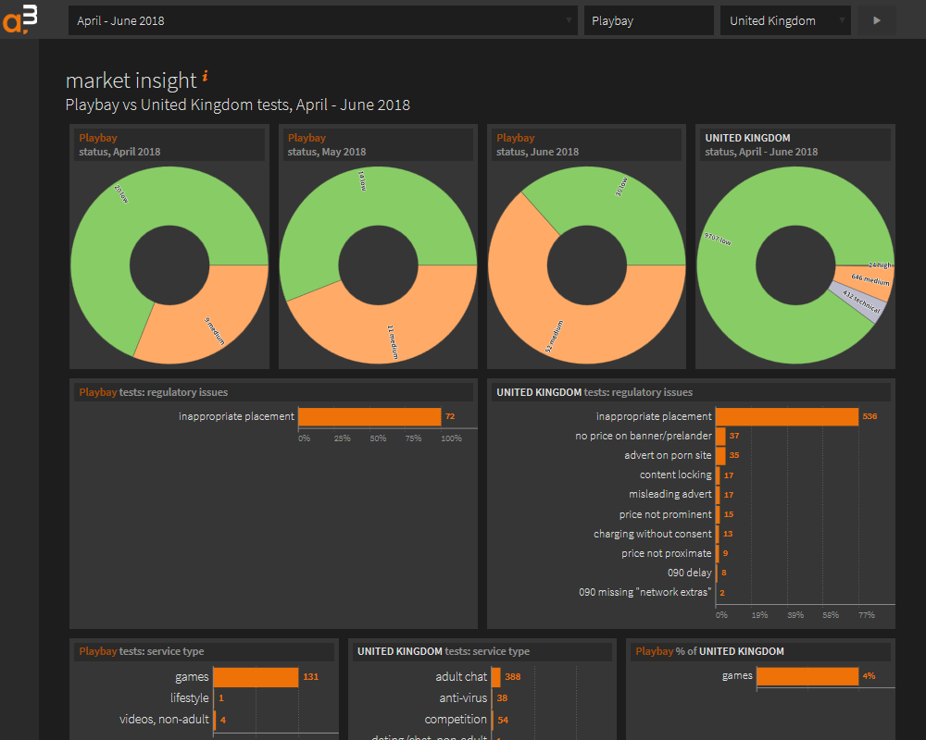
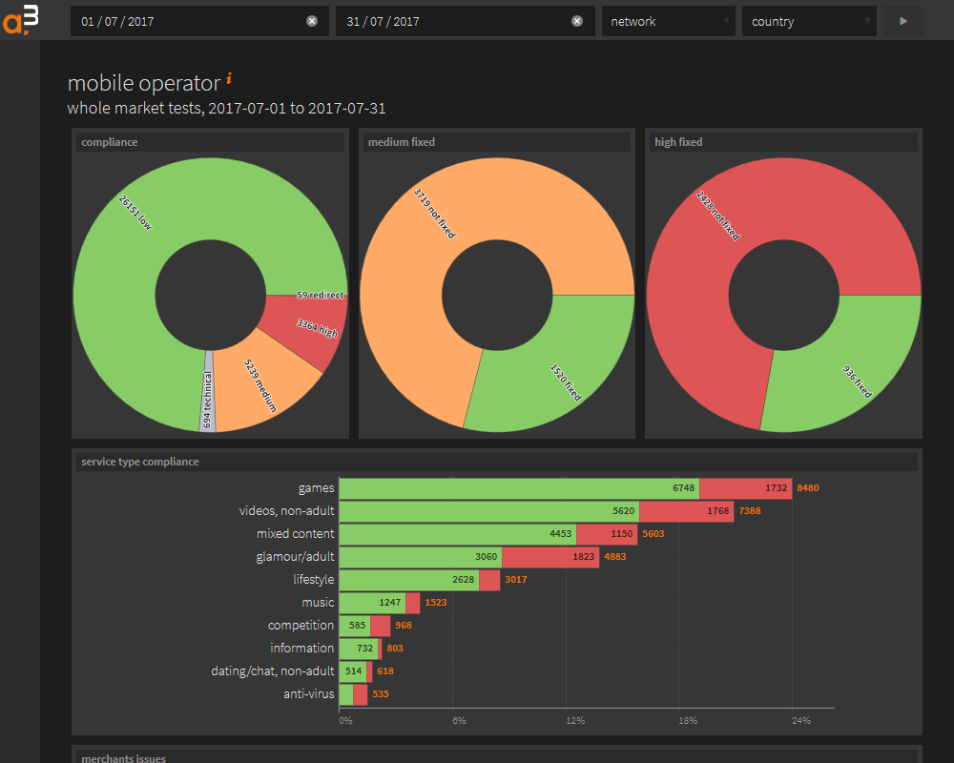
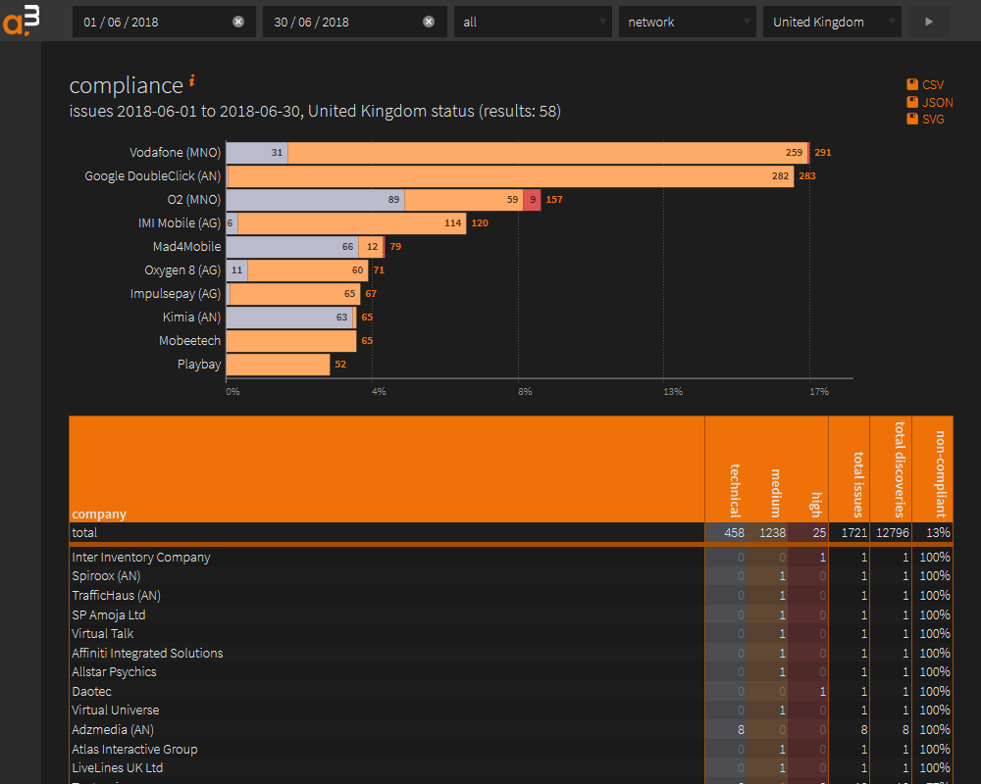
Back story
Notes:
I’ve built on web application for one of my clients
It's nothing revolutionary: usual stuff
They add data and their customers can interact with it
Those customers can run reports and get all sorts of amazing business insights with a few clicks
I was smuggly satisfied with the system

Slide 6


Emailed reports
Notes:
But how wrong I was
But my client contacted me last year to say they were spending several days every month creating PDF reports which they emailed to their clients.
[CLICK]
Why?
What possible reason would you have to do that when the same information and more is a click away.

Slide 7
The reason…
I KNOW NOTHING ABOUT MARKETING
Notes:
The reason was simple.
I don’t understand marketing.
But I’m not a typical user. And nor are any of you.
We’re all curious about technology and data and serverless and blockchain.
So if we want to find something out, we go looking for it. We ask others. We search the web. We go to conferences.
Normal people are not like us.
They like to be told what’s good for them without going to any effort of doing research for themselves.
They’ve got important jobs to do and their far too busy to analyse facts.
Emailing a report allowed them to view it anywhere
And reminded them they were getting a useful service for their money even if they weren’t using it every day.
So this monthly PDF report worked well.
So I had to accept it was probably a good thing and stopped thinking that I somehow knew their business better than they did.

Slide 8
What process was used?
For every client…
Access their web reports.
Take a screenshot.
Paste into PowerPoint.
Edit.
Save as PDF.
Email to client.
Notes:
So my next question was: how are you producing these reports?
Well, Craig, we access various application reports for each individual client.
Then we grab screenshots.
What? You don’t download the CSV or SVGs?
No.
Then we paste them into PowerPoint.
PowerPoint? Not Excel or anything practical for further analysis?
No. We like PowerPoint. Our staff understand it.
And it means we can edit the information easily.
Then we export a PDF.
OK, but isn’t the quality fairly poor.
Yes it’s terrible. The screenshots go all blocky. We often have to go back, zoom the page, then stitch screens together.
Then we email the files.
OK, but aren’t those files fairly big.
Yes, they are. Most are several megabytes in size which causes problems for some clients.
So the question was: could I replicate this process in a more practical way to create a PDF?

Slide 9
Create a PDF from a web app…
METHOD 1
print to PDF
easy
very limited
METHOD 2
PDF creation
flexible
very difficult
Notes:
So there are two main ways of creating a PDF from a browser-based application
The first is what most developers use and you don’t need to really do anything.
You just allow the browser to print to a PDF which effectively converts HTML to Postscript.
It works, but control over that process is limited.
There are some CSS printing properties but…
you couldn't, for example, make some pages portrait and some landscape.
And you’re often relying on the user to tweak export settings and they never get it right.
The second option is to output a PDF directly by drawing onto the paper canvas.
You could write raw Postscript code but it’s more practical to use a library.
Now this has ultimate flexibly because you're positioning text and lines on paper.
But it’s difficult do to anything of any complexity.
I tried several libraries to convert tables and SVGs and the results were variable.
Little choice between these two extremes.
You either use one or the other and neither was ideal.
I started to question my life choices and how pointless everything was.

Slide 10

The eureka moment…
Notes:
But I got though that darkness and experienced a rare moment of clarity.
Why am I even trying to convert one document format to another?
Am I using PDF because that’s what’s expected rather than it being the best solution?
These reports are HTML. Couldn’t I email people an HTML document instead?
That would be easier to develop.

Slide 11
What has HTML ever done for us?
all OSes have a browser
responsive layout
small file size
text copy/paste
accessibility
open standard
Notes:
But it would also be more useful to users.
First, all OSes have a browser so there’s nothing to install
some don’t have a default PDF reader
documents can be responsive and work on any device whether it’s a smartphone, desktop PC or TV
PDFs are always a fixed size and you end up zooming and panning on smaller screens
HTML file sizes should be much smaller.
A table or SVG image doesn’t need to be rasterized for example
Copy and paste normally works on an HTML document
Which isn’t always the case for PDFs or the readers people use
It's accessible
HTML content can be read with screen readers
We can use HTML for free.
PDF is also an open standard but the software used to create it rarely is free

Slide 12
Bring PDF benefits to HTML?
preview before saving
easy distribution
work offline
prints well
read-only(-ish)
users expect it
Notes:
The only way I could win this argument is if I could bring the benefits of PDF to HTML.
It certainly couldn’t be any more difficult to create or distribute
This last point got the most concern from my client.
Surely users expect PDFs?
Let's face it: few users rarely know or care what type of file they're receiving.
But I had to prove the benefits of HTML would more than outweigh PDF.
Has this been attempted before?Do any of you remember MHTML? Most of you will be far too young.MIME Encapsulation of Aggregate HTML Documents. Content of an MHTML file is encoded the same as HTML email message. In the 1990s, web users often used it to download web pages over 56K modems for offline use rather tying up the phone line while they read it.Unfortunately, not all browsers support MHTML and the format has largely fallen from favour.

Slide 13
Objectives
preview page and download itself
looks like a paged document
printer-friendly
no external assets
no JavaScript in the output
Notes:
So my plan was to
Create a web report which you could view and do some simple editing
But you could then download a static representation of that page
It would look documenty.
It would have actual PDF-like pages even though that was more for show than practicalities
It would print well.
There’s no way HTML will ever print better than a PDF but the results should be reasonable.
I had to offer a single file which could be viewed offline
So it couldn’t rely on external assets such as fonts
CSS and images had to be embedded into the document
Finally, the document could not contain JavaScript.
Many systems would flag JS as a security alert so it wasn’t worth the hassle.
But Craig I hear you cry: we use React. Or Vue. Or Angular. We need JavaScript.
That’s not a problem though. All client-side libraries ultimately place HTML on the page.
That could be output in a static document without having to include the JavaScript which created it.
Now there are some options from distant history.
Do any of you remember MHTML?
You’re all too young. So ask your grandparents about 56K modems and how they surfed the web in the 90s.
So MHTML is:
MIME Encapsulation of Aggregate HTML Documents.
When you came across a page, you could save it as a single MHTML file for offline reading rather than hogging the telephone line.
Yes, exactly. You kids with your fibre wifi and instant instagramming don’t know you’re born!
MHTML effectively encodes HTML as it’s done in email. Which is horrible.
But it’s only directly supported by Internet Explorer so thankfully, it’s not an option.

