Slide 1
Comparing the performance between a stack-based VM and a register-based VM
… and the results
Alex Fang <frjalex@temple.edu>

Slide 2
The Question
Performance wars between interpreted languages
E.g. Python vs. Lua, JVM vs. Erlang VM, etc.
If one of them, e.g. JVM, is faster, then WHY?
The performance of an interpreted language is essentially the virtual machine’s performance

Slide 3
Into the virtual machine
Two MOST popular types of VM architectures today:
Stack-based architecture: CPython, JVM. Employs stacks to store data; implicit to specify memory address of storage in byte code
Register-based architecture: Lua, PHP*. Simulates a physical CPU (operates on registers; memory address needs to be explicitly specified)
Other architectures exist, e.g. Hybrid, Accumulator (not extremely popular)
*: Another controversial topic

Slide 4
Stack-based and register-based VM, which is faster?

Slide 5
Problem rephrased
1: What approach to take?
2: Measuring performance
The less time it takes, the faster!
dispatch time = the time spent matching a byte code instructor with a particular operation function on VM (we use only switch dispatch);
fetch time = the time spent to fetch ONE instruction from a sequence of processed inputs
execution time = total time spent executing byte code instructions

Slide 6
What is performance?
In an interpreted language: runtime performance
Directly, the less time the better
Since register byte code contains 3 operands and stack contains only one, stack can be faster on overall fetch time
Since register byte code contains memory addresses (and stack doesn’t) registers can be faster on dispatch time, having less amount of dispatches
Factors of performance:
Amount of dispatches
Total time spent in dispatch
Total time spent in fetch
Execution time (not including the part parsing byte code)

Slide 7
Our approach
Writing two new VMs with timing mechanisms built-in and with structural similarities in mind - and measure the runtime performance - “Conceptum”, the stack-based VM, and “Inertia”, the register-based VM, written entirely in ANSI C11
Timing: the less the faster
A few vocab:
dispatch time = the time spent matching a byte code instructor with a particular operation function on VM (we use only switch dispatch);
fetch time = the time spent to fetch ONE instruction from a sequence of processed inputs
execution time = total time spent executing byte code instructions

Slide 8
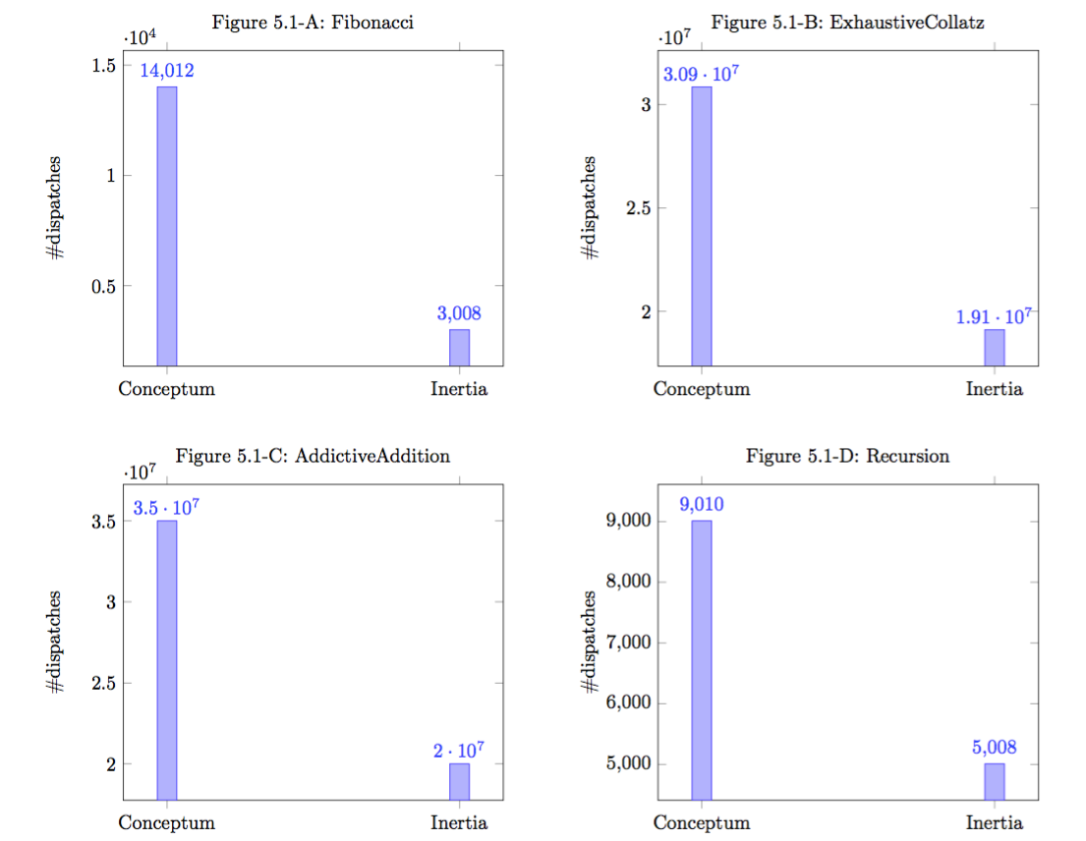
Result: Dispatch amount

Slide 9
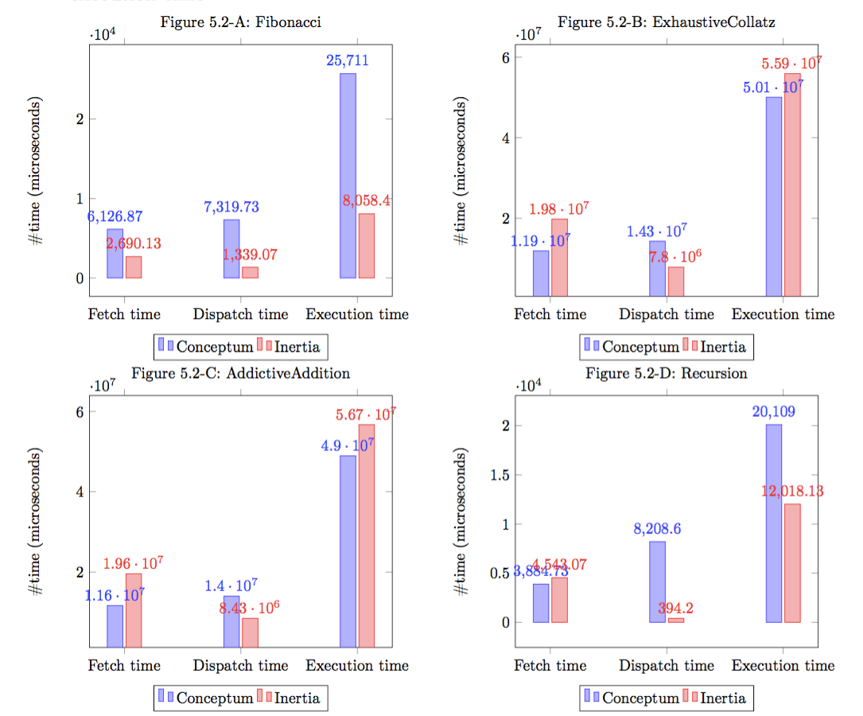
Result: Time spent

Slide 10
Conclusion
Overall a register-based VM implementation is faster
Stack-based VM performs better in fetch time (less)
If you want to implement a high performance, compact DSL on limited hardware, go for a register-based VM!
If you favor simplicity (both in byte code and in code for VM) over performance and want to perform dense read/write to the VM’s memory space, implement a stack-based VM!

Slide 11
Source code?
This PDF available at https://www.github.com/Conceptual-Inertia/presentations/plugtalk.pdf
Source code of Conceptum available at: https://www.github.com/Conceptual-Inertia/Conceptum
Source code of Inertia available at: https://www.github.com/Conceptual-Inertia/Inertia
The official paper available at: http://fat-sausage.derros.in/papers/vmplug.pdf
Questions? Critics? Suggestions? Email: frjalex@temple.edu

Slide 12

