Slide 1
Advanced Programming Practices (SOEN 6441)
Project Build 1
Team Members:
1. Amal Gupta (Student ID: 40293339)

Slide 2
Architectural Design Diagram

Slide 3
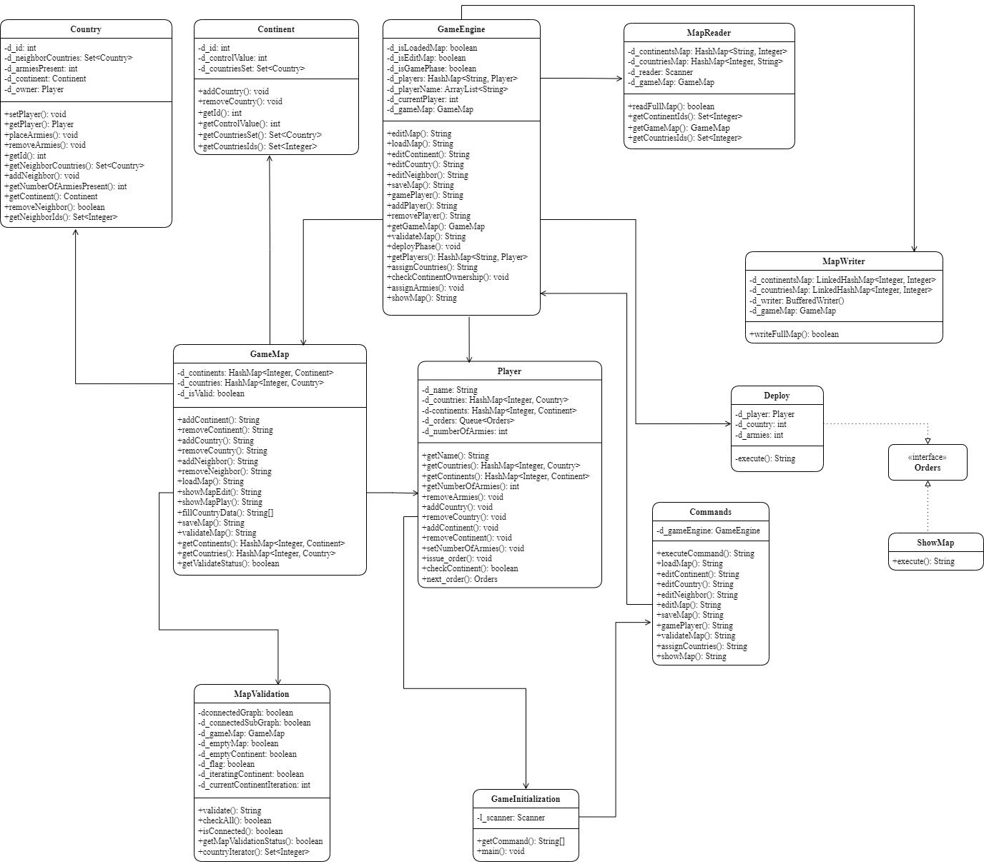

Slide 4
Description

Slide 5
Class Commands:
This Class is used to execute all commands by user which are fetched from GameInitialization Class.
Class GameInitialization:
This class is used to get user commands and call executeCommand() in Commands Class.
Class GameEngine:
This class is used to handle most part of the game. It is controller of the game and all the operations will execute from this class.

Slide 6
Class Country:
This class contains all details of country like ID, Continent, Neighbors, Owner, No. of Armies, etc.
Class Continent:
This class contains all details of continent like ID, Control Value, etc.
Class Player:
This class contains all details of player like name of player, ID, dominated Countries and Continents, No. of Armies, Orders etc.

Slide 7
Class GameMap:
This class is used to handle all the operations related to map like add/remove Countries and/or Continents, add/remove neighbors, load map, save map, etc.
Class MapWriter:
This class is used to write game map as text in map file.
Class MapReader:
This class is used to read data from map file.

Slide 8
Class MapValidation:
This class is used to validate map which is created by user, according to rules of the game.
Class Deploy:
This class is used to deploy armies according to orders issued by the player.
Class ShowMap:
This class is used to execute show map command at any time in the game.

Slide 9
Interface Orders:
This interface provides structure for execute order.

Slide 10
Thank You!

