Slide 1
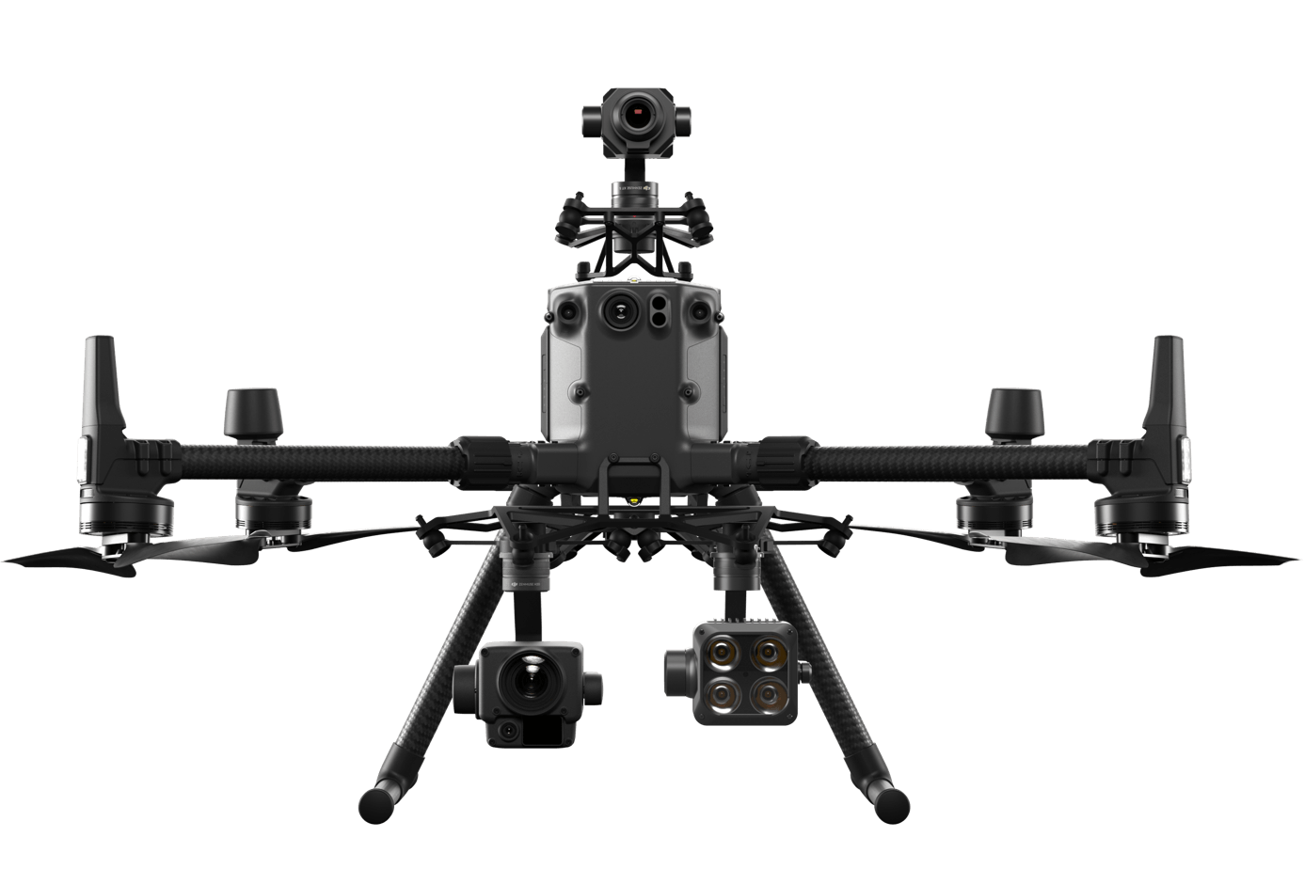

9
15
21
12
20
28

Slide 2
4
2
1
5
3
N
6
flight direction

