Slide 1
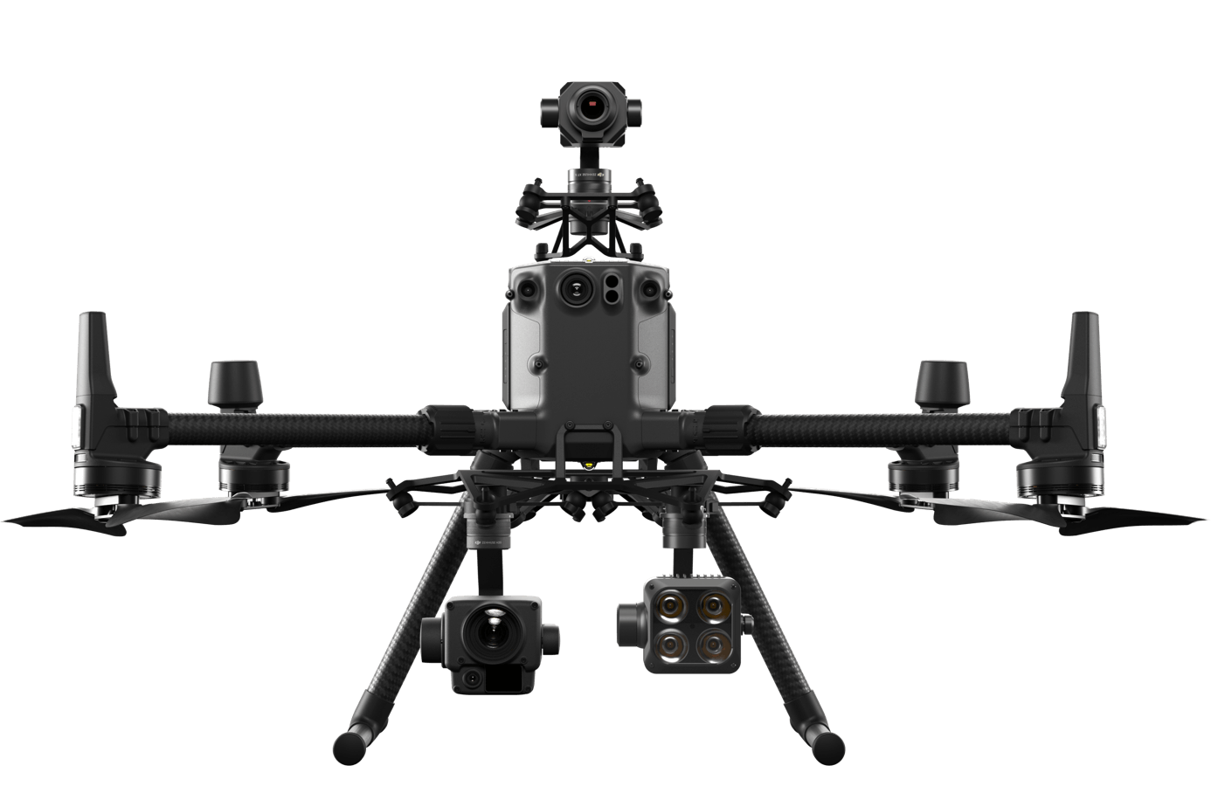
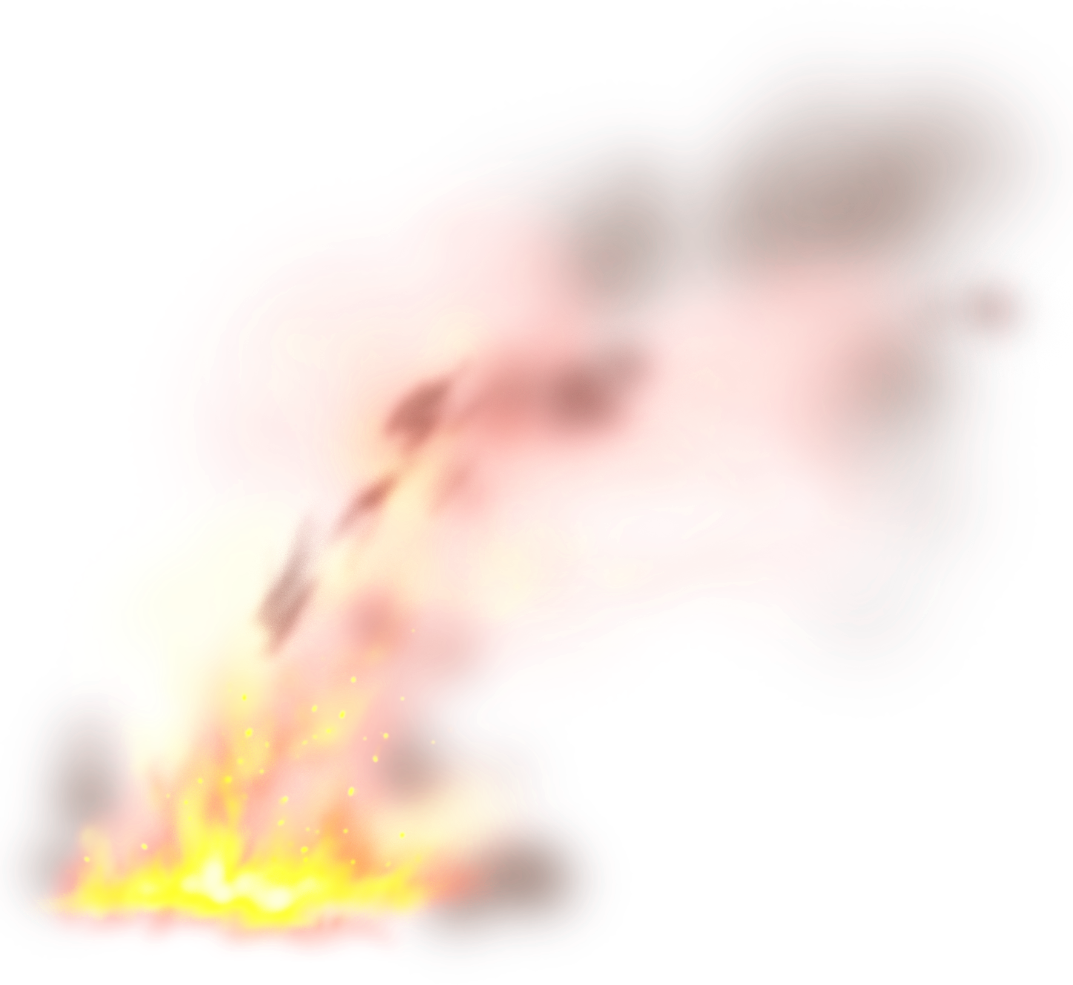
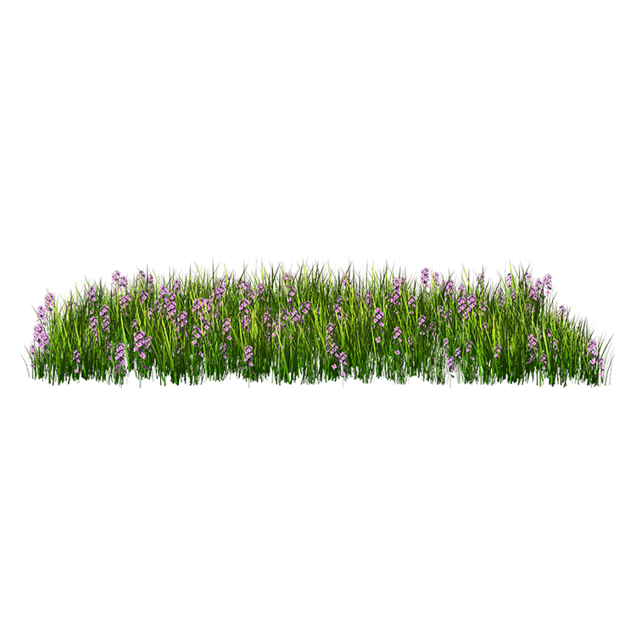
4
Take off
Fly along the predefined trajectory
If the fire and smoke is detected, adjust the camera to record and detect in detail. Else, keep flying.
Go home
2
3
1
early

Slide 2

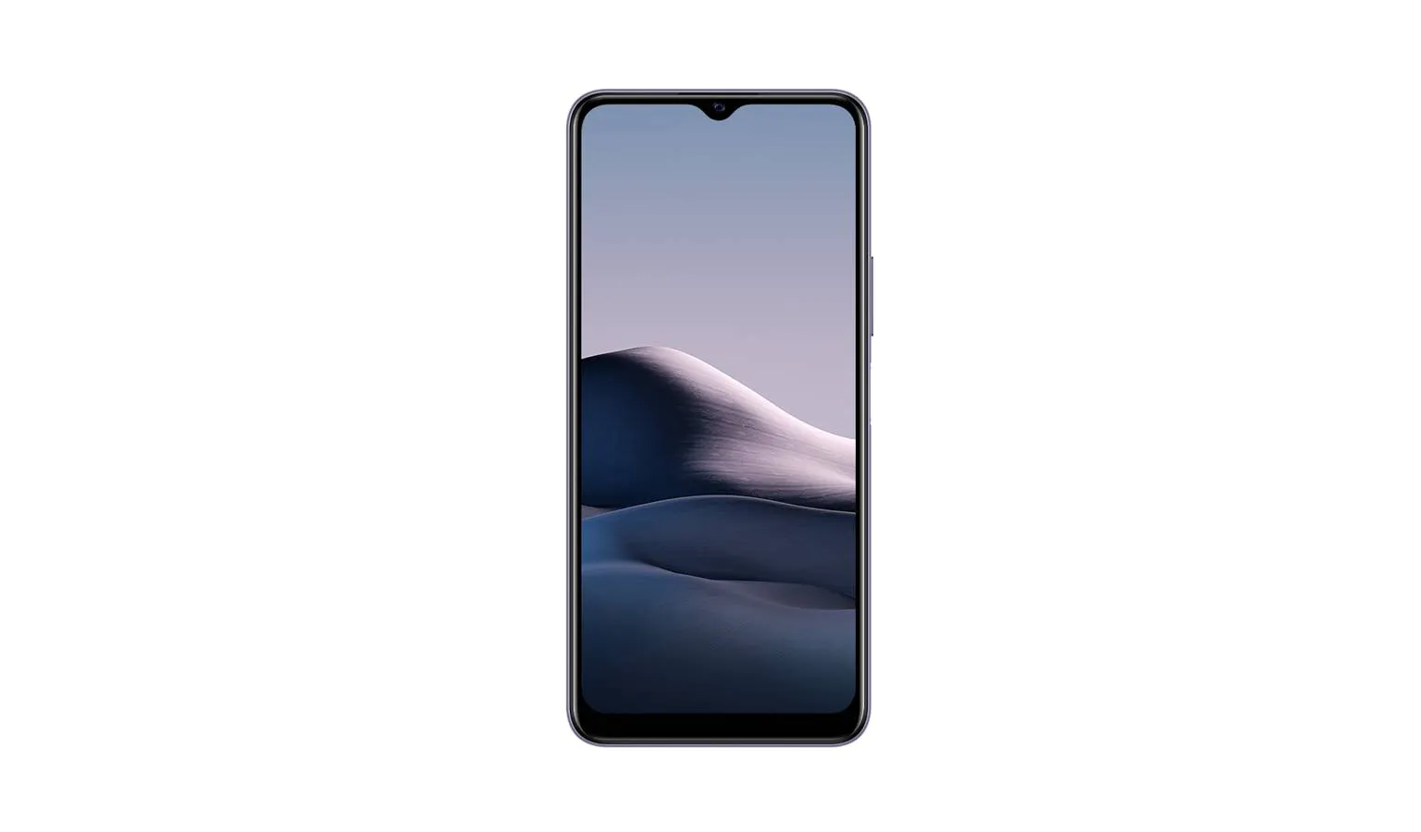

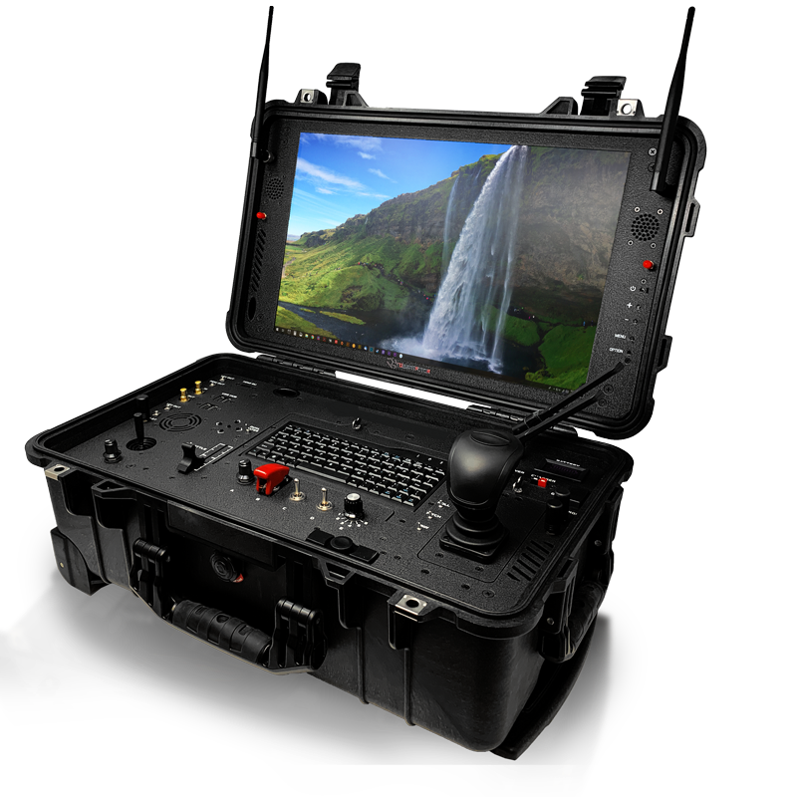
Drone Platforms
Smart Phones
Ground Station

Slide 3
Improvement:
Mission Logic
The motion control and computer vision worked separately last time. This time the 2 applications will work cooperatively.
Waypoint Flight
The first flight test, we use the joystick(remote controller) command to control the M300 to fly along the trajectory. This time we will use the GPS-based waypoints, which is much more flexible.
Fire & Smoke Detector
Last time, the false positive rate of the segmentation is too high! This time we will make progress on the segmentation algorithm.
Last time, we do not use the infrared camera image, this time this information will be used to reduce the missing of the potential fire.
A 2-stage detecting strategy will be used to save the computational resource of YUNGUAN.

Slide 4
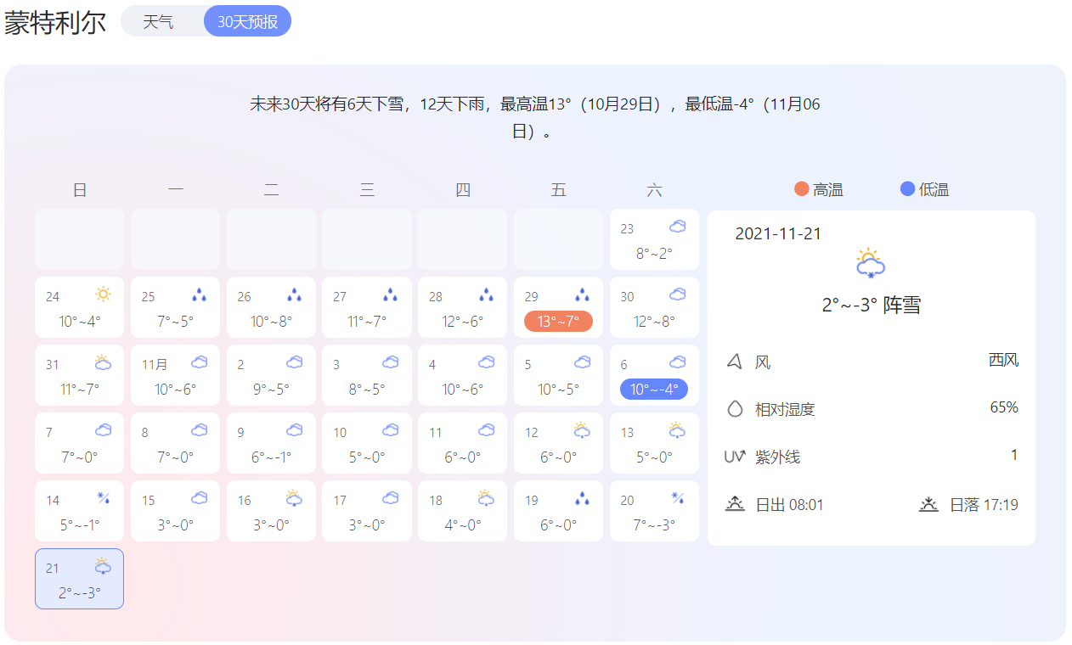
Consideration：
Time and Capacity:
The weather will be much cooler than it is right now!
The content of work and the time we should take into consideration.
In other words, we need to finish the designing, coding and ground testing in ONE Month.

Slide 5
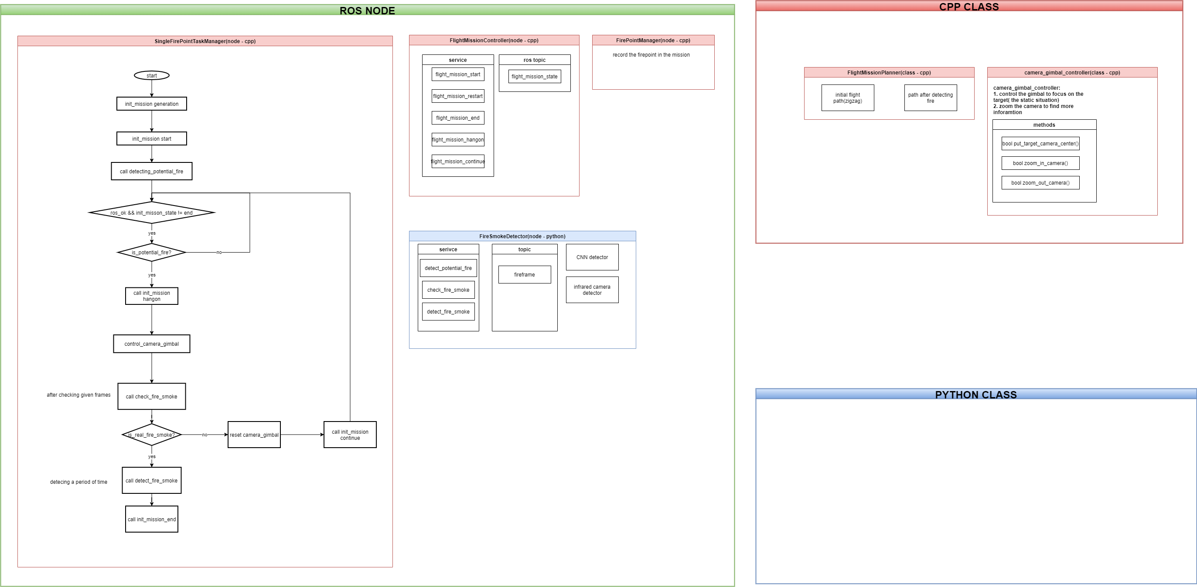
Why we do not prepare to develop the “replanning”?
First localization, then replanning!

