Slide 1
Algorithm Design and Applications
算法设计与应用基础
Xiaola Lin （林小拉）
Department of Computer Science
Sun Yat-sen University
Email: linxl@mail.sysu.edu.cn

Slide 2
Textbook & Reference Books
Textbook
Algorithms
Sanjoy Dasgupta, University of California-San Diego
Christos Papadimitriou, University of California at Berkeley
Umesh Vazirani, University of California at Berkeley
McGraw-Hill, 2007
Available at:
http://www.cs.berkeley.edu/~vazirani/algorithms.html
Various related books and research papers

Slide 3
中文版教材
算法概论（注释版）
[美] Sanjoy Dasgupta，
[美] Christos Papadimitriou，
[美] Umesh Vazirani 著；
钱枫，邹恒明 注
ISBN：9787111253617
机械工业出版社

Slide 4
Grading Scheme
Homework assignments: 20%
Midterm examination or project: 20%
Final examination (online): 60%
Leetcode
https://leetcode.com/problemset/algorithms/
网站

Slide 5
Outlines
Prologue
Algorithms with Numbers
Divide & Conquer Algorithms
Sorting & Order Statistics
Greedy Algorithms
Dynamic Programming
Backtracking
Linear Programming & Reductions
NP-Completeness
Introduction to Parallel Algorithms (option)

Slide 6
Chapter 0. Prologue

Slide 7
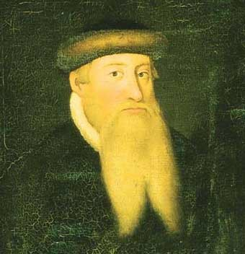
Johann Gutenberg
Johann Gutenberg (c. 1398 – February 3, 1468)
In 1448 in the German city of Mainz a goldsmith named Johann Gutenberg
discovered a way to print books by putting together movable metallic pieces.

Slide 8
Two ideas changed the world
Because of the typography, literacy spread, the Dark Ages ended, the human intellect was liberated, science and technology triumphed, the Industrial Revolution happened.
Many historians say we owe all this to typography. But others insist that the key development was not typography, but algorithms.

Slide 9
Decimal system
Gutenberg would write the number 1448 as MCDXLVIII. How do you add two Roman numerals? What is MCDXLVIII + DCCCXII ?
The decimal system was invented in India around AD 600.
Using only 10 symbols, even very large numbers could be written down compactly, and arithmetic could be done efficiently on them by following elementary steps.

Slide 10
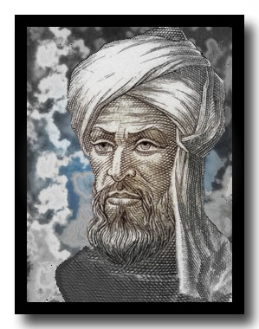
Al Khwarizmi
Al Khwarizmi (c.780 – c.850)
In the 12th century, Latin translations of his work on the Indian numerals, introduced the decimal system to the Western world. (Source: Wikipedia)

Slide 11
Algorithms
Al Khwarizmi laid out the basic methods for
adding, multiplying, dividing numbers,
extracting square roots,
calculating digits of π.
These procedures were precise, unambiguous, mechanical, efficient, correct. They were algorithms, a term coined to honor the wise man after the decimal system was finally adopted in Europe, many centuries later.

Slide 12
Algorithms
Algorithm ?= Program
Algorithm (webster.com)
-- A well-defined computational procedure that takes some value, or set of values, as input and produces some value, or set of values, as output.
-- Broadly: a step-by-step procedure for solving a problem or accomplishing some end especially by a computer.
Input
Algorithm
Output
-- Issues: correctness, efficiency (amount of work done and space used), simplicity and clarity, optimality, etc.

Slide 13
What kind of problems
Human Genome Project
  100,000 genes, sequences of the 3 billion chemical base pairs
Internet
  Finding good routes on which the data will travel
  Search engine
Electronic commerce
  Public-key cryptography and digital signatures
Manufacturing
  Allocate scarce resources in the most beneficial way

Slide 14
A concrete problem
Problem: you are given n integers (there may be negative ones but not all) a₁, a₂, …, a_{n}, determine i and j which maximize the sum from a_{i} to a_{j .}
Case: 6 integers: (-2，11，-4，13，-5，-2)
Answer: i=2, j=4, max sum is 20.

Slide 15
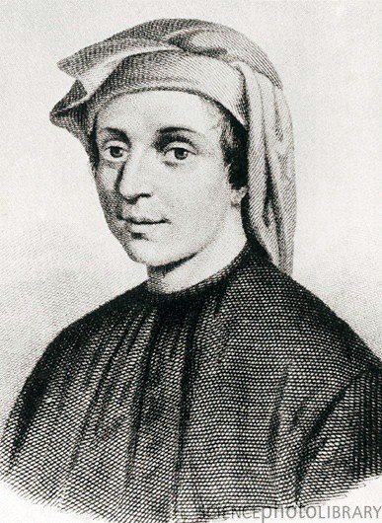
Leonardo Fibonacci
Leonardo Fibonacci (c. 1170 – c. 1250)
Fibonacci helped the spread of the decimal system in Europe, primarily through the publication in the early 13th century of his Book of Calculation, the Liber Abaci. (Source: Wikipedia)

Slide 16
Fibonacci sequence
Fibonacci sequence:
0, 1, 1, 2, 3, 5, 8, 13, 21, 34, ...
Formally,
F₀ =0, F₁=0, F_{n} = F_{n-1} +F_{n-2} (n>2)
What is F₁₀₀ or F₂₀₀?

Slide 17
An exponential algorithm
function fib1(n)
if n = 0: return 0
if n = 1: return 1
return fib1(n - 1) + fib1(n - 2)

Slide 18
Three questions about an algorithm
Is it correct?
How much time does it take, as a function of n?
And can we do better?
The first question is moot here, as this algorithm is precisely Fibonacci’s definition of F_{n}.

Slide 19
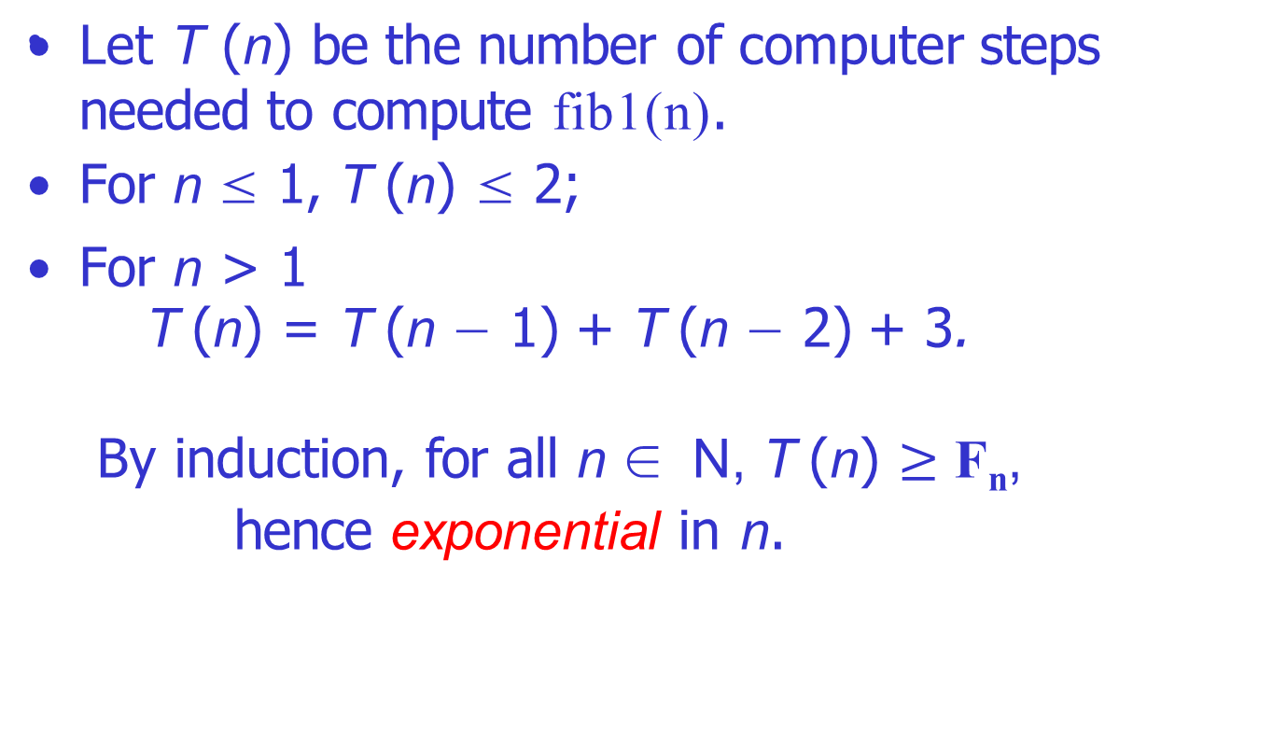
How much time?

Slide 20
Why exponential is bad?
T (200) ≥ F₂₀₀ ≥ 2¹³⁸ ≈ 2.56 × 10⁴² .
Not long ago, the fastest computer in the world is the Tianhe-2 system in Guangzhou, China. Its speed is 33.86 × 10¹⁵ steps per second.
Thus to compute F₂₀₀ Tianhe-2 needs roughly
7.57 × 10²⁵ seconds ≈ 2.41 × 10¹⁸ years.
Even if we started computing from the Big Bang, which is roughly 1.4 × 10¹⁰ years ago, only a tiny fraction has been completed.

Slide 21
What about Moore’s law?
Computer speeds have been doubling roughly every 18 months.
The running time of fib1(n) is proportional to
2^{0.694n} ≈ (1.6)^{n}.
Thus, it takes 1.6 times longer to compute F_{n+1} than F_{n} .
So if we can reasonably compute F₁₀₀ with this year’s technology, then next year we will manage F₁₀₁. And the year after, F₁₀₂. And so on:
just one more Fibonacci number every year!
Such is the curse of exponential time.

Slide 22
Algorithm for Fibonacci sequence
Recall the three questions about an algorithm:
Is it correct?
How much time does it take, as a function of n?
And can we do better?
Now we know fib1(n) is correct and inefficient, so can we do better?

Slide 23
A polynomial algorithm
function fib2(n)
if n = 0
return 0
create an array f[0...n] f[0] = 0, f[1] = 1
for i = 2...n:
f[i] = f[i - 1] + f[i - 2] return f[n]
The correctness of fib2(n) is trivial.
How long does it take? The inner loop consists of a single computer step and is executed n − 1 times. Therefore the number of computer steps used by fib2 is linear in n.

Slide 24
A more careful analysis
We have been counting the number of basic computer steps executed by each algorithm and thinking of these basic steps as taking a constant amount of time.
It is reasonable to treat addition as a single computer step if small numbers are being added, e.g., 32-bit numbers.
But the nth Fibonacci number is about 0.694n bits long, and this can far exceed 32 as n grows.
Arithmetic operations on arbitrarily large numbers cannot possibly be performed in a single, constant-time step.

Slide 25
A more careful analysis (cont’d)
We will see in Chapter 1 that the addition of two n-bit numbers takes time roughly proportional to n.
Thus fib1, which performs about F_{n} additions, uses a number of basic steps roughly proportional to nF_{n} .
Likewise, the number of steps taken by fib2 is proportional to n², still polynomial in n and therefore exponentially superior to fib1.

Slide 26
But can we do even better than fib2?
Indeed we can: see Exercise 0.4.

Slide 27
Counting the number of steps
We’ve seen how sloppiness in the analysis of running times can lead to unacceptable inaccuracy.
But it is also possible to be too precise to be useful.
Expressing running time in terms of basic computer steps is already a simplification. The time taken by one such step depends crucially on the particular processor, etc. Accounting for these architecture-specific details is too complicated and yields a result that does not generalize from one computer to the next.

Slide 28
Counting the number of steps (cont’d)
It therefore makes more sense to seek an machine-independent characterization of an algorithm’s efficiency.
To this end, we will always express running time by counting the number of basic computer steps, as a function of the size of the input.
Moreover, instead of reporting that an algorithm takes, say, 5n³ + 4n + 3 steps on an input of size n, it is much simpler to leave out lower-order terms such as 4n and 3 (which become insignificant as n grows).
Even the detail of the coefficient 5 in the leading term (computers will be five times faster in a few years anyway), and just say that the algorithm takes time O(n³) (pronounced “big oh of n³”).

Slide 29
Big-O notation
f (n) and g (n) are the running times of two algorithms on inputs of size n.
Let f (n) and g (n) be functions from positive integers to positive reals. We say f = O(g) (which means that “f grows no faster than g”) if there is a constant c > 0,
such that f (n) ≤ c · g (n).
f = O(g ) is a very loose analog of “f ≤ g .” It differs from the usual notion of because of the constant c , so that for instance 10n = O(n).

Slide 30
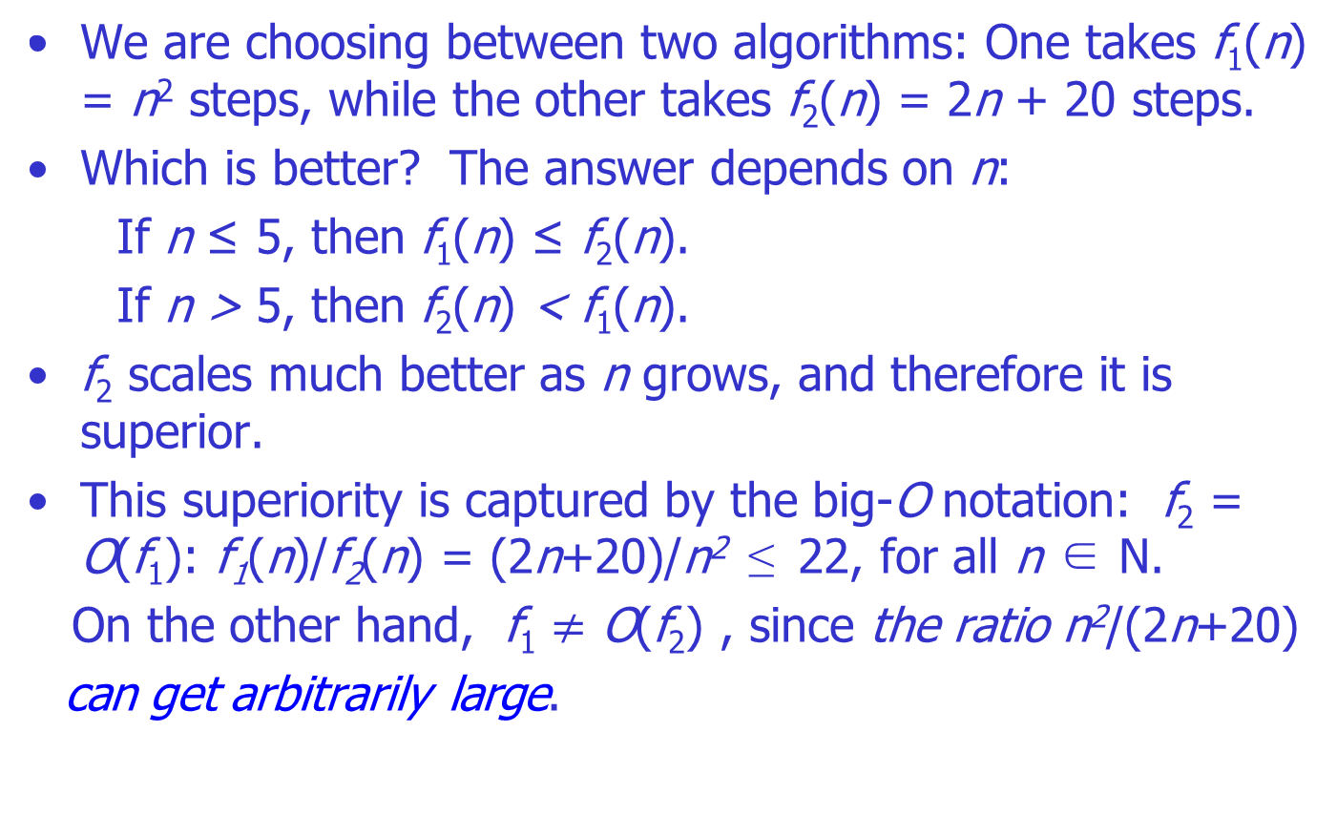
Why disregard the constant?

Slide 31
Why disregard the constant? (cont’d)
Recall f₁(n) = n² and f₂(n) = 2n + 20.
Suppose we have a third algorithm which uses
f₃(n) = n + 1 steps.
Is this better than f₂? Certainly, but only by a constant factor.
The discrepancy between f₂ and f₃ is tiny compared to the huge gap between f1 and f₂. In order to stay focused on the big picture, we treat functions as equivalent if they differ only by multiplicative constants.
Returning to the definition of big-O, we see that f₂ =O(f₃): f₂(n)/f₃(n) = (2n+20)/(n+1) ≤ 20 and f₃ = O(f₂) with c = 1.

Slide 32
Other similar notations
Just as O(·) is an analog of ≤, we also define analogs of ≥ and = as follows:
f = Ω(g ) means g =O(f)
f = Θ(g ) means f = O(g) and f = Ω(g)
Recall f₁(n) = n², f₂(n) = 2n + 20 and f₃(n) = n + 1. Then
f₂ = Θ(f₃) and f₁ = Ω(f₃).

Slide 33
Some simple rules
Big-O notation lets us focus on the big picture. When faced with a complicated function like 3n² + 4n + 5, we just replace it with O(f (n)), where f (n) is as simple as possible.
In this particular example we’d use O(n²), because the quadratic portion of the sum dominates the rest.

Slide 34
Some commonsense rules
Here are some commonsense rules that help simplify functions by omitting dominated terms:
Multiplicative constants can be omitted: 14n² becomes n².
nª dominates n^{b} if a > b: for instance, n² dominates n.
Any exponential dominates any polynomial: 3^{n} dominates n⁵ (it even dominates 2^{n} ).
Likewise, any polynomial dominates any logarithm: n dominates (log n)³. This also means, for example, that n² dominates n log n.

Slide 35
Warning
Programmers and algorithm developers are very interested in constants and would gladly stay up nights in order to make an algorithm run faster by a factor of 2.
But understanding algorithms at the level of this book would be impossible without the simplicity afforded by big-O notation.

Slide 36
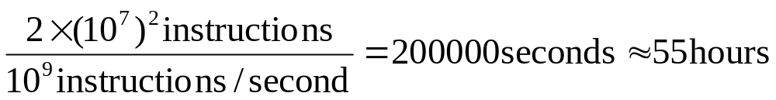
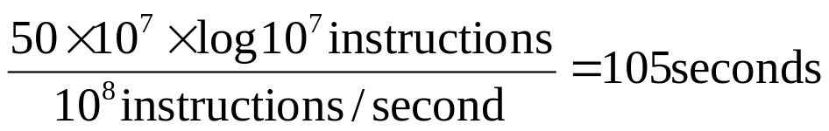
Importance of algorithm efficiency
Problem: sorting 10,000,000 integers
  Case 1: Computer A executes one billion instructions per second (1G/s), an algorithm taking time roughly equal to 2n² to sort n integers.
  Case 2: Computer B executes one hundred million instructions per second (100M/s), an algorithm taking time roughly equal to 50nlgn to sort n integers.
  Case 1:
  Case 2:

Slide 37
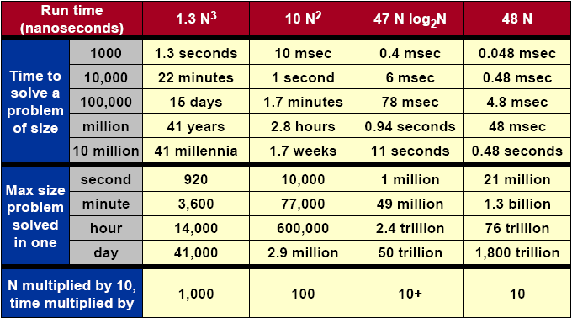
Importance of algorithms

Slide 38
Analysis of algorithms
The theoretical study of computer-program performance and resource usage.
What’s more important than performance?
--modularity --user-friendliness
--correctness --programmer time
--maintainability --simplicity
--functionality --extensibility
--robustness --reliability

Slide 39
Why study algorithm and performance?
Algorithms help us to understand scalability.
Performance often draws the line between what is feasible and what is impossible.
Algorithmic mathematics provides a language for talking about program behavior.
The lessons of program performance generalize to other computing resource.
Speed is fun.
Notes:
Scalability：可量测性

Slide 40
Example: The problem of sorting
Input: sequence <a₁,a₂,…,a_{n}> of n natural numbers
Output: permutation <a’₁,a’₂,…,a’_{n}> such that a’₁≤a’₂≤…≤a’_{n}
Example
--Input: <5, 2, 4, 6, 1, 3>
--Output: <1, 2, 3, 4, 5, 6>

Slide 41
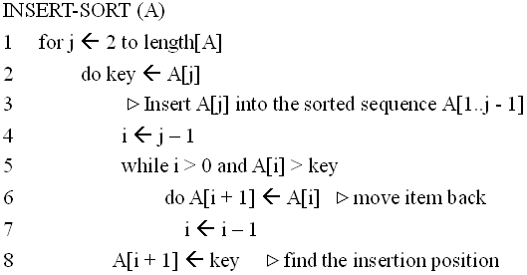
Insertion Sort
1
i
j
n
sorted
key

Slide 42
Insertion Sort
初始
j=2
j=3
1
2
3
4
5
6
1
2
3
4
5
6
1
2
3
4
5
6
-∞
8
5
7
9
6
4
-∞
8
5
7
9
6
4
-∞
5
8
7
9
6
4
j=4
j=5
j=6
1
2
3
4
5
6
1
2
3
4
5
6
1
2
3
4
5
6
-∞
5
7
8
9
6
4
-∞
5
7
8
9
6
4
-∞
5
6
7
8
9
4

Slide 43
Running time
The running time depends on the input: an already sorted sequence is easier to sort.
Parameterize the running time by the size of the input, since short sequences are easier to sort than long ones.
Generally, we seek upper bounds on the running time, because everybody likes a guarantee.

Slide 44
Kinds of analysis
Worst-case: (usually)
-- T(n) = maximum time of algorithm on any input of size n.
Average-case: (sometimes)
-- T(n) = expected time of algorithm over all inputs of size n.
-- Need assumption of statistics distribution of inputs.
Best-case: (bogus)
-- Cheat with a slow algorithm that works fast on some input.
Notes:
Bogus：假的, 伪造的

Slide 45
Machine-independent time
What is insertion sort’s worst-case time?
-- It depends on the speed of our computer:
>> relative speed (on the same machine)
>> absolute speed (on different machine)
BIG IDEA:
-- Ignore machine-dependent constants.
-- Look at growth of T(n) as n → ∞
“Asymptotic Analysis”

Slide 46
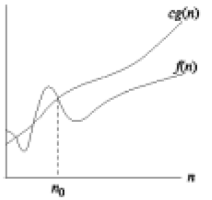
More about O-notation
O(g(n)) = { f(n): There exist positive constants c and n₀ such that 0≤f(n) ≤cg(n) for all n≥n₀ }
--O(.) is used to asymptotically upper bound a function.
--O(.) is used to bound worst-case running time.

Slide 47
More about O-notation, cont.
Examples:
-- 1/3n² – 3n ∈O(n²) because 1/3n² – 3n ≤cn² if c≥1/3-3/n which holds for c = 1/3 and n >1
-- k₁n²+k₂n+k₃∈O(n²) because k₁n² + k₂n+ k₃≤(k₁+|k₂|+|k₃|)n² and for c > k₁ + |k₂| + |k₃| and n≥ 1, k₁n² + k₂n + k₃ ≤ cn²

Slide 48
O-notation: Note
--When we say “the running time is O(n²)” we mean that the worst-case running time is O(n²) – the best case might be better.
--Use of O-notation often makes it much easier to analyze algorithms; we can easily prove the O(n²) insertion-sort time bound.
--We often abuse the notation a little:
>> We often write f(n) = O(g(n)) instead of f(n) ∈O(g(n))
>> We often use O(n) in equations: e.g. 2n² + 3n + 1 = 2n² + O(n) (meaning that 2n² + 3n + 1=2n² + f(n) where f(n) is some function in O(n))
>>We use O(1) to denote constant time.

Slide 49
More about Θ-notation
Math:
Θ(g(n)) = {f(n): There exist positive constants c₁, c₂, and n₀ > 0 such that 0≤c₁g(n) ≤f(n)≤c₂g(n) for all n≥n₀}
Engineering:
--Drop low-order terms; ignore leading constants.
--Example: 3n³ + 90n² – 5n + 6046 = Θ(n³)

Slide 50
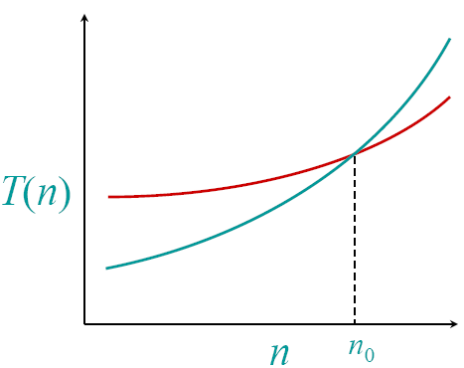
Asymptotic performance
When n gets larger enough, a Θ(n²) algorithm always beats a Θ(n³) algorithm
-- We shouldn’t ignore asymptotically slower algorithms, however.
-- Real-world design situations often call for a careful balancing of engineering objectives.
-- Asymptotic analysis is a useful tool to help to structure our thinking.

Slide 51
Insertion sort analysis
Worst case: Input reverse sorted
Best case: Input already sorted
Is insertion sort a fast sorting algorithm?
--Moderately so, for small n.
--Not at all, for large n.

Slide 52
Analysis algorithms
Analysis of an algorithm: predicting the resources, including memory, communication bandwidth, or computer hardware and so on, that the algorithm requires.
But most often we want to measure the computational time of an algorithm.
Before we can analyze an algorithm, we must have a model of the implementation technology that will be used, including a model for the resources of that technology and their costs.

Slide 53
Analysis algorithms
We shall assume a generic one-processor, random-access machine (RAM) model of computation.
-- Instructions are executed one after another, with no concurrent operations.
-- Each time, an instruction of a program is executed as an atom operation. An instruction includes arithmetic operations, logical operations, data movement and control operations.
-- Each such instruction takes a constant amount of time.
-- RAM capacity is large enough.
-- …
Under RAM model: count fundamental operations

Slide 54
Exercises
Exercises 0.1 and 0.2.

