Slide 1
NP-Completeness: Preliminary
Computational Complexity
Topics:
-- Computability
-- Analysis of Algorithms

Slide 2
Computability: undecidable Problems
In computability theory and computational complexity theory, an undecidable problem is a decision problem for which it is known to be impossible to construct a single algorithm that always leads to a correct yes-or-no answer.
Notes:
devise：设计
multivariate:多元的
polynomial：多项式

Slide 3
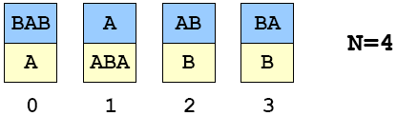
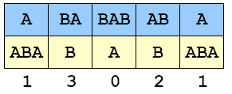
Post’s Correspondence Problem邮差问题
Given a set of cards:
-- N card types (can use as many of each type as possible)
-- Each card has a top string and bottom string.
Example 1:
Puzzle:
-- Is it possible to arrange cards so that top and bottom strings are the same?
Solution 1:

Slide 4
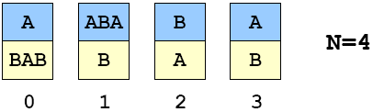
A Puzzle (“Post’s Correspondence Prob.”)
Given a set of cards:
-- N card types (can use as many of each type as possible)
-- Each card has a top string and bottom string.
Example 2:
Puzzle:
-- Is it possible to arrange cards so that top and bottom strings are the same?
Solution 2: ?
Notes:
波斯特对应问题

Slide 5
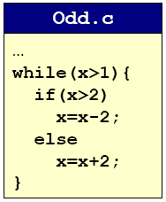
Undecidable Problems
Post’s Correspondence Problem.
Halting Problem
Halting Problem.停机问题
  Write a C program that reads in another program and its inputs, and decides whether or not it goes into an infinite loop.
    loop infinite often signifies a bug
  Program 1.
    8 6 4 2 4 2 4 2 4 2 4 2 4 2 4
    9 7 5 3 1

Slide 6
Undecidable Problems
Hilbert’s 10th Problem.
Post’s Correspondence Problem.
Halting Problem.
Program Equivalence.
Optimal Data Compression.
Virus Identification.
Impossible to write C program to solve any of these problem!

Slide 7
Consequences
Halting problem is “not artificial.”在实际生活中，是存在的
  Undecidable problem reduced to simplest form to simplify proof.
  Closely related to practical problems.
  Hilbert’s 10th problem, Post’s correspondence problem, program equivalence, optimal data compression
How to show new problem X is undecidable?
  Use fact that Halting problem is undecidable.
  Design algorithm to solve Halting problem, using (alleged) algorithm for X as a subroutine.
  Reduction
Notes:
alleged：所谓的

Slide 8
Implications
Practical:
  Work with limitations.现在的计算机无能为了
  Recognize and avoid unsolvable problems.避免做无用功
  Learn from structure.
    Same theory tells us about efficiency of algorithms
Philosophical (caveat: ask a philosopher):
  We “assume” that any step-by-step reasoning will solve any technical or scientific problem.这是错误的
  “Not quite” says the halting problem.
  Anything that is like (could be) a computer has the same flaw缺陷.
Notes:
caveat:警告

Slide 9
Summary
What is an algorithm?
  Informally: a step-by-step procedure for solving a problem.
  Formally: a Turing machine图灵机
Is it possible, in principle, to write a program to solve any problem?
  No.

Slide 10
Analysis of Algorithm
For many problems, there may be several competitive algorithms.
  Which one should I use?
Analysis of algorithms.
  framework for comparing algorithms and performance prediction.
  case study: sorting
Computational complexity.
  framework for studying intrinsic difficulty of problems.

Slide 11
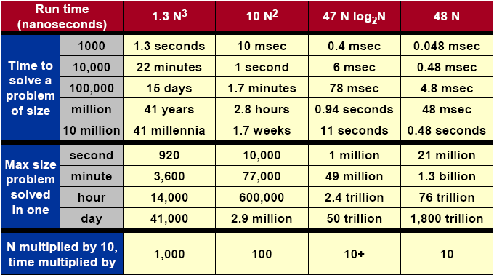
What Does It Matter?
Notes:
millennia:千年

Slide 12
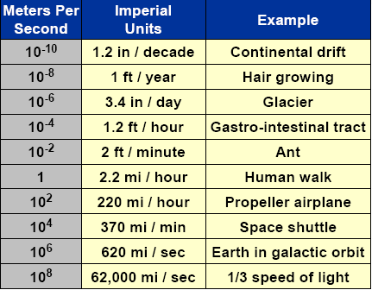
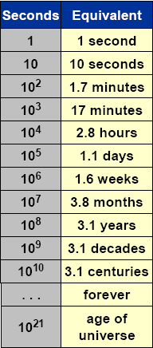

Orders of Magnitude

Slide 13
Better Machines vs. Better Algorithms
New machine.
  Costs $$$ or more.
  Makes “everything” finish sooner.
  Incremental quantitative improvements (Moore’s Law).机器的进步贴合摩尔定律
  May not help much with some problems.
New algorithm.
  Costs $ or less.
  Dramatic qualitative improvements possible! (million time faster)
  May make the difference, allowing specific problem to be solved.
  May not help much with some problems.

Slide 14
Implementation of Algorithms
Algorithm.
  “Step-by-step recipe” used to solve a problem.
  Generally independent of programming language or machine on which it is to be executed.
Design.
  Find a method to solve the problem.
Analysis.
  Evaluate its effectiveness and predict theoretical performance.
Implementation.
  Write actual code and test your theory.
Notes:
方法，烹饪法

