Slide 1

Computer Organization and Design
中山 大 学
数据科学与计算机学院
郭雪梅
Tel:39943108
Email:guoxuem@mail.sysu.edu.cn

Slide 2
Introduction
To command a computer’s hardware, you must speak its
language.
The words of a machine’s language are called “Instructions”.
The vocabulary is called an “Instruction set”.
Machine’s languages are simpler and easier, once you learn one, you can pick up others easily.
Reason:
(1) Hardware and operating principle are similar.
(2) Basic operations (add, mul, move) are similar.

Slide 3
计算机中数的表示的基本问题
基本约束：采用二进制，只有1和0；
数的表示要解决的问题
数的符号：正数、负数、零
数的形态：整数、小数、小数点的性质；
数的
01000001
字符：字母A（ASCII码）
整数：65
小数：0.253906绝对值

Slide 4
Encoding（信息的表示）
Encoding = assign representation to information
Examples:
  suppose you have two “things” (symbols) to encode
    one is ☞ and other ☜
    what would you do?
  now suppose you have 4 symbols to encode
    😄 (smiley), 😱 (screamie), 😖 (confusie), 😪 (sleepy)
    what would you do?
  now suppose you have the following numbers to encode
    1, 3, 5 and 7
    what would you do?

Slide 5
Fixed-Size Codes
Length of a fixed-length code （位数相同的编码）
If all choices are equally likely (or we have no reason to expect otherwise), then a fixed-size code is often used. Such a code should use at least enough bits to represent the information content.
ex. Decimal digits 10 = {0,1,2,3,4,5,6,7,8,9} 4-bit BCD (binary coded decimal)
BCD
0 - | 0000
1 - | 0001
2 - | 0010
3 - | 0011
4 - | 0100
5 - | 0101
6 - | 0110
7 - | 0111
8 - | 1000
9 - | 1001
log (10/1) = 3.322 < 4 bits
2
ex. ~84 English characters = {A-Z (26), a-z (26), 0-9 (10),
punctuation (8), math (9),
financial (5)}
7-bit ASCII (American Standard Code for Information Interchange) log₂(84/1) = 6.392 < 7 bits
08/24/2018

Slide 6
ASCII
 | 0000 | 0001 | 0010 | 0011 | 0100 | 0101 | 0110 | 0111 | 1000 | 1001 | 1010 | 1011 | 1100 | 1101 | 1110 | 1111
000 | NUL | SOH | STX | ETX | EOT | ACK | ENQ | BEL | BS | HT | LF | VT | FF | CR | SO | SI
001 | DLE | DC1 | DC2 | DC3 | DC4 | NAK | SYN | ETB | CAN | EM | SUB | ESC | FS | GS | RS | US
010 |  | ! | " | # | $ | % | & | ' | ( | ) | * | + | , | - | . | /
011 | 0 | 1 | 2 | 3 | 4 | 5 | 6 | 7 | 8 | 9 | : | ; | < | = | > | ?
100 | @ | A | B | C | D | E | F | G | H | I | J | K | L | M | N | O
101 | P | Q | R | S | T | U | V | W | X | Y | Z | [ | \ | ] | ^ | _
110 | ` | a | b | c | d | e | f | g | h | i | j | k | l | m | n | o
111 | p | q | r | s | t | u | v | w | x | y | z | { | | | } | ~ | DEL
For letters upper and lower case differ in the 6th "shift" bit 10XXXXX is upper, and 11XXXXX is lower
Special "control" characters set upper two bits to 00
ex. cntl-g → bell, cntl-m → carriage return, cntl-[ → esc
This is why bytes have 8-bits (ASCII + optional parity). Historically, there were computers built with 6-bit bytes, which required a special "shift" character to set case.
08/24/2018

Slide 7
Unicode（统一码）
ASCII is biased towards western languages, esp. English
In fact, many more than 256 chars in common use:
â, m, ö, ñ, è, ¥, 揗, 敇, 횝, カ, ℵ, ℷ, ж, ค
Unicode is a worldwide standard that supports all languages, special characters, classic, and arcane
  Several encoding variants, e.g. 16-bit (UTF-8)
ASCII equiv range:
0
x
x
x
x
x
x
x
16-bit Unicode
1
1
0
y
y
y
y
x
1
0
x
x
x
x
x
x
24-bit Unicode
1
1
1
0
z
z
z
z
1
0
z
y
y
y
y
x
1
0
x
x
x
x
x
x
1
1
1
1
0
w
w
w
1
0
w
w
z
z
z
z
1
0
z
y
y
y
y
x
1
0
x
x
x
x
x
x
32-bit Unicode

Slide 8

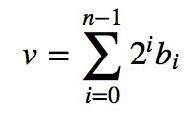
Encoding Positive Integers
It is straightforward to encode positive integers as a sequence of bits. Each bit is assigned a weight. Ordered from right to left, these weights are increasing powers of 2. The value of an n-bit number encoded in this fashion is given by the following formula:
₂15 ₂14 ₂13 ₂12 ₂11 ₂10 ₂9 ₂8 ₂7 ₂6 ₂5 ₂4 ₂3 ₂2 ₂1 ₂0
0 | 0 | 0 | 0 | 0 | 1 | 1 | 1 | 1 | 1 | 1 | 0 | 0 | 0 | 1 | 0
2¹ = 2
+ 2⁵ = 32
+ 2⁶ = 64
+ 2⁷ = 128
+ 2⁸ = 256
+ 2⁹ = 512
+ 2¹⁰ = 1024
2018
08/24/2018

Slide 9
Some Bit Tricks（一些技巧）
Get used to working in binary
Here are some helpful guides
Memorize the first 10 powers of 2
  2⁰ = 1 2⁵ = 32
  2¹ = 2 2⁶ = 64
  2² = 4 2⁷ = 128
  2³ = 8 2⁸ = 256
  2⁴ = 16 2⁹ = 512
2. Memorize the prefixes for powers of 2 that are
multiples of 10（记住2的10的倍数幂）
  2¹⁰ = Kilo (1024)
  2²⁰ = Mega (1024*1024)
  2³⁰ = Giga (1024*1024*1024)
  2⁴⁰ = Tera (1024*1024*1024*1024)
  2⁵⁰ = Peta (1024*1024*1024 *1024*1024)
  2⁶⁰ = Exa (1024*1024*1024*1024*1024*1024)

Slide 10
Even More Tricks with Bits
Get used to working in binary
Here are some helpful guides
01
0000000011
0000001100
0000101000
When you convert a binary number to decimal, first break it down into clusters of 10 bits（先分成10位一组）.
Then compute the value of the leftmost remaining bits (1) find the appropriate prefix (GIGA) (Often this is sufficient)，1G
Compute the value of and add in each remaining 10-bit cluster

Slide 11
Binary Number Conversion
(二进制数转换)
Binary → Decimal
Decimal → Binary
1001010_{two} = ?_{ten}
74_{ten} = ?two
Binary Digit | Decimal Value
0 | 0 x 2⁰ = 0
1 | 1 x 2¹ = 2
0 | 0 x 2² = 0
1 | 0 x 2³ = 8
0 | 0 x 2⁴ = 0
0 | 0 x 2⁵ = 0
1 | 1 x 2⁶ = 64
 | Σ = 74_{ten}
Decimal | Binary (odd?)
74 | 0
/2 = 37 | 1
/2 = 18 | 0
/2 = 9 | 1
/2 = 4 | 0
/2 = 2 | 0
/2 = 1 | 1
Collect → | 1001010_{two}
Notes:
Computers work with binary numbers.
Digits are only 0 or 1. Not 0 … 9, like in decimal.
Since we work close to the hardware, we occasionally deal with binary numbers.
Frequently we want to convert between decimal and binary. Many ways to do this. Here I show you a simple approach. If you are familiar with something else, use that.
B->D
Binary number goes in left column. LSB at the top.
Determine decimal value of each digit.
Sum up the individual values.
D->B
Start with decimal value.
Binary digit is 1 if decimal is odd, 0 otherwise.
Divide by 10, ignore fraction. Repeat down to 1.
Collect binary digits. MSB is at bottom.

Slide 12
Hexadecimal
Binary | Hex
0000 | 0
0001 | 1
0010 | 2
0011 | 3
0100 | 4
0101 | 5
0110 | 6
0111 | 7
1000 | 8
1001 | 9
1010 | A
1011 | B
1100 | C
1101 | D
1110 | E
1111 | F
Problem: many digits
  e.g. 7643_{ten} = 1110111011011_{two}
Solutions:
  Grouping: 1 1101 1101 1011_{two}
  Hexadecimal: 1DDB_{hex}
  Octal: 1 110 111 011 011_{two}
  16733_{oct}
Notes:
Binary numbers have many digits:
In binary, everybody is “rich”!
Computer do not care (nor do they mix up long sequences of bits).
Human’s need “crutches”.
Hexadecimal is most common: map 4 bits to a single character.

Slide 13
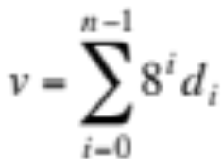
Other Helpful Clusterings(其他有用的聚类)
Sometimes convenient to use other number “bases”
  often bases are powers of 2: e.g., 8, 16
    allows bits to be clustered into groups
  base 8 is called octal ➔ groups of 3 bits
    Convention: lead the number with a 0
2¹¹
2¹⁰
2⁹
2⁸
2⁷
2⁶
2⁵
2⁴
2³
2²
2¹
2⁰
0
1
1
1
1
1
0
1
0
0
0
0
= 2000₁₀
03720
Octal - base 8
000 - 0
001 - 1
010 - 2
011 - 3
100 - 4
101 - 5
110 - 6
111 - 7
3
7
2
0
0*8⁰ = 0
+ 2*8¹ = 16
+ 7*8² = 448
+ 3*8³ = 1536
2000₁₀

Slide 14
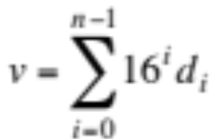
One Last Clustering
Base 16 is most common!
  called hexadecimal or hex ➔ groups of 4 bits
  hex ‘digits’ (“hexits”): 0-9, and A-F
  each hexit position represents a power of 16
    Convention: lead with 0x
2¹¹
2¹⁰
2⁹
2⁸
2⁷
2⁶
2⁵
2⁴
2³
2²
2¹
2⁰
0
1
1
1
1
1
0
1
0
0
0
0
= 2000₁₀
0x7d0
Hexadecimal - base 16
0000 - 0 1000 - 8
0001 - 1 1001 - 9
0010 - 2 1010 - a
0011 - 3 1011 - b
0100 - 4 1100 - c
0101 - 5 1101 - d
0110 - 6 1110 - e
0111 - 7 1111 - f
7
d
0
0*16⁰ = 0
+ 13*16¹ = 208
+ 7*16² = 1792
2000₁₀

Slide 15
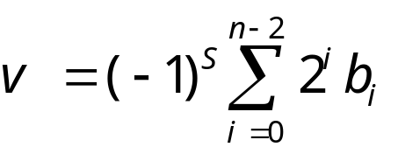
Signed-Number Representations
有符号数的表示
What about signed numbers?机器数表示
  one obvious idea: use an extra bit to encode the sign
  (数的正负问题：设符号位,“0”表示“正”，“1”表示“负”，固定为编码的最高位。)
    convention: the most significant bit (leftmost) is used for the sign
    called the SIGNED MAGNITUDE representation
S
2¹⁰
2⁹
2⁸
2⁷
2⁶
2⁵
2⁴
2³
2²
2¹
2⁰
1
0
1
1
1
1
1
0
1
0
0
0
0
2000
-2000

Slide 16
Signed Integer Representation
有符号整数的表示
Sign & magnitude (8-bit example):
Rules for addition，a + b:
If (a>0 and b>0): add, sign 0
If (a>0 and b<0): subtract, sign …
… (有符号数加法怎样确定正负，有4种情况)
+0, -0 → are they equal? comparator must handle special case!真值0怎么办：正零，负零
Cumbersome（这种表示方法麻烦）
”Complicated” hardware: reduced speed / increased power
Is there a better way?（有没有更好的表示方法）
sign | 7-bit magnitude (0 … 127)
Notes:
Familiar decimal notation: just prepend minus sign to signify negative value.
It’s like an extra bit reserved to indicating the sign.
No change to magnitude.
Could do the same with binary numbers.
Unfortunately the result is a nightmare:
rules of addition depend on signs of operands
two representations for zero: + and minus. Cannot just compare bits to determine equality!
It’s possible to build computers that use signed-magnitude integers.
But this adds complexity to the hardware doing arithmetic.
Just like programmer hates slow algorithms, computer architect hates slow hardware.
Complexity reduces speed (maximum frequency at which operations can be performed). Or increases power dissipation. And size. And cost.
Fortunately there is a better way!

Slide 17
补码表示法 Signed-2’s complement Representation
1．模和同余 n=K*q+r(余数)
一个计量器的容量或一个计量单位叫做模数（Module），简称模，记作M或mod。
一个n位的二进制计数器的模是2^{n}。
对于两个整数a、b，若用某一正数M去除，所得的余数相同，则称a、b对模M是同余的。
当a、b对模M同余时，就称a、b在以M为模时是相等的，记作 a=b （mod M）。
例如，a=14，b=24，M=10，则用10去除a和b，余数都是4，所以14和24在以10为模时是同余的，记作 14=24 （mod 10）。
可推出，a+M=a （mod M）
a+2M=a （mod M）
当a=0时，有0=M （mod M）。
当a为负数时，例如a=－2
－2+10=－2 （mod 10）
-2=0*10+（-2）
8=－2 （mod 10）
8=1*10+（-2）

Slide 18
4-bit Example（用4位数的计算举例说明为什么使用补码表示）
Decimal
Binary
 | 7
+ | -3
 | 4
 | 7
+ | -3 | + 16
 | 4 | + 16
 | 7
+ | 13
 | 4 + 16
 | 0111
+ | 1101
 | 1 0100 | 0100 + 1 0000
Map negative → positive numbers
  Example for N=4-bit: -3 → 2⁴ – 3 = 13
  “Two’s complement”
  No special rules for adding positive and negative numbers
-8 | -7 | … | -1 | 0 | 1 | … | 7
 |  |  |  | 0 | 1 | … | 7 | 8 | 9 | … | 15
+ 2⁴ = 16

Slide 19
Two’s Complement
(8-bit example)
Signed Decimal | Unsigned Decimal | Binary Two’s Complement
-128 | 128 | 1000 0000
-127 | 129 | 1000 0001
… | … | …
-2 | 254 | 1111 1110
-1 | 255 | 1111 1111
0 | 0 | 0000 0000
1 | 1 | 0000 0001
… | … | ...
127 | 127 | 0111 1111
+256
+0
Note: Most significant bit (MSB) equals sign

Slide 20
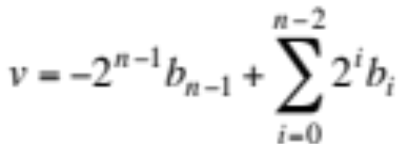
二进制补码的其它表示
N bits
-2^{N-1}
2^{N-2}
…
…
…
2³
2²
2¹
2⁰
Range: – 2^{N-1} to 2^{N-1} – 1
“sign bit”
“binary” point
简单地修正了无符号数的表示，只是把符号位当做负数。
符号数
8-bit 2’s complement example:
11010110 = –2⁷ + 2⁶ + 2⁴ + 2² + 2¹
= – 128 + 64 + 16 + 4 + 2 = – 42

Slide 21

Why 2’s Complement?
Benefit: 模 2^{n} 的运算，用补码表示减法变成了加负数
  只有加法没有减法运算，不用管符号位!
  处理无符号数同样适用!
Example:
55₁₀ = 00110111₂
+ 10₁₀ = 00001010₂
65₁₀ = 01000001₂
When using signed magnitude representations, adding a negative value really means to subtract a positive value. However, in 2’s complement, adding is adding regardless of sign. In fact, you NEVER need to subtract when you use a 2’s complement representation.
55₁₀ = 00110111₂
+ -10₁₀ = 11110110₂
45₁₀ = 100101101₂

Slide 22
2’s Complement
How to negate a number（怎样求补）?
  First complement every bit (i.e. 1 → 0, 0 → 1), then add 1（按位求反加1）
    Example: 20 = 00010100, -20 = 11101011 + 1 = 11101100
Sign-Extension（符号扩展）
  suppose you have an 8-bit number that needs to be “extended” to 16 bits
    Why? Maybe because we are adding it to a 16-bit number…
  Examples
    16-bit version of 42 = 0000 0000 0010 1010
    8-bit version of -2 = 1111 1111 1111 1110

Slide 23
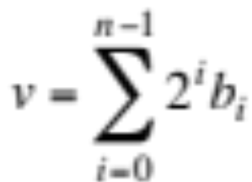
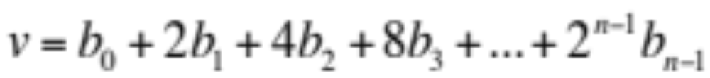
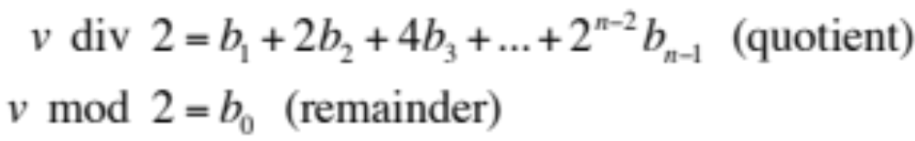
基本转换(+ve ints)
Binary to Decimal（二进制转换10进制）
  multiply each bit by its positional power of 2
  add them together
Decimal to Binary（10进制转换二进制）
  Problem: given v, find b_{i} (inverse problem)
  Hint: expand series
    observe: every term is even except first
      this determines b₀
      divide both sides by 2

Slide 24
Tutorial on Base Conversion (+ve ints)
Decimal to Binary
  Problem: given v, find b_{i} (inverse problem)
  Algorithm（除2求余）:
    Repeat
      divide v by 2
      remainder becomes the next bit, b_{i}
      quotient becomes the next v
    Until v equals 0
Note: Same algorithm applies to other number bases
  just replace divide-by-2 by divide-by-n for base n

Slide 25
Non-Integral Numbers
How about non-integers（非整数怎么表示）?
  examples
    1.234
    -567.34
    0.00001
    0.0000000000000012
  fixed-point representation（定点表示）
  floating-point representation（浮点表示）

Slide 26
Fixed-Point Representation（定点表示）
Set a definite position for the “binary” point
  everything to its left is the integral part of the number
  everything to its right is the fractional part of the number
（定点左边表示整数部分，右边表示小数部分）
  1101.0110 = 2³ + 2² + 2⁰ + 2⁻² + 2⁻³
  = 8 + 4 + 1 + 0.25 + 0.125
  = 13.375
2³
2²
2¹
2⁰
2⁻¹
2⁻²
2⁻³
2⁻⁴
Or
1101.0110 = 214 * 2⁻⁴ = 214/16 = 13.375

Slide 27
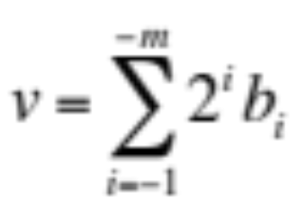
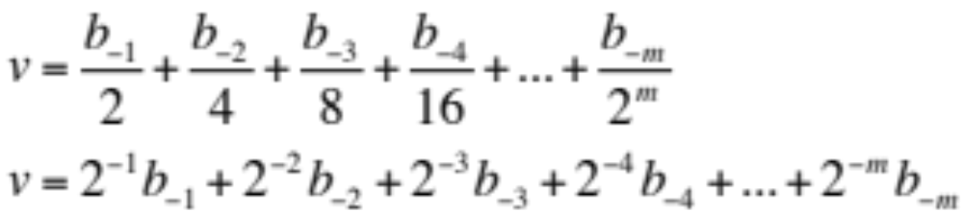
Fixed-Point Base Conversion
Binary to Decimal
  multiply each bit by its positional power of 2
  just that the powers of 2 are now negative
  for m fractional bits
Examples
  0.1₂ = ½ = 0.5₁₀
  0.0011₂ = 1/8 + 1/16 = 0.1875₁₀
  0.001100110011₂= 1/8+1/16+1/128+1/256+1/2048+1/4096 = 0.19995117187₁₀ (getting close to 0.2)
  0.0011₂ (repeats) = 0.2₁₀

Slide 28
Signed fixed-point numbers
（有符号数的定点表示）
How do you incorporate a sign（怎样加入符号）?
  use sign magnitude representation
    an extra bit (leftmost) stores the sign
    just as in negative integers
  2’s complement
    leftmost bit has a negative coefficient
    1101.0110 = -2³ + 2² + 2⁰ + 2⁻² + 2⁻³
    = -8 + 4 + 1 + 0.25 + 0.125 = -2.625
    OR:
      first ignore the binary point, use 2’s complement, put the point back
    1101.0110 = (-128 + 64 + 16 + 4 + 2)* 2⁻⁴
    = -42/16 = -2.625
-2³
2²
2¹
2⁰
2⁻¹
2⁻²
2⁻³
2⁻⁴

Slide 29
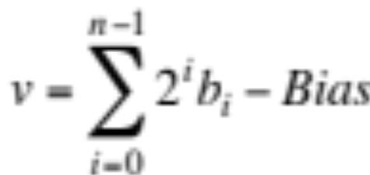
Bias Notation（偏差表示）
Idea: add a large number to everything, to make everything look positive（加一个大数，使所有数都变成正数）!
  must subtract this “bias” from every representation
  This representation is called “Bias Notation”.
2⁷
2⁶
2⁵
2⁴
2³
2²
2¹
2⁰
1
1
0
1
0
1
1
0
6 * 1 = 6
Ex: (Bias = 127)
13 * 16 = 208
Why? Monotonicity（单调性）
- 127
87

Slide 30

Floating-Point Representation（浮点表示）
Another way to represent numbers is to use a notation similar to Scientific Notation.
  This format can be used to represent numbers with fractions (3.90 x 10⁻⁴), very small numbers (1.60 x 10⁻¹⁹), and large numbers (6.02 x 10²³).
  This notation uses two fields to represent each number. The first part represents a normalized fraction (called the significand尾数), and the second part represents the exponent (i.e. the position of the “floating” binary point).
  每个数用两部分表示，第一部分用来表示规格化分数，另一部分表示指数部分
Exponent
Normalized Fraction
“dynamic range”
“bits of accuracy”

Slide 31
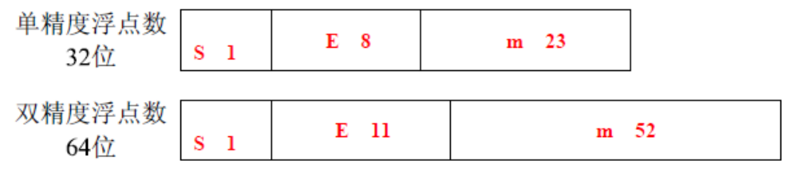
浮点数表示（IEEE 754）
IEEE 754：符号（Sign）、阶码（Exponent）和尾数（Mantissa）。
IEEE 754标准：单精度浮点数32位，双精度浮点数64位，
数符S： 1位，0表示正数，1表示负数
阶码E：用移码表示，n 位阶码偏移量为2^(n-1)-1。如8位阶码
偏移量为7FH（即127），11位阶码偏移量3FFH（即1023
尾数M： 尾数必须规格化成小数点左侧一定为1，并且小数点前面这个1作为隐含位被省略。这样单精度浮点数尾数实际上为24位。M=1.m

Slide 32
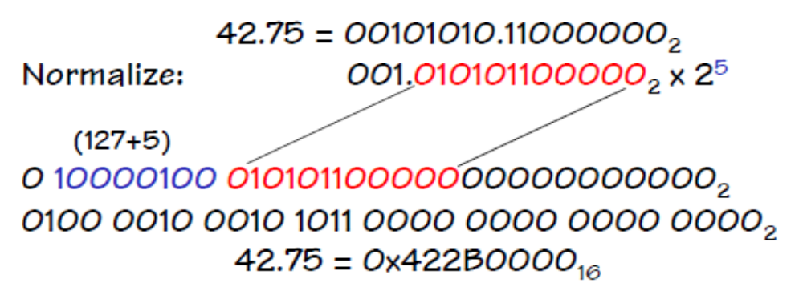
IEEE 754 Floating-Point Formats
IEEE 754 Format
The 1 is hidden because it provides no information after the number is “normalized”
This is effectively a signed magnitude fixed-point number with a “hidden” 1.
Single-precision format
S
Exponent
Significand
1
8
23
The exponent is represented in bias 127 notation. Why?

Slide 33
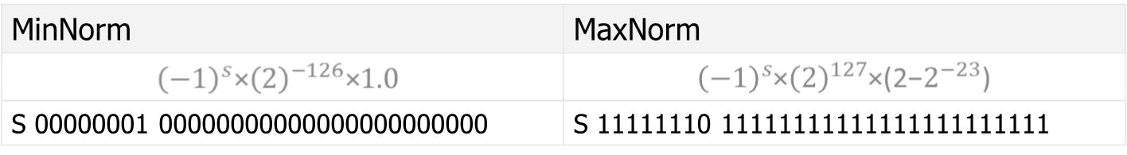
IEEE 754 Floating-Point Formats
IEEE 754 Format
Single precision limitations（单精度浮点表示范围）
- A little more than 7 decimal digits of precision
- minimum positive normalized value: ~1.18 x 10-38
- maximum positive normalized value: ~3.4 x 1038
Inaccuracies become evident after multiple single precision
operations
Double-precision format双精度浮点表示
S
Exponent
Significand
1
11
52

Slide 34
浮点数的表示有一定的范围，超出范围时会产生溢出（Flow），一般称大于绝对值最大的数据为上溢（Overflow），小于绝对值最小的数据为下溢（Underflow）。
1、浮点数的表示约定
单精度浮点数和双精度浮点数都是用IEEE 754标准定义的，其中有一些特殊约定，例如：
1、当指数E=0，尾数M=0时，表示0。
2、当指数E=255，尾数M=0时，表示无穷大，用符号位来确定是正无穷大还是负无穷大。
3、当指数E=255，M≠0时，表示NaN（Not a Number，不是一个数）。
2、非规范浮点数
当 两个绝对值极小的浮点数相减后，其差值的指数可能超出允许范围，最终只能近似为0。为了解决此类问题，IEEE标准中引入了非规范 （Denormalized）浮点数，规定当浮点数的指数为允许的最小指数值时，尾数不必是规范化（Normalized）的。有了非规范浮点数，去掉了隐含的尾数位的制约，可以保存绝对值更小的浮点数。而且，由于不再受到隐含尾数域的制约，上述关于极小差值的问题也不存在了，因为所有可以保存的浮点数之 间的差值同样可以保存。

Slide 35
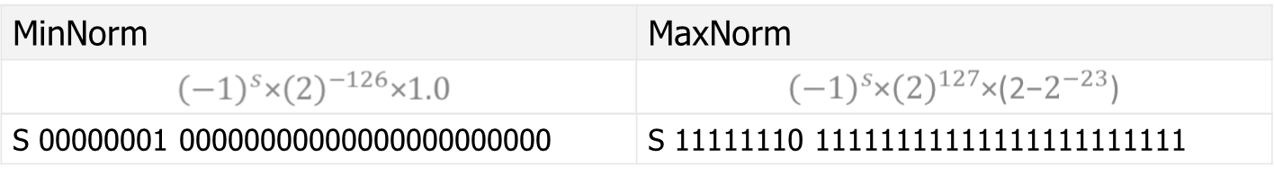
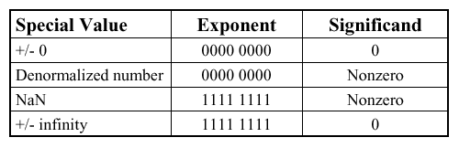
Special values in the IEEE 754 standard.
Sign | 8-Bit Based Exponent | 23-Bit Normalized Fraction
[31] | [30:23] | [22:0]
Ebais=2^(8−1)−1=127，偏移量取127
指数E的取值范围是 (−2^(8−1)+1)−2^(8−1), 即-127 -- 128
做为常规值， E的取值范围是-126 -- 127
最大值和最小值为

Slide 36

Bits You can See
The smallest element of a visual display is called a “pixel”. Pixels have three independent color components that generate most of the perceivable color range.
Why three and what are they
How are they represented in A computer?
First, let’s discuss this notion of perceivable
08/27/2018

Slide 37
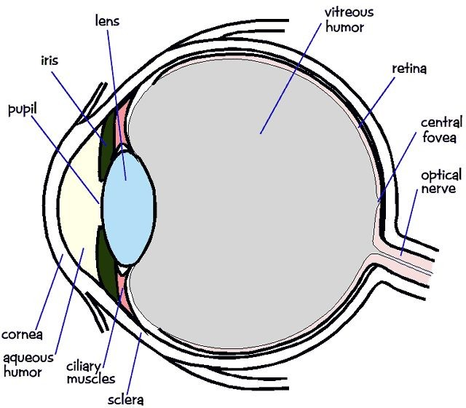
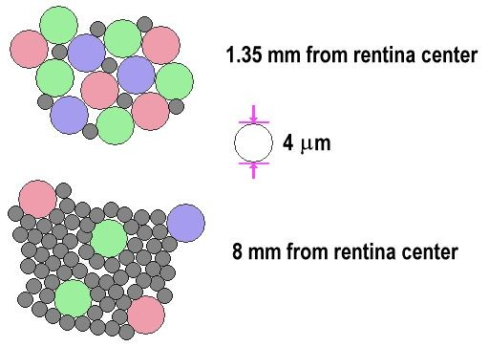
It starts with the Eye
The photosensitive part of the eye is called the retina视网膜.
The retina is largely composed of two cell types, called rods and cones.
Cones are responsible for color perception.
Cones are most dense within the fovea.
There are three types of cones, referred to as S, M, and L whose spectral sensitivity varies with wavelength.
08/27/2018
Comp 411 - Fall 2018

Slide 38
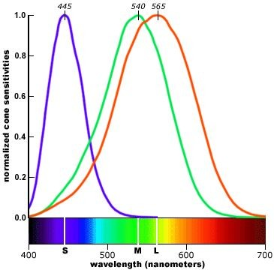
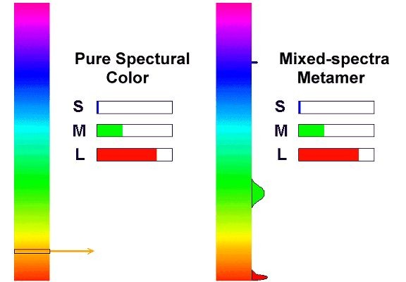
Why we see in color
Pure spectral colors simulate all cones to some extent.
Mixing multiple colors can stimulate刺激the cones to respond in a way that Is indistinguishable from a pure color.
Perceptually identical sensations are called metamers感知相同的感觉被称为条件等色.
This allows us to use just three colors to generate all others.
08/27/2018

Slide 39
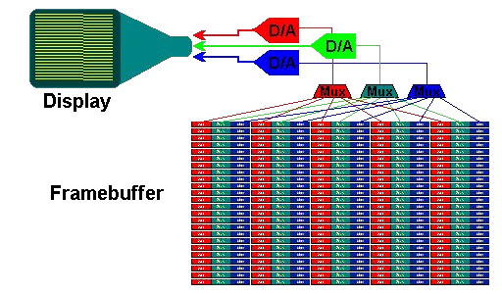
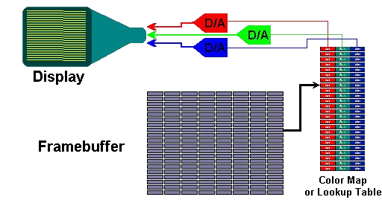
How colors Are Represented
Each pixel is stored as three primary parts
Red, green, and blue
Usually around 8-bits per channel
Pixels can have individual R,G,B components or
they can be stored indirectly via a “look-up table”
8-bits | 8-bits | 8-bits
3 - 8-bit unsigned binary integers (0,255)
-OR-
3 - fixed point 8-bit values (0-1.0)
08/27/2018
20

Slide 40
Color Specifications
Web colors:
Name | Hex | Decimal Integer | Fractional
Orange | #FFA500 | (255, 165, 0) | (1.0, 0.65, 0.0)
Sky Blue | #87CEEB | (135, 206, 235) | (0.52, 0.80, 0.92)
Thistle | #D8BFD8 | (216, 191, 216) | (0.84, 0.75, 0.84)
Colors are stored as binary too. You’ll commonly see them in Hex, decimal, and fractional formats.
08/27/2018

Slide 41
Summary
ALL modern computers represent signed integers using a two’s-complement representation
Two’s-complement representations eliminate the need for separate addition and subtraction units
Addition is identical using either unsigned and two’s-complement numbers
FInite representations of numbers on computers leads to anomalies异常
Floating point numbers have separate fractional and exponent components.
08/27/2018

Slide 42
[例.1]： 单精度浮点数0x00280000（real*4）
转换成二进制
00000000001010000000000000000000（非规格化数，指数为0，尾数不为0）
符号位 指数部分（8位） 尾数部分
0 00000000 01010000000000000000000
符号位=0；因指数部分=0，则：尾数部分M为m：
0.01010000000000000000000=0.3125
该浮点数的十进制为： (-1)^0*2^(-126)*0.3125
=3.6734198463196484624023016788195e-39
[例2]： 双精度浮点数0xC04E000000000000（real*8） 转换成二进制
1100000001001110000000000000000000000000000000000000000000000000
符号位 指数部分（11位）
1 10000000100
尾数部分1110000000000000000000000000000000000000000000000000
符号位=1；指数=1028，因指数部分不为全'0'且不为全'1'，则：尾数部分M为1+m：
1.1110000000000000000000000000000000000000000000000000=1.875
该浮点数的十进制为：(-1)^1*2^(1028-1023)*1.875=-60

Slide 43
将十进制数转换成浮点格式（real*4）
[例3]：26.0，十进制26.0转换成二进制11010.0
规格化二进制数1.10100*2^4
计算指数4+127=131
符号位 指数部分 尾数部分
0 10000011 10100000000000000000000
以单精度（real*4）浮点格式存储该数
0100 0001 1101 0000 0000 0000 0000 0000 0x41D0 0000
[例4]：0.75，十进制0.75转换成二进制0.11
规格化二进制数1.1*2^-1 计算指数-1+127=126
符号位 指数部分 尾数部分
0 01111110 10000000000000000000000
以单精度（real*4）浮点格式存储该数
0011 1111 0100 0000 0000 0000 0000 0000 0x3F40 0000
[例5]：-2.5 十进制-2.5转换成二进制-10.1
规格化二进制数-1.01*2^1
计算指数1+127=128
符号位 指数部分 尾数部分
1 10000000 01000000000000000000000
以单精度（real*4）浮点格式存储该数
1100 0000 0010 0000 0000 0000 0000 0000
0xC020 0000

Slide 44
Addition
4-bit Example
Unsigned
Signed (Two’s Complement)
3_{ten}
0011_{two}
3_{ten}
0011_{two}
+ 4_{ten}
+ 0100_{two}
+ 4_{ten}
+ 0100_{two}
7_{ten}
0111_{two}
7_{ten}
0111_{two}
3_{ten}
0011_{two}
3_{ten}
0011_{two}
+ 11_{ten}
+ 1011_{two}
+ -5_{ten}
+ 1011_{two}
14_{ten}
1110_{two}
-2_{ten}
1110_{two}
No special rules for two’s complement signed addition
Notes:
Now let’s try addition.
Note there are no special rules for negative numbers.
Everything just comes out right.

Slide 45
Overflow
4-bit Example
Unsigned
Signed (Two’s Complement)
13_{ten}
1101_{two}
-3_{ten}
1101_{two}
+ 14_{ten}
+ 1110_{two}
+ -2_{ten}
+ 1110_{two}
27_{ten}
1 1011_{two}
-5_{ten}
1 1011_{two}
carry-out and overflow
carry-out but no overflow
7_{ten}
0111_{two}
7_{ten}
0111_{two}
+ 1_{ten}
+ 0001_{two}
+ 1_{ten}
+ 0001_{two}
8_{ten}
0 1000_{two}
-8_{ten}
0 1000_{two}
no carry-out and no overflow
no carry-out but overflow
Carry-out → Overflow
Carry-out → Overflow
Notes:
With one caveat: since computer numbers have a finite number of bits,
the results of addition can exceed the maximum number that can be represented.
With only 4 bits, that’s very easy.
Of course, we could just use 8, 16, or even 32 bits to make overflow less likely.
But even with 64 bit numbers, overflow is possible.
Let’s look at a few examples, for signed and unsigned integers. We again stick to just 4 bits to make everything fit on the page and in our heads.
For unsigned numbers it’s easy: the carry-out indicates overflow.
For signed numbers that’s not the case. Actually, it’s not immediately obvious how to detect overflow for addition of two’s complement numbers.

Slide 46
Overflow Detection
4-bit Example
Unsigned
Signed (Two’s Complement)
Carry-out indicates overflow
Overflow if
  Signs of operands are equal
  AND
  Sign of result differs from sign of operands
No overflow when signs of operands differ
Overflow rules depend on operands (signed vs unsigned)
Notes:
A little more investigation shows that the rules are not really complicated …
But we must remember that they are DIFFERENT for unsigned and signed numbers!
Acceptable tradeoff for making addition simple and fast

