Slide 1
Computer Organization and Design
Assembly & Simulation
XM GUO
Feb, 2019

Slide 2
Today
Assembly programming
  structure of an assembly program
  assembler directives
  data and text segments
  allocating space for data
MIPS assembler: MARS
  development environment
A few coding examples
  self-study
  Reading: Ch. 2.10, Appendix B.1-B.5

Slide 3
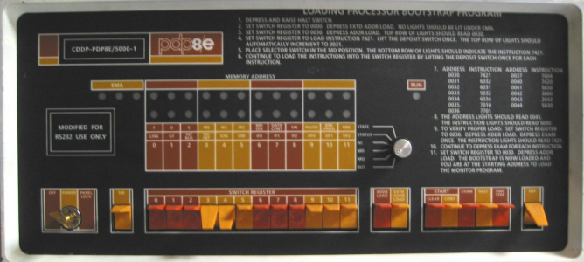


What is an Assembler?
A program for writing programs
Machine Language:
  1’s and 0’s loaded into memory.
  (Did anybody ever really do that?)
Assembly Language:
Front panel of a classic PDP8e. The toggle switches were used to enter machine language.
.globl main
main:
subu $sp, $sp, 24
sw $ra, 16($sp)
li $a0, 18
li $a1, 12
li $a2, 6
jal tak
move $a0, $v0
ASM
01101101
11000110
00101111
10110001
.....
STREAM of
bits to be
loaded into memory
Symbolic
SOURCE
text file
ASSEMBLER
Translator
program
Binary
Machine
Language
Assembler:
  1. A Symbolic LANGUAGE for representing strings of bits
  2. A PROGRAM for translating Assembly Source to binary

Slide 4
Assembly Source Language
An Assembly SOURCE FILE contains, in symbolic text, values of successive bytes to be loaded into memory... e.g.
.data 0x10000000
.byte 1, 2, 3, 4
.byte 5, 6, 7, 8
.word 1, 2, 3, 4
.asciiz "Comp 411"
.align 2
.word 0xfeedbeef
Specifies “current” address, i.e., start of data
Four byte values
Another four byte values
Four word values (each is 4 bytes)
A zero-terminated ASCII string
Align to next multiple of 2²
A hex-encoded word value
Resulting memory dump:
[0x10000000] 0x04030201 0x08070605 0x00000001 0x00000002
[0x10000010] 0x00000003 0x00000004 0x706d6f43 0x31313420
[0x10000020] 0x00000000 0xfeedbeef 0x00000000 0x00000000
Notice the byte ordering. This MIPS is “little-endian” (The least significant byte of a word or half-word has the lowest address)

Slide 5
Assembler Syntax
Assembler DIRECTIVES = Keywords prefixed with ‘.’
  Control the placement and interpretation of bytes in memory
    .data <addr> Subsequent items are considered data
    .text <addr> Subsequent items are considered instructions
    .align N Skip to next address multiple of 2^{N}
  Allocate Storage
    .byte b₁, b₂, …, b_{n} Store a sequence of bytes (8-bits)
    .half h₁, h₂, …, h_{n} Store a sequence of half-words (16-bits)
    .word w₁, w₂, …, w_{n} Store a sequence of words (32-bits)
    .ascii “string” Stores a sequence of ASCII encoded bytes
    .asciiz “string” Stores a zero-terminated string
    .space n Allocates n successive bytes
  Define scope
    .globl sym Declares symbol to be visible to other files
    .extern sym size Sets size of symbol defined in another file
    (Also makes it directly addressable)

Slide 6
More Assembler Syntax
Assembler COMMENTS
  All text following a ‘#’ (sharp) to the end of the line is ignored
Assembler LABELS
  Labels are symbols that represent memory addresses
    labels take on the values of the address where they are declared
    labels can be for data as well as for instructions
  Syntax: <start_of_line><label><colon>
    .data 0x80000000
    item: .word 1 # a data word
    .text 0x00010000
    start: add $3, $4, $2 # an instruction label
    sll $3, $3, 8
    andi $3, $3, 0xff
    beq ..., ..., start

Slide 7
Even More Assembler Syntax
Assembler PREDEFINED SYMBOLS
  Register names and aliases
    $0-$31, $zero, $v0-$v1, $a0-$a3, $t0-$t9, $s0-$s7,
    $at, $k0-$k1, $gp, $sp, $fp, $ra
Assembler MNEMONICS
  Symbolic representations of individual instructions
    add, addu, addi, addiu, sub, subu, and, andi, or, ori, xor, xori, nor, lui, sll, sllv, sra, srav, srl, srlv, div, divu, mult, multu, mfhi, mflo, mthi, mtlo, slt, sltu, slti, sltiu, beq, bgez, bgezal, bgtz, blez, bltzal, bltz, bne, j, jal, jalr, jr, lb, lbu, lh, lhu, lw, lwl, lwr, sb, sh, sw, swl, swr, rfe
    not all implemented in all MIPS versions
  Pseudo-instructions (mnemonics that are not instructions)
    abs, mul, mulo, mulou, neg, negu, not, rem, remu, rol, ror, li, seq, sge, sgeu, sgt, sgtu, sle, sleu, sne, b, beqz, bge, bgeu, bgt, bgtu, ble, bleu, blt, bltu, bnez, la, ld, ulh, ulhu, ulw, sd, ush, usw, move,syscall, break, nop
    not real MIPS instructions; broken down by assembler into real ones

Slide 8
A Simple Programming Task
Add the numbers 0 to 4 …
  10 = 0 + 1 + 2 + 3 + 4
Program in “C”:
Now let’s code it in ASSEMBLY
int i, sum;
main() {
sum = 0;
for (i=0; i<5; i++)
sum = sum + i;
}

Slide 9
First Step: Variable Allocation
Two integer variables (by default 32 bits in MIPS)
Thing to note:
  “.data” assembler directive places the following words into the data segment
  “.globl” directives make the “sum” and “i” variables visible to all other assembly modules (in other files)
  “.space” directives allocate 4 bytes for each variable
    in contrast to “.word”, “.space” does not initialize the variables
.data 0x80000000
.globl sum
.globl i
sum: .space 4
i: .space 4

Slide 10

Actual “Code”
Next we write ASSEMBLY code using instr mnemonics
A common convention, which originated with the ‘C’ programming language, is for the entry point (starting location) of a program to named “main”.
.text 0x10000000
.globl main
main:
add $8,$0,$0 # sum = 0
add $9,$0,$0 # for (i = 0; ...
loop:
addu $8,$8,$9 # sum = sum + i;
addi $9,$9,1 # for (...; ...; i++
slti $10,$9,5 # for (...; i<5;
bne $10,$0,loop
end:
Bookkeeping:
1) Register $8 is allocated as the “sum” variable
2) Register $9 is allocated as the “i” variable
We will talk about how to exit a program later

Slide 11
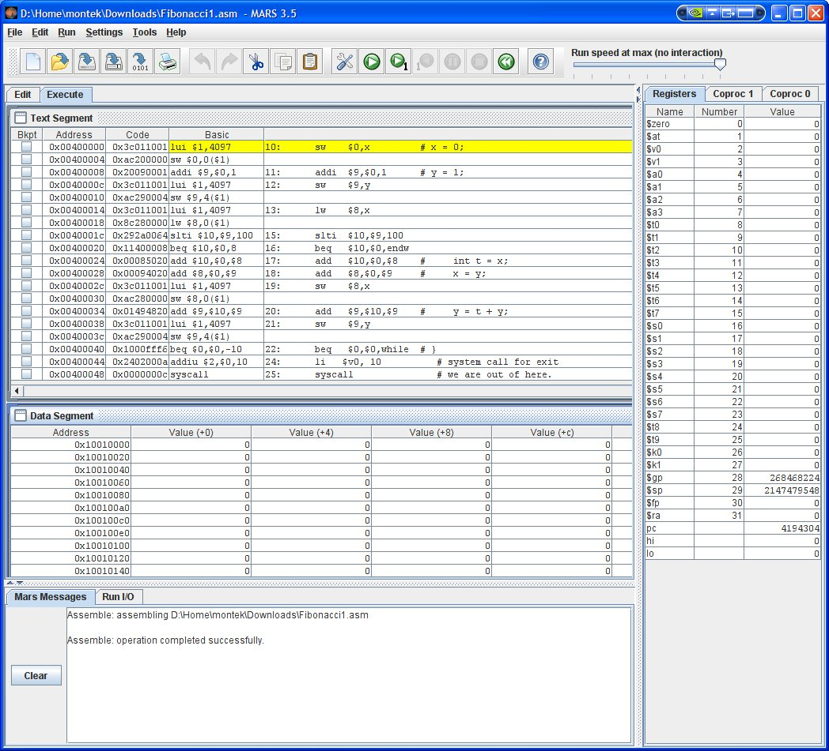
MARS
MIPS Assembler and Runtime Simulator (MARS)
  Java application
  Runs on all platforms
  Links on class website
  Download it now!

Slide 12

A Slightly More Challenging Program
Add 5 numbers from a list …
  sum = n₀ + n₁ + n₂ + n₃ + n₄
In “C”:
Once more… let’s code it in assembly
int i, sum;
int a[5] = {7,8,9,10,8};
main() {
sum = 0;
for (i=0; i<5; i++)
sum = sum + a[i];
}

Slide 13
Variable Allocation
Variables will be allocated to memory locations…
  … rather than registers
This time we add the contents of an array
Note: “.word” also works for an array of words
  allows us to initialize a list of sequential words in memory
  label represents the address of the first word in the list, or the name of the array
.data 0x0
sum: .space 4
i: .space 4
a: .word 7,8,9,10,8
Arrays have to be in memory. Why?

Slide 14
The New Code
Note the small changes:
.text 0x3000
.globl main
main:
sw $0,sum # sum = 0;
sw $0,i # for (i = 0;
lw $9,i # allocate register for i
lw $8,sum # allocate register for sum
loop:
sll $10,$9,2 # covert "i" to word offset
lw $10,a($10) # load a[i]
addu $8,$8,$10 # sum = sum + a[i];
sw $8,sum # update variable in memory
addi $9,$9,1 # for (...; ...; i++
sw $9,i # update memory
slti $10,$9,5 # for (...; i<5;
bne $10,$0,loop
end: # code for exit here

Slide 15
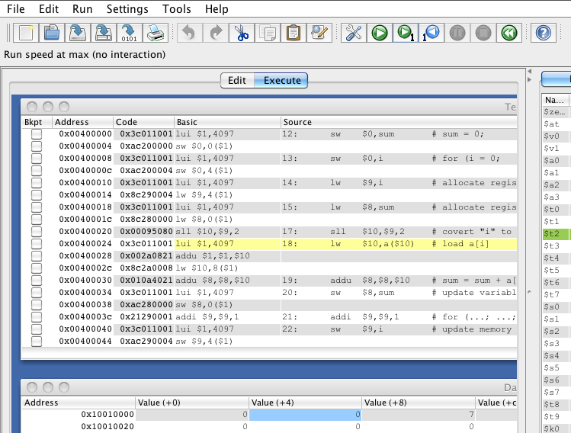

A Little “Weirdness”
The Assembler rewrote one of our instructions. What’s going on?

Slide 16


A Coding Challenge
What is the largest Fibonacci number less than 100?
  Fibonacci numbers:
  F_{i+1} = F_{i} + F_{i-1}
  F₀ = 0
  F₁ = 1
  0, 1, 1, 2, 3, 5, 8, 13, 21, 34, …
In “C”:
int x, y;
main() {
x = 0;
y = 1;
while (y < 100) {
int t = x;
x = y;
y = t + y;
}
}

Slide 17
MIPS Assembly Code
In assembly
.data 0x0
x: .space 4
y: .space 4
.text 0x3000
.globl main
main:
sw $0,x # x = 0;
addi $9,$0,1 # y = 1;
sw $9,y
lw $8,x
while: # while (y < 100) {
slti $10,$9,100
beq $10,$0,endw
add $10,$0,$8 # int t = x;
add $8,$0,$9 # x = y;
sw $8,x
add $9,$10,$9 # y = t + y;
sw $9,y
j while # }
endw:
# code for exit here
# answer is in x

Slide 18


Procedures and Stacks
Parameterized Programs
Procedures
Stacks
MIPS procedure linkage conventions

Slide 19
Procedures and Stacks
Procedures
  What are procedures?
  Why use them?
  How is call/return implemented in assembly?
  Recursion
Stacks
  Push and pop
  How useful for implementing procedures?
Reading: Ch. 2.8, Appendix B.6

Slide 20



The Beauty of Procedures
Reusable code fragments (modular design)
clear_screen();
… clear_screen();
…
# code to draw a bunch of lines
Parameterized procedures (variable behaviors)
for (i=0; i < N-1; i++) line(x[i],y[i],x[i+1],y[i+1],color);
line(x[i],y[i],x[0],y[0],color);
line(x1, y1, x2, y2, color); line(x2,y2,x3,y3, color);
…
Functions (procedures that return values)
xMax = max(max(x1,x2),x3); yMax = max(max(y1,y2),y3);

Slide 21
More Procedure Power
Global vs. Local scope (Name Independence)
int x = 9;
These are different “x”s
int fee(int x) { return x+x-1;
}
How do we keep track of all the variables
int foo(int i) { int x = 0; while (i > 0) {
x = x + fee(i); i = i - 1;
}
return x;
}
This is yet another “x”
That “fee()” seems odd to me? And, foo()’s a little square.
main() {
fee(foo(x));
}

Slide 22
Using Procedures
A “calling” program (Caller) must:
  Provide procedure parameters. In other words, put the arguments in a place where the procedure can access them
  Transfer control to the procedure. “Jump” to it, and provide a “link” back
A “called” procedure (Callee) must:
  Acquire/create resources needed to perform the function (local variables, registers, etc.)
  Perform the function
  Place results in a place where the Caller can find them
  Return control back to the Caller through the supplied link
Solution (a least a partial one):
  WE NEED CONVENTIONS, agreed upon standards for how arguments are passed in and how function results are retrieved
  Solution part #1: Allocate registers for these specific functions

Slide 23
What are Procedures?
Also called:
  functions
  methods
  subroutines
Key Idea:
  main routine M calls a procedure P
  P does some work, then returns to M
    execution in M picks up where left off
    i.e., the instruction in M right after the one that called P

Slide 24
Six Steps in Execution of a Procedure
Main routine (caller) places parameters in a place where the procedure (callee) can access them
  $a0 - $a3: four argument registers
Caller transfers control to the callee
Callee acquires the storage resources needed
Callee performs the desired task
Callee places the result value in a place where the caller can access it
  $v0 - $v1: two value registers for result values
Callee returns control to the caller
  $ra: one return address register to return to the point of origin

Slide 25
Instruction for Calling a Procedure
MIPS procedure call instruction:
jal ProcAddress #jump and link
Saves PC+4 in register $ra as the link to the following instruction to set up the procedure return
Machine format:
Then can do procedure return with just
jr $ra #return
op 26 bit address
J format
3 ????
Notes:
jr jumps to the address stored in the register – in this case $ra – which is just what we want.

Slide 26

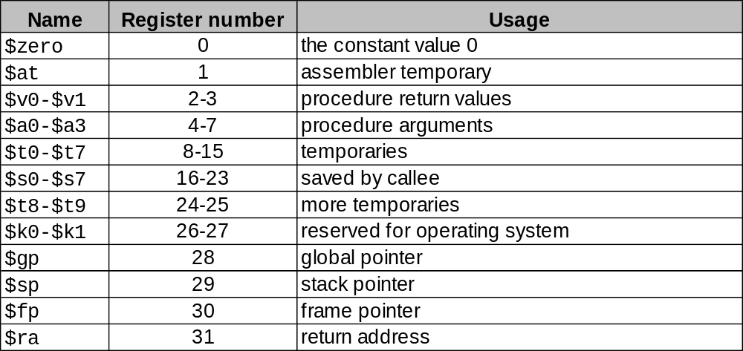
MIPS Register Usage
Conventions designate registers for procedure arguments ($4-$7) and return values ($2-$3).
The ISA designates a “linkage register” for calling procedures ($31)
Transfer control to Callee using the jal instruction
Return to Caller with the jr $31 or jr $ra instruction
The “linkage register” is where the return address of back to the callee is stored. This allows procedures to be called from any place, and for the caller to come back to the place where it was invoked.

Slide 27
Basic Procedure Flow
For a procedure that computes the GCD of two values i (in $t0) and j (in $t1)
gcd(i,j);
The caller puts the i and j (the parameters values) in $a0 and $a1 and issues a
jal gcd #jump to routine gcd
The callee computes the GCD, puts the result in $v0, and returns control to the caller using
gcd: . . . #code to compute gcd
jr $ra #return

Slide 28
And It “Sort Of” Works
Example:
.globl x
.data
x: .word 9
.globl fee
.text
fee:
add $v0,$a0,$a0
addi $v0,$v0,-1
jr $ra
.globl main
.text
main:
lw $a0,x
jal fee
jr $ra
Works for special cases where the Callee needs few resources and calls no other functions.
This type of function is called a LEAF function.
But there are lots of issues:
How can fee call functions?
More than 4 arguments?
Local variables?
Where will main return to?
Let’s consider the worst case of a Callee as a Caller…
Callee
Caller

Slide 29
Recursion! A Callee who calls itself!
How do we go about writing callable
int sqr(int x) {
if (x > 1)
x = sqr(x-1)+x+x-1; return x;
procedures? We’d like to support not only LEAF procedures, but also procedures that call other procedures, ad infinitum (e.g. a recursive function).
}
main()
{
sqr(10);
}
sqr(10) = sqr(9)+10+10-1 = 100 sqr(9) = sqr(8)+9+9-1 = 81 sqr(8) = sqr(7)+8+8-1 = 64 sqr(7) = sqr(6)+7+7-1 = 49 sqr(6) = sqr(5)+6+6-1 = 36 sqr(5) = sqr(4)+5+5-1 = 25 sqr(4) = sqr(3)+4+4-1 = 16 sqr(3) = sqr(2)+3+3-1 = 9 sqr(2) = sqr(1)+2+2-1 = 4
sqr(1) = 1
sqr(0) = 0
Oh, recursion gives me a headache.

Slide 30
Procedure Linkage: First Try
Callee/Caller
int sqr(int x) {
if (x > 1)
x = sqr(x-1)+x+x-1;
return x;
}
main()
{
sqr(10);
}
sqr: slti $t0,$a0,2
    beq $t0,$0,then #!(x<2)
    add $v0,$0,$a0
    beq $0,$0,rtn
  then:
  add $t0,$0,$a0
    addi $a0,$a0,-1
    jal sqr
    add $v0,$v0,$t0
    add $v0,$v0,$t0
    addi $v0,$v0,-1
  rtn:
    jr $ra
OOPS!
Caller
$t0 is clobbered on successive calls.
Will saving “x” in some register or at some fixed location in memory help?
MIPS Convention:
pass 1st arg x in $a0
save return addr in $ra
return result in $v0
use only temp registers
to avoid saving stuff
We also clobber our return address, so there’s no way back!
Notes:
STACK
fact
CALLER:

Slide 31
A Procedure’s Storage Needs
Basic Overhead for Procedures/Functions:
  Caller sets up ARGUMENTs for callee
    f(x,y,z) or even... sin(a+b)
  Caller invokes Callee while saving the
  Return Address to get back
  Callee saves stuff that Caller expects
  to remain unchanged
  Callee executes
  Callee passes results back to Caller.
Local variables of Callee:
  ...
  {
  int x, y;
  ... x ... y ...;
  }
Each of these is specific to a “particular” invocation or activation of the Callee. Collectively, the arguments passed in, the return address, and the callee’s local variables are its activation record, or call frame.
In C it’s the caller’s job to evaluate its arguments as expressions, and pass the resulting values to the callee… Therefore, the CALLEE has to save arguments if it wants access to them after calling some other procedure, because they might not be around in any variable, to look up later.

Slide 32
Lives of Activation Records
Where do we store activation records?
int sqr(int x) {
if (x > 1)
x = sqr(x-1)+x+x-1;
return x;
}
TIME
sqr(3)
sqr(3)
sqr(3)
sqr(3)
sqr(3)
sqr(2)
sqr(2)
sqr(2)
sqr(1)
A procedure call creates a new activation record. Caller’s record is preserved because we’ll need it when call finally returns.
Return to previous activation record when procedure finishes, permanently discarding activation record created by call we are returning from.

Slide 33

We Need Dynamic Storage!
Some interesting properties of stacks:
SMALL OVERHEAD. Only the top is directly visible, the so-called
“top-of-stack”
Add things by PUSHING new values on top.
Remove things by POPPING off values.
What we need is a SCRATCH memory for holding temporary variables. We’d like for this memory to grow and shrink as needed. And, we’d like it to have an easy management policy.
One possibility is a
STACK
A last-in-first-out (LIFO)
data structure.

Slide 34
MIPS Stack Convention
CONVENTIONS:
  • Waste a register for the Stack Pointer
  ($sp = $29).
  • Stack grows DOWN (towards lower addresses) on
  pushes and allocates
  • $sp points to the
  TOP *used* location.
  • Place stack far away
  from our program
  and its data
8000000₁₆
Higher addresses
“stack” segment
$sp
Data
Humm… Why
is that the TOP
of the stack?
10008000₁₆
10000000₁₆
“text” segment
(Program)
00400000₁₆
Reserved
Lower addresses
Other possible implementations include:
1) stacks that grow “UP”
2) SP points to first UNUSED location

Slide 35
Stack Management Primitives
ALLOCATE k: reserve k WORDS of stack
Reg[SP] = Reg[SP] - 4*k
DEALLOCATE k: release k WORDS of stack
Reg[SP] = Reg[SP] + 4*k
PUSH rx: push Reg[x] onto stack
  Reg[SP] = Reg[SP] - 4
  Mem[Reg[SP]] = Reg[x]
POP rx: pop the value on the top of the stack into Reg[x]
Reg[x] = Mem[Reg[SP]]
  Reg[SP] = Reg[SP] + 4;
addi $sp,$sp,-4*k
addi $sp,$sp,4*k
addi $sp,$sp,-4
sw $rx, 0($sp)
lw $rx, 0($sp)
addi $sp,$sp,4

Slide 36
Fun with Stacks
Stacks can be used to squirrel away variables for later. For instance, the following code fragment can be inserted anywhere within a program.
#
# Argh!!! I’m out of registers Scoty!!
#
You should ALWAYS
allocate prior to saving, and deallocate after restoring in order to be SAFE!
addiu sw
sw lw
lw suspense: addiu
bne sw lw lw
addiu
$sp,$sp,-8
$s0,4($sp)
$s1,0($sp)
# allocate 2
# Free up s0
# Free up s1
$s0,dilithum_xtals
$s1,seconds_til_explosion
$s1,$s1,-1
$s1,$0,suspense
$s0,warp_engines
$s1,0($sp)
$s0,4($sp)
$sp,$sp,8
# Restore s1
# Restore s0
# deallocate 2
AND Stacks can also be used to solve other problems...

Slide 37
Solving Procedure Linkage “Problems”
In case you forgot, a reminder of our problems
  We need a way to pass arguments into procedures
  Procedures need storage for their LOCAL variables
  Procedures need to call other procedures
  Procedures might call themselves (Recursion)
But first: Let’s “waste” some more registers:
  $30 = $fp (frame pointer)
    points to the callee’s local variables on the stack
    we also use it to access extra args (>4)
  $31 = $ra (return address back to caller)
  $29 = $sp (stack pointer, points to TOP of stack)
Now we can define a STACK FRAME
  a.k.a. the procedure’s Activation Record

Slide 38
More MIPS Procedure Conventions
What needs to be saved?
  CHOICE 1… anything that a Callee touches
    except the return value registers
  CHOICE 2… Give the Callee access to everything
    Caller saves those registers it expects to remain unchanged
  CHOICE 3… Something in between
    Give the Callee some “scratch” registers to play with
      If the Caller cares about these, it must preserve them
    Give the Caller some registers that the Callee won’t clobber
      If the Callee touches them, it must restore them

Slide 39
Stack Frame Overview
CALLER’s
Stack Frame
The STACK FRAME contains storage for the CALLER’s volatile state that it wants preserved after the invocation of CALLEEs.
In addition, the CALLEE will use the stack for the following:
1) Accessing the arguments that the
CALLER passes to it
(specifically, the 5th and greater)
2) Saving non-temporary registers that
it wishes to modify
3) Accessing its own local variables
The boundary between stack frames falls at the first word of state saved by the CALLEE, and just after the extra arguments (>4, if used) passed in from the CALLER. The FRAME POINTER keeps track of this boundary between stack frames.
Args > 4
FP:
Saved regs
CALLEE’s
Stack Frame
Local variables
SP:
(unused)
It’s possible to use only the SP to access a stack frame, but offsets may change due to ALLOCATEs and DEALLOCATEs. For convenience a $fp is used to provide CONSTANT offsets to local variables and arguments

Slide 40
Procedure Stack Usage
ADDITIONAL space must be allocated in the stack frame for:
  Any SAVED registers the procedure uses ($s0-$s7)
  Any TEMPORARY registers that the procedure wants preserved
  IF it calls other procedures ($t0-$t9)
  Any LOCAL variables declared within the procedure
  Other TEMP space IF the procedure runs out of registers (RARE)
  Enough “outgoing” arguments to satisfy the worse case ARGUMENT SPILL of ANY procedure it calls.
  (SPILL is the number of arguments greater than 4).
Each procedure has keep track of how many SAVED and TEMPORARY registers are on the stack in order to calculate the offsets to LOCAL VARIABLES.

Slide 41














More MIPS Register Usage
The registers $s0-$s7, $sp, $ra, $gp, $fp, and the memory contents “above” the stack pointer must be preserved by the CALLEE
The CALLEE is free to use $t0-$t9, $a0-$a3, and $v0-$v1, and the memory below the stack pointer.
No “user” program can use $k0-$k1, or $at

Slide 42
Stack Snap Shots
此图描述的是一种典型的MIPS stack frame 组织方式，sp(stack pointer)(栈基址,又称fp) 就是当前函数的栈指针，它指向栈顶的位置。 在MIPS这种寄存器的目标架构中，进入一个函数时需要将当前栈指针向下移动 n个byte(字节)，这个大小为n个byte 的存储空间就是此函数的 stack frame 的存储区域。此后栈指针便不再移动，只能在函数返回时再将栈指针加上这个偏移量恢复栈现场。所以寄存器压栈和出栈都必须指定偏移量
CALLER’s $fp
Space for $ra
Space for $fp
Space for $s3
Space for $s2
Space for $s1
Space for $s0
$t2
$t1
Caller’s local 1
…
Caller’s local n
Arg[5]
Arg[4]
Space for $ra
Space for $fp
Callee’s local 1
Callee’s local 2
Arg[6]
Arg[5]
Arg[4]
CALLER’S
FRAME
$sp (prior to call)
CALLEE’s $fp
CALLEE’S
FRAME
$sp (after call)

Slide 43

Back to Reality
Now let’s make our example work, using the MIPS procedure linking and stack conventions.
ALLOCATE minimum stack frame. With room for the return address and the passed in argument.
int sqr(int x) {
if (x > 1)
x = sqr(x-1)+x+x-1;
return x;
}
main()
{
sqr(10);
}
sqr: addi $sp,$sp,-8
sw $ra,4($sp)
  sw $a0,0($sp)
slti $t0,$a0,2
    beq $t0,$0,then
    add $v0,$0,$a0
    beq $0,$0,rtn
  then:
    addi $a0,$a0,-1
    jal sqr
    lw $a0,0($sp)
    add $v0,$v0,$a0
    add $v0,$v0,$a0
    addi $v0,$v0,-1
  rtn:
    lw $ra,4($sp)
  addi $sp,$sp,8
    jr $ra
Save registers that must survive the call.
Pass arguments
Q: Why didn’t we save and update $fp?
A: Don’t have local
variables or spilled
args.
DEALLOCATE
stack frame.
Restore saved registers.
Notes:
编译器在编译函数时，能够计算出其局部变量以及参数需要的存储空间，在函数前言部分通过偏移sp指针为这些变量分配空间。例如funB()分配的栈空间为：ra+fp+local variables+arguments。

Slide 44
Back to our Recursive Example
Now let’s make our example work, using the MIPS procedure
linking and stack conventions.
ALLOCATE stack frame. With room for the return address, a local saved register, and the argument spill for calls.
int sqr(int x) { if (x > 1)
x = sqr(x-1)+x+x-1; return x;
}
sqr:
addiu $sp,$sp,-32 sw $ra,20($sp)
sw $s0,24($sp)
move $s0,$a0 addiu $t8,$0,1 slt $1,$t8,$s0
beq $1,$0,endif addiu $a0,$s0,-1 jal sqr
addu $v0,$v0,$s0
addu $v0,$v0,$s0 addiu $v0,$v0,-1
rtn
$v0,$s0
lw $s0,24($sp)
lw $ra,20($sp) addiu $sp,$sp,32 jr $ra
Save
registers that must survive the call.
Address | Contents
$sp+44 | $a3
$sp+40 | $a2
$sp+36 | $a1
$sp+32 | $a0 = x
$sp+28 | **unused**
$sp+24 | $s0
$sp+20 | $ra
$sp+16 | $fp
$sp+12 | $a3
$sp+8 | $a2
$sp+4 | $a1
$sp  | $a0
main()
{
sqr(10);
}
Pass arguments
Q: Why isn’t the $fp being used?
A: Stack frame size within a call remains constant, so the compiler makes all accesses relative to $sp.
b endif: move
rtn:
DEALLOCATE
stack frame.
Restore
saved registers.

Slide 45
Testing Reality’s Boundaries
Now let’s take a look at the active stack frames at some point during the procedure’s execution.
sqr: addiu $sp,$sp,-8
sw $ra,4($sp)
  sw $a0,0($sp)
slti $t0,$a0,2
    beq $t0,$0,then
    move $v0,$a0
    beq $0,$0,rtn
  then:
    addi $a0,$a0,-1
    jal sqr
    lw $a0,0($sp)
    add $v0,$v0,$a0
    add $v0,$v0,$a0
    addi $v0,$v0,-1
  rtn:
    lw $ra,4($sp)
  addiu $sp,$sp,8
    jr $ra
Return Address to original caller
$ra = 0x00400018
$a0 = 10₁₀
$ra = 0x00400074
$a0 = 9₁₀
$ra = 0x00400074
$a0 = 8₁₀
PC
$sp
一个函数需要的所有的栈空间(活动记录)必须在函数开始的时候一次全部分配,还必须双字对齐.

Slide 46
Procedure Linkage: Caller Contract
The CALLER will:
  Save all temp registers that it wants
  to survive subsequent calls in its
  stack frame
  (t0-$t9, $a0-$a3, and $v0-$v1)
  Pass the first 4 arguments in registers
  $a0-$a3, and save subsequent arguments on stack, in *reverse* order. Why?
  Call procedure, using a jal instruction
  (places return address in $ra).
  Access procedure’s return values in $v0-$v1

Slide 47
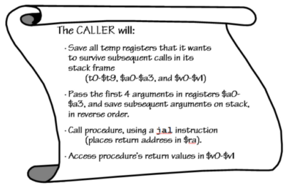

Code Lawyer
Our running example is a CALLER. Let’s make sure it obeys its contractual obligations
sqr: addiu $sp,$sp,-8
sw $ra,4($sp)
sw $a0,0($sp)
slti $t0,$a0,2
beq $t0,$0,then
add $v0,$0,$a0
beq $0,$0,rtn
then:
addi $a0,$a0,-1
jal sqr
lw $a0,0($sp)
add $v0,$v0,$a0
add $v0,$v0,$a0
addi $v0,$v0,-1
rtn:
lw $ra,4($sp)
addiu $sp,$sp,8
jr $ra
int sqr(int x) {
if (x > 1)
x = sqr(x-1)+x+x-1;
return x;
}

Slide 48
Procedure Linkage: Callee Contract
If needed the CALLEE will:
1) Allocate a stack frame with space for saved
registers, local variables, and spilled args
2) Save any “preserved” registers used:
($ra, $sp, $fp, $gp, $s0-$s7)
3) If CALLEE has local variables -or- needs access to
args on the stack, save CALLER’s frame pointer and set $fp to 1st entry of CALLEE’s stack
  4) EXECUTE procedure
  5) Place return values in $v0-$v1
  6) Restore saved registers
  7) Fix $sp to its original value
  8) Return to CALLER with jr $ra

Slide 49
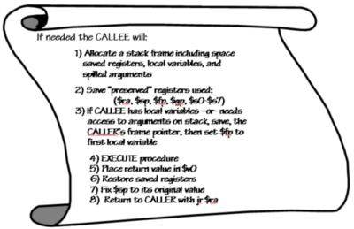
More Legalese
Our running example is also a CALLEE. Are these contractual obligations satisfied?
sqr: addiu $sp,$sp,-8
sw $ra,4($sp)
sw $a0,0($sp)
slti $t0,$a0,2
beq $t0,$0,then
add $v0,$0,$a0
beq $0,$0,rtn
then:
addi $a0,$a0,-1
jal sqr
lw $a0,0($sp)
add $v0,$v0,$a0
add $v0,$v0,$a0
addi $v0,$v0,-1
rtn:
lw $ra,4($sp)
addiu $sp,$sp,8
jr $ra
int sqr(int x) {
if (x > 1)
x = sqr(x-1)+x+x-1;
return x;
}

Slide 50
On Last Point: Dangling References
Stacks can be an unreliable place to put things…
int *p; /* a pointer */
int h(x)
{
int y = x*3;
p = &y;
return 37;
}
h(10);
print(*p);
$fp
caller
(TEMPS)
$sp
$fp
space for $ra
space for $fp
?
space for args
h(10)
(unused
$sp
Y=30
space)
What do we expect to be printed?
P = ?
P = ?
“During Call”
“After Call”

