Slide 1
存储访问的局部性原理
◆局部性原理(principle of locality): 在访问存储器时，无论是存取指令或存取数据所访问的存储单元，都趋于聚集在一个较小的连续单元区域中。
时间局部性(temporal locality)：最近访问的存储单元在不久的将来仍将被访问
空间局部性(spatial locality)：下次访问的存储单元很可能就在刚刚访问的存储单元附近

Slide 2
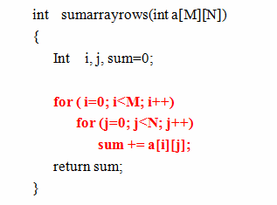
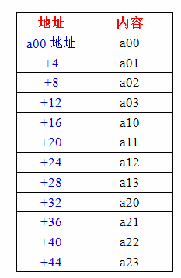
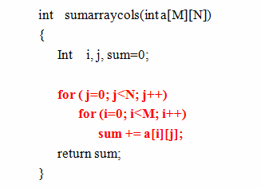
存储访问的局部性原理
❖程序示例
存储空间（M=3，N=4）
程序a
局部性分析
➢程序a：sum具有较好的时间局部性，数组a的空间局部性较好；
➢程序b ：sum具有较好的时间局部性，数组a的空间局部性不好；
程序b

Slide 3
高速缓冲存储器产生的前提
❖单级存储系统中，主存速度与CPU速度不匹配，造成CPU资源浪费
❖程序运行时访问内存在时间和空间上存在明显的局部性特征
❖存在比主存普遍采用的DRAM速度更快的存储单元电路

Slide 4
Characteristics of the Memory Hierarchy
Processor
Inclusive– what is in L1$ is a subset of what is in L2$ is a subset of what is in MM that is a subset of is in SM
4-8 bytes (word)
Increasing distance from the processor in access time
L1$
8-32 bytes (block)
L2$
1 to 4 blocks
Main Memory
1,024+ bytes (disk sector = page)
Secondary Memory
(Relative) size of the memory at each level
Notes:
Because the upper level is smaller and built using faster memory parts, its hit time will be much smaller than the time to access the next level in the hierarchy (which is the major component of the miss penalty).

Slide 5
高速缓冲存储器(Cache)的原理
Cache要解决的问题
➢提供快速访问的能力；
➢具有存取数据的能力和与主存交换数据的能力；
➢由于CPU总是以主存地址访问存储器，所以Cache应具备判断CPU当前要访问的内容是否在Cache中的能力，并具有根据主存地址在Cache中访问相应单元的能力。
➢具备在Cache容量不够的前提下替换Cache中的内容的决策能力。

Slide 6
高速缓冲存储器(Cache)的原理
Cache的基本结构
➢存储机构：保存数据，存取数据，一般采用SRAM构成。
以Block（若干字）为单位；
➢地址机构：地址比较机制，地址转换机制，地址标记（Tag），一个Block具有一个Tag；
➢替换机制：记录Block的使用情况，替换策略，有效位（v）记录对应数据块中的数据是否有效。
Block
Main Memory
v | Tag | Data Block
v | Tag | Data Block
v | Tag | Data Block
v | Tag | Data Block
Block
Cache 的基本结构

Slide 7
高速缓冲存储器(Cache)的原理
Cache的有关术语
➢数据块（block）：Cache与主存的基本划分单位，也是主存与
Cache一次交换数据的最小单位，由多个字节（字）组成，取决于
Cache从主存一次读写操作所能完成的数据字节数。也表明主存与
Cache之间局部总线的宽度。
➢标记（tag）：Cache每一数据块有一个标记字段，用来保存该数据块对应的主存数据块的地址信息。
➢有效位（valid bit）：Cache中每一Block有一个有效位，用于指示相应数据块中是否包含有效数据。
➢行（line )：Cache中 一个block及其 tag、valid bit构成1行。
➢组（set）：若干块(Block)构成一个组，地址比较一般能在组内各块间同时进行。
➢路（way）：Cache相关联的等级，每一路具有独立的地址比较机构，各路地址比较能同时进行（一般与组结合），路数即指一组内的块数。
➢命中（hit）： CPU要访问的数据在Cache中。
➢缺失（miss）： CPU要访问的数据不在Cache中 。

Slide 8
高速缓冲存储器(CACHE)的原理
CACHE的有关指标
命中率（hit rate）：目标数据在Cache中的存储访问的比例
缺失率（miss rate）：目标数据不在Cache中的存储访问的比例
在一个程序执行期间，设Nc是Cache完成存取的总次数，Nm是主存完成存取的总次数
那么Cache命中率为：H = Nc / (Nc + Nm)
Cache缺失率为：1 － H
CPU
Cache
操作：
命中(在Cache中)
主存
未命中
(不在Cache中)

Slide 9
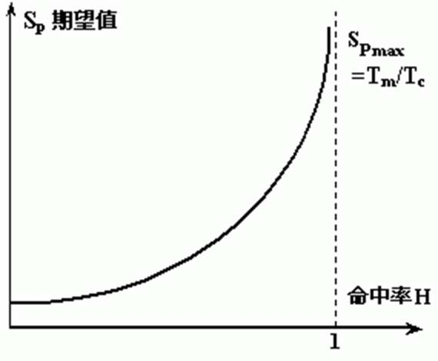
高速缓冲存储器(CACHE)的原理
Cache的性能计算
■存储访问时间
若：T_{m}为主存储器的访问周期；
T_{c}为Cache的访问周期；
H为Cache命中率
则存储系统的等效访问周期T为：
T = T_{c} × H + T_{m} × (1− H )
■加速比SP（Speedup）
存储系统的加速比S_{p}为：
₌ T_{m}
T H ×T_{c} + (1− H ) ×T_{m}
S
=
T_{m}
=
1
p
(1− H ) + H ×^{Tc}
T_{m}
加速比与命中率的关系

Slide 10
How is the Hierarchy Managed?
registers ↔ memory
by compiler (programmer?)
cache ↔ main memory
by the cache controller hardware
main memory ↔ disks
by the operating system (virtual memory)
virtual to physical address mapping assisted by the hardware (TLB)
by the programmer (files)

Slide 11
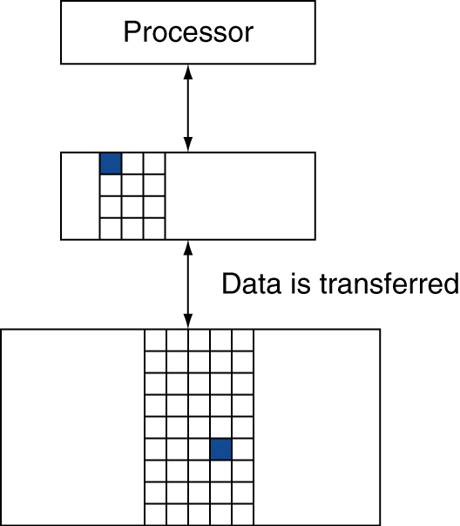
存储层次的级别
块 (行): 复制的单元
可能是多个字
如果被访问的数据在高层中
命中Hit：访问被高层满足
命中率：hits/accesses
如果访问的数据不存在
缺失Miss: 从低层复制块
时间开销：缺失代价
缺失率：misses/accesses = 1 – hit ratio
以后访问的数据由高层提供

Slide 12
Cache Basics
Two questions to answer (in hardware):
Q1: How do we know if a data item is in the cache?
Q2: If it is, how do we find it?
Direct mapped
Each memory block is mapped to exactly one block in the cache
lots of lower level blocks must share blocks in the cache
Address mapping (to answer Q2):
(block address) modulo (# of blocks in the cache)
Have a tag associated with each cache block that contains the address information (the upper portion of the address) required to identify the block (to answer Q1)

Slide 13
最简单的Cache: 直接映射Cache
Direct-Mapped Cache
主存中每一个页(block)只能映射到某一固定的Cache页中
主存地址
主存
0
1
2
3
4
5
6
7
8
9
A B
C D E F
4 字节直接映射Cache
Cache索引（Index）
0
1
2
3
°位置 0 可以被来自以下位置的数据占用：
主存位置0、4、8, ... 等等
一般情况：任何地址最低两位为0的主存位置
地址<1:0> ⇒ cache索引
°我们应该将哪一个放置在cache中?
°我们如何知道到底哪一个在cache中呢?

Slide 14
基本的Cache设计
直接映射
主存中每一个页只能映射到某一固定的Cache页中，直接映射有如下函数关系：
K = j mod
Cache中的页数
K : Cache的页号
Cache中的页数 = 2^{n}
j : 主存的页号
n : Cache页号的位数

Slide 15
基本的Cache设计
假定：
主存的容量为1MB，每页大小512B,分为2048页；
Cache的容量为8KB，每页大小512B,分为16页；
二者必须相等

Slide 16
基本的Cache设计
7
4
9
主存
组号
组内页号
页内地址
第0页
第1页
XX
YY
ZZ
0组
组号
第0页
…
组号
第1页
第15页
…
…
第16页
定位Cache页，读取组号
组号
第15页
第17页
1组
7位
Cache
…
第31页
…
相等吗？
第2032页
第2033页
据此判断内存目标页是否在Cache中
127组
…
第2047页

Slide 17



基本的Cache访问
内存地址结构的设计
主存的容量为1MB，每页大小512B,分为2048页
7位
4位
9位
组号
组内页号
数据页（512B）
$$512=2^{9}$$
$$16=2^{4}$$
$$2048/16={128=2}^{7}$$
$$标记位=2048÷16=128=2^{7}$$

Slide 18
Cache的访问
必须与主存页大小相同
Cache地址结构的设计
Cache的容量为8KB，每页大小512B,分为16页
$$标记位=2048÷16=128=2^{7}$$
7位
1位
标记位
有效位
数据页（512B）
What if there is no data in a location?
Valid bit: 1 = present, 0 = not present
Initially 0

Slide 19
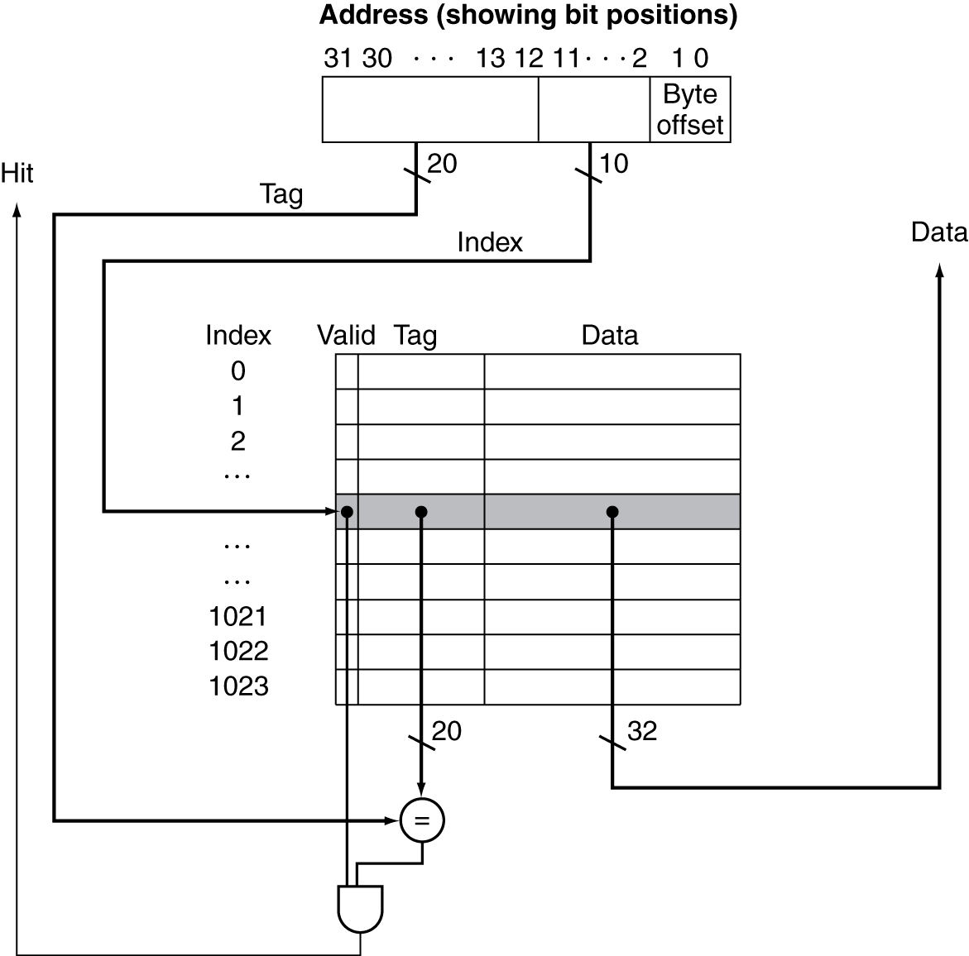
Address Subdivision（地址细分）
The number of bits in a cache includes both the storage for data and for the tags
32-bit byte address
For a direct mapped cache with 2^{n} blocks, n bits are used for the index（组内 block 序号）
For a block size of 2^{m} words (2^{m+2} bytes), m bits are used to address the word within the block and 2 bits are used to address the byte within the word
What is the size of the tag field?(组)
32 – (n+m+2)
The total number of bits in a direct-mapped cache is then
2^{n} x (block size + tag field size + valid field size)
Tags(内存分组)
Valid（1位）
Block size
标记位
有效位
数据页（data）
Notes:
Subdivision 细分，一部，分支

Slide 20
Cache Field Sizes
How many total bits are required for a direct mapped cache with 16KB of data and 4-word blocks assuming a 32-bit address?
16KB is 4K (2¹²) words
With a block size of 4 words, there are 1024 (2¹⁰) blocks
Each block has 4x32 or 128 bits of data plus a tag which is 32 – (10 + 2 + 2) = 18 bits, plus a valid bit = 19 bits
So the total cache size is
2¹⁰ x (4x32 +18 + 1) = 2¹⁰ x 147 = 147Kbits
or about 1.15x as many as needed just for storage of the data

Slide 21
Caching: A Simple First Example
Main Memory
0000xx
0001xx
0010xx
0011xx
0100xx
0101xx
0110xx
0111xx
1000xx
1001xx
1010xx
1011xx
1100xx
1101xx
1110xx
1111xx
Cache
One word blocks
Two low order bits define the byte in the word (32b words)
Index
Valid
Tag
Data
00
01
10
11
Q2: How do we find it?
Use next 2 low order memory address bits – the index – to determine which cache block (i.e., modulo the number of blocks in the cache)
Q1: Is it there?
Compare the cache tag to the high order 2 memory address bits to tell if the memory block is in the cache
(block address) modulo (# of blocks in the cache)
Notes:
For class handout

Slide 22
Caching: A Simple First Example
Main Memory
0000xx
0001xx
0010xx
0011xx
0100xx
0101xx
0110xx
0111xx
1000xx
1001xx
1010xx
1011xx
1100xx
1101xx
1110xx
1111xx
Cache
One word blocks
Two low order bits define the byte in the word (32b words)
Index
Valid
Tag
Data
00
01
10
11
Q2: How do we find it?
Use next 2 low order memory address bits – the index – to determine which cache block (i.e., modulo the number of blocks in the cache)
Q1: Is it there?
Compare the cache tag to the high order 2 memory address bits to tell if the memory block is in the cache
(block address) modulo (# of blocks in the cache)
Notes:
For lecture
Valid bit indicates whether an entry contains valid information – if the bit is not set, there cannot be a match for this block

Slide 23
Direct Mapped Cache
Consider the main memory word reference string
0 1 2 3 4 3 4 15
Start with an empty cache - all blocks initially marked as not valid
0
1
2
3
4
3
4
15
Notes:
For class handout

Slide 24
Direct Mapped Cache
Consider the main memory word reference string
0 1 2 3 4 3 4 15
Start with an empty cache - all blocks initially marked as not valid
0
miss
1
miss
2
miss
3
miss
00 Mem(0)
00 Mem(0)
00 Mem(0)
00 Mem(1)
00 Mem(0)
00 Mem(1)
00 Mem(2)
00 Mem(1)
00 Mem(2)
00 Mem(3)
4
miss
3
hit
4
hit
15
miss
01
4
00 Mem(0)
00 Mem(1)
00 Mem(2)
00 Mem(3)
01 Mem(4)
00 Mem(1)
00 Mem(2)
00 Mem(3)
01 Mem(4)
00 Mem(1)
00 Mem(2)
00 Mem(3)
01 Mem(4)
00 Mem(1)
00 Mem(2)
00 Mem(3)
11
15
8 requests, 6 misses
Notes:
For lecture
Reference string is word addresses (or block number since we are using one word blocks) – i.e., the low order two bits used to selected the byte in the 32-bit word are ignored

Slide 25
MIPS Direct Mapped Cache Example
One word blocks, cache size = 1K words (or 4KB)
Byte offset
7
4
9
31 30 . . . 13 12 11 . . . 2 1 0
组号
组内页号
页内地址
Hit
Tag
20
10
Data
XX
YY
ZZ
Index
Index
Valid
Tag
Data
0
1
2
.
.
.
1021
1022
1023
定位Cache页，读取组号
相等吗？
20
32
据此判断内存目标页是否在Cache中
What kind of locality are we taking advantage of?
Notes:
Let’s use a specific example with realistic numbers: assume we have a 1 K word (4Kbyte) direct mapped cache with block size equals to 4 bytes (1 word).
In other words, each block associated with the cache tag will have 4 bytes in it (Row 1).
With Block Size equals to 4 bytes, the 2 least significant bits of the address will be used as byte select within the cache block.
Since the cache size is 1K word, the upper 32 minus 10+2 bits, or 20 bits of the address will be stored as cache tag.
The rest of the (10) address bits in the middle, that is bit 2 through 11, will be used as Cache Index to select the proper cache entry
Temporal!

Slide 26
Multiword Block Direct Mapped Cache
Four words/block, cache size = 1K words
Byte offset
Hit
31 30 . . . 13 12 11 . . . 4 3 2 1 0
Data
Tag
20
8
Block offset
Index
Index
Valid
Tag
Data
0
1
2
.
.
.
253
254
255
20
32
What kind of locality are we taking advantage of?
Notes:
to take advantage for spatial locality want a cache block that is larger than word word in size.

Slide 27
Taking Advantage of Spatial Locality
Let cache block hold more than one word
0 1 2 3 4 3 4 15
Start with an empty cache - all blocks initially marked as not valid
0
1
2
3
4
3
4
15
Notes:
For class handout

Slide 28
Taking Advantage of Spatial Locality
Let cache block hold more than one word
0 1 2 3 4 3 4 15
Start with an empty cache - all blocks initially marked as not valid
0
miss
1
hit
2
miss
00 Mem(1) Mem(0)
00 Mem(1) Mem(0)
00 Mem(1) Mem(0)
00 Mem(3) Mem(2)
3
hit
4
miss
3
hit
01
5
4
00 Mem(1) Mem(0)
00 Mem(1) Mem(0)
01 Mem(5) Mem(4)
00 Mem(3) Mem(2)
00 Mem(3) Mem(2)
00 Mem(3) Mem(2)
4
hit
15
miss
01 Mem(5) Mem(4)
11
01 Mem(5) Mem(4)
15
14
00 Mem(3) Mem(2)
00 Mem(3) Mem(2)
8 requests, 4 misses
bigger LINE means fewer misses because of spatial locality，
but bigger LINE means longer time on miss
Notes:
For lecture
Show the 4-bit address mapping – 2-bits of tag, 1-bit of set address (index), 1-bit of word-in-block select

Slide 29
Miss Rate vs Block Size vs Cache Size
Cache的容量
相对于Cache的容量来说，块太大缺失率反而上升
Cache块较大时，一 旦缺失，带来的延时和开销是比较大的。
最简单的解决办法是提前重启（early restart）
当块中所需字一旦返回就马上执行，而不需要等待整个块都传过来再执行。
Notes:
Increasing the block size usually decreases the miss rate.
A more serious problem is that the miss penalty goes up since it is primarily determined by the time to fetch the block from the next lower level of the hierarchy and load it into the cache.

Slide 30



另一个极端的示例
有效位
Cache 标签
Cache 数据
Byte 3 | Byte 2 | Byte 1 | Byte 0
0
°Cache大小 = 4 bytes 块大小 = 4 bytes
cache中只能有唯一一个数据块
°真: 如果正在访问一个信息项，那么很可能在最近的将来还将访问该信息项
但是，通常却不会立即再次使用该信息项!!!
那么，再次访问该信息项时，仍然很可能会失效
继续向cache中装入数据，但是在它们被再次使用之前会被强行排出
cache
cache设计人员最害怕出现的事情: 乒乓现象
°冲突失效（Conflict Misses）是下述原因导致的失效:
不同的存储位置映射到同一cache索引
解决方案 1: 增大cache容量
解决方案 2: 对同一Cache索引可以有多个信息项

Slide 31
直接映射
Cache与主存之间的映射—直接映像优缺点
❖优点：
实现简单，只需利用主存地址中的区地址，与块地址对应的Cache块中Tag 进行1次比较，即可确定是否命中
❖缺点：
映射关系不灵活，因每个主存块只能固定地对应某个确定的Cache块，会出现Cache有很多空闲，但新块不能直接写入而需要替换的现象，Cache空间的利用不充分

Slide 32
Reducing Cache Miss Rates
Allow more flexible block placement
通过灵活放置块来减少Cache的缺失
In a direct mapped cache a memory block maps to exactly one cache block
At the other extreme, could allow a memory block to be mapped to any cache block – fully associative cache（一个数据块可映射到Cache的任何位置
检索项多、硬件实现复杂，Cache利用率高）
n-way set associative是一种直接映射和全相联映射的折衷方案。主存和Cache都分组，主存中组内的页数与Cache的分组数相同。
(block address) modulo (# sets in the cache)
Notes:
All of the tags of all of the elements of the set must be searched for a match.

Slide 33
Cache与主存之间的映射—全相联
❖全相联映射（Associative Mapping）
主存分为若干Block，Cache按同样大小分成若干Block，
Cache中的Block数目显然比主存的Block数少得多。
主存中的某一Block可以映射到Cache中的任意一Blcok。
?

Slide 34
Fully Associative Cache
Cache与主存之间的映射—全相联
One cache “LINE”
Address bits 31-2 from CPU
TAG |  | Data
READ HIT:
One of the cache tags matches the incoming address; the data associated with that tag is returned to CPU.
READ MISS:
None of the cache tags
matched, so initiate access to main memory and stall CPU until complete. Update cache entry with new tag (address) and data.
Miss
= ?
Each cache “line” has is associated with a “tag”
TAG |  | Data
= ?
…
TAG |  | Data
= ?
0
Data to CPU
Data from memory
1
❖全相联映射（Associative Mapping）
主存分为若干Block，Cache按同样大小分成若干Block，
Cache中的Block数目显然比主存的Block数少得多。
主存中的某一Block可以映射到Cache中的任意一Blcok。

Slide 35
Fully Associative Cache
Fully Associative: Every block can hold any line
Address does not include a cache index
Compare Cache Tags of all Cache Entries in Parallel
Example: Block Size=32B blocks
We need N 27-bit comparators
Still have byte select to choose from within block
❖全相联映射（Associative Mapping）主存中的某一Block可以映射到Cache中的任意一Blcok。
31
4
0
Cache Tag (27 bits long)
Byte Select
Ex: 0x01
Cache Tag
Valid Bit
Cache Data
=
Byte 31
:
Byte 1
Byte 0
=
Byte 63
:
Byte 33
Byte 32
=
=
:
:
:
=
Notes:
While the direct mapped cache is on the simple end of the cache design spectrum, the fully associative cache is on the most complex end.
It is the N-way set associative cache carried to the extreme where N in this case is set to the number of cache entries in the cache.
In other words, we don’t even bother to use any address bits as the cache index.
We just store all the upper bits of the address (except Byte select) that is associated with the cache block as the cache tag and have one comparator for every entry.
The address is sent to all entries at once and compared in parallel and only the one that matches are sent to the output. This is called an associative lookup.
Needless to say, it is very hardware intensive. Usually, fully associative cache is limited to 64 or less entries.
Since we are not doing any mapping with the cache index, we will never push any other item out of the cache because multiple memory locations map to the same cache location.
Therefore, by definition, conflict miss is zero for a fully associative cache. This, however, does not mean the overall miss rate will be zero.
Assume we have 64 entries here. The first 64 items we accessed can fit in.
But when we try to bring in the 65th item, we will need to throw one of them out to make room for the new item. This bring us to the third type of cache misses: Capacity Miss.
+3 = 41 min. (Y:21)

Slide 36
Tags Are Expensive!
Tag comparison logic is LARGE
An XOR gate is as large as a memory bit!
Tag comparison logic is SLOW
High-Fan-In NOR gate
Tag storage overhead is high
^{B}n-1 ^{A}n-1 ^{B}n-2 ^{A}n-2
.
.
.
A == B
Rather store data, not Tags
^{B}3
e.g. For a Fully Associative Cache
A₃
^{B}2
Tag bits/cache entry = 30 bits Data bits/cache entry = 32 bits
A₂
^{B}1
A₁ B₀
A₀
48% of cache’s memory is devoted to tag storage!

Slide 37
全相联映射
Cache与主存之间的映射—全相联
❖优点：
对Cache的使用可以有最大的灵活性：
如Cache空闲，能确保新块直接写入
如Cache已满，也可方便地选择一个Cache块来替换
❖缺点：
在执行Cache读写操作时，主存地址中的块地址要与 Cache中所有Tag都比较后，才能知晓是否不命中
由于实现这一比较操作的电路过多过于复杂，实现成本太高而难以实用，因此仅在Cache容量很小时采用

Slide 38


Cache与主存之间的映射 — 组相联
组相联映射（Set Associative Mapping）
➢映射关系：Cache 分成 K 组，每组分成 L 块（L即为路数）；主存的块 J
以下列原则映射到 Cache 的组 I 中的任何一块。
I = J mod K
➢实际上主存与Cache都分成 K 组，主存每一组内的块数与Cache一组内的
块数不一致，主存组M内的某一块只能映射到Cache组M内，但可以是组
M内的任意一块。
Cache
Main Memory
Tag
Tag
Block 0
Set 0
Block k
Block 0
Block k
Block (m-1)k
Block 1
Set 1
Block k+1
Block 1
Block k+1
Block (m-1)k+1
Block k-1
 | Block 2k-1
et k-1
Block k-1
Block 2k-1
Block mk-1
S

Slide 39
Another Reference String Mapping
Consider the main memory word reference string
0 4 0 4 0 4 0 4
Start with an empty cache - all blocks initially marked as not valid
0
miss
4
miss
0
miss
4
miss
01
4
00
0
01
00 Mem(0)
00 Mem(0)
01 Mem(4)
4
00 Mem(0)
0
miss
01
4
miss
00
0
miss
01
4
miss
00
0
4
0
4
01 Mem(4)
00 Mem(0)
01 Mem(4)
00 Mem(0)
8 requests, 8 misses
Ping pong effect due to conflict misses - two memory locations that map into the same cache block
Notes:
For class handout

Slide 40
Set Associative Cache Example
Main Memory
0000xx
0001xx
0010xx
0011xx
0100xx
0101xx
0110xx
0111xx
1000xx
1001xx
1010xx
1011xx
1100xx
1101xx
1110xx
1111xx
One word blocks
Two low order bits define the byte in the word (32b words)
Cache
Way
Set
V
Tag
Data
0
0
1
0
1
1
Q2: How do we find it?
Use next 1 low order memory address bit to determine which cache set (i.e., modulo the number of sets in the cache)
Q1: Is it there?
Compare all the cache tags in the set to the high order 3 memory address bits to tell if the memory block is in the cache
Notes:
For lecture
This picture is as opposed to
Way 0
both red Set 0
Way 1
------------------------------------
Way 0
both green Set 1
Way 1

Slide 41
Another Reference String Mapping
Consider the main memory word reference string
0 4 0 4 0 4 0 4
Start with an empty cache - all blocks initially marked as not valid
0
4
0
4
Notes:
For class handout

Slide 42
Another Reference String Mapping
Consider the main memory word reference string
0 4 0 4 0 4 0 4
Start with an empty cache - all blocks initially marked as not valid
0
miss
4
miss
0
hit
4
hit
000 Mem(0)
000 Mem(0)
000 Mem(0)
000 Mem(0)
010 Mem(4)
010 Mem(4)
010 Mem(4)
8 requests, 2 misses
Solves the ping pong effect in a direct mapped cache due to conflict misses since now two memory locations that map into the same cache set can co-exist!
Notes:
For lecture
Another sample string to try 0 1 2 3 0 8 11 0 3

Slide 43
Four-Way Set Associative Cache
2⁸ = 256 sets each with four ways (each with one block)
31 30 . . . 13 12 11 . . . 2 1 0
Byte offset
Tag
22
8
Index
Index
V
Tag
Data
V
Tag
Data
V
Tag
Data
V
Tag
Data
0
1
2
.
.
.
253
254
255
0
1
2
.
.
.
253
254
255
0
1
2
.
.
.
253
254
255
0
1
2
.
.
.
253
254
255
Way 0
Way 1
Way 2
Way 3
32
4x1 select
Hit
Data
Notes:
This is called a 4-way set associative cache because there are four cache entries for each cache index. Essentially, you have four direct mapped cache working in parallel.
This is how it works: the cache index selects a set from the cache. The four tags in the set are compared in parallel with the upper bits of the memory address.
If no tags match the incoming address tag, we have a cache miss.
Otherwise, we have a cache hit and we will select the data from the way where the tag matches occur.
This is simple enough. What is its disadvantages?
+1 = 36 min. (Y:16)

Slide 44
N-Way Set-Associative Cache
INCOMING ADDRESS
TARGET INDEX
“N direct-mapped caches”, each with 2^{t} entries of N lines
Lines that share a common index are a set
There are N possible places that a given item could be stored in the cache
k
t
=?
=?
=?
MEM DATA
DATA TO CPU
HIT

Slide 45
Range of Set Associative Caches
For a fixed size cache, each increase by a factor of two in associativity doubles the number of blocks per set (i.e., the number or ways) and halves the number of sets – decreases the size of the index by 1 bit and increases the size of the tag by 1 bit
Tag
Index
Block offset
Byte offset
Notes:
For class handout

Slide 46
Range of Set Associative Caches
For a fixed size cache, each increase by a factor of two in associativity doubles the number of blocks per set (i.e., the number or ways) and halves the number of sets – decreases the size of the index by 1 bit and increases the size of the tag by 1 bit
Used for tag compare
Selects the set
Selects the word in the block
Tag
Index
Block offset
Byte offset
Increasing associativity
Decreasing associativity
Fully associative
(only one set)
Tag is all the bits except
block and byte offset
Direct mapped
(only one way)
Smaller tags, only a single comparator
Notes:
For lecture
In 2008, the greater size and power consumption of CAMs generally leads to 2-way and 4-way set associativity being built from standard SRAMs with comparators with 8-way and above being built using CAMs

Slide 47
Costs of Set Associative Caches
When a miss occurs, which way’s block do we pick for replacement?
Least Recently Used (LRU): the block replaced is the one that has been unused for the longest time
Must have hardware to keep track of when each way’s block was used relative to the other blocks in the set
For 2-way set associative, takes one bit per set → set the bit when a block is referenced (and reset the other way’s bit)
N-way set associative cache costs
N comparators (delay and area)
MUX delay (set selection) before data is available
Data available after set selection (and Hit/Miss decision). In a direct mapped cache, the cache block is available before the Hit/Miss decision
So its not possible to just assume a hit and continue and recover later if it was a miss
Notes:
First of all, a N-way set associative cache will need N comparators instead of just one comparator (use the right side of the diagram for direct mapped cache).
A N-way set associative cache will also be slower than a direct mapped cache because of this extra multiplexer delay.
Finally, for a N-way set associative cache, the data will be available AFTER the hit/miss signal becomes valid because the hit/mis is needed to control the data MUX.
For a direct mapped cache, that is everything before the MUX on the right or left side, the cache block will be available BEFORE the hit/miss signal (AND gate output) because the data does not have to go through the comparator.
This can be an important consideration because the processor can now go ahead and use the data without knowing if it is a Hit or Miss. Just assume it is a hit.
Since cache hit rate is in the upper 90% range, you will be ahead of the game 90% of the time and for those 10% of the time that you are wrong, just make sure you can recover.
You cannot play this speculation game with a N-way set-associative cache because as I said earlier, the data will not be available to you until the hit/miss signal is valid.
+2 = 38 min. (Y:18)

Slide 48
Benefits of Set Associative Caches
The choice of direct mapped or set associative depends on the cost of a miss versus the cost of implementation
Data from Hennessy & Patterson, Computer Architecture, 2003
Largest gains are in going from direct mapped to 2-way (20%+ reduction in miss rate)
Notes:
As cache sizes grow, the relative improvement from associativity increases only slightly; since the overall miss rate of a larger cache is lower, the opportunity for improving the miss rate decreases and the absolute improvement in miss rate from associativity shrinks significantly.

Slide 49
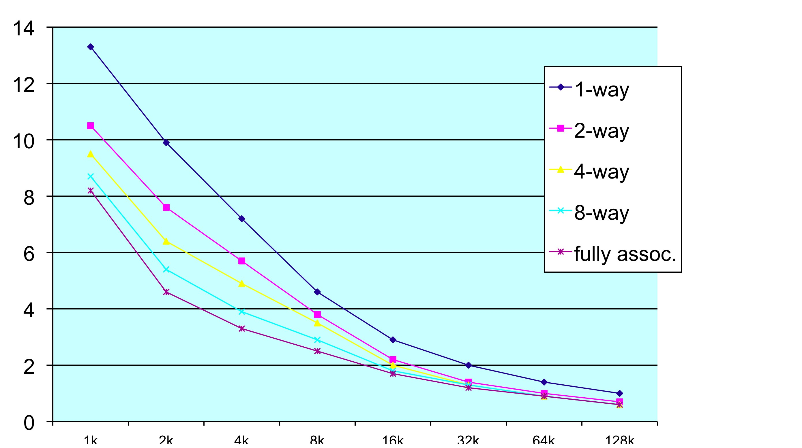
Associativity vs. Miss Rate
Associativity
Direct-mapped
Miss rate (%)
Cache size (bytes)
8-way is (almost) as effective as fully-associative
rule of thumb: N-byte M-way set assoc ≈ N/2-byte 2M-way set assoc.

Slide 50
Continuum of Associativity
Fully associative
N-way set associative Direct-mapped
address
address
N
address
compares addr with
all tags simultaneously
location A can be stored in any cache line
compares addr with N
tags simultaneously
Data can be stored in any of the N cache lines belonging to a “set”
like N Direct-mapped
caches
Allocates 1 of N lines in a set
compare addr with only one tag
location A can be stored in exactly one cache line
ON A MISS?
Allocates a cache entry
Only one place to put it

Slide 51
组相联映射主存地址格式
组相联映射
➢主存的地址格式：
➢Tag的内容：主存中与该Cache数据块对应的数据块的组内块地址。
组内块地址 (tag) | 组地址way | 块内偏移index
该映射方式将所有Cache分为K组，每组有R块，则有以下关系: i =j mod K 其中i,j的含义与直接映射中的含义一致。上述表达式意思即为某一主存块按模K将其映射到缓存的第i组内。i=组内块地址 (tag)

Slide 52
组相联映射举例
➢主存：1M Bytes
➢Cache：16K Bytes
➢Block：256 Bytes
➢Way : 4 Ways（Cache每组包含4个Block）
解答
➢Cache行数＝ 2¹⁴ ÷(2⁸×2²）＝ 2⁴ ＝16 行
➢主存组块数＝ 2²⁰ ÷(2⁸×2⁴）＝ 2⁸ ＝256 组
➢主存地址：20 位，其中高8 位为组内块地址，中间4 位为路地址，低 8位
为cache块内地址index.
➢Cache的Tag应该为 8 位。
Cache Tag(8位)
Valid Bit
Way0 Cache Data
Way3 Cache Data
Byte 255
:
Byte 1
Byte 0
Byte 255
:
Byte 1
Byte 0
0
1
.
.
.
13
14
15
Byte 511
:
Byte 257
Byte 256
Byte 511
:
Byte 257
Byte 256
…
:
:
:
:

Slide 53
Cache与主存之间的映射 — 组相联
CACHE
way0
way1
way2
wayF
00000H
00100H
00200H
00F00H
000FFH
01000H
001FFH
01100H
002FFH
01200H
00FFFH
01F00H
010FFH
011FFH
012FFH
01FFFH
主存

Slide 54
Cache与主存之间的映射 — 组相联
CACHE
way0
way1
way 2
way F
00000H
00100H
00200H
00F00H
000FFH
01000H
001FFH
01100H
002FFH
01200H
00FFFH
01F00H
010FFH
02000H
011FFH
02100H
012FFH
02200H
01FFFH
02F00H
020FFH
03000H
021FFH
03100H
022FFH
03200H
02FFFH
03F00H
030FFH
031FFH
032FFH
03FFFH
FF000H
FF100H
FF200H
FFF00H
FF0FFH
主存
FF1FFH
FF2FFH
FFFFFH

Slide 55
Cache与主存之间的映射 — 组相联
CACHE
way 2
way 0
way 1
way F
03
FF
01
02
03
00000H
00100H
00200H
00F00H
000FFH
01000H
001FFH
01100H
002FFH
01200H
00FFFH
01F00H
010FFH
02000H
011FFH
02100H
012FFH
02200H
01FFFH
02F00H
020FFH
03000H
021FFH
03100H
022FFH
03200H
02FFFH
03F00H
030FFH
031FFH
032FFH
03FFFH
FF000H
FF100H
FF200H
FFF00H
FF0FFH
主存
FF1FFH
FF2FFH
FFFFFH

Slide 56
Cache与主存之间的映射 — 组相联
Cache结构示例：Cache容量4KB，4路组相联，数据块大小4B，主存地址32位。
主存地址 tag（22b) set(8b) 2b
22 8
➢Cache行数＝ 2¹² ÷(2²×2²）＝256行
Cache容量4KB，4路组相联,每一路大小1KB。
➢主存组块数＝ 2³² ÷(2¹⁰）＝ 2²² 组
➢主存地址：32 位，其中高22 位为组内块地址，2-10 为cache块内地址8位index.,低2位为数据offset.
➢Cache的Tag应该为 22 位。
组有效位 标记
0
1
2
数据
有效位 标记
数据
有效位 标记
数据
有效位 标记
数据
255
22
32
=
=
=
=
4选1多路开关
命中
数据

Slide 57








Cache与主存之间的映射 — 组相联
Cache举例： 2路组相联Cache的地址机构
组内块地址 组地址 块内地址
TAG Index Data
有效位
有效位
Tag
W0
W1
W2
W3
组地址
Tag
W0
W1
W2
W3
组地址
组内块地址
比较器
比较器
块内地址
字选择
字选择
字选择
 | Data

Slide 58


Cache与主存之间的映射 — 组相联
组相联映射
组相联映射是直接映射和全相联映射的折衷
主存块与Cache组之间是一一对应关系，好似直接映射方式，简化了实现
主存块与对应组中的Cache块是任意对应关系，好似全相联映射方式，体现了一定的灵活性
组相联映射兼顾了实现成本和灵活性

Slide 59
Associativity Example
Compare 4-block caches
Direct mapped, 2-way set associative, fully associative
Block access sequence: 0, 8, 0, 6, 8
Direct mapped
Block address | Cache index | Hit/miss | Cache content after access
 |  |  | 0 | 1 | 2 | 3
0 | 0 | miss | Mem[0]
8 | 0 | miss | Mem[8]
0 | 0 | miss | Mem[0]
6 | 2 | miss | Mem[0] |  | Mem[6]
8 | 0 | miss | Mem[8] |  | Mem[6]

Slide 60
Associativity Example
Block address | Cache index
0 | 0 modulo 2=0
8 | 8 modulo 2=0
0 | 0 modulo 2=0
6 | 6 modulo 2=0
8 | 8 modulo 2=0
2-way set associative
Block address | Cache index | Hit/miss | Cache content after access
 |  |  | Set 0 |  | Set 1
0 | 0 | miss | Mem[0]
8 | 0 | miss | Mem[0] | Mem[8]
0 | 0 | hit | Mem[0] | Mem[8]
6 | 0 | miss | Mem[0] | Mem[6]
8 | 0 | miss | Mem[8] | Mem[6]
Fully associative
Block address |  | Hit/miss | Cache content after access
0 |  | miss | Mem[0]
8 |  | miss | Mem[0] | Mem[8]
0 |  | hit | Mem[0] | Mem[8]
6 |  | miss | Mem[0] | Mem[8] | Mem[6]
8 |  | hit | Mem[0] | Mem[8] | Mem[6]

Slide 61
Measuring Cache Performance
Assuming cache hit costs are included as part of the normal CPU execution cycle, then
CPU time = IC（指令计数器） × CPI × CC（时钟周期）
= IC × (CPI_{ideal} + Memory-stall cycles) × CC
CPI_{stall}
Memory-stall cycles come from cache misses (a sum of read-stalls and write-stalls)
Read-stall cycles = reads/program × read miss rate × read miss penalty
Write-stall cycles = (writes/program × write miss rate × write miss penalty)
+ write buffer stalls
For write-through caches, we can simplify this to
Memory-stall cycles = accesses/program × miss rate × miss penalty
Notes:
Reasonable write buffer depth (e.g., four or more words) and a memory capable of accepting writes at a rate that significantly exceeds the average write frequency means write buffer stalls are small

Slide 62
Cache Performance Example
Given
I-cache miss rate = 2%
D-cache miss rate = 4%
Miss penalty = 100 cycles
Base CPI (ideal cache) = 2
Load & stores are 36% of instructions
Miss cycles per instruction
I-cache: 0.02 × 100 = 2
D-cache: 0.36 × 0.04 × 100 = 1.44
Actual CPI = 2 + 2 + 1.44 = 5.44
Ideal CPU is 5.44/2 =2.72 times faster

Slide 63
Average Access Time
Hit time is also important for performance
Average memory access time (AMAT)
AMAT = Hit time + Miss rate × Miss penalty
Example
CPU with 1ns clock, hit time = 1 cycle, miss penalty = 20 cycles, I-cache miss rate = 5%
AMAT = 1 + 0.05 × 20 = 2ns
2 cycles per instruction

Slide 64
Clickers/Peer Instruction
AMAT = Time for a hit + Miss rate x Miss penalty
Given a 200 psec clock, a miss penalty of 50 clock cycles, a miss rate of 0.02 misses per instruction and a cache hit time of 1 clock cycle, what is AMAT?
A: ≤200 psec
B: 400 psec
C: 600 psec
D: ≥ 800 psec
1 clock cycle + .02 * 50 clock cycles = 2 clock cycles

Slide 65
Performance Summary
When CPU performance increased
Miss penalty becomes more significant
Decreasing base CPI
Greater proportion of time spent on memory stalls
Increasing clock rate
Memory stalls account for more CPU cycles
Can’t neglect cache behavior when evaluating system performance

Slide 66
CACHE的其它问题 —— Cache容量的计算
Cache的容量
➢不作特殊申明时，Cache的容量指Cache数据块的容量；
➢Cache实际总的存储容量实际上还包含tag和valid bit的位数。
假设一直接映射像Cache，有16KB数据，块大小为4个字（32位字），主存地址32位，那么Cache总共有多少位？
Cache每数据块大小：4×32 = 128 bits = 2⁴ Bytes; （块内地址）
Cache块数：16KB ÷ 2⁴ B = 2¹⁰ 块；（区内块地址）
➢ tag位数：32 – 10 – 4 = 18 bits （区地址）
有效位：1 bit
➢ Cache实际总容量：2¹⁰ × (128+18+1) = 147Kbit ≈ 18.4KByte

