Slide 1
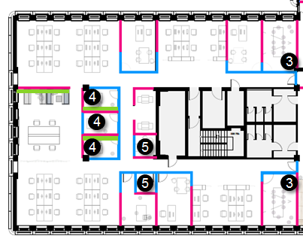
Sitzordnung Interim
Table | Name
1 | Weyers
2 | Adelt
3 | Hoppe
4 | Farrant
5 | Koschubs
6 | Marzahl
7 | Yang
8 | Hoffmann
9 | Pascoletti
10 | Scherer
11 | ok
12 | ok
13 | ok
14 | ok
15 | ok
16 | ok
17 | ok
18 | Geisselmeier
19 | ok
20 | Berntgen
21 | ok
22 | Schröder
23 | ok
24 | ok
25 | ok
Table | Name
26 | ok
27 | ok
28 | ok
29 | ok
30 | ok
31 | ok
32 | ok
33 | ok
34 | ok
35 | ok
36 | ok
37 | ok
38 | ok
39 | ok
40 | ok
41 | Axel
42 | Steinmann
43 | Vennemann
44 | Gilgenberg
45 | Vogel
46 | Schöpfer
47 | ok
48 | Hemsen
49 | Kosar
--
Overview
20 / 17
14 / 11
7
5
3
2 / 1
21 / 18
10 / 9
8
4
15 / 12
6
22 / 19
16 / 13
23 / 24 / 25
26 / 27 / 28
29 / 32
35 / 38
30 / 33
36 / 39
44
47 / 48
31 / 34
37 / 40
41
42 / 43
45 / 46
49

