Slide 1
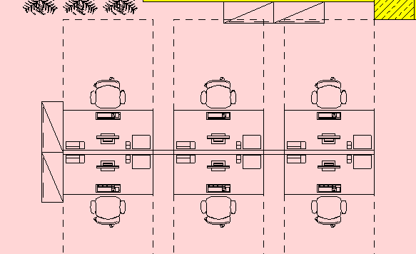
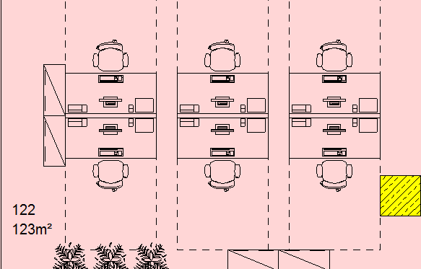
Andreas
Kircher AP01
Sören
Tetzner AP02
Stefan
Michaelis AP03
Jürgen
Horsch AP06
Martina
Radke AP04
Ulrich
Schröder AP05
Fabian
Beusch AP07
Jens
Greiner AP08
Miriam
Mohr AP09
Rudolf
Fischer AP12
Lukas
Reckebeil AP11
Holger
Seguin AP10

