Slide 1
The Outliers
Siddharth Sharma | 2022 | PSIT College of Engineering, Kanpur
Mohd Mizan Ali | 2022 | PSIT College of Engineering, Kanpur
Jayesh Rohan Singh | 2022 | PSIT College of Engineering, Kanpur
Saumya Verma | 2022 | PSIT College of Engineering, Kanpur

Slide 2
Tell us a bit about yourself
Projects we’ve worked on
Facial Recognition Software.
Fake News Classifier (CNN, DCNN, LSTM, Multi-Channel CNN).
Smart Bag Creator .
Past Hackathon experiences
Participated in Flipkart GRID 3.0

Slide 3
Instant Chat Application for Doctors
Database
Logout/
Exit Window
Online status
User’s/ Doctor’s Screen
Chat window
Medical profile
Authenticator
User/ Doctor
login/ sign-up
Chat history
Online Doctors/
Users

Slide 4
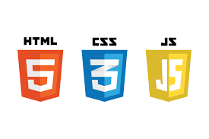






Tech Stack

Slide 5

Backend
Database
Client Application
Application Server
Client
Front-end
Flask
Socket IO
SignUp
Patient
Flask
Server
Sign-In
Doctor
Chat Screen

Slide 6
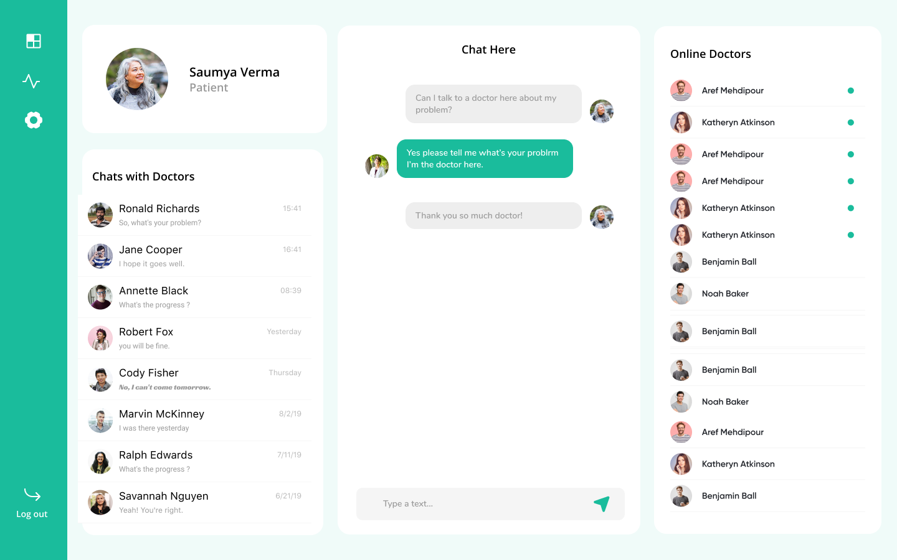
Frontend
Chat Screen
All Available Doctors, with their Online Indicators
Current User Info
Past Chat History
Logout

Slide 7
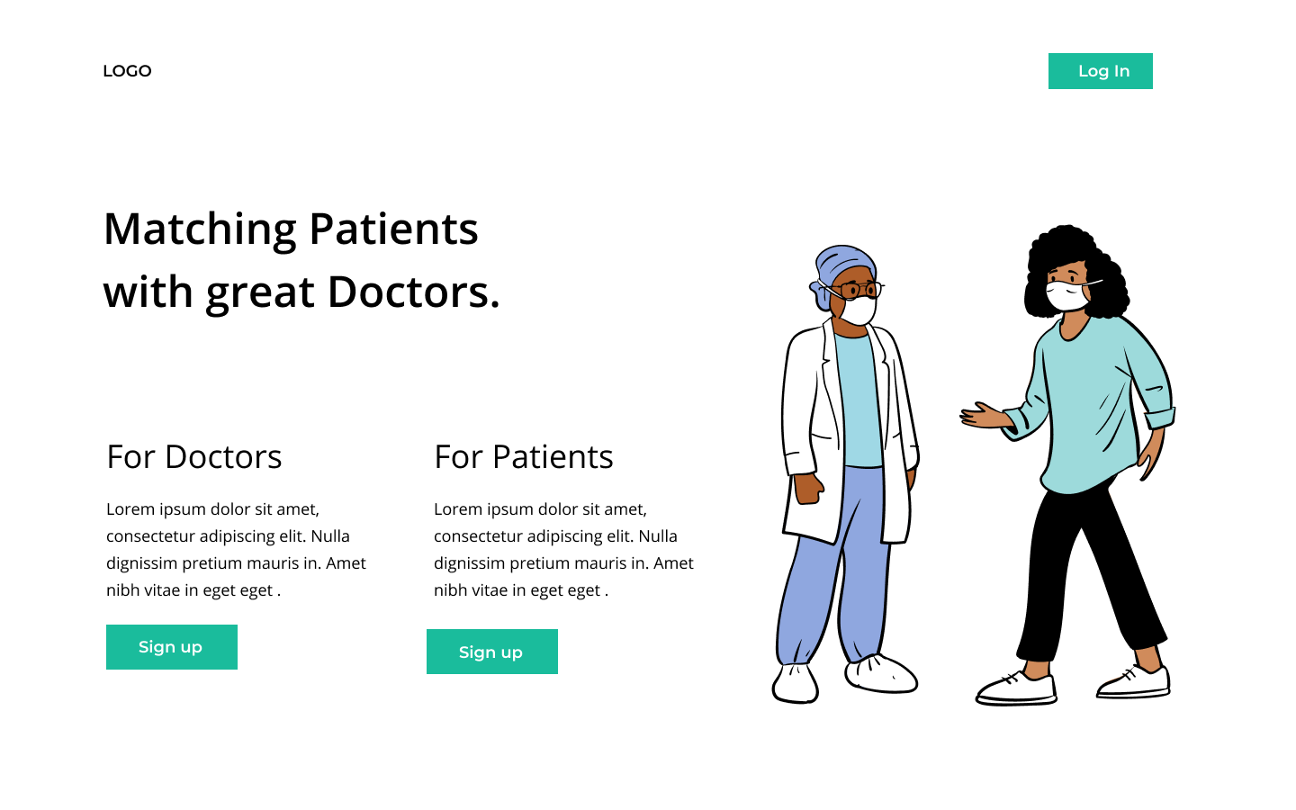
Login/ Sign-up
Login
New User/ Doctor Sign-up

Slide 8
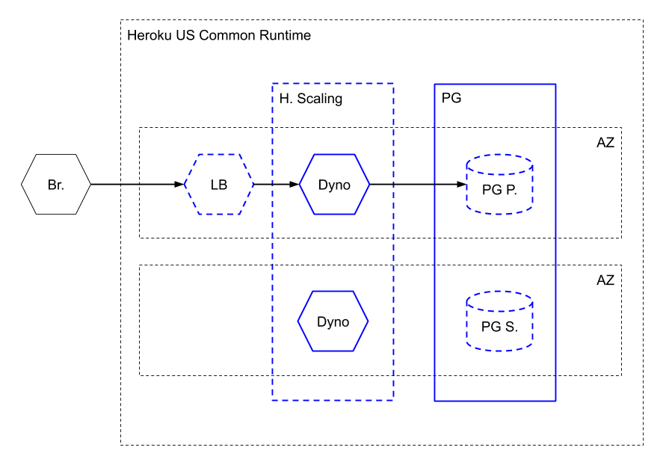
Cloud Service Providers

Slide 9
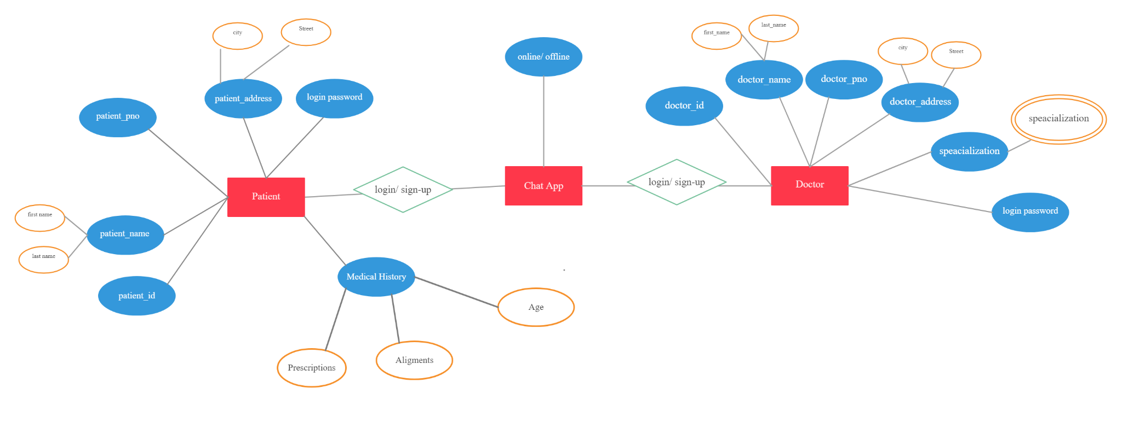
Database - ER Diagram

Slide 10

How our solution is different
Prescription
All the prescription generated will be available for future reference of the user.
The user can share the previous prescription with the doctor, if needed.
User medical history
Medical history of the user will be stored in the user profile.
The user can share the necessary information with the doctor on will.
Doctor Profile
Verification of the information provided by the doctors.
User Privacy
No one except the doctor will be able to view the user’s medical information.
The user’s medical information will not be stored in the chat, i.e. once the session is closed the doctor will not be able to view the information.

Slide 11
Future possible enhancements
Voice Call/ Chat Between Patient and Doctor
Video Call Between Patient and Doctor
Notification when our desired Doctor is online.
Doctor profile verification.
More Security Features

Slide 12
Risks/ Challenges / Dependencies
Challenges :-
Doctor Patient Confidentiality.
Online/Offline indicator.
Security of User’s Medical info
Risks :-
Doctor Portfolio Not Verified.
Not Fully Implemented Doctor Patient Confidentiality
Notes:
Typo sahi kerne hai frontend me

Slide 13
Dependencies
SignUp Backend
User Chat Backend
SignUp / Login Database
SignUp Frontend
User Chat Database
User Chat Frontend
Sign-in Backend
Sign-in Frontend

Slide 14
Demo - GitHub LINK

Slide 15
References
Flask Documentation (Click Here)
MongoDB Documentation (Click here)
Socket IO Documentation (Click here)
Heroku Documentation (Click Here)
Health Technologies Privacy Norms (Click Here)

