Slide 1



Transcript Identification
with Long-Read RNA-seq
Ana Conesa · VALT Summer School 2026
Spanish National Research Council, ES
Conesa Lab · Genomics of Gene Expression — I2SysBio (CSIC–University of Valencia)
VALT Summer Course · Long-Read Transcriptomics

Slide 2
Outline
From error-prone long reads to a curated, quantified transcriptome — and the algorithms that get us there.
1
Why long reads?
2
The identification problem
Full-length isoforms vs. the short-read assembly problem
What is hard, and why precision is the bottleneck
3
A map of the methods
4
Seven algorithms in depth
Cluster · graph · class-based; reference-free; annotation-driven
Iso-Seq · FLAIR · Bambu · IsoQuant · isONclust · lr-kallisto · Oarfish
5
What benchmarks tell us
6
Choosing & evaluating
LRGASP & friends — accuracy, power, reproducibility
SQANTI3 categories and a practical decision guide

Slide 3
Why long reads for transcriptomics?
A transcript is a full chain of exons. Short reads see fragments; long reads see the molecule.
Short reads (50–150 bp)
Long reads (PacBio HiFi / ONT)
Fragment every transcript, then must computationally RE-ASSEMBLE isoforms from overlapping pieces. Splice combinations are inferred, not observed → ambiguity, and reads shared between isoforms cannot be assigned uniquely.
Span the FULL transcript in a single read — the exact exon chain, TSS and TTS are observed directly. Isoform structure becomes a measurement rather than an inference; read-to-isoform assignment is far less ambiguous.
▸ Direct isoform resolution — novel isoforms, alternative TSS/TTS, fusion & chimeric transcripts seen end-to-end.
▸ More power for differential transcript expression — less read-sharing ambiguity than short reads at equal depth (LRGASP).
▸ The trade-off: higher per-base error (esp. ONT) and shorter library fragments bias → the analysis problem moves from assembly to error-tolerant model building.
▸ Two platforms, two regimes: PacBio HiFi = high accuracy, broad length range; ONT = longest reads + native RNA / modifications.
Source: Monzó, Liu & Conesa, Nat Rev Genet 2025 — “Transcriptomics in the era of long-read sequencing”

Slide 4
Two goals: identification & quantification
Transcript identification and quantification are the primary goals of long-read RNA-seq.
1 · Transcript IDENTIFICATION
2 · Transcript QUANTIFICATION
Infer the set of transcript MODELS present — the exon/intron structures — from the reads, with or without a reference annotation. → Enables NOVEL isoform discovery. → Computationally intensive. → Output: an experiment-defined transcriptome.
Estimate the abundance of each transcript by assigning reads to models. → On a NEW transcriptome (after identification), or → Directly on a reference transcriptome (pseudo-mapping). → Fast, but reference-only misses novel isoforms.
The catch with long-read data:
lrRNA-seq characteristically detects a large number of NOVEL transcripts (albeit of low expression). Reference annotations are therefore expected to be incomplete — which biases pure annotation-based read assignment and makes identification, not just quantification, unavoidable for most studies.

Slide 5
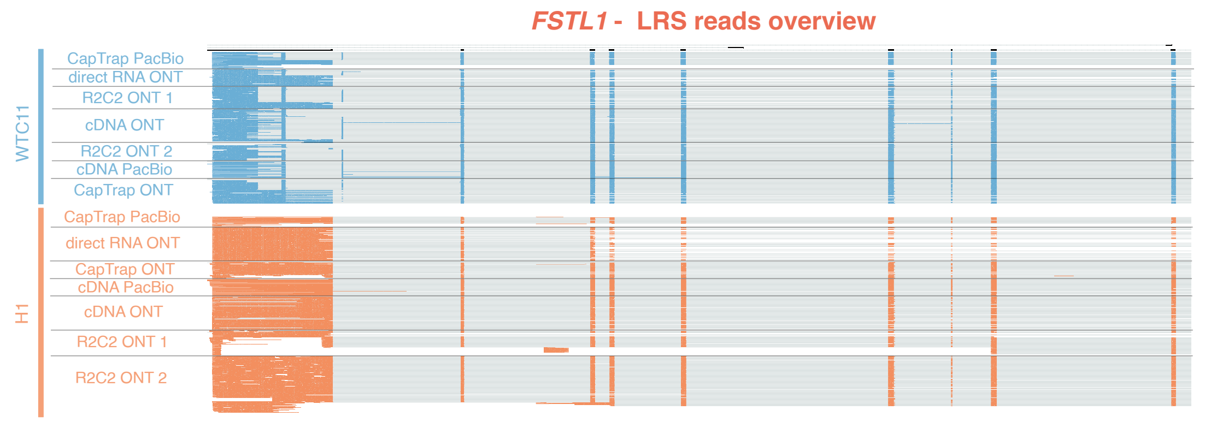
But…. Long reads are noisy….
Long-reads methods
Alternative isoforms
Global patterns
noisy signals
noisy signals
Human cell-lines
RNA degradation
noisy signals
noisy signals
noisy signals
Global patterns

Slide 6
Why is identification hard? The core challenges
Even the best-performing tools still show low precision — orthogonal validation of novel transcripts is essential.
Errors at splice junctions
RNA degradation & 5′ truncation
Mis-mapping of error-containing reads around splice sites produces wrong splice-junction predictions and spurious novel models.
Degraded RNA yields 5′-incomplete models and unreliable TSS/TTS, hurting mapping accuracy and quantification.
Low precision / false positives
Poor replicability at low expression
Distinguishing real low-abundance isoforms and splicing noise from sequencing noise is unsolved — high false-discovery risk.
Medium-to-low-expression transcripts replicate poorly across samples; depth boosts sensitivity but not model accuracy.
Platform & library variability
Incomplete reference annotation
Read length distributions and error profiles differ by platform (PacBio vs ONT) and library type — no single optimal setting.
Reference transcriptomes are incomplete for lrRNA-seq, so reads are mis-assigned when relying purely on annotation.

Slide 7
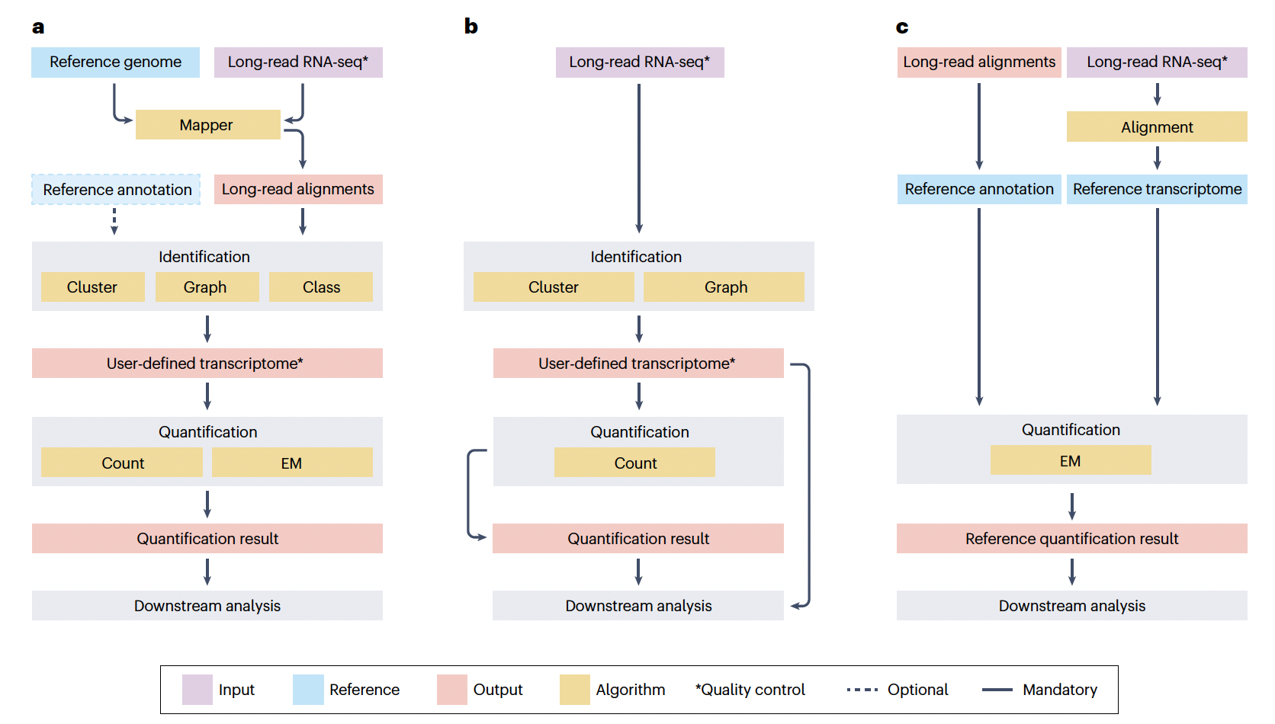
Why is identification hard? The core challenges
Reference -based
Reference-free
Pseudomappers

Slide 8
Why is identification hard? The core challenges
Reference -based
Reference-free
Pseudomappers

Slide 9
Why is identification hard? The core challenges
Reference -based
Reference-free
Pseudomappers

Slide 10
Three strategies to get transcripts & counts
The strategy you choose depends on the goal of the study — and on whether a reference exists.
A · Reference-based inference
B · Reference-free inference
C · Annotation-driven quantification
Map reads to a reference GENOME → build an experiment-defined transcriptome → identify (cluster / graph / class) → quantify.
Reconstruct transcripts ENTIRELY from reads by clustering & assembly. A genome, if available, only joins isoforms post-hoc.
(Pseudo)map reads directly to a reference TRANSCRIPTOME and quantify with an EM algorithm. No identification step.
Novel discovery · most common · needs genome
For species without a reference
Fast & light · misses novel isoforms
Tools
FLAIR · IsoQuant · Bambu · StringTie2 · Iso-Seq
Tools
isONclust→isONform · RATTLE · RNA-Bloom2 · IsoSeq3
Tools
lr-kallisto · Oarfish · NanoCount · LIQA
Adapted from Monzó, Liu & Conesa, Nat Rev Genet 2025, Fig. 3

Slide 11
A map of identification algorithms
Reference-based identifiers fall into three algorithmic families — by how they group reads into models.
CLUSTER-based
GRAPH-based
CLASS-based
Align reads to the genome, then GROUP them by shared splice-junction chains. Each group → one isoform model.
Build a SPLICE / INTRON GRAPH of the locus (junctions = nodes). Transcripts = paths through the graph.
CLASSIFY each read by its splice-junction pattern as known / novel / uncertain; validate & rank candidates.
FLAIR · Mandalorion
IsoQuant · IsoTools · StringTie2 · Isosceles
Bambu · ESPRESSO · TALON · FLAMES
REFERENCE-FREE (de novo)
Cluster reads with no annotation, then assemble. For non-model organisms.
isONclust → isONform · RATTLE · RNA-Bloom2 · IsoSeq3
ANNOTATION-DRIVEN (quant only)
Skip identification; (pseudo)map to a reference transcriptome + EM.
lr-kallisto · Oarfish · NanoCount · LIQA
Highlighted tools detailed next →

Slide 12
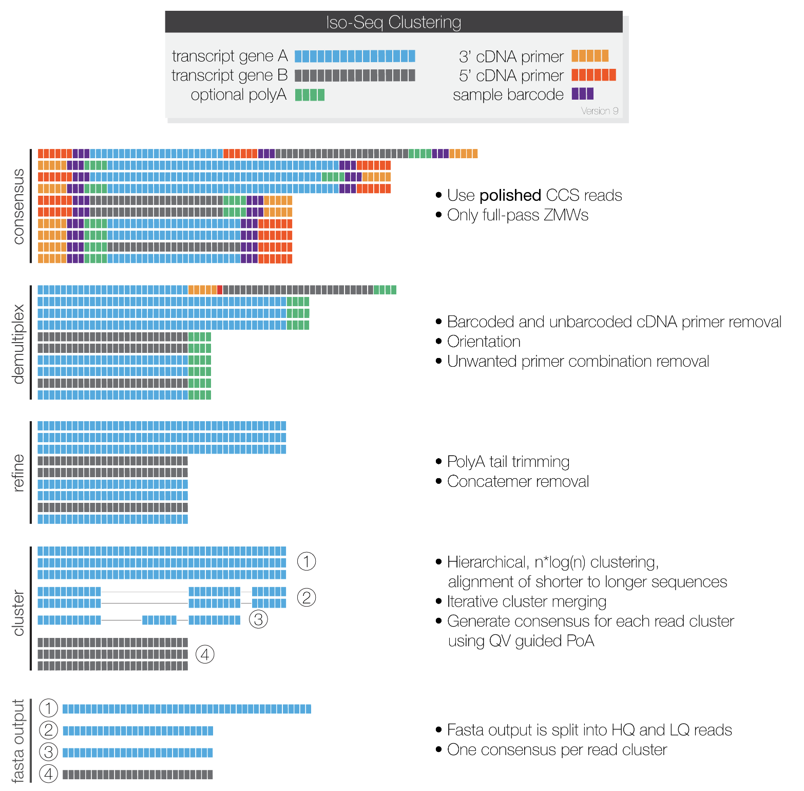
Iso-Seq — PacBio's de novo isoform discovery pipeline
Key idea: Polish reads into high-fidelity, full-length isoform consensus before genome mapping
How it works
FAMILY
Cluster-based / reference-free clustering
PLATFORM
PacBio HiFi (cDNA · Kinnex)
REFERENCE
Official PacBio pipeline (IsoSeq v4)
OUTPUT
Polished, near-error-free full-length isoform sequences + a GFF transcriptome
PROCEDURE
HiFi CCS reads
▸
lima + refine (FLNC)
▸
Cluster reads per isoform
▸
Polish consensus
▸
Map to genome (pbmm2)
▸
Collapse → isoforms
github.com/PacificBiosciences/IsoSeq · isoseq.how

Slide 13
Iso-Seq — PacBio's de novo isoform discovery pipeline
Key idea: Polish reads into high-fidelity, full-length isoform consensus before genome mapping
How it works
FAMILY
Cluster-based / reference-free clustering
PLATFORM
PacBio HiFi (cDNA · Kinnex)
REFERENCE
Official PacBio pipeline (IsoSeq v4)
OUTPUT
Polished, near-error-free full-length isoform sequences + a GFF transcriptome
PROCEDURE
HiFi CCS reads
▸
lima + refine (FLNC)
▸
Cluster reads per isoform
▸
Polish consensus
▸
Map to genome (pbmm2)
▸
Collapse → isoforms
github.com/PacificBiosciences/IsoSeq · isoseq.how

Slide 14
Iso-Seq — PacBio's de novo isoform discovery pipeline
Key idea: Polish reads into high-fidelity, full-length isoform consensus before genome mapping
How it works
FAMILY
Cluster-based / reference-free clustering
PLATFORM
PacBio HiFi (cDNA · Kinnex)
REFERENCE
Official PacBio pipeline (IsoSeq v4)
OUTPUT
Polished, near-error-free full-length isoform sequences + a GFF transcriptome
PROCEDURE
HiFi CCS reads
▸
lima + refine (FLNC)
▸
Cluster reads per isoform
▸
Polish consensus
▸
Map to genome (pbmm2)
▸
Collapse → isoforms
github.com/PacificBiosciences/IsoSeq · isoseq.how

Slide 15
Iso-Seq — PacBio's de novo isoform discovery pipeline
Key idea: Polish reads into high-fidelity, full-length isoform consensus before genome mapping
How it works
FAMILY
Cluster-based / reference-free clustering
PLATFORM
PacBio HiFi (cDNA · Kinnex)
REFERENCE
Official PacBio pipeline (IsoSeq v4)
OUTPUT
Polished, near-error-free full-length isoform sequences + a GFF transcriptome
PROCEDURE
HiFi CCS reads
▸
lima + refine (FLNC)
▸
Cluster reads per isoform
▸
Polish consensus
▸
Map to genome (pbmm2)
▸
Collapse → isoforms
github.com/PacificBiosciences/IsoSeq · isoseq.how

Slide 16
Iso-Seq — PacBio's de novo isoform discovery pipeline
Key idea: Polish reads into high-fidelity, full-length isoform consensus before genome mapping
How it works
FAMILY
Cluster-based / reference-free clustering
PLATFORM
PacBio HiFi (cDNA · Kinnex)
REFERENCE
Official PacBio pipeline (IsoSeq v4)
OUTPUT
Polished, near-error-free full-length isoform sequences + a GFF transcriptome
PROCEDURE
HiFi CCS reads
▸
lima + refine (FLNC)
▸
Cluster reads per isoform
▸
Polish consensus
▸
Map to genome (pbmm2)
▸
Collapse → isoforms
github.com/PacificBiosciences/IsoSeq · isoseq.how

Slide 17
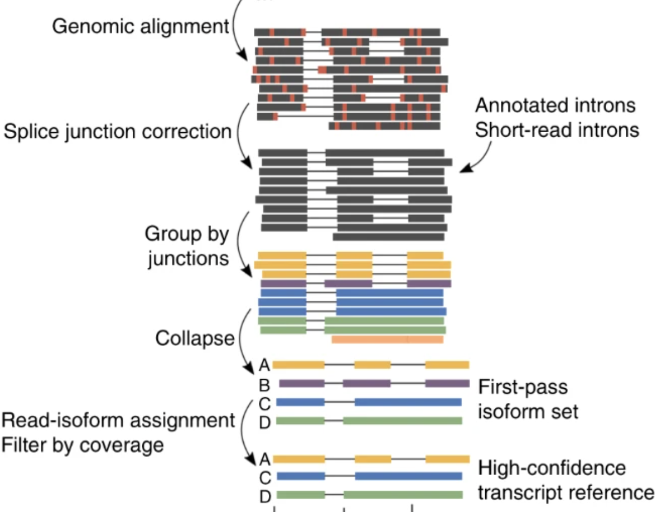
FLAIR — Full-Length Alternative Isoform analysis of RNA
Key idea: Correct noisy splice junctions against trusted evidence, then group reads by junction chain
How it works
FAMILY
Cluster-based (reference-guided)
PLATFORM
ONT & PacBio (cDNA)
REFERENCE
Tang et al., Nat Commun 2020
OUTPUT
High-confidence isoform models (BED/GTF) + isoform usage matrices
PROCEDURE
Long reads
▸
Align (minimap2)
▸
Correct splice junctions
▸
Group by junction chain
▸
Collapse + filter
▸
Isoform models
flair.readthedocs.io · Tang et al. 2020; Nguyen et al. (FLAIR2), Genome Biol 2024

Slide 18
FLAIR — Full-Length Alternative Isoform analysis of RNA
Key idea: Correct noisy splice junctions against trusted evidence, then group reads by junction chain
How it works
FAMILY
Cluster-based (reference-guided)
PLATFORM
ONT & PacBio (cDNA)
REFERENCE
Tang et al., Nat Commun 2020
OUTPUT
High-confidence isoform models (BED/GTF) + isoform usage matrices
PROCEDURE
Long reads
▸
Align (minimap2)
▸
Correct splice junctions
▸
Group by junction chain
▸
Collapse + filter
▸
Isoform models
flair.readthedocs.io · Tang et al. 2020; Nguyen et al. (FLAIR2), Genome Biol 2024

Slide 19
FLAIR — Full-Length Alternative Isoform analysis of RNA
Key idea: Correct noisy splice junctions against trusted evidence, then group reads by junction chain
How it works
FAMILY
Cluster-based (reference-guided)
PLATFORM
ONT & PacBio (cDNA)
REFERENCE
Tang et al., Nat Commun 2020
OUTPUT
High-confidence isoform models (BED/GTF) + isoform usage matrices
PROCEDURE
Long reads
▸
Align (minimap2)
▸
Correct splice junctions
▸
Group by junction chain
▸
Collapse + filter
▸
Isoform models
flair.readthedocs.io · Tang et al. 2020; Nguyen et al. (FLAIR2), Genome Biol 2024

Slide 20
FLAIR — Full-Length Alternative Isoform analysis of RNA
Key idea: Correct noisy splice junctions against trusted evidence, then group reads by junction chain
How it works
FAMILY
Cluster-based (reference-guided)
PLATFORM
ONT & PacBio (cDNA)
REFERENCE
Tang et al., Nat Commun 2020
OUTPUT
High-confidence isoform models (BED/GTF) + isoform usage matrices
PROCEDURE
Long reads
▸
Align (minimap2)
▸
Correct splice junctions
▸
Group by junction chain
▸
Collapse + filter
▸
Isoform models
flair.readthedocs.io · Tang et al. 2020; Nguyen et al. (FLAIR2), Genome Biol 2024

Slide 21
FLAIR — Full-Length Alternative Isoform analysis of RNA
Key idea: Correct noisy splice junctions against trusted evidence, then group reads by junction chain
How it works
FAMILY
Cluster-based (reference-guided)
PLATFORM
ONT & PacBio (cDNA)
REFERENCE
Tang et al., Nat Commun 2020
OUTPUT
High-confidence isoform models (BED/GTF) + isoform usage matrices
PROCEDURE
Long reads
▸
Align (minimap2)
▸
Correct splice junctions
▸
Group by junction chain
▸
Collapse + filter
▸
Isoform models
flair.readthedocs.io · Tang et al. 2020; Nguyen et al. (FLAIR2), Genome Biol 2024

Slide 22
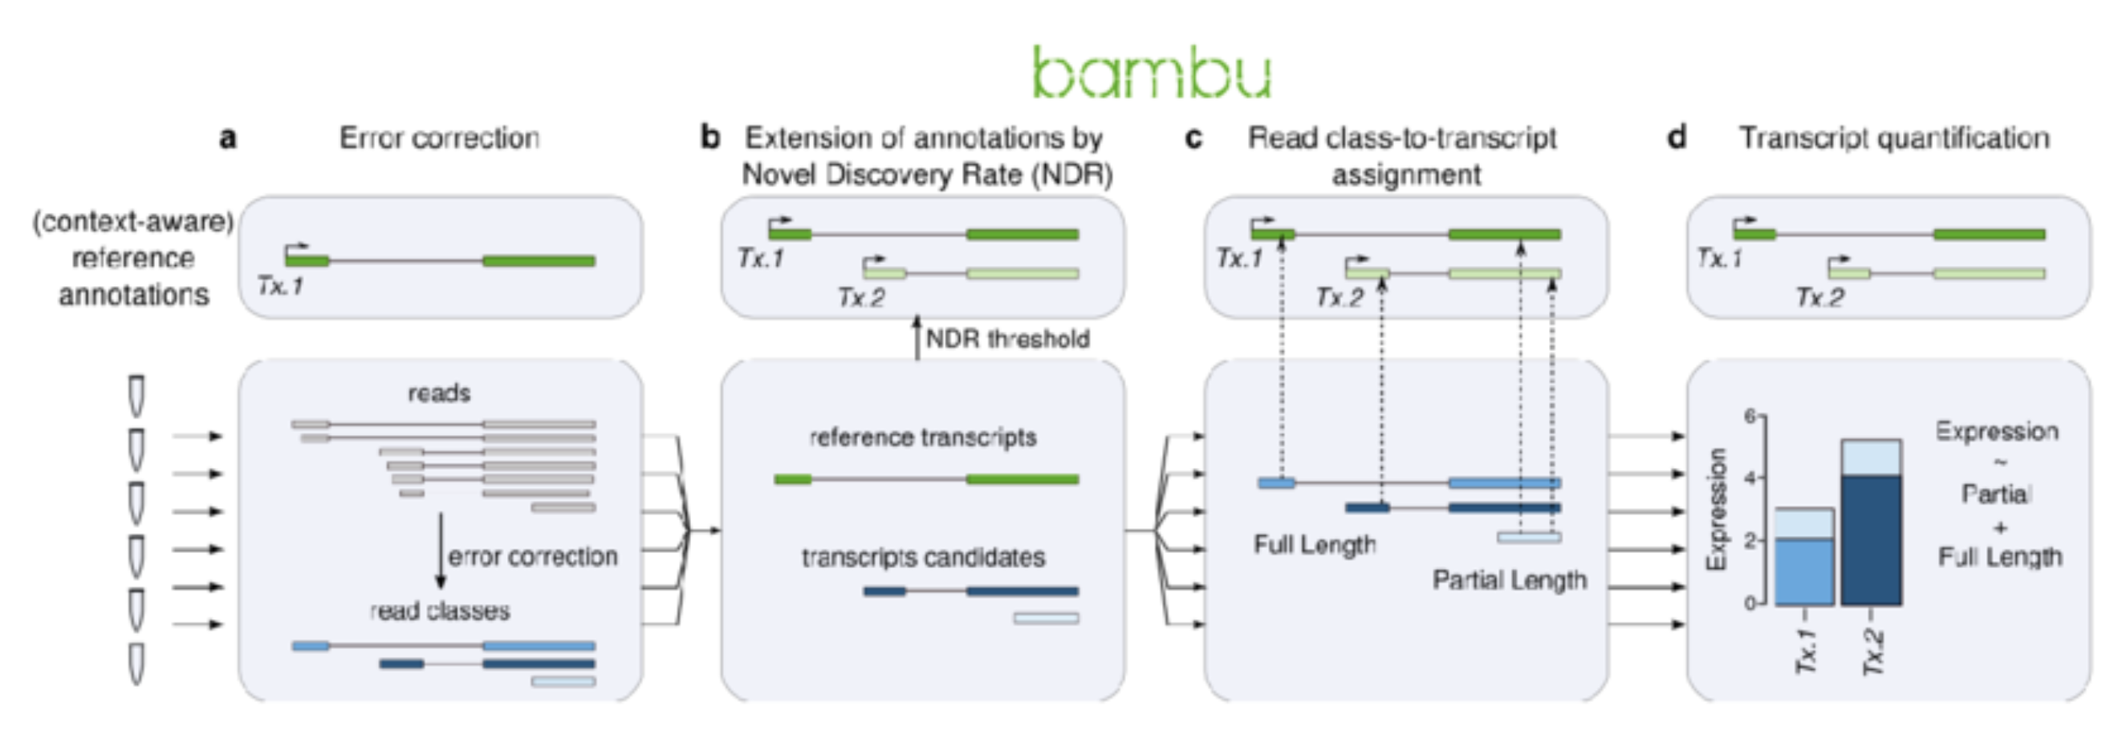
Bambu — Context-aware discovery + quantification, one model
Key idea: A single, interpretable precision knob — the Novel Discovery Rate (NDR)
How it works
FAMILY
Class-based (reference-guided)
PLATFORM
ONT & PacBio
REFERENCE
Chen et al., Nat Methods 2023
OUTPUT
Extended annotation (GTF) + transcript & gene count matrices (R/Bioconductor)
PROCEDURE
Aligned reads + annotation
▸
Classify reads (known/novel)
▸
ML score novel candidates
▸
Apply NDR threshold
▸
Read class-to-transcript assignment
▸
Context-aware quantification
github.com/GoekeLab/bambu · Chen et al., Nat Methods 2023

Slide 23
Bambu — Context-aware discovery + quantification, one model
Key idea: A single, interpretable precision knob — the Novel Discovery Rate (NDR)
How it works
FAMILY
Class-based (reference-guided)
PLATFORM
ONT & PacBio
REFERENCE
Chen et al., Nat Methods 2023
OUTPUT
Extended annotation (GTF) + transcript & gene count matrices (R/Bioconductor)
PROCEDURE
Aligned reads + annotation
▸
Classify reads (known/novel)
▸
ML score novel candidates
▸
Apply NDR threshold
▸
Read class-to-transcript assignment
▸
Context-aware quantification
github.com/GoekeLab/bambu · Chen et al., Nat Methods 2023

Slide 24
Bambu — Context-aware discovery + quantification, one model
Key idea: A single, interpretable precision knob — the Novel Discovery Rate (NDR)
How it works
FAMILY
Class-based (reference-guided)
PLATFORM
ONT & PacBio
REFERENCE
Chen et al., Nat Methods 2023
OUTPUT
Extended annotation (GTF) + transcript & gene count matrices (R/Bioconductor)
PROCEDURE
Aligned reads + annotation
▸
Classify reads (known/novel)
▸
ML score novel candidates
▸
Apply NDR threshold
▸
Read class-to-transcript assignment
▸
Context-aware quantification
github.com/GoekeLab/bambu · Chen et al., Nat Methods 2023

Slide 25
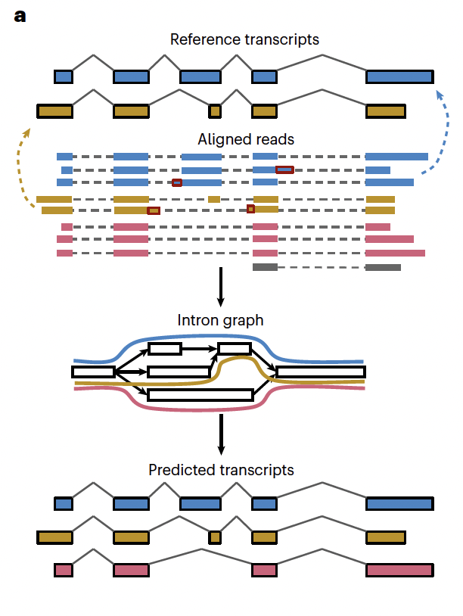
IsoQuant — Accurate isoform discovery via intron graphs
Key idea: Intron graph + error-tolerant intron-chain matching
How it works
FAMILY
Graph-based (reference-based or -free)
PLATFORM
ONT & PacBio
REFERENCE
Prjibelski et al., Nat Biotechnol 2023
OUTPUT
Reference-corrected & novel transcript models (GTF) + quantification
PROCEDURE
Spliced alignments
▸
Build intron graph
▸
Inexact match to annotation
▸
Construct paths = transcripts
▸
Collapse novel models
▸
Quantify
github.com/ablab/IsoQuant · Prjibelski et al., Nat Biotechnol 2023

Slide 26
IsoQuant — Accurate isoform discovery via intron graphs
Key idea: Intron graph + error-tolerant intron-chain matching
How it works
FAMILY
Graph-based (reference-based or -free)
PLATFORM
ONT & PacBio
REFERENCE
Prjibelski et al., Nat Biotechnol 2023
OUTPUT
Reference-corrected & novel transcript models (GTF) + quantification
PROCEDURE
Spliced alignments
▸
Build intron graph
▸
Inexact match to annotation
▸
Construct paths = transcripts
▸
Collapse novel models
▸
Quantify
github.com/ablab/IsoQuant · Prjibelski et al., Nat Biotechnol 2023

Slide 27
IsoQuant — Accurate isoform discovery via intron graphs
Key idea: Intron graph + error-tolerant intron-chain matching
How it works
FAMILY
Graph-based (reference-based or -free)
PLATFORM
ONT & PacBio
REFERENCE
Prjibelski et al., Nat Biotechnol 2023
OUTPUT
Reference-corrected & novel transcript models (GTF) + quantification
PROCEDURE
Spliced alignments
▸
Build intron graph
▸
Inexact match to annotation
▸
Construct paths = transcripts
▸
Collapse novel models
▸
Quantify
github.com/ablab/IsoQuant · Prjibelski et al., Nat Biotechnol 2023

Slide 28
isONclust — Reference-free clustering of long reads by gene origin
Key idea: Greedy, quality-value-aware clustering with minimizers — no reference needed
How it works
FAMILY
Reference-free (de novo clustering)
▸ Goal: group reads that come from the same gene/transcript BEFORE any reference exists (step 1 of de novo reconstruction).
▸ Sort: order reads by a combination of quality value × length (best first).
▸ Greedy assign: each read is compared to existing cluster representatives via MINIMIZERS; high similarity → join, otherwise → seed a new cluster — avoiding costly all-vs-all.
▸ Quality-aware: uses per-base quality to tolerate variable ONT error rates.
▸ isONclust3: dynamically updates each cluster's minimizer set; scales to very large datasets.
▸ Then: isONcorrect polishes each cluster; isONform builds isoforms via a DAG that preserves real splicing variation.
PLATFORM
ONT & PacBio (Iso-Seq)
REFERENCE
Sahlin & Medvedev, RECOMB/JCB 2020
OUTPUT
Read clusters (one per gene family) → input to de novo isoform reconstruction
PROCEDURE
Raw long reads
▸
Sort by quality × length
▸
Greedy cluster (minimizers)
▸
isONcorrect polish
▸
isONform DAG assembly
▸
De novo isoforms
github.com/ksahlin/isONclust · Sahlin et al. 2020; isONclust3 (2024)

Slide 29
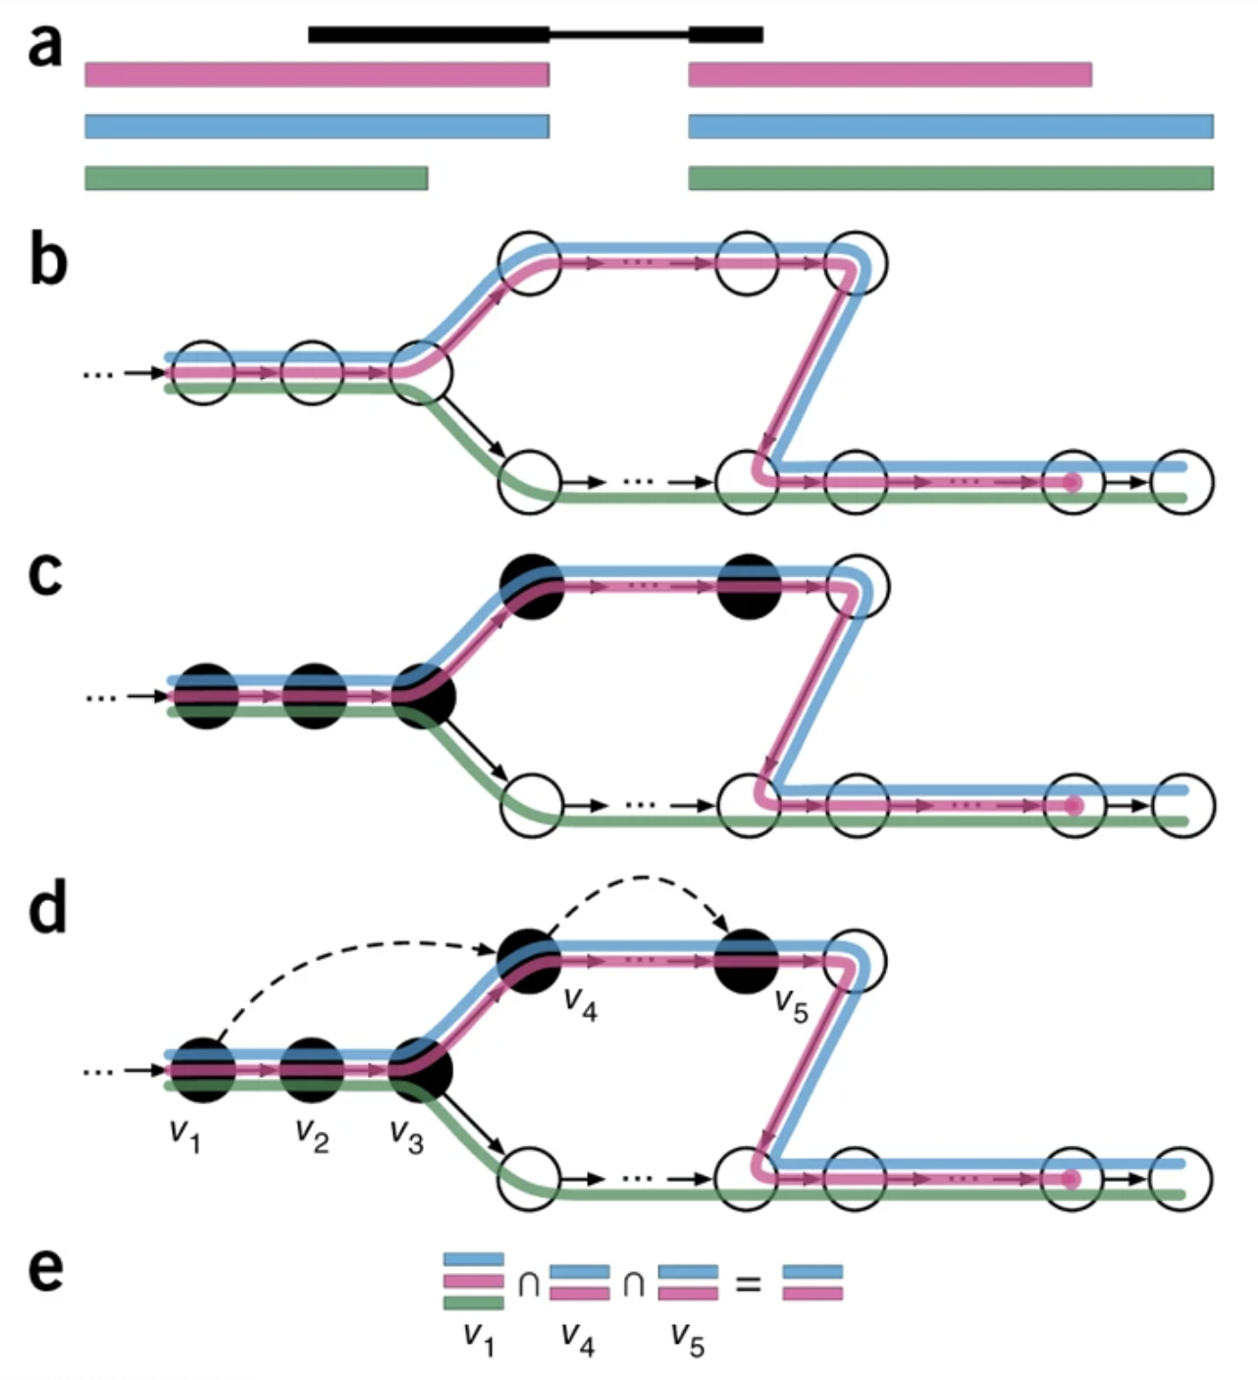
lr-kallisto — Pseudoalignment quantification, adapted for long reads
Key idea: kallisto's pseudoalignment + EM, retuned for long, error-prone reads
How it works
FAMILY
Annotation-driven (quantification)
▸ Pseudoalignment: matches reads to a transcript-compatibility class via k-mers — no base-level alignment, so it is extremely fast and light.
▸ Longer k-mers: An index is constructed by creating the transcriptome de Bruijn Graph (T-DBG) where nodes (v1, v2, v3, ... ) are k-mers.
▸ Chaining: chains k-mer matches along long reads and reduces transcript-compatibility-graph complexity for speed.
▸ EM: expectation-maximization resolves multi-mapping reads into transcript abundances.
▸ Scope: quantifies a GIVEN reference transcriptome (bulk, single-cell, single-nuclei) — no novel-isoform discovery.
PLATFORM
ONT & PacBio · bulk & single-cell
REFERENCE
Loving et al., 2024 (Pachter lab)
OUTPUT
Transcript & gene count matrices (+ pseudobam) — fast, low-memory
PROCEDURE
Reads + ref. transcriptome
▸
Build index create De-bruijn graph
▸
Pseudoalign + chain
▸
Compatibility classes
▸
EM abundance
▸
Counts
github.com/pachterlab/kallisto (≥ v0.51) · Loving et al., PLOS Comput Biol 2025

Slide 30
lr-kallisto — Pseudoalignment quantification, adapted for long reads
Key idea: kallisto's pseudoalignment + EM, retuned for long, error-prone reads
How it works
FAMILY
Annotation-driven (quantification)
▸ Pseudoalignment: matches reads to a transcript-compatibility class via k-mers — no base-level alignment, so it is extremely fast and light.
▸ Longer k-mers: An index is constructed by creating the transcriptome de Bruijn Graph (T-DBG) where nodes (v1, v2, v3, ... ) are k-mers,
▸ Chaining: chains k-mer matches along long reads and reduces transcript-compatibility-graph complexity for speed.
▸ EM: expectation-maximization resolves multi-mapping reads into transcript abundances.
▸ Scope: quantifies a GIVEN reference transcriptome (bulk, single-cell, single-nuclei) — no novel-isoform discovery.
PLATFORM
ONT & PacBio · bulk & single-cell
REFERENCE
Loving et al., 2024 (Pachter lab)
OUTPUT
Transcript & gene count matrices (+ pseudobam) — fast, low-memory
PROCEDURE
Reads + ref. transcriptome
▸
Build index create De-bruijn graph
▸
Pseudoalign + chain
▸
Compatibility classes
▸
EM abundance
▸
Counts
github.com/pachterlab/kallisto (≥ v0.51) · Loving et al., PLOS Comput Biol 2025

Slide 31
lr-kallisto — Pseudoalignment quantification, adapted for long reads
Key idea: kallisto's pseudoalignment + EM, retuned for long, error-prone reads
How it works
FAMILY
Annotation-driven (quantification)
▸ Pseudoalignment: matches reads to a transcript-compatibility class via k-mers — no base-level alignment, so it is extremely fast and light.
▸ Longer k-mers: An index is constructed by creating the transcriptome de Bruijn Graph (T-DBG) where nodes (v1, v2, v3, ... ) are k-mers,
▸ Chaining: chains k-mer matches along long reads and reduces transcript-compatibility-graph complexity for speed.
▸ EM: expectation-maximization resolves multi-mapping reads into transcript abundances.
▸ Scope: quantifies a GIVEN reference transcriptome (bulk, single-cell, single-nuclei) — no novel-isoform discovery.
PLATFORM
ONT & PacBio · bulk & single-cell
REFERENCE
Loving et al., 2024 (Pachter lab)
OUTPUT
Transcript & gene count matrices (+ pseudobam) — fast, low-memory
PROCEDURE
Reads + ref. transcriptome
▸
Build index create De-bruijn graph
▸
Pseudoalign + chain
▸
Compatibility classes
▸
EM abundance
▸
Counts
github.com/pachterlab/kallisto (≥ v0.51) · Loving et al., PLOS Comput Biol 2025

Slide 32
lr-kallisto — Pseudoalignment quantification, adapted for long reads
Key idea: kallisto's pseudoalignment + EM, retuned for long, error-prone reads
How it works
FAMILY
Annotation-driven (quantification)
▸ Pseudoalignment: matches reads to a transcript-compatibility class via k-mers — no base-level alignment, so it is extremely fast and light.
▸ Longer k-mers: An index is constructed by creating the transcriptome de Bruijn Graph (T-DBG) where nodes (v1, v2, v3, ... ) are k-mers,
▸ Chaining: chains k-mer matches along long reads and reduces transcript-compatibility-graph complexity for speed.
▸ EM: expectation-maximization resolves multi-mapping reads into transcript abundances.
▸ Scope: quantifies a GIVEN reference transcriptome (bulk, single-cell, single-nuclei) — no novel-isoform discovery.
PLATFORM
ONT & PacBio · bulk & single-cell
REFERENCE
Loving et al., 2024 (Pachter lab)
OUTPUT
Transcript & gene count matrices (+ pseudobam) — fast, low-memory
PROCEDURE
Reads + ref. transcriptome
▸
Build index create De-bruijn graph
▸
Pseudoalign + chain
▸
Compatibility classes
▸
EM abundance
▸
Counts
github.com/pachterlab/kallisto (≥ v0.51) · Loving et al., PLOS Comput Biol 2025

Slide 33
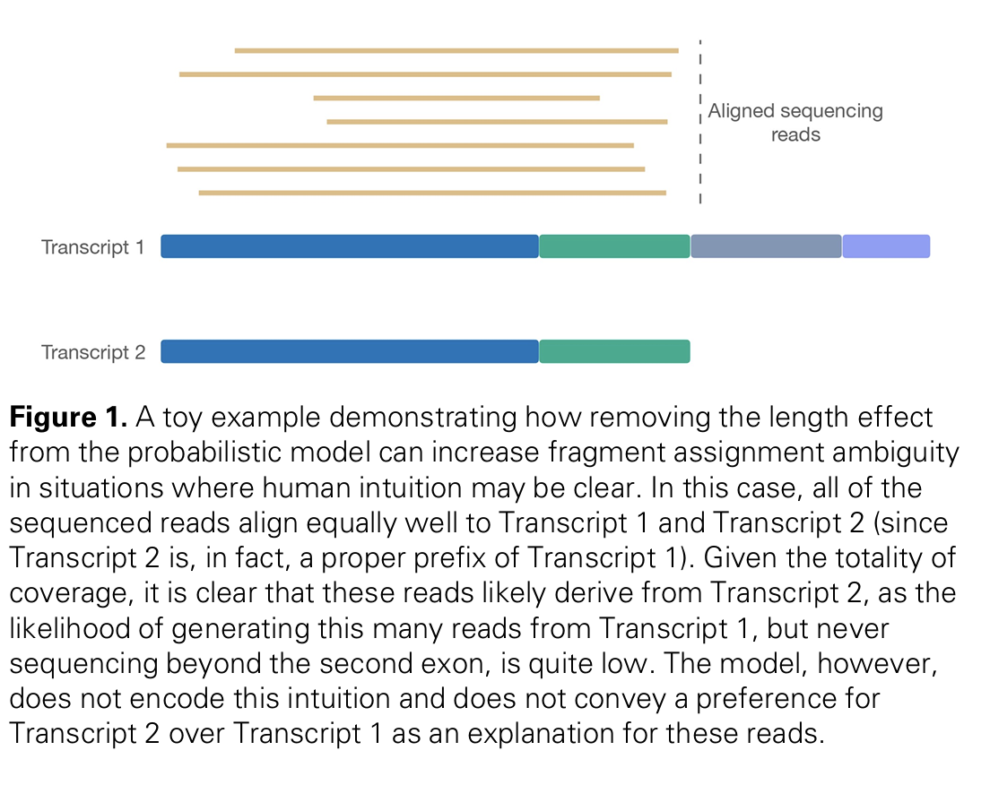
Oarfish — Coverage-aware probabilistic long-read quantification
Key idea: An EM model enriched with a transcript-coverage score
How it works
FAMILY
Annotation-driven (quantification)
▸ Input: reads aligned to a reference transcriptome (e.g. with minimap2).
▸ EM allocation: resolves multi-mapping reads by maximum-likelihood estimation of relative isoform abundances.
▸ Coverage model (--model-coverage): a novel coverage SCORE enters the per-fragment assignment probability, correcting for uneven / 3′-biased long-read coverage.
▸ Effect: more accurate estimates than prior long-read quantifiers, especially for the primary isoforms of a cell type.
▸ Engineering: written in Rust — fast, parallel, open source.
PLATFORM
ONT cDNA & direct-RNA · PacBio
REFERENCE
Jousheghani & Patro, ISMB/Bioinformatics 2025
OUTPUT
Transcript-level abundance estimates (counts / TPM)
PROCEDURE
Align to ref. transcriptome
▸
Per-fragment probabilities
▸
Add coverage model
▸
EM estimation
▸
Abundances (TPM)
github.com/COMBINE-lab/oarfish · Jousheghani & Patro, Bioinformatics 2025

Slide 34
The seven algorithms at a glance
Discovery tools build models; quantification tools assume a transcriptome. Match the tool to the question.
Tool | Task | Approach | Reference need | Best for
Iso-Seq | Discovery+ | Cluster→collapse | Genome (post) | PacBio HiFi, polished full-length isoforms
FLAIR | Discovery+quant | Cluster (junction chains) | Genome + annot/SR | ONT correction, isoform usage
Bambu | Reference transcripts | Class + ML (NDR) | Genome + annotation | Controlled novel discovery, many samples
IsoQuant | Discovery+quant | Intron graph | Genome (±annot) | Low false positives, ONT & PacBio
isONclust | Clustering (de novo) | Greedy minimizers | None | No reference / non-model organisms
lr-kallisto | Quantification | Pseudoalign + EM | Transcriptome | Fast bulk/single-cell counts
Oarfish | Quantification | Coverage EM | Transcriptome | Accurate abundance, 3′-bias correction
“Discovery+” = identifies novel transcripts and quantifies them.

Slide 35
Time to test your knowledge
You have a reference annotation but want no find novel transcripts

Slide 36
Why is identification hard? The core challenges
Reference -based
Reference-free
Pseudomappers

Slide 37
Why is identification hard? The core challenges
Reference -based
Reference-free
Pseudomappers
You have a reference annotation but want no find novel transcripts

Slide 38
Why is identification hard? The core challenges
Reference -based
Reference-free
Pseudomappers
You have a reference annotation but want no find novel transcripts
Lenient:
Isoseq2, FLAIR
Conservative:
IsoQuant, Bambu

Slide 39
Why is identification hard? The core challenges
Yo do not have a reference annotation

Slide 40
Why is identification hard? The core challenges
Reference-free
Pseudomappers

Slide 41
Why is identification hard? The core challenges
Reference-free
Pseudomappers
Yo do not have a reference annotation

Slide 42
Why is identification hard? The core challenges
Reference-free
Pseudomappers
Yo do not have a reference annotation
Still not working very well

Slide 43
Why is identification hard? The core challenges
Reference -based
Reference-free
Pseudomappers
You have a reference annotation but want no find novel transcripts
Yo do not have a reference annotation
Lenient:
Isoseq2, FLAIR
Conservative:
IsoQuant, Bambu
Still not working very well

Slide 44
Why is identification hard? The core challenges
You do not care about novel transcripts

Slide 45
Why is identification hard? The core challenges
Pseudomappers

Slide 46
Why is identification hard? The core challenges
Pseudomappers
You do not care about novel transcripts

Slide 47
Why is identification hard? The core challenges
Pseudomappers
You do not care about novel transcripts
If the reference is incomplete, you may introduces biases

Slide 48
Summary
Reference -based
Reference-free
Pseudomappers
You have a reference annotation but want no find novel transcripts
Yo do not have a reference annotation
You do not care about novel transcripts
Lenient:
Isoseq2, FLAIR
Conservative:
IsoQuant, Bambu
Still not working very well
If the reference is incomplete, you may introduces biases

Slide 49
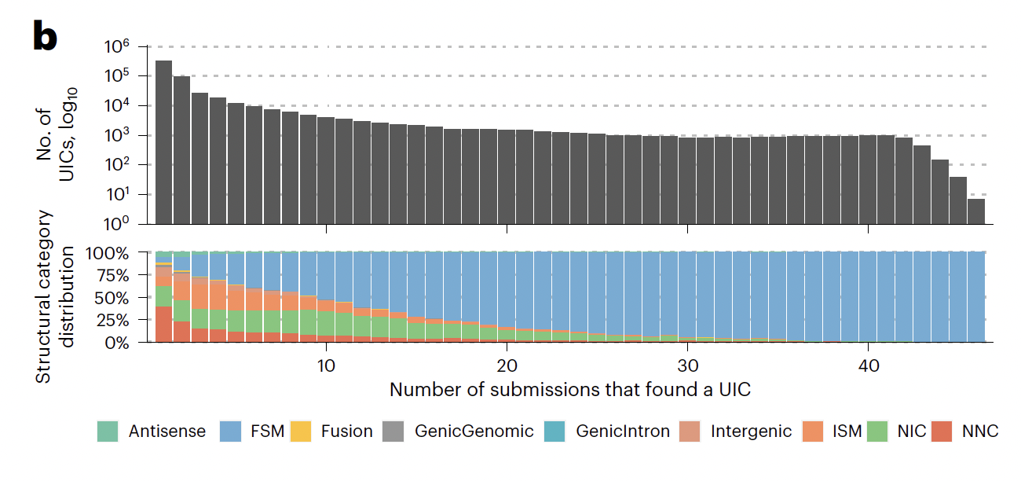
Evaluating concordance: LRGASP
SQANTI3 — Pardo-Palacios et al., Nat Methods 2024; widely adopted standard for lrRNA-seq transcriptome QC.

Slide 50
What the benchmarks tell us
LRGASP (Pardo-Palacios et al.) and independent benchmarks — distilled.
PacBio HiFi → more accurate models
No single best tool
High-precision PacBio data yields more accurate transcript models than ONT; ONT wins on length & native RNA.
IsoQuant, StringTie2, Bambu and FLAIR are all effective; StringTie2 often most accurate, Bambu highest power for novel isoforms.
Precision is the bottleneck
Depth ↑ sensitivity, not accuracy
Even top tools show low precision for novel transcripts → always validate with orthogonal data (CAGE, short reads, poly(A)).
More reads detect more low-expression isoforms but do not make individual models more accurate.
Annotation helps — when good
Tunable by design
Using a high-quality reference annotation increases true-positive detection; incomplete annotations mislead.
Tools expose parameters to trade error tolerance vs. biological assumptions — tune to your platform & question.

Slide 51
Which tool? A practical decision guide
Start from your biological question and the resources available for your organism.
Do you have a genome + annotation?
YES → reference-based identification. NO → reference-free (isONclust → isONcorrect → isONform).
Do you need NOVEL isoforms, or just counts?
Novel discovery → IsoQuant / Bambu / FLAIR / Iso-Seq. Counts on known transcripts only → lr-kallisto / Oarfish.
PacBio HiFi or ONT?
PacBio → Iso-Seq, IsoQuant (high precision). ONT → FLAIR / IsoQuant (error correction), Oarfish for dRNA.
Worried about false positives across many samples?
Bambu's NDR gives one calibrated, reproducible precision knob; IsoQuant minimizes false positives by design.
Whatever you pick:
Run SQANTI3, validate novel models with orthogonal data, and report structural categories.

Slide 52
Summary & outlook
Where we are
What's still hard
Long reads turn isoform structure into a measurement. A mature toolkit — Iso-Seq, FLAIR, Bambu, IsoQuant — reconstructs transcripts via cluster, graph and class-based logic; lr-kallisto & Oarfish quantify fast; isONclust opens non-model organisms.
Precision for novel, low-expression isoforms; reproducibility across replicates; separating biological splicing noise from technical noise; complete & accurate TSS/TTS; fair, standardized benchmarking.
▸ Take-home: there is no single best tool — choose by question, platform and reference, and always curate with SQANTI3 + orthogonal evidence.
▸ Direction of travel: single-cell & spatial long reads, native-RNA modifications, and ML-based confidence scoring (à la Bambu) for trustworthy novel discovery.
Full review: Monzó, Liu & Conesa, Nature Reviews Genetics 2025, doi:10.1038/s41576-025-00828-z

Slide 53
Method papers — fetch the original figures
Procedure diagrams above are schematic. Original workflow figures are in these papers (open access where noted).
Iso-Seq
PacBio official pipeline
isoseq.how · github.com/PacificBiosciences/IsoSeq
FLAIR
Tang et al., Nat Commun 2020 (OA) — Fig. 1
nature.com/articles/s41467-020-15171-6
Bambu
Chen et al., Nat Methods 2023 — Fig. 1
nature.com/articles/s41592-023-01908-w · PMC10448944
IsoQuant
Prjibelski et al., Nat Biotechnol 2023 — Fig. 1
nature.com/articles/s41587-022-01565-y · PMC10344776
isONclust
Sahlin & Medvedev, J Comput Biol 2020; isONclust3 (OA)
doi.org/10.1089/cmb.2019.0299 · biorxiv 2024.10.29.620862
lr-kallisto
Loving et al., PLOS Comput Biol 2025 (OA) — Fig. 1
biorxiv 2024.07.19.604364 · PMC11275803
Oarfish
Jousheghani & Patro, Bioinformatics 2025 (OA)
biorxiv 2024.02.28.582591 · PMC12261437

Slide 54

Thank You!
For more information about the Conesa Lab:
https://conesalab.org

