Slide 1


Bioinformatics Summer School
Long-reads Transcriptomics
Carolina Monzó
I2SysBio, Valencia, Spain
LongTREC - The Long-reads TRanscriptome European Consortium
Marie Skłodowska-Curie grant agreement No 101072892

Slide 2
Course Contents
1
Introduction to Long-read Technologies
2
Experimental design
3
Use cases and wrap up
4

Slide 3
Section 1
Introduction to Long-read Technologies
Understanding the fundamentals of third-generation sequencing

Slide 4

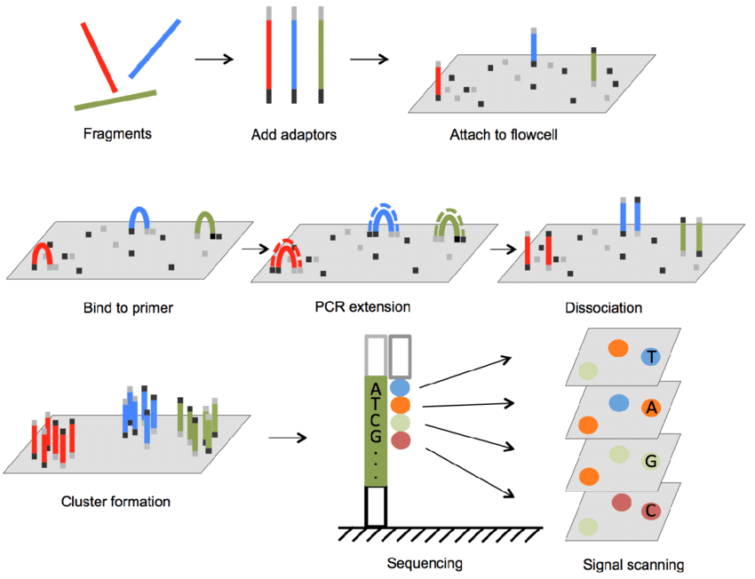
Classical sequencing, 2nd generation

Slide 5
Classical sequencing, 2nd generation
Advantages:
Higher accuracy
Higher throughput
Cost-effective
Disadvantages:
Repetitive sequences
Structural variants
Isoform resolution – Alternative splicing

Slide 6
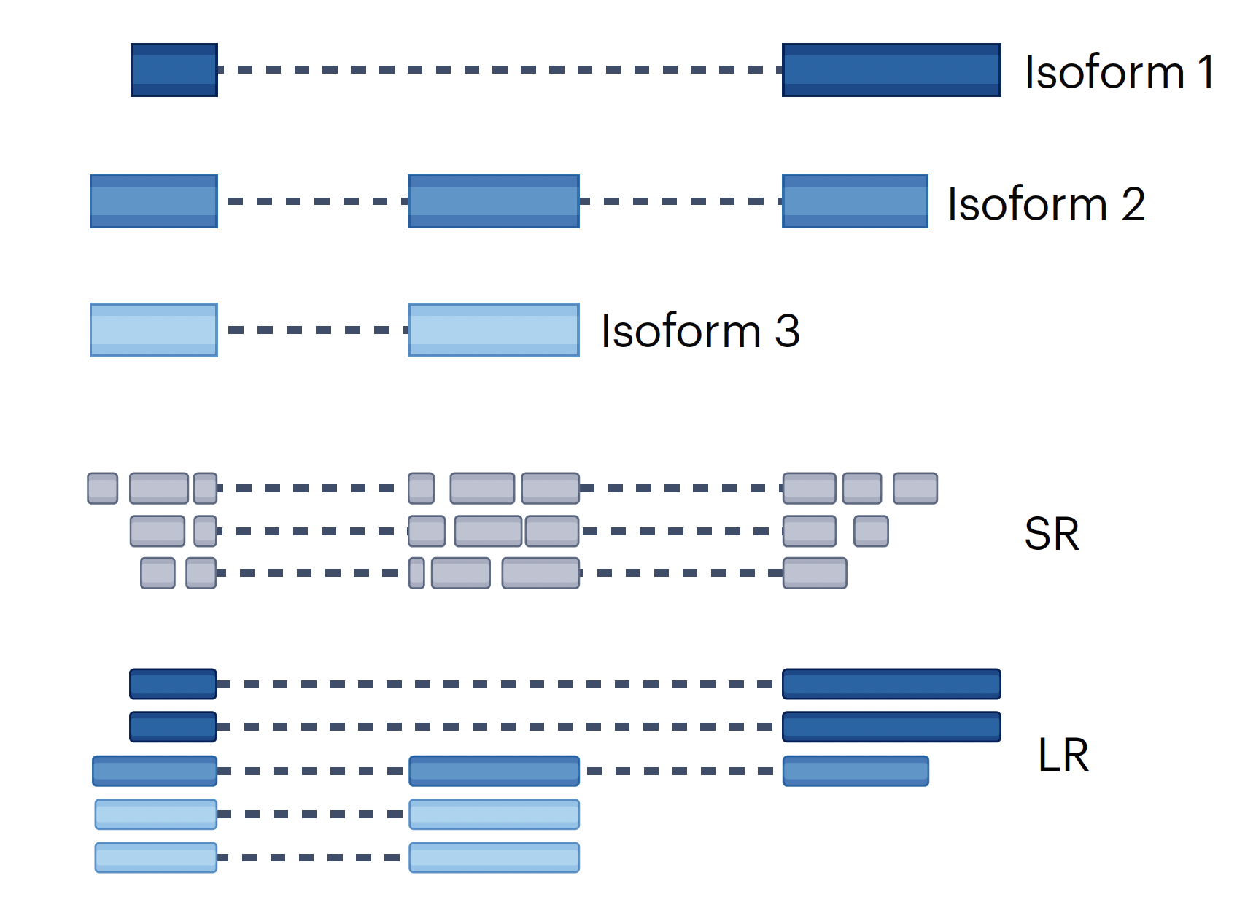
Solving the issues: long-read sequencing
Short-read sequencing
Long-read sequencing
Figure source: Monzó, Liu, Conesa. 2025. 10.1038/s41576-025-00828-z

Slide 7


Introduction to Long-read Sequencing, 3rd generation
Advantages:
Single-molecule
Isoform resolution – Alternative splicing
Assembly simplification
Disadvantages:
Lower accuracy
Lower throughput
Higher costs
Bioinformatic challenges

Slide 8
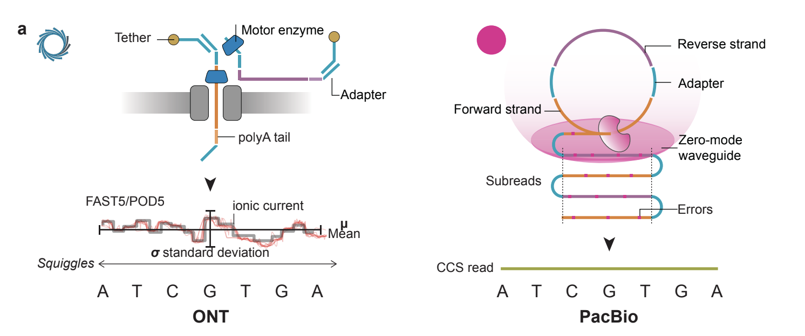
Introduction to Long-read Sequencing, 3rd generation
Figure source: Monzó, Liu, Conesa. 2025. 10.1038/s41576-025-00828-z

Slide 9
Introduction to Long-read Sequencing, 3rd generation
Figure source: Monzó, Liu, Conesa. 2025. 10.1038/s41576-025-00828-z

Slide 10
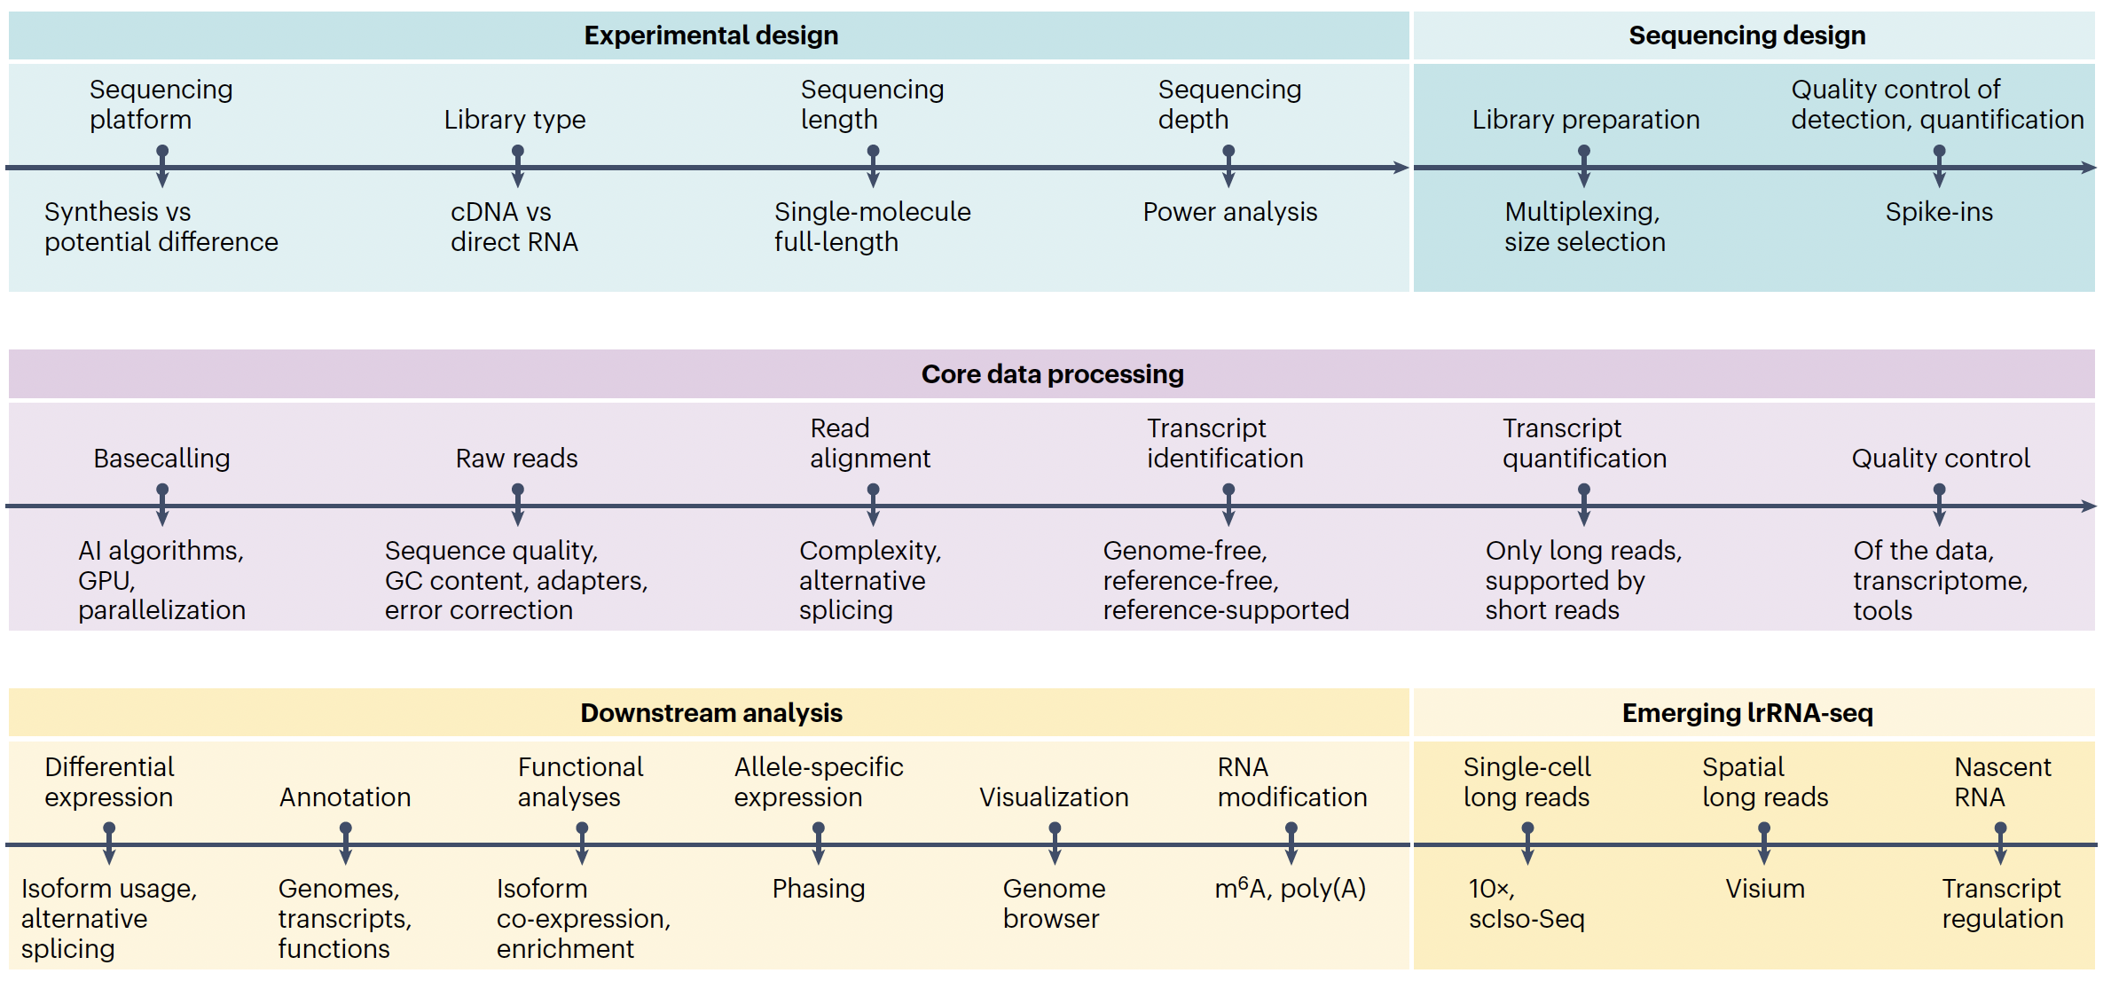
The Long-read transcriptomics sequencing roadmap
Figure source: Monzó, Liu, Conesa. 2025. 10.1038/s41576-025-00828-z

Slide 11
The Long-read transcriptomics sequencing roadmap
Figure source: Monzó, Liu, Conesa. 2025. 10.1038/s41576-025-00828-z

Slide 12
Section 2
Experimental design
Understanding the fundamentals of third-generation sequencing

Slide 13
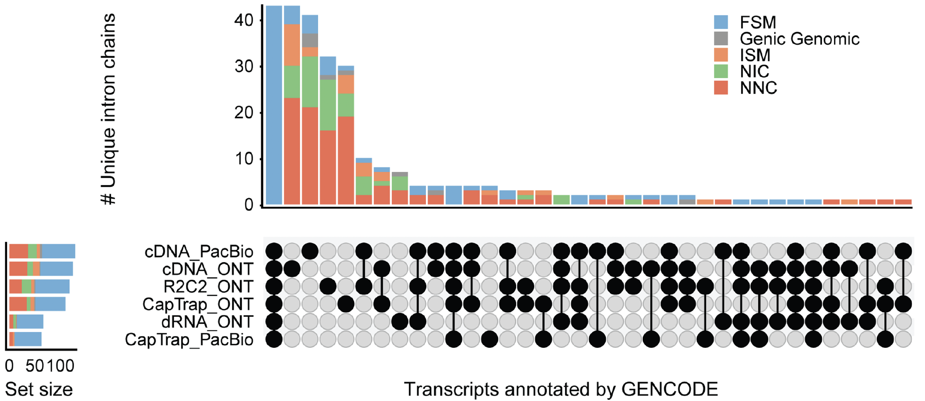
Impact of sequencing platform and library preparation choice
Expected
Unexpected
WARNING!! Combination of sequencing platform and library preparation find different transcripts
Figure source: Monzó, Frankish, Conesa. 2025. 10.1101/gr.279865.124

Slide 14
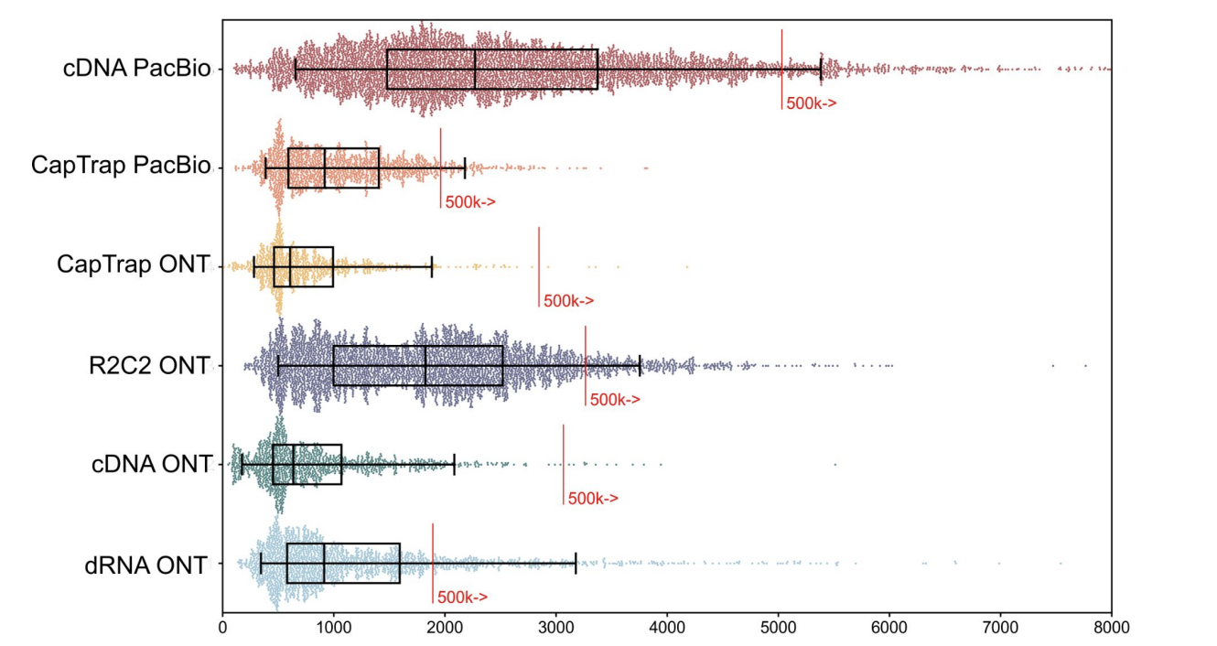
Impact of sequencing platform and library preparation choice
WARNING!! Combination of sequencing platform and library preparation find different transcripts
Figure source: Pardo-Palacios. 2024. 10.1038/s41592-024-02298-3

Slide 15
What is your biological question?

Slide 16
RNA quality
Degraded RNA:
Incomplete transcripts (difficulty to differentiate TSS and TTS)
Biased coverage, tendency to over-represent 3’ ends
Compromised measurements of polyA tail lengths
RNA Integrity Number: ratio of intact ribosomal RNA peaks to degraded RNA fragments
Get RIN as high as possible
RIN > 7 is the minimum, but RIN > 8 recommended by ONT and PacBio
Validate TTS and TSS with orthogonal data (CAGE-Seq or Quant-Seq)
Incorporate RIN as a covariate in the Differential Expression analysis

Slide 17
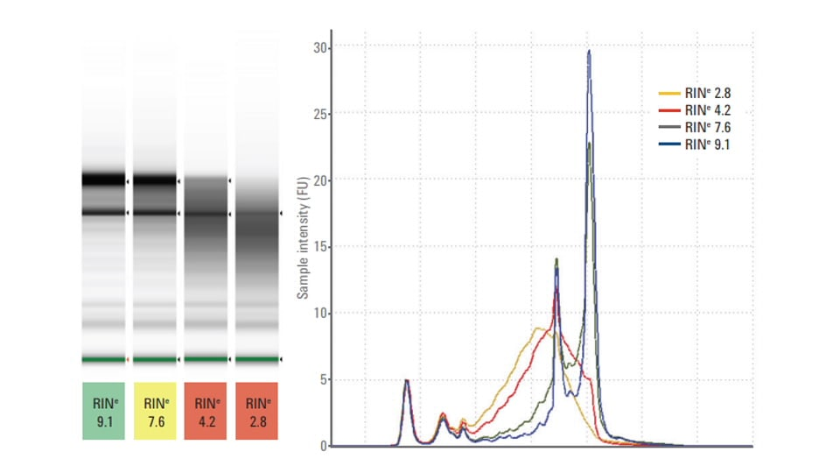
RNA quality
Checking the RNA quality is not only important to get good quality full-length transcripts, but also to see the distribution of transcripts that we have in the transcriptome of our sample
Figure source: Pardo-Palacios. 2024. 10.1038/s41592-024-02298-3

Slide 18
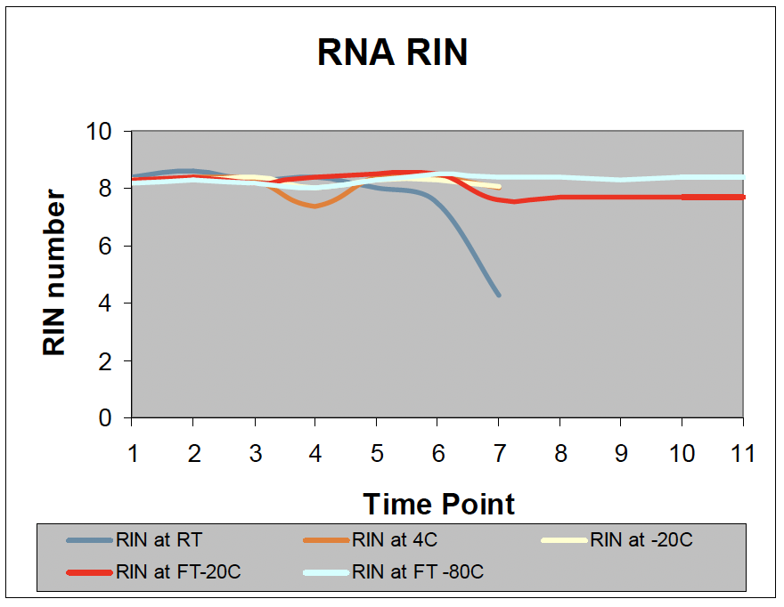
RNA quality
Tissue extracted RNA integrity is not affected by the storage conditions in 14 days, and not affected by freeze-thaws up to 10 cycles.
Extract the RNA from your samples quickly!
Don’t store the whole tissue, store the RNA
Figure source: Kim, Wu, Huang et al. 2011

Slide 19
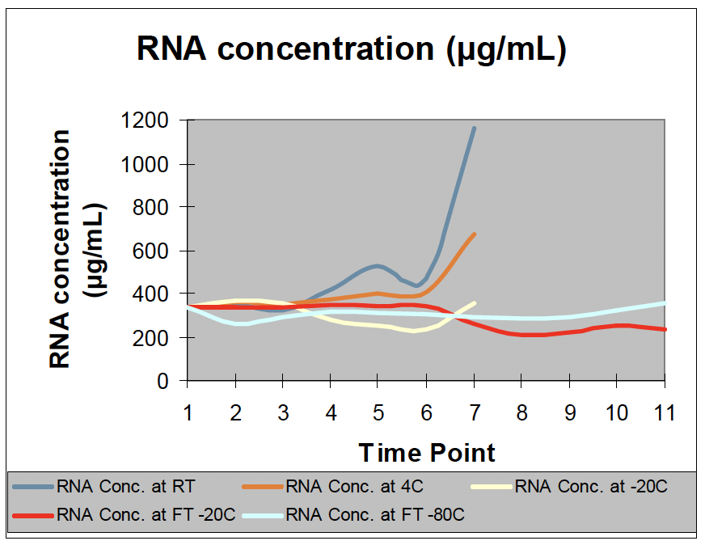
RNA concentration
The RNA concentration increased over time at both room temperature and 4°C, showing that evaporation occurred at room temperature from day 3 and at 4°C from day 7.
Figure source: Kim, Wu, Huang et al. 2011

Slide 20
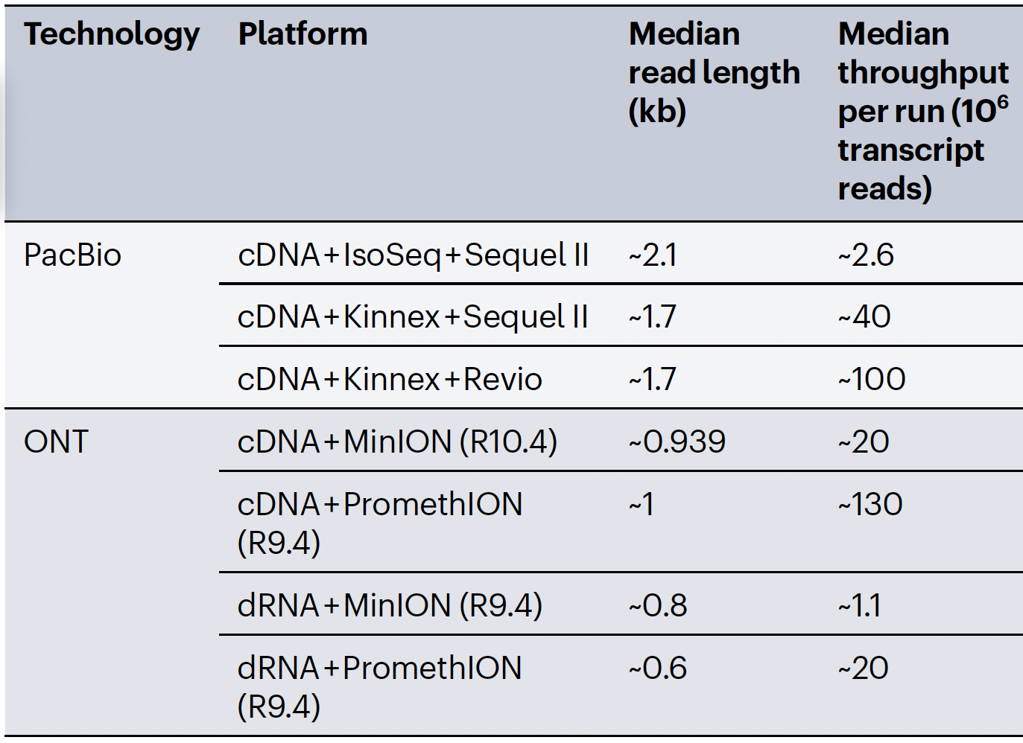
Choosing a sequencing platform
Similarities between PacBio and ONT:
Throughput (high number of reads per run)
Capacity to sequence full-length transcripts
Figure source: Monzó, Liu, Conesa. 2025. 10.1038/s41576-025-00828-z

Slide 21
Choosing a sequencing platform
Can sequence cDNA or dRNA
Can simultaneously sequence dRNA and epitranscriptomic modifications
Specific protocols can sequence ultra-long reads. But standard protocols are biased towards short reads*
Lower read accuracy
Difficulty differentiating modifications
Higher read accuracy
Commercial protocols have broad read length distribution
Can’t sequence dRNA or direct modifications

Slide 22
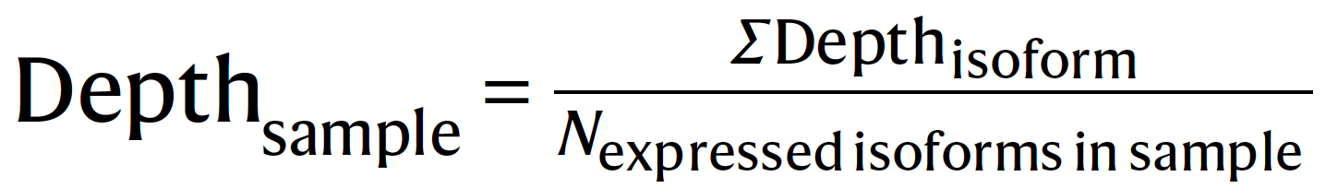
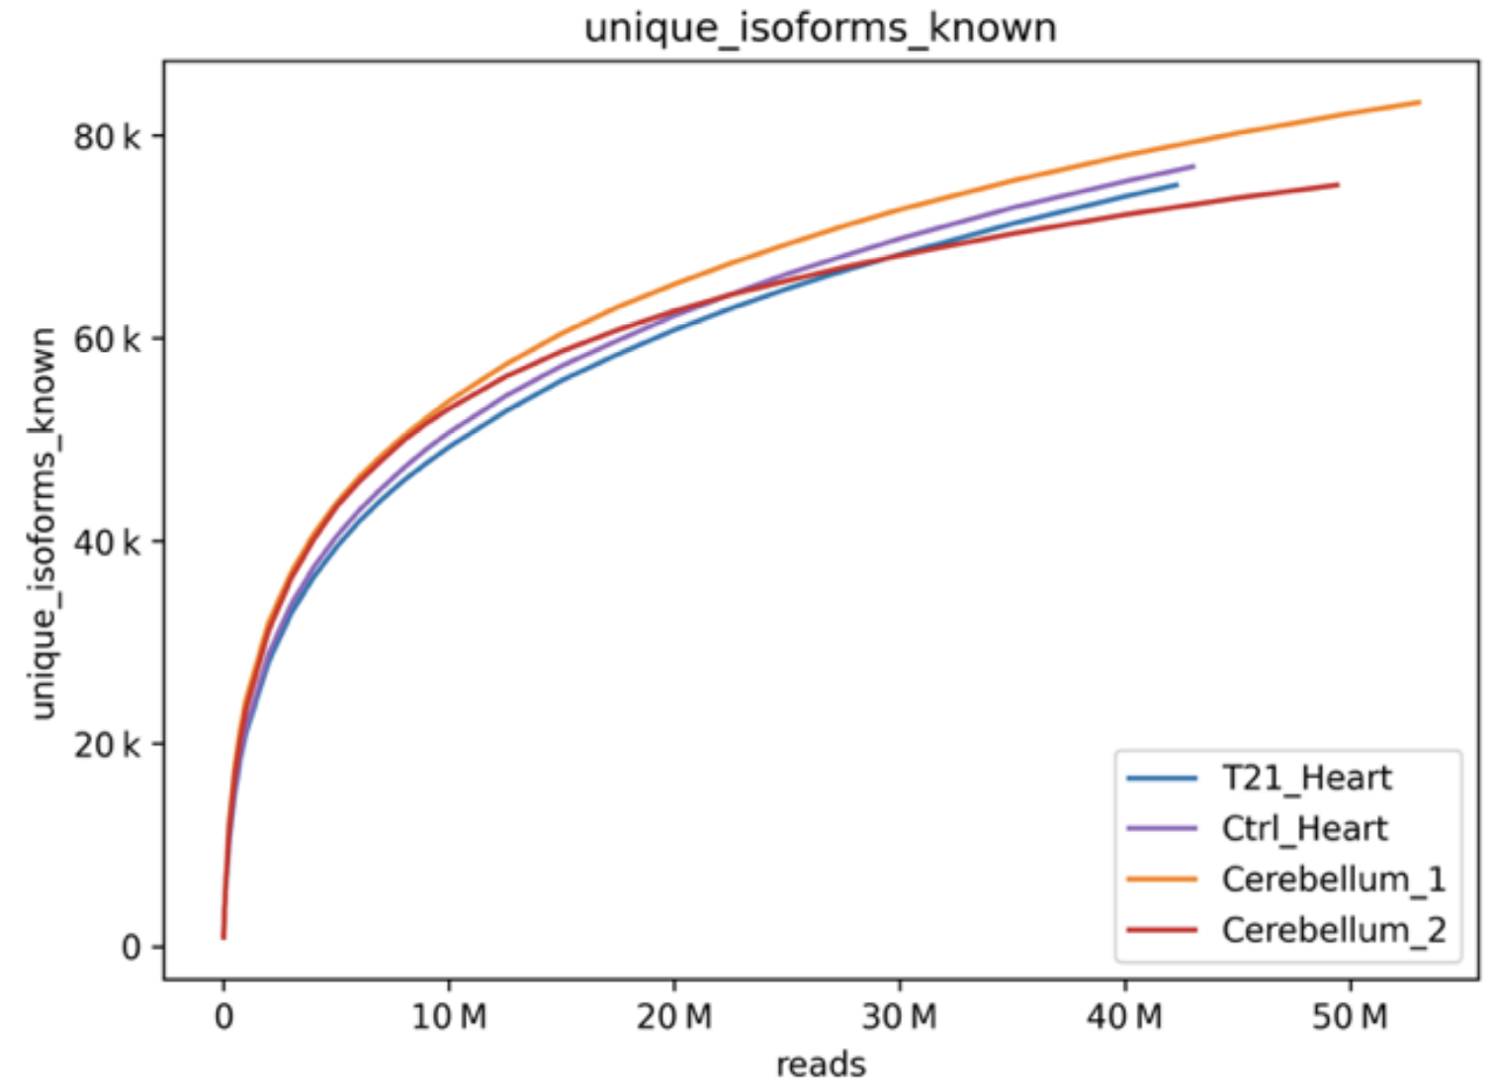
Sequencing depth
Number of reads per sample:
Higher depth discovers more novel transcripts
More complex organisms require more sequencing depth
Recommendations (human):
10 million reads for 80% of known isoforms
> 20 million reads for detection of rare isoforms
Figure source: https://www.pacb.com/wp-content/uploads/Application-note-Kinnex-full-length-RNA-kit-for-isoform-sequencing.pdf

Slide 23
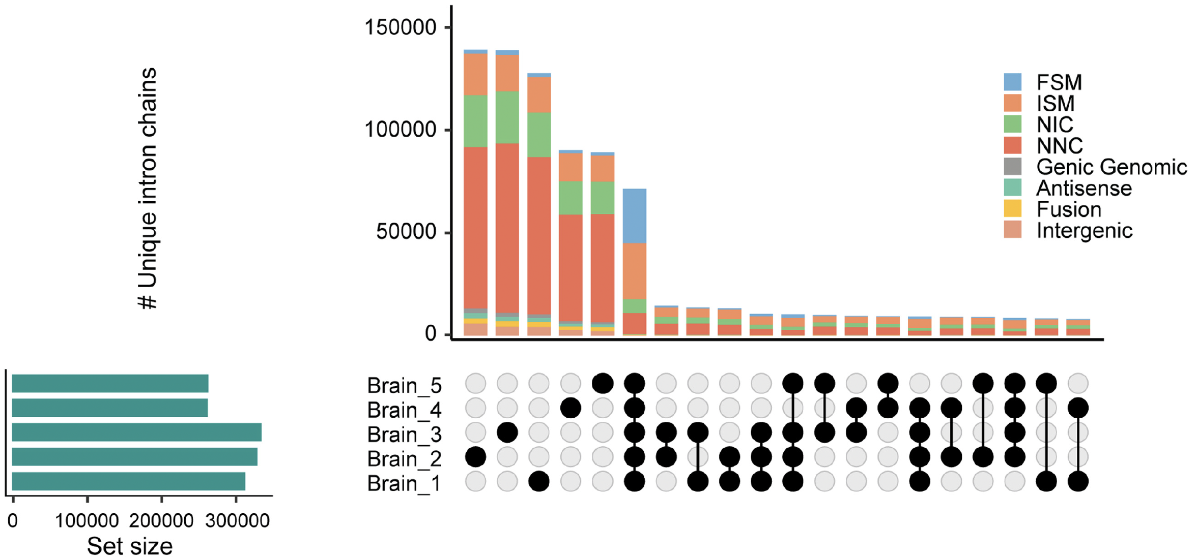
Impact of replication
Expected
Unexpected
Bimodal distribution, most transcripts are present in all samples or are sample-specific, few are found in two or more samples
Figure source: Monzó, Frankish, Conesa. 2025. 10.1101/gr.279865.124

Slide 24
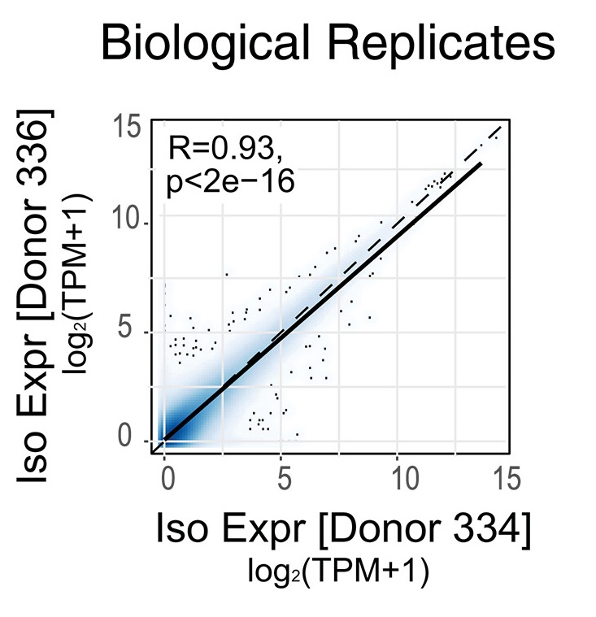
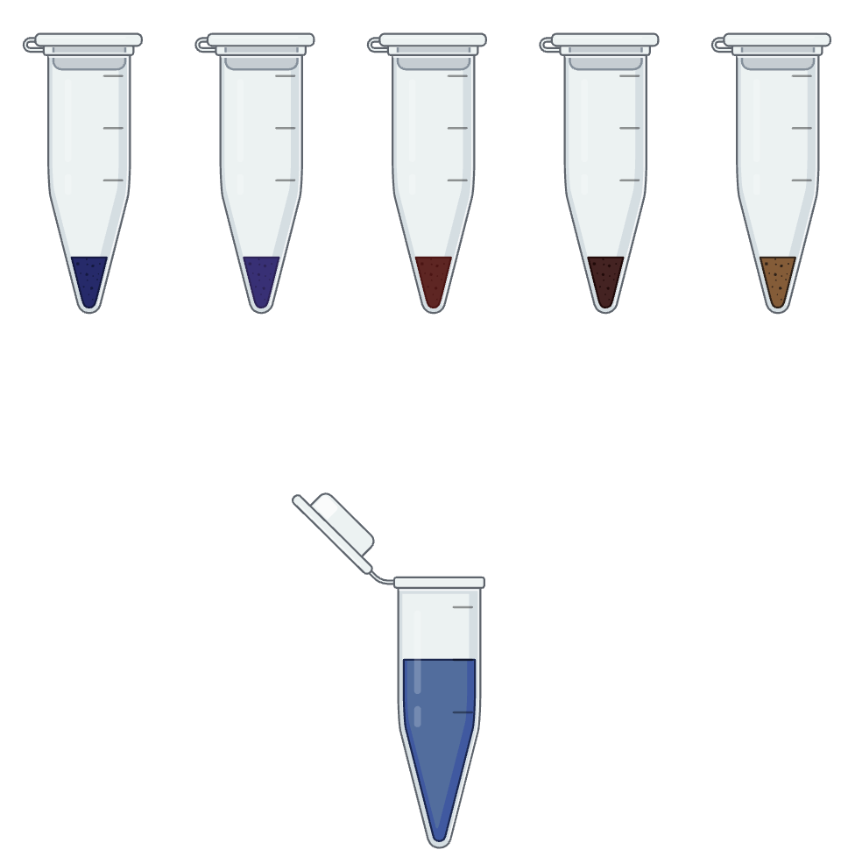
Replication and multiplexing
Replication is necessary for statistical power and to reduce the inclusion of spurious transcripts in downstream analyses.
High expression correlation between replicates
Figure source: Patowary, Zhang et al. 2024. 10.1126/science.adh7688

Slide 25
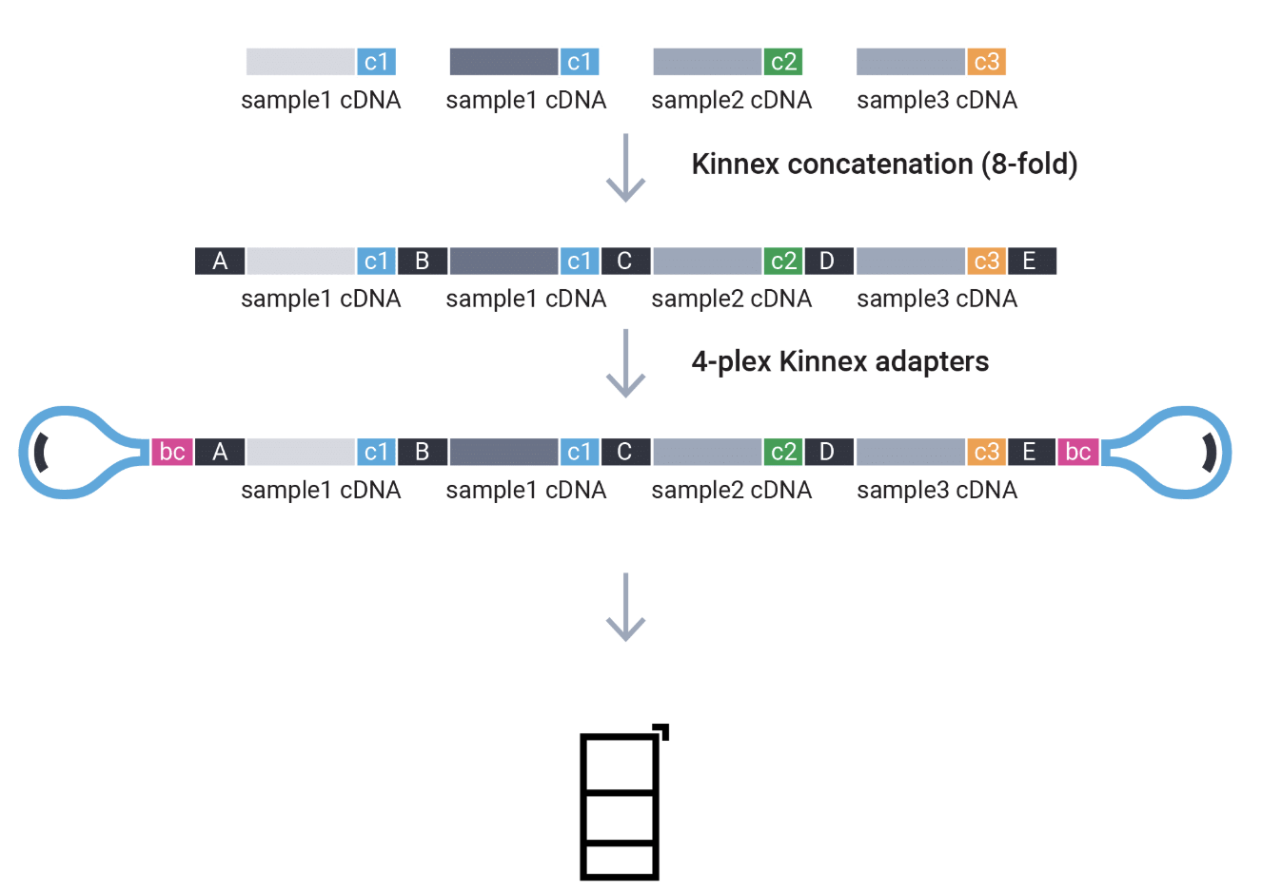
Replication and multiplexing
bc = 4 different barcodes for library prep
cx = 12 different barcodes for cDNA synthesis
Possible to have 48 samples in one run
Figure source: https://www.pacb.com/multiplexing/

Slide 26
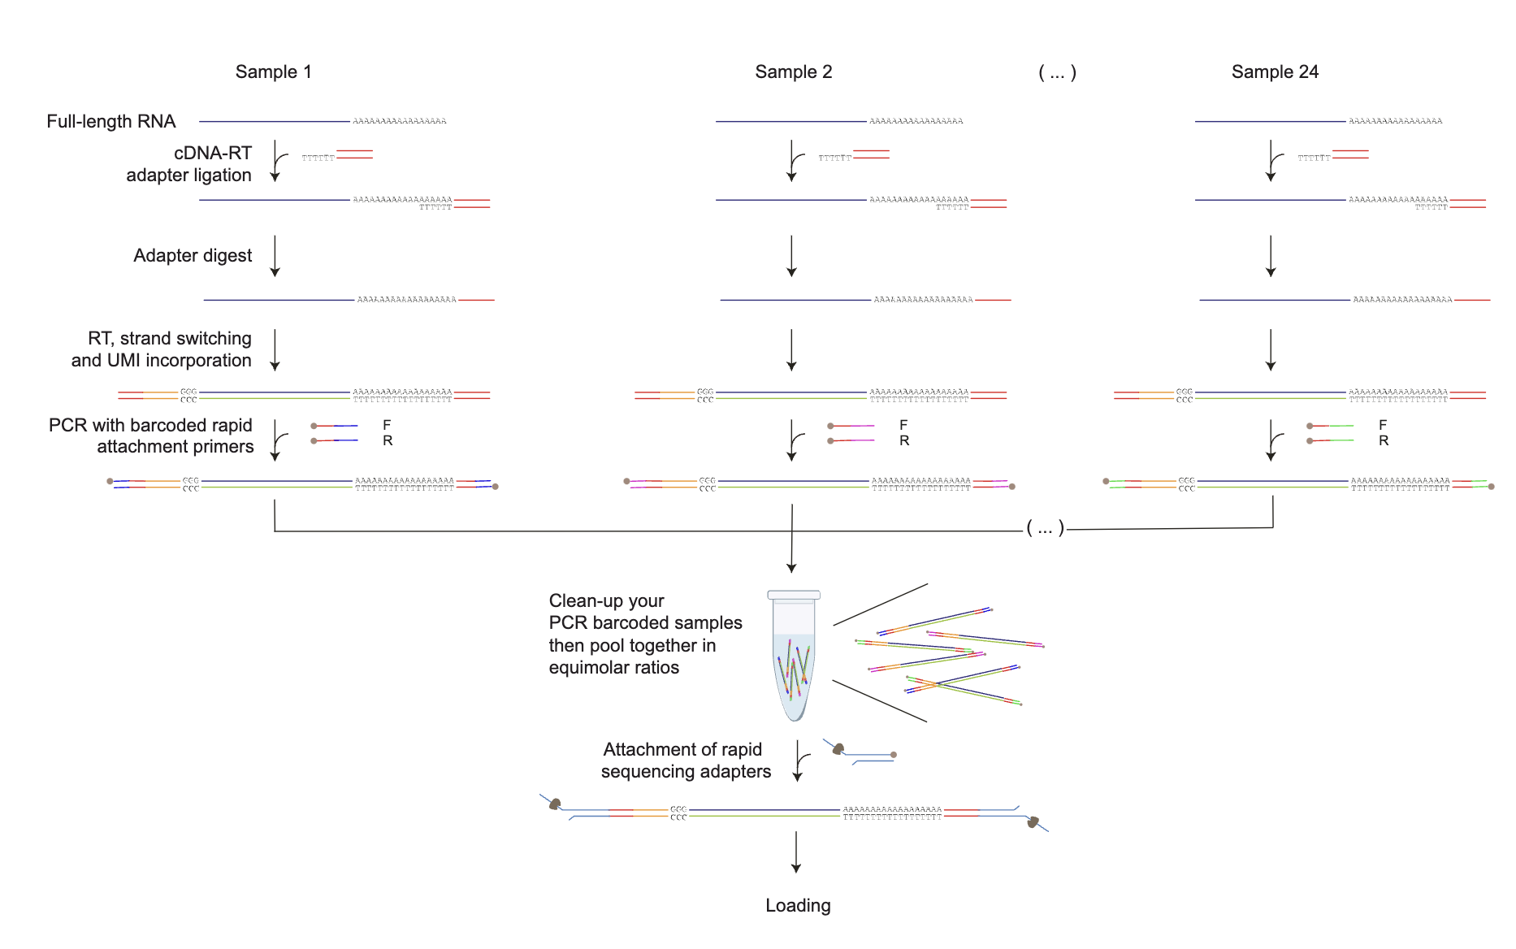
Replication and multiplexing
For cDNA
Possible to have 24 samples in one run

Slide 27
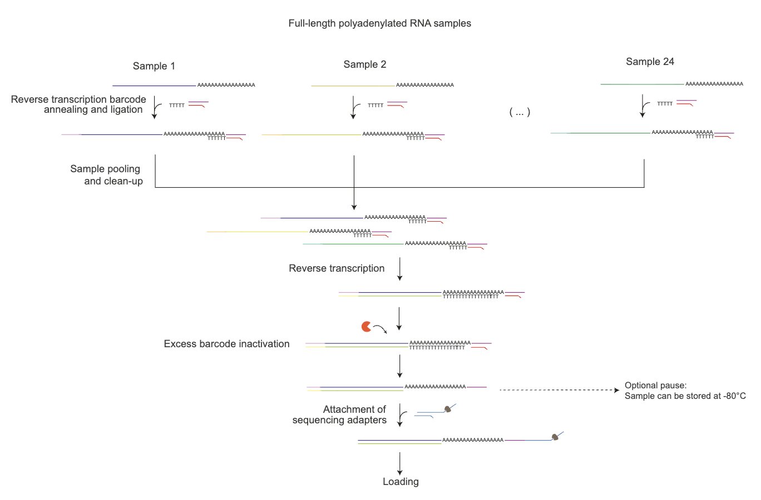
Replication and multiplexing
For dRNA
Possible to have 24 samples in one run

Slide 28
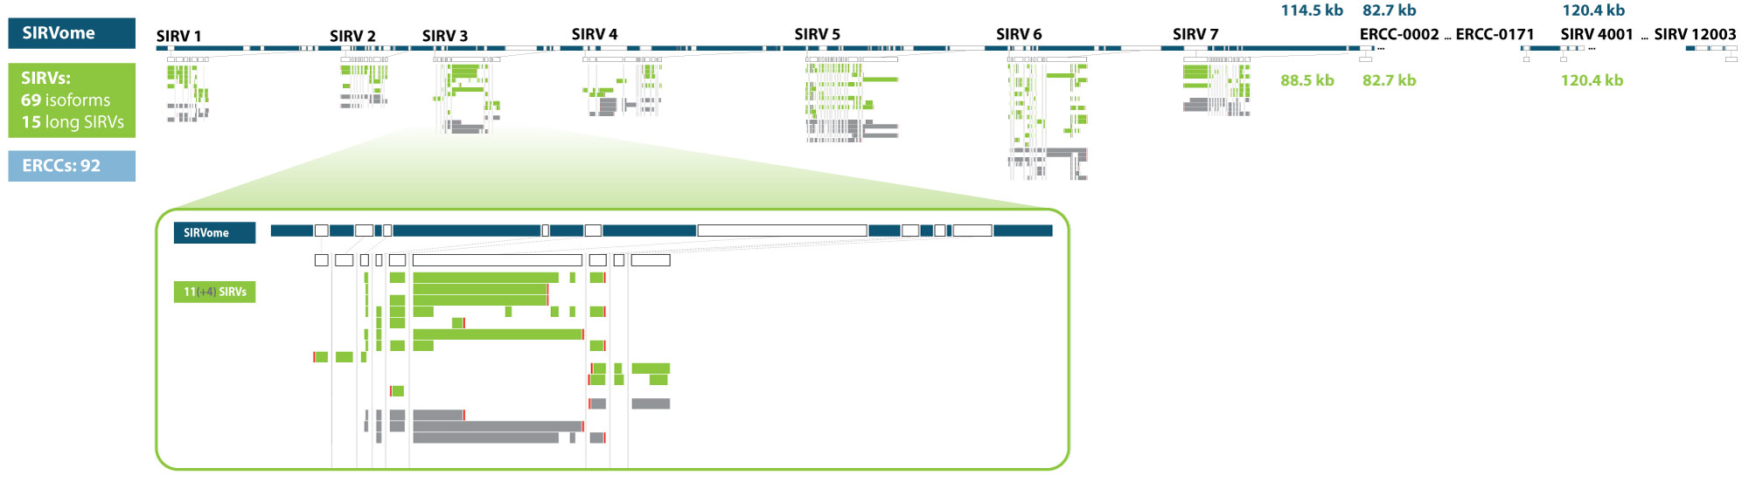
Ground truth spike-ins
Synthetic RNA molecules that mimic: isoforms, abundance, and transcript length
SIRVs and sequins
Figure source: https://www.lexogen.com/sirvs/design/

Slide 29
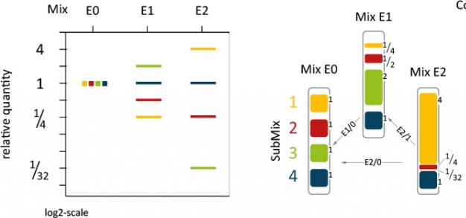
Ground truth spike-ins
Check if all SIRVs in the mix were detected in my sample (read length or depth biases)
Check that quantification of SIRVs in the mix is as expected
Figure source: https://www.lexogen.com/sirvs/design/

Slide 30
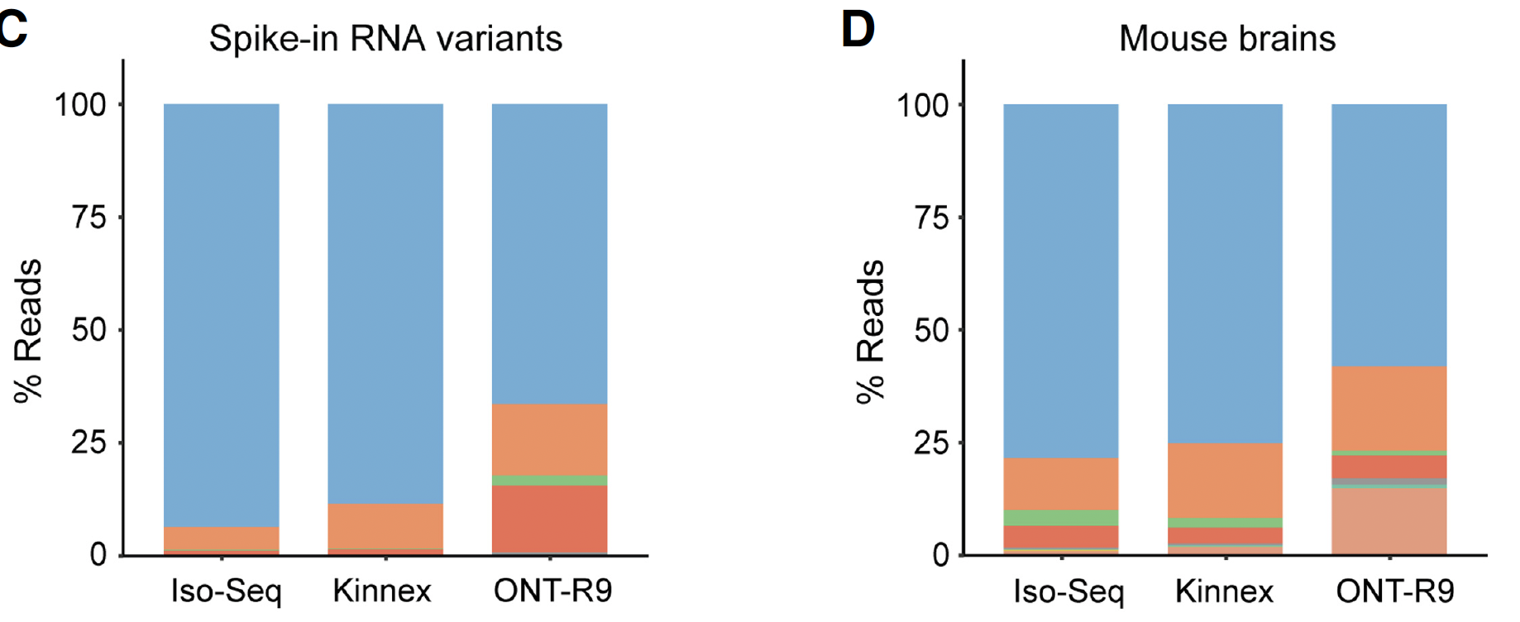
Ground truth spike-ins
Non-blue reads in spike-ins represent the technical noise level of the technology
Non-blue reads in the mouse brains are a combination of technical and biological noise
Figure source: Monzó, Frankish, Conesa. 2025. 10.1101/gr.279865.124

Slide 31
Use cases and wrap up

Slide 32
Use cases
What’s the most important thing to take into account when:
1. Studying drought effect on polyA length in Arabidopsis over time
2. Reconstructing the transcriptome of a non-model organism
3. Benchmarking bioinformatic tools for transcript quantification

Slide 33
Use cases
What is the most important aspect in the experimental design to answer your biological question?

Slide 34
Take home messages
Figure out your biological question before deciding on sequencing platform and library preparation method
Use good quality RNA
Sequence with enough depth
Use biological replicates in your experiment
Use synthetic controls

Slide 35


Thank You!
For more information about the LongTREC Summer School:
https://longtrec.eu

