Slide 1



Bioinformatics Summer School
Long-reads Transcriptomics
Carolina Monzó, adapted from Satrio Wibowo
I2SysBio, Valencia, Spain
LongTREC - The Long-reads TRanscriptome European Consortium Marie Skłodowska-Curie grant agreement No 101072892

Slide 2

Section 1
Library preparation
Library preparation strategies for long-reads RNA-seq experiments

Slide 3
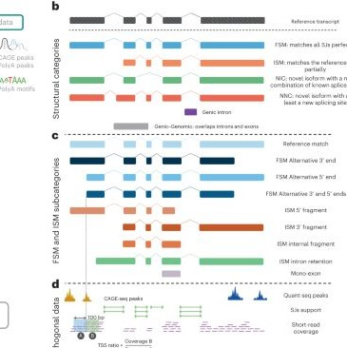
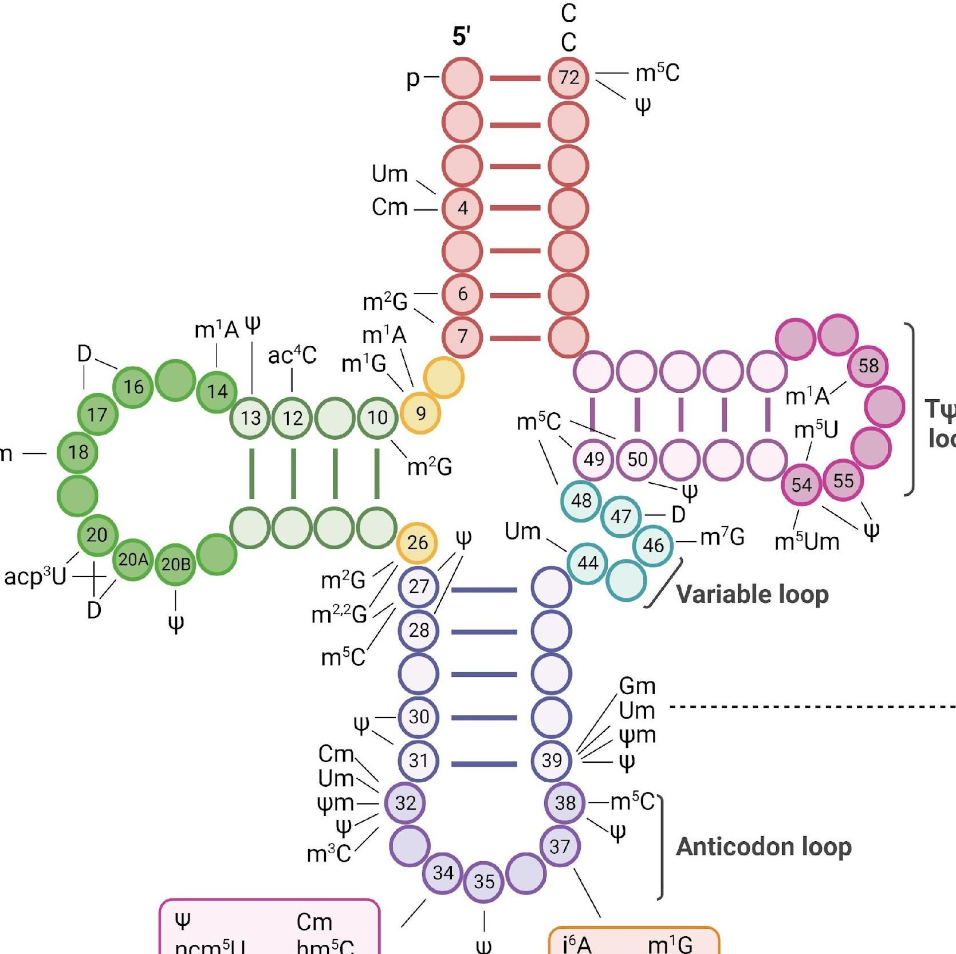
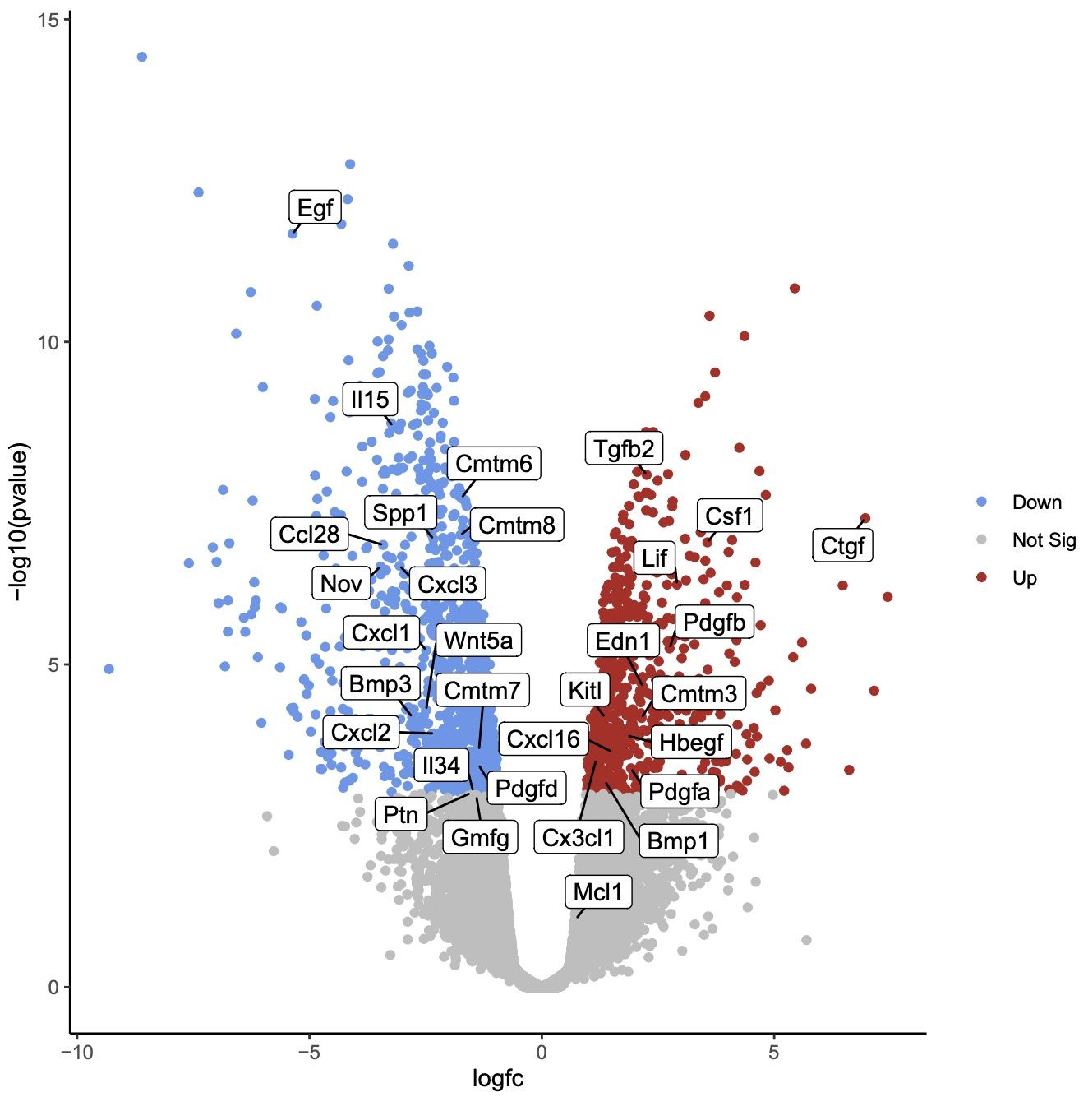

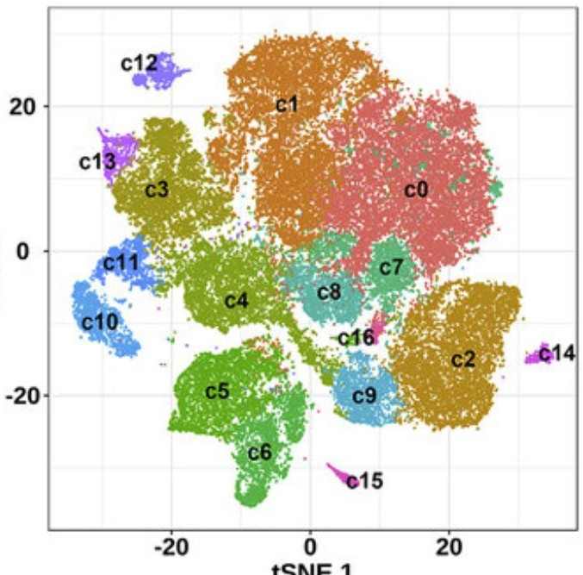

Library preparation
Knowing your goal
What is your goal?
Transcriptomics
Epi-transcriptomics
Bulk
Meta-transcriptomics
Single-cell
Spatial

Slide 4
Library preparation
RNA-seq
Main difference with short-reads lib-prep
AAAAAAAA
mRNA
Image: PacBio

Slide 5
Library preparation
RNA-seq
Main difference with short-reads lib-prep
AAAAAAAA
Fragmentation
mRNA
Image: Thermo

Slide 6
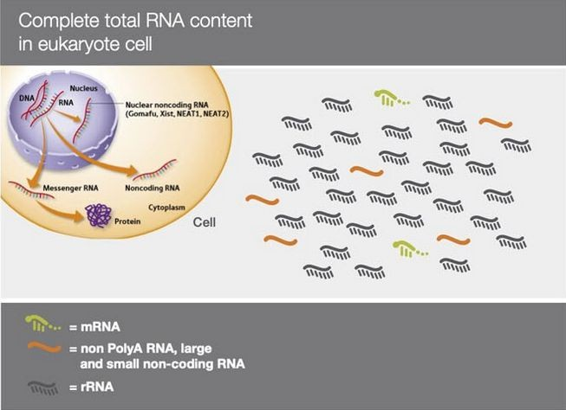
Library preparation
RNA-seq
Main difference with short-reads lib-prep
AAAAAAAA
mRNA
Image: Thermo

Slide 7
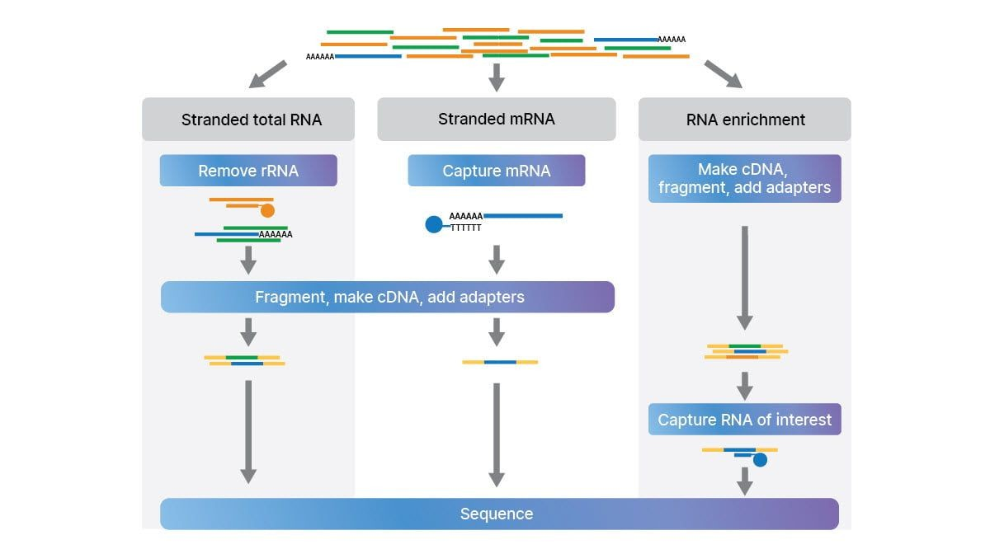
Library preparation
RNA-seq
Main difference with short-reads lib-prep
AAAAAAAA
mRNA
Image: Illumina

Slide 8
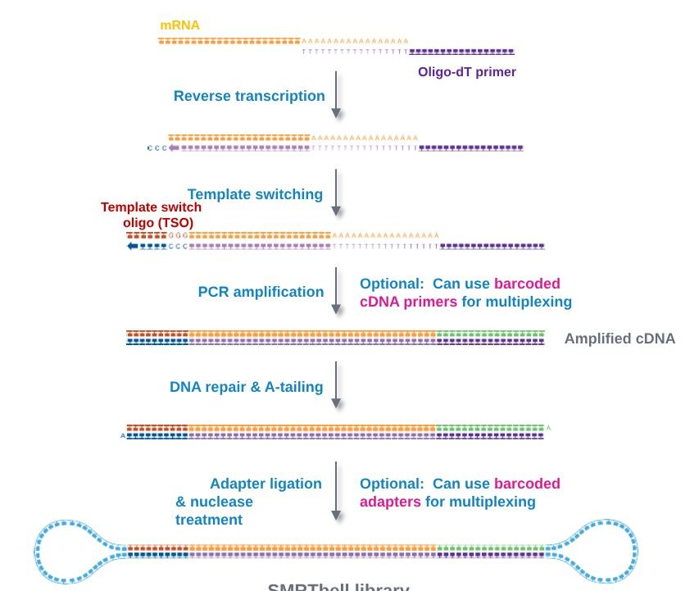
Library preparation
cDNA
Iso-Seq
PacBio
Description | Full-length transcript isoform sequencing
Kit | SMRTbell prep kit 3.0
Multiplex | up to 12
Preparation time | 8 Hours 2 Safe stop point
Input | 300 ng Total RNA
Output | 1M (Sequel I); 8M (Sequel II); Full-length HiFi transcripts
Completed Library
Image: PacBio

Slide 9
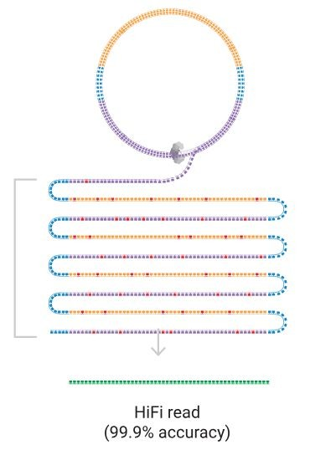
Library preparation
cDNA
Iso-Seq
PacBio
Description | Full-length transcript isoform sequencing
Kit | SMRTbell prep kit 3.0
Multiplex | up to 12
Preparation time | 8 Hours 2 Safe stop point
Input | 300 ng Total RNA
Output | 1M (Sequel I); 8M (Sequel II); Full-length HiFi transcripts
HiFi long reads generated from PacBio sequencing
Image: PacBio

Slide 10
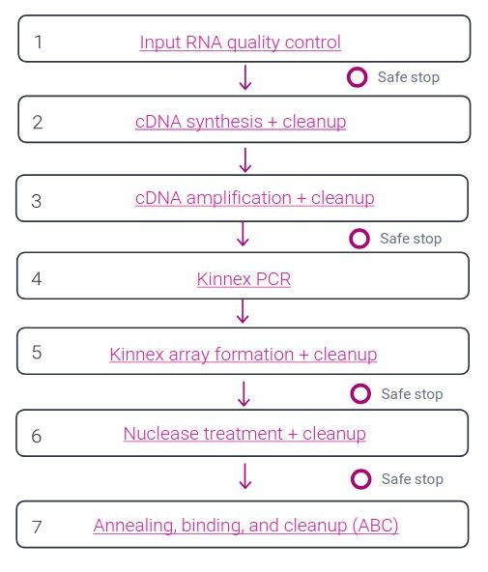
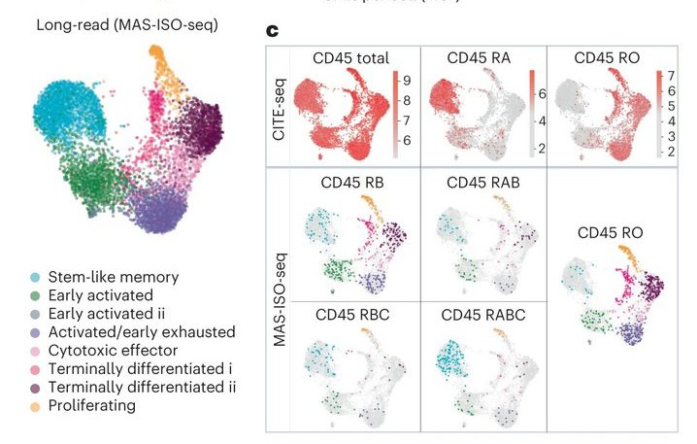
Library preparation
cDNA
Kinnex (Commercial version of MAS-ISO-seq)
PacBio
Increasing the throughput >15-fold to nearly 40 million cDNA reads per run. MAS-ISO-seq demonstrated a 12- to 32-fold increase in the discovery of differentially spliced genes.
Al’Khafaji, A.M., Smith, J.T., Garimella, K.V. et al (2024).
High-throughput RNA isoform sequencing using programmed cDNA
Complete Kinnex library preparation workflow for cDNA sequencing
Image: PacBio
concatenation. https://doi.org/10.1038/s41587-023-01815-7

Slide 11
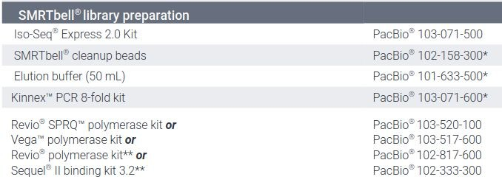
Library preparation
cDNA
Kinnex (Commercial version of MAS-ISO-seq)
PacBio
Complete Kinnex library preparation workflow for cDNA sequencing
Image: PacBio

Slide 12
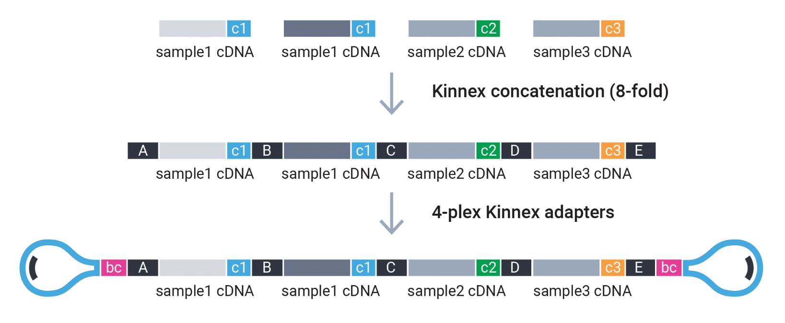
Library preparation
cDNA
Kinnex (Commercial version of MAS-ISO-seq)
PacBio
Complete Kinnex library preparation workflow for cDNA sequencing
Image: PacBio

Slide 13
Library preparation
cDNA
Kinnex (Commercial version of MAS-ISO-seq)
PacBio
Description | Full-length isoform discovery with flexible sample multiplexing
Kit | Kinnex full-length RNA kit
Multiplex | 5M × 3-plex (Sequel II); 5M x 6-plex (Vega); 10M × 6-plex (Revio SPRQ)
Preparation time | 1.5 days 4 Safe stop point
Input | 300 ng Total RNA
Output | 15-20M (Sequel II); 20-30M (Vega); 50-60M (Revio SPRQ) Full-length HiFi transcripts (Q40)
Notable Studies | Al Khafaji et al., 2023. Nature Portofolio
Completed Library with cDNA concatenated
Image: PacBio

Slide 14
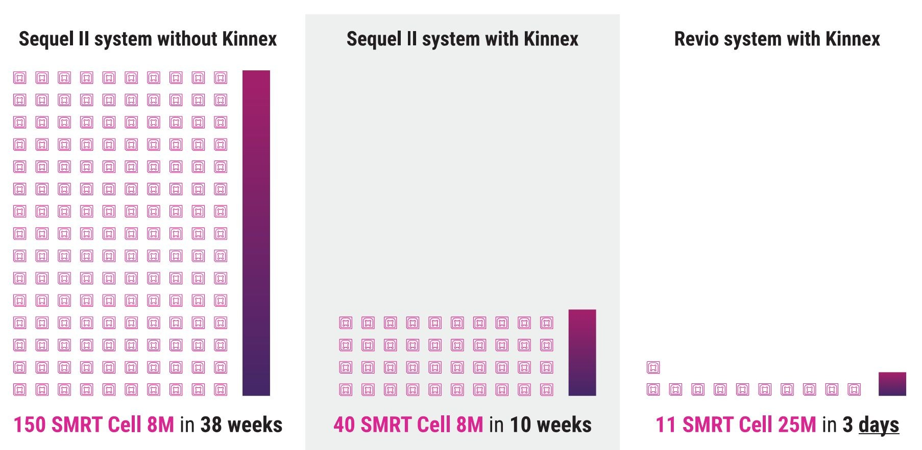
Library preparation
cDNA
Kinnex (Commercial version of MAS-ISO-seq)
PacBio
Description | Full-length isoform discovery with flexible sample multiplexing
Kit | Kinnex full-length RNA kit
Multiplex | 5M × 3-plex (Sequel II); 5M x 6-plex (Vega); 10M × 6-plex (Revio SPRQ)
Preparation time | 1.5 days 4 Safe stop point
Input | 300 ng Total RNA
Output | 15-20M (Sequel II); 20-30M (Vega); 50-60M (Revio SPRQ) Full-length HiFi transcripts (Q40)
Notable Studies | Al Khafaji et al., 2023. Nature Portofolio
Completed Library with cDNA concatenated
Kinnex increase throughput significantly
Image: PacBio

Slide 15
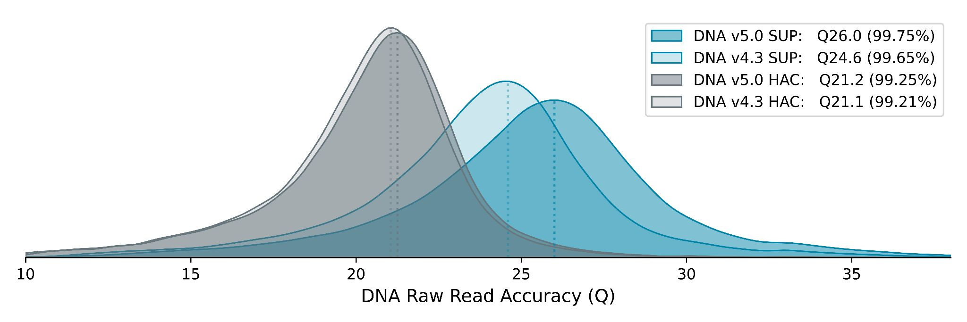
Library preparation
cDNA
cDNA-PCR (R10.4.1)
Nanopore
Description | A sequencing kit optimised for identification and quantification of full-length transcripts with highest output.
Kit | cDNA-PCR Sequencing Kit V14
Multiplex | up to 24-plex (cDNA-PCR Barcoding Kit V14)
Preparation time | 225 minutes + PCR
Input | 10 ng poly(A)+ RNA or 500 ng total RNA
Output | 10-15 million cDNA (MinION); 100 million cDNA (PromethION)
Latest transformer model and R10 pores deliver higher accuracy
Image: Nanopore

Slide 16
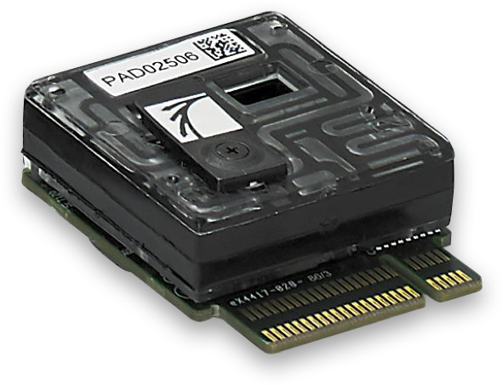
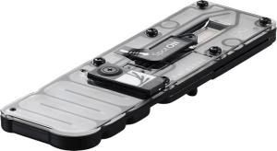
Library preparation
cDNA
cDNA-PCR (R10.4.1)
Nanopore
Description | A sequencing kit optimised for identification and quantification of full-length transcripts with highest output.
Kit | cDNA-PCR Sequencing Kit V14
Multiplex | up to 24-plex (cDNA-PCR Barcoding Kit V14)
Preparation time | 225 minutes + PCR
Input | 10 ng poly(A)+ RNA or 500 ng total RNA
Output | 10-15 million cDNA (MinION); 100 million cDNA (PromethION)
Two types of nanopore device with different sequencing throughput (Left: PromethION, Right: MinION)
Image: Nanopore

Slide 17
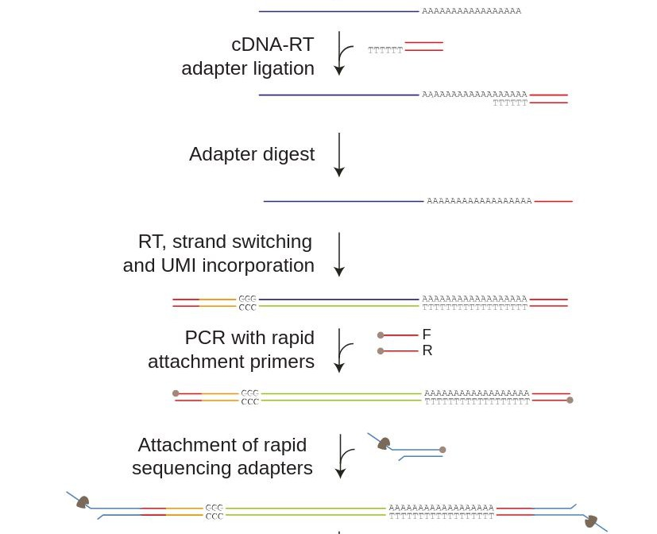
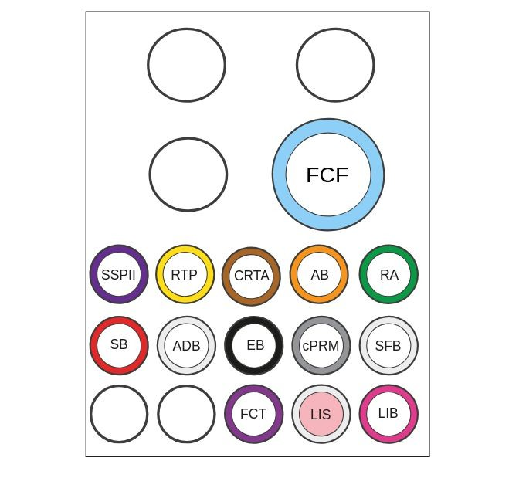
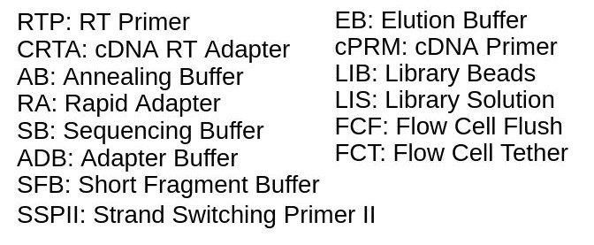
Library preparation
cDNA
cDNA-PCR (R10.4.1)
Common Problem
Always perform flow cell QC prior lib prep, ensure you have enough pores!
Nanopore
Complete library workflow for cDNA sequencing with cDNA-PCR kit
Image: Nanopore

Slide 18
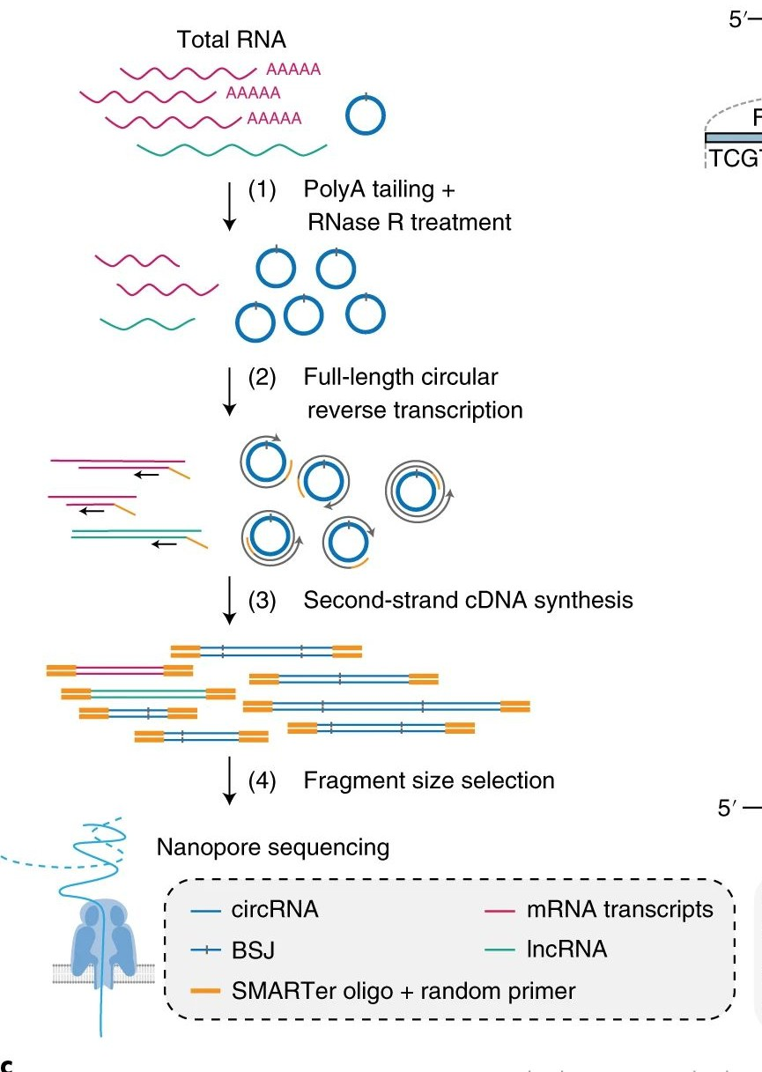
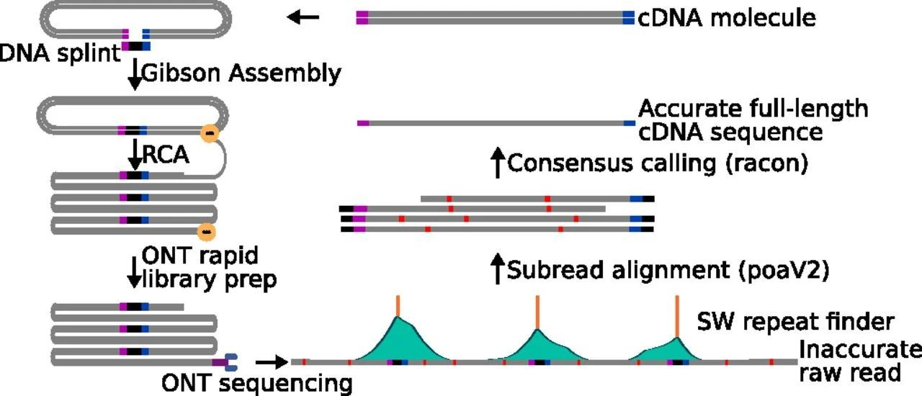

Library preparation
cDNA
cDNA-PCR (R10.4.1)
Nanopore
Community
Mandalorion was used to analyze the R2C2 reads of the 96 B cells and identified several surface receptor isoforms expressed by 96 distinct single human B cells.
Circular reverse transcription and size selection achieves a 20-fold higher enrichment of circRNAs from total RNA compared to previous methods.
R. Volden, et. al. Improving nanopore read accuracy with the R2C2 method enables the sequencing of highly multiplexed full-length single-cell
cDNA. https://doi.org/10.1073/pnas.1806447115 (2018).
Zhang, J., Hou, L., Zuo, Z. et al. Comprehensive profiling of circular RNAs with nanopore sequencing and CIRI-long. Nat Biotechnol 39, 836–845 (2021). https://doi.org/10.1038/s41587-021-00842-6

Slide 19
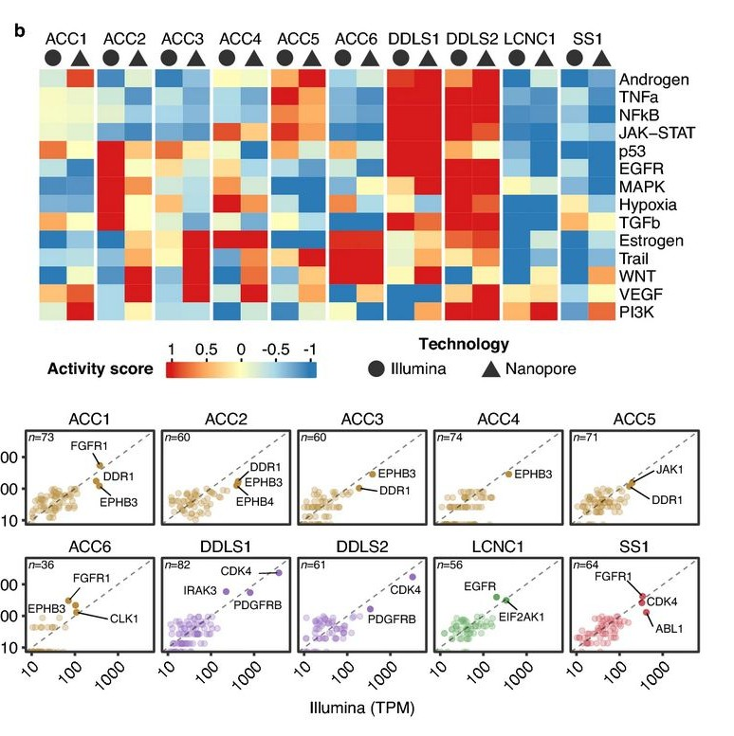
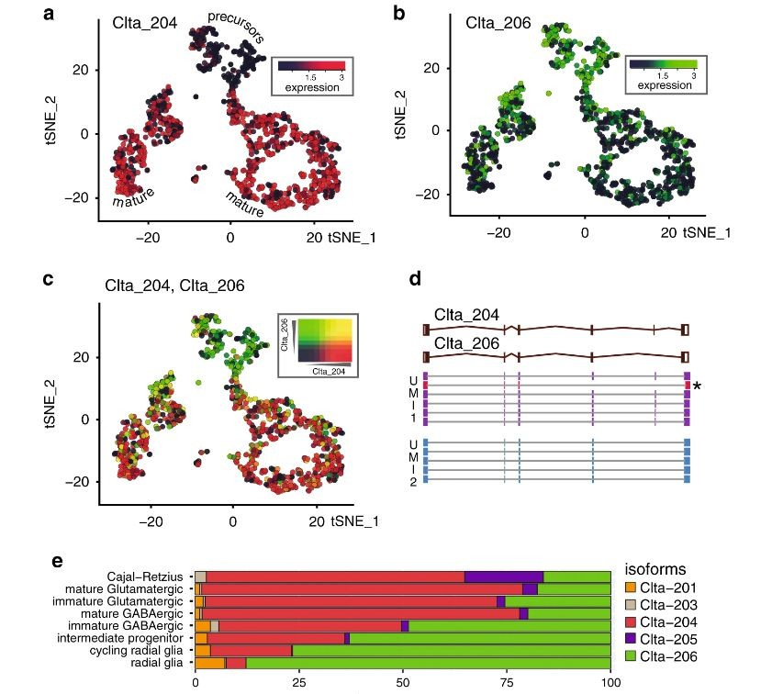
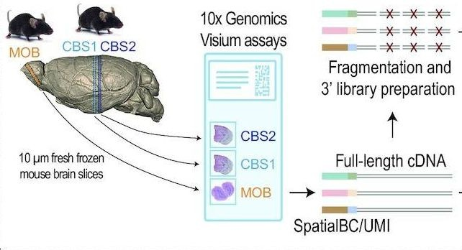
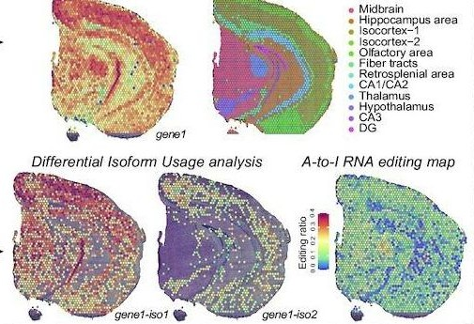
Library preparation
cDNA
cDNA-PCR (R10.4.1)
Nanopore
Community
Shallow nanopore RNA-seq enables rapid and biologically meaningful transcriptome profiling of tumors (Mock et al 2023)
Nanopore scRNA-seq reveals transcript isoform diversity (Lebrigand et al 2020).
SiT can be used to profile isoform expression and sequence heterogeneity in different areas of the tissue (Lebrigand et al 2023).

Slide 20
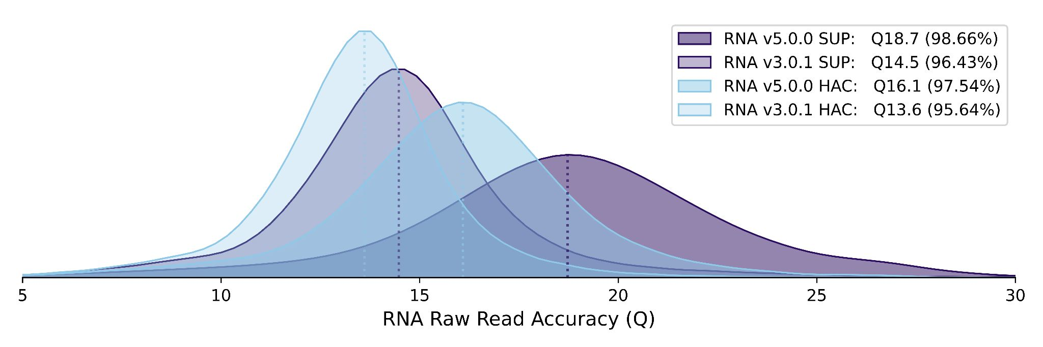
Library preparation
mRNA
Direct RNA sequencing (RNA004)
Nanopore
Description | A sequencing kit optimised for sequencing native RNA with improved output and accuracy.
Kit | Direct RNA Sequencing Kit
Multiplex | Under development
Preparation time | 135 minutes
Input | 300 ng poly(A)+ RNA or 1 ug total RNA
Output | 2 GB cDNA (MinION); 30 million cDNA (PromethION)
Latest transformer model and RP4 pores deliver higher accuracy
Image: Nanopore

Slide 21
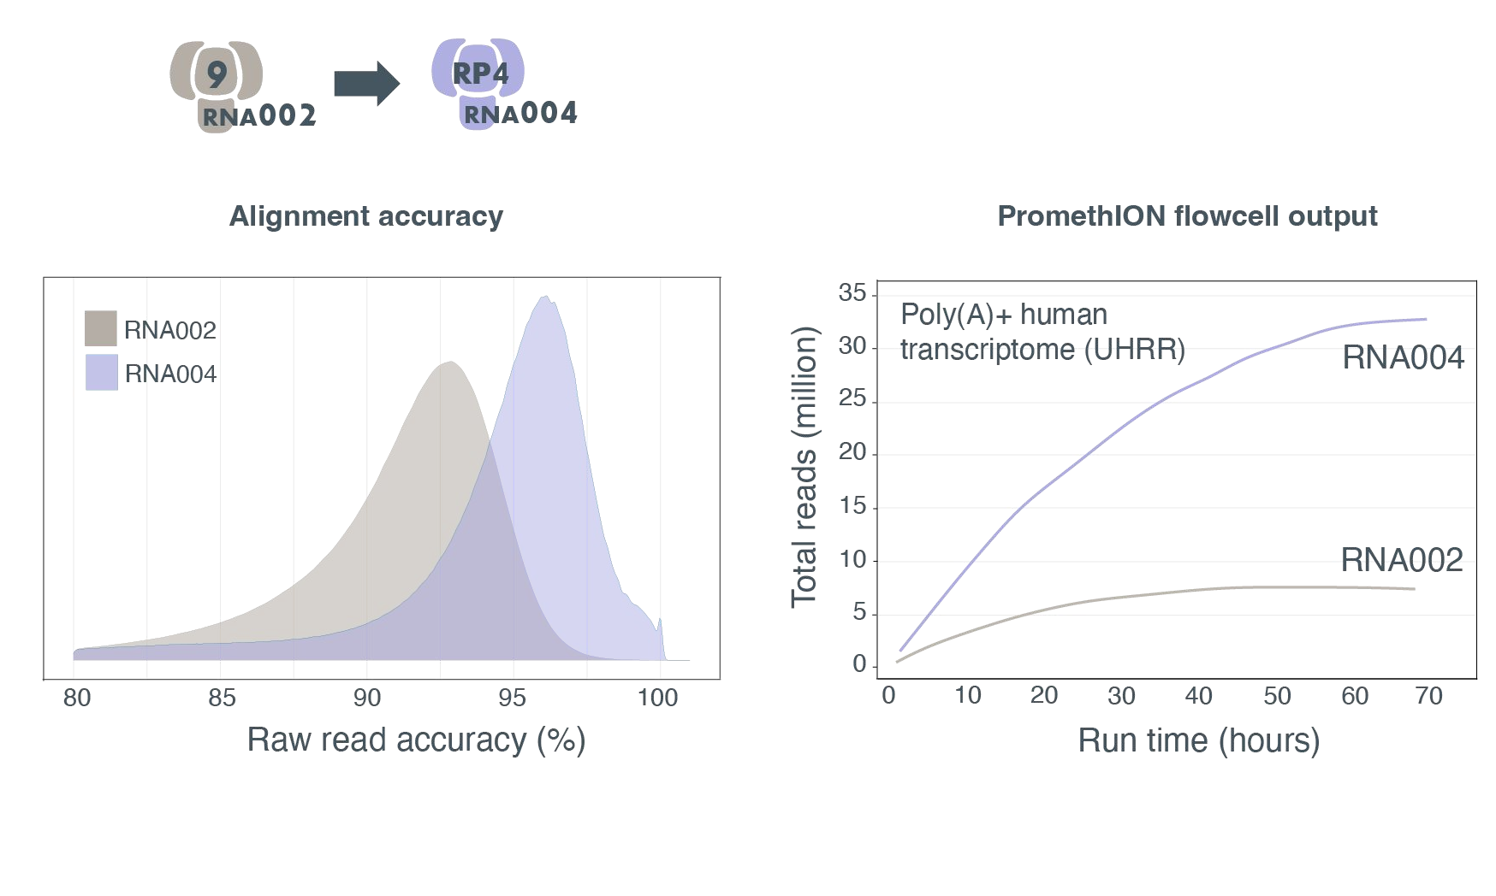
Library preparation
mRNA
Direct RNA sequencing (RNA004)
Nanopore
Description | A sequencing kit optimised for sequencing native RNA with improved output and accuracy.
Kit | Direct RNA Sequencing Kit
Multiplex | Under development
Preparation time | 135 minutes
Input | 300 ng poly(A)+ RNA or 1 ug total RNA
Output | 2 GB cDNA (MinION); 30 million cDNA (PromethION)
Overall quality and throughput significantly improved in RNA004. Libprep step is the same.
Image: Nanopore

Slide 22
Library preparation
mRNA
Direct RNA sequencing (RNA004)
Nanopore
Description | A sequencing kit optimised for sequencing native RNA with improved output and accuracy.
Kit | Direct RNA Sequencing Kit
Multiplex | Under development
Preparation time | 135 minutes
Input | 300 ng poly(A)+ RNA or 1 ug total RNA
Output | 2 GB cDNA (MinION); 30 million cDNA (PromethION)
Two types of nanopore device with different sequencing throughput (Left: PromethION, Right: MinION)
Image: Nanopore

Slide 23
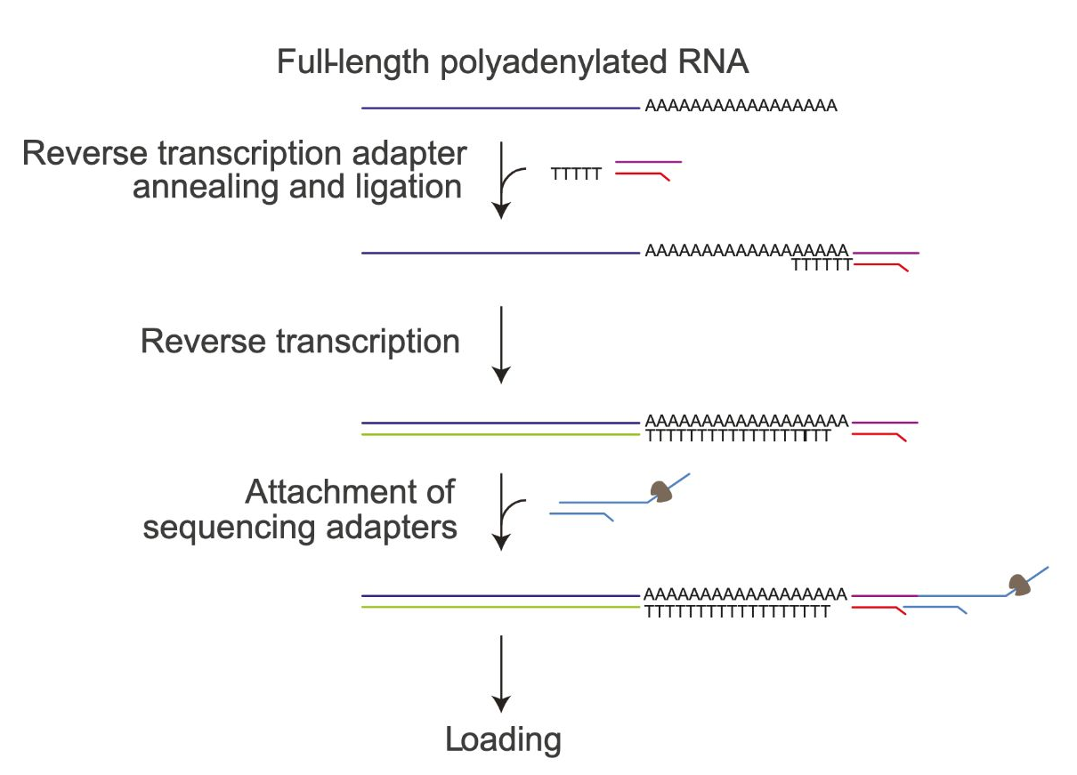
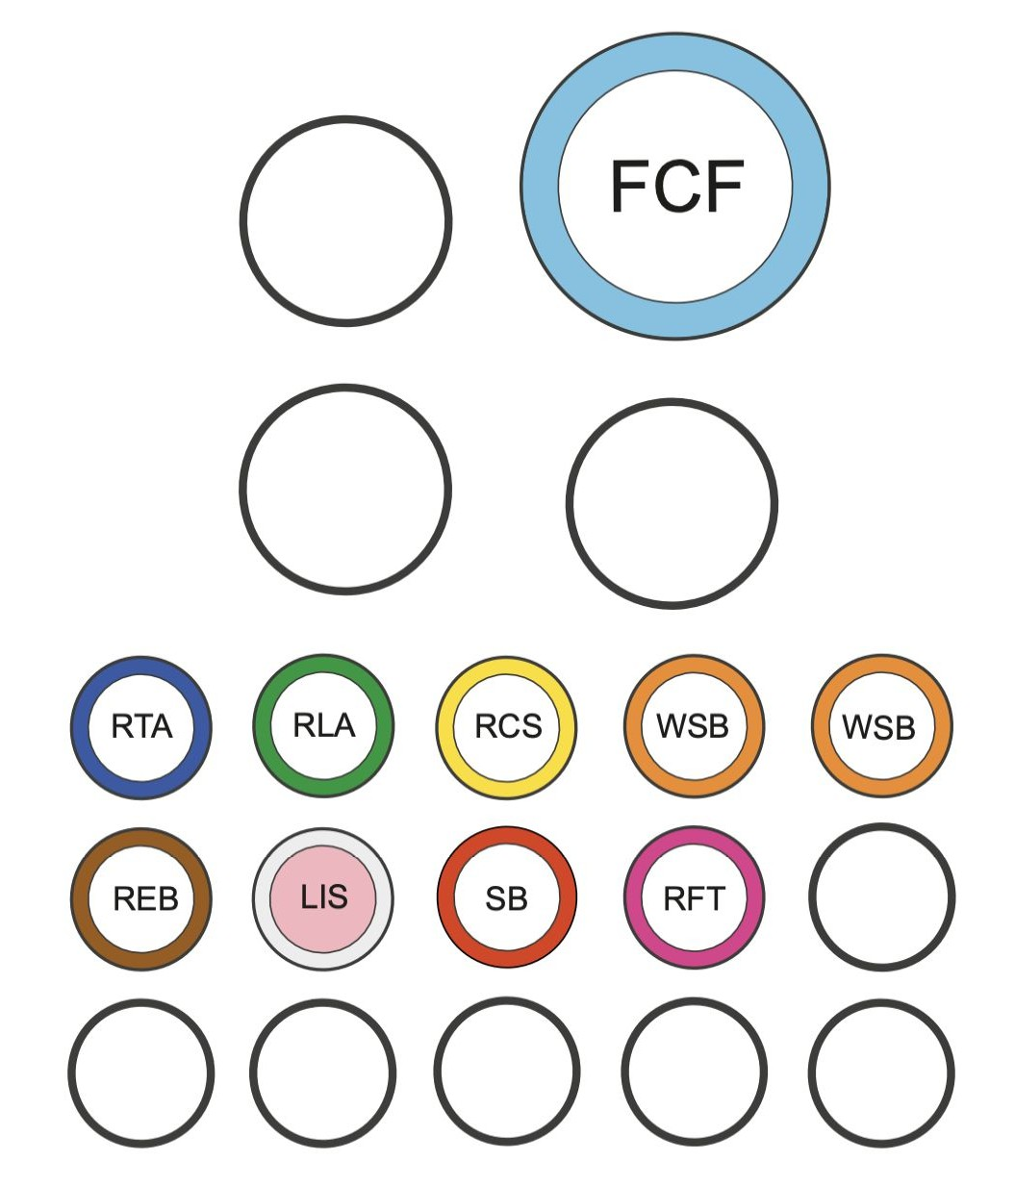
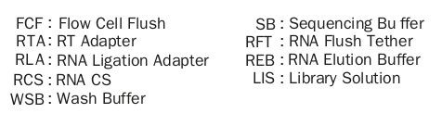
Library preparation
mRNA
Direct RNA sequencing (RNA004)
Common Problems
Always perform flow cell QC prior lib prep, ensure you have enough pores!
Nanopore
Complete library workflow for Direct RNA sequencing with Direct RNA Sequencing kit
Image: Nanopore

Slide 24
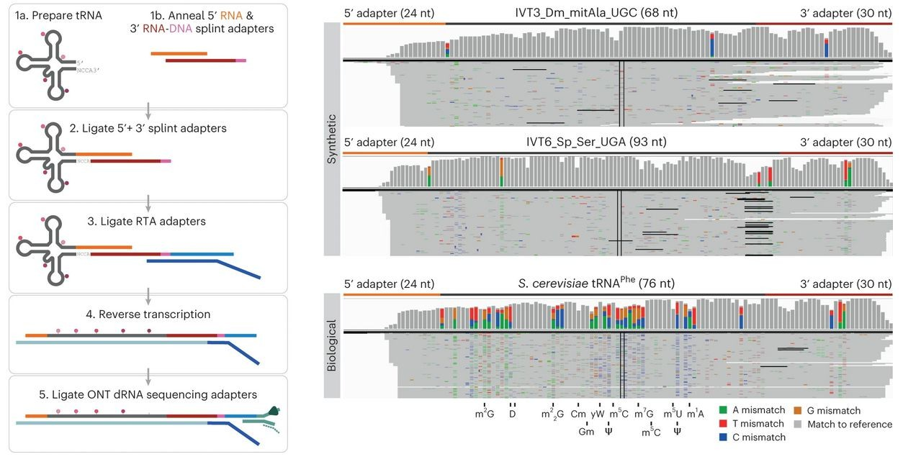
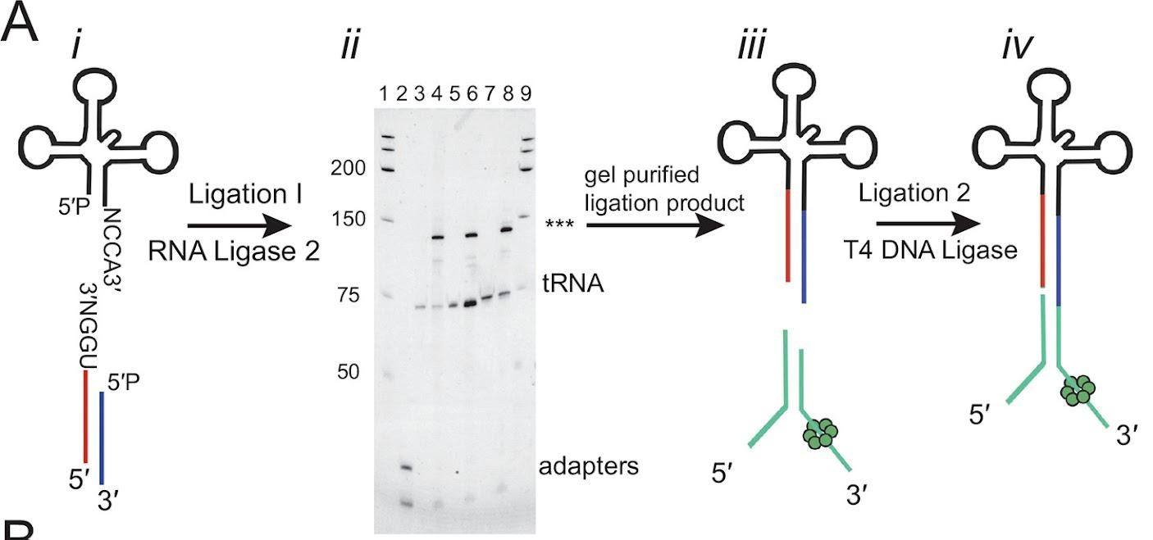
Library preparation
tRNA (Native RNA)
Direct RNA sequencing (RNA004)
Nanopore
Community
Nanopore sequencing detected all 43 expected isoacceptors in total E. coli MRE600 tRNA
Nano-tRNAseq can efficiently sequence both IVT and native tRNA populations
Thomas, N. K., Poodari, V. C., Jain, M., Olsen, H. E., Akeson, M., & Abu-Shumays, R. L. (2021). Direct Nanopore Sequencing of Individual Full Length tRNA Strands. ACS nano, 15(10), 16642–16653. https://doi.org/10.1021/acsnano.1c06488
Lucas, M.C., Pryszcz, L.P., Medina, R. et al. Quantitative analysis of tRNA abundance and modifications by nanopore RNA sequencing.
Nat Biotechnol 42, 72–86 (2024). https://doi.org/10.1038/s41587-023-01743-6

Slide 25
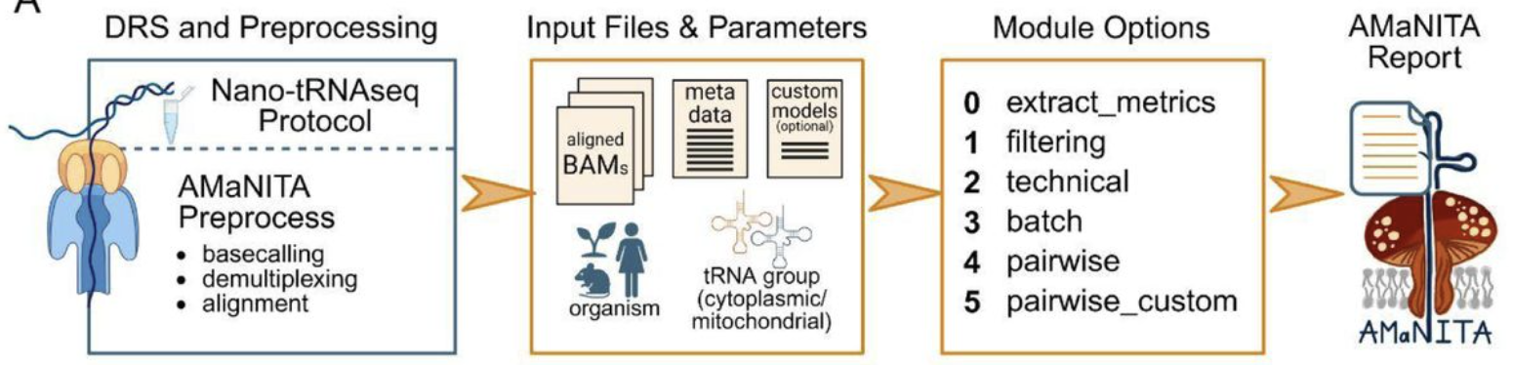
Library preparation
tRNA (Native RNA)
Direct RNA sequencing (RNA004)
Nanopore
Community
New specialized tools to analyze Nano-tRNAseq
Nano-tRNAseq can efficiently sequence both IVT and native tRNA populations
Katopodi, X.L., Pryszcz, L.P., Llovera, L., Ollivier, A., Cozzuto, L., Ponomarenko, J., Novoa E.M. AMaNITA: an end-to-end workflow for native tRNA nanopore sequencing data analysis.
BiorXiv 2026
https://doi.org/10.64898/2026.06.16.732588
Lucas, M.C., Pryszcz, L.P., Medina, R. et al. Quantitative analysis of tRNA abundance and modifications by nanopore RNA sequencing.
Nat Biotechnol 42, 72–86 (2024). https://doi.org/10.1038/s41587-023-01743-6

Slide 26
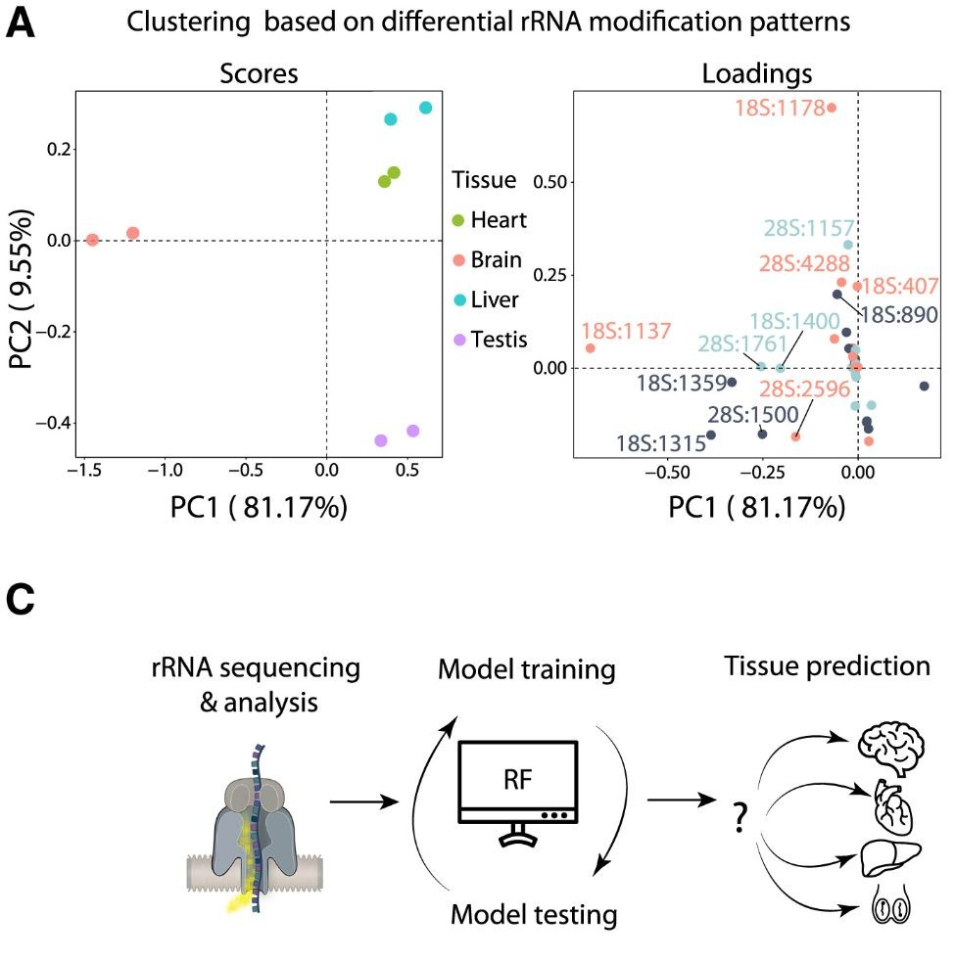
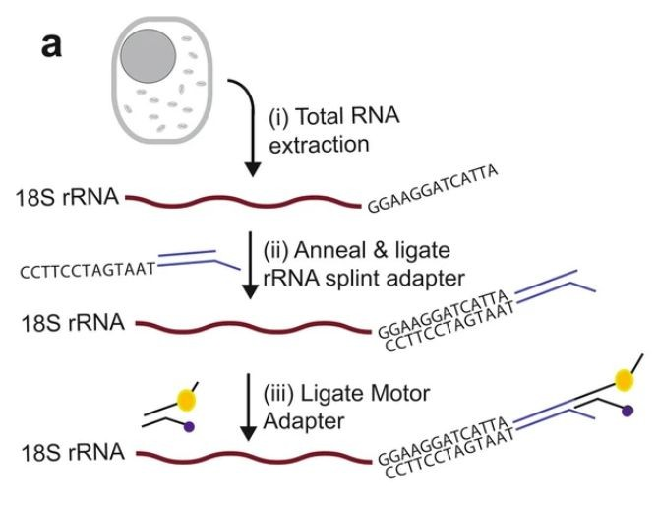
Library preparation
rRNA (Native RNA)
Direct RNA sequencing (RNA004)
Nanopore
Community
Differential rRNA modification patterns can be used to predict tissue types and developmental stages
Jain, M., Olsen, H.E., Akeson, M., Abu-Shumays, R. (2021).
Adaptation of Human Ribosomal RNA for Nanopore Sequencing of Canonical and Modified Nucleotides.
Inhttps://doi.org/10.1007/978-1-0716-1374-0_4
Milenkovic, et al. (2025). Epitranscriptomic rRNA fingerprinting reveals tissue-of-origin and tumor-specific signatures. Molecular cell, 85(1), 177–190.e7. https://doi.org/10.1016/j.molcel.2024.11.014

Slide 27
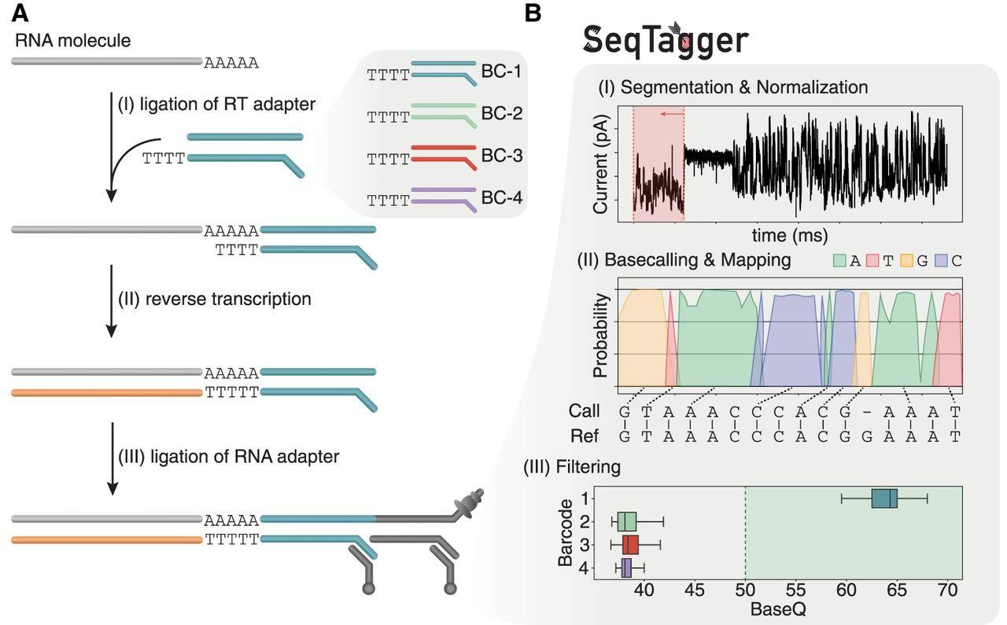
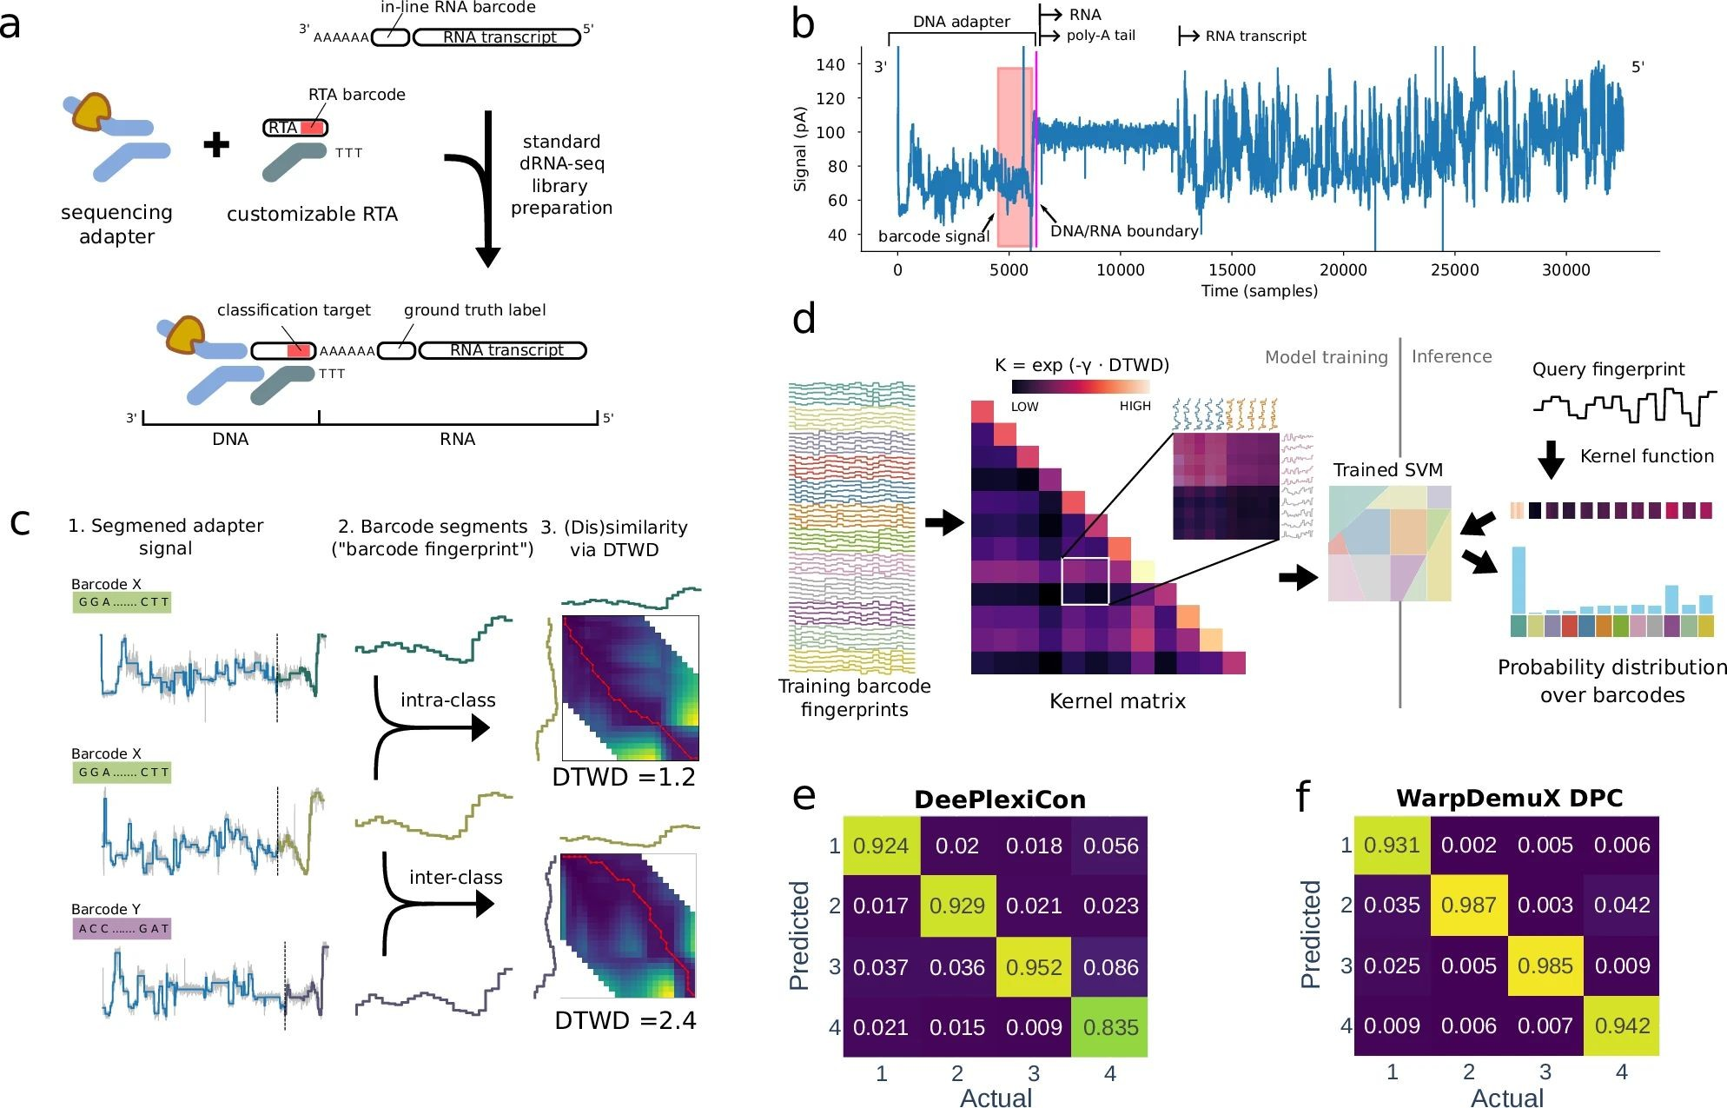
Library preparation
Multiplexing
Direct RNA sequencing (RNA004)
Nanopore
Community
SeqTagger, a rapid and robust method that can demultiplex DRS data sets with 99% precision and 95% recall.
Thomas, N. K., Poodari, V. C., Jain, M., Olsen, H. E., Akeson, M., & Abu-Shumays, R. L. (2021). Direct Nanopore Sequencing of Individual Full Length tRNA Strands. ACS nano, 15(10), 16642–16653. https://doi.org/10.1021/acsnano.1c06488
Rapid phenotypic profiling of different SARS-CoV-2 viruses through multiplexed sequencing of longitudinal samples on a single flowcell, identifying systematic differences in transcript abundance and poly(A) tail lengths
van der Toorn, W., Bohn, P., Liu-Wei, W. et al. Demultiplexing and barcode-specific adaptive sampling for nanopore direct RNA sequencing. Nat Commun 16, 3742 (2025). https://doi.org/10.1038/s41467-025-59102-9

Slide 28
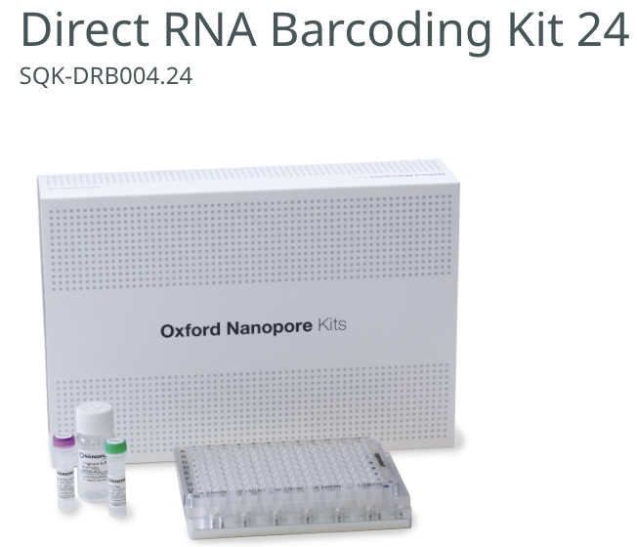
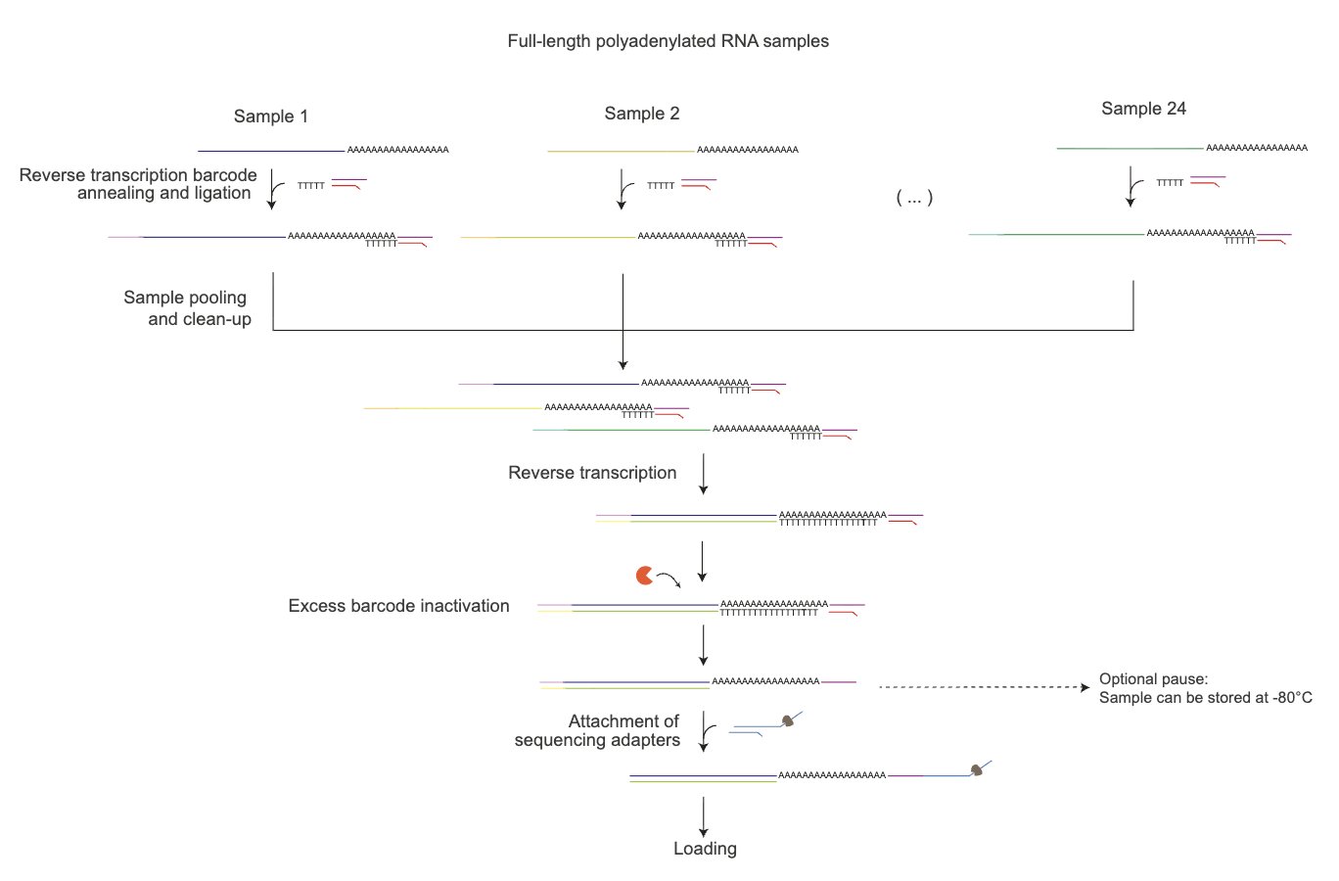
Library preparation
Multiplexing
Direct RNA sequencing (RNA004)
Nanopore

Slide 29
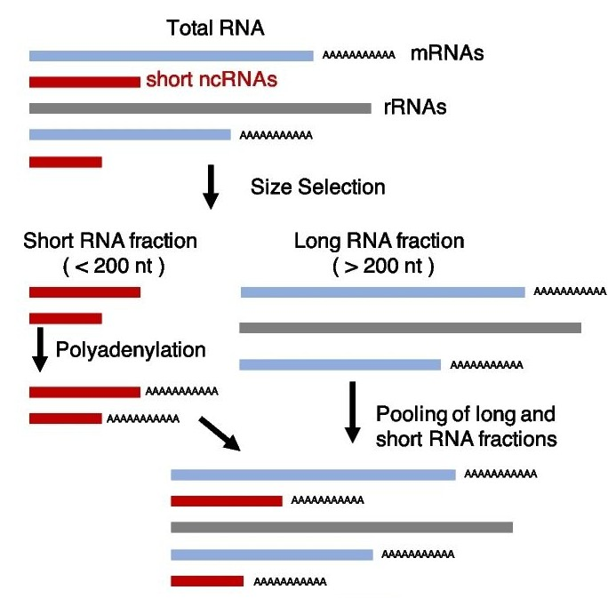
Library preparation
Improving Representation
Direct RNA sequencing (RNA004)
Nanopore
Community
NERD-seq expands representation of frequently modified non-coding RNAs, such as snoRNAs, snRNAs, scRNAs, srpRNAs, tRNAs, and rRFs.
Saville, L., Wu, L., Habtewold, J. et al. NERD-seq: a novel approach of Nanopore direct RNA sequencing that expands representation of non-coding RNAs. Genome Biol 25, 233 (2024). https://doi.org/10.1186/s13059-024-03375-8

Slide 30
Section 1.2
Adaptive sampling
Library preparation strategies for long-reads RNA-seq experiments

Slide 31
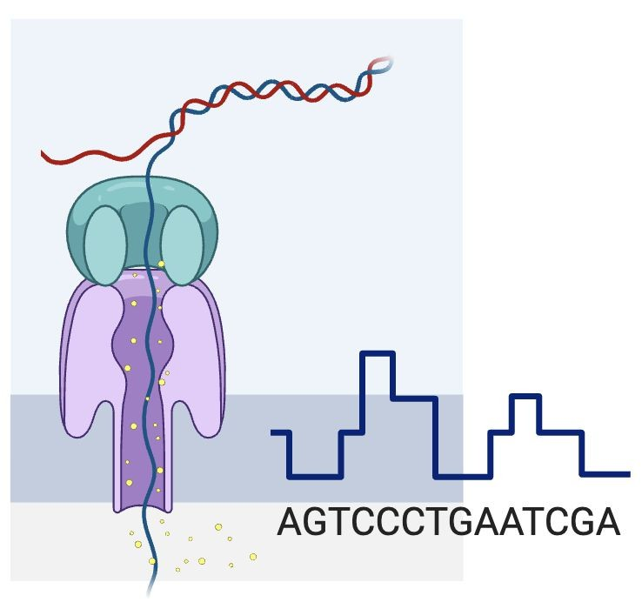
Bonus
Adaptive Sampling
Direct RNA sequencing (RNA004)
Nanopore
Community
Adaptive sampling can be used to enrich or deplete target transcripts.
Image: Nanopore

Slide 32


Bonus
Adaptive Sampling
Direct RNA sequencing (RNA004)
Nanopore
Community
Process data in realtime
Adaptive sampling can be used to enrich or depletes target transcripts.
Image: Nanopore

Slide 33
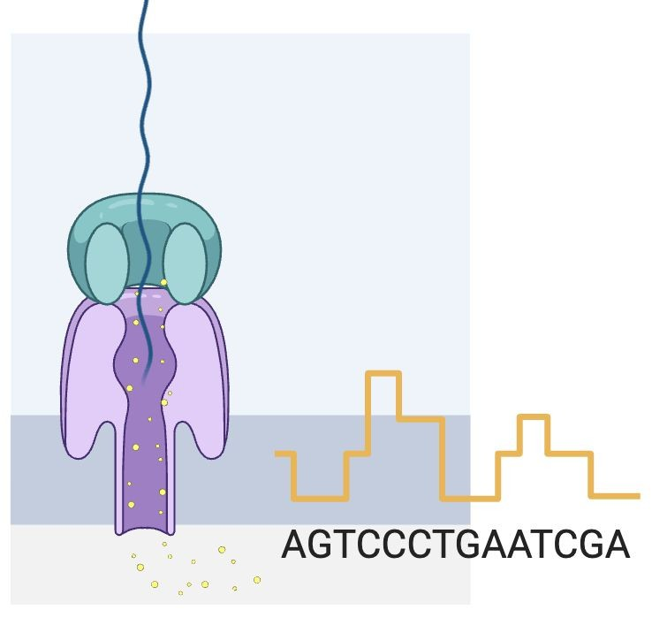
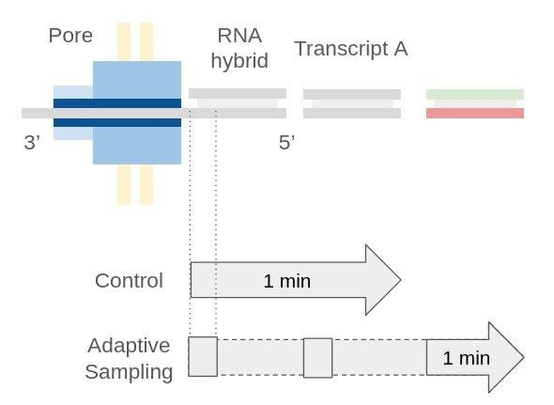

Bonus
Adaptive Sampling
Direct RNA sequencing (RNA004)
Nanopore
Community
Process data in realtime
Adaptive sampling can be used to enrich or depletes target transcripts.
Image: Nanopore

Slide 34
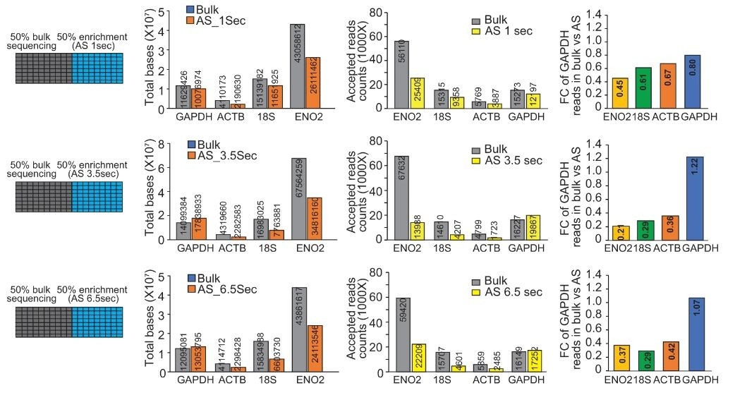
Bonus
Adaptive Sampling
Direct RNA sequencing (RNA004)
Nanopore
Community
Adaptive sampling performed on a pool of in vitro transcribed RNAs resulted in a net increase of 22-30% in the proportion of transcripts of interest in the population.
Wang, J., et al.. (2024). Direct RNA sequencing coupled with adaptive sampling enriches RNAs of interest in the transcriptome. https://doi.org/10.1038/s41467-023-44656-3
Image: Nanopore

Slide 35
Section 2
Basecalling
Raw data formats and Basecalling

Slide 36
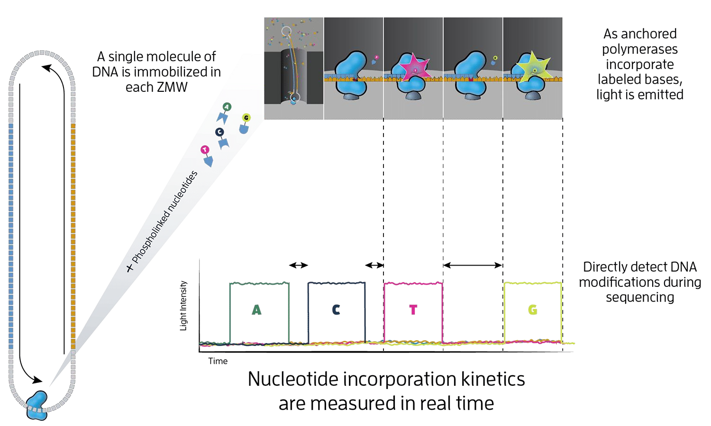
Primary Analysis
PacBio
.
PacBio
Official tool | ICS v13.3 (Revio)
 | Base calling HiFi read generation with DeepConsensus Methylation calling Barcode demultiplexing BAM file generation
Image: Nanopore

Slide 37
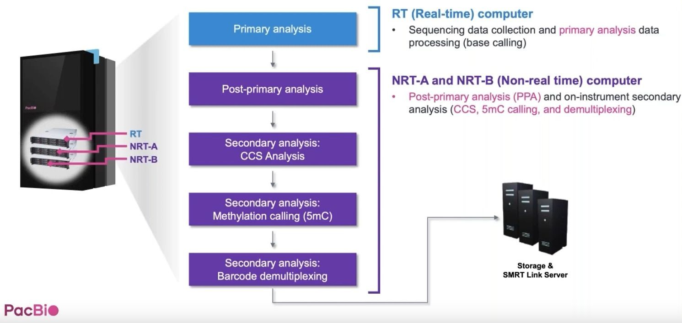
Primary Analysis
PacBio
.
PacBio
Official tool | ICS v13.3 (Revio)
 | Base calling HiFi read generation with DeepConsensus Methylation calling Barcode demultiplexing BAM file generation
Image: Nanopore

Slide 38
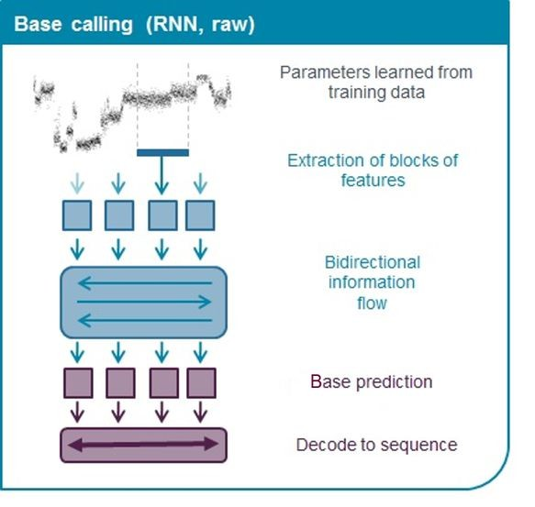
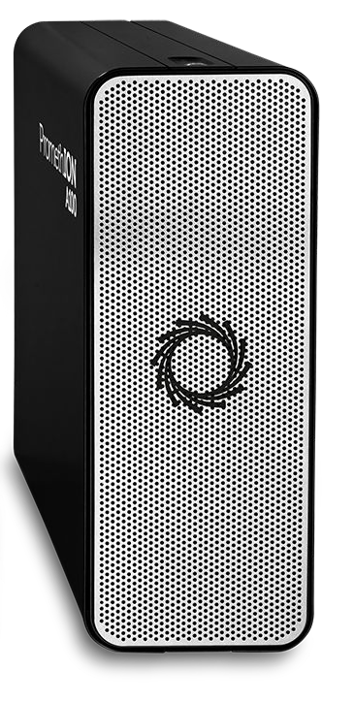
Primary Analysis
Nanopore Basecalling
cDNA-PCR (R10.4.1)
Nanopore
Official tool | MinKNOW (dorado) Dorado standalone
Model | dna_r10.4.1_e8.2_400bps_fast@v5.2.0 dna_r10.4.1_e8.2_400bps_hac@v5.2.0 dna_r10.4.1_e8.2_400bps_sup@v5.2.0
Resource | PromethION Tower, P2I Professional/Gaming Laptop/Tower
Image: Nanopore

Slide 39
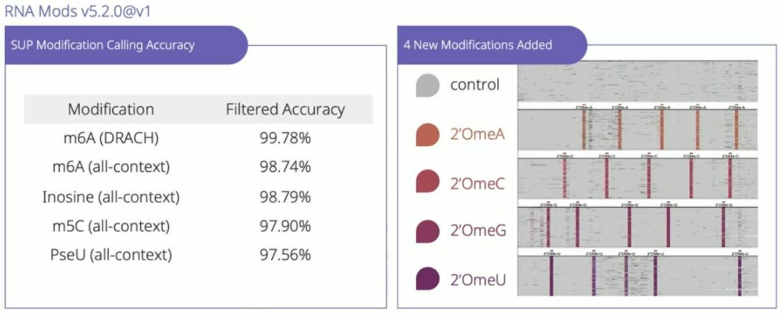
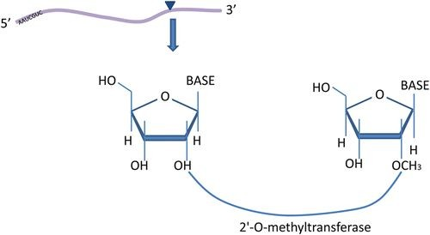
Primary Analysis
Nanopore Modcalling
Direct RNA sequencing (RNA004)
Nanopore
Official tool | MinKNOW (dorado) Dorado standalone Remora
Model and mods | rna004_130bps_fast@v5.2.0 rna004_130bps_hac@v5.2.0 m5C m6A_DRACH inosine_m6A pseU rna004_130bps_sup@v5.2.0 m5C_2OmeC m6A_DRACH inosine_m6A_2OmeA pseU_2OmeU 2OmeG
Resource | PromethION Tower, P2I Professional/Gaming Laptop/Tower
Image: Nanopore

Slide 40


Primary Analysis
Nanopore Modcalling
Direct RNA sequencing (RNA004)
Nanopore
Community tool | EpiNano (Liu et al, 2019) m6A Nanocompore (Leger, 2021) De novo in comparison with IVT m6anet (Hendra et al, 2022) m6A NanoRMS (Begik, 2022) De novo, modification sites m6ABasecaller (Cruciani, 2023) m6A and many more …
Image: Nanopore

Slide 41
Questions
What method kinnex was based on?
What improved throughput in Kinnex kit?
Why RT is performed in dRNA sequencing?
What mods supported by dorado?
Long-reads Transcriptomics

Slide 42

Thank You!
For more information about the LongTREC Summer School:
https://longtrec.eu

