Slide 1



Bioinformatics Summer School
Long-reads Transcriptomics
Eamon McAndrew
Ipmc - Institute of Molecular and Cellular Pharmacology
LongTREC - The Long-reads TRanscriptome European Consortium
Marie Skłodowska-Curie grant agreement No 101072892

Slide 2

Section 4
Long Read Single Cell Transcriptomics

Slide 3
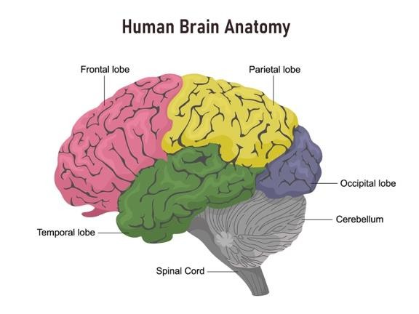
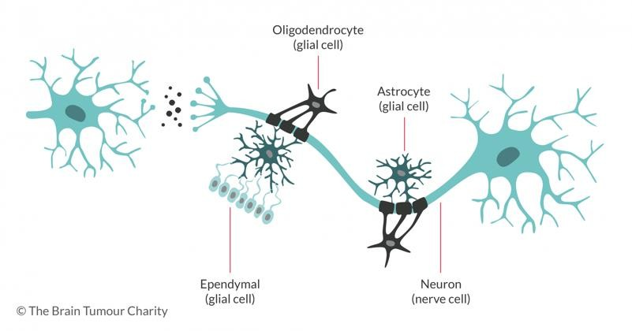
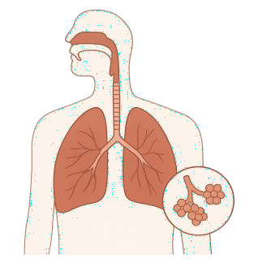
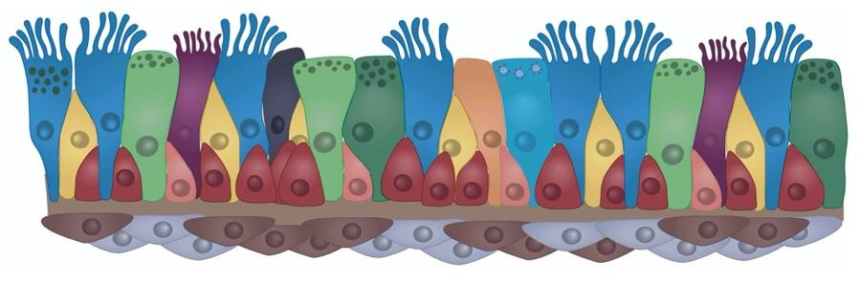
Why Single Cell?
So after this week we know all about Long Read Bulk Transcriptomics:
But what about complex tissue?

Slide 4

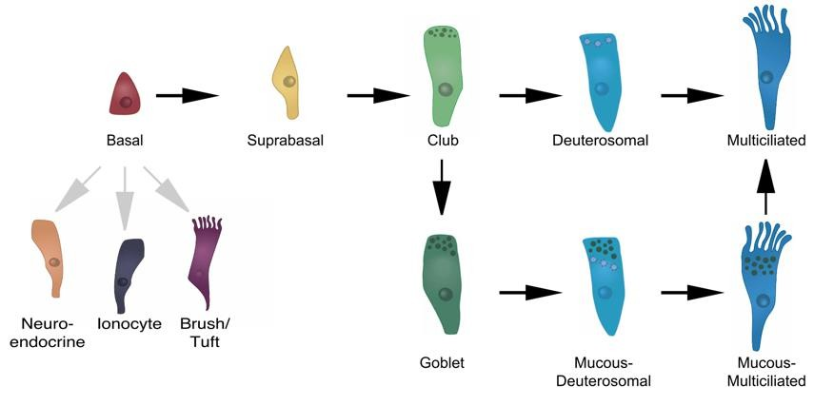
Why Single Cell?
In complex tissue the signal we generate with bulk assays is a linear combination derived from many cell types.

Slide 5
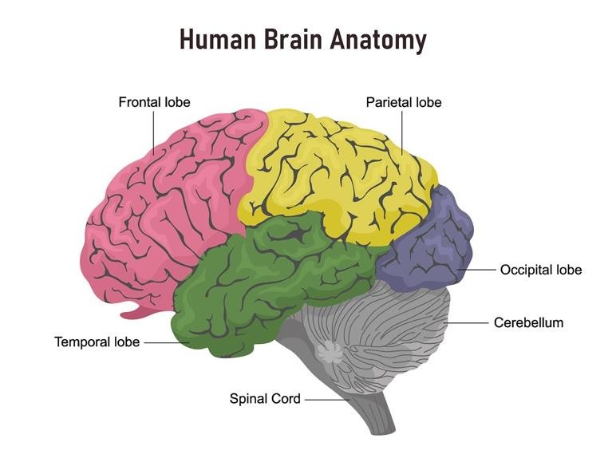
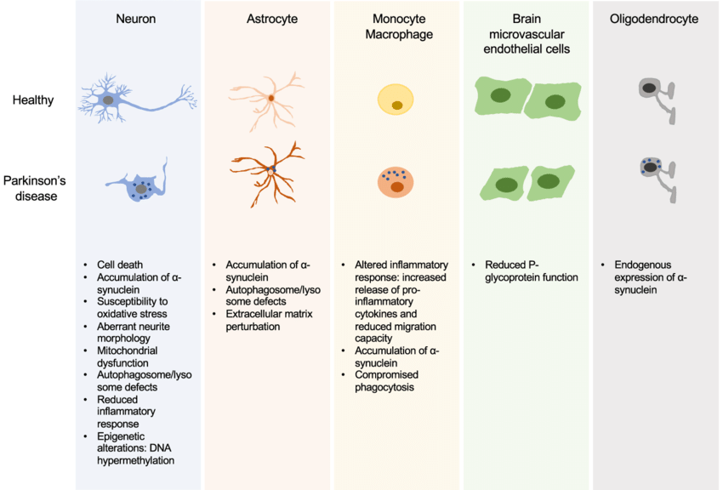
Why Single Cell?
In complex tissue the signal we generate with bulk assays is a linear combination derived from many cell types (subtypes, states, diseased affected/healthy)

Slide 6
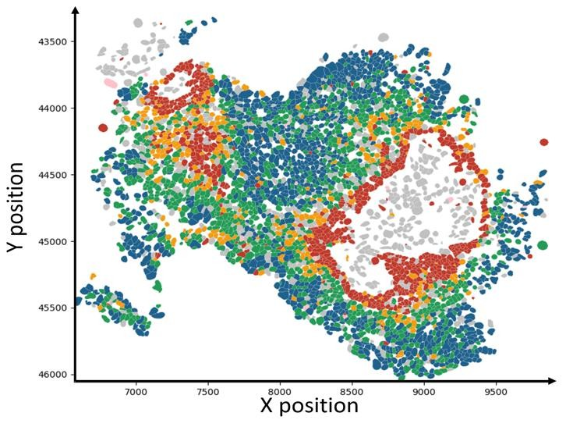
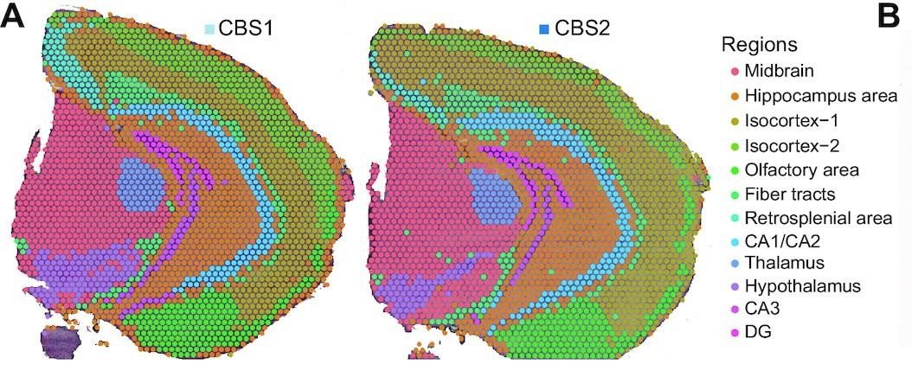
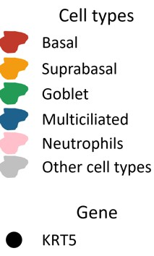
Why Single Cell?
Cells don’t exist or operate in Isolation.
Mouse Coronal Brain Section
Bronchial COPD biopsy

Slide 7
Bulk averages, single cell resolves
Bulk RNA-seq
One averaged profile
cell identities lost
Complex tissue
Pool all cells,
sequence together
Single-cell RNA-seq
Keep cells separate,
barcode each one
Many
resolved
profiles
Cell types & states stay resolved

Slide 8
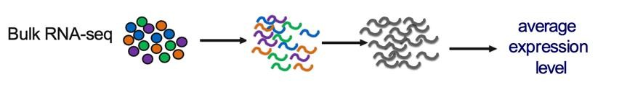
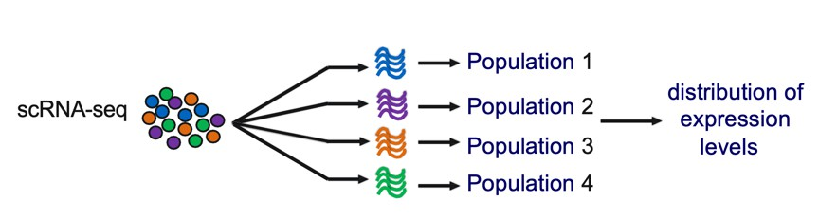
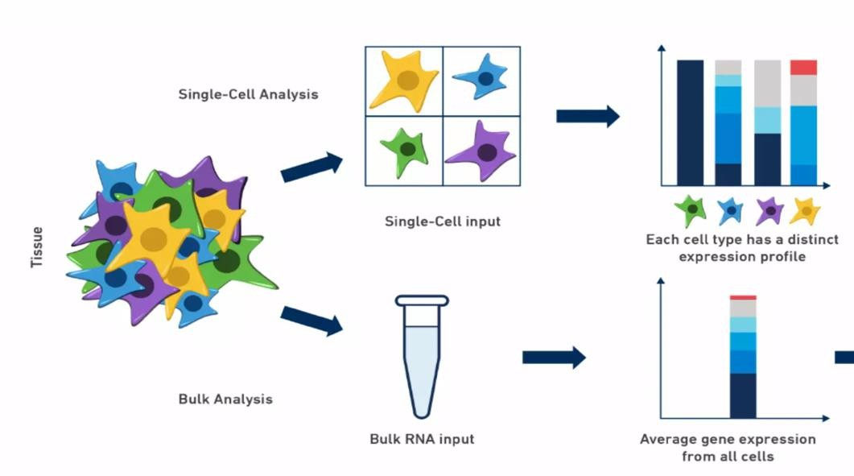
Preserving cellular heterogeneity
The core idea: bulk gives one averaged profile; single cell resolves the distribution, so distinct cell types and states stay visible instead of being averaged away.

Slide 9
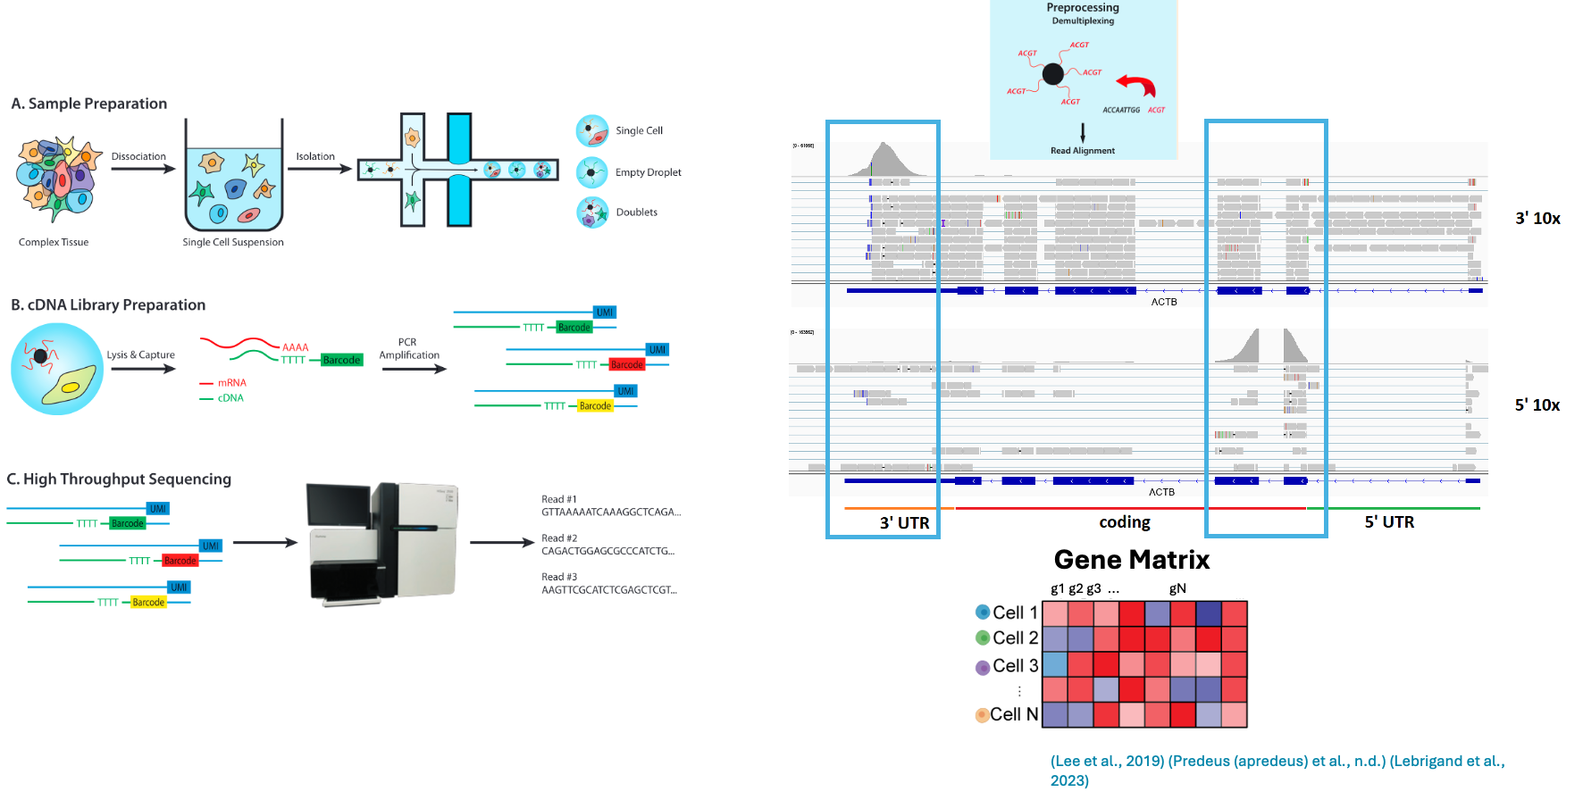
Limitations of short read

Slide 10
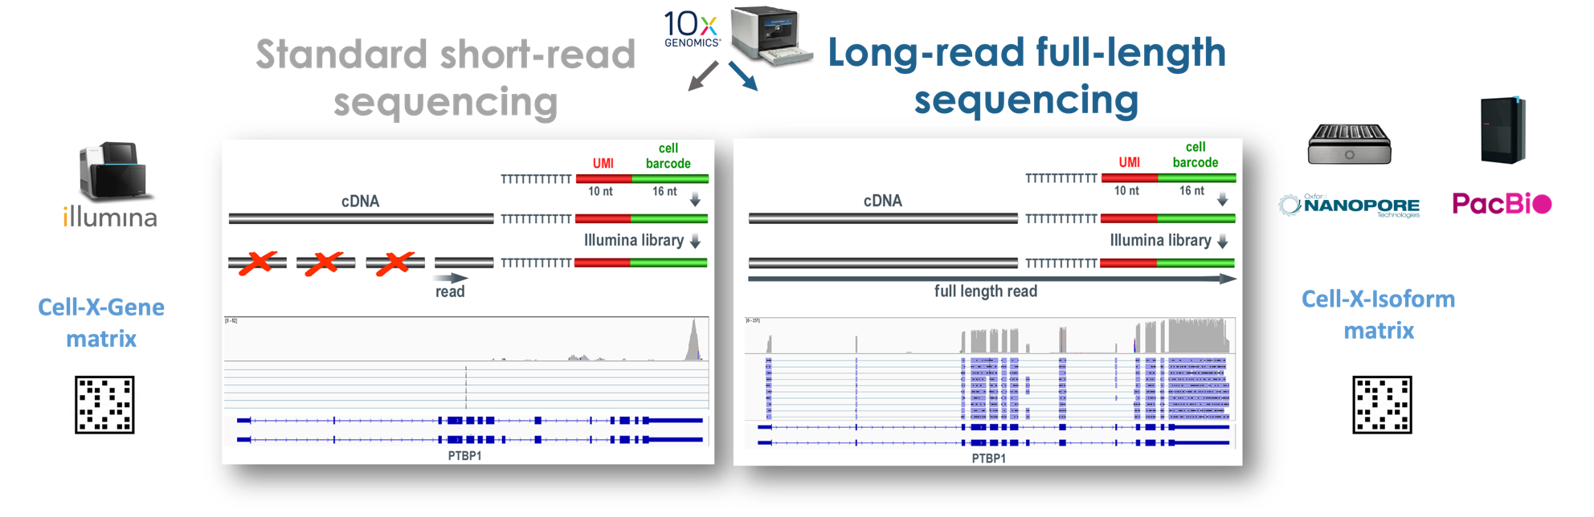
Long Read single Cell Transcriptomics

Slide 11
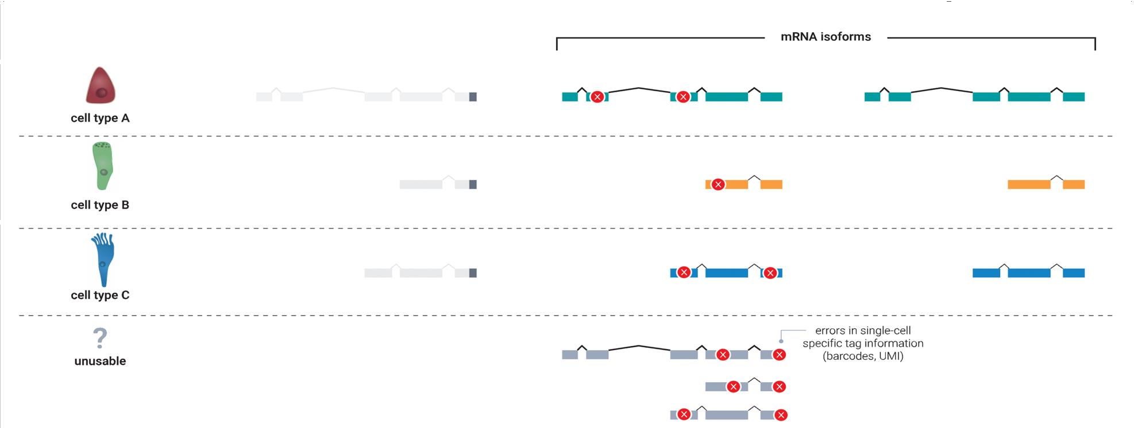
Individual reads assigned to individual cells

Slide 12
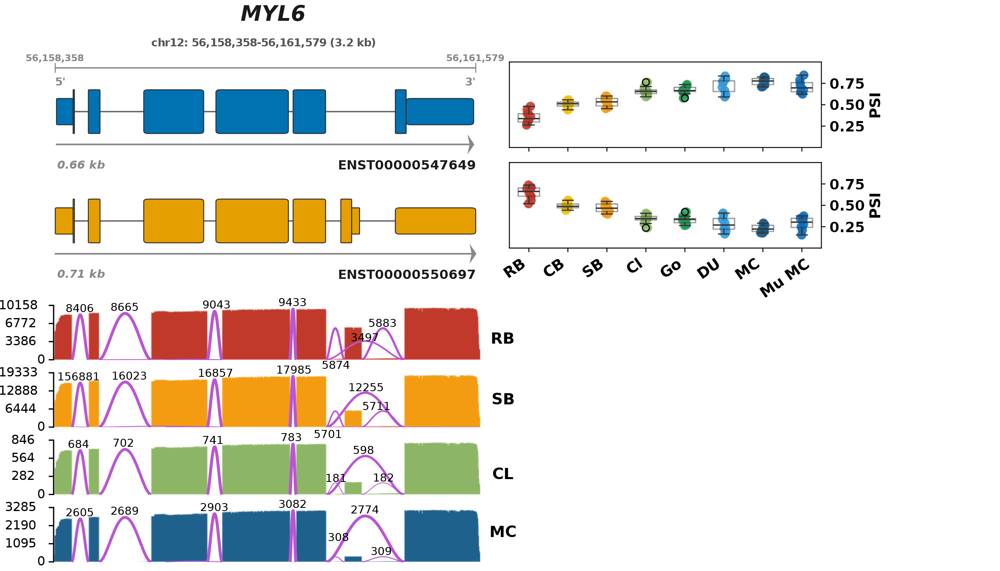
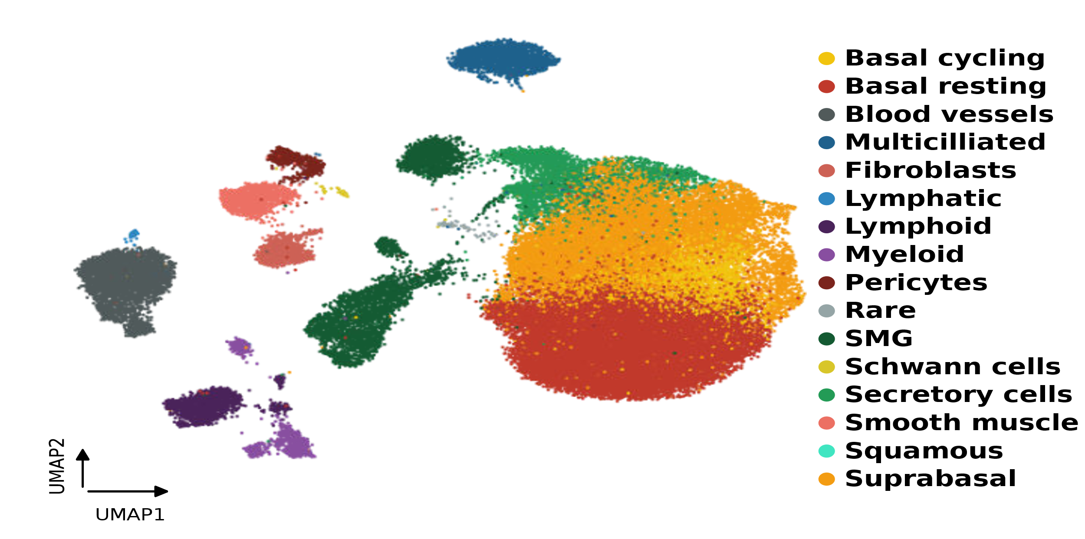
Why Single Cell?
60,037 Cells × 220,116 Transcripts

Slide 13
The challenges of Single Cell Long Reads
1
Cost & throughput
2
Higher error rates
High per-cell sequencing cost and lower throughput vs. short-read platforms.
Higher raw read error rates complicate accurate isoform identification.
3
Sparse coverage
4
Barcode / UMI
Limited detection of low-abundance transcripts; short-read gene-level single cell is already sparse.
Barcode and UMI assignment inefficiencies, plus cDNA length biases.
5
Compute & storage
6
Immature tooling
Demanding compute and storage requirements for long-read datasets.
Limited mature analysis tools for downstream isoform work.

Slide 14
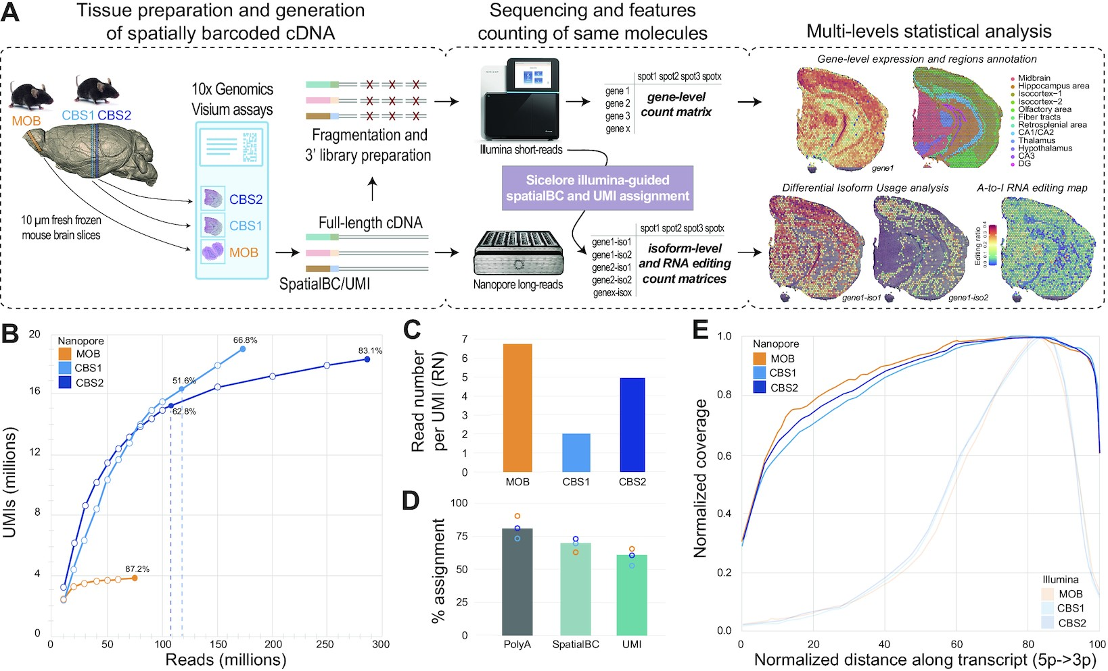
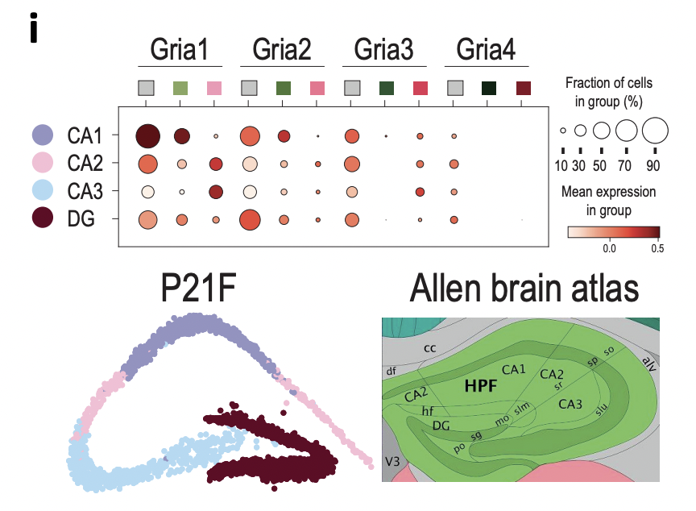
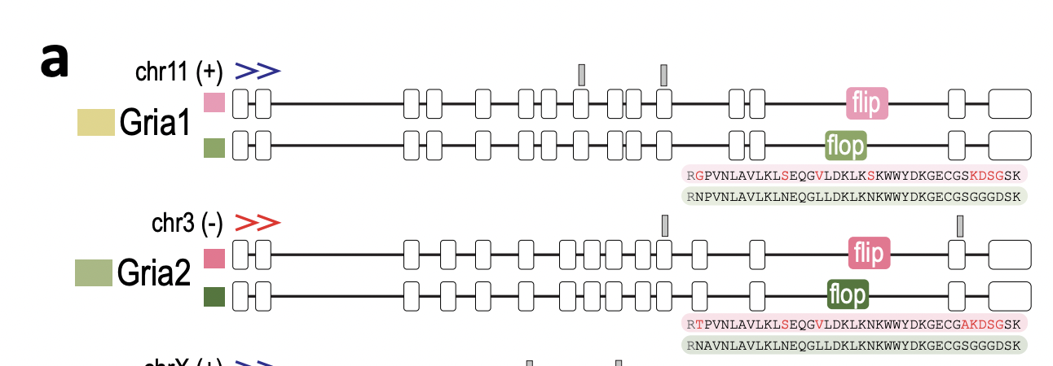
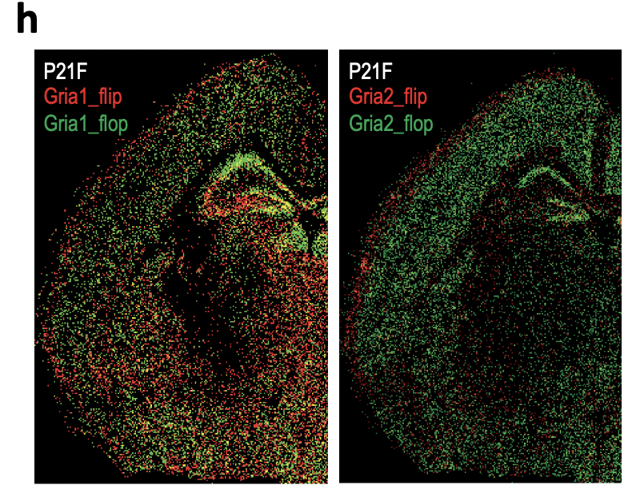
What about spatial context?

Slide 15
Isoform diversity is more than splicing
Splicing is just one of several mechanisms that let a single gene produce diverse final mRNA products
Alternative splicing
Exon skipping, intron retention, alternative 5′/3′ sites, mutually exclusive exons.
Alternative TSS / promoter
Different start sites change the 5′ end and are often coupled to downstream splicing.
Alternative polyadenylation
>Half of human genes; 3′UTR length tunes mRNA stability and localisation.
A-to-I RNA editing
ADAR recodes bases and can create or remove splice sites.
m6A & RNA modifications
Marks shape splicing, export, stability and translation.
Fusions & readthrough
Chimeric transcripts spanning genes; frequent in cancer.
Long reads capture these events co-occurring on the same molecule; short-read 3′/5′ capture sees only one end.

Slide 16
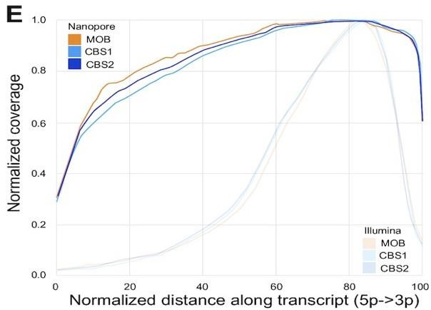
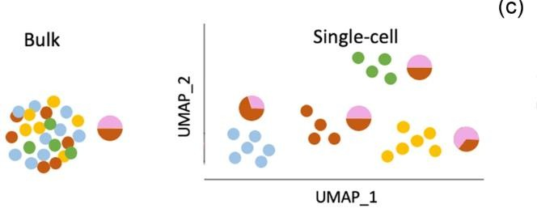
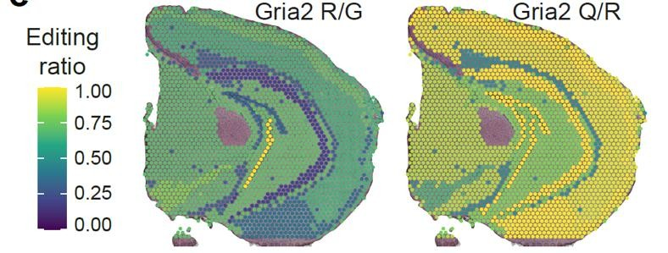
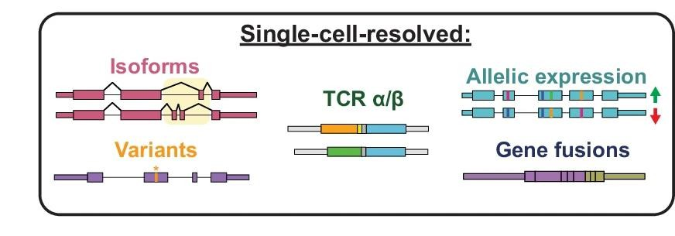
The promise of single cell long reads
Full Gene Body Coverage
Allele Specific Expression
A -> I RNA-Editing
And more – All at once* !
Individual A-to-I editing site editing ratio per region

Slide 17
Question Time
What does single cell offer over bulk transcriptomic approaches?
1
What are the challenges of long read single cell approaches?
2

Slide 18
Section 4
Tertiary Analysis

Slide 19
Library curation
Curate the cDNA library so long-read depth is spent on real, full-length, informative molecules.
Clean-up
Strip template-switch, primer-dimer and barcode-free reads that waste long-read throughput.
bead / size clean-up
Length selection
Remove truncated cDNA and short fragments; enrich longer, full-insert molecules.
SPRI · BluePippin
Full-length selection
5′ cap + poly-A capture so reads span true 5′-to-3′ transcript ends.
5’ vs 3’ kits, Existing full transcript selection protocols, various long read single cell protocols
Exon enrichment
Single-nucleus libraries are intron- and nascent-rich; enrich mature, exonic transcripts for cleaner isoform calls.
especially for snRNA-seq
Target enrichment
Hybridisation panel capture focuses depth on chosen genes for deep isoform coverage.
scTaILoR-seq
Throughput boost
Concatenate multiple cDNAs per read to multiply usable molecules per run.
MAS-seq · HIT-scISOseq

Slide 20
The single-cell isoform analysis workflow
Cell × isoform matrix
+
GTF annotation
Upstream (covered earlier):
demux · alignment · isoform ID & quantification
FLAMES · sicelore · IsoQuant – IsoSeq – wf-SingleCell
1 Build the single-cell atlas
QC
(empties, doublets,
ambient RNA)
Normalise
Feature
selection
(HV genes/isoforms)
Dimensionality
reduction +
clustering
Cell-type
annotation
2 Resolve isoform biology
Pseudobulk
aggregation
Differential isoform
usage (ΔPSI)
Sierra · satuRn · DTUrtle ·
IsoformSwitchAnalyzeR
Isoform switching
across trajectory
along pseudotime
Gene-level steps build the map; isoform-level steps are where long reads pay off.

Slide 21
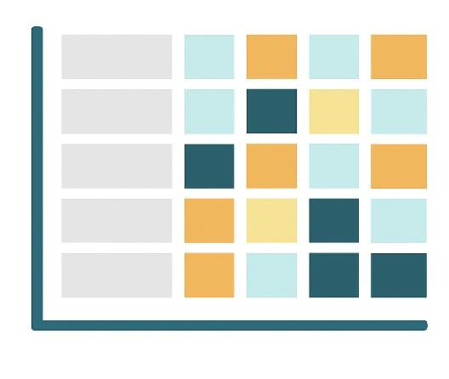


What do we need to begin tertiary analysis of Isoforms at Single Cell Resolution?
To start, we need two things: a cell-by-isoform count matrix (what was measured) and a transcriptome annotation (GTF/GFF) that defines which isoform each transcript is.
Cell X Isoform Matrix
Annotation

Slide 22
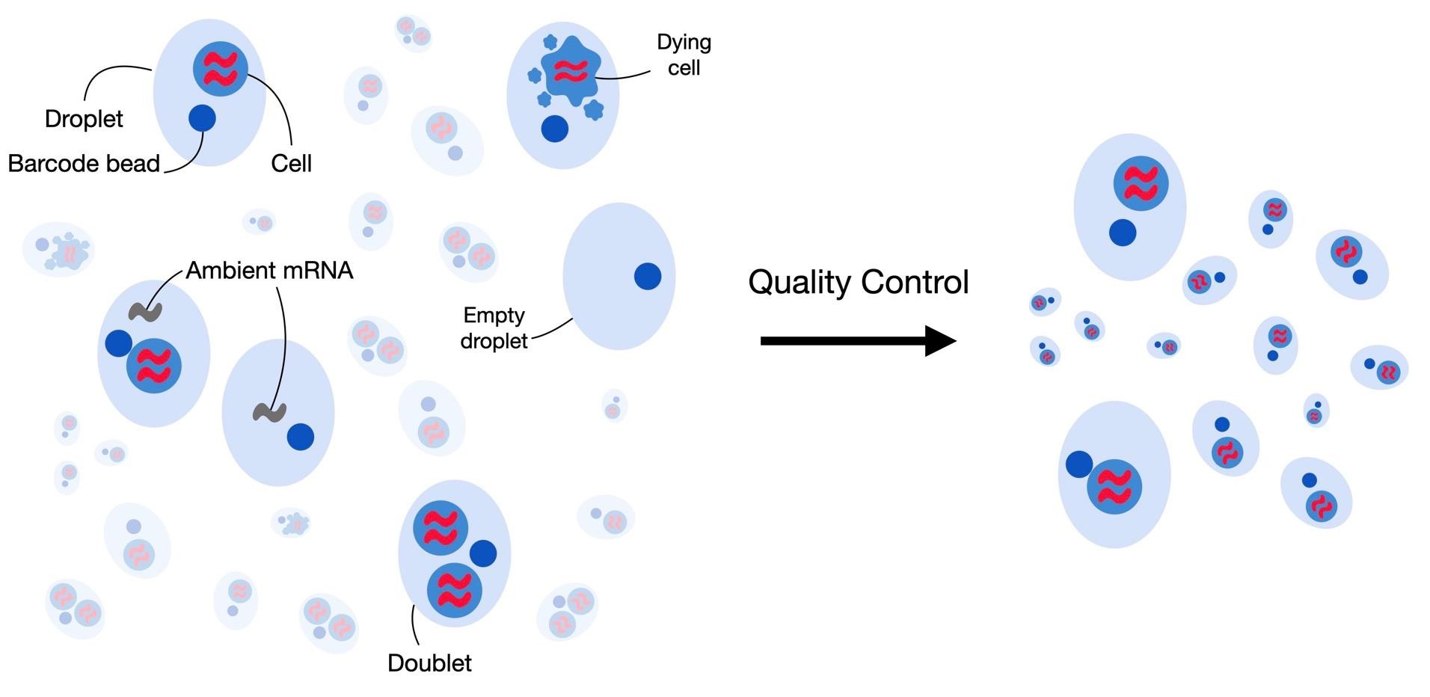
Removing Low Quality Cells If necessary
Before analysis, we filter out empty droplets, dying cells, doublets and ambient RNA so each barcode reflects one real, intact cell.

Slide 23
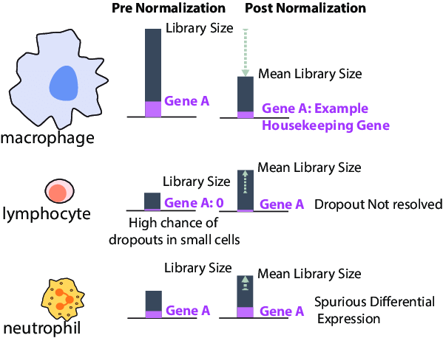
Normalization and why it matters
Why normalise? Cells differ in total counts purely for technical reasons. Scaling to a common library size stops these differences from masquerading as real biology, though dropouts in small cells remain.

Slide 24
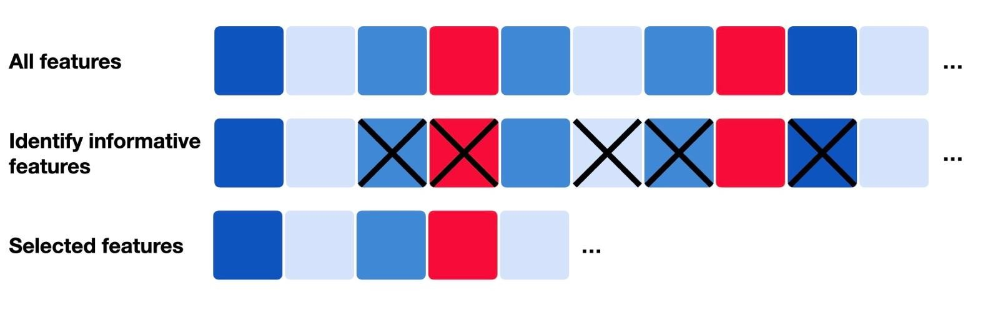
Selecting the most Informative Features
Feature selection: most genes/isoforms add noise, not signal. We keep the highly variable features that separate cell types and drop the rest, cutting dimensionality and computation.

Slide 25
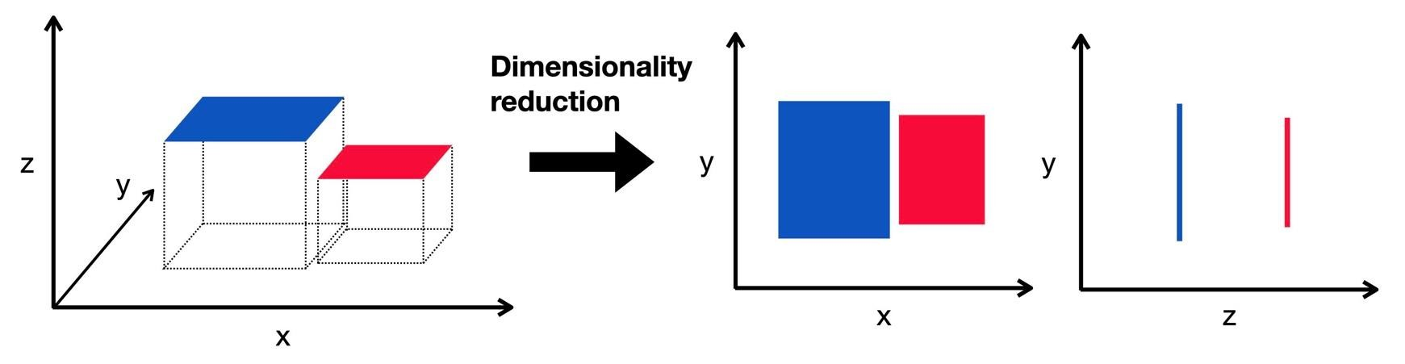
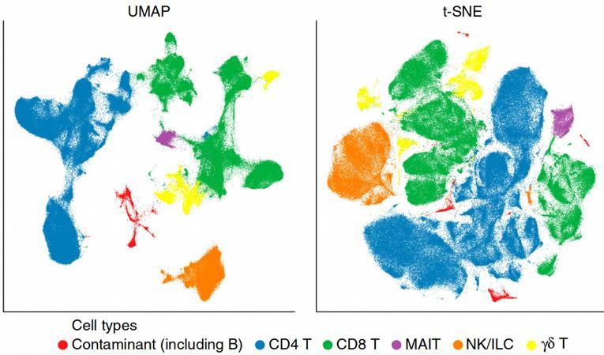
Reducing Dimensionality
Fewer axes, same structure. PCA then UMAP/t-SNE compress thousands of features into 2-3 dimensions so related cells cluster together and can be visualised.

Slide 26
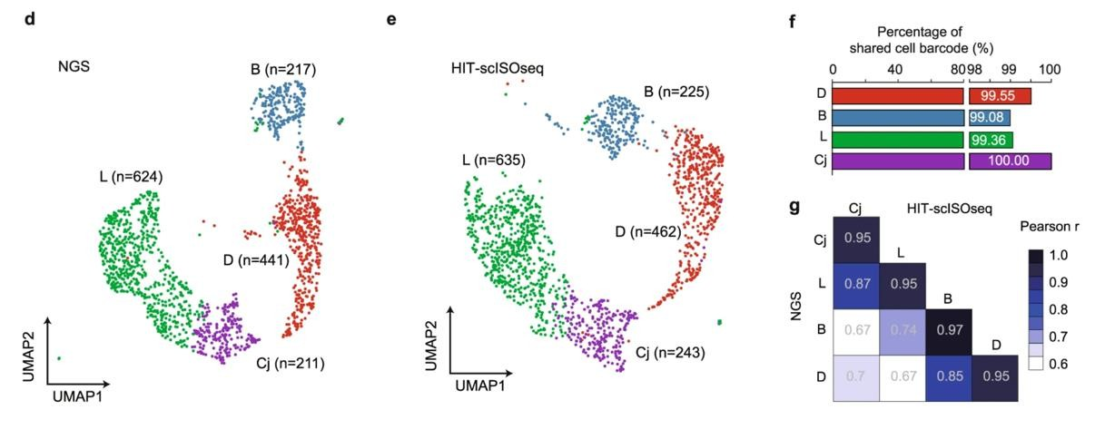
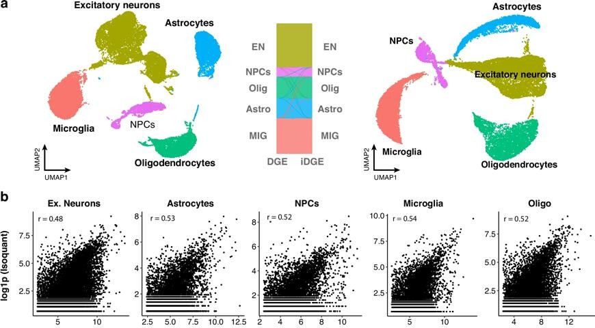
Do I define my clusters on Gene or Isoform Features?
Pacbio
Nanopore
Same cells – two related feature spaces
(Shi et al., 2023)

Slide 27
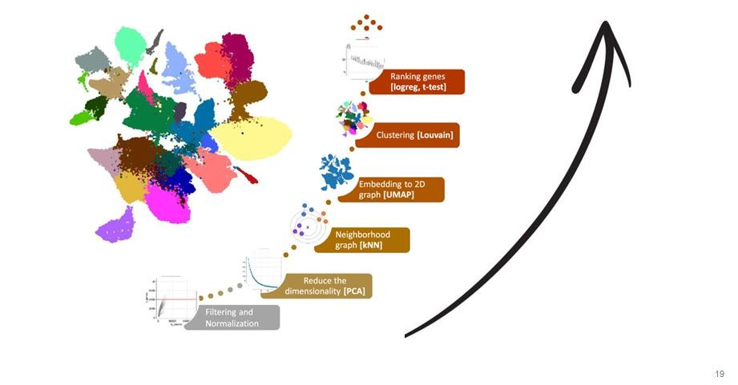
Putting it all together to Annotate Cell Types
The pipeline: QC and normalisation feed dimensionality reduction, clustering and marker ranking, which together let us label each cluster as a known cell type.

Slide 28
Pseudobulk
Pseudobulk: sum single-cell counts within each sample × cell-type group, then analyse like bulk RNA-seq.
Single cells
group by
sample × cell type
Σ counts
Pseudobulk matrix
Bulk DE frameworks
DESeq2 · edgeR
limma-voom · dreamlet
well-calibrated statistics
cells × isoforms
sparse, noisy
samples × isoforms
dense, robust counts
Proper replication
Cells are aggregated to biological replicates (e.g. donors), so cells are not mistaken for replicates. This controls the false positives of cell-level tests.
Squair et al. 2021
Plug-and-play
Reuse mature, well-calibrated bulk DE methods and their flexible designs, contrasts and random effects.
Trade-off
Needs enough cells per group, and collapses within-group heterogeneity (see the coverage / heterogeneity slide).

Slide 29
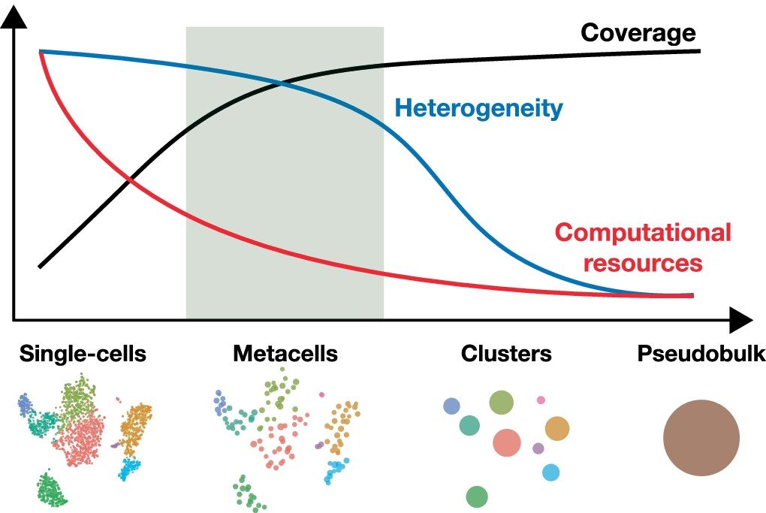
Coverage/Heterogeneity Trade-off

Slide 30
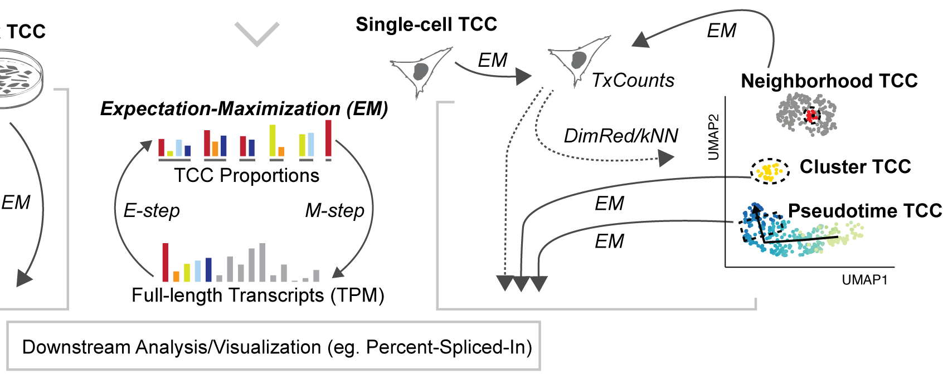
Finding the optimal Resolution

Slide 31
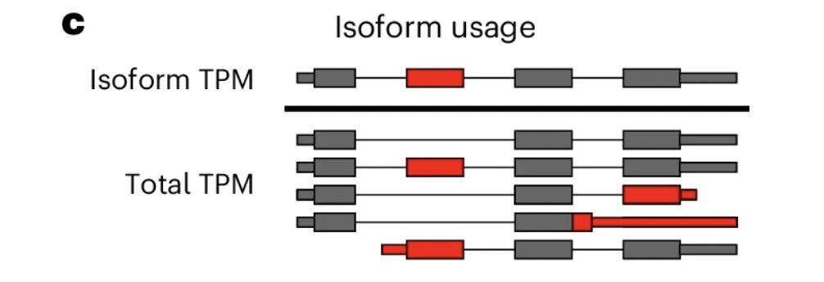
Percent spliced in as a metric for Isoform changes
𝐼𝑛𝑑𝑖𝑣𝑖𝑑𝑢𝑎𝑙 𝐶𝑜𝑢𝑛𝑡
𝑇𝑜𝑡𝑎𝑙 𝐺𝑒𝑛𝑒 𝐶𝑜𝑢𝑛𝑡
Isoform Usage/ Percent Spliced in =

Slide 32
DGE, DTE and DTU: three questions
One gene, two isoforms, two conditions — three different questions:
isoform A
isoform B
DGE
DTE
DTU
Does the gene's TOTAL output change?
Does an individual transcript's level change?
Do the relative PROPORTIONS shift?
total unchanged
A down, B up
proportions flip
Cond 1 Cond 2
Cond 1 Cond 2
Cond 1 Cond 2
DESeq2 · edgeR · dreamlet
transcript-level DE · swish
Sierra · satuRn · DTUrtle · scisorseqr
A gene can show no change in total expression yet a clear isoform switch — e.g. RTN4 switches dominant isoform between fetal and adult human cortex.

Slide 33
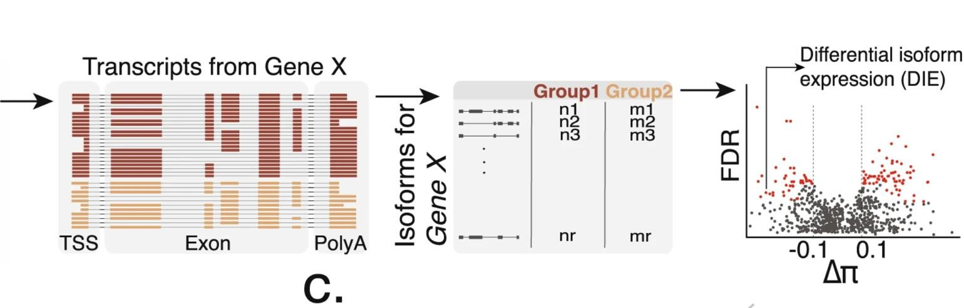
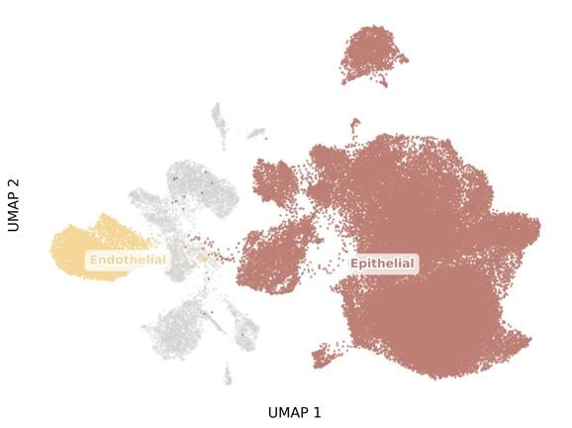
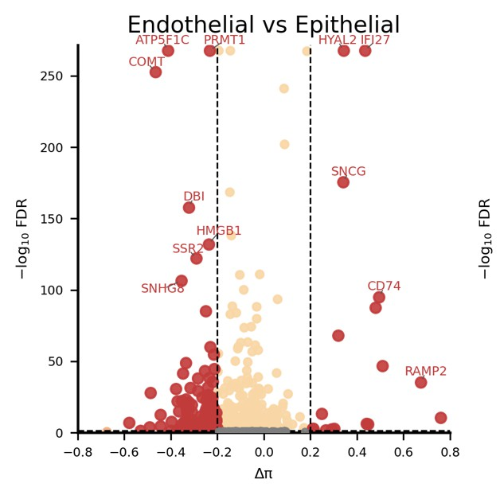
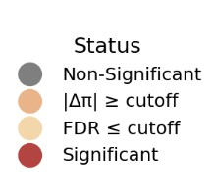
Detecting Differential Isoform Usage across Cell Types

Slide 34
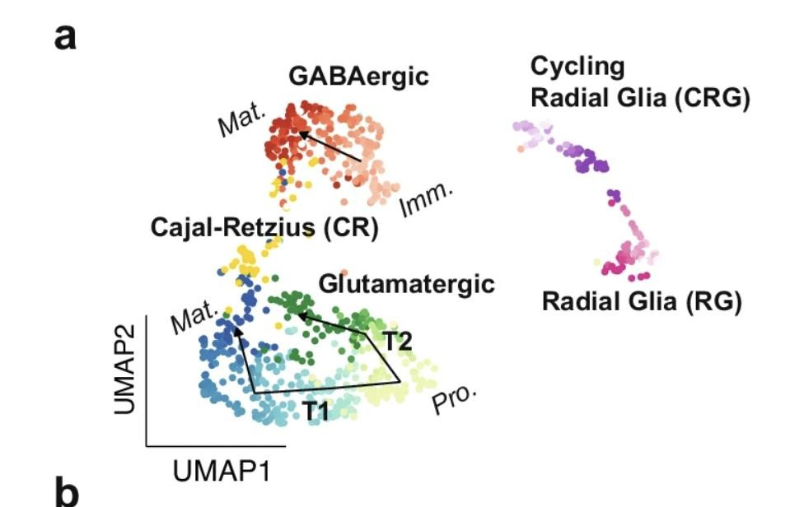
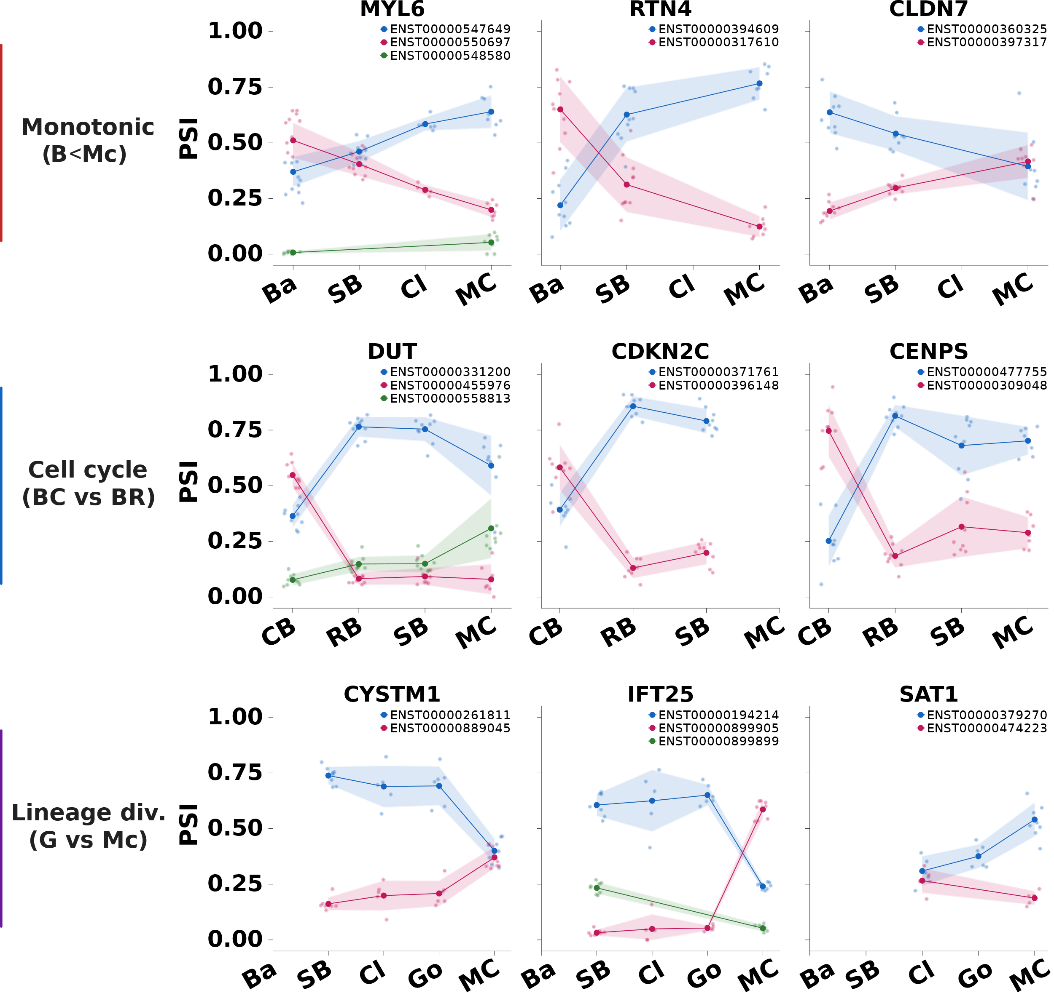
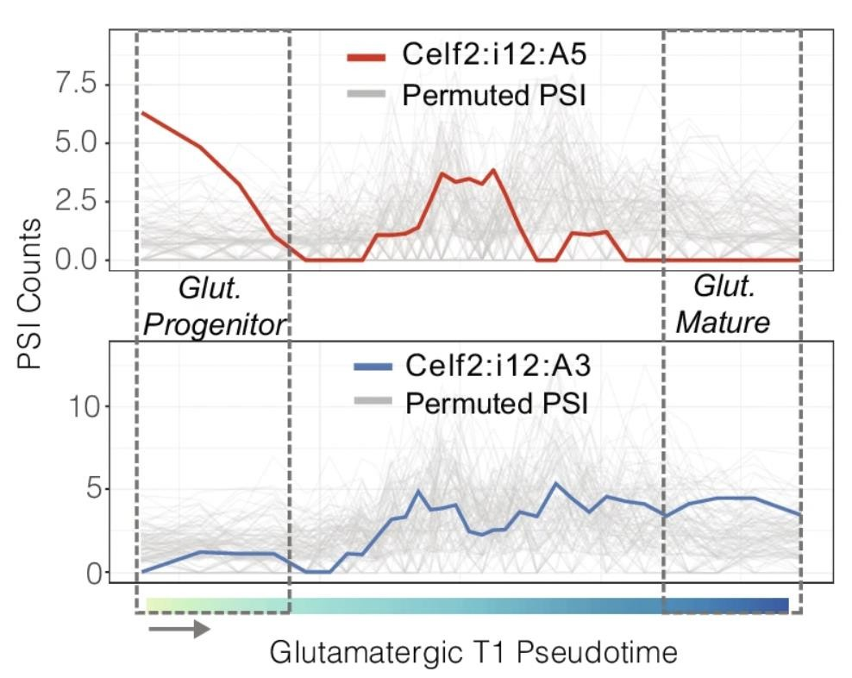
Isoform switching Across a differentiation trajectory

Slide 35
Where does the isoform diversity live?
Bulk and pseudobulk give one number per group. A gene at PSI = 0.50 can hide two very different cell populations:
Intra-cellular diversity
every cell co-expresses both isoforms
Inter-cellular diversity
each cell is committed to one isoform
vs
average PSI = 0.50
average PSI = 0.50
Bulk / pseudobulk sees PSI = 0.50 in BOTH — they look identical.
Only single-cell isoforms separate three levels: within a cell · between cells of one type · between cell types.

Slide 36
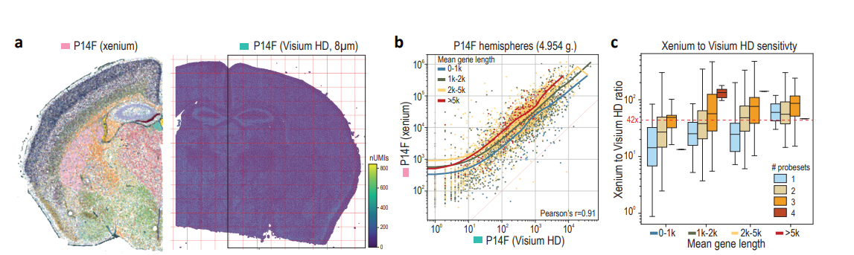
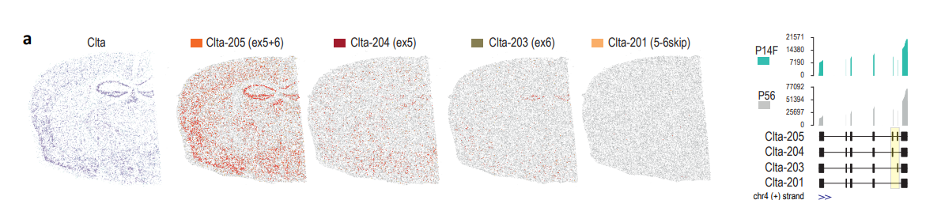
The limitations of length

Slide 37
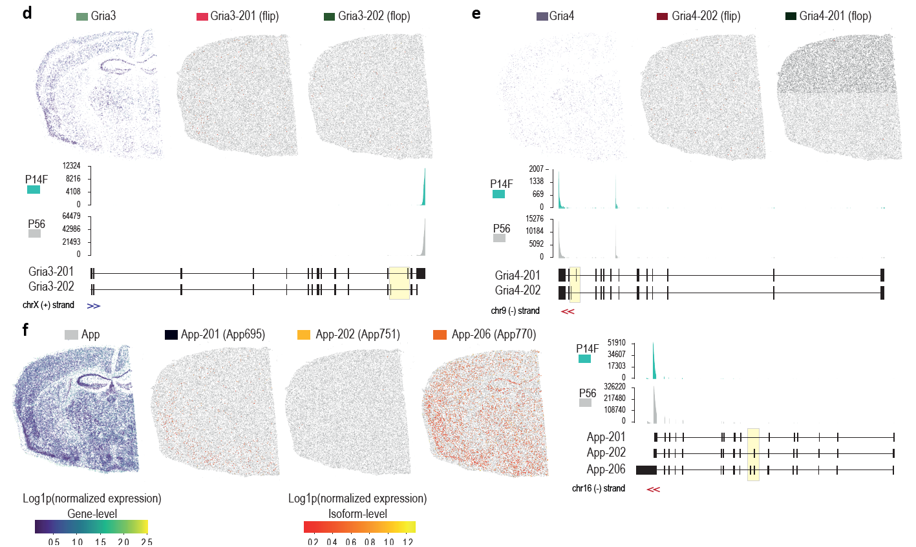
The limitations of length

Slide 38
Question Time
Why is normalisation a crucial step of single cell analysis?
1
Should I do dimensionality reduction and clustering on gene or isoform features?
2
When aggregating cells (pseudobulk, metacells, etc.), what do we trade off as we increase the number of cells aggregated into a single unit?
3

Slide 39
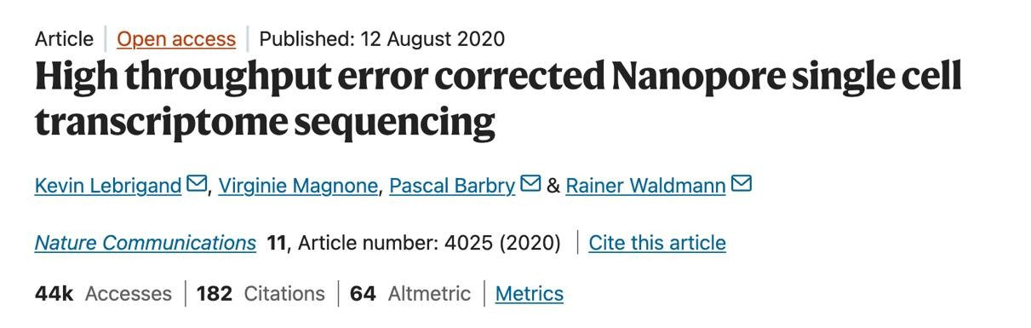
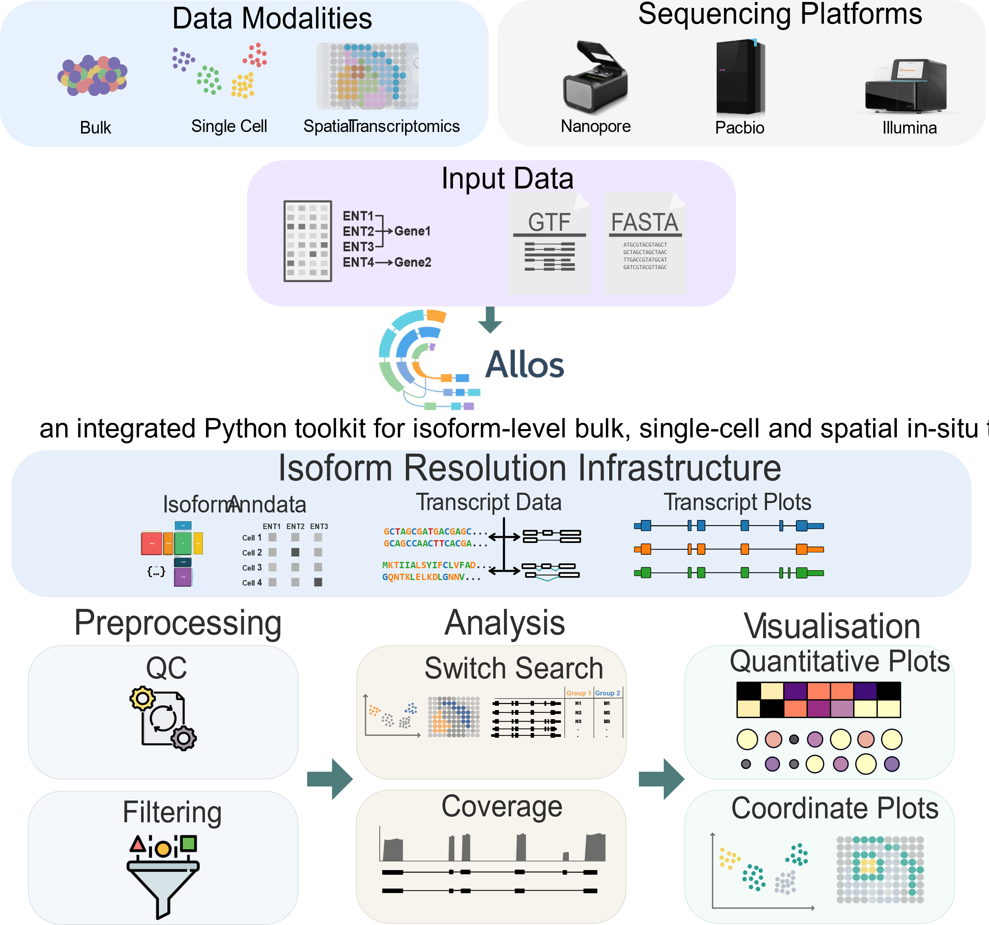

Practical session : Exploring Differential Isoform Usage in the Mouse Brain

Slide 40

Thank You!
For more information about the LongTREC Summer School:
https://longtrec.eu

