Slide 1


Bioinformatics Summer School
Structural Genome Annotation
Pablo Atienza López
Genomics of Gene Expression Lab

Slide 2
Section 1
Introduction & Basics

Slide 3
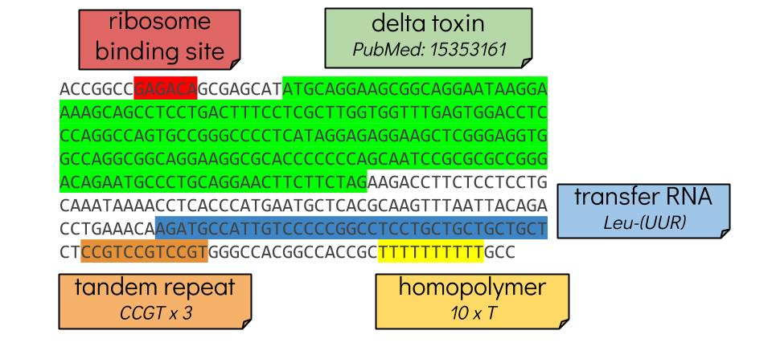
What is an annotation?
The process of annotating a genome is to find the structures that the genome encodes
Genes
Regulatory elements
Transposons
Binding sites
Functional domains
For now, we will focus on gene finding

Slide 4
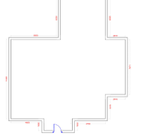
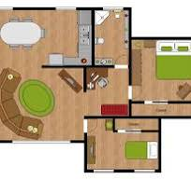
Structural vs Functional
There are two ways to annotate a genome:
Structural → What are the physical elements of the genome?
Funcional → What is the biological meaning of them?
Kitchen
Bathroom
Bedroom
Living room
Kids Bedroom
Notes:
Here, the house metaphor works great. One thing is to identigy the parts of a house: the walls, the ceiling, the light cables, the plumbing, but a different thing is to look at the whole picture and trying to find which are the main walls and which are not, what is the living room and what is the bedroom, etc. Thisshould be fused with the preivous slide

Slide 5

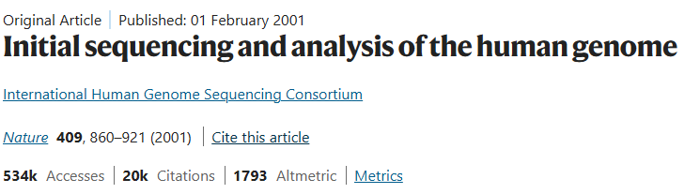
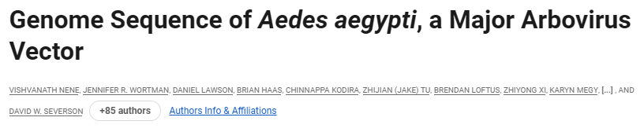
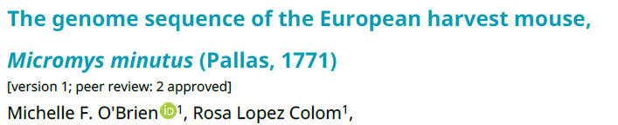
A bit of history
The first way to find genes on organisms was through evidence alone
Align expressed sequence tags (ESTs) directly to genome assemblies
Large team of experts to annotate a single genome:
248 authors
95 authors
Notes:
Used to be very resuource and time expensive. Nowadays, just two people can assemble and annotate and do it. YOU can do it

Slide 6
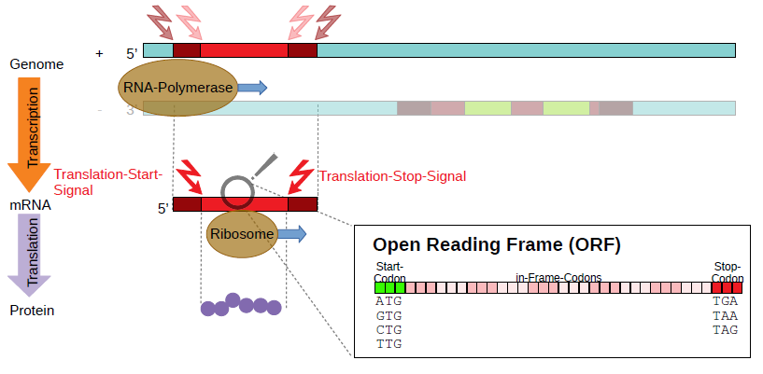
Remembering the biology
Prokaryotes are amazing
Adapted from Katerina Hoff

Slide 7
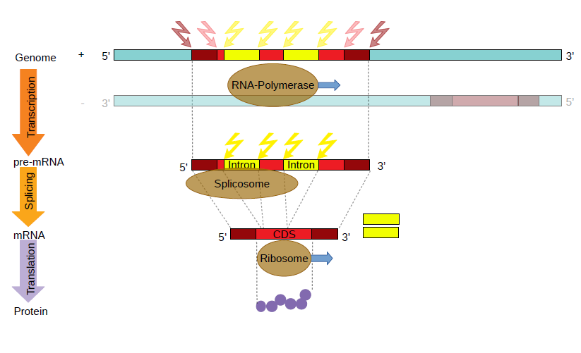
Remembering the biology
Eukayrotes… not so much
Adapted from Katerina Hoff

Slide 8
How to annotate a genome?
As of today, three main approaches:
Evidence-based
Evidence-driven
Ab initio
Notes:
Add images on the squares with the things. Just say what they represent

Slide 9
Section 2
Main annotation approaches

Slide 10

Ab initio
Rely exlusively on the raw genomic DNA sequence and matematical models
The models need to be pretrained
Highly accurate on simple genomes (Prokaryotes…)
Most common → Hidden Markov Models (HMMs)
Rely on two sets of probabilities to work
Transition probability → How the hidden reality changes
Emission probability → How the hidden reality gives clues
Notes:
Revise the roomate example. The dirty or clean kitchen is the visible state and your roomate being home that day or not, is the hidden

Slide 11
Ab initio – Hidden Marov Models
Start (S)
Intergenic region (I)
Coding region (C)

Slide 12
Ab initio – Hidden Marov Models
Start (S)
Intergenic region (I)
Coding region (C)
Hidden states

Slide 13
Ab initio – Hidden Marov Models
Start (S)
Intergenic region (I)
Coding region (C)
Hidden states
A possible path for the genome sequence:
AABBBAA

Slide 14
Ab initio – Hidden Marov Models
Start (S)
Intergenic region (I)
Coding region (C)
Hidden states
A possible path for the genome sequence:
AABBBAA I

Slide 15
Ab initio – Hidden Marov Models
Start (S)
Intergenic region (I)
Coding region (C)
Hidden states
A possible path for the genome sequence:
AABBBAA II

Slide 16
Ab initio – Hidden Marov Models
Start (S)
Intergenic region (I)
Coding region (C)
Hidden states
A possible path for the genome sequence:
AABBBAA IIC

Slide 17
Ab initio – Hidden Marov Models
Start (S)
Intergenic region (I)
Coding region (C)
Hidden states
A possible path for the genome sequence:
AABBBAA IICC…

Slide 18
Ab initio – Hidden Marov Models
Start (S)
Intergenic region (I)
Coding region (C)
Hidden states
A
B
A possible path for the genome sequence:
AABBBAA IICC…
Notes:
Now the things get a bit more complicated, because in reality, we do not now the hidden states, we only know the visible observation, and the chance of a hidden state producing a visible observation is called the emission probability

Slide 19
Ab initio – Hidden Marov Models
Start (S)
P(I|S)
P(C|S)
P(I|I)
P(C|I)
P(C|I)
Intergenic region (I)
Coding region (C)
Hidden states
P(I|C)
With a lot of data!
A
B
How do we find out the probabilities?

Slide 20
Ab initio – Hidden Marov Models
Start (S)
P(I|S)
P(C|S)
P(I|I)
P(C|I)
P(C|I)
Intergenic region (I)
Coding region (C)
Hidden states
P(I|C)
Training data: AABABA
ICCIII
A
B
Start probability
P(I|S) = ?

Slide 21
Ab initio – Hidden Marov Models
Start (S)
P(I|S)=1
P(C|S)=1
P(I|I)
P(C|I)
P(C|I)
Intergenic region (I)
Coding region (C)
Hidden states
P(I|C)
Training data: AABABA
ICCIII
A
B
Start probability
P(I|S) = 1

Slide 22
Ab initio – Hidden Marov Models
Start (S)
P(I|S)=1
P(C|S)=1
P(I|I)=2/3
P(C|I)
P(C|I)
Intergenic region (I)
Coding region (C)
Hidden states
P(I|C)=1/3
Training data: AABABA
ICCIII -++
A
B
Intergenic probability
P(I|I) = 2/3 P(I|C) = 1-P(I|I) = 1/3

Slide 23
Ab initio – Hidden Marov Models
Start (S)
P(I|S)=1
P(C|S)=1
P(I|I)=2/3
P(C|I)=1/2
P(C|I)=1/2
Intergenic region (I)
Coding region (C)
Hidden states
P(I|C)=1/3
P(A|I)
P(B|C)
Training data: AABABA
ICCIII
A
P(A|C)
P(B|I)
B
Intergenic emission probabilities
P(A|I) = ? P(B|I) = ?

Slide 24
Ab initio – Hidden Marov Models
Start (S)
P(I|S)=1
P(C|S)=1
P(I|I)=2/3
P(C|I)=1/2
P(C|I)=1/2
Intergenic region (I)
Coding region (C)
Hidden states
P(I|C)=1/3
P(A|I)=3/4
P(B|C)
Training data: AABABA
ICCIII + +-+
A
P(A|C)
P(B|I)=1/4
B
Intergenic emission probabilities
P(A|I) = 3/4 P(B|I) = 1/4

Slide 25
Ab initio – Hidden Marov Models
Start (S)
P(I|S)=1
P(C|S)=1
P(I|I)=2/3
P(C|I)=1/2
P(C|I)=1/2
Intergenic region (I)
Coding region (C)
Hidden states
P(I|C)=1/3
P(A|I)=3/4
P(B|C)=1/2
Training data: AABABA
ICCIII
A
P(A|C)=1/2
P(B|I)=1/4
B

Slide 26
Ab initio – Hidden Marov Models
Start (S)
P(I|S)=1
P(C|S)=1
P(I|I)=2/3
P(C|I)=1/2
P(C|I)=1/2
Intergenic region (I)
Coding region (C)
Hidden states
P(I|C)=1/3
P(A|I)=3/4
P(B|C)=1/2
Training data: AABABA
ICCIII
A
P(A|C)=1/2
P(B|I)=1/4
B

Slide 27
Ab initio – Hidden Marov Models
Start (S)
P(I|S)=1
P(C|S)=1
P(I|I)=2/3
P(C|I)=1/2
P(C|I)=1/2
Intergenic region (I)
Coding region (C)
Hidden states
P(I|C)=1/3
P(A|I)=3/4
P(B|C)=1/2
Actual data: BBA
ICC
A
P(A|C)=1/2
P(B|I)=1/4
B
P(Path)=?

Slide 28
Ab initio – Hidden Marov Models
Start (S)
P(I|S)=1
P(C|S)=1
P(I|I)=2/3
P(C|I)=1/2
P(C|I)=1/2
Intergenic region (I)
Coding region (C)
Hidden states
P(I|C)=1/3
P(A|I)=3/4
P(B|C)=1/2
Actual data: BBA
ICC
A
P(A|C)=1/2
P(B|I)=1/4
B
P(Path)=P(I|S)

Slide 29
Ab initio – Hidden Marov Models
Start (S)
P(I|S)=1
P(C|S)=1
P(I|I)=2/3
P(C|I)=1/2
P(C|I)=1/2
Intergenic region (I)
Coding region (C)
Hidden states
P(I|C)=1/3
P(A|I)=3/4
P(B|C)=1/2
Actual data: BBA
ICC
A
P(A|C)=1/2
P(B|I)=1/4
B
P(Path)=P(I|S)*P(B|I)

Slide 30
Ab initio – Hidden Marov Models
Start (S)
P(I|S)=1
P(C|S)=1
P(I|I)=2/3
P(C|I)=1/2
P(C|I)=1/2
Intergenic region (I)
Coding region (C)
Hidden states
P(I|C)=1/3
P(A|I)=3/4
P(B|C)=1/2
Actual data: BBA
ICC
A
P(A|C)=1/2
P(B|I)=1/4
B
P(Path)=P(I|S)*P(B|I)*P(C|I)

Slide 31
Ab initio – Hidden Marov Models
Start (S)
P(I|S)=1
P(C|S)=1
P(I|I)=2/3
P(C|I)=1/2
P(C|I)=1/2
Intergenic region (I)
Coding region (C)
Hidden states
P(I|C)=1/3
P(A|I)=3/4
P(B|C)=1/2
Actual data: BBA
ICC
A
P(A|C)=1/2
P(B|I)=1/4
B
P(Path)=P(I|S)*P(B|I)*P(C|I)*P(B|C)

Slide 32
Ab initio – Hidden Marov Models
Start (S)
P(I|S)=1
P(C|S)=1
P(I|I)=2/3
P(C|I)=1/2
P(C|I)=1/2
Intergenic region (I)
Coding region (C)
Hidden states
P(I|C)=1/3
P(A|I)=3/4
P(B|C)=1/2
Actual data: BBA
ICC
A
P(A|C)=1/2
P(B|I)=1/4
B
P(Path)=P(I|S)*P(B|I)*P(C|I)*P(B|C)*P(C|C)

Slide 33
Ab initio – Hidden Marov Models
Start (S)
P(I|S)=1
P(C|S)=1
P(I|I)=2/3
P(C|I)=1/2
P(C|I)=1/2
Intergenic region (I)
Coding region (C)
Hidden states
P(I|C)=1/3
P(A|I)=3/4
P(B|C)=1/2
Actual data: BBA
ICC
A
P(A|C)=1/2
P(B|I)=1/4
B
P(Path)=P(I|S)*P(B|I)*P(C|I)*P(B|C)*P(C|C)*P(A|C)

Slide 34
Ab initio – Hidden Marov Models
Start (S)
P(I|S)=1
P(C|S)=1
P(I|I)=2/3
P(C|I)=1/2
P(C|I)=1/2
Intergenic region (I)
Coding region (C)
Hidden states
P(I|C)=1/3
P(A|I)=3/4
P(B|C)=1/2
Actual data: BBA
ICC
A
P(A|C)=1/2
P(B|I)=1/4
B
P(Path)=1*1/4*1/2*1/2*1/2*1/2=1/64

Slide 35
Ab initio – Hidden Markov Model
Then, the idea is simple:
Train the model to learn each probability
Generatew as many states as possible
Select the one with the highest probability
However…
It is highly expensive computationally
20 nucleotides, with 2 possible states = 1 Million possibilities
In Augustus there are 46 possible states, and a human genome has 3.2 billion nucleotides
There are strategies to speed this up

Slide 36

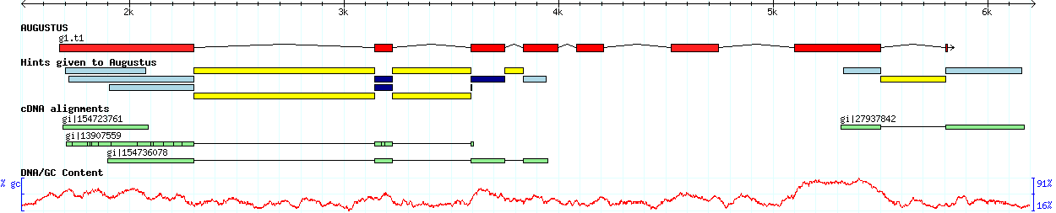
Ab initio - AUGUSTUS
One of the most used tools for gene prediction
Highly flexible and customizable!
Uses a Generalized Hidden Markov Model
47 possible states
Looks at chunks of the genome at once
It can incorporate extrinsic information → Evidence-driven approach
https://github.com/gaius-augustus/augustus

Slide 37
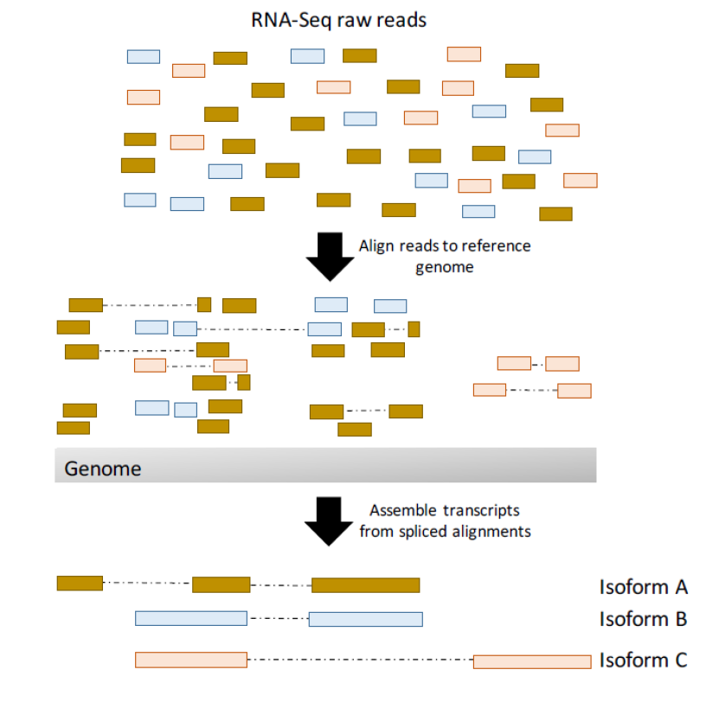
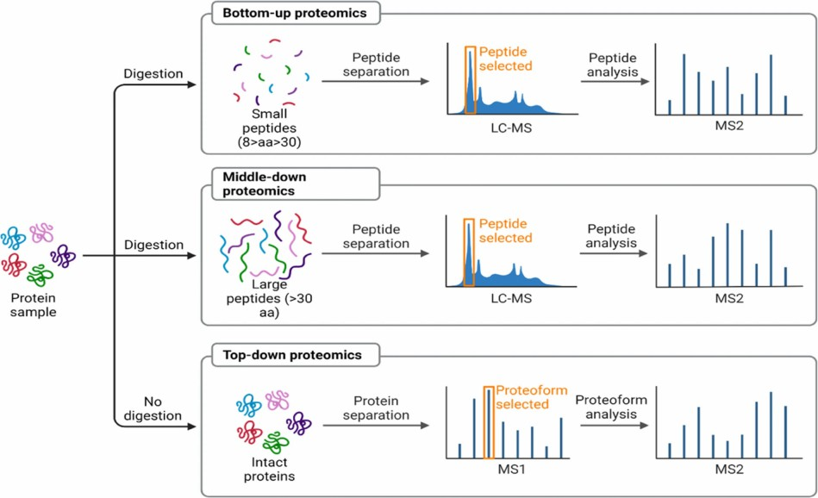
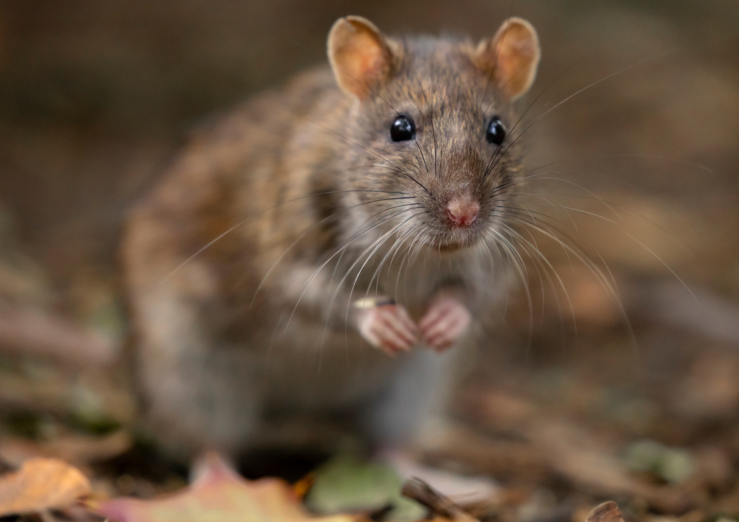
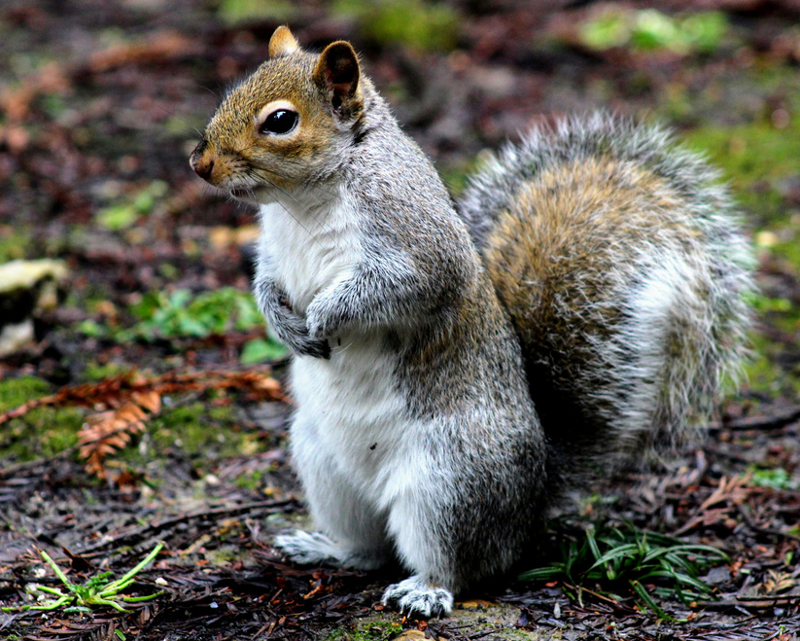
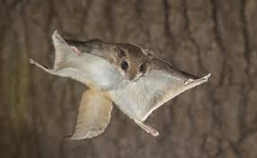
Evidence-based
Generating gene models directly from the empirical evidence
RNA-seq
Proteins
Notes:
Aquí meter un grafico que sea la combinacion de RNA y el genoma, mapeandolo y luego de ahí se saca la evidencia. A lo mejor un gráfico similar al de Katerina, que se vaya viendo la integración!

Slide 38
Evidence-based - Sources
Transcriptome data
Source
Expressed Sequence Tags
cDNA
Direct RNA req
Provides
Exon-intron structure
UTRs
Alternative splicing
Limitations
No info on reading frame (only through predictions)
Incomplete data
Proteome data
Source
MS/MS peptides
Proteins of related species
Core proteins
Provides
CDS-intron structure
Alternative splicing
Conservation information
Limitations
Difficult alignment and correlation
Incomplete data

Slide 39
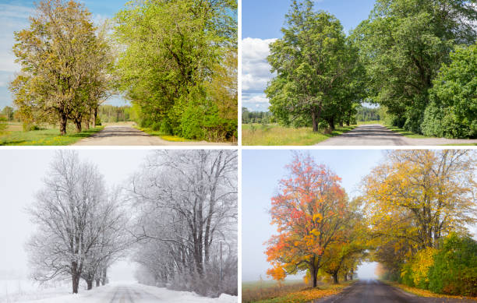
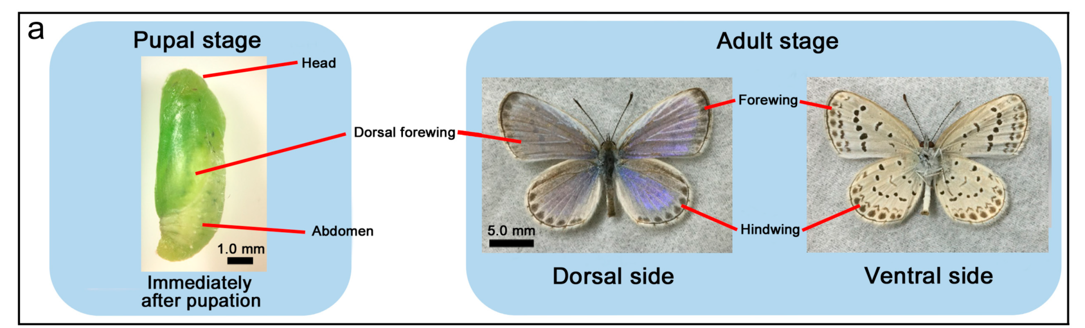
Evidence based – Transcriptome curation
Any time you are using a long-reads defined transcriptome (or a transcriptome) is fundamental to curate it
Even though we already know, here the curation takes a new perspective
You do not have a reference annotation → Filtering via TTS/Structural categories not feasible
Many times, there are no short reads available
Variety is key!
Notes:
Hacer un cuestario en el que digan que columnas de SQANTI-classification nos sirven si no nos podemos fiar de la referencia.
Aquí meter las imágenes que representan que para completar una imagen panorama hay que tener snapshots de sus diferentes partes. Completar el skyline de madrid

Slide 40
Evidence driven
Offers the combination of empirical data and genome prediction
It is a synergistic approach towards annotation
The ab initio model still predicts the different structures
If it matches the empirical evidence = bonus
If it does not match the empirical evidence = penalization

Slide 41
Evidence driven - Augustus
Augustus can be given hints
Gff file with different types of evidence
Weights of the different hints
HS04636 mario exonpart 500 506 . - . source=M
HS04636 mario exon 966 1017 . + 0 source=P
HS04636 AGRIPPA start 966 968 6.3e-239 + 0 group=gb|AAA35803.1;source=P
HS04636 AGRIPPA dss 2199 2199 1.3e-216 + . group=gb|AAA35803.1;source=P
HS04636 mario stop 7631 7633 . + 0 source=M
HS08198 AGRIPPA intron 2000 2000 0 + . group=ref|NP_000597.1;source=E
HS08198 AGRIPPA ass 757 757 1.4e-52 + . group=ref|NP_000597.1;source=E
[GENERAL]
start 1 1 M 1 1e+100 RM 1 1 lrRNA 1 1e3
stop 1 1 M 1 1e+100 RM 1 1 lrRNA 1 1e3
tss 1 1 M 1 1e+100 RM 1 1 lrRNA 1 1
tts 1 1 M 1 1e+100 RM 1 1 lrRNA 1 1
ass 1 1 M 1 1e+100 RM 1 1 lrRNA 1 1
exonpart 1 0.85 M 1 1e+100 RM 1 1 lrRNA 1 1e2
exon 1 1 M 1 1e+100 RM 1 1 lrRNA 1 1e3
intronpart 1 1 M 1 1e+100 RM 1 1 lrRNA 1 1
intron 1 .1 M 1 1e+100 RM 1 1 lrRNA 1 1e3
UTR 1 1 M 1 1e+100 RM 1 1 lrRNA 1 1e3

Slide 42

SQANTI-evidence
Reference genome
BUSCO
Core genes
Augustus
Snakemake based tool
Can be run using one command only
Beta-version available
Augustus
Annotation model
Repeat masker
Ab initio annotation
Augustus
Evidence-driven annotation
User-defined annotation
lr-RNA data
IsoSeq3
Raw transcriptome
Quality Control Report
Ortogonal data
Sqanti3 QC
Curated transcriptome
Notes:
Una explicacion sobre el pipeline, contando como funciona la prediccion incial de genes.

Slide 43
SQANTI-evidence (preliminary benchmark)

Slide 44
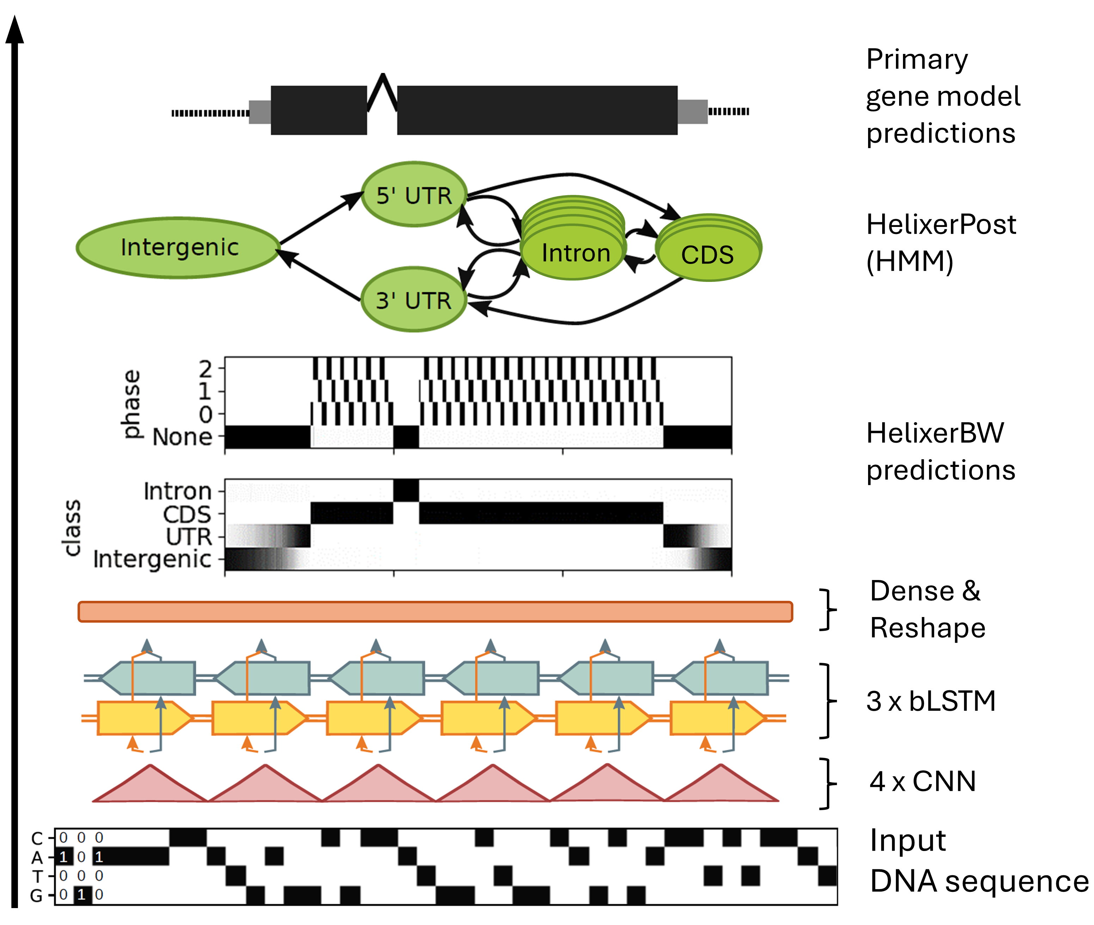
Deep learning genome annotation methods
Helixer is the best option as of today
Pre-trained models
Fungi
Land plant
Vertebrate
Invertebrate
Has a web service as well

Slide 45
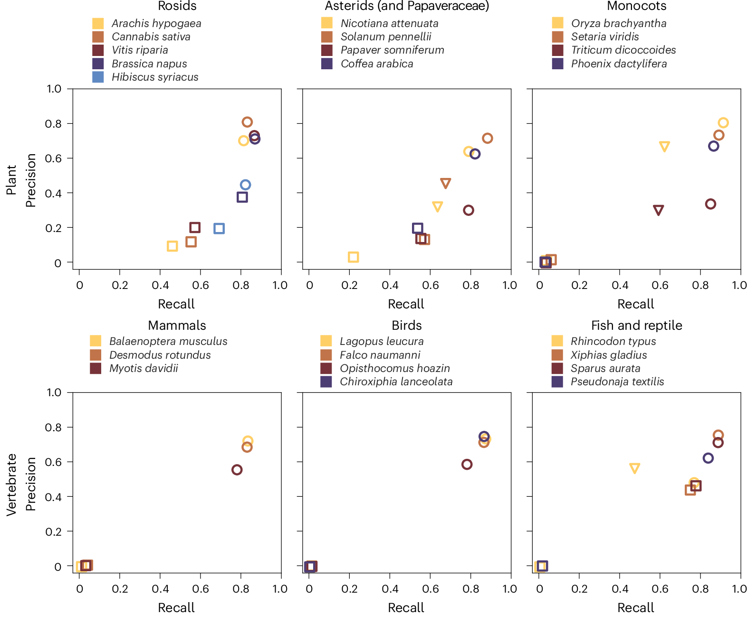
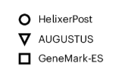
Deep learning based
Not everything is so perfect:
no evidence integration
no alternative splicing isoform prediction
require expensive GPUs for a feasible runtime
limited to specific clades

Slide 46
Section 3
How good (or bad) is my annotation?

Slide 47
Quality Control
It is important to understand how well your annotation is done
Different ways to do the assessment
Via comparison with a “gold standard” → Gffcompare
Metrics
AGAT
BUSCO
OMARK

Slide 48
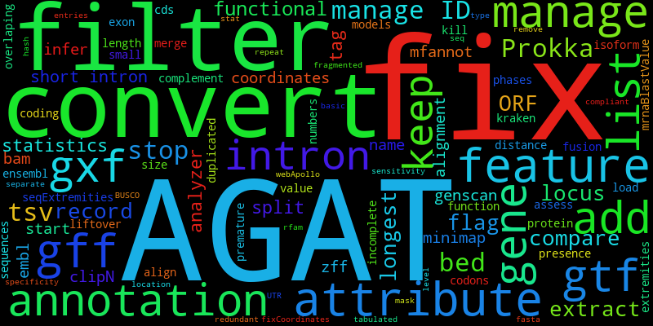
Quality Control - AGAT
The annotation field can get messy
Each tool used to generate its own kind of report for genomics
No standarization whatsoever
AGAT fixed this (Another GTF/GFF Analysis Toolkit)
Standarizes and completes (almost) any kind of GFF file
Produces different metrics
https://github.com/NBISweden/AGAT

Slide 49

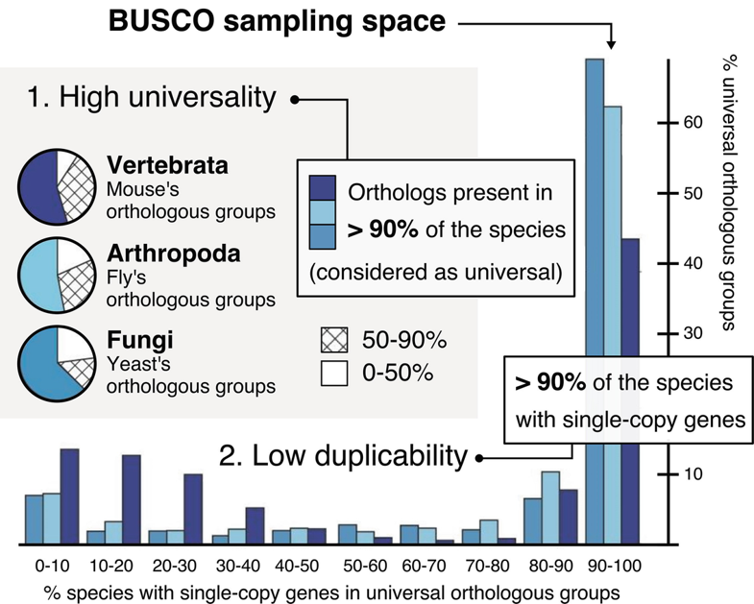
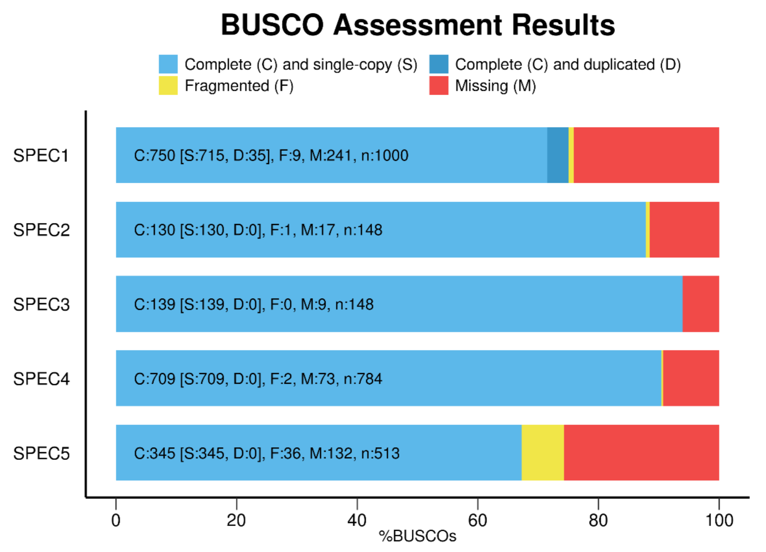
Quality Control - BUSCO
Gold standard to estimate the completeness and redundancy of your genomic data
Based on conserved set of genes
Measure of the CONSERVED GENE SPACE

Slide 50

Quality Control - BUSCO
Website
Single : Found in one copy
(expected)
Duplicated : Found in multiple copies
Fragmented: Length deviates >2 std from the mean
Missing : Not found

Slide 51

Quality Control - BUSCO

Slide 52
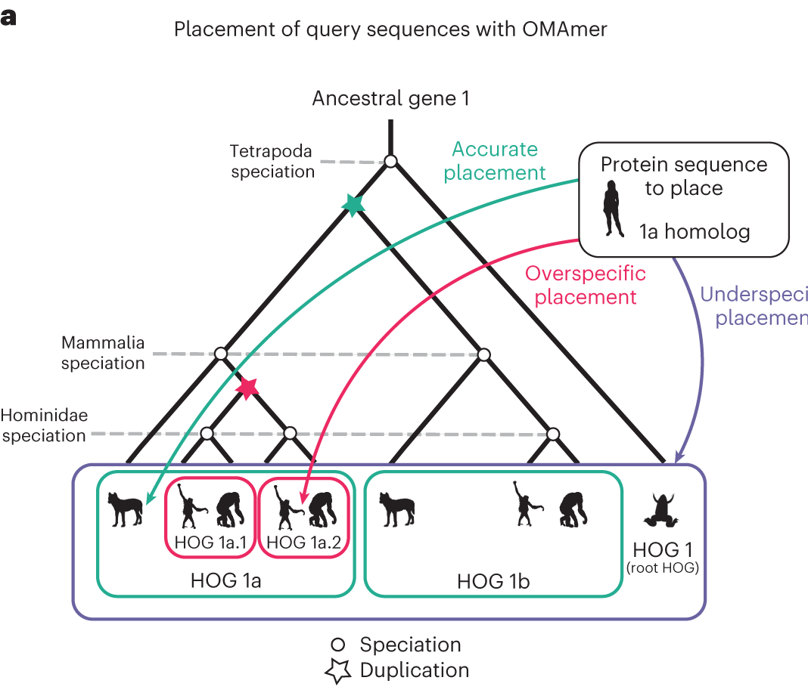

Quality Control - OMARK
Similar phylosophy as BUSCO, but a level higher
Completeness and Consistency
Not only of proteins in the set, but also from similar species
Precomputed gene families → Hierarchical Orthologous Groups
Contamination
Identifies likely cross-species contamination even
Possible over-prediction
https://github.com/DessimozLab/OMArk

Slide 53
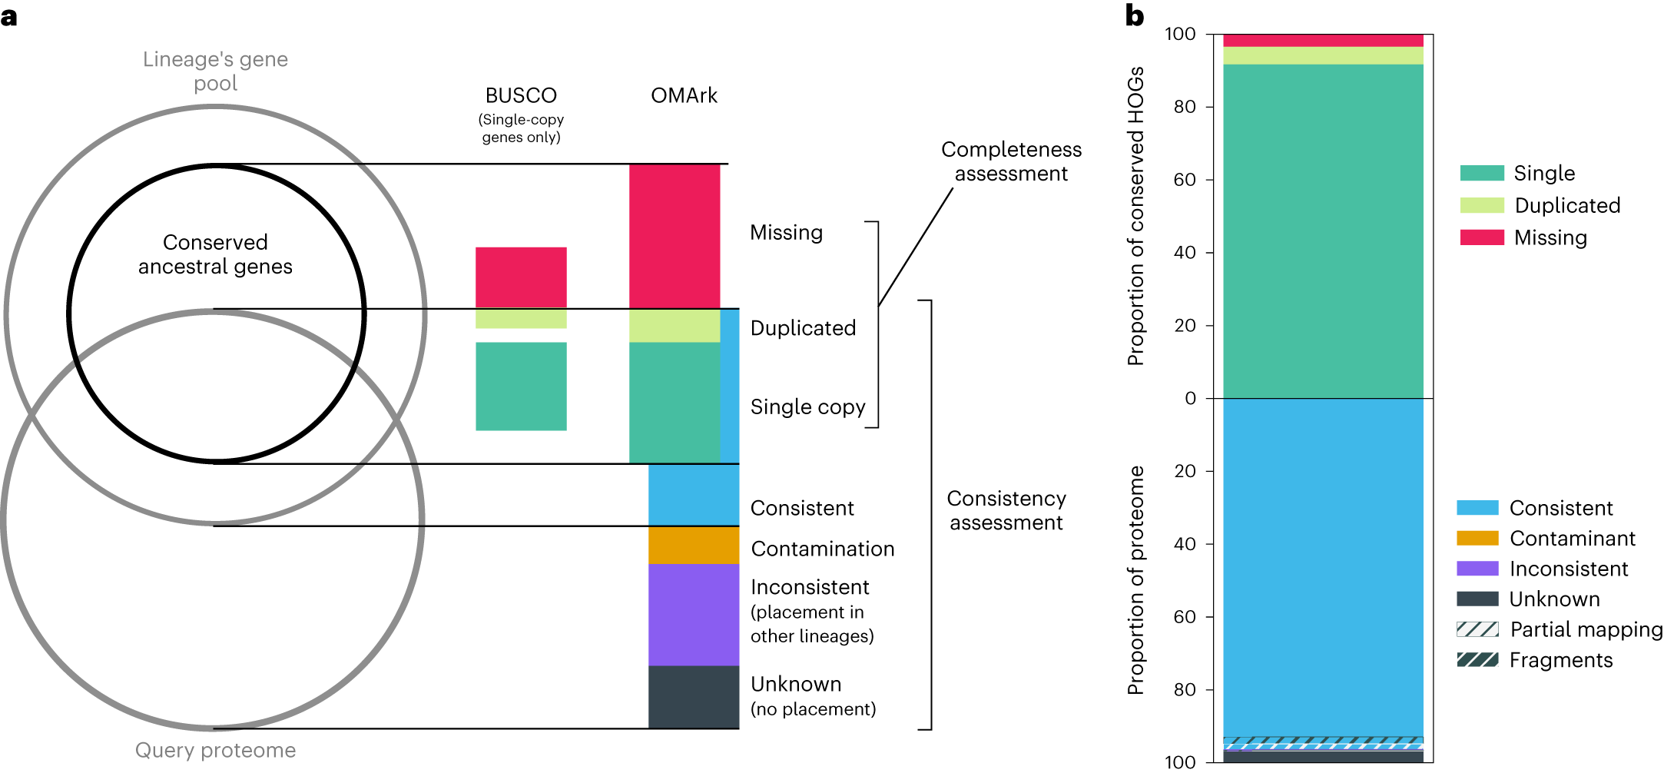
Quality Control - OMARK

Slide 54
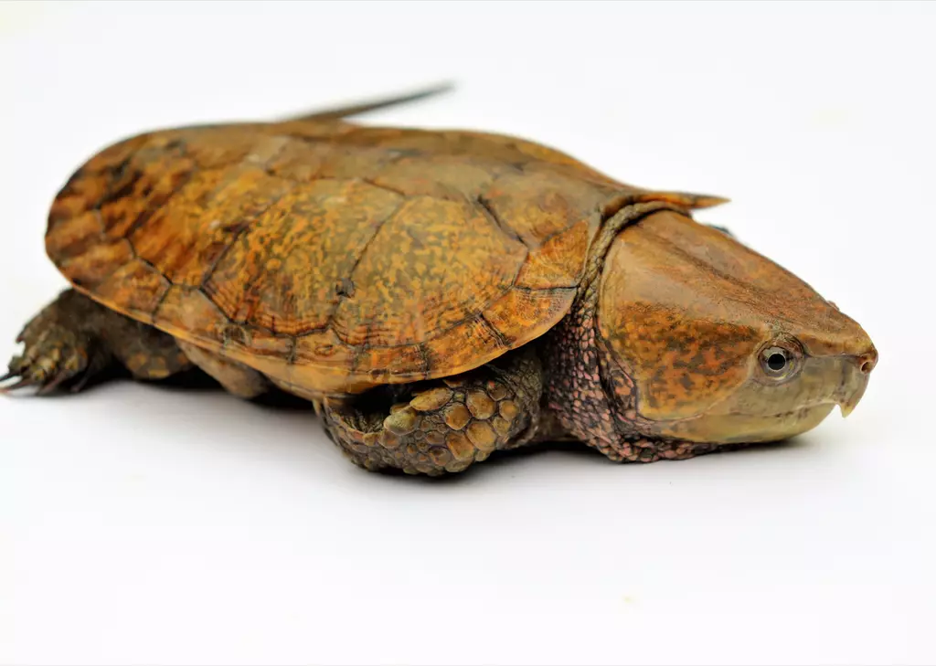
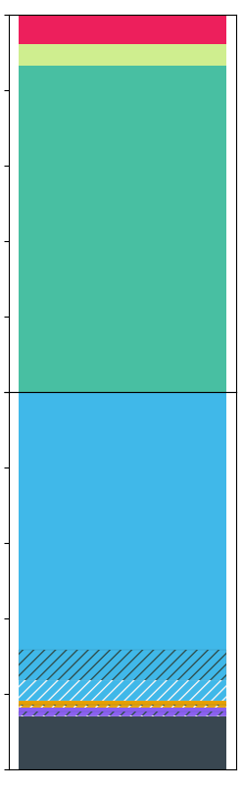


Quality Control - OMARK
Source: London zoo
100
Missing - 8%
80
Duplicated - 6%
60
Platysternon megacephalum
Single - 86%
% of conserved HOGs
40
Clade : Archelosauria
10,514 conserved HOGs
20
0
Consistent - 82%
20
Contamination - 2%
40
Inconsistent - 2%
Number of genes :
21,371
% of proteome
60
Unknown - 14%
80
Partial mapping
100

Slide 55
Section 4
Functional Annotation

Slide 56
Functional annotation
Once the different gene models and structures are ready, we need to find out what they do → Functional annotation
Many levels of resolution are available
Usually based on how well characterized is the organisim that you are working with
Main strategies
Gene and protein homology → Blast2GO/eggNOG-mapper
Direct transference → IsoAnnotLite
Pattern recognition → InterProScan
Deep learning → DeepGO, FANTASIA
Notes:
Think here about a visual example of this. What could be used as a metaphor?

Slide 57
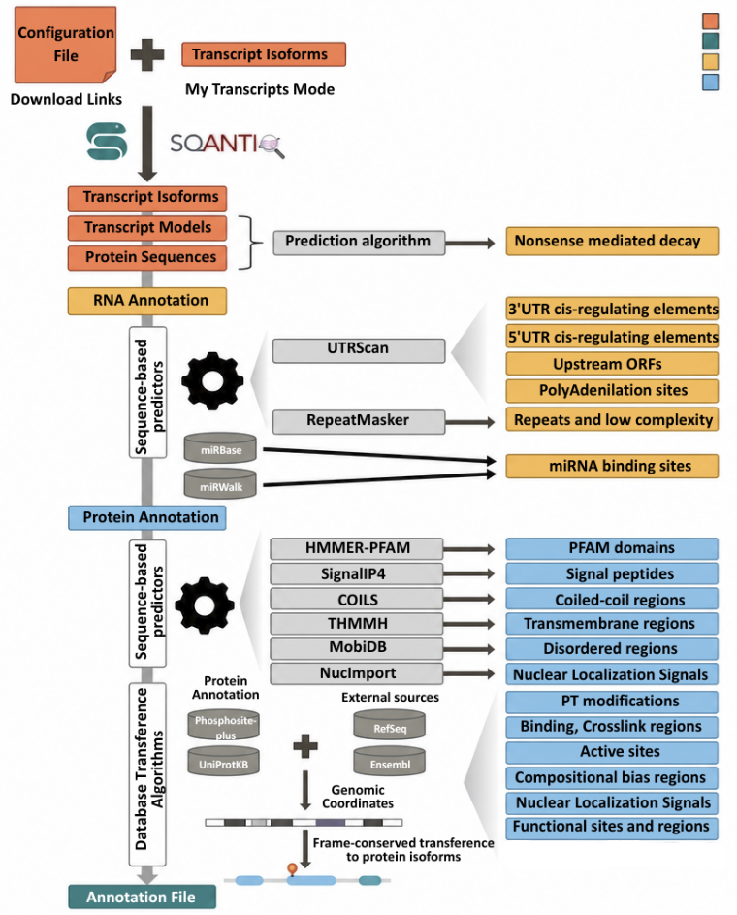
Functional Annotation - IsoAnnot
IsoAnnot is a workflow that annotates functionally at isoform level
Many layers that combine prediction, with positional transference with homology
How to use it?
The organisim has to be present either in RefSeq or Ensembl
There is a fast approach called IsoAnnotLite
Has a pretrained GFF3 for several species
Directpositiohn transference from the annotation to the isoforms

Slide 58

Novel methods - FANTASIA
Uses Protein Language Models to compare proteins in a embedding space
Captures deep funciontal and structural properties
Annotations are transfered by similarity in this space
Predicts Gene Ontology (GO) terms
Highly customizable if you know the field
They have a lightweight version in FantasiaLite (direct annotation)
Notes:
Maybe an explanation?

Slide 59
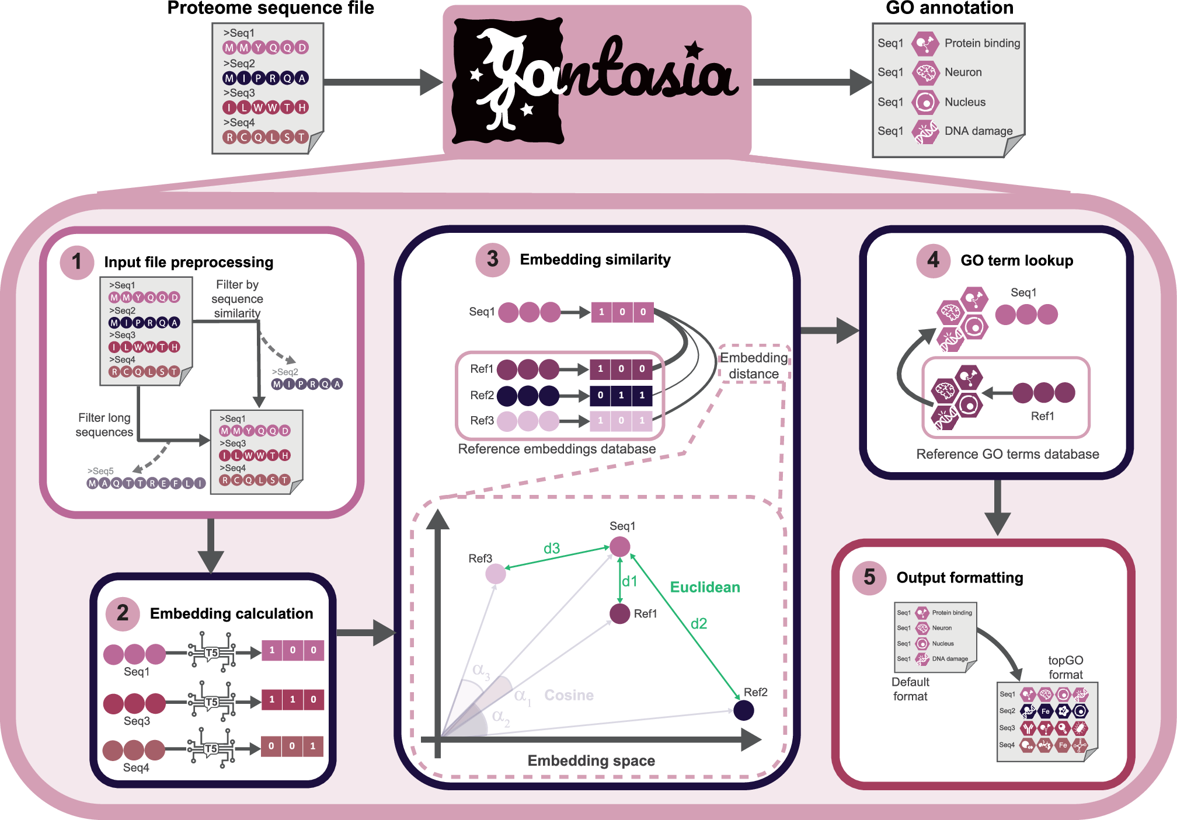
Functional Annotation Fantasia

Slide 60
Take home messages
When it comes to genome annotation, the more the merrier.
Evidence driven predictions tend to outperform, at a higher resources and time cost
There is no “Gold Standard” when it comes to genome annotation
Combinations of different approaches tend to work best
Always benchmark and take time on this
The base of all of the downprocessing
Notes:
Summary?

