Slide 1


Bioinformatics Summer School
SQANTI3: Transcriptomics Quality Control
Pablo Atienza López
Genomics of Gene Expression Lab

Slide 2
Section 1
Reminer of Long-read Technologies
Understanding the fundamentals of third-generation sequencing
Remembering

Slide 3
Why should you control the quality?
Long reads are noisy
In general,
Long-read RNA sequencing (lrRNA-seq) has displayed great potential for transcriptome analysis
Applications include isoform identification, fusion gene detection, and allele-specific expression
Computational challenges require specialized bioinformatics approaches

Slide 4
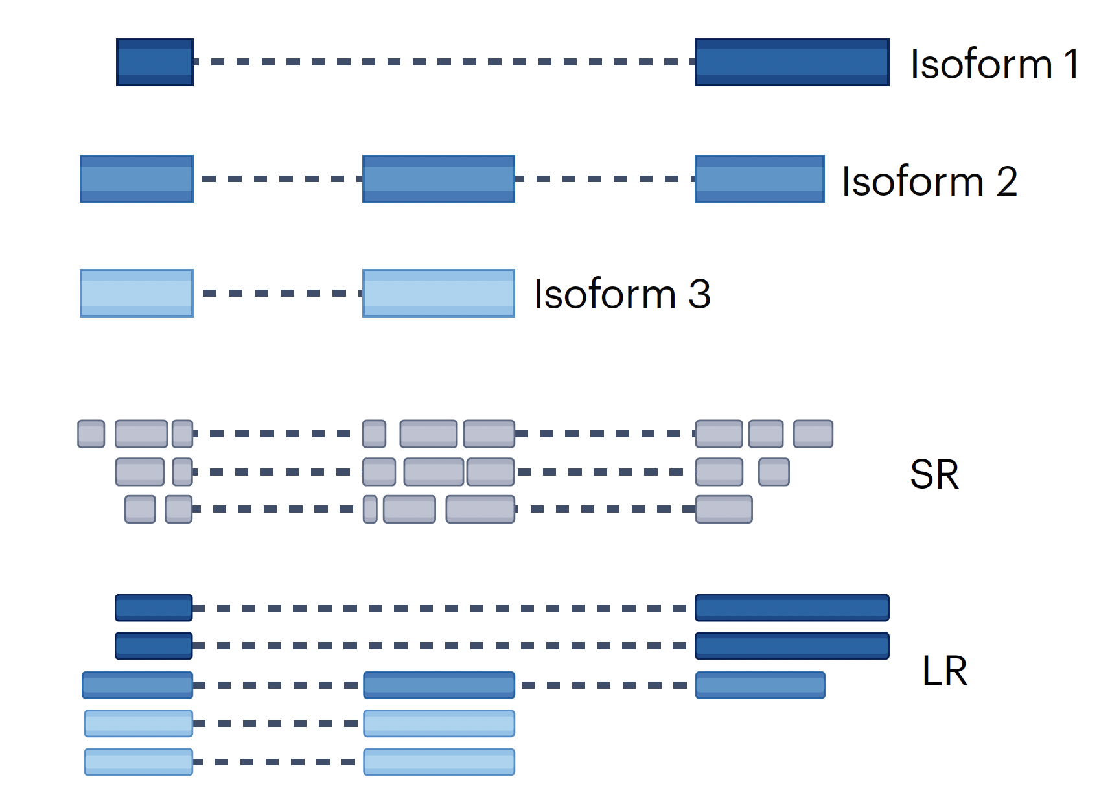
Advantages:
Higher accuracy
Higher throughput
Cost-effective
Disadvantages:
Repetitive sequences
Structural variants
Isoform resolution –
Alternative splicing
Short-read sequencing
Figure source: Monzó, Liu, Conesa. 2025. 10.1038/s41576-025-00828-z

Slide 5
Advantages:
Single-molecule
Isoform resolution –
Alternative splicing
Assembly simplification
Disadvantages:
Lower accuracy
Lower throughput
Higher costs
Bioinformatic challenges
Short-read sequencing
Long-read sequencing
Figure source: Monzó, Liu, Conesa. 2025. 10.1038/s41576-025-00828-z

Slide 6
However, sequencing is not a perfect process…
Technical challenges have not disapeared in long reads, they have just shifted
Different parts of the pipeline yield different articats we need to take into account
Library preparation
RT switching
Intra-priming
Sequencing technology
Length biases
Transcript degradation
Transcriptome reconstruction
Incorrect TSS and TTS
Lack of supporting evidence

Slide 7
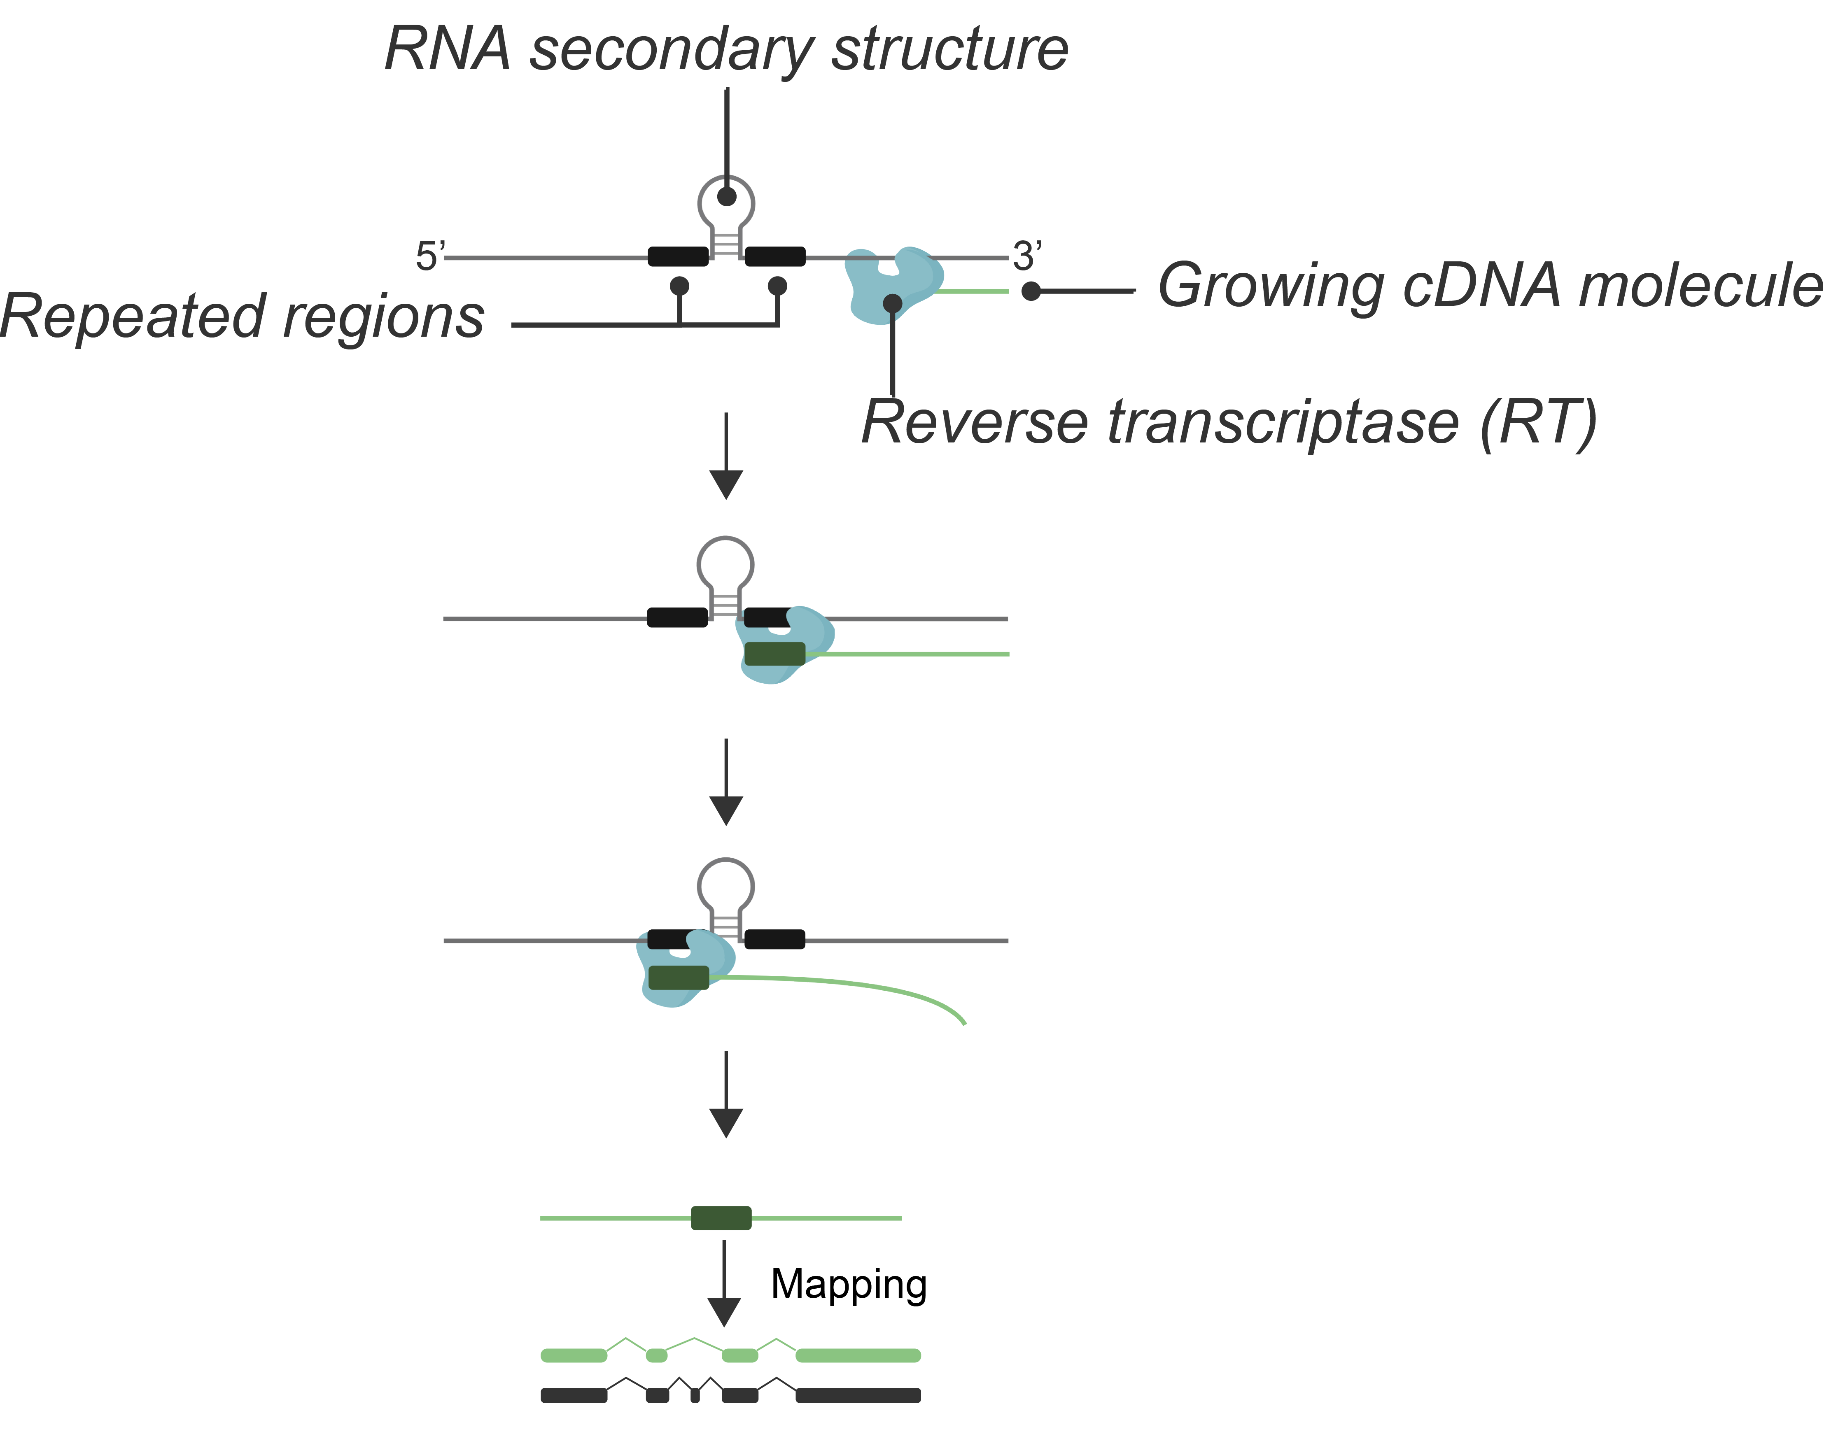
Retrotranscriptase Template Switching
RT enzyme can ”jump” between templates at repeated regions, creating chimeric cDNA products that confound transcript analysis

Slide 8
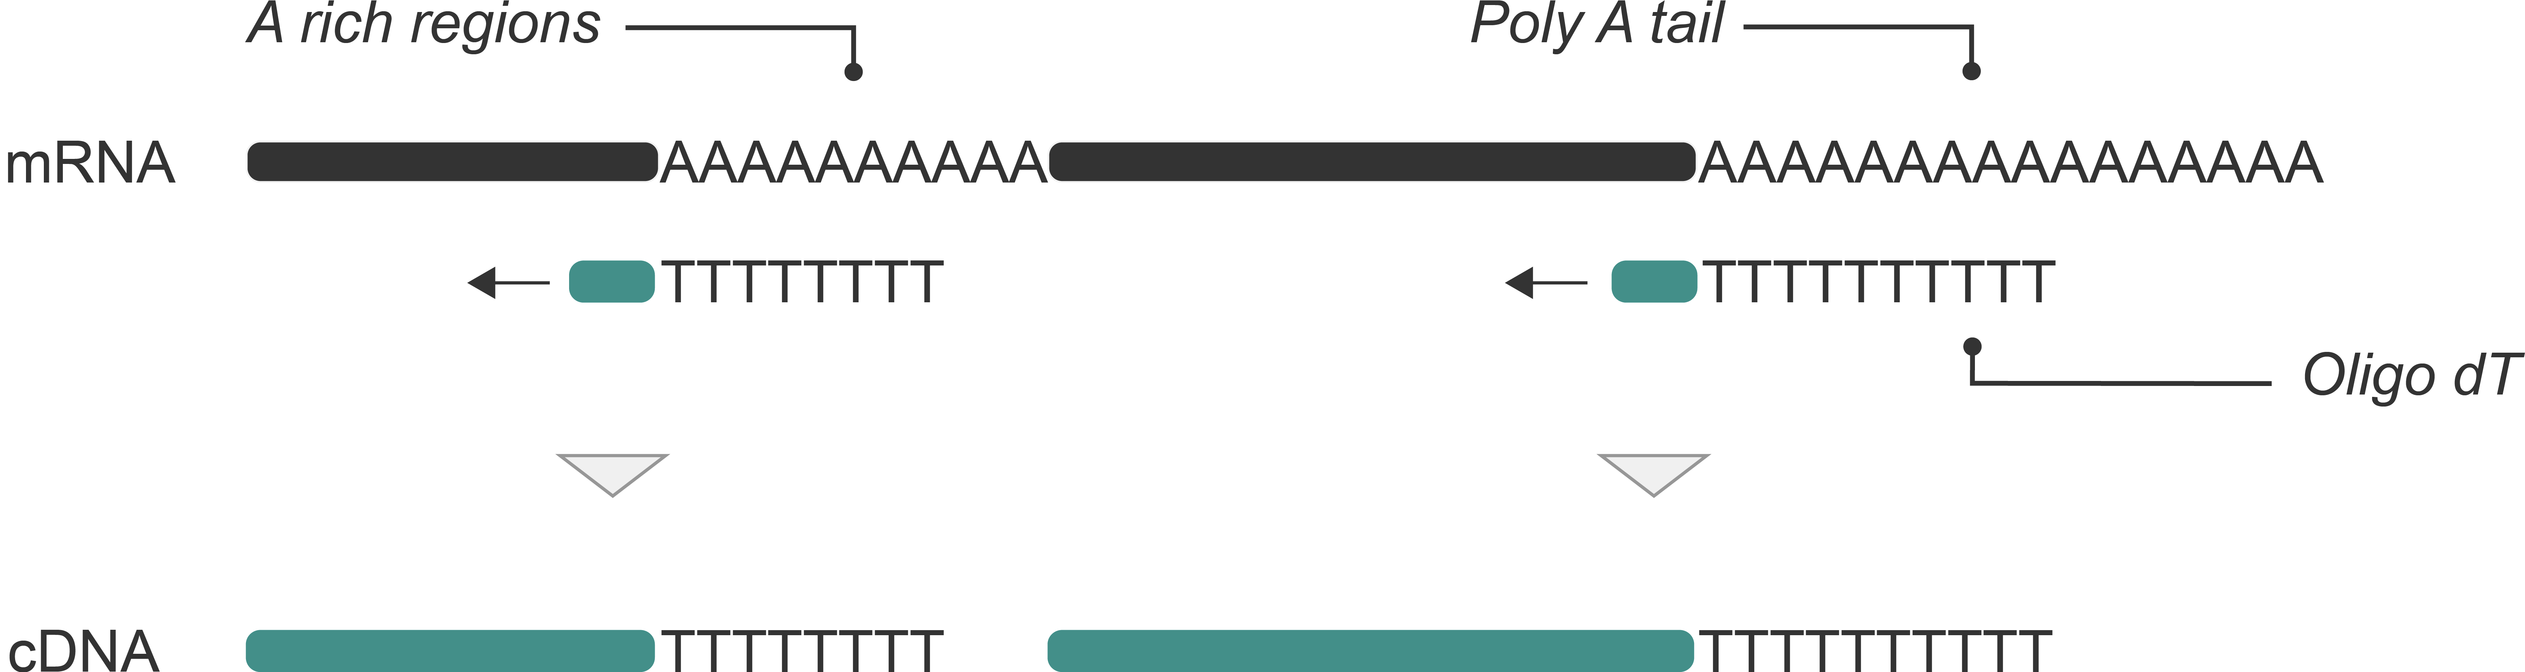
Intra-priming
Oligo-dT primers can bind to internal A-rich regions, causing truncated cDNA synthesis

Slide 9
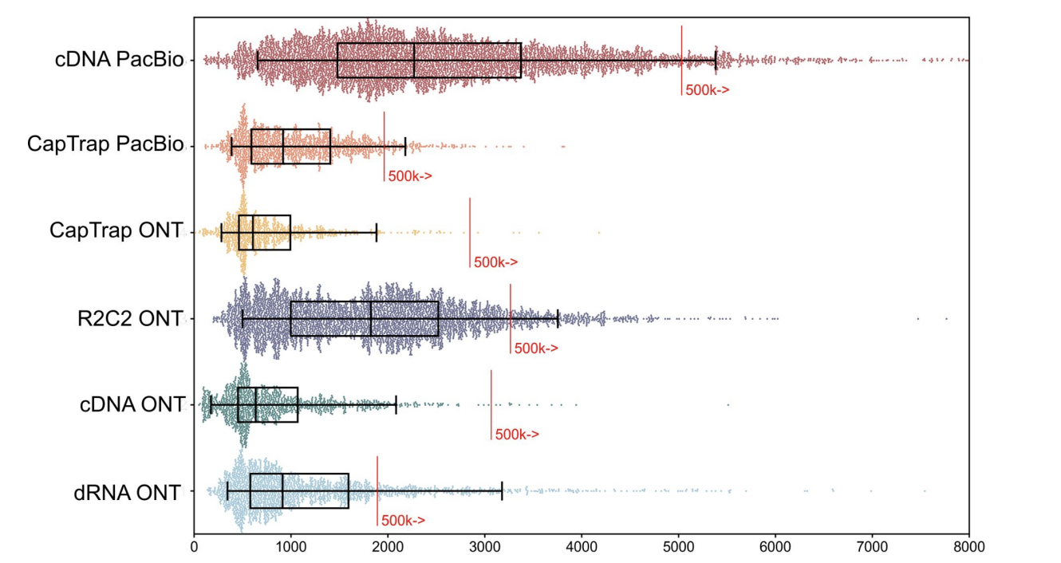
Impact of sequencing platform and library preparation choice
WARNING!! Combination of sequencing platform and library preparation find different transcripts
Figure source: Pardo-Palacios. 2024. 10.1038/s41592-024-02298-3

Slide 10
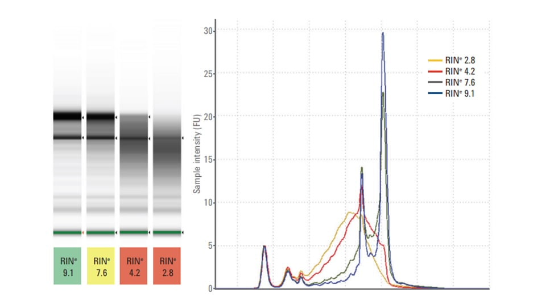
RNA quality
Checking the RNA quality is not only important to get good quality full-length transcripts, but also to see the distribution of transcripts that we have in the transcriptome of our sample
Figure source: Pardo-Palacios. 2024. 10.1038/s41592-024-02298-3

Slide 11
Solution: Transcript models
Reference transcript
Millions of reads, many minor differences
Goal: collapse similar reads to identify consistently occurring transcript models
Differentiate biological and technical artifacts from real transcripts

Slide 12
Solution: Transcript models
Reference transcript
Millions of reads, many minor differences
Goal: collapse similar reads to identify consistently occurring transcript models
Differentiate biological and technical artifacts from real transcripts
This process is also called:
Transcript | isoform identification | discovery
Transcriptome reconstruction
Transcript(ome) assembly (inherited from short-reads)

Slide 13
From raw reads
Reference transcript

Slide 14
To transcript models
Reference transcript

Slide 15
Section 2
The Swiss-army knife of long-read Transcriptomics
One tool to curate them all

Slide 16


User-friendly software developed by the ConesaLab
Performs multiple funcions with multiple modules
Structural classification of transcripts
Integration of orthogonal data
Visualization of quality features
Filtering of transcripts
Retrieval of lost biological functions
And much more…
Find it in GitHub!

Slide 17
Quality Control!
Full Splice Match (FSM)
Incomplete Splice Match (ISM)
Novel In Catalogue (NIC)
Novel Not in Catalogue (NNC)
Source: Pardo-Palacios. 2024. 10.1038/s41592-024-02298-3

Slide 18
To transcript models
Reference transcript

Slide 19
To transcript models
Reference transcript

Slide 20
Novel FSM categories in SQANTI3
Source: Pardo-Palacios. 2024. 10.1038/s41592-024-02298-3

Slide 21
Other novel categories in SQANTI3
Source: Pardo-Palacios. 2024. 10.1038/s41592-024-02298-3

Slide 22
Distance to TSS, TTS and to known junctions
Some of the parameters that SQANTI3 is able to produce
Reference
TSS dist
TTS dist
Splice site diff
d
d
d
d
Source: Pardo-Palacios. 2024. 10.1038/s41592-024-02298-3

Slide 23

CAGE and polyA support
If orthogonal data is provided, it can be included into the analysis
polyA sites
Reference
TSS dist
TTS dist
Splice site diff
CAGE support
PolyA support
d
d
d
d
Source: Pardo-Palacios. 2024. 10.1038/s41592-024-02298-3

Slide 24
Short reads and lrRNA-seq support
Short reads can be integrated in multiple ways
polyA sites
Reference
TSS dist
TTS dist
Splice site diff
CAGE support
PolyA support
SR junctions
TSS ratio
SR expression
FL expression
Fractional expr.
d
d
d
d
Source: Pardo-Palacios. 2024. 10.1038/s41592-024-02298-3

Slide 25
Canonical junction, intraprimming, RT-switching etc
Finally, just by using the reference genome, we can get a lot of information
polyA sites
Reference
TSS dist
TTS dist
Splice site diff
CAGE support
PolyA support
SR junctions
TSS ratio
SR expression
FL expression
Fractional expr.
Canonical junct.
Donor type
Acceptor type
Intraprimming
RT-switching
etc
d
d
NN. NN
AAAAAAA
d
d
Source: Pardo-Palacios. 2024. 10.1038/s41592-024-02298-3

Slide 26
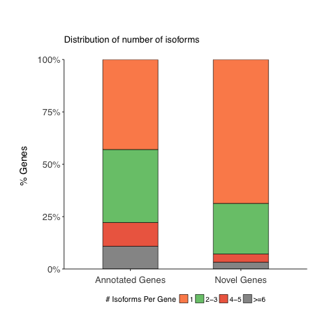
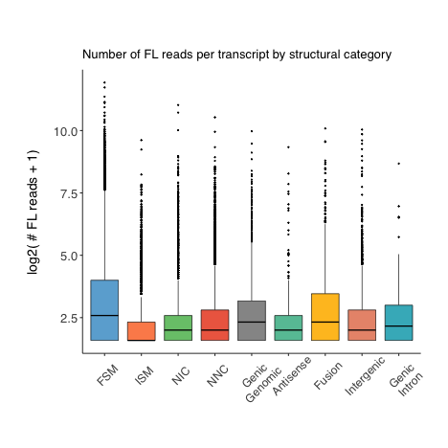
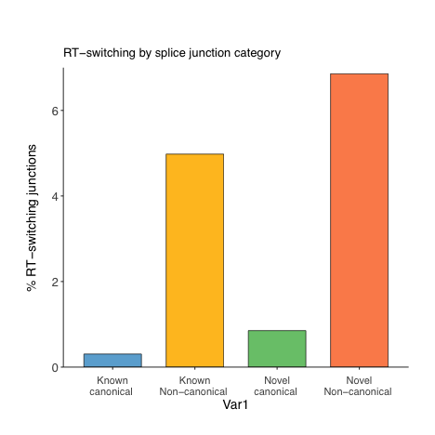
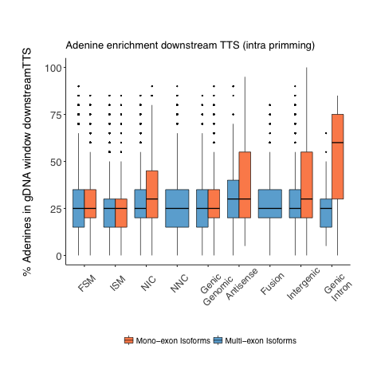
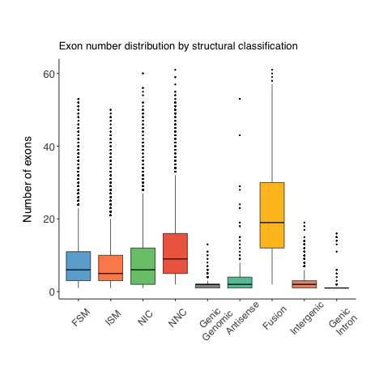
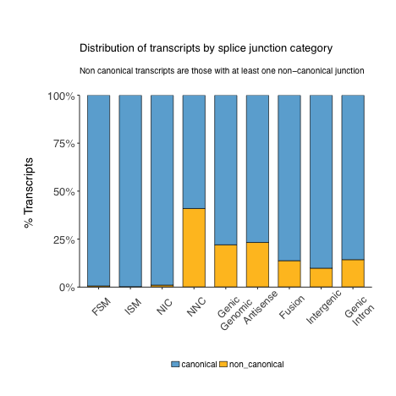
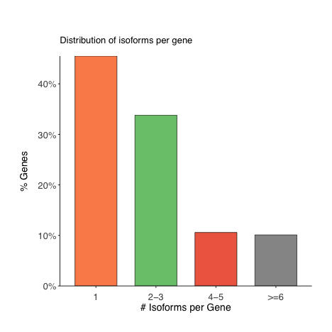
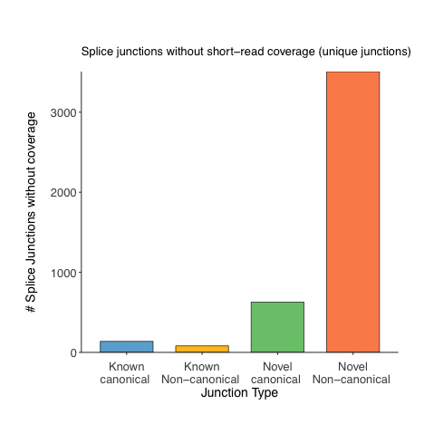
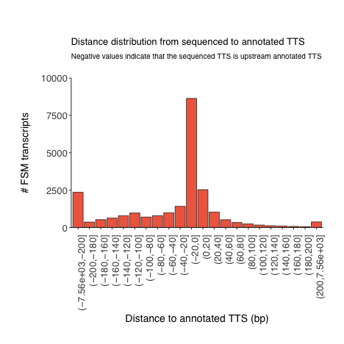
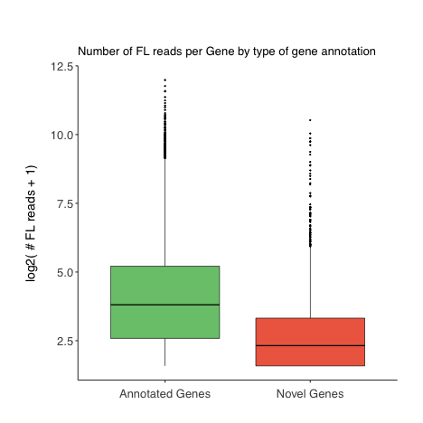
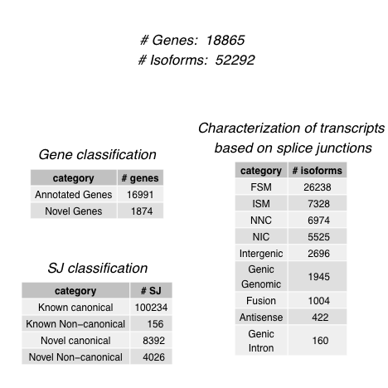
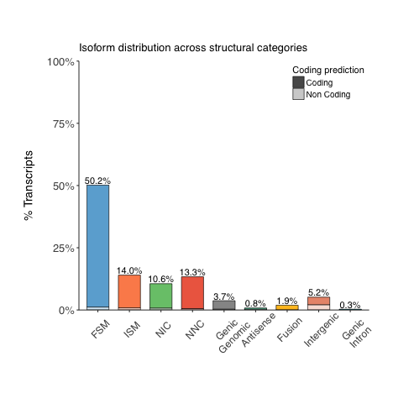
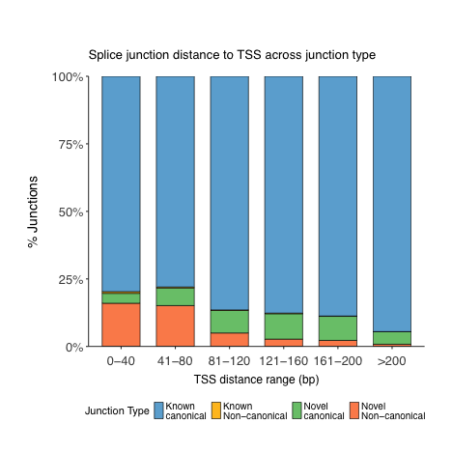
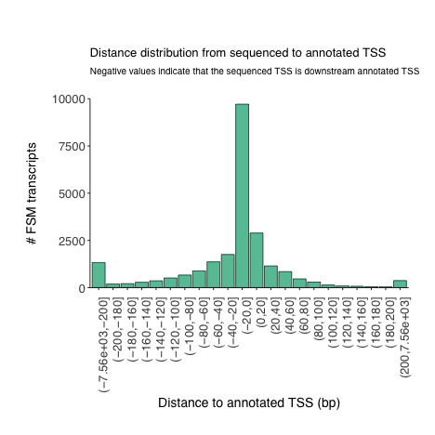
SQANTI3 report
Source: Pardo-Palacios. 2024. 10.1038/s41592-024-02298-3

Slide 27
Section 3
How to use SQANTI3 in practice?
Holding the knife wihtout cutting yourself

Slide 28
Important conclusions from SQANTI3
Pipeline 1
Pipeline 2
Pipeline 3
Source: Pardo-Palacios. 2024. 10.1038/s41592-024-02298-3

Slide 29
CAGE data may support FSM
Source: Pardo-Palacios. 2024. 10.1038/s41592-024-02298-3

Slide 30
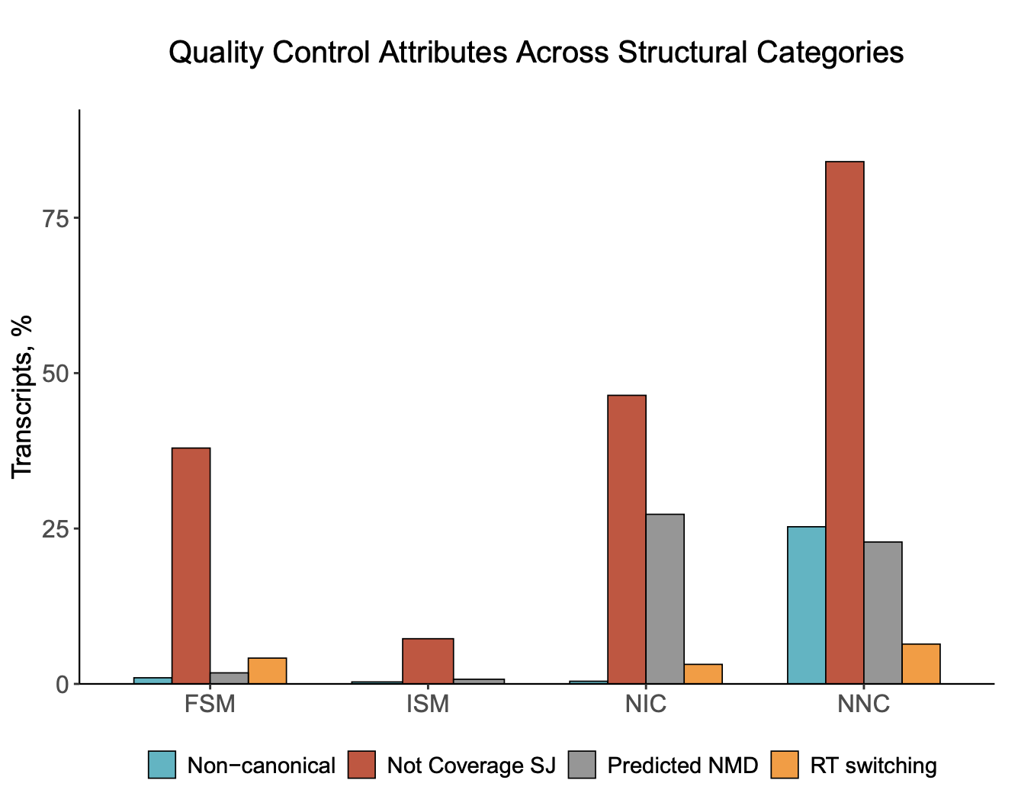
Bad quality features
Source: Pardo-Palacios. 2024. 10.1038/s41592-024-02298-3

Slide 31
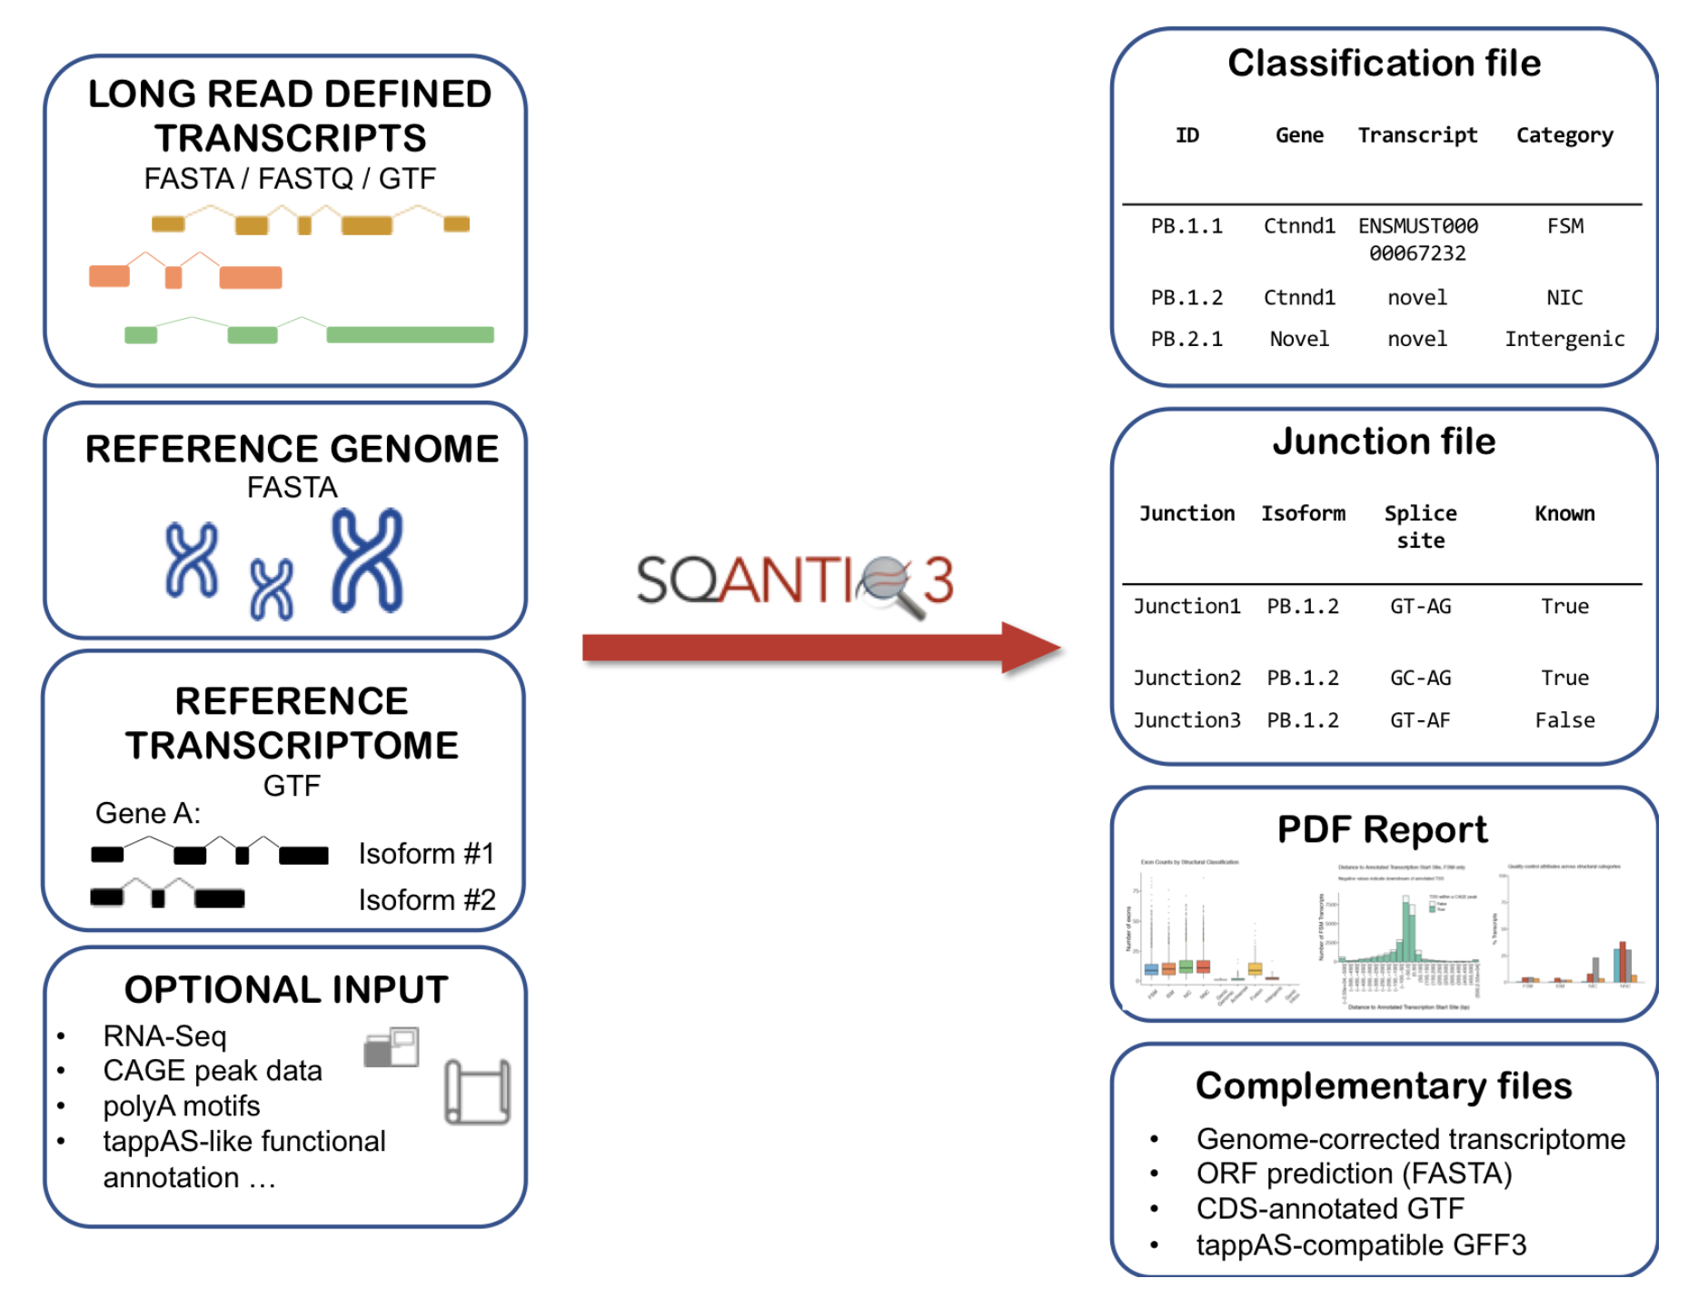
Solving problems: SQANTI-filter
CURATED
TRANSCRIPTOME
QC
Filter
Machine
Learning
Rules
Source: Pardo-Palacios. 2024. 10.1038/s41592-024-02298-3

Slide 32
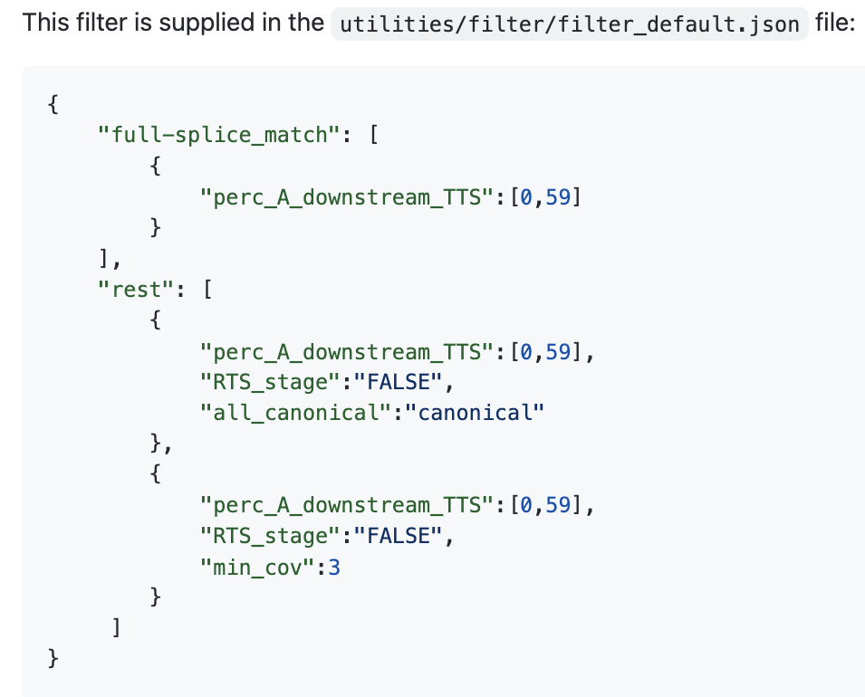


Solving problems: SQANTI-filter
Rules
ML
SQANTI variables
True & Negative Set
True: FSM reference match
Negative: NNC – non canonical
Non-canonical
Isoforms
Random Forest
ALL transcripts
Artifacts
Source: Pardo-Palacios. 2024. 10.1038/s41592-024-02298-3

Slide 33
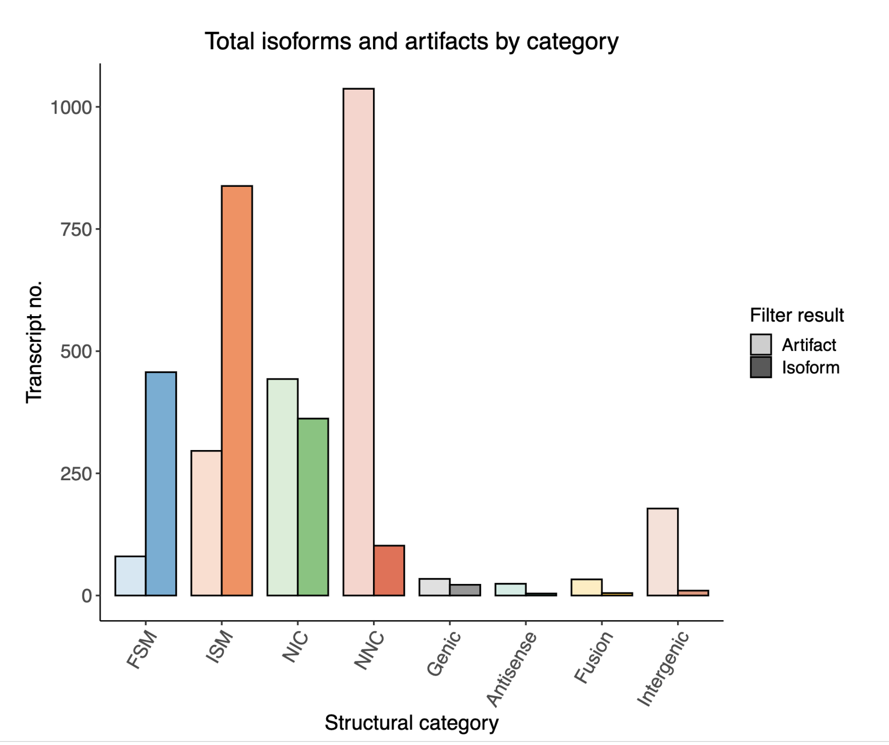
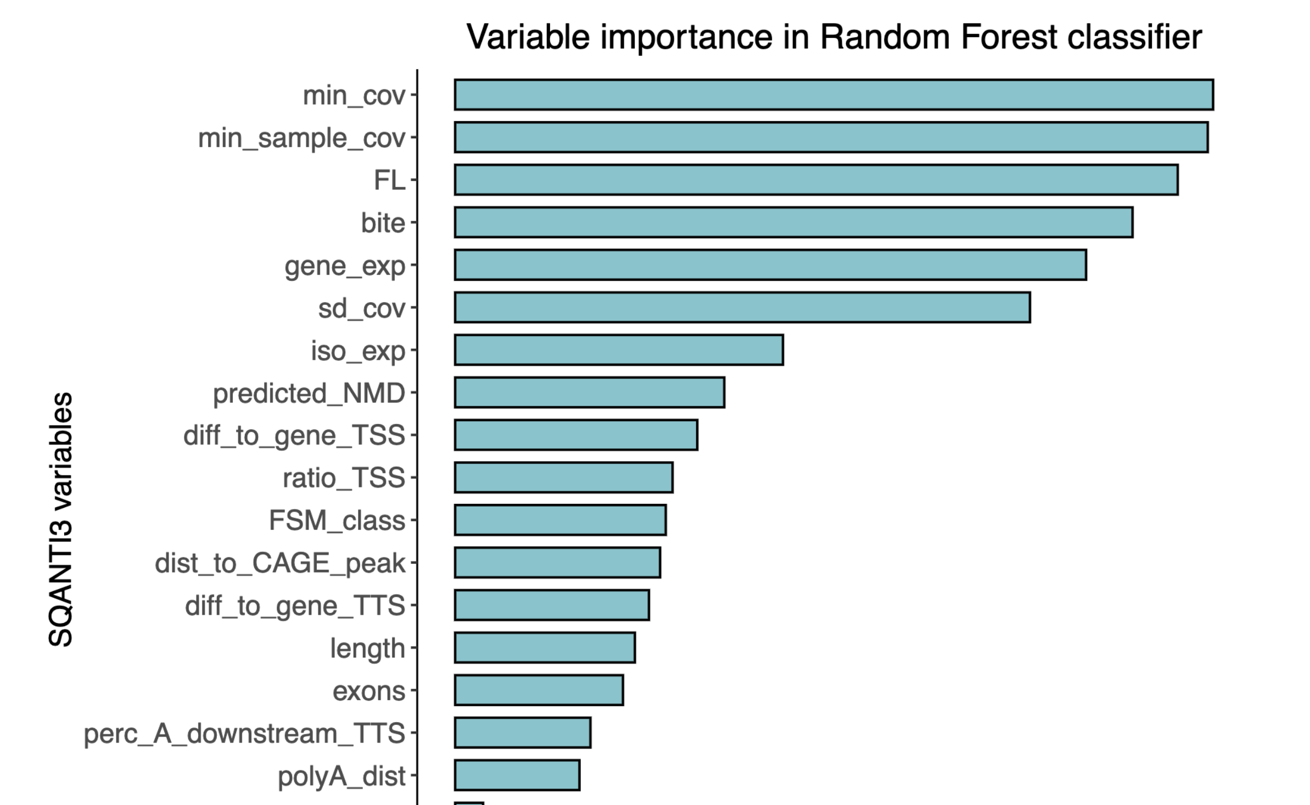
Clean transcriptome! And SQANTI-filter report
Source: Pardo-Palacios. 2024. 10.1038/s41592-024-02298-3

Slide 34


SQANTI rescue
After filtering, what happens with the lost isoforms?
Lost isoform = lost data = lost money
If they are artifacts, they might come from somewhere
Sometimes, transcripts do not reach the desired threshold by a little bit, or the orthogonal data is not enough, but they are there
Rescue prevents the loss of known genes and transcripts that have evidence of expression

Slide 35
Rescue semantics
Raw transcriptome
Isoforms
Artifacts
Rescueable
non-rescueable
BMI
rescued
not rescued
Reference transcript
Transcript Divergency
Not-reintroduced
Reintroduced

Slide 36
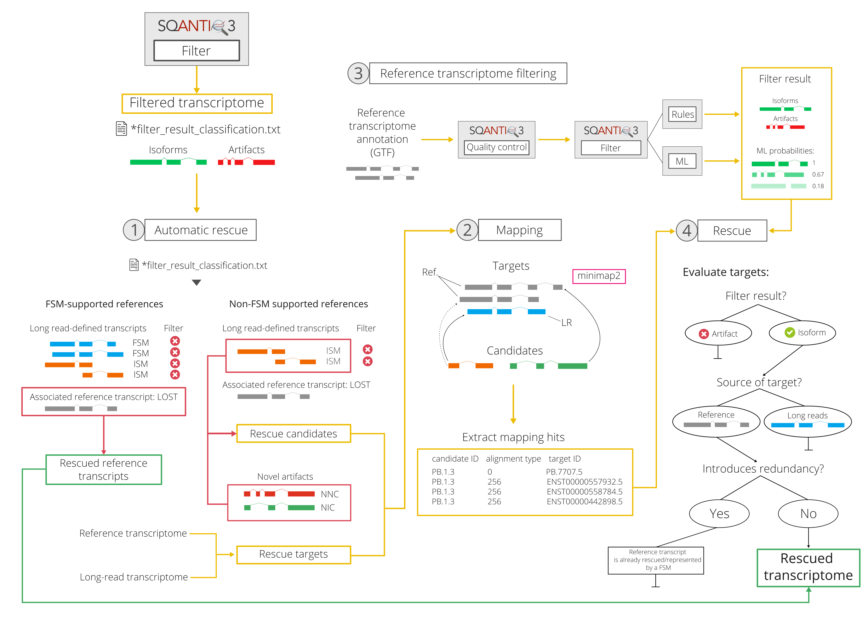
Rescue workflow

Slide 37
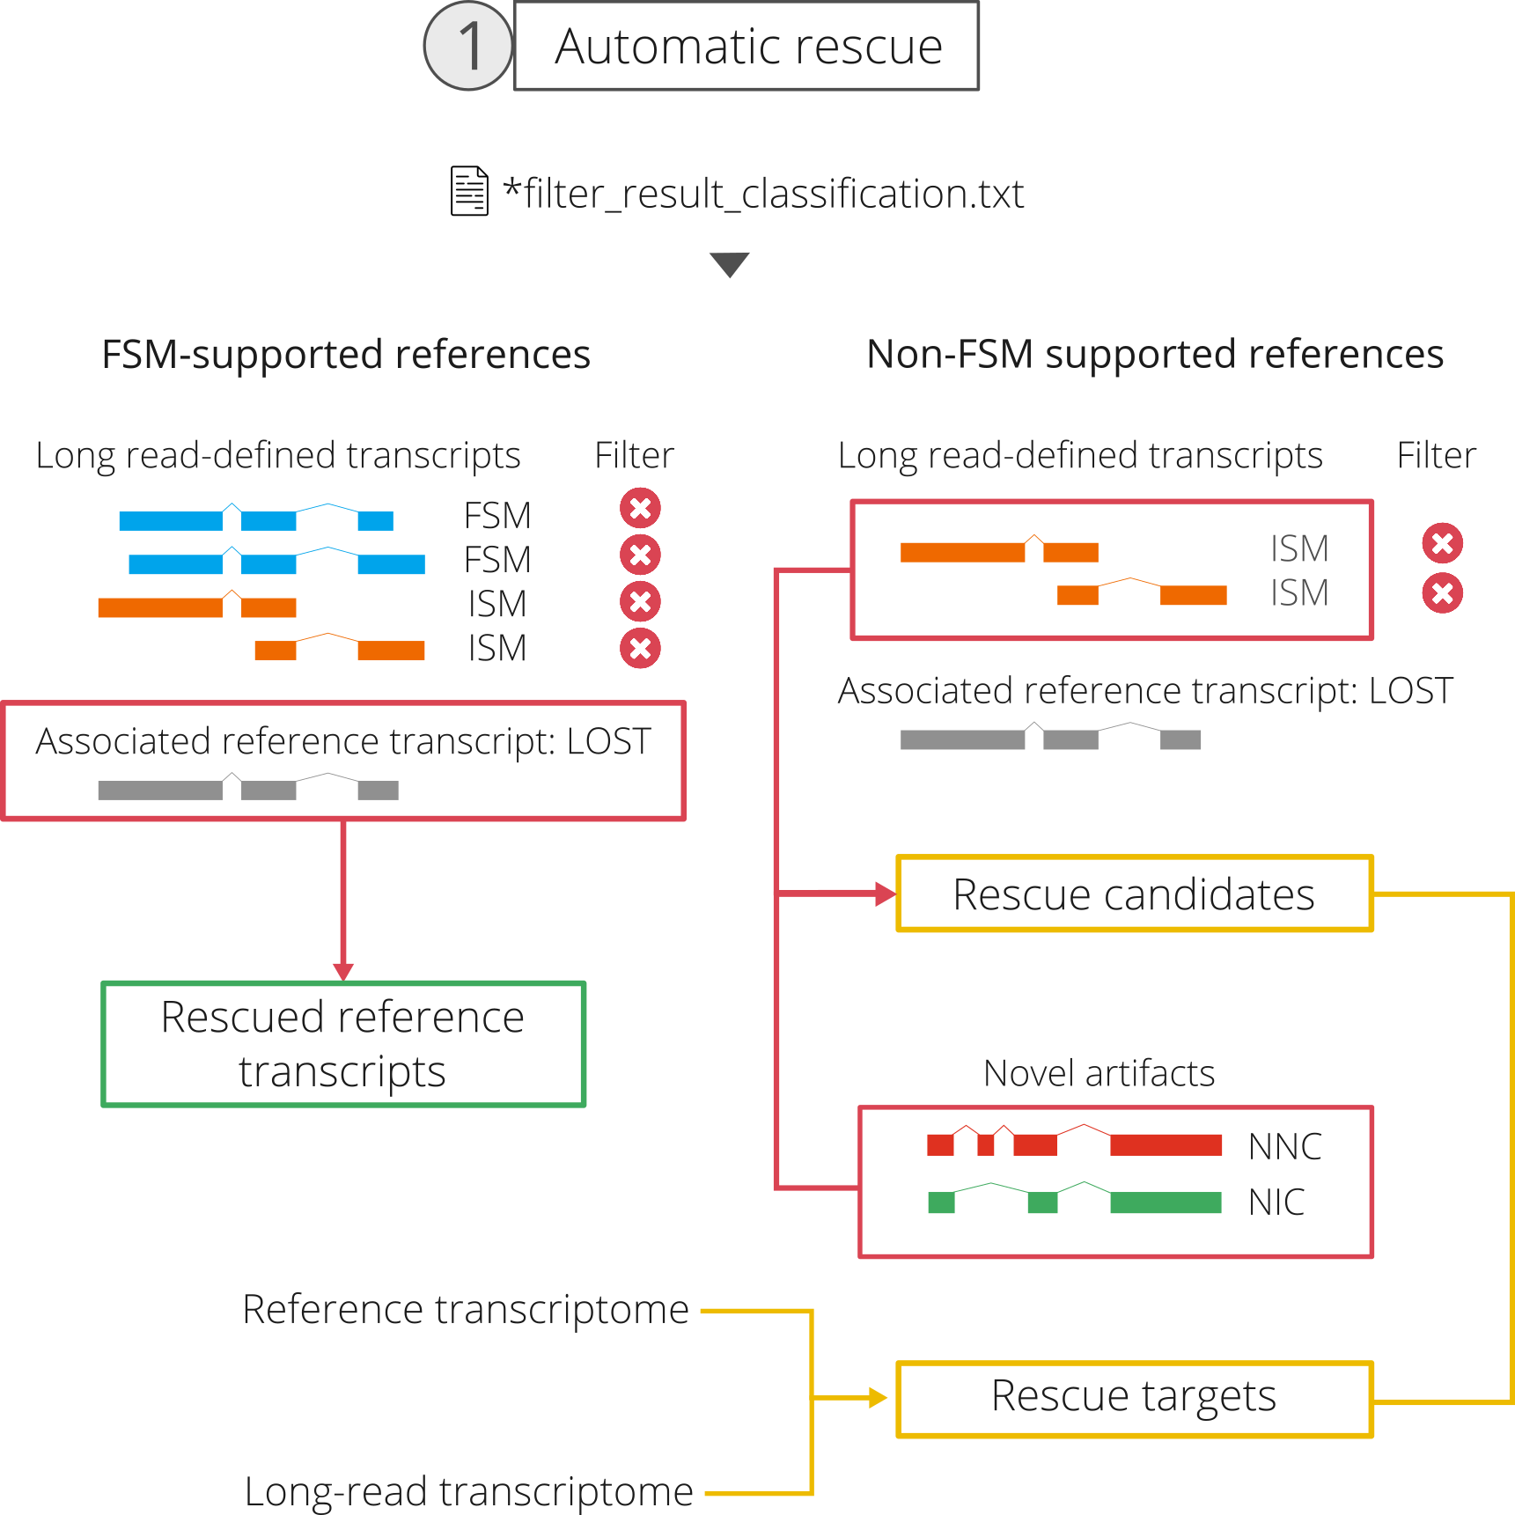
Automatic rescue
If any reference isoform lost all of its FSM isoforms, it is reintroduced into the transcriptome
The idea: Not loosing biological information
Then, we select the candidates to be rescued:
Lost ISM transcripts where the reference was lost
NNC and NIC artifacts
The targets will be:
The reference transcirpts
The long-read isoforms

Slide 38
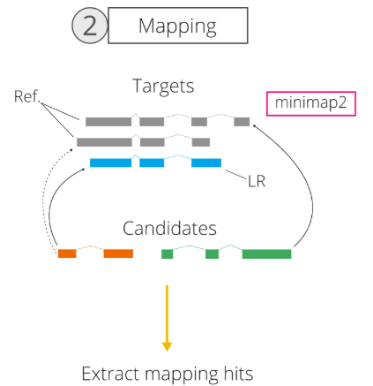

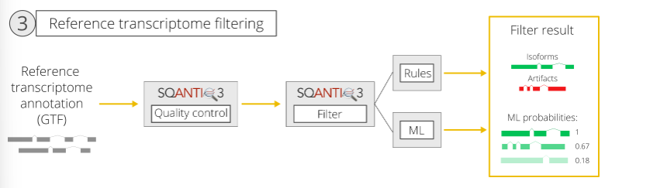
Rescue-by-mapping
How do we select the Best Mapping Hit?

Slide 39
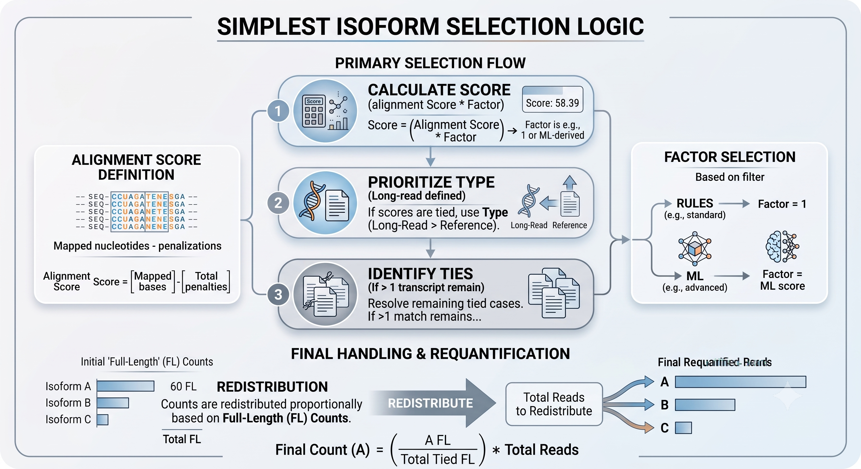
Best mapping hit selection
Score based system

Slide 40

Bonus!! SQANTI-verse
SQANTI3
SQANTI-filter
SQANTI-rescue
SQANTI-reads
SQANTI-tusco
SQANTI-single-cell
SQANTI-browser
SQANTI-proteins
IsoAnnot
TappAS
…

Slide 41

Thank You!
Now, lets go to the practical!

