Slide 1


Bioinformatics Summer School
SQANTI3: Transcriptomics Quality Control
Pablo Atienza López
Earlham Institute, Norwich, UK

Slide 2
Course Contents
1
Introduction to Long-read Technologies
2
Long-read Sequencing Platforms
3
Bioinformatics Analysis
4
Applications

Slide 3
Section 1
Reminer of Long-read Technologies
Understanding the fundamentals of third-generation sequencing
Remembering

Slide 4
Why should you control the quality?
Long reads are noisy
In general,
Long-read RNA sequencing (lrRNA-seq) has displayed great potential for transcriptome analysis
Applications include isoform identification, fusion gene detection, and allele-specific expression
Computational challenges require specialized bioinformatics approaches
LongTREC consortium develops methods and tools for long-read transcriptomics data analysis

Slide 5
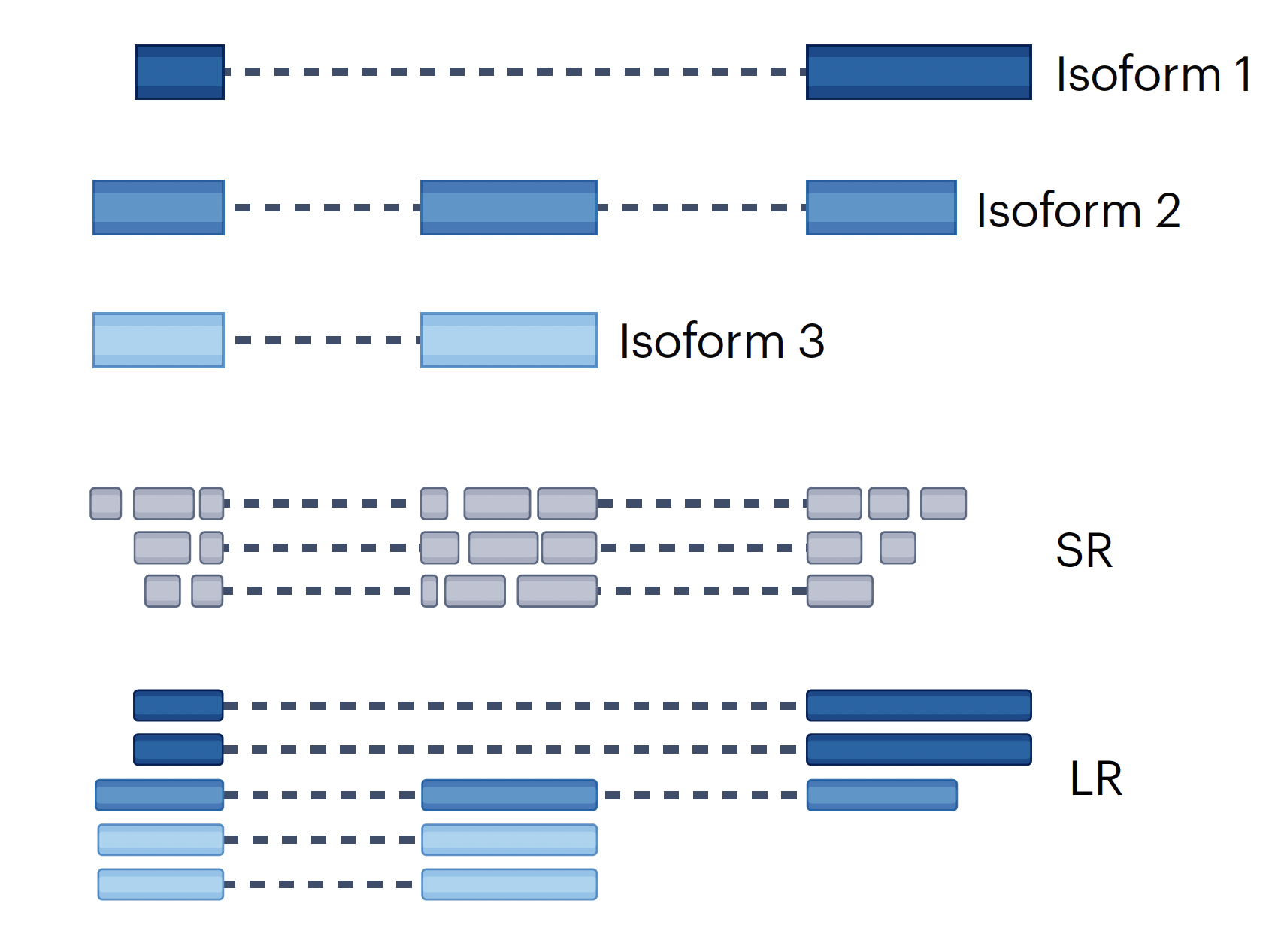
Advantages:
Higher accuracy
Higher throughput
Cost-effective
Disadvantages:
Repetitive sequences
Structural variants
Isoform resolution –
Alternative splicing
Short-read sequencing
Figure source: Monzó, Liu, Conesa. 2025. 10.1038/s41576-025-00828-z

Slide 6
Advantages:
Single-molecule
Isoform resolution –
Alternative splicing
Assembly simplification
Disadvantages:
Lower accuracy
Lower throughput
Higher costs
Bioinformatic challenges
Short-read sequencing
Long-read sequencing
Figure source: Monzó, Liu, Conesa. 2025. 10.1038/s41576-025-00828-z

Slide 7
However, sequencing is not a perfect process…
Technical challenges have not disapeared in long reads, they have just shifted

Slide 8
How ever, sequencing is not a perfect process…
Errors may occur at different points of the pipeline
Biological errors
Technical artifacts
Mapping issues

Slide 9
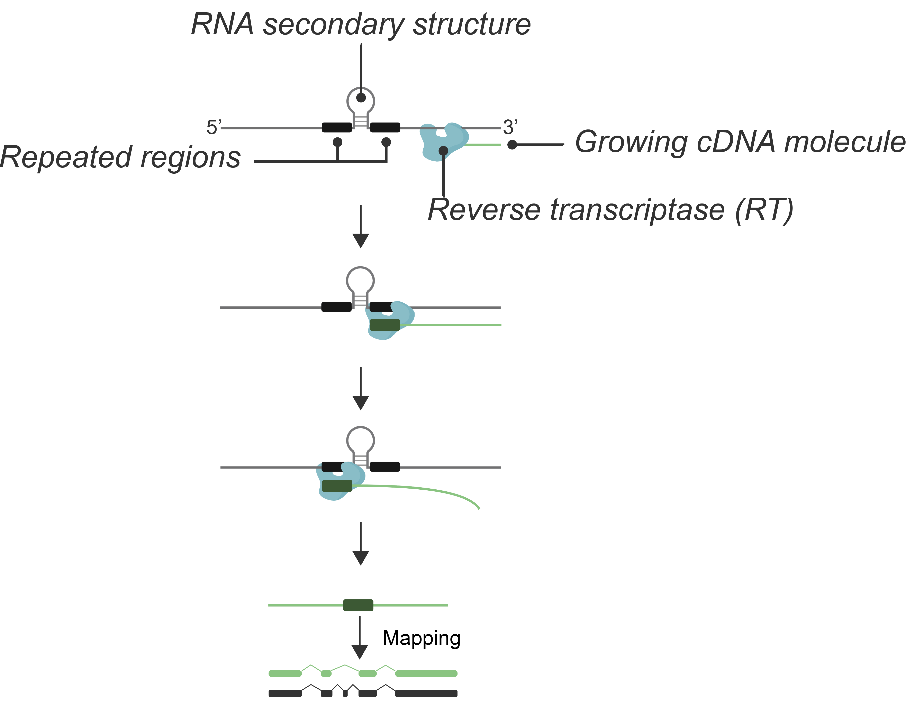
Retrotranscriptase Template Switching
RT enzyme can ”jump” between templates at repeated regions, creating chimeric cDNA products that confound transcript analysis

Slide 10
Library prep errors: Reverse transcriptase template switching (RT-switching)
RT enzyme can ”jump” between templates at repeated regions, creating chimeric cDNA products that confound transcript analysis

Slide 11
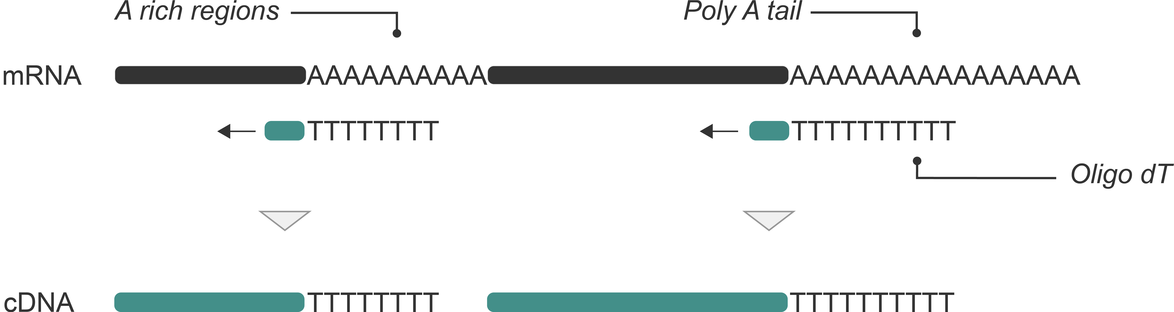
Library prep errors: intra-priming
Oligo-dT primers can bind to internal A-rich regions, causing truncated cDNA synthesis

Slide 12
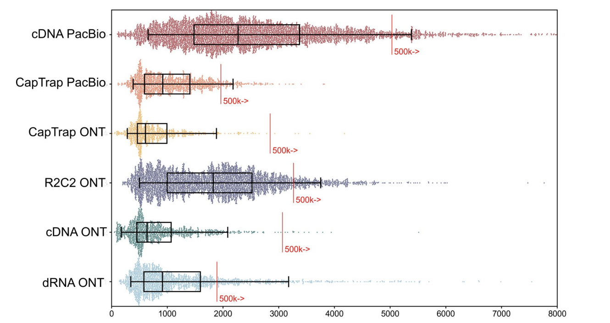
Impact of sequencing platform and library preparation choice
WARNING!! Combination of sequencing platform and library preparation find different transcripts
Figure source: Pardo-Palacios. 2024. 10.1038/s41592-024-02298-3

Slide 13
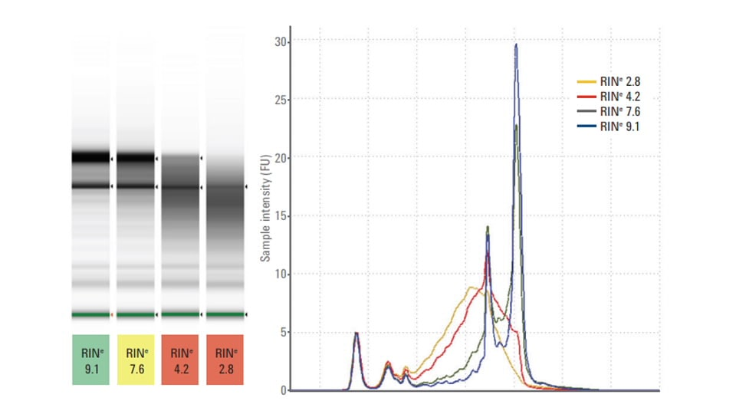
RNA quality
Checking the RNA quality is not only important to get good quality full-length transcripts, but also to see the distribution of transcripts that we have in the transcriptome of our sample
Figure source: Pardo-Palacios. 2024. 10.1038/s41592-024-02298-3

Slide 14
Solution: Transcript models
Reference transcript
Millions of reads, many minor differences
Goal: collapse similar reads to identify consistently occurring transcript models
Differentiate biological and technical artifacts from real transcripts

Slide 15
Solution: Transcript models
Reference transcript
Millions of reads, many minor differences
Goal: collapse similar reads to identify consistently occurring transcript models
Differentiate biological and technical artifacts from real transcripts
This process is also called:
Transcript | isoform identification | discovery
Transcriptome reconstruction
Transcript(ome) assembly (inherited from short-reads)

Slide 16
From raw reads
Reference transcript

Slide 17
To transcript models
Reference transcript

Slide 18
To transcript models
Reference transcript

Slide 19

Quality Control!
Full Splice Match (FSM)
Incomplete Splice Match (ISM)
Novel In Catalogue (NIC)
Novel Not in Catalogue (NNC)
Source: Pardo-Palacios. 2024. 10.1038/s41592-024-02298-3

Slide 20
To transcript models
Reference transcript

Slide 21
Novel FSM categories in SQANTI3
Source: Pardo-Palacios. 2024. 10.1038/s41592-024-02298-3

Slide 22
Other novel categories in SQANTI3
Source: Pardo-Palacios. 2024. 10.1038/s41592-024-02298-3

Slide 23
Distance to TSS, TTS and to known junctions
Reference
TSS dist
TTS dist
Splice site diff
d
d
d
d
Source: Pardo-Palacios. 2024. 10.1038/s41592-024-02298-3

Slide 24

CAGE and polyA support
polyA sites
Reference
TSS dist
TTS dist
Splice site diff
CAGE support
PolyA support
d
d
d
d
Source: Pardo-Palacios. 2024. 10.1038/s41592-024-02298-3

Slide 25
Short reads and lrRNA-seq support
polyA sites
Reference
TSS dist
TTS dist
Splice site diff
CAGE support
PolyA support
SR junctions
TSS ratio
SR expression
FL expression
Fractional expr.
d
d
d
d
Source: Pardo-Palacios. 2024. 10.1038/s41592-024-02298-3

Slide 26
Canonical junction, intraprimming, RT-switching etc
polyA sites
Reference
TSS dist
TTS dist
Splice site diff
CAGE support
PolyA support
SR junctions
TSS ratio
SR expression
FL expression
Fractional expr.
Canonical junct.
Donor type
Acceptor type
Intraprimming
RT-switching
etc
d
d
NN. NN
AAAAAAA
d
d
Source: Pardo-Palacios. 2024. 10.1038/s41592-024-02298-3

Slide 27
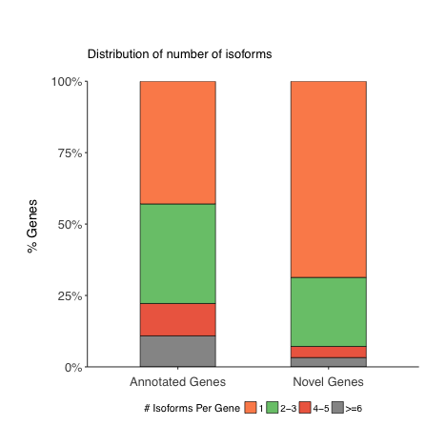
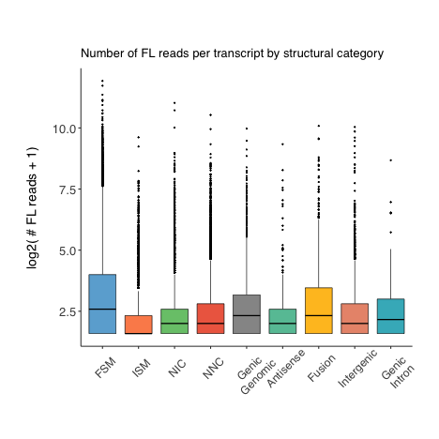
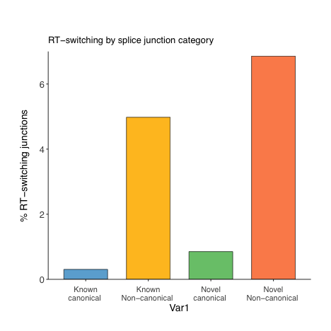
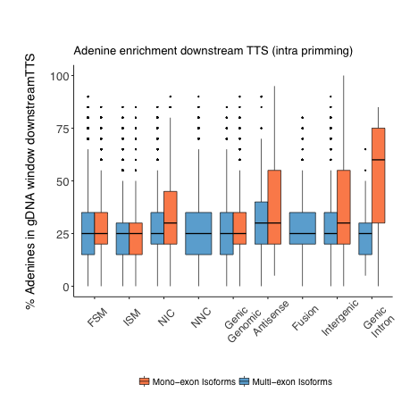
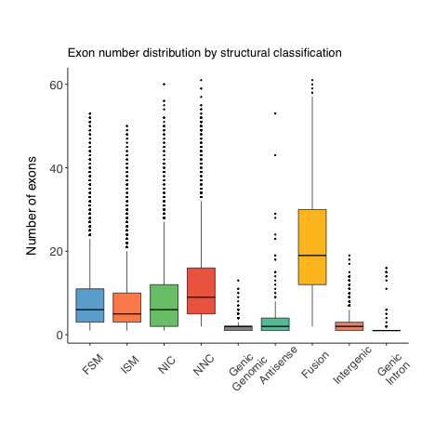
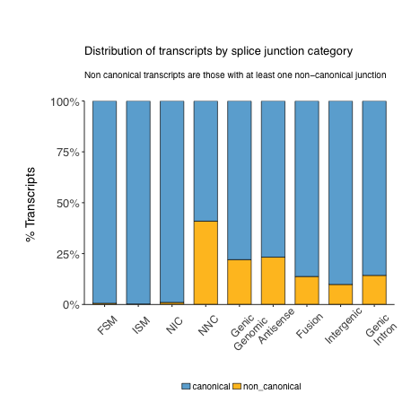
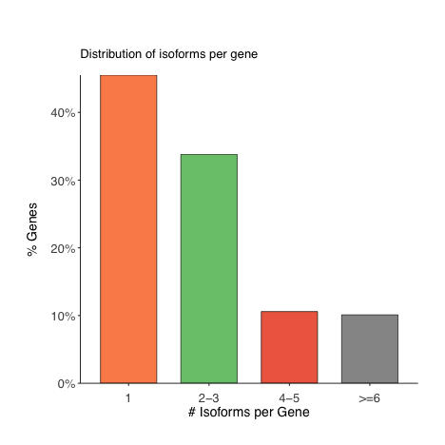
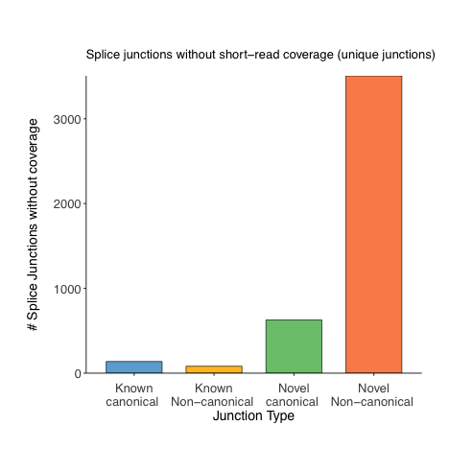
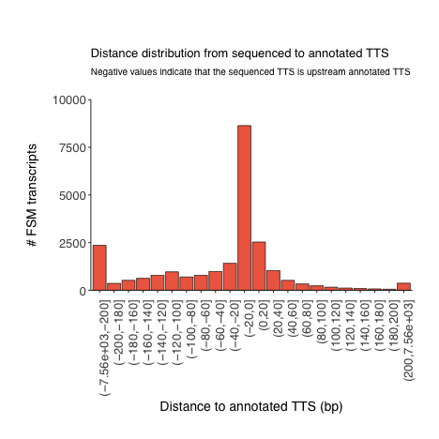
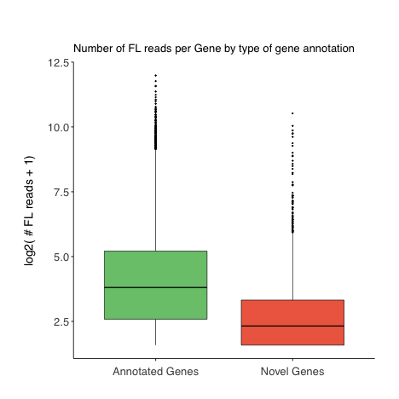
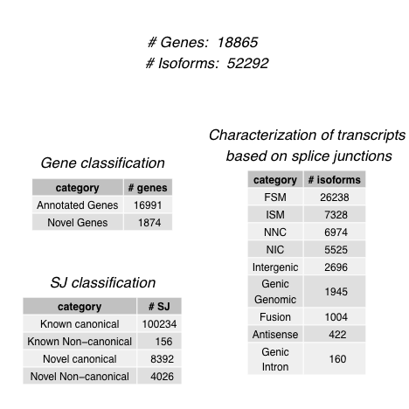
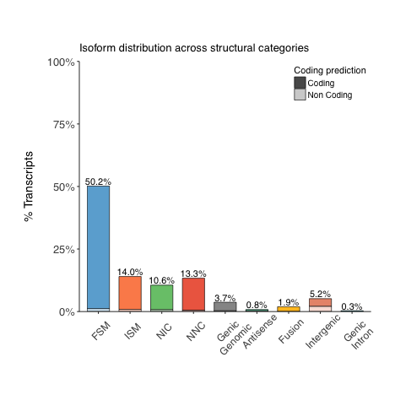
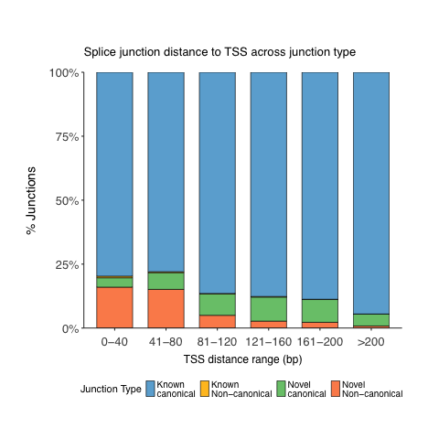
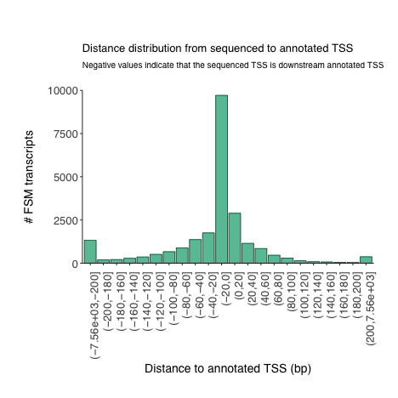
SQANTI3
Source: Pardo-Palacios. 2024. 10.1038/s41592-024-02298-3

Slide 28
Important conclusions from SQANTI3
Pipeline 1
Pipeline 2
Pipeline 3
Source: Pardo-Palacios. 2024. 10.1038/s41592-024-02298-3

Slide 29
CAGE data may support FSM
Source: Pardo-Palacios. 2024. 10.1038/s41592-024-02298-3

Slide 30
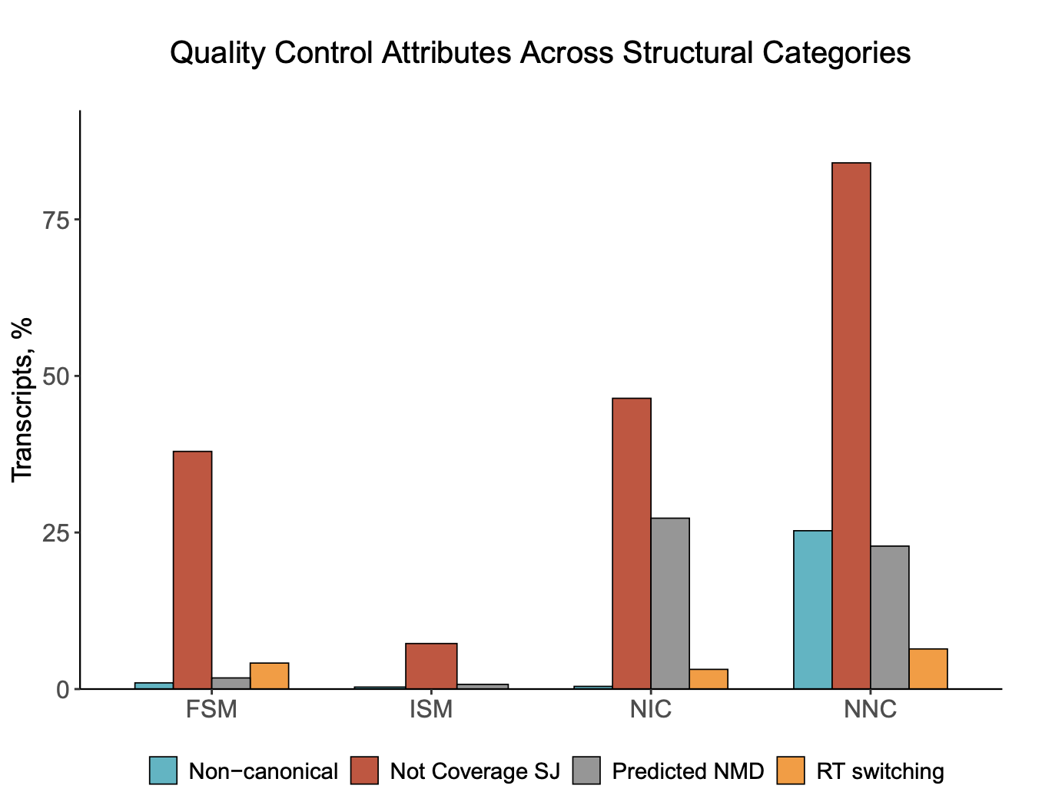
Bad quality features
Source: Pardo-Palacios. 2024. 10.1038/s41592-024-02298-3

Slide 31
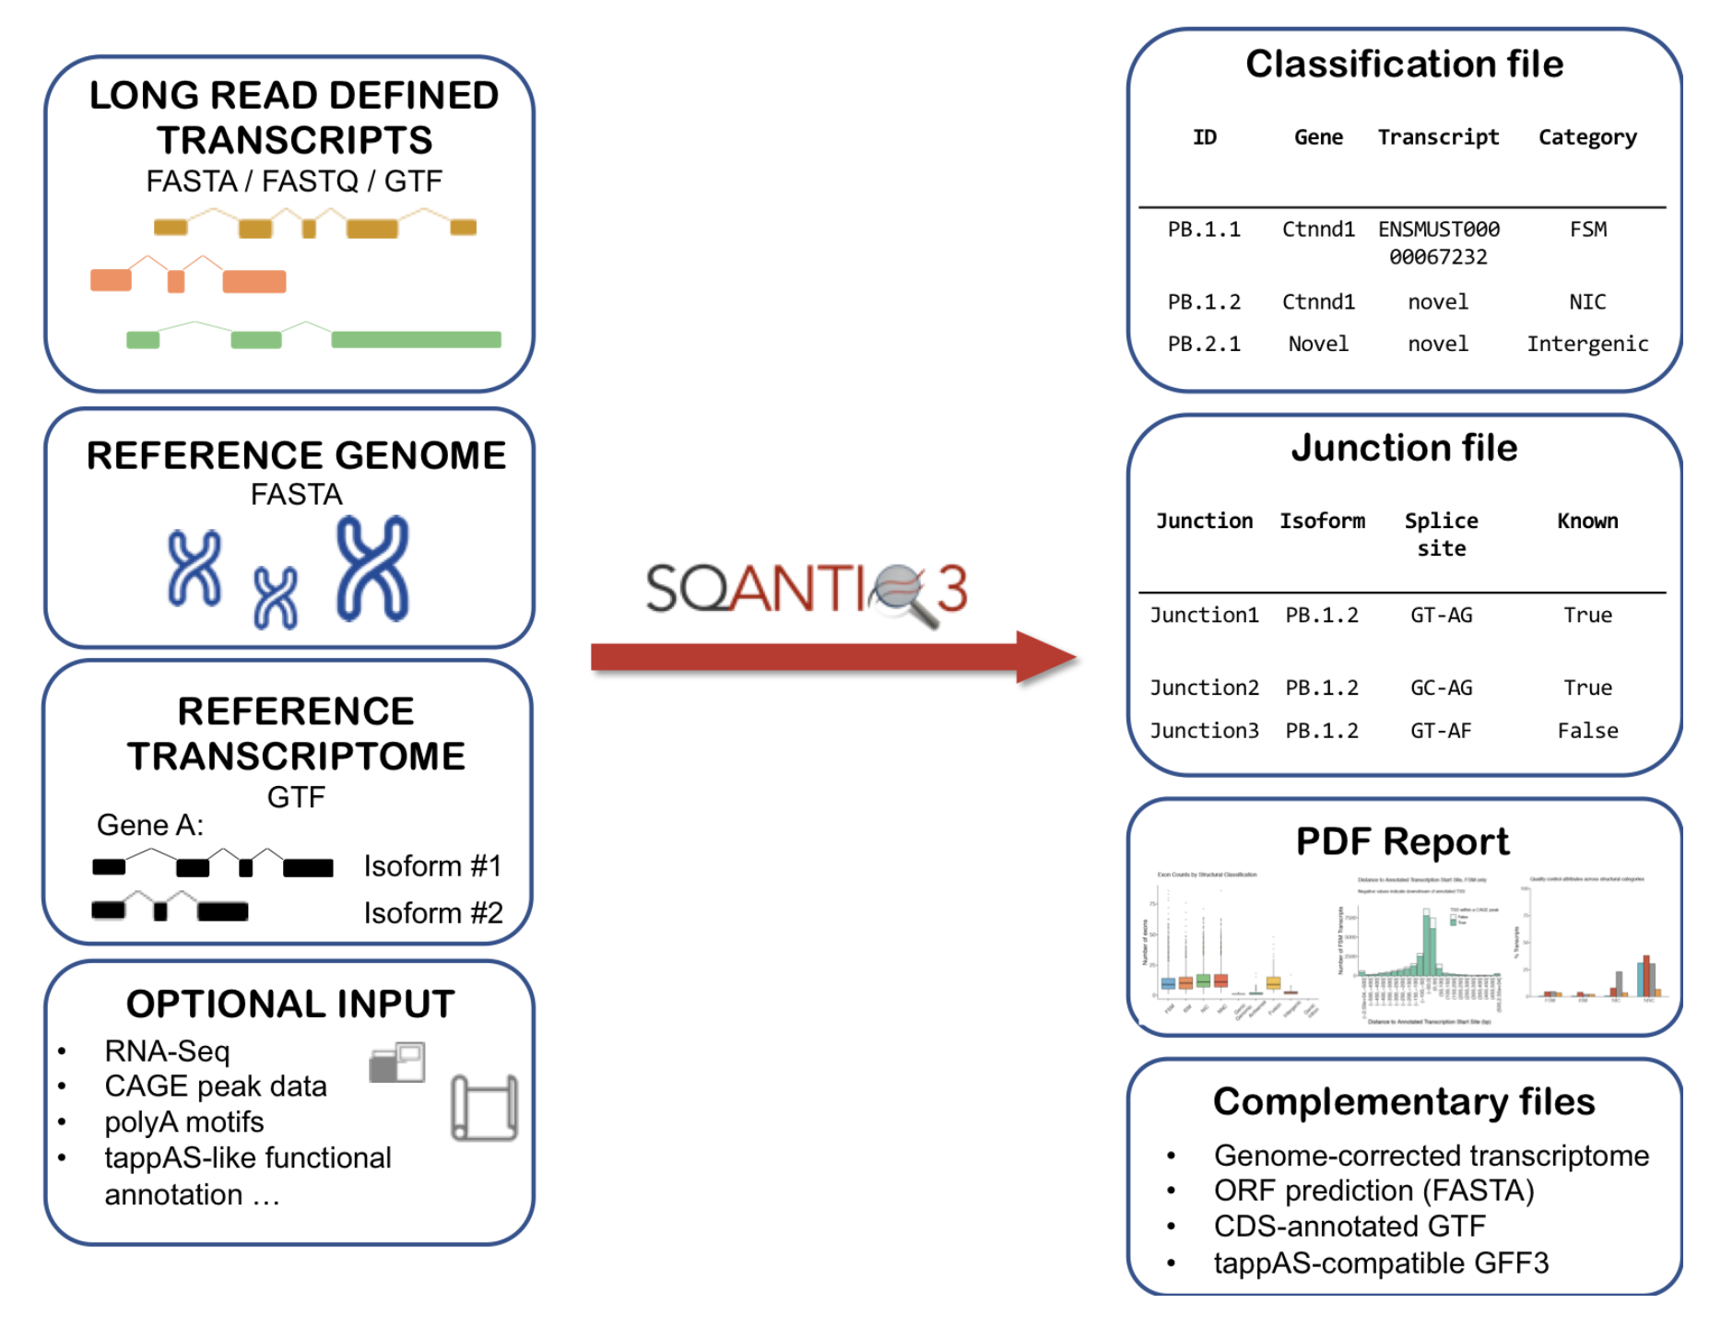
Solving problems: SQANTI-filter
CURATED
TRANSCRIPTOME
QC
Filter
Machine
Learning
Rules
Source: Pardo-Palacios. 2024. 10.1038/s41592-024-02298-3

Slide 32
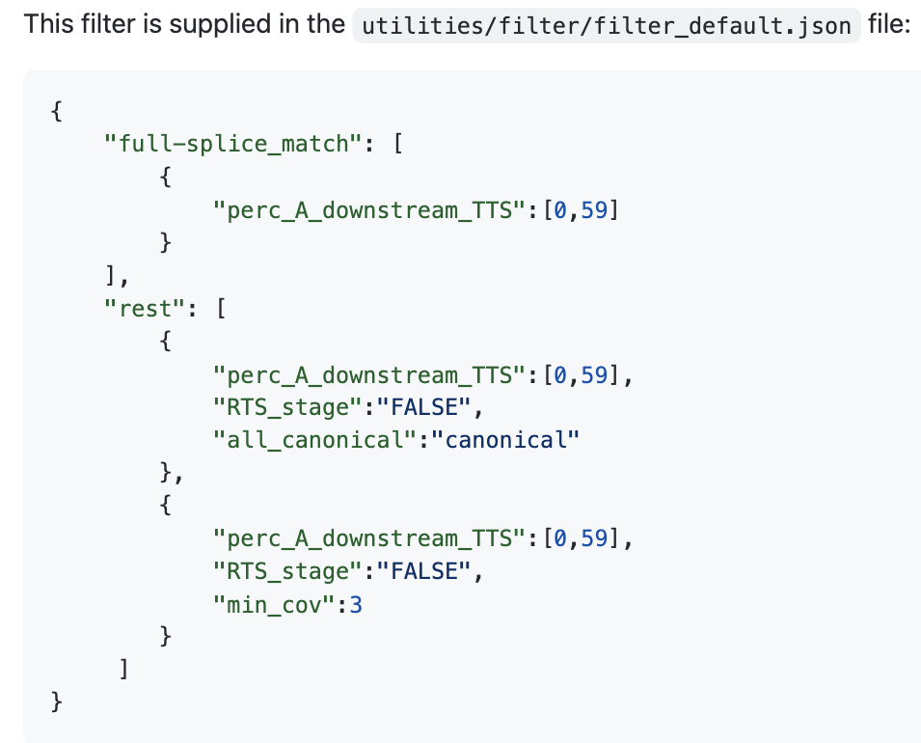


Solving problems: SQANTI-filter
Rules
ML
SQANTI variables
True & Negative Set
True: FSM reference match
Negative: NNC – non canonical
Non-canonical
Isoforms
Random Forest
ALL transcripts
Artifacts
Source: Pardo-Palacios. 2024. 10.1038/s41592-024-02298-3

Slide 33
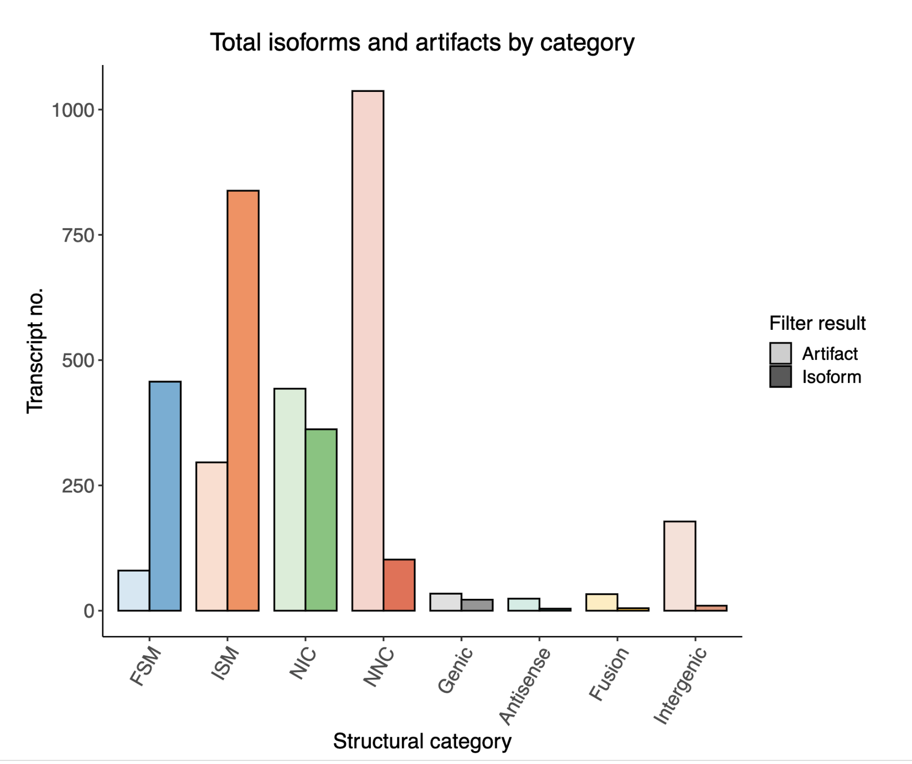
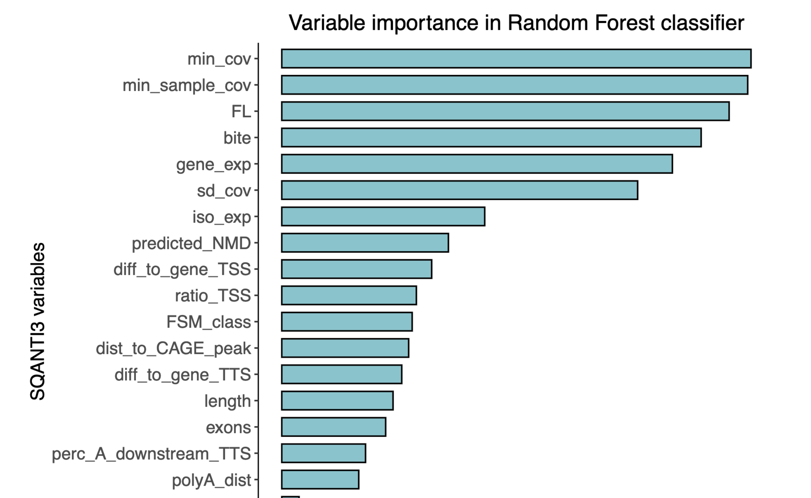
Clean transcriptome! And SQANTI-filter report
Source: Pardo-Palacios. 2024. 10.1038/s41592-024-02298-3

Slide 34

Bonus!! SQANTI-verse
SQANTI3
SQANTI-filter
SQANTI-rescue
SQANTI-reads
SQANTI-tusco
SQANTI-single-cell
SQANTI-browser
SQANTI-proteins
IsoAnnot
TappAS
…

Slide 35
Data Analysis Results
[Chart Area: Insert data visualization here]
The chart demonstrates the
key advantages
of long-read sequencing compared to short-read technologies:
Improved isoform detection
Better handling of repetitive regions
Direct detection of modifications
Data source: LongTREC consortium research, 2024

Slide 36


Thank You!
For more information about the LongTREC Summer School:
https://longtrec.eu

