Slide 1


Bioinformatics Summer School
Long-reads Transcriptomics
Nadja Nolte and Pablo Angulo Lara
National Institue of Biology. Slovenia
Italian Institute of technology. Italy
LongTREC - The Long-reads TRanscriptome European Consortium
Marie Skłodowska-Curie grant agreement No 101072892

Slide 2
Day 3
Haplotype analysis
Allele-specific expression – fundamentals and methodology

Slide 3
INDEX
Introduction to Allele specific expression.
Long-reads VS Short reads.
ASE analysis overview.
Haplotype assembly.
Read mapping to haplotype resolved assemblies.
Haplotype-specific quantification.
Quality control.
ASE testing.
Further steps.
Take-home messages.

Slide 4
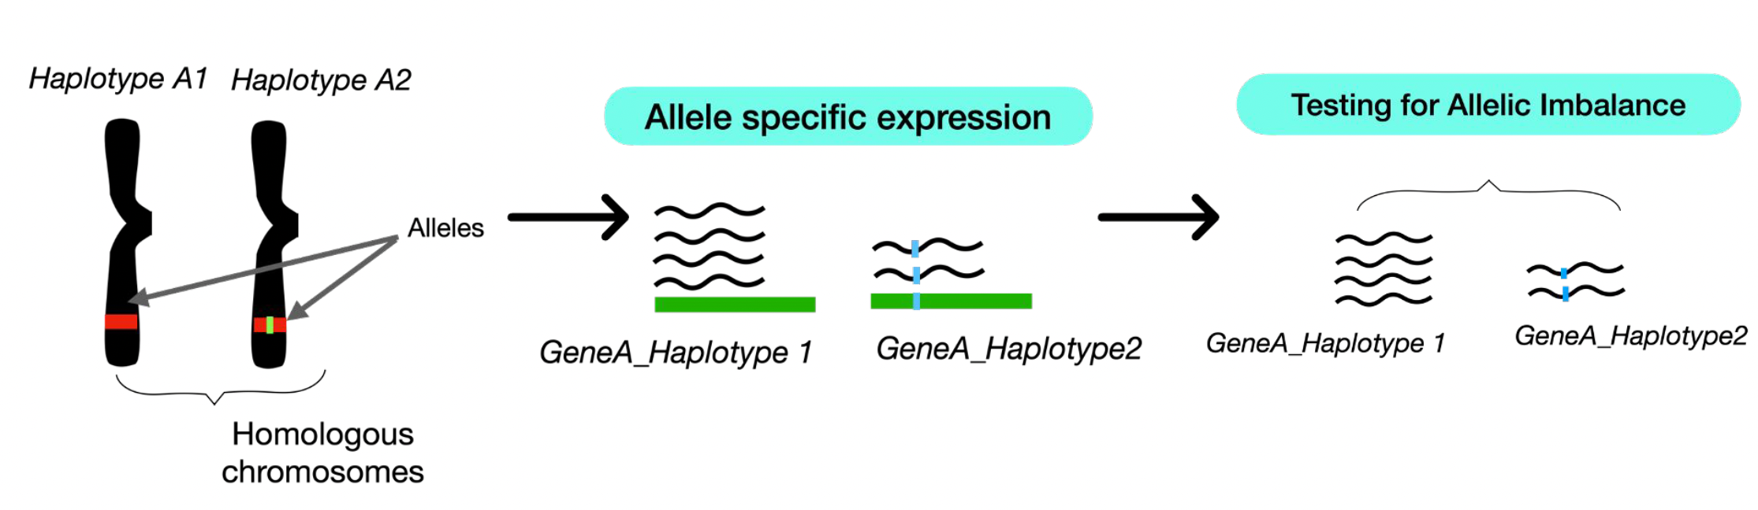
WHAT IS ALLELE-SPECIFIC EXPRESSION?
- Quantification of the expression of of the different alleles present in a gene.
- Allelic Imbalance (AI): unequal expression level between alleles.

Slide 5
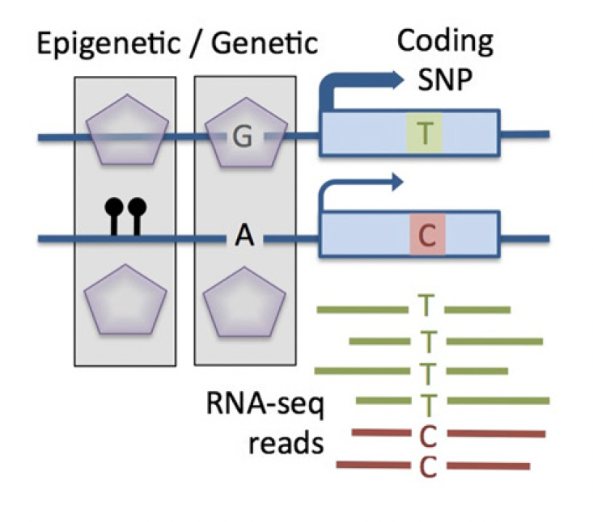
CAUSES OF ALLELIC IMBALANCE
Cis-regulatory mechanisms with epigenetic/genetic origin
Castel et al., Genome Biology, 2015

Slide 6
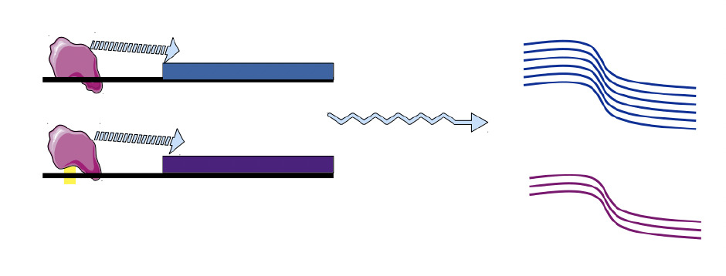
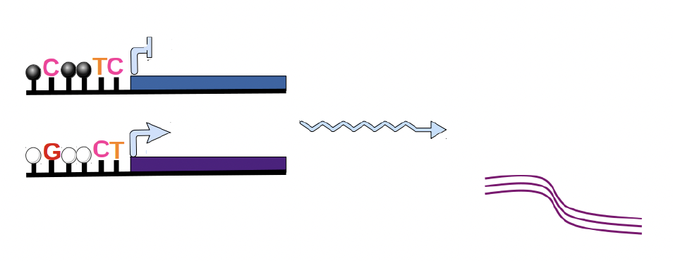
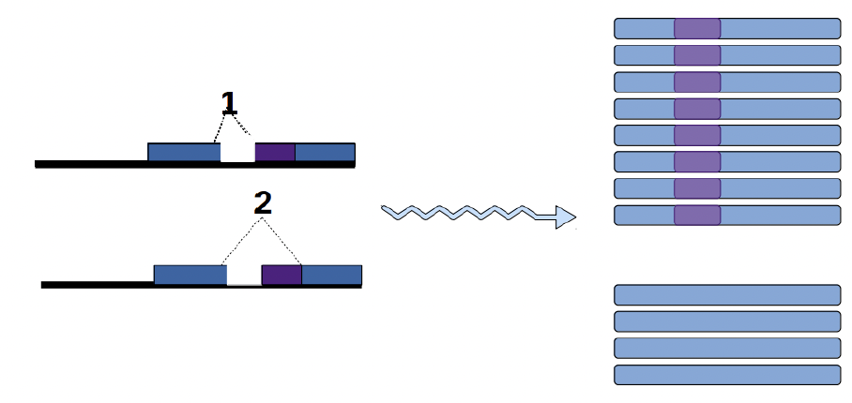
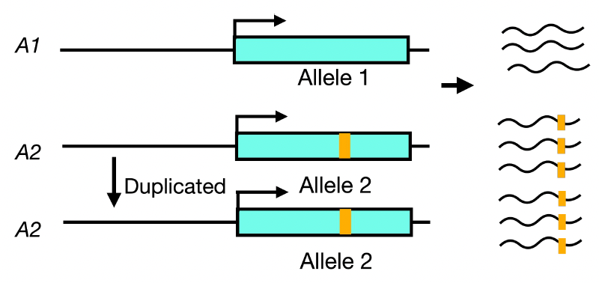
CAUSES OF ALLELIC IMBALANCE
Cis-regulatory mechanisms with epigenetic/genetic origin
Transcriptional level
Transcription factor binding affinity
Allele-specific DNA methylation
Cleary, S et al., Annual reviews, 2021
Cleary, S et al., Annual reviews, 2021
Alternative splicing
Somatic copy number variation
Cleary, S et al., Annual reviews, 2021

Slide 7
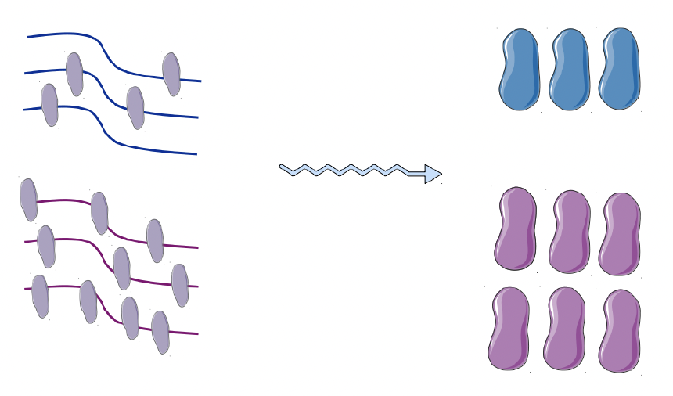
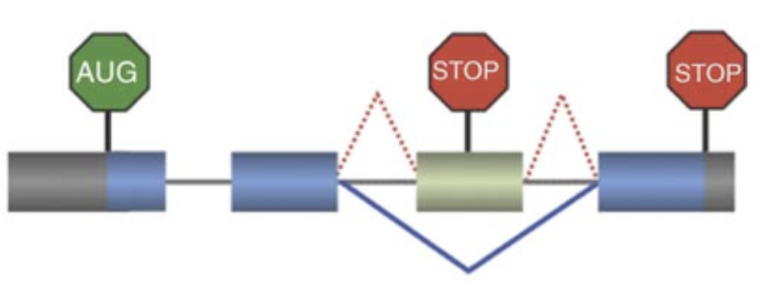
CAUSES OF ALLELIC IMBALANCE
Cis-regulatory mechanisms with epigenetic/genetic origin
Post - transcriptional level
RNA-binding proteins affinity
Non-sense mediated decay (NMD
Huang, L et al., WIREs RNA, 2009
Cleary, S et al., Annual reviews, 2021

Slide 8
CAUSES OF ALLELIC IMBALANCE
ASE analysis allows the identification of cis-regulatory mechanisms
Impact
X-chromosome inactivation.
Imprinting disorders.
Variability in complex disease susceptibility.
Dysregulation of cancer driver genes.
Castel et al., Genome Biology, 2015

Slide 9
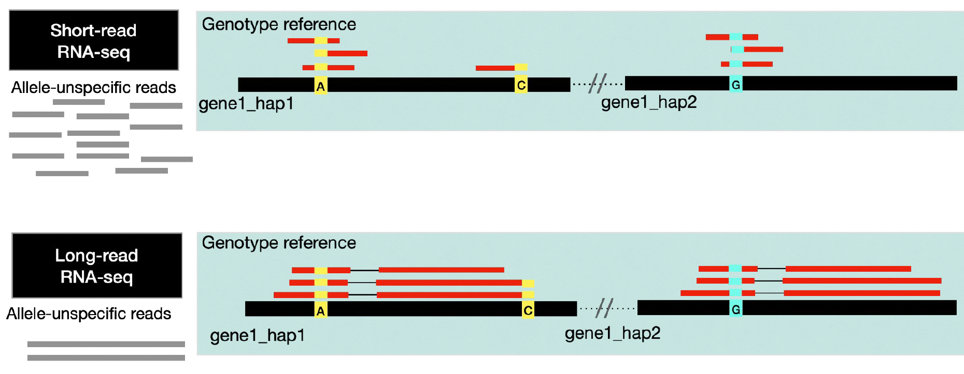
LONG READS VS SHORT READS
Advantages
Limitations
Full-length transcripts.
Enhance phasing of variants and haplotype assignment.
Less mapping bias.
Gene/Isoform level analysis.
Lower depth.
Technical variability.
Higher error rate.

Slide 10
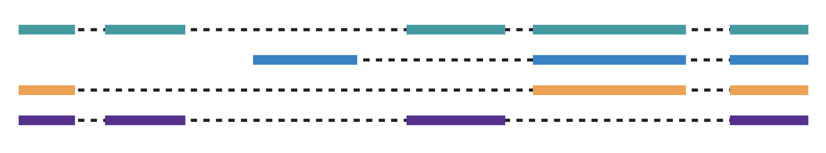


ASE ANALYSIS OVERVIEW
INPUT
Long read dataset
Reference assembly
Gene annotation (gff)
Read mapping
Haplotype specific quantification
ASE testing
Haplotype assembly
QC
Biological replicates: 3
Minimum coverage: 15-20X
WORKFLOW

Slide 11
HAPLOTYPE ASSEMBLY
+
-
Reference assembly (Haploid)
Variant calling
Phasing
Haplotag
Reference
Reference
Reference
Reference
Updated reference with phased SNPs
Mapping bias
Analysis complexity
Hap1
Reference
Hap2
Haplotype resolved assembly
-
+
Hap1
Hap2

Slide 12
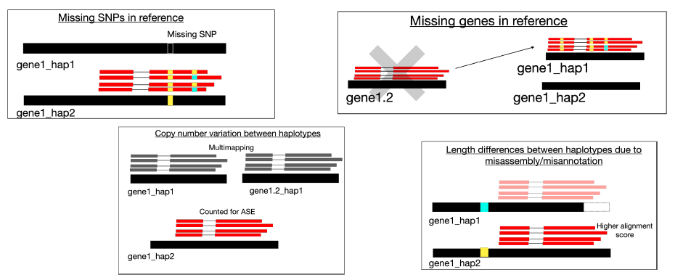
HAPLOTYPE ASSEMBLY: POTENTIAL BIASES
Check gene annotations and differences between haplotypes before starting the analysis
Missing SNPs.
Copy number in each haplotype.
Length difference.
Difference in number of exons.
Chromosome location.
Structural variations.

Slide 13
CHECK-IN QUESTIONS
Which are the main causes for allelic imbalance?
What are the benefits of using long reads for ASE analysis compared to short-read RNA-seq?
Which are the different strategies to build your haplotype assembly?

Slide 14
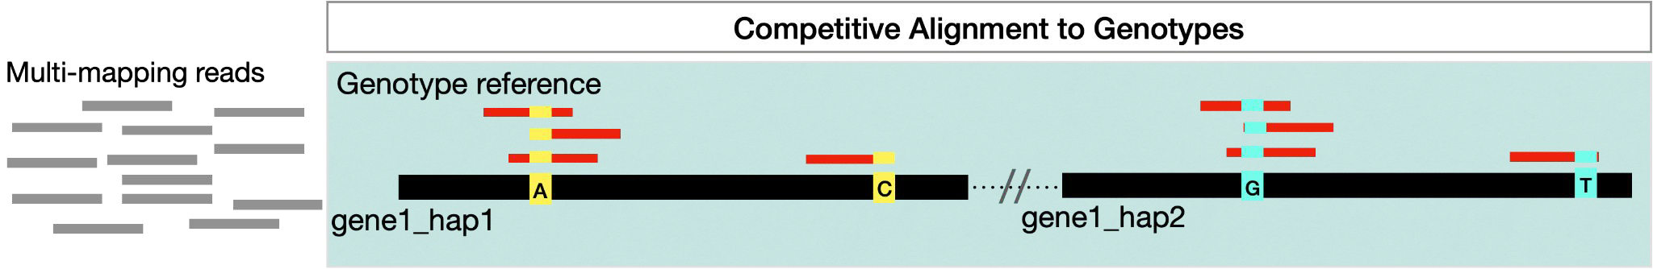
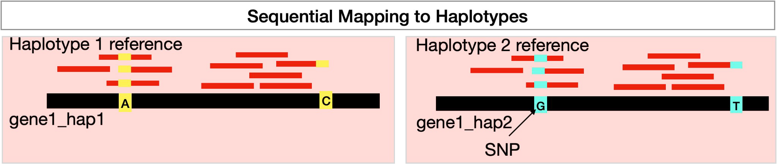
READ MAPPING
1. Mapping strategies
Important
Reads can map equally well to different locations increasing secondary alignments and MAPQ0
We don’t discard multimapping reads, secondary alignments or MAPQ0.
Mapping-score (ms) or Alignment Score (AS) can be used to evaluate alignment differences for the same read.

Slide 15
READ MAPPING
2. Selection of alignments with best mapping score
160
100
160
80
For every read, we select the alignments with best mapping-score (ms).
There can be multiple alignments with best ms (Align equally well) and MAPQ0.

Slide 16
READ MAPPING
2. Selection of alignments with best mapping score
160
160
For every read, we select the alignments with best mapping-score (ms).
There can be multiple alignments with best ms (Align equally well) and MAPQ0.

Slide 17
HAPLOTYPE-SPECIFIC QUANTIFICATION
Goal: classify reads in groups and quantify them by gene
Haplotype 1 (H1)
Read 1
Multimapping
Read 2
Haplotype 2 (H2)
Read 3
Multigene
Read 4
Gene specific (GS)

Slide 18
HAPLOTYPE-SPECIFIC QUANTIFICATION
1. Assignment of alignments to genes/isoforms
160
160
GeneA
GeneB
GeneC
GeneA
GeneB
GeneC
We can use a quantification tool to assign the alignments: FeatureCounts, Isoquant, Oarfish, etc.

Slide 19
HAPLOTYPE-SPECIFIC QUANTIFICATION
2. Classification of reads
Gene specific read (GS)
GS
GS
GeneA
GeneB
GeneC
GeneA
GeneB
GeneC
We can use a quantification tool to assign the alignments: FeatureCounts, Isoquant, Oarfish, etc.

Slide 20
HAPLOTYPE-SPECIFIC QUANTIFICATION
2. Classification of reads
GS
H2
GS
H1
H1
H2
GS
H1
H1
GS
H2
GS
H1
H1
GS
H2
H2
GeneA
GeneB
GeneC
GeneA
GeneB
GeneC
H1 - H1_multimapping - H1_multigene - H1_multimapping_multigene
H2 - H2_multimapping - H2_multigene - H2_multimapping_multigene
GS - GS _multimapping - GS _multigene - GS _multimapping_multigene
Non-haplotype-specific_complex - Non-haplotype-specific_complex_multimapping

Slide 21
HAPLOTYPE-SPECIFIC QUANTIFICATION
3. Quantification
GS
H2
GS
H1
H1
H2
GS
H1
H1
GS
H2
GS
H1
H1
GS
H2
H2
GeneA
GeneB
GeneC
GeneA
GeneB
GeneC
Gene | H1 | H2 | GS
A | 125 | 300 | 40
B | 500 | 490 | 30
C | 2 | 1 | 800
D | 30 | 700 | 2

Slide 22
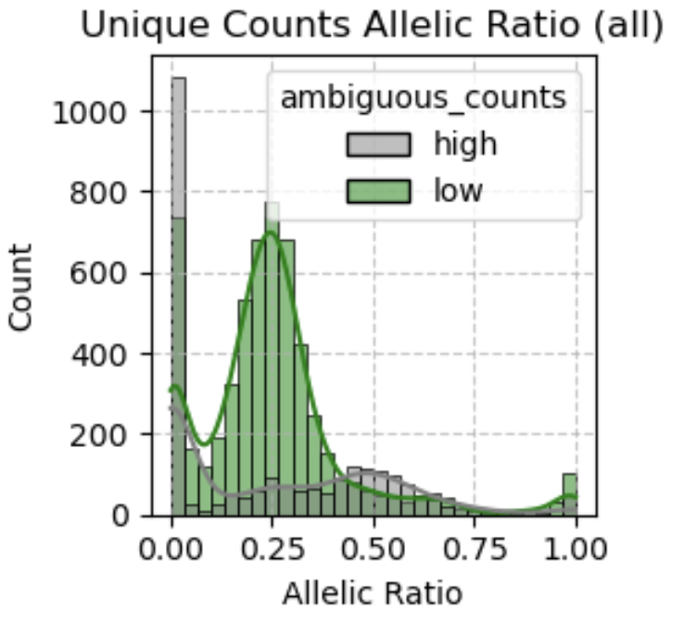
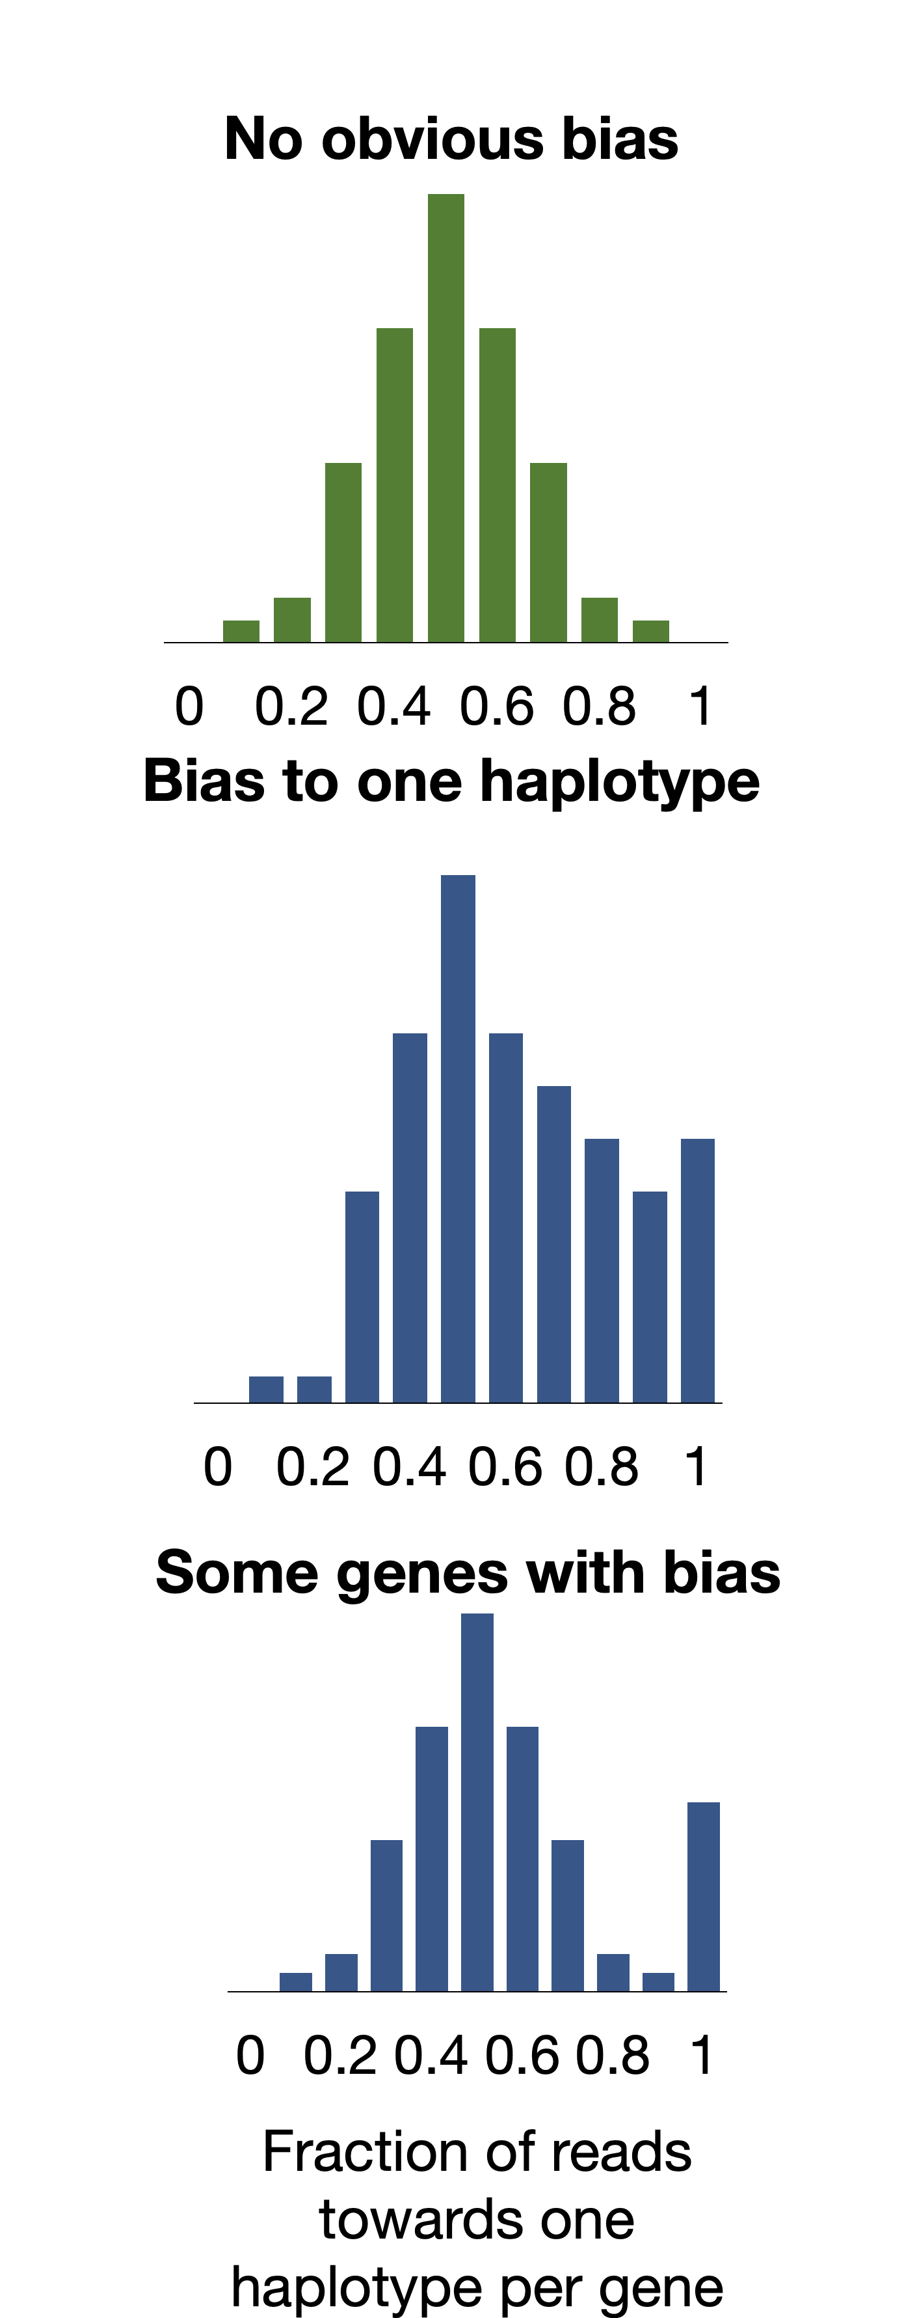
QUALITY CONTROL
Low expressed genes.
High multimapping ratio: low haplotype-specific signal.
High number of multigene assigned reads.
Mapping bias: Is there a strong bias to one of the haplotypes?
Allelic ratios (hap1/total counts)

Slide 23
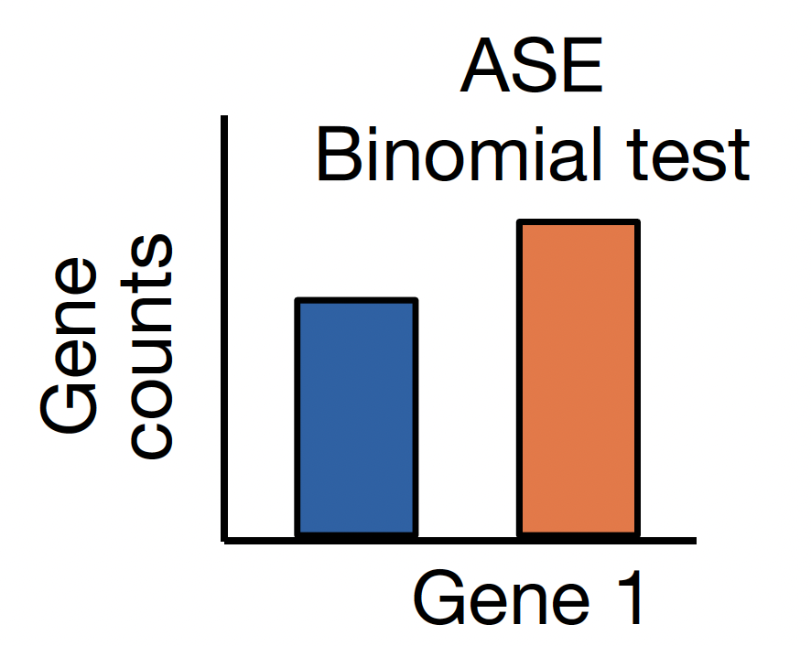
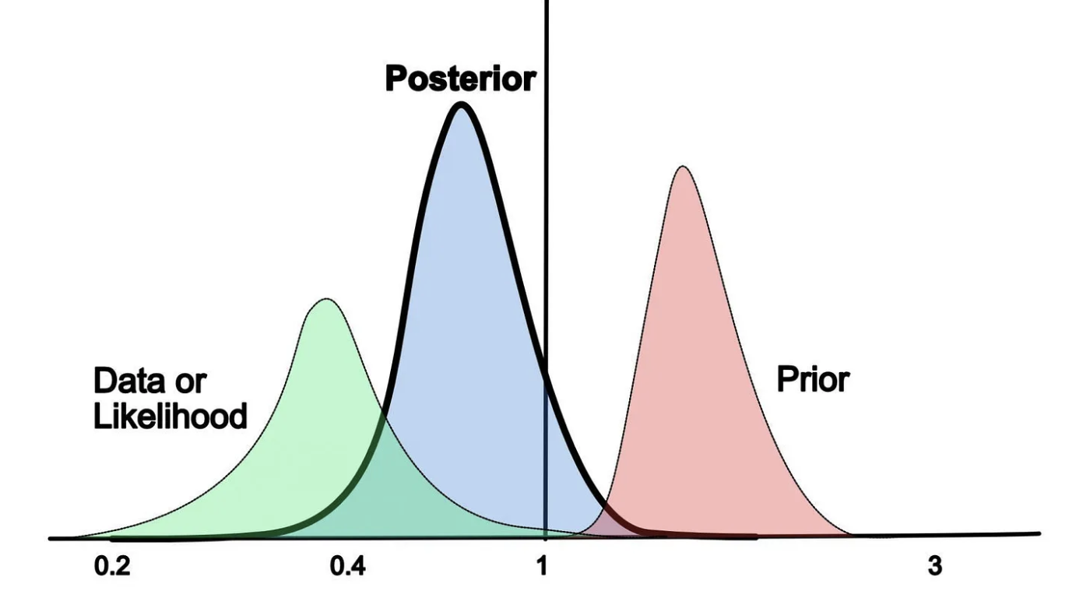
ASE TESTING
Null hypothesis: equal frequency from haplotypes.
Limitation: overdispersion.
Tools: LongcallR, LORALS, MBASED...
Binomial testing
Glinos D et al., Nature. 2022
Uses a prior distribution (genotype data or flat prior).
MCMC to calculate probability from posterior distribution.
Tools: IDP-ASE, BYASE, Skelly....
Bayesian model

Slide 24
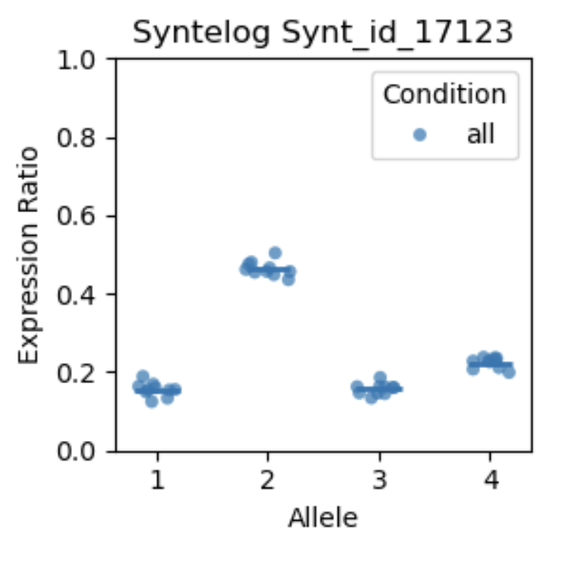
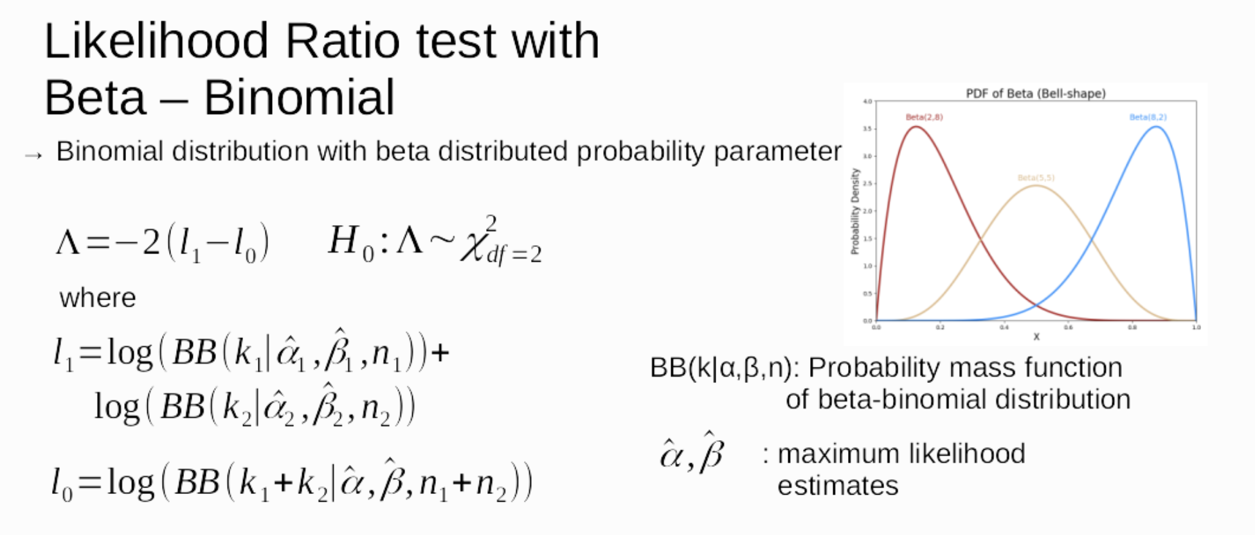
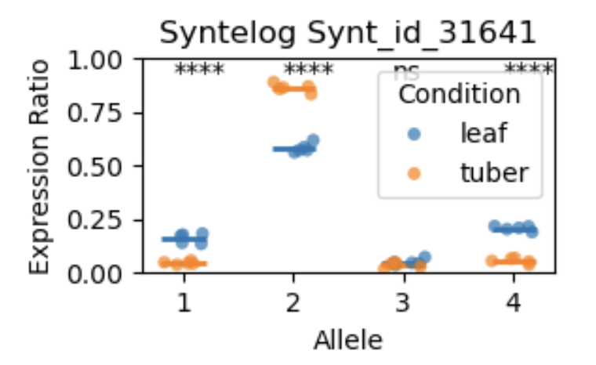
ASE TESTING
Polyase: allele-specific expression in polyploid plants
Within condition
Between conditions
Based on Isotools differential splicing test. Lienhard, M et al., Bioinformatics. 2023

Slide 25
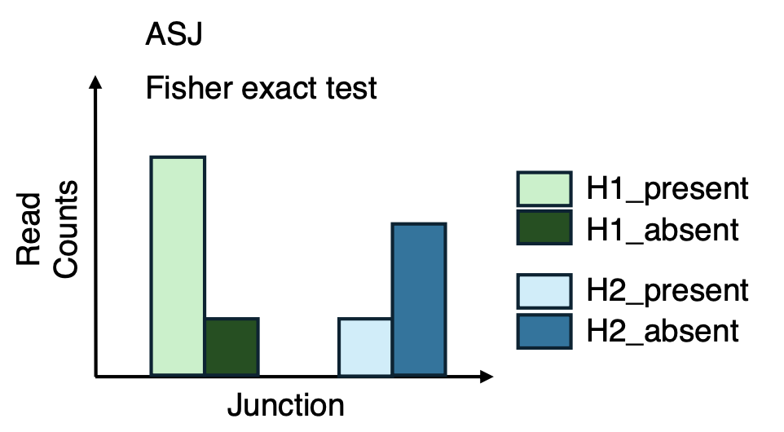
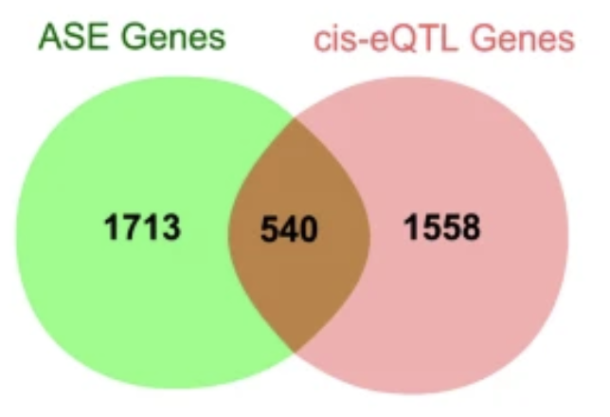
FURTHER STEPS
Differential allele-usage between isoforms
Validation of cis-eQTLs
Huang N et al., Biorxiv. 2025
Liu Y et al., Genetics Selection Evolution. 2020
Combination of ASE with overall differential gene/isoform expression.
Association of ASE with disease-related genetic variants detected with GWAS.
Detection of cis-regulatory elements (genetic variants, DNA methylation, NMD, SCNAs).

Slide 26
CHECK-IN QUESTIONS
Which are the main strategies for read mapping?
Which metric can we use to evaluate alignment differences by read?
How can we perform a quality control of the data before ASE testing?

Slide 27
TAKE-HOME MESSAGES
Allele-specific expression analysis is useful to detect cis-regulatory variants with impact in relevant biological processes.
It is important to characterize the differences between haplotypes prior to the analysis.
There are several sources of bias that can lead to false positives in the results.

Slide 28


Thank You!
For more information about the LongTREC Summer School:
https://longtrec.eu

Slide 29
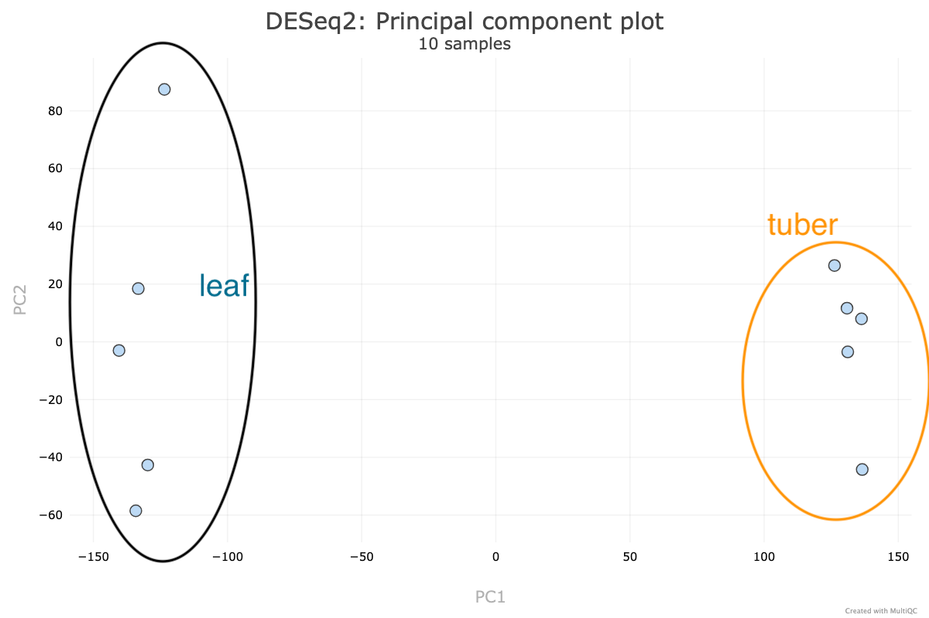

Hands-on: Allele-specific expression analysis in potato
Goal: Identify genes with allelic imbalance in one tissue and allelic changes between tissues

Slide 30
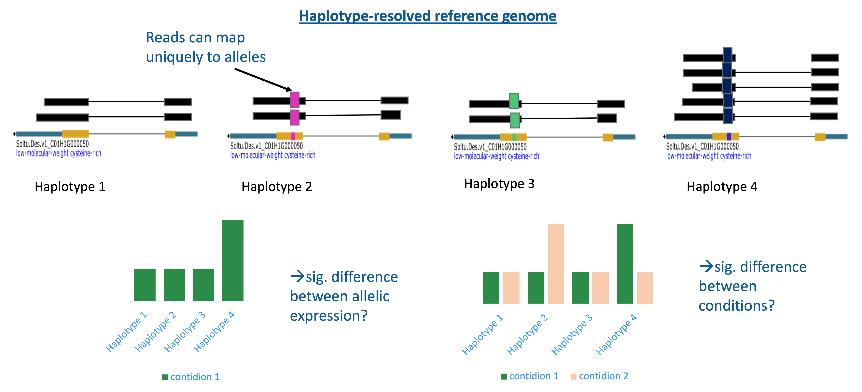
Hands-on: Allele-specific expression analysis in potato

Slide 31

Hands-on: Allele-specific expression analysis in potato
Connect to VM
Optional: download new notebook from git
conda activate polyase
cd longTREC/day3
jupyter lab notebooks/Jupyter_potato_allele_expression.ipynb

