Slide 1
ER continued, and
ER to Relational Mappings
R&G Chapters 2, 3
Lecture 22

Slide 2
Administrivia
Homework 4 Due Tuesday
Today: More on the ER Model & DB Design
Next week: Concurrency Control & Recovery

Slide 3
Review: the ER Model
name
ssn
lot
cost
pname
age
Employees
Policy
Dependents
Entities and Entity Set (boxes)
Relationships and Relationship sets (diamonds)
  binary
  n-ary
Key constraints (1-1,1-M, M-N, arrows on 1 side)
Participation constraints (bold for Total)
Weak entities - require strong entity for key
Next, a couple more “advanced” concepts…

Slide 4
ISA (`is a’) Hierarchies
name
ssn
lot
As in Java, attributes inherited.
If we declare A ISA B, every A entity is also considered to be a B entity.
Employees
hourly_wages
hours_worked
ISA
contractid
Hourly_Emps
Contract_Emps
Overlap constraints: Can Simon be an Hourly_Emps as well as a Contract_Emps entity? (Allowed/disallowed)
Covering constraints: Does every Employees entity also have to be an Hourly_Emps or a Contract_Emps entity? (Yes/no)
Reasons for using ISA:
  To add descriptive attributes specific to a subclass.
    i.e. not appropriate for all entities in the superclass
  To identify entities that participate in a particular relationship
    i.e., not all superclass entities participate
Notes:
12

Slide 5
Aggregation
name
ssn
lot
Used to model a relationship involving a relationship set.
Allows us to treat a relationship set as an entity set for purposes of participation in (other) relationships.
Employees
Monitors
until
started_on
since
dname
pid
pbudget
did
budget
Projects
Sponsors
Departments
Aggregation vs. ternary relationship?
Monitors is a distinct relationship, with a descriptive attribute.
Also, can say that each sponsorship is monitored by at most one employee.
Notes:
2

Slide 6
Conceptual Design Using the ER Model
ER modeling can get tricky!
Design choices:
  Should a concept be modeled as an entity or an attribute?
  Should a concept be modeled as an entity or a relationship?
  Identifying relationships: Binary or ternary? Aggregation?
Note constraints of the ER Model:
  A lot of data semantics can (and should) be captured.
  But some constraints cannot be captured in ER diagrams.
    We’ll refine things in our logical (relational) design
Notes:
3

Slide 7
Entity vs. Attribute
Should address be:
  attribute of Employees or
  an entity (related to Employees)?
Depends upon use of address information, and the semantics of the data:
    If several addresses per employee, address must be an entity (since attributes cannot be set-valued).
    If structure (city, street, etc.) is important, address must be modeled as an entity (since attribute values are atomic).

Slide 8
Entity vs. Attribute (Cont.)
from
to
name
dname
ssn
lot
did
budget
Works_In2 does not allow an employee to work in a department for two or more periods.
Similar to the problem of wanting to record several addresses for an employee: we want to record several values of the descriptive attributes for each instance of this relationship.
Employees
Works_In2
Departments
name
dname
ssn
lot
did
budget
Employees
Works_In3
Departments
from
Duration
to
Notes:
5

Slide 9
Entity vs. Relationship
OK as long as a manager gets a separate discretionary budget (dbudget) for each dept.
What if manager’s dbudget covers all managed depts?
(can repeat value, but such redundancy is problematic)
since
dbudget
name
dname
ssn
lot
did
budget
Employees
Manages2
Departments
name
ssn
lot
dname
Employees
did
budget
Departments
is_manager
managed_by
since
apptnum
Mgr_Appts
dbudget
Notes:
6

Slide 10
These things get pretty hairy!
Many E-R diagrams cover entire walls!
A modest example:

Slide 11
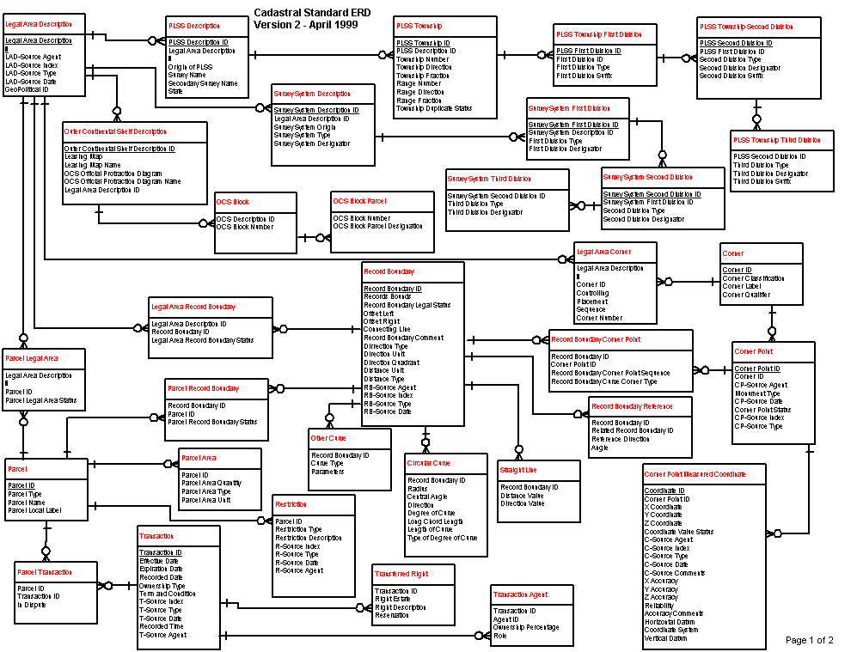
A Cadastral E-R Diagram
cadastral: showing or recording property boundaries, subdivision lines, buildings, and related details
Source: US Dept. Interior Bureau of Land Management,
Federal Geographic Data Committee Cadastral Subcommittee
http://www.fairview-industries.com/standardmodule/cad-erd.htm

Slide 12
Demo of a Real Tool

Slide 13
Next: Mapping ER Models to Relational Schemas

Slide 14
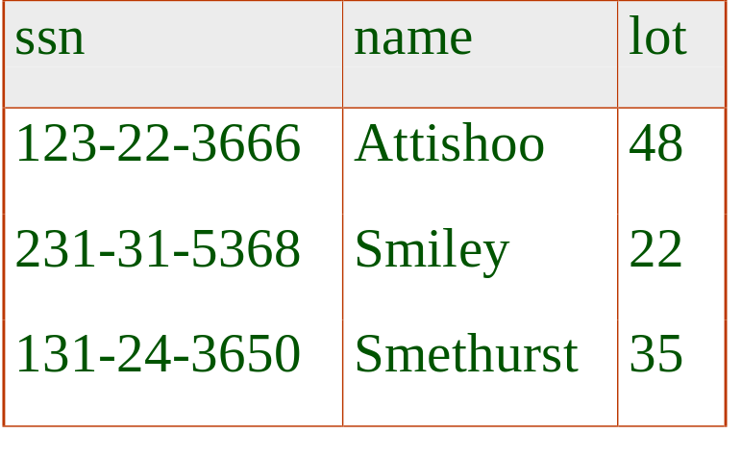
Logical DB Design: ER to Relational
Entity sets to tables.
name
ssn
lot
Employees
CREATE TABLE Employees
(ssn CHAR(11),
name CHAR(20),
lot INTEGER,
PRIMARY KEY (ssn))
Notes:
3
The slides for this text are organized into several modules. Each lecture contains about enough material for a 1.25 hour class period. (The time estimate is very approximate--it will vary with the instructor, and lectures also differ in length; so use this as a rough guideline.) This covers Lectures 1 and 2 (of 6) in Module (5).
Module (1): Introduction (DBMS, Relational Model)
Module (2): Storage and File Organizations (Disks, Buffering, Indexes)
Module (3): Database Concepts (Relational Queries, DDL/ICs, Views and Security)
Module (4): Relational Implementation (Query Evaluation, Optimization)
Module (5): Database Design (ER Model, Normalization, Physical Design, Tuning)
Module (6): Transaction Processing (Concurrency Control, Recovery)
Module (7): Advanced Topics

Slide 15
Relationship Sets to Tables
In translating a many-to-many relationship set to a relation, attributes of the relation must include:
  Keys for each participating entity set (as foreign keys).
    This set of attributes forms a superkey for the relation.
  All descriptive attributes.
since
name
dname
ssn
lot
did
budget
Employees
Works_In
Departments
Notes:
5

Slide 16
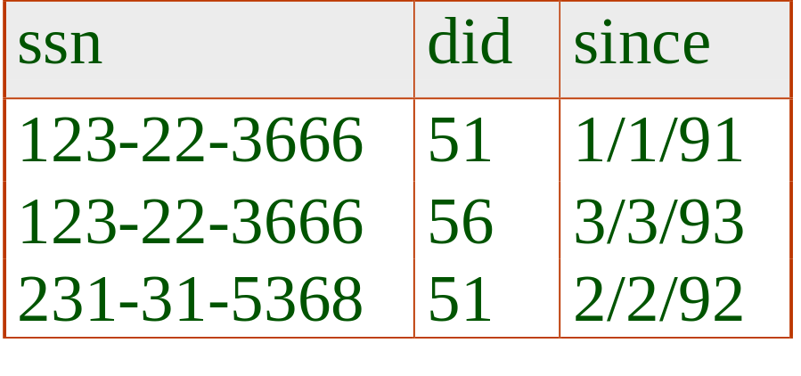
Relationship Sets to Tables
since
name
dname
ssn
lot
did
budget
Employees
Works_In
Departments
CREATE TABLE Works_In(
ssn CHAR(1),
did INTEGER,
since DATE,
PRIMARY KEY (ssn, did),
FOREIGN KEY (ssn)
REFERENCES Employees,
FOREIGN KEY (did)
REFERENCES Departments)
Notes:
5

Slide 17
Review: Key Constraints
since
Each dept has at most one manager, according to the key constraint on Manages.
name
dname
ssn
lot
did
budget
Employees
Manages
Departments
Translation to
relational model?
1-to-1
1-to Many
Many-to-1
Many-to-Many
Notes:
6

Slide 18
name
since
dname
ssn
lot
did
budget
Employees
Manages
Departments
Two approaches:
Map relationship set to a table:
  Note that did is the key now!
  Separate tables for Employees and Departments.
Since each department has a unique manager, we could instead combine Manages and Departments.
CREATE TABLE Manages(
ssn CHAR(11),
did INTEGER,
since DATE,
PRIMARY KEY (did),
FOREIGN KEY (ssn) REFERENCES Employees,
FOREIGN KEY (did) REFERENCES Departments)
CREATE TABLE Dept_Mgr(
did INTEGER,
dname CHAR(20),
budget REAL,
mgr_ssn CHAR(11),
since DATE,
PRIMARY KEY (did),
FOREIGN KEY (mgr_ssn) REFERENCES Employees (ssn))
Notes:
7

Slide 19
Review: Participation Constraints
Does every department have a manager?
  If so, this is a participation constraint: the participation of Departments in Manages is said to be total (vs. partial).
    If Manages becomes a table (1st approach) every did value in Departments table must appear in a row of the Manages table (with a non-null ssn value!)
since
since
name
name
dname
dname
ssn
did
did
budget
lot
budget
Employees
Manages
Departments
Works_In
since
Notes:
8

Slide 20
Participation Constraints in SQL
We can capture participation constraints involving one entity set in a binary relationship, but little else (without resorting to CHECK constraints).
CREATE TABLE Dept_Mgr(
did INTEGER,
dname CHAR(20),
budget REAL,
mgr_ssn CHAR(11) NOT NULL,
since DATE,
PRIMARY KEY (did),
FOREIGN KEY (mgr_ssn) REFERENCES Employees (ssn),
ON DELETE NO ACTION)
Notes:
9

Slide 21
Review: Weak Entities
A weak entity can be identified uniquely only by considering the primary key of another (owner) entity.
  Owner entity set, weak entity set must participate in a one-to-many relationship set (1 owner, many weak entities).
  Weak entity set must have total participation in this identifying relationship set.
name
ssn
lot
cost
pname
age
Employees
Policy
Dependents
Notes:
10

Slide 22
Translating Weak Entity Sets
Weak entity set and identifying relationship set are translated into a single table.
  When the owner entity is deleted, all owned weak entities must also be deleted.
CREATE TABLE Dep_Policy (
pname CHAR(20),
age INTEGER,
cost REAL,
ssn CHAR(11) NOT NULL,
PRIMARY KEY (pname, ssn),
FOREIGN KEY (ssn) REFERENCES Employees,
ON DELETE CASCADE)
Notes:
11

Slide 23
Review: ISA Hierarchies
name
ssn
lot
Employees
hourly_wages
hours_worked
As in C++, or other PLs, attributes are inherited.
If we declare A ISA B, every A entity is also considered to be a B entity.
ISA
contractid
Hourly_Emps
Contract_Emps
Overlap constraints: Can Joe be an Hourly_Emps as well as a Contract_Emps entity? (Allowed/disallowed)
Covering constraints: Does every Employees entity also have to be an Hourly_Emps or a Contract_Emps entity? (Yes/no)
Notes:
12

Slide 24
Translating ISA Hierarchies to Relations
General approach:
  3 relations: Employees, Hourly_Emps and Contract_Emps.
    Hourly_Emps: Every employee is recorded in Employees. For hourly emps, extra info recorded in Hourly_Emps (hourly_wages, hours_worked, ssn); must delete Hourly_Emps tuple if referenced Employees tuple is deleted).
    Queries involving all employees easy, those involving just Hourly_Emps require a join to get some attributes.
Alternative: Just Hourly_Emps and Contract_Emps.
  Hourly_Emps: ssn, name, lot, hourly_wages, hours_worked.
  Contract_Emps: ssn, name, lot, contractid
  Each employee must be in one of these two subclasses.
Notes:
13

Slide 25
Review: Binary vs. Ternary Rel’nships
name
ssn
lot
pname
age
If each policy is owned by just 1 employee:
  Key constraint on Policies would mean policy can only cover 1 dependent!
Employees
Covers
Dependents
Bad design
Policies
policyid
cost
name
pname
age
ssn
lot
Dependents
Employees
Purchaser
Beneficiary
Better design
Policies
policyid
cost
Notes:
7

Slide 26
Binary vs. Ternary Relationships (Contd.)
CREATE TABLE Policies (
policyid INTEGER,
cost REAL,
ssn CHAR(11) NOT NULL,
PRIMARY KEY (policyid).
FOREIGN KEY (ssn) REFERENCES Employees,
ON DELETE CASCADE)
The key constraints allow us to combine Purchaser with Policies and Beneficiary with Dependents.
Participation constraints lead to NOT NULL constraints.
CREATE TABLE Dependents (
pname CHAR(20),
age INTEGER,
policyid INTEGER,
PRIMARY KEY (pname, policyid).
FOREIGN KEY (policyid) REFERENCES Policies,
ON DELETE CASCADE)
Notes:
8

Slide 27
Ternary Relationships (cont.)
qty
Many-Many-Many relationship
Same as many-many: create table Contract with foreign keys to other 3 tables
Parts
Contract
Departments
Suppliers

Slide 28
Summary of Conceptual Design
Conceptual design follows requirements analysis,
  Yields a high-level description of data to be stored
ER model popular for conceptual design
  expressive constructs
  close to how people think
  Note: Many variations on ER model, Both graphically and conceptually
Basic constructs:
  entities,
  relationships, and
  attributes (of entities and relationships).
Some additional constructs:
  weak entities,
  ISA hierarchies, and
  aggregation.
Notes:
11

Slide 29
Summary of ER (Cont.)
Several kinds of integrity constraints:
  key constraints
  participation constraints
  overlap/covering for ISA hierarchies.
Some foreign key constraints are also implicit in the definition of a relationship set.
Many other constraints (notably, functional dependencies) cannot be expressed.
Constraints play an important role in determining the best database design for an enterprise.
Notes:
12

Slide 30
Summary of ER (Cont.)
ER design is subjective.
  often many ways to model a given scenario!
Analyzing alternatives can be tricky, especially for a large enterprise. Common choices include:
  Entity vs. attribute,
  entity vs. relationship,
  binary or n-ary relationship,
  whether or not to use ISA hierarchies,
  aggregation.
Ensuring good database design: resulting relational schema should be analyzed and refined further.
  Functional Dependency information and normalization techniques are especially useful.
Notes:
13

