Slide 1


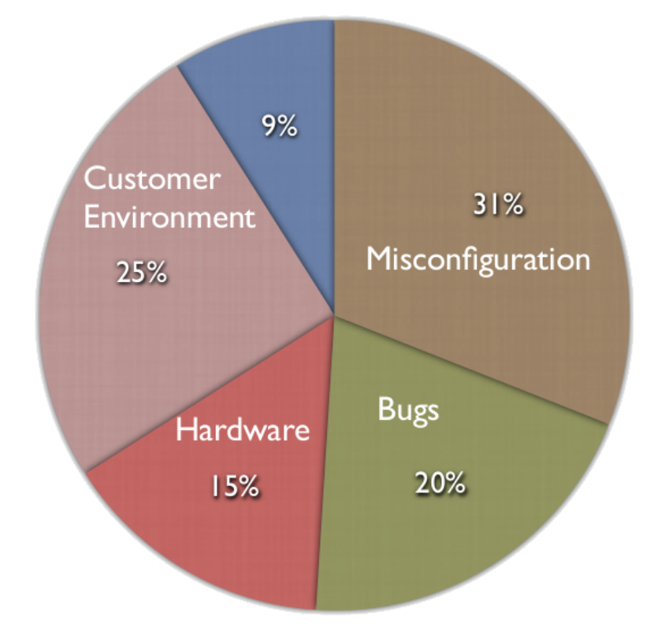
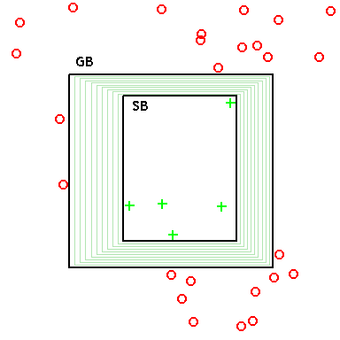
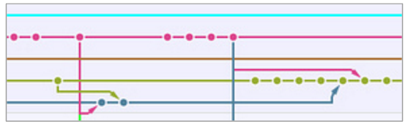
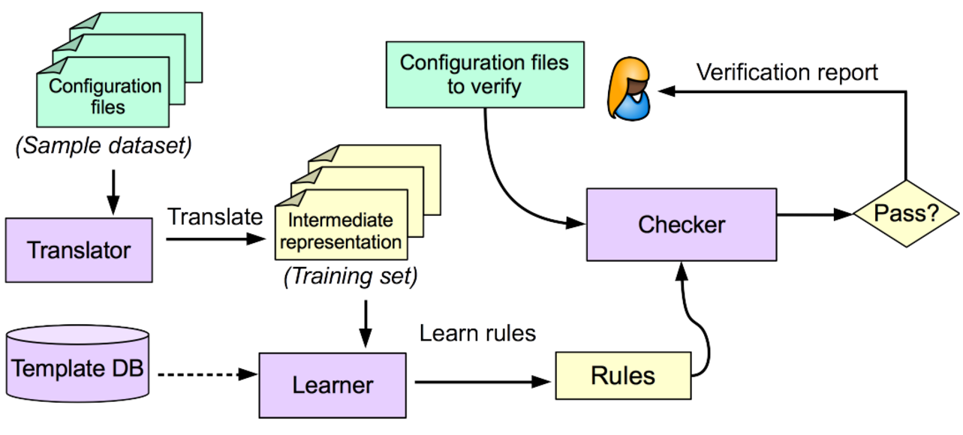

Version Space Learning for Verification on Temporal Differentials
Mark Santolucito
Ennan Zhai, Ruzica Piskac
Yale University
Motivation
Software or service failure are very expensive.
Software misconfiguration problems are the most common root-cause (31%), e.g., Amazon EC2 outage Apr 2011.
Misconfiguration examples
Solution Attempt #2
extension = mysql.so
… ...
extension = recode.so
Problem Type: Ordering error
Description: When using PHP in Apache, the extension “mysql.so” depends on “recode.so”. Thus, the order between them matters. The user configured the order in a wrong way.
Impact: Apache cannot start due to segment fault
We extend ConfigC to also build the general boundary – the set of weakest condition for a correct file.
Instead of building a concrete relation set from the learning files, we build an SMT formula in the theory of sets.
“recode.so” must be put before “mysql.so”
general_log = /var/log/mysql/mysql.log
Problem Type: Value type error
Description: The parameter “general_log” should be an integer, rather than path (string). In MySQL, there is another parameter “general_log_file” used to point the log path.
Impact: MySQL log cannot be correctly written.
Greatest Boundary = Breaking : {Relations}
Specific Boundary = Necessary : {Relations}
Status(F) = Pass ⇒ ∀r ∈ Relations (F), r ∉Breaking
Status(F) = Err ⇒ ∃r ∈ Relations (F), r ∈Breaking
The formula can be extended with extra observations - for example using temporal structures in the learning set.
Solution Attempt #1
In our previous work, ConfigC[1] can learn a language model from a learning set of configuration files by building a set of necessary relations over a learning set of correct files.
File F
A=1
B=2
C=3
Relations (F) =
{ A<B, B<C, A<C,
(A,B), (B,C), (A,C), A:Int, B:Int, C:Int, …}
Status(F1) = Pass ∧ Status(F2) = Err ⇒
∃r ∈ Relations (F1) `setDiff` Relations (F2), r ∈ Necessary ⋁
∃r ∈ Relations (F2) `setDiff` Relations (F1), r ∈ Breaking
Proposed Application
Travis Continuous Integration[2] service for testing
~30% of large projects on Github use TravisCI
15-20% of failed TravisCI builds are due to ”errors”
Since the start of 2014, approximately 88,000 hours of server time was used on TravisCI projects that resulted in an error status.
Because commits are incremental, set differences are small, which lets the SMT solver run relatively quickly.
Relations (F1) `setDiff` Relations (F2) << Relations (F2)
ConfigC is an instance of version space learning. But it only builds the specific boundary (Necessary set) – the strongest conditions for a correct file.
Error Type | Relations | Passing Tests | False Positives
Missing Entry | X in same files as Y | 5/5 | 1, 0, 0, 0, 4
Type Error | X : Int | 5/5 | 0, 0, 0, 0, 0
Keyword Ordering | X before Y | 5/5 | 0, 2, 1, 0, 6
Value Relations | X > Y, X=Y | 4/5 | 0, 0, 0, 1, 0
This is guaranteed to detect all incorrect files, but also generates many false positives – errors that are not true errors.
[1] M. Santolucito, E. Zhai, and R. Piskac, “Probabilistic automated language learning for configuration files,” in CAV, 2016, pp. 80–87.
[2] Z. A. Beller M, Gousios G, “Oops, my tests broke the build: An analysis of travis ci builds with github,” PREPRINT, 2016. [Online]. Available: https://doi.org/10.7287/peerj.preprints.1984v1
This work was funded in part by NSF grant #1302327
Notes:
<number>

