Slide 1

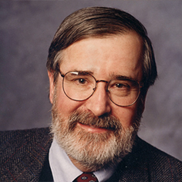
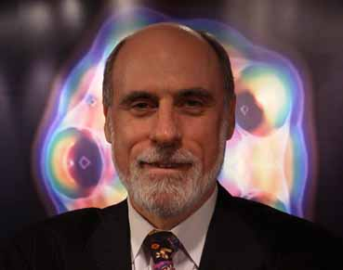
NETWORK VERIFICATION: WHEN CLARKE MEETS CERF
FOR PUBLIC CLOUDS, PRIVATE CLOUDS, ENTERPRISE NETWORKS, ISPs, . . .
TOOLS
George Varghese
UCLA
(with collaborators from CMU, MSR, Stanford, UCLA)
Notes:
It’s a pleasure to be here. I’d like to talk today about what could happen if the world of verification (symbolized by Ed Clarke, who thinks of programs as mathematical objects) met and worked with the world of network (symbolized by Vince Cerf, who likes working code, the TCP/IP headers) not just to think about networks in a new way but also to build tools for networks. This is joint work with collaborators at many institutions who I enumerate later.

Slide 2
Model and Terminology
1.8.*
Engineering
1.2.*
Accounting
1.2.*, SQL, Drop
1.2.*
1.2.*
1.
HTTP | 1.2.3.4
Routers, links, interfaces
Packets, headers
Prefix match rules, manually placed Access Control (ACL) rules
Notes:
Let me define terms I will use for non-networking people. A network is a collection of boxes called routers interconnected by links that forward packets from entry points like Engineering to exit points like Accounting. Each router forwards packets (Click) received on an input interface called an input port to an output interface called an output port. When you send an email attachment it is broken up into smaller messages called packets that have headers (Click) that include a destination Internet address like 1.2.3.4 (in the IP header) that specifies the endpoint and other information (in the TCP header) that indicate the application type (video, audio, web etc).
For the first port of the talk, I abstract a router as a collection of rules, where each rule is a match predicate and an action: a match occurs if certain bit positions in the header equal specified values; actions tell you how to forward matched packets. A packet is forwarded by following matching rules at routers till it reaches the exit point.
Most forwarding is done by prefix rules with wildcards such as 1.2.* that matches all packets going to destination addresses that start with 1.2 where each integer between dots represents a byte. When multiple prefixes match a packet, the longest prefix 1.2.3 at the second router, wins.
While prefix rules are built automatically using routing protocols, network operators can also manually add rules to drop or steer traffic called Access Control Lists (ACLs). (Click twice). These are more complex rules that can refer to other fields in the header such as the application type so that messages from different apps can be forwarded differently.
TRANSITION: Even the combination of automatically generated prefix rules and manually entered ACLs leads to enormous problems in large clouds today

Slide 3
Problem with Networks today
Shortest Path
D
S
Manual Configurations: Managers override default shortest paths for security, load balancing, and economic reasons
Data Plane + Control Plane: Vendor-specific knobs in both
Problem: Manually programming individual routers to implement global policy leads to cloud failures
Notes:
But to understand why correct design is hard it is important to see even why just understanding ordinary working networks such as lurk behind your university firewall is hard.

Slide 4
Manual Traffic “steering knobs”
Data forwarding/Data Plane:
  Access Control Lists (predicates on headers)
  VLANs (a way to virtualize networks)
  MAC Bridging Rules (ACLs at the Ethernet Level)
Routing/ Control Plane:
  Communities: equivalence classes on routes via a tag
  Static routes: a manager supplied route
  Local preference: “priority” of a route at this router regardless of global cost of the route
Managers use all these knobs for isolation, economics
Notes:
Manual reasoning is challenging fundamentally because there are too many headers to test. Looking for a bug in a bad ACL is like looking for a needle in a haystack. This is compounded by the scale and diversity of large clouds and the rapidity of deployment.
Others besides Microsoft find reasoning about networks challenging. A third of surveyed respondents had had one high severity problem per day. Google and Amazon have had high profile failures router config failures, and United Airlines in July shut down 59 flights because of a router configuration error.
But what brings it home to me the most is our dependence on services. We at Microsoft are transitioning our crown jewel Office from Office on disk to Office365 over the cloud at say $20 per month. If the operational expenditures of the network is significant, it will significantly affect our profits. As the world move to services, automated reasoning is imperative.

Slide 5

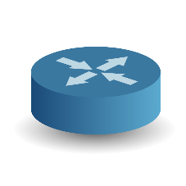


Why manual reasoning is hard
I
POLICY
Internet and Compute can communicate
Internet cannot send to controllers
Deny Any C UDP
Allow Any C
Allow C Any
B
E
Cluster C
F
G
H
DNS Services are now blocked!
Notes:
To illustrate why manual reasoning about correctness is hard, let me describe an incident that happened in a real cloud. The blue screens at the bottom are compute servers, the routers are the boxes with crosses and the policy was that the Internet hosts could communicate with the compute servers; however, there are privileged controllers such as the routers that the Internet hosts cannot send messages to.
Since enumerating all servers would take too many ACL rules the cloud operators had a general rule at Router B that allowed folks from the Internet to send and receive messages to and from *anyone* in cluster C. A security audit by an external auditor on Feb 8th found that this allowed an external laptop to attack a router like E using a so-called UDP message. They tried to close this security hole (CLICK) by adding a rule at N which denied UDP traffic from the Internet to send to the cluster. This ought to work because communicating with the compute cluster requires a different protocol called TCP.
(CLICK)
They forgot that the Domain Name Service, also used UDP ; the result of this “fix” was that a good service was now blocked.
This kind of manual trial-and-error reasoning about reachability goes on a great deal, alternating between leaving security holes and denying access to valid users. It often brings down large swaths of the network when done wrongly or leaves dangerous security gaps.
TRANSITION: Manual reasoning is hard

Slide 6
Why automated reasoning is imperative
Challenges: 2^{100} possible headers to test!
  Scale: devices (1000s), rules (millions), ACL limits (< 700)
  Diversity: 10 different vendors, > 10 types of headers
  Rapid changes (new clusters, policies, attacks)
Severity: (2012 NANOG Network Operator Survey):
  35% have 25 tickets per month, take > 1 hour to resolve
  Welsh: vast majority of Google “production failures” due to “bugs in configuration settings”
  Amazon, GoDaddy, United Airlines: high profile failures
As we migrate to services ($100B public cloud market), network failure a debilitating cost.
Notes:
Manual reasoning is challenging fundamentally because there are too many headers to test. Looking for a bug in a bad ACL is like looking for a needle in a haystack. This is compounded by the scale and diversity of large clouds and the rapidity of deployment.
Others besides Microsoft find reasoning about networks challenging. A third of surveyed respondents had had one high severity problem per day. Google and Amazon have had high profile failures router config failures, and United Airlines in July shut down 59 flights because of a router configuration error.
But what brings it home to me the most is our dependence on services. We at Microsoft are transitioning our crown jewel Office from Office on disk to Office365 over the cloud at say $20 per month. If the operational expenditures of the network is significant, it will significantly affect our profits. As the world move to services, automated reasoning is imperative.

Slide 7
Simple questions hard to answer today
  Which packets from A can reach B?
  Is Group X provably isolated from Group Y?
  Is the network causing poor performance or the server?
  Why is my backbone utilization poor?
NEED BOTTOM UP ANALYSIS OF EXISTING SYSTEMS
Notes:
As we have seen, even simple questions about a network are hard to answer. We don’t know which packet headers from A can reach B let alone secucirty questions like whether group X is isolated from Y. There are also important quantitative questions such as whether the network is causing poor performance or the server and why the utilization of our backbones is poor. What we need urgently and minimally today is bottom-up automated analysis of existing systems.
For most of this talk we will restrict ourselves to bottom up analysis of existing systems to answer these questions using automated reasoning based on formal methods.

Slide 8
Formal methods have been used to verify (check all cases) large programs and chips (FMCAD!)
Can we use formal methods across all headers, & inputs for large clouds?
Notes:
What we would ideally like is to verifying reachability across all sources and destinations and headers rather than test some cases. Formal methods have been used before in hardware and software, so why not in networking?

Slide 9
Approach: Treat Networks as Programs
Model header as point in header space, routers as functions on headers, networks as composite functions
P1
Packet
Forwarding
P2
Action
Match
0xx1..x1
Send to interface 2
Rewrite with 1x01xx..x1
CAN NOW ASK WHAT THE EQUIVALENT OF ANY PROGRAM
ANALYSIS TOOL IS FOR NETWORKS
Notes:
Our broad philosophical approach is based on treating a network as a program. To a networking person like Vint Cerf, a router forwarding rule consists of matching some bits in the header and then forwarding to an output port after possible rewriting. This does abstract across the diversity of manufacturers but is hard to reason about mathematically.
Instead, (CLICK) a Programmibg Languages/Verifiation person like Tony Hoare may think of every bit as being a dimension and a packet header as having saying a 100 relevant bits for forwarding (the IP headers and TCP minimally), then perhaps a more geometric view is that all possible headers form a header space of 2^100 packets in a 100 dimensional space, together with one extra dimension for the interface the packet is currently at. Each match rule maps from a subspace (a hypercube) anchored at an input interface to a hypercube anchored at an output interface. An input packet is a point that is mapped to an output packet which is just another point in this header space.
The forwarding rules in a router become a set of guarded commands: if you match space A, map to space A’; if you match space B, map to space B’ etc. So the forwarding behavior of a router becomes a program. We then compose the router programs to form a network program that takes points at the network entrance and transform them via intermediate spaces to points at the network exit.
If the network with its cabling and boxes is abstracted as a large program, this suggests we build PL tools for networks: static checkers, compilers, and debuggers. We will develop this thought later but for now lets concentrate on building only a static checker for reachability.

Slide 10
Problems addressed/Outline
Classical verification tools can be used to design static checkers for networks but do not scale
  Part 1: Scaling via Symmetries and Surgeries (POPL 16)
Bugs exist in the routing protocols that build forwarding tales
  Part 2: Control Plane Verification (OSDI 2016)
A vision for Network Design Automation (NDA)
Notes:
The rest of the talk is an attempt to answer this broad question. First, you must wonder why classical verification engines like SAT solvers and Model checkers cannot just be repurposed. We tried and found they scaled badly to large networks and header spaces. Worse, they provide only one counterexample rather than all counterexamples, when a packet reaches some place it should not. I will first describe a network verification technique called Header Space Analysis that works well for medium size networks and provides all counterexamples
Second, while the fastest tools like Veriflow take less than a second to verify reachability between one pair of stations there are a large number of pairs in a data center that can make overall verification times take 2 days which is too slow. I will describe very recent work that allows us to scale to such
Large networks by exploiting symmetries in existing designs.
Finally, instead of analyzing messy existing networks, I will provide a brief vision of correct by construction designs as part of what might call network design automation. I will focus on synthesizing router microcode and only briefly touch on synthesizing network programs.

Slide 11


Scaling Network Verification
(Plotkin, Bjorner, Lopes, Rybalchenko, Varghese, POPL 2016)
- exploiting regularities in networks
- symmetries and surgeries
Scaling Network Verification
Control Plane Verification
Notes:
I start with a technique for automated static reasoning about router forwarding rules and a way to scale to very large data centers. This work began when Gordon Plotkin and I were forced into each other’s company after they fired most other folks at MSR in Silicon Valley!

Slide 12
Formal Network Model [HSA 12]
1 - Model sets of packets based on relevant header bits, as subsets of a {0,1, *}^{L} space – the Header Space
2 – Define union, intersection on Header Spaces
3 – Abstract networking boxes (Cisco routers, Juniper Firewalls) as transfer functions on sets of headers
4– Compute packets that can reach across a path as composition of Transfer Functions of routers on path
5. Find all packets that reach between every pair of nodes and check against reachability specification
All Network boxes modelled as a Transfer Function:
Notes:
Recall from the last time that our first step in handling the reachability problem was to abstract across the variety of headers in networking such as Ethernet, IP etc. and just represent packets in terms of the relevant headers that matter for forwarding as ternary strings of 0s, 1s, and wildcards. This has two aspects: every prefix or ACL rule is just a ternary string, but also the sets of packets that match a rule or flows from a router input interface to an output interface is also a set of such ternary strings.

Slide 13

Computing Reachability [HSA 12]
All Packets that A
can possibly send
All Packets that A can possibly
send to box 2 through box 1
A
Box 1
Box 2
T₂(T₁(X,A))
T₁(X,A)
T₄(T₁(X,A))
All Packets that A can
possibly send to box 4
through box 1
Box 4
Box 3
B
T₃(T₂(T₁(X,A)) U T₃(T₄(T₁(X,A))
COMPLEXITY DEPENDS ON HEADERS, PATHS, NUMBER OF RULES
Notes:
We can put these tools to work to compute all packet headers if any that can reach between any two hosts, say A and B.
Here is the problem statement. We get to read all the rules of all the routers in network statically before packets are sent in run time. Some can be Cisco routers others Arista firewalls. We have parsers that represent these different synactic forms into the header space representation so we can answere reachability questions such as all headers from A can reac B
Modern SAT solvers do not do this; they only give you 1 header that will not reach.
To do so, we inject the space of all packets headers that A can send into box 1; algebraically, this a packet with wildcards in all L bit.
When this space is passed through the transfer function at box 1 it can split into two subspace, the headers from A that reach box 2 though box 1, and the headers from A that reach box 4 through box 4. Applying this procedure recursively at Box 2 and Box 4 and Box 3 almost like a simulation except that we are treating large sets of packets in one step, we get the set of packets that reach B from A as the composition of the transfer functions of the routers in all possible paths.
But since packets may be rewritten, we must invert them to find the set of packets that A actually sent that reach B.
The basic algorithm can easily extended to verify other reachability predicates such as ensuring that packets from A through B pass through a security middlebox C, or that two groups are isolated.
This looks easy and is only around 12 lines using the higher level constructs like composition, union and inverses. But the real problem is scalability. Without care, the number of header spaces at intermediate routers can fragment into millions of pieces, and there can be an exponential number
of paths to consider most of which will never be used.
We need a data structure to compress intermediate header spaces and enables quickly eliminating useless paths. We call this data structure a difference of cubes because the representation is the difference of unions of hypercubes.

Slide 14

Unfortunately, in practice . . .
Header space equivalencing: 1 query in < 1 sec. Major improvement over standard verification tools like SAT solvers and model checkers
But our data centers: 100,000 hosts, 1 million rules, 1000s of routers, 100 bits of header
So N^2 pairs takes 5 days to verify all specs.
Notes:
What is the scaling problem? We have 100,000 hosts in our large data centers. Header Space and all existing techniques take less than a second to verify all headers between one pair of hosts, but we can N^2 pairs of hosts, and a naïve implementation takes 5 days to check all reachability specifications. But really, data centers are designed very uniformly. Can we exploit this to make all-pairs verification much faster say less than a minute to make this part of operational networks.

Slide 15
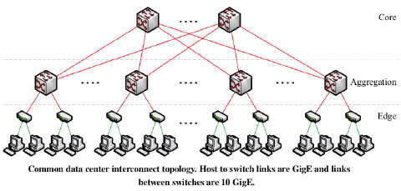
Exploit Design Regularities to scale?
Symmetry
Can exploit regularities in rules and topology (not headers):
Reduce fat tree to “thin tree”; verify reachability cheaply in thin tree.
How can we make this idea precise?
Notes:
Most company data centers are laid out in fat tree topologies with considerable redundancy and load balancing between equivalent routers at each level of the topology. Thus one might expect considerable symmetry between rule sets at equivalent routers. We show how to reduce a fat tree to an equivalent thin tree and verify reachability cheaply in the thin tree.

Slide 16


Logical versus physical symmetry
(Emerson-Sistla): Symmetry on state space
(Us): Factor: symmetries on topology, headers Define symmetry group G on topology
Theorem: Any reachability formula R for holds iff R’ holds for quotient network
Notes:
The classical program to exploit symmetry in model checking works by defining symmetries on the state transition graph. The state for reachability is the header h and the interface portp it is at in the network. We are interested in reachability transitions where a header h at port p reaches in any number of transitions another interface p’. Symmetries are then defined by mappings pi of the state transition graph onto itself, such that a transition in the unmapped network occurs iff it occurs in the mapped network.
pioneered by Emerson defines a permutation group on the entire state space of the program to be verified. For network reachability the state is the bits in a header h and the port p is at. In the classical approach, we would define a permutation group of automorphisms on this composite state space and show that any reachability formula such as h at port p can reach port p’ after being rewritten to h’ is true iff the corresponding formula when suitably modified in the permuted network is true.
This classical program has been difficult to achieve however because of the difficulty of finding such groups automatically (intuitively as hard as graph isomorphism). Instead, we choose to factor the symmetries into symmetries on the headers and symmetries on the state space. Putting aside symmetries on the header space (which are addressed by Difference of Cubes) we focus on symmetries on the topology. We define a symmetry group G on the topology which is a set of nodes and links on the physical topology which when permuted appropriately make no difference to reachability. We can then literally divide out the original network by this group G (which really amounts to computing the equivalence classes and replacing each group by a representative) and call this N/G. We then prove using bi-simulation that any reachability formula (defined in a suitably general modal logic that can express fairly complex reachability conditions) holds iff it holds in the the quotient network. Of course, the bottom line is that the quotient network has fewer components and rules and hence is easier to verify.
Note that we avoid the Emerson-Sistla difficulties because we do not aim to find all symmetries but particular symmetries we can easily identify (such as between pairs of routers at the same level which are available in the topology data) and this can easily be verified

Slide 17
Topological Group Symmetry
Z
Z
R1
R2
R1
R2
R3
R4
Transforms to
R3
R5
R5
X
Y
X
Y
REQUIRES PERFECTLY SYMMETRICAL RULES AT R3 & R4.
IN PRACTICE, A FEW RULES ARE DIFFERENT.
Notes:
In pictures, consider the simple fat tree on the left. We have marked with dashed lines the permutations on the topology that leave unchanged the reachability between stations like X and Y and Z. For example, we can interchange R3 and R4 as long as we interchange their links to their neighbors appropriately.
The quotient network then is just one representative for each pair that has been permuted so we replace R3 and R4 by one representative R3 bar. Unfortunately this requires . . .

Slide 18
Near-symmetry → rule (not box) surgery
Transform (Redirect
X to R3 only in R1, R2
Transform (Remove
X Rule in R4
X
R2
R1
X
X
X
X
R2
X
X
R1
R1
R2
X
X
X
X
R3
R4
X
X
R3
R4
R4
X
X
R3
X
R5
R5
R5
X
X
Instead of removing boxes, “squeeze” out redundant rules iteratively by redirection and removal. How to automate?
Notes:
We can deal with near-symmetry by looking for symmetries at a less coarse level: rules and not boxes. Consider rules for forwarding packets to destination x from the cloud. From the standpoint of reachability, assuming there are no ACLs that spoil the symmetry at R1 and R2, we might as well route traffic to X via R3 alone which we can do by removing some load balancing rules. Once we have done so, the x rule in R4 is “orphaned” and we can remove it as well. Note that this only works for strict reachability questions and not for quantitative questions like are there two disjoint paths to x from the cloud. We keep doing this and the vast majority of symmetric rules are drained out of backup ro uters leaving only a small residue of locally specific or buggy rules.

Slide 19
Step 1: Compute header equivalence classes (Yang-Lam 2013)
1** →
*1* →
REWRITE PREFIXES AS UNION OF DISJOINT
SETS EACH OF WHICH GETS AN INTEGER LABEL
L1, L3 →
L2, L3 →
Notes:
How do we find which rules are equivalent so they can be removed without actually computing paths in the first place which would defeat the point. One can cheat by trying to annotate which routers are supposed to be backups and then look for equivalent rules within backups. However, we wanted a more general algorithm that is completely automatic.
We start first by decomposing the set of possible headers on which rules operate into equivalence classes: symmetries of headers. For example, if one router has a rule that operates on 1** and the second on *1* these two sets intersect. We first rewrite these sets as disjoint regions and then give each disjoint region an integer label. We can then treat each disjoint set of headers as separate universes that do not interact

Slide 20
Computing labels in linear time
1**
11*
*1*
L1
L3
L2
Efficiently compute labels using a graph
on sets that we call a ddNF, takes linear
time on our datasets
Notes:
The disjoint regions correspond to disjoint regions on a Venn diagram as one would expect. But if we try and compute the Venn diagram naively we may compute N squared intersections between every pair of header guards. With a million rules that would be slow. Instead we devised a data structure called a ddNF in which sets are represented as nodes in a DAG and we place an edge from u to v if v is a subset of u and there is no larger subset of u in the DAG. In the common case, the ddNF can be built in close to linear time because when we add a new header we only need traverse a single path from the root to a leaf. The labels then correspond to nodes in the graph where each node represents a set of headers that must be differenced from all its children in order to make it disjoint

Slide 21
Step 2: compute interface equivalence classes via Union-Find
X
R2
R1
X
X
X
X
k ≡ l
k
l
x
R3
R4
X
X
i
j
i ≡ j
x
R5
e ≡ e
e
x
X
For each header equivalence class, find all equivalent interfaces
Notes:
Once we have done this we create several logical networks one for each header label and now we can implement the rule removal idea by computing equivalence classes on ports or interfaces with respect to a header. For example, edges I an j are equivalent with respect to j because they both lead to edge e and then to x. This in turn makes k and l equivalent. This in turn allows us to see that the two rules for x at R1 are equivalent and we can remove one of them. Similarly, we can do the same for the rules at R2. The equivalemce class algorithm is very fast because we use Union-Find data structure which has almost linear running time in the number of ports being equivalence. Note that This algorithm is very general and can work on arbitrary topologies and will find whatever symmetries exist and is not just confined to fat trees in data centers.

Slide 22
Exhaustive verification solutions
Header equivalence classes: 2¹⁰⁰ → 4000
Rule surgery: 820,000 rules → 10K rules
Rule surgery time → few seconds
Verify all pairs: 131→ 2 hours
65 x improvement with simplest hacks. With 32-core machine & other surgeries → 1 minute goal
→ Can do periodic rapid checking of network invariants. Simple version in operational practice
Notes:
The bottom line is that the apparent complexity of a large data center collapses. 2^100 headers become 4000 header equivalence classes and the rule surgery reduces nearly a million rules to less than 10,000. Each of the 4000 networks we verify per header class is much simpler than the original network because we replace each symmetry class by a representative. Verifying all pairs now goes from 131 hours to 2 hours using the simplest surgeries. Using some parallelism and more surgeries, we hope to meet our 1 minute goal for exhaustive (that is all, pairs) verification in a minute. We have automated all of these transformations.

Slide 23
Ongoing work
Limitation | Research Project
Booleans only (Reachability) | Quantitative Verification (QNA)
No incremental way to compute header equivalence classes | New data structure (ddNFs) Venn diagram intersection
Data plane only: no verification of routing computation | Control Space Analysis (second part of talk)
Correctness faults only (no performance faults) | Data-plane tester ATPG (aspects in Microsoft clouds)
Stateless Forwarding Only Work at Berkeley, CMU
Notes:
What have we have done so far is useful but limited. We are working to extend it for example from reasoning about Booleans like reachability to quantitative metrics like bandwidths. Further, HSA ignores the routing protocols which build the forwarding tables in which many bugs lurk; we are developing something we called Control Space Analysis (with folks at CMU and UCLA) to verify routing protocols like BGP. We also built an accompanying run time tester that checks performance by sending crafted test packets called ATPG which is partially used at Microsoft. HSA is also limited to stateless rules; work at Berkeley and CMU extends this analysis to stateful rules like NAT.

Slide 24
Progress in Data Plane Verification
FlowChecker (UNC 2009): reduces network verification to model checking. Not scalable
Anteater (UIUC 2011): reduces to SAT solving. One counterexample only
Veriflow (UIUC 2012): Finds all headers using header equivalence classes
HSA(Stanford 2012): Header Space Analysis
Atomic Predicates(UT 2013): Formalizes Header ECs and provides algorithm to precompute them
NoD(MSR 2014): Reduces to Datalog, new fused operator
Surgeries (MSR 2016): Exploits symmetries to scale
Notes:
More gen

Slide 25
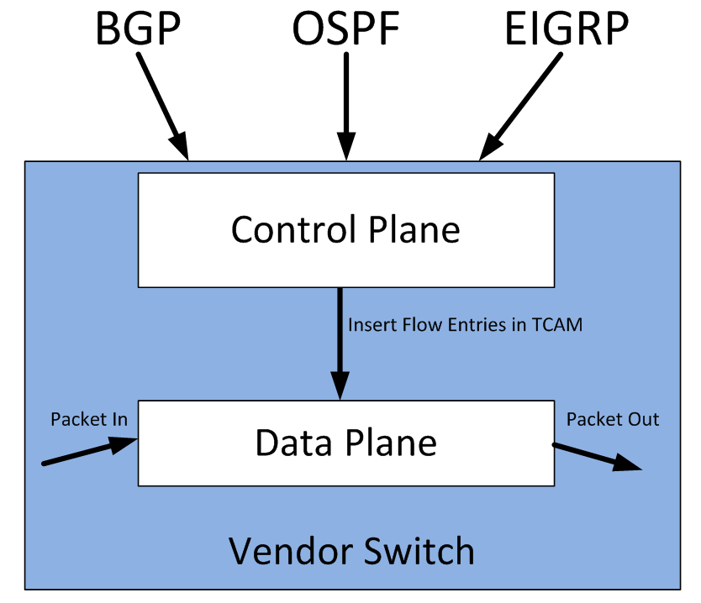
Topic 2: Control Plane Verification
Fayaz et al, OSDI 2016
Data Plane Scaling
Control Plane Verification
Notes:
Before we worry about synthesizing networks, I’d like to start to peek inside the hood and look at the inside of a router. Today the inside of a router is tightly written low level microcode. Could we instead write a high level specification of a router and synthesize the microcode within a router? This has become interesting in recent years because of a new movement towards flexible or reconfigurable routers
I’d like to give you a quick flavor of what router synthesis may look like by describing two problems for reconfigurable routers:
Table allocation, analogous to register allocation and code generation for stage microcode

Slide 26
But there is also a Control Plane
Can reach 1.2 in 1 hop
1.2.*
Accounting
1.2.*
1.2.*
1.2.*
Can reach 1.2 in 2 hops
1.2.*
Data Plane (DP): Collection of forwarding tables and logic that forward data packets, aka Forwarding
Control Plane (CP): Program that takes failed links, load into account to build data plane, aka Routing
Notes:
Lets see the control versus data plane distinction in a simple picture. Assume that Engineering wants to send expenses to accounting and accounting is all addresses that start with 1.2., So the two routers on top have forwarding rules that route packets with such destinations addresses to the right. But now suppose the topmost link fails. In order to still get our expenses paid, we need some other protocol to change the forwarding rule at the upper left router to reroute packets via the bottom router. So informally, the data plane is the collection of . . . and the control plane s

Slide 27
BGP Routing: Beyond shortest path
Route1 (p, . .)
Route2 (p, . .)
LP = 120
LP = 80
Route Processing Policy
Static Route
For p
Static Routes take precedence
Then come local preferences at this router (higher wins)
Then comes some form of path length
And more . . .
Notes:
Lets see the control versus data plane distinction in a simple picture. Assume that Engineering wants to send expenses to accounting and accounting is all addresses that start with 1.2., So the two routers on top have forwarding rules that route packets with such destinations addresses to the right. But now suppose the topmost link fails. In order to still get our expenses paid, we need some other protocol to change the forwarding rule at the upper left router to reroute packets via the bottom router. So informally, the data plane is the collection of . . . and the control plane s

Slide 28
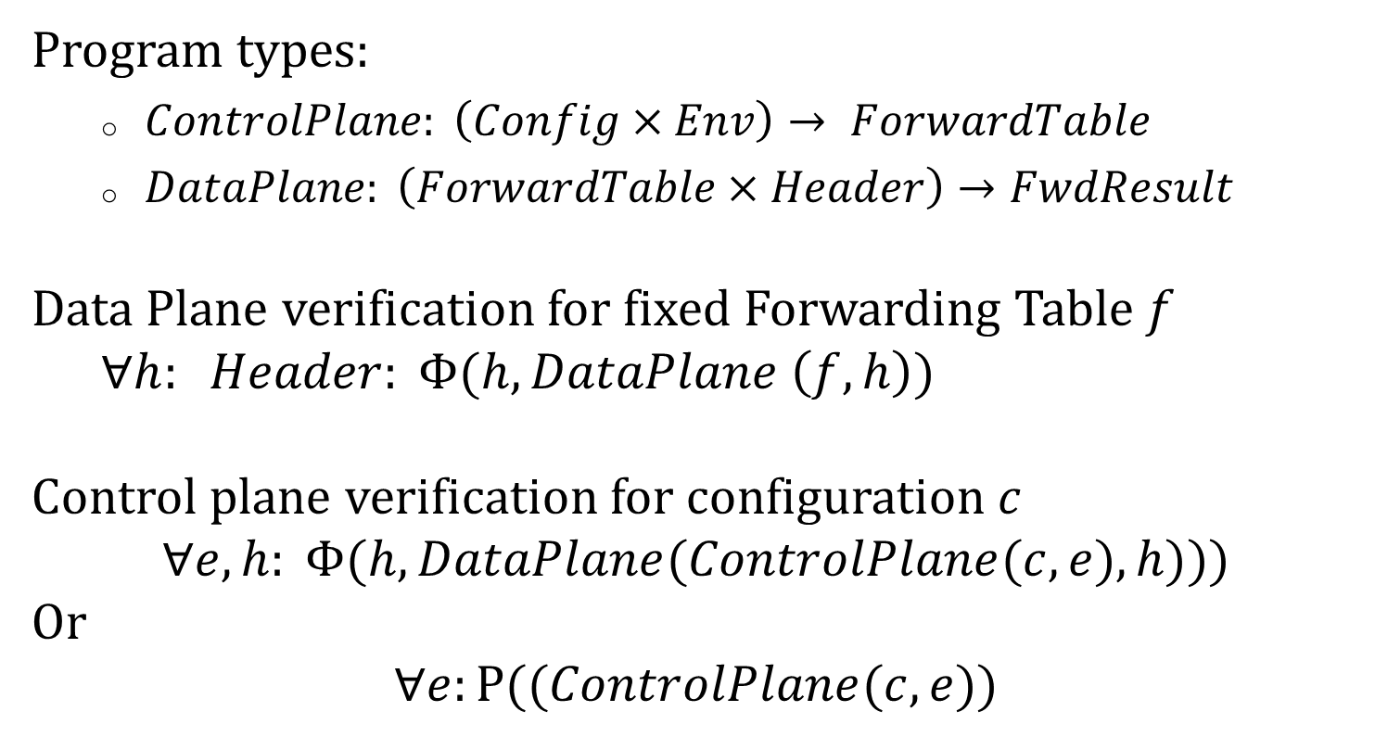
Control versus Data Plane Verification
Program types:
  $ControlPlane: \left(Config×Env\right)→ ForwardTable$
  $DataPlane: \left(ForwardTable×Header\right)→FwdResult$
Data Plane verification for fixed Forwarding Table $f$
$∀h: Header: Φ(h, DataPlane \left(f, h\right))$
Control plane verification for configuration $c$
$$∀e, h: Φ(h, DataPlane(ControlPlane(c, e), h)))$$
Or
$$∀e:P((ControlPlane(c, e))$$
Notes:
We can be mildly more formal about by saying the control plane maps a set of configurations (remember those additional directives at each router, we”ll see examples of routing configs shortly) and environments (these are inputs like routing updates and failed links) and maps these into a set of forwarding tables, the data plane uses forwarding tables to map headers into forwarding results. The data plane verification task we have seen is to guarantee that for all headers (the header space), we maintain some predicate phi on the forwarding results such as Customer Virtual Machines should not access privileged routers etc. The control plane task is strictly harder: we want to show that for all environments (i.e, routing program inputs, we could call it the control space) and for all headers, we meet the same predicate. If we do only data plane verification and not verify the control plane, we risk the possibility of there being some routing input that could trigger a very bad forwarding bug in the future: what we call a latent bug

Slide 29
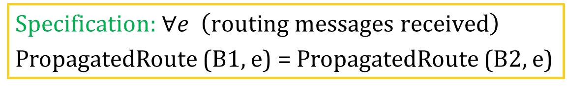
Errors manifest as Latent Bugs
Core
C via up
C via up
Static Route: C via M
B1
B2
C via up
C via M
management network
M
Data Center Network
Buggy static route causes B1 to propagate wrong route to C. Works fine till . . .
Specification: $∀e \left(routing messages received\right)$
PropagatedRoute (B1, e) = PropagatedRoute (B2, e)
Notes:
Here is a real latent routing bug that brought down one of our data centers recently. There are two routers B1 and B2 that backup for each other and provide connectivity for the data center to the Core. In B1, a manager set up something called a virtual route wrongly with just a small typing error and it set a manual so-called static route that said effectively that all packets to the Core C was to be sent to the management network M. As a result when the core sent route advertisements downward, B2 sent them down to the data center network but B1 did not because in BGP, static routes have priority. All this worked fine because B2 still provided connnectivity. But when B2 was taken down for maintenance, B1 began routing traffic to the core to the management network, losing data center connectivity to the Internet for several hours.
Without complely soilving global route verification, there is an easy local specification that we can hope for

Slide 30
Symbolic Execution of Route Propagation
Model BGP Code in Router using C
  Can now do symbolic execution
  Many tools, we used Klee for a prototype
Can encode symbolic route packets:
Then propagate routes as in Header Space.
Encoding routers in Klee, we found . . .
Prefix Local Preference AS Path . . . .
Notes:
To solve this route verification problem, I need to give you a very simplified picture of the route propagation decision procedure in something called BGP. When a router receives a route update to a prefix P from a neighbor, it goes through a multistep decisoion procedure: first, if it has a static route to P, it chooses that and rejects the update as we have seen, then it uses a parameter called Local Preference which can be configured to prefer some routes over others, and so on and the propagate the result.
We can encode all the relevant fields in the BGP decision procedure as fields in a symbolic routing packet and we can simulate the BGP decision procedure by a simple lexicographic comparison without loss of precision. Now here’s the point. This lexicographic procedure is evocative of the rule matching for IP destination and ACLs we did for data plane forwarding. So we could think of propagating rout packets as we did data packets, creating a control space rather than a header space.
As a first quick hack, we encoded the buggy router configurations in KLEE after the fact, and were able to find this and other latent bugs. It is only a first start though

Slide 31
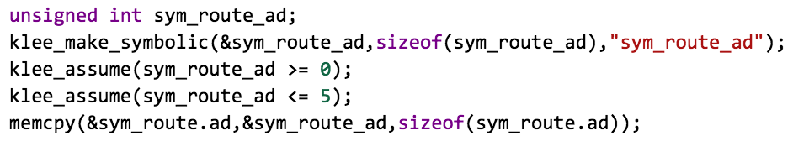
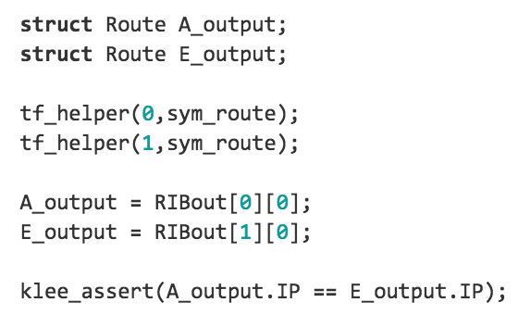
Using Klee to uncover latent bug
Create symbolic attribute
scope a field for faster verification
KLEE assertion
KLEE finds counterexample: sym_route.prefix = C

Slide 32
Progress in Control Plane Validation
RCC (MIT 2005): static checker for common BGP faults (mostly syntactical, cannot catch deeper bugs)
Batfish (MSR, UCLA 2015): computes data plane for 1 BGP environment (cannot reason across environments)
ARC (MSR, Wisconsin 2016): For a rich class of BGP operators, can reason across all failures
ERA (CMU, MSR, UCLA 2016): Reasons across a subset of maximal environments to find bugs
Bagpipe (Washington 2016): Reasons about BGP only and for a sunset of topologies
NetKat (Princeton, Cornell 2014): Data plane synthesis
Propane : (Princeton, MSR, 2016): Control plane synthesis
Notes:
More gen

Slide 33

NETWORK DESIGN AUTOMATION?
Notes:
So lets go back to the big picturewe talked about: of network design automation that mirrors electronic design automation and see what else there might be to do.

Slide 34
Digital Hardware Design as Inspiration
Specification
Specification
Functional Description (RTL)
Testbench & Vectors
Policy Language
Testing
Functional Verification
Verification
Logical Synthesis
Synthesis
Static Timing
Place & Route
Topology Design
Design Rule Checking (DRC)
Layout vs Schematic (LVS)
Wiring Checkers
Parasitic Extraction
Manufacture
& Validate
Debuggers
Electronic Design Automation
(McKeown SIGCOMM 2012)
Network Design Automation
(NDA)?
Notes:
My friend Nick McKeown at Stanford first made this analogy between Network Design Automation and Electronic Design Automation, a very successful 10 billion dollar tool industry for hardware. I have tried to conjecture what the corresponding layers might be for Network Design Automation. Without looking at details, functional description in hardware may correspond to policy languages in networks and test vectors to test packets. What we have talked about so far is really just one small slice of this vision: verification.
An exciting aspect of the EDA vision is the amount of hardware design done by synthesis. So in this part lets look very briefly at what synthesis might look like for networks

Slide 35
NDA: Broader Research Agenda
Bottom up (analysis):
  Run time support (automatic test packets?)
  Debuggers (how to “step” through network?)
  Specification Mining (infer reachability specs?)
Top Down (synthesis):
  Expressivity (load balancing, security policies?)
  Scalable specifications (network types?)
  New Optimization Problems (stochastic?)
Notes:
Much future work is needed to complete this vision . I have said nothing of run time systems including debuggers. How might one step through a network? Second, network managers do not know reachability specification; could they be mined?
In terms of top down, while the Cornell Princeton Brown work has laid a strong theoretical foundation, I believe we need to go further in the direction of expressing all current policies that operators use. Further, most network synthesis algorithms today require too much specification. For example, the Princeton work on generating router rules from network policy requires as input a specification of the reachability of every pair of endnodes which is hard to do with millions of nodes; is there is a natural notion of node types that can lead to more succinct specifications?

Slide 36
Yawn. We have seen it all years ago!
Verification Exemplar | Network Verification Idea
Ternary Simulation, Symbolic Execution [Dill 01] | Header Space Analysis [Kazemian 2013]
Certified Development of an OS Sel4 [Klein 09] | Certified Development of an SDN Controller [Guha 13]
Specification Mining [Bodek 02] | Mining for Enterprise Policy [Benson 09]
Exploit Symmetry in Model Checking [Sistla 09] | Exploit Symmetry in Data Centers [Plotkin 16]
Notes:
First, it is an article of faith for me that every novel idea in verification can be repurposed for networking. The following table shows ideas like Ternary Simulation, Certified Development and Specification mining appearing in our community with a 5-10 year lag.

Slide 37
Yes, but scale by exploiting domain
Technique | Structure exploited
Header Space Analysis | Limited negation, no loops, small equivalence classes
Exploiting Symmetry | Symmetries in physical topology
ATPG (Automatic Test Packet Generation) | Network graph limits size of state space compared to KLEE
Netplumber (incremental network verification) | Simple structure of rule dependencies
Requires Interdisciplinary work between formal methods and networking Researchers
Notes:
The first lesson seems to imply that one just has to dust off existing methods from the verification community and everything will work well, Not true. When we tried existing model checkers and even Klee on existing networks they did really poorly. One must scale by exploiting the domain. For example, in HSA. I haven’t talked about it but data plane testing is much easier than symbolic testing of code because there is no path explosion problem as we have no cycles in bug.

Slide 38
Conclusion
Inflection Point: Rise of services, SDNs
Intellectual Opportunity: New techniques
Working chips with billion transistors. Large networks next?
Notes:
In conclusion, I believe we have a real inflection point today that enables a different approach to network verification and synthesis caused by the rise of services and SDNs. But for academic researchers, besides the potential real-world impact I hope this talk conveys some of the intellectual opportunity where we do not merely reuse existing techniques in verification and synthesis but rethink them as in ideas like factoring symmetries, where standard ideas like biconnected components translate into the complexity of stateful instructions.
But the ultimate goal, the North Star, we aim is to design large customized networks that work well operationally so services can be delivered seamlessly. Thank you.

Slide 39
Thanks
(MSR): N. Bjorner, N. Lopes, R. Mahajan, G. Plotkin,
(CMU): S. Fayaz, V. Sekar
(Stanford): P. Kazemian, N. McKeown
(UCLA): A. Fogel, T. Millstein
Notes:
A big thanks to my fellow adventurers listed. Some are Hoarites and some are Cerfers. I am aware, of course, that the former category name has a short form that would have unfortunate connotations. This is specially true because my interaction with my verification folks has been fueled by pleasure and not by money. Thank you!

