Slide 1

Marathon Skills 2015

Slide 2
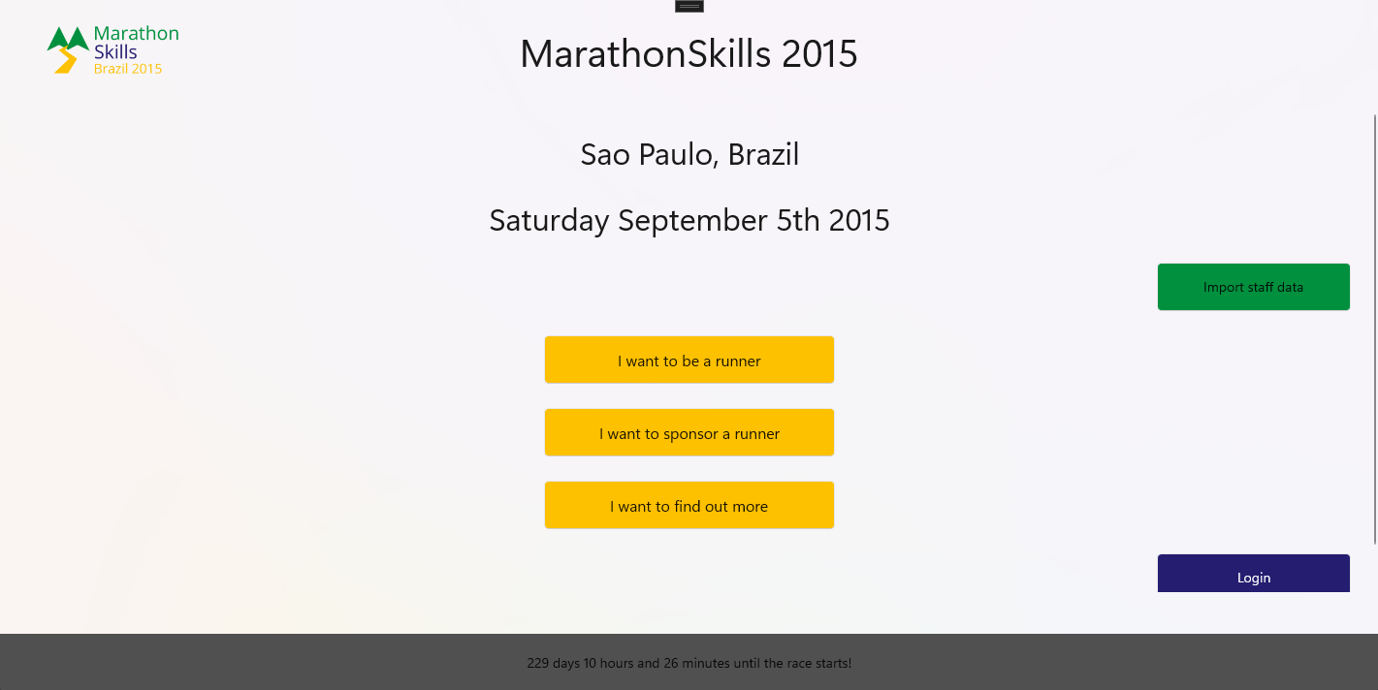
Starting Page
Staff data import via file selection
Race countdown at the bottom
Navigation to login, registration, sponsorships and more information about the event

Slide 3
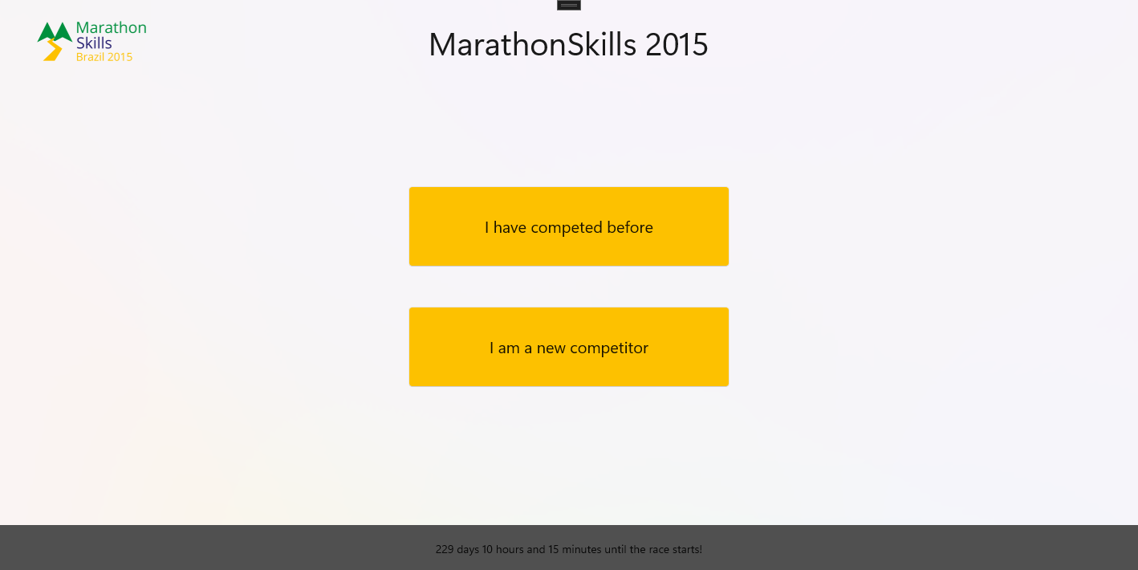
Become A Runner Page
Choice between login and registration
Depends on the fact if user has participated before

Slide 4
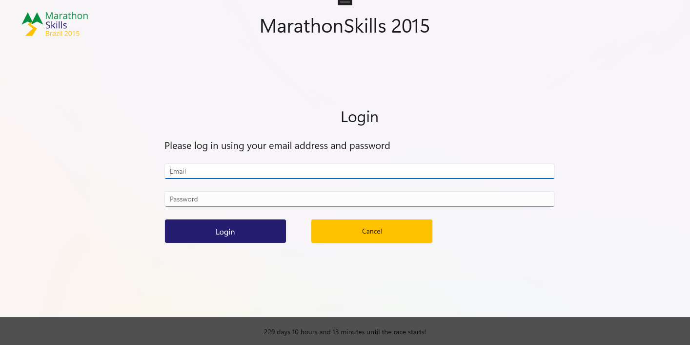
Login Page
Login using Email and Password

Slide 5
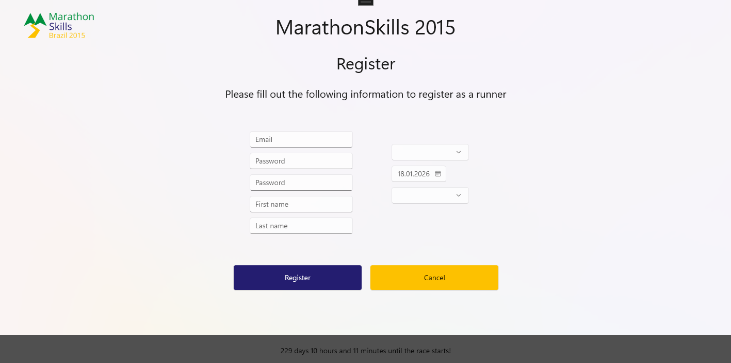
Registration Page
Registration as runner
Personal data has to be complete
Country and Gender can be selected from drop-down-menu

Slide 6
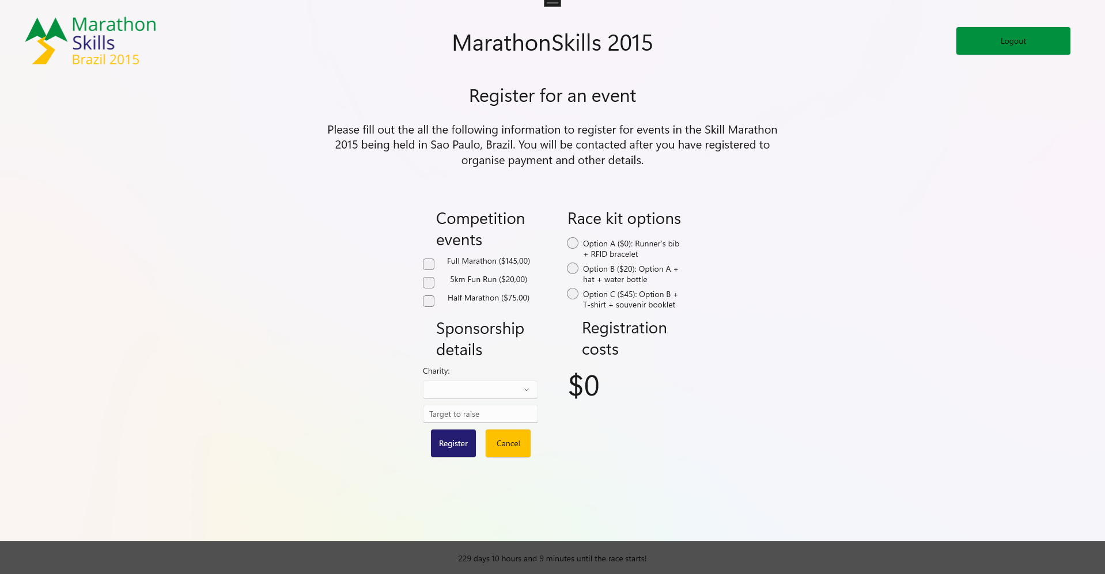
Event Registration Page
Event Type has to be selected
Different kit options available
Charity and Sponsorship target need to be filled out
Total costs automatically calculated

Slide 7
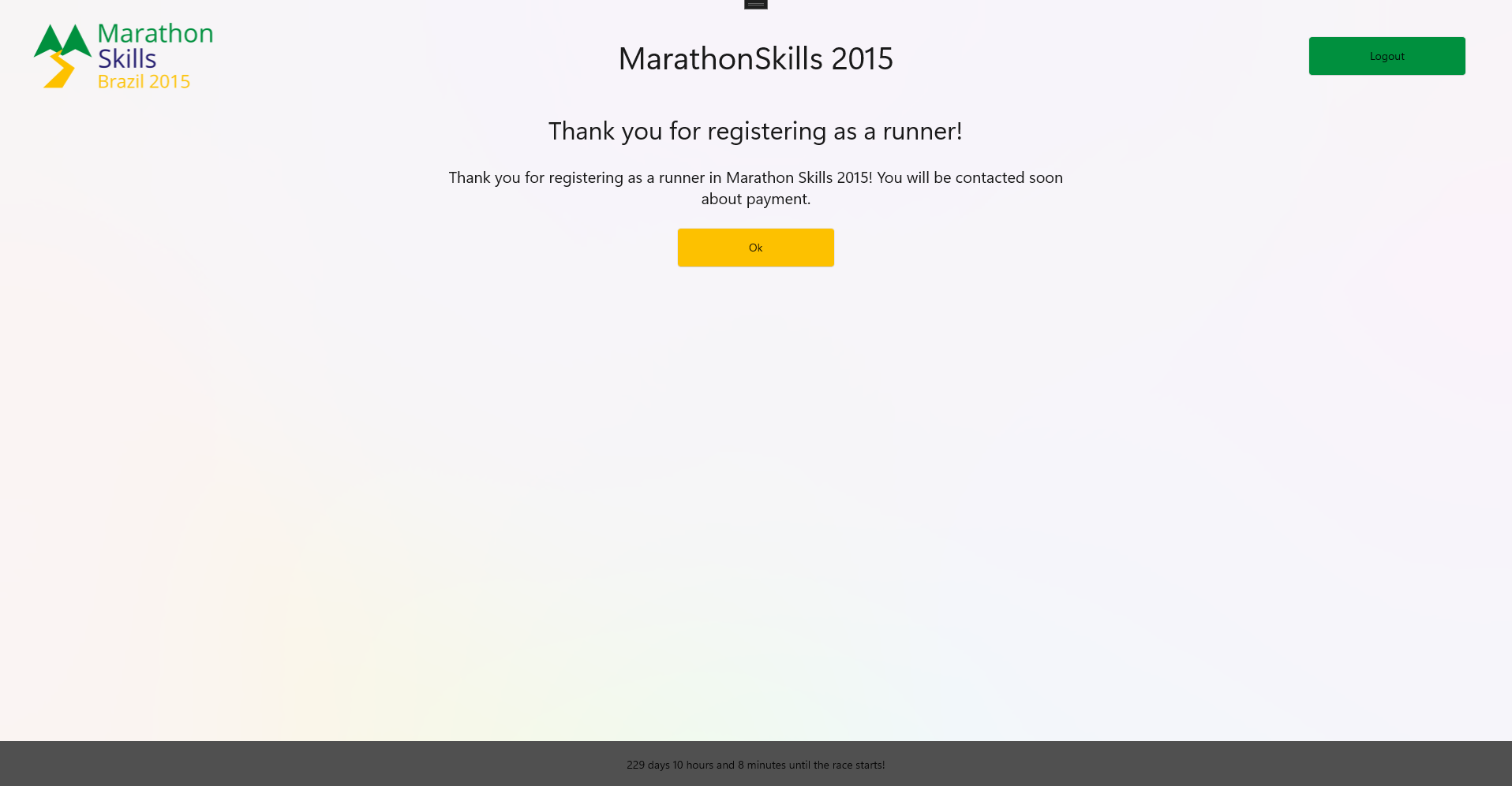
Registration Confirmation Page
Registration confirmation message
´Ok´-Button navigates to Runner Menu Page

Slide 8
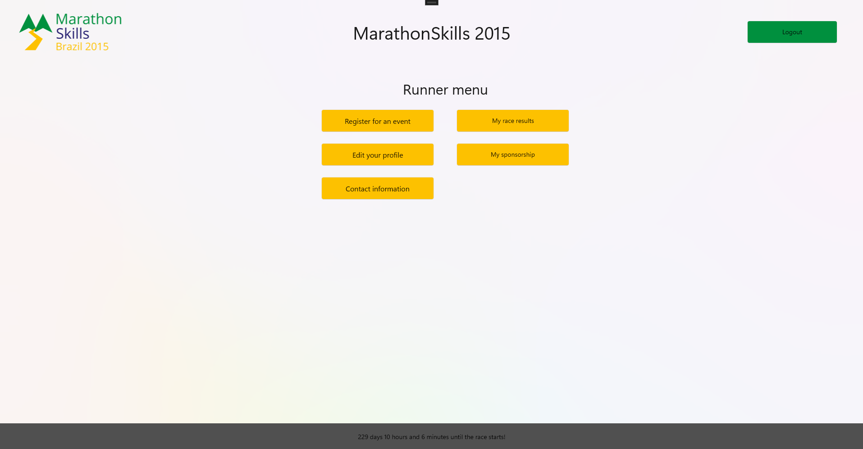
Runner Page
Availabel navigation options after login/registration as runner
Logout possible with green button like on most pages

Slide 9
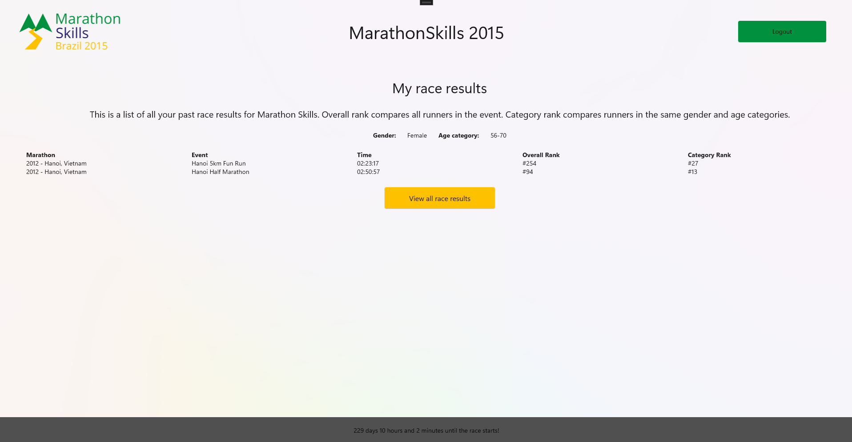
My Race Results Page
Personal race results for prior events
Overall and category rank as well as time are displayed
Category rank depends on age and gender

Slide 10
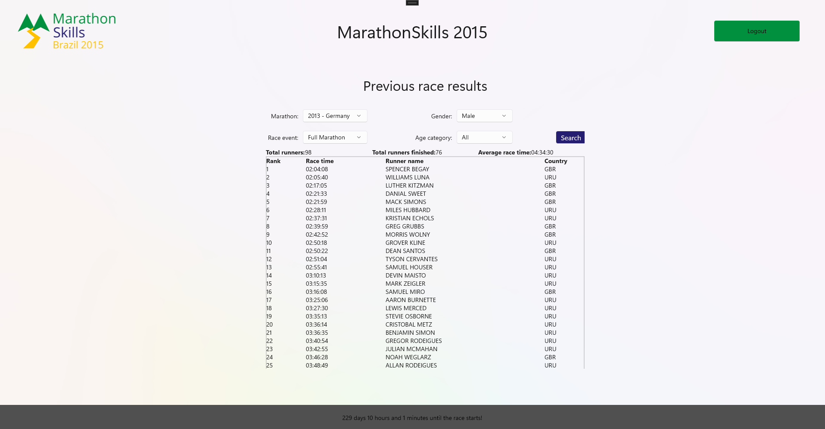
Previous Race Results Page
View complete race results for an entire event
Filtering by gender and age category possible

Slide 11
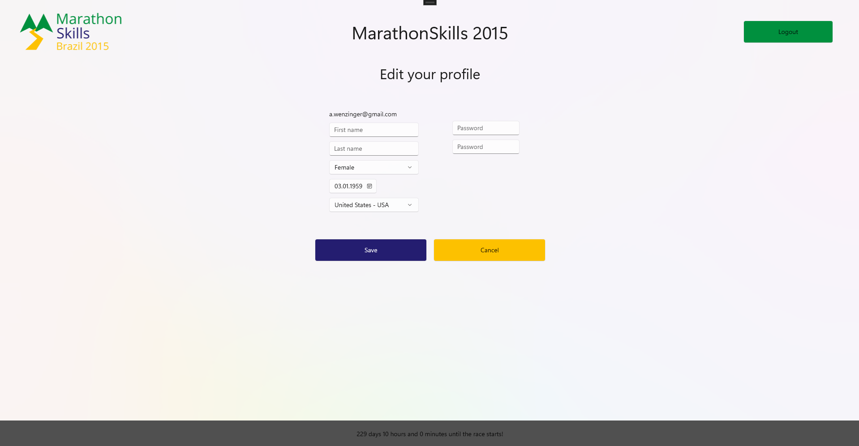
Edit Your Profile Page
User can edit own profile
Name, gender, country, date of birth and password can be changed

Slide 12
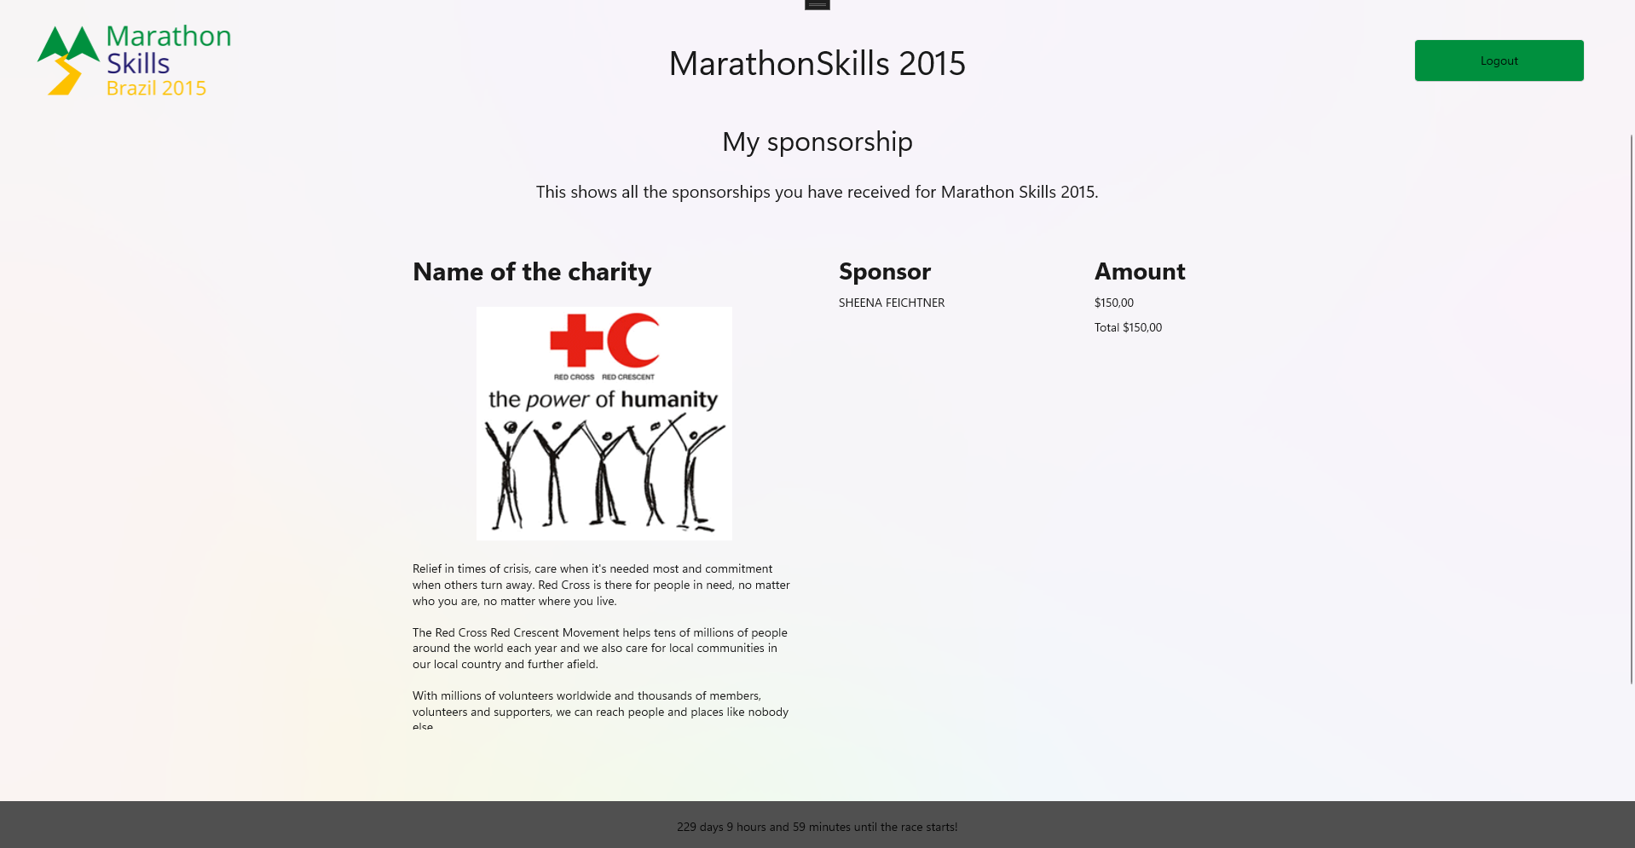
My Sponsorship Page
User can view own sponsorship
Charity with icon and description is displayed
Sponsorship donations and total amount are listed for runner

Slide 13
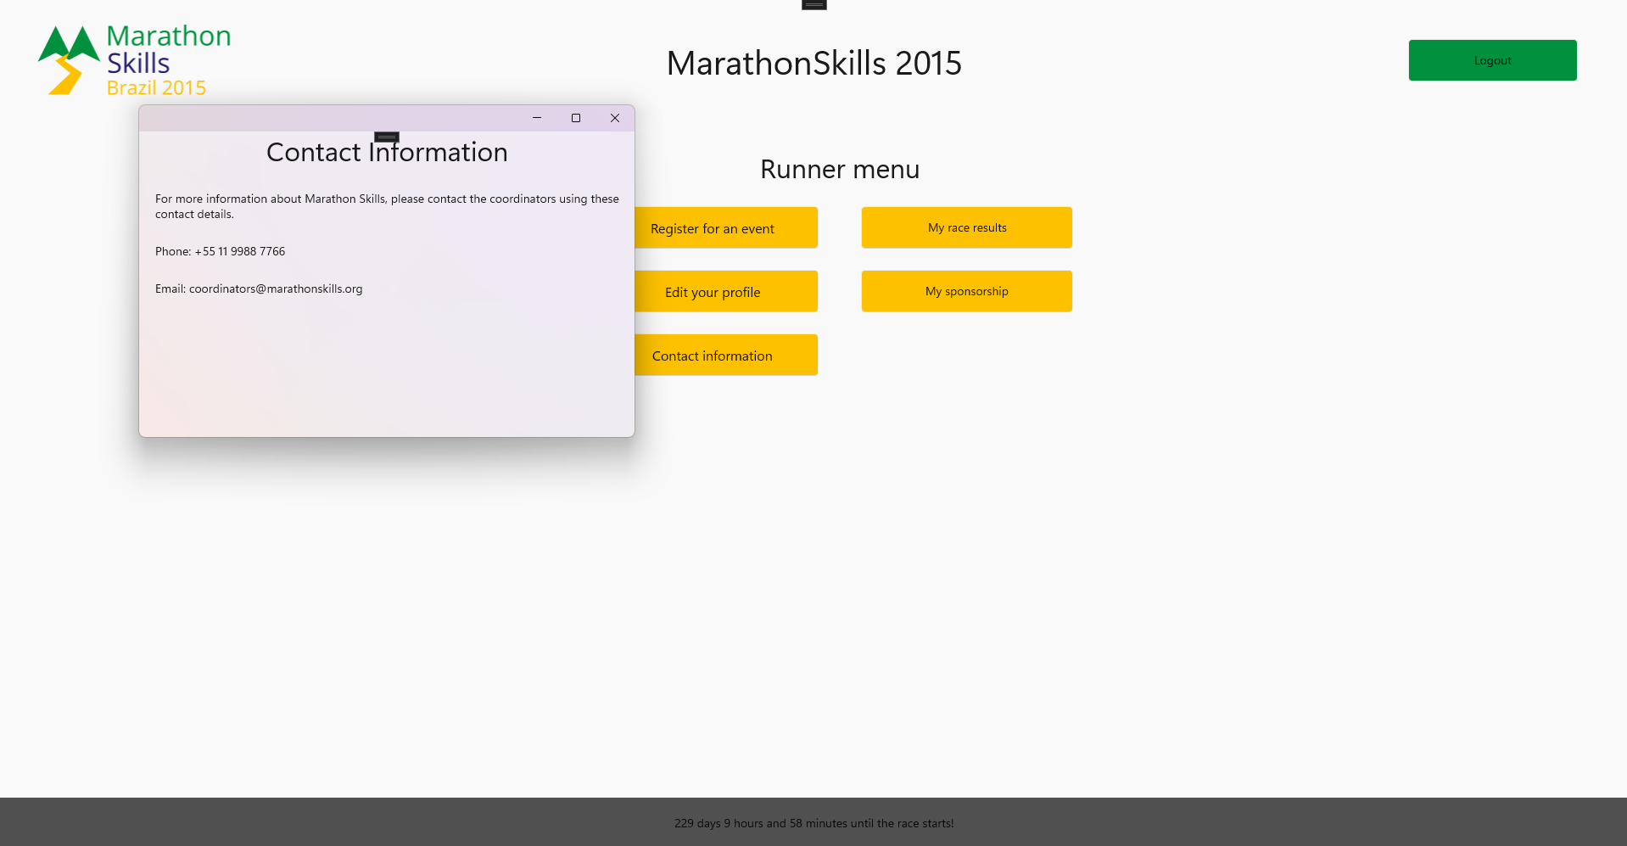
Contact Information Window
Popup-window with contact information

Slide 14
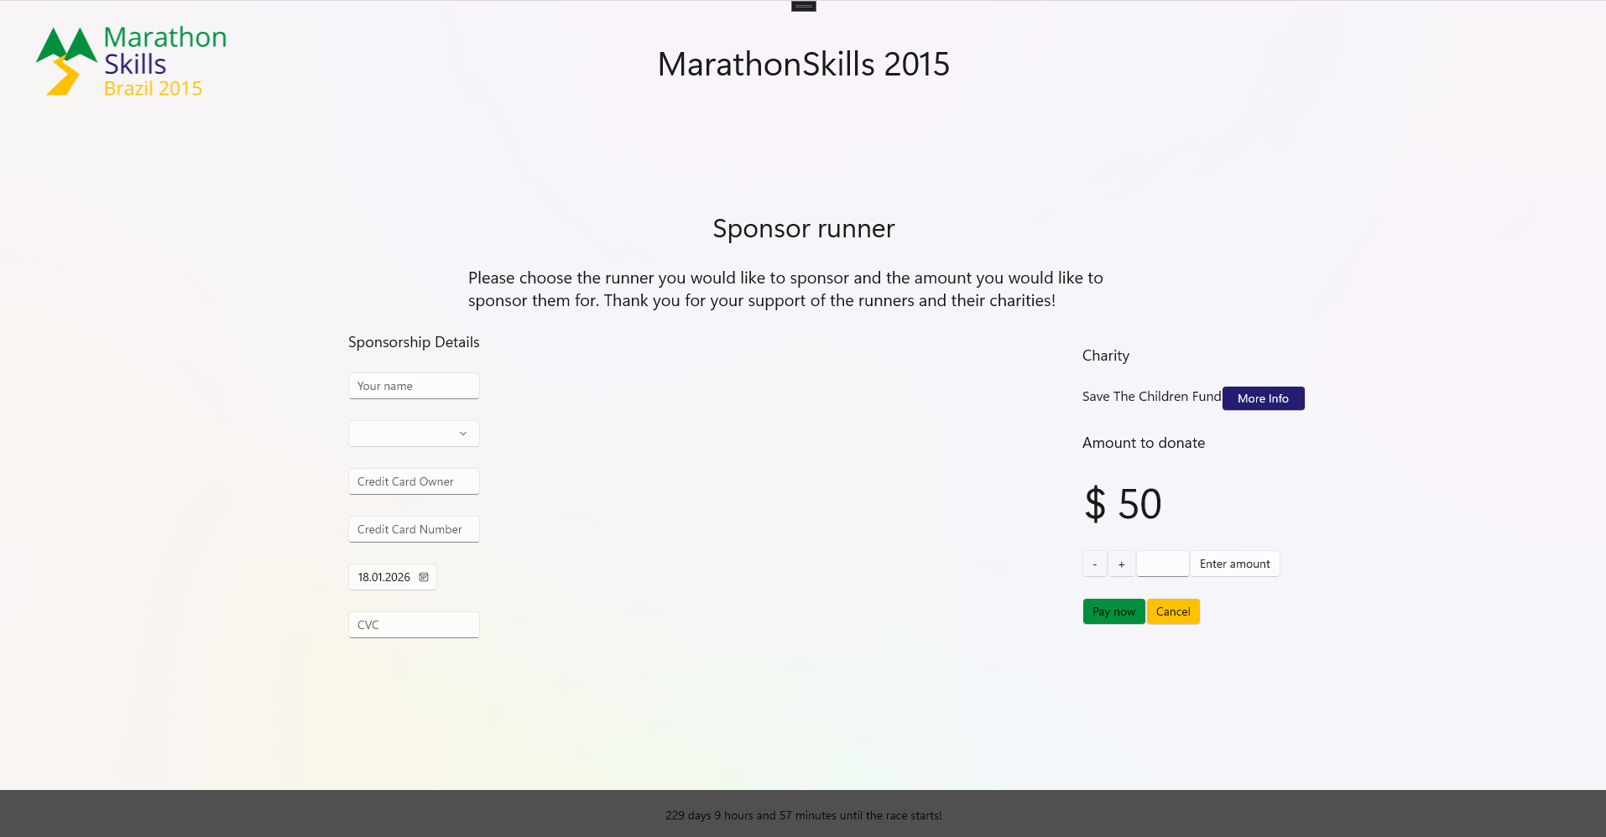
Sponsor Runner Page
Runner can be sponsored by entering credit card details
Donation amount can be changed on the right

Slide 15
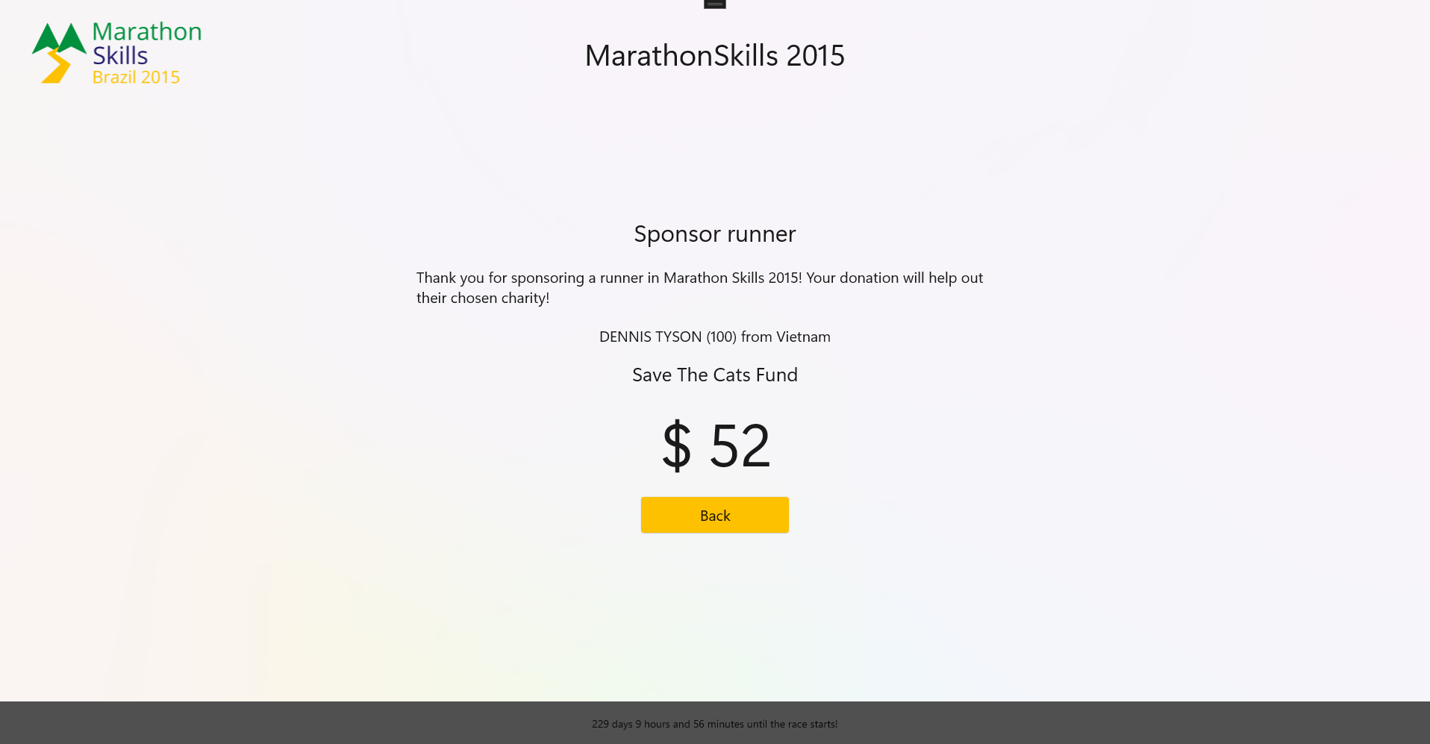
Sponsorship Confirmation Page
Sponsorship confirmation with amount after submitting donation

Slide 16
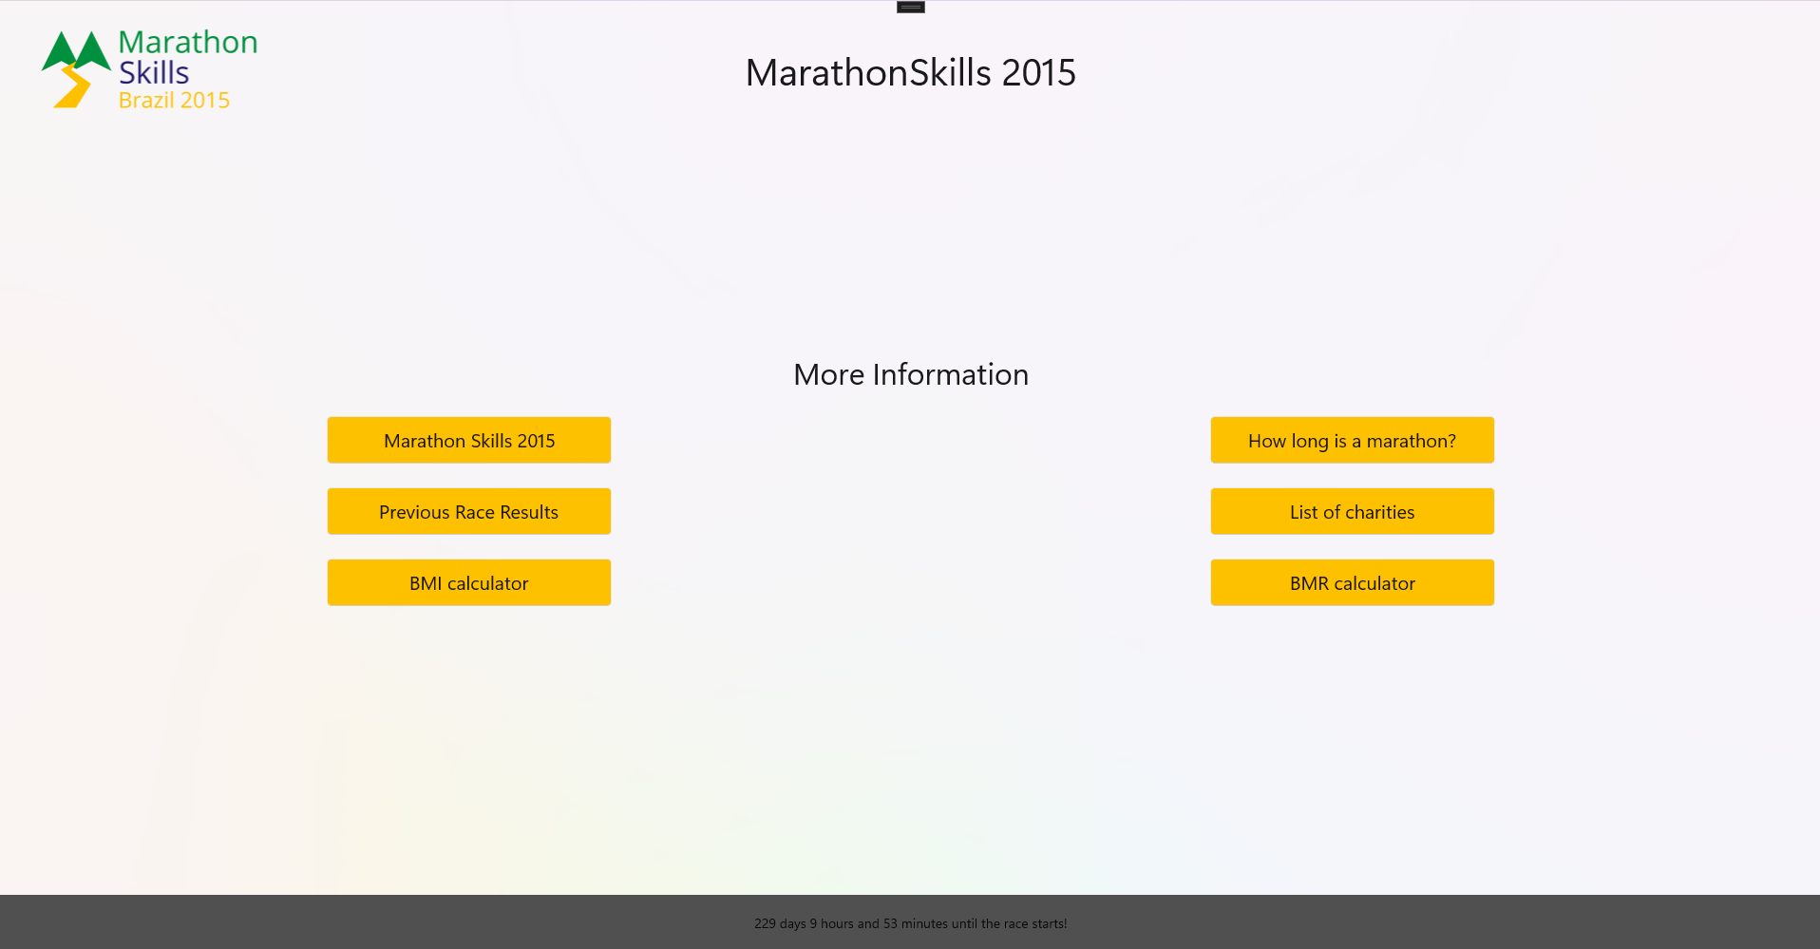
More Information Page
Navigation to different pages with helpful information about the event

Slide 17

About Marathon Skills 2015 Page
Information about the event in total + images
Preview of the interactive map (clickable)

Slide 18
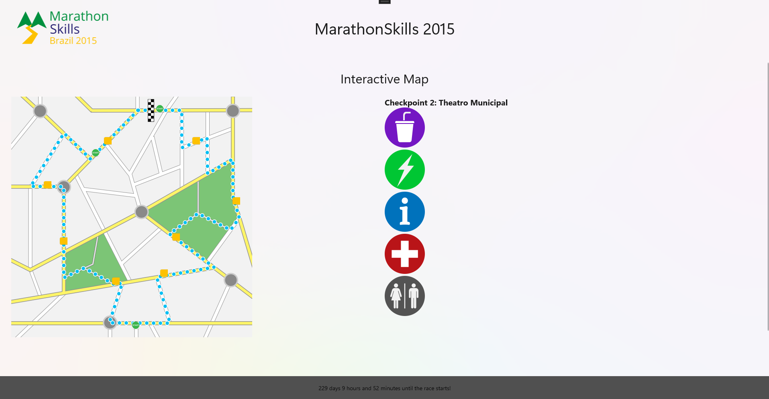
Interactive Map Page
Interactive map with starting points and checkpoints
Clicking on checkpoint (orange) reveals more information

Slide 19
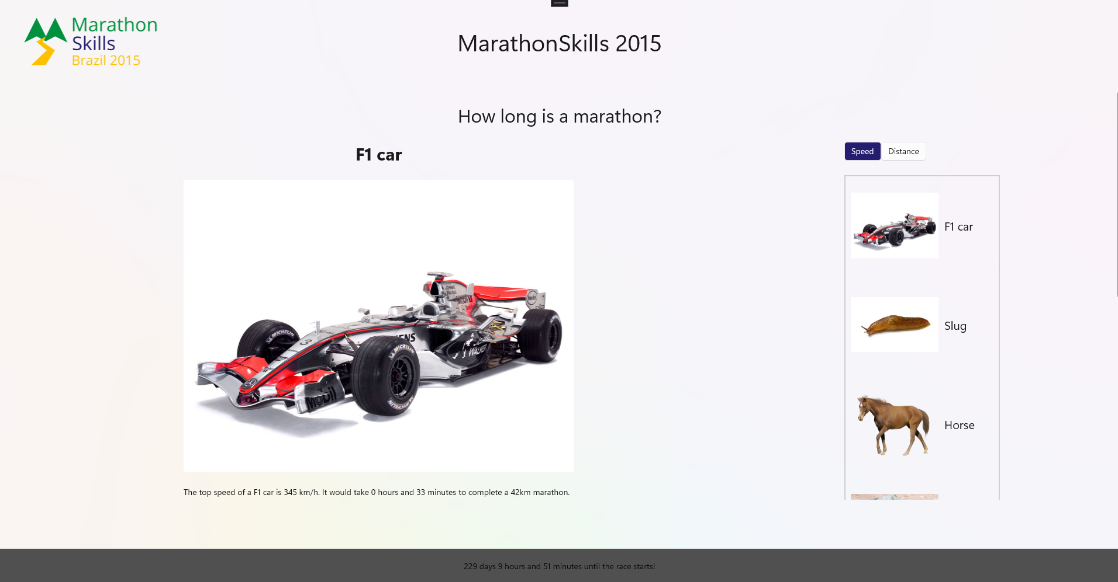
How Long Is A Marathon? Page
Different size and speed comparisons about how long a a a marathon is
User can switch between speed and distance menu

Slide 20
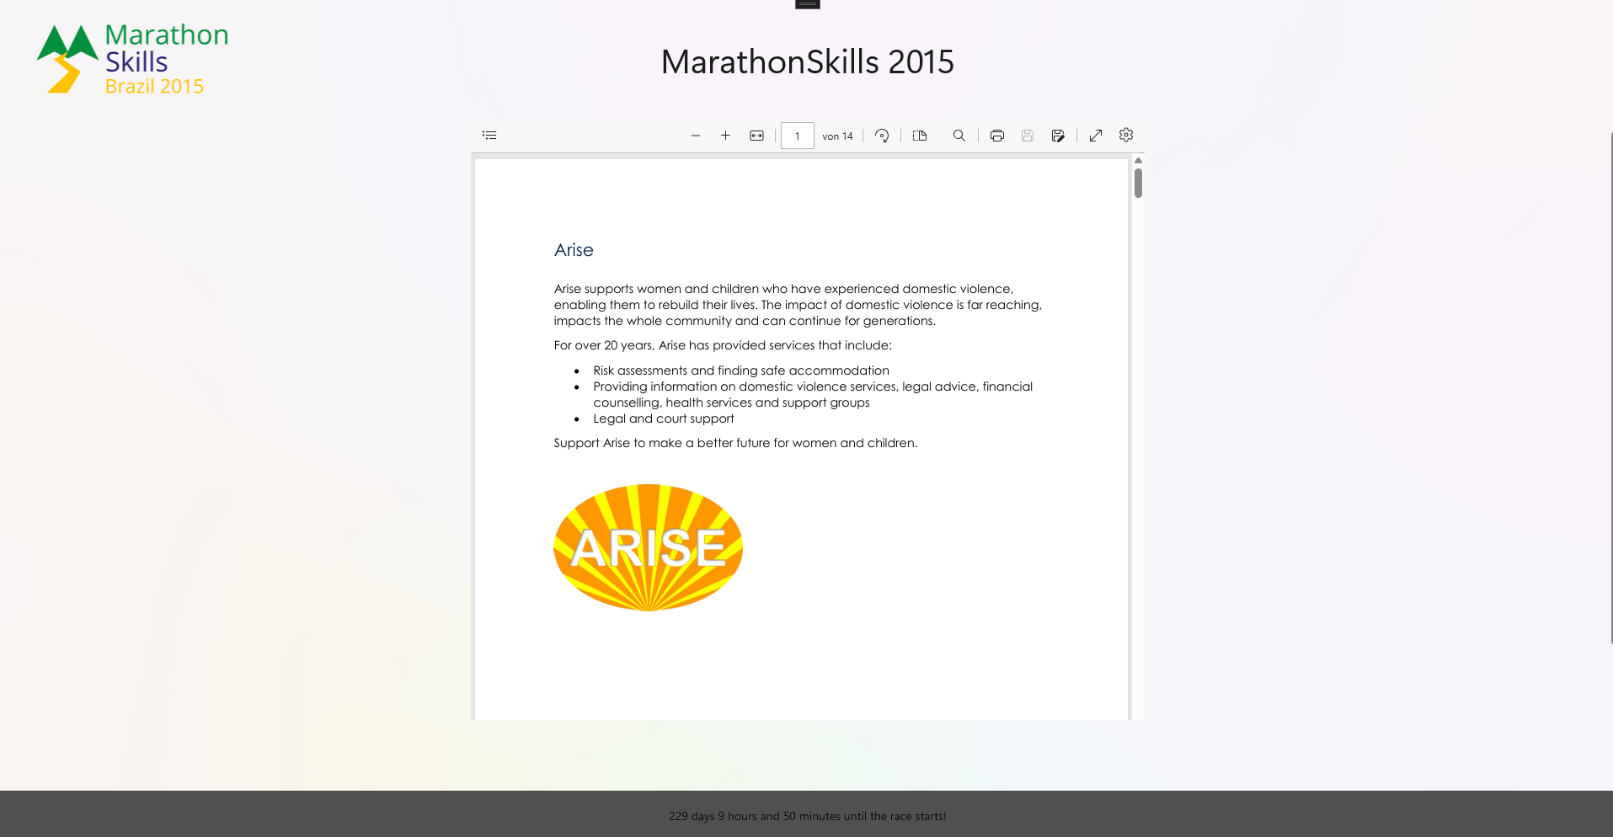
List Of Charities Page
All charities with logo and description are listed

Slide 21
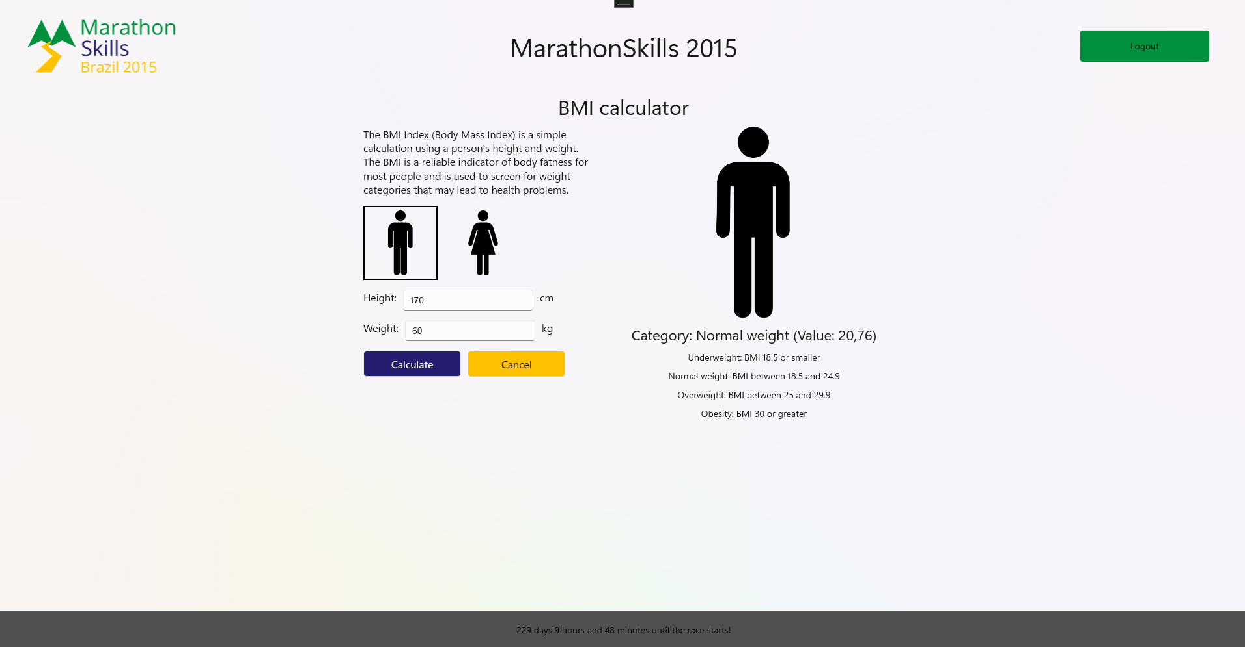
BMI Calculator Page
Calculate BMI (body mass index) based on body height and weight
Explanation on BMI and result image

Slide 22
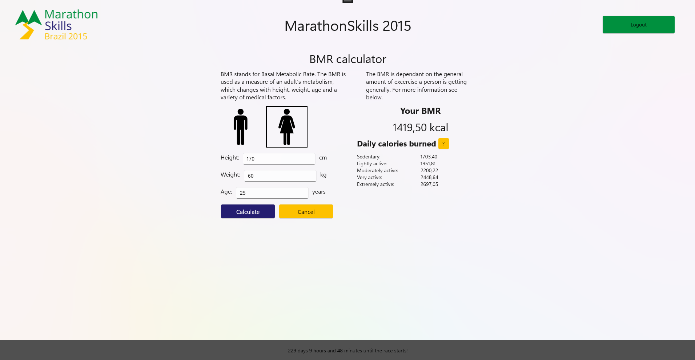
BMR Calculator Page
Calculate BMR (base metabolic rate) based on body height and weight as well as age
Daily calories presented on the right

Slide 23
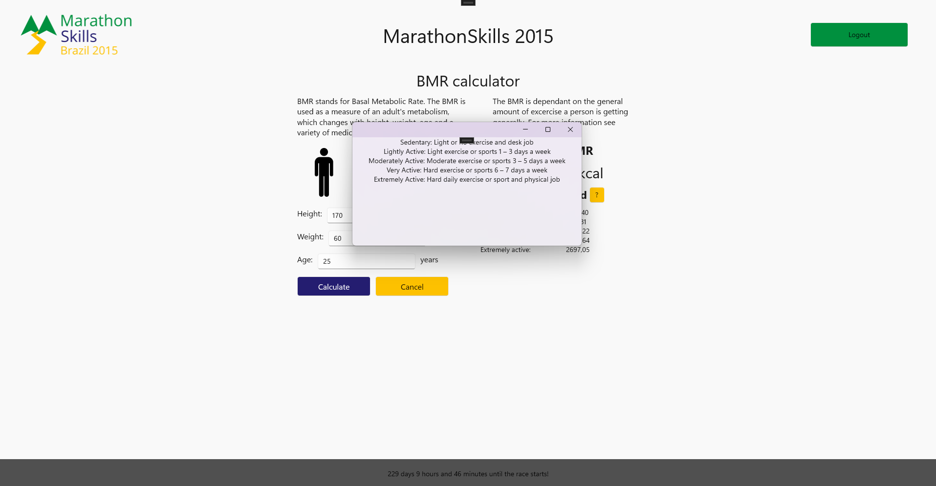
BMR Calculator Calories Info Window
Explanation on the different excercise types for BMR calculation

Slide 24
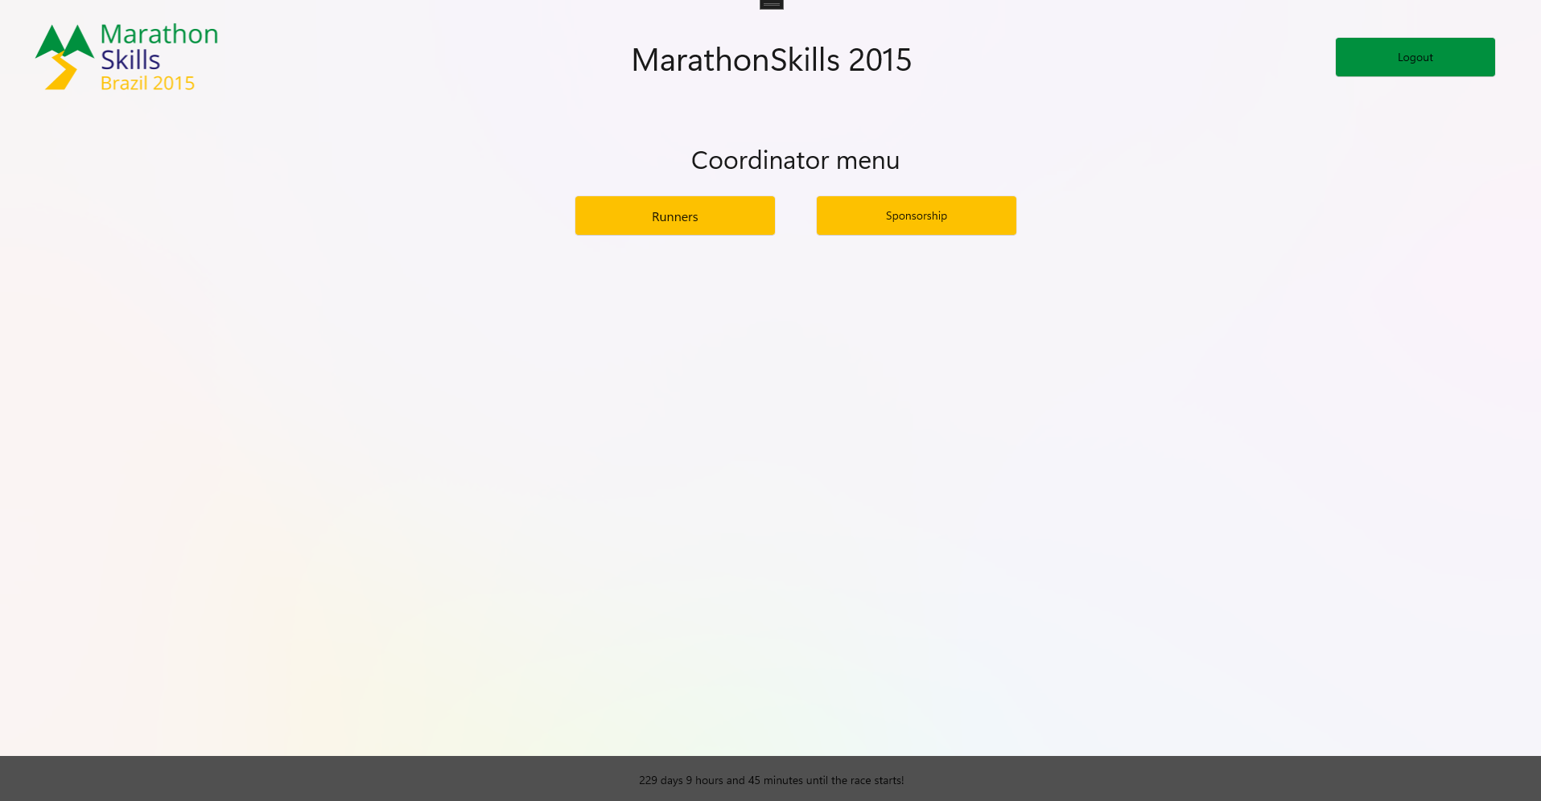
Coordinator Menu Page
Navigation menu for coordinator who is logged in

Slide 25
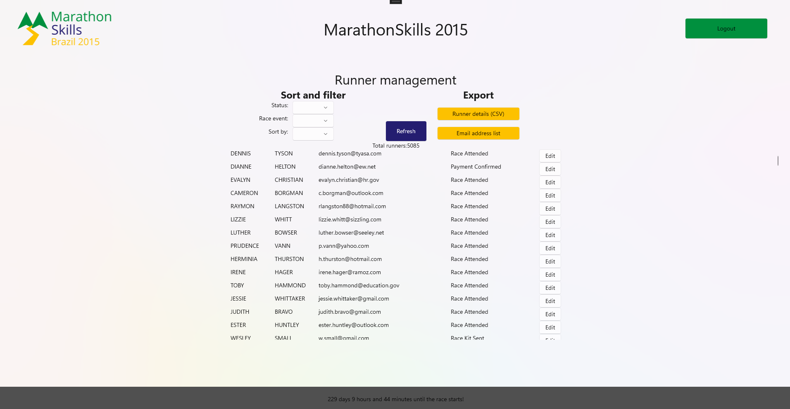
Runner Management Page
Runners overview which can be filtered and sorted
Export of email addresses and runner details (as CSV) possible

Slide 26
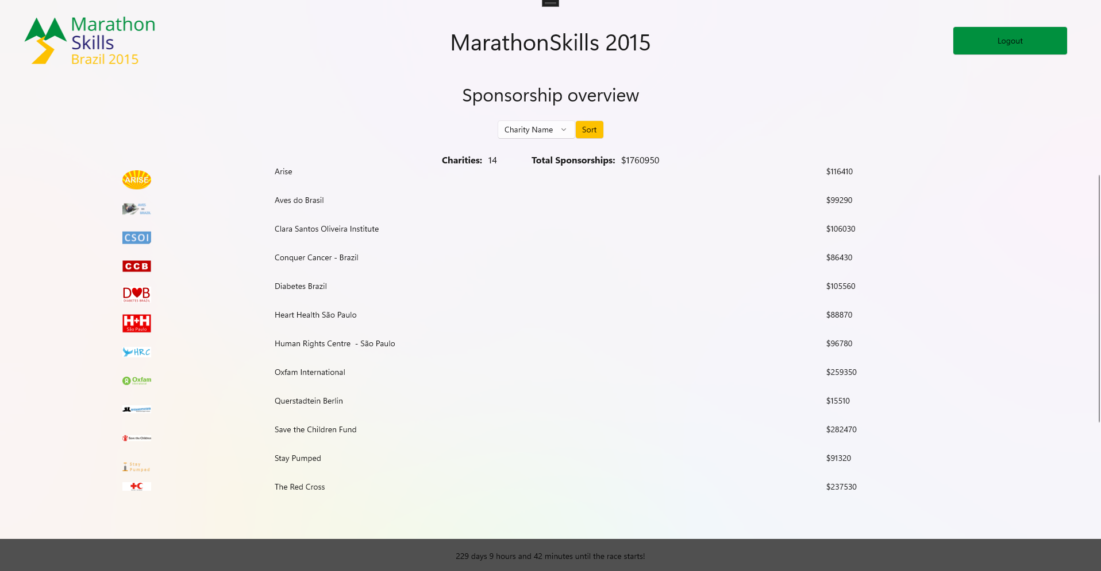
Sponsorship Overview Page
Overview of all sponsorships for coordinator
Financial statistics included
Sorting by name and amount

Slide 27
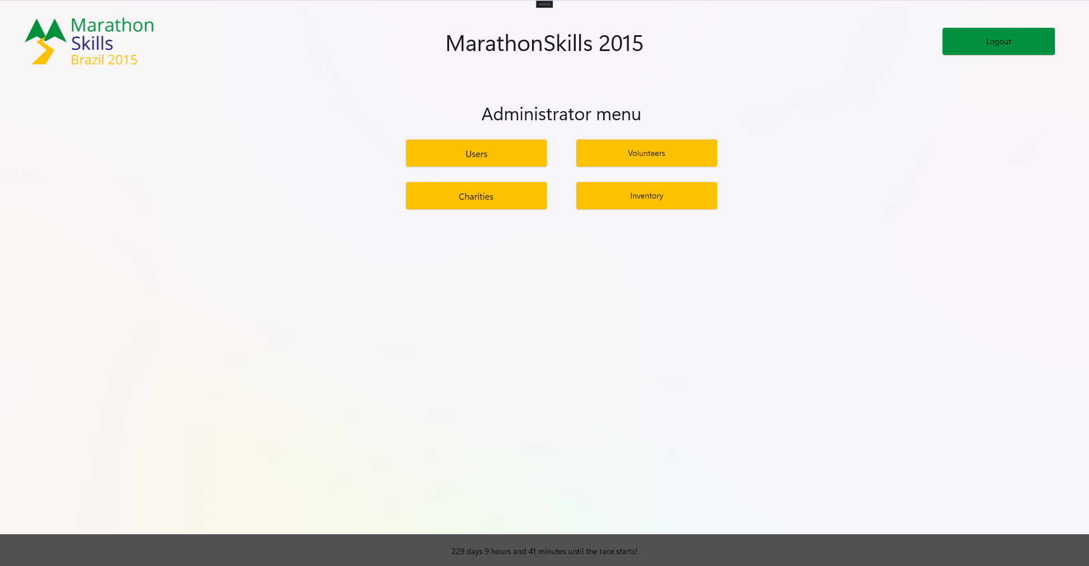
Administrator Menu Page
Navigation page for administrator who is logged in

Slide 28
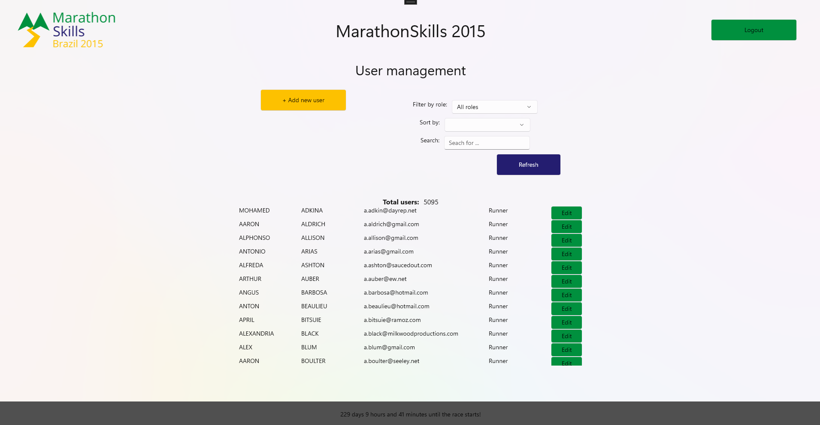
User Management Page
Users can be managed
Sorting and filtering
Edit and adding new users

Slide 29
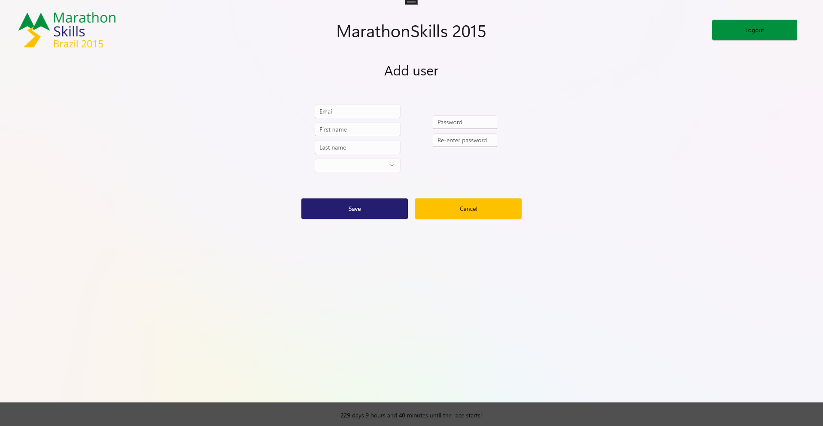
Add New User Page
Adding new user
All fields blank in the start
Every field needs to have a value

Slide 30
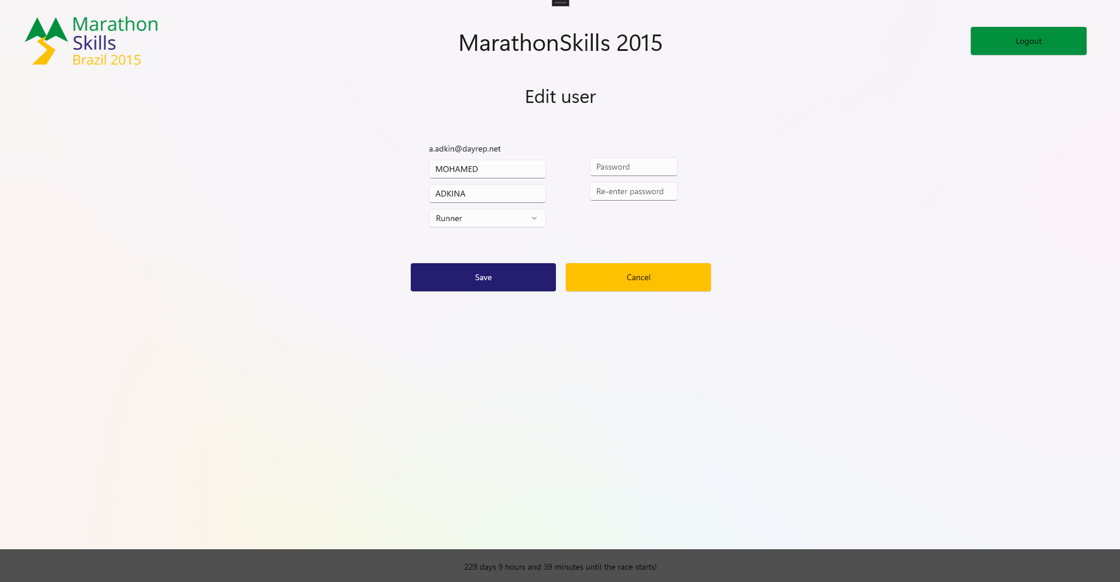
Edit User Page
Editing user selected in user management
Email can not be changed

Slide 31
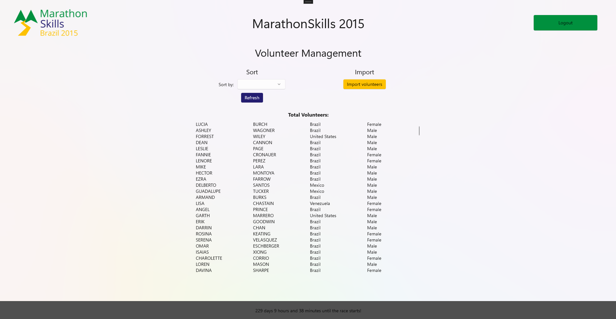
Volunteer Management Page
Volunteer overview with sorting
Navigation to importing page

Slide 32
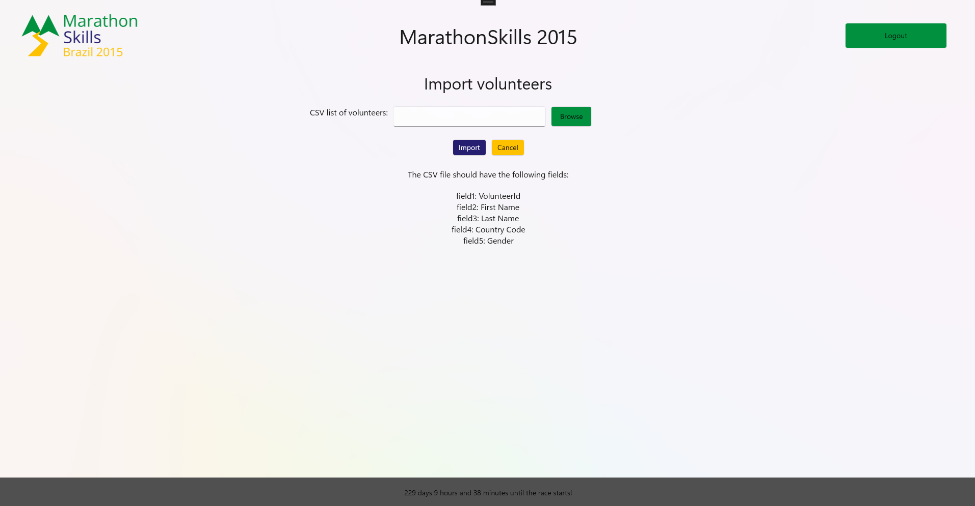
Import Volunteers Page
Importing volunteers from CSV file in the correct format
Can be selected with file picker

Slide 33
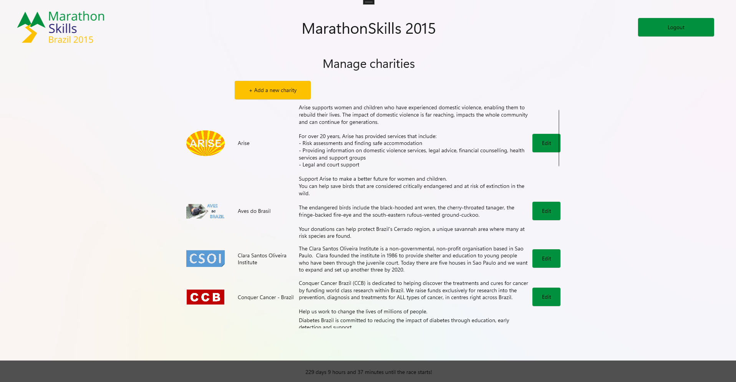
Manage Charities Page
Charity overview with description
Can be edited and added

Slide 34
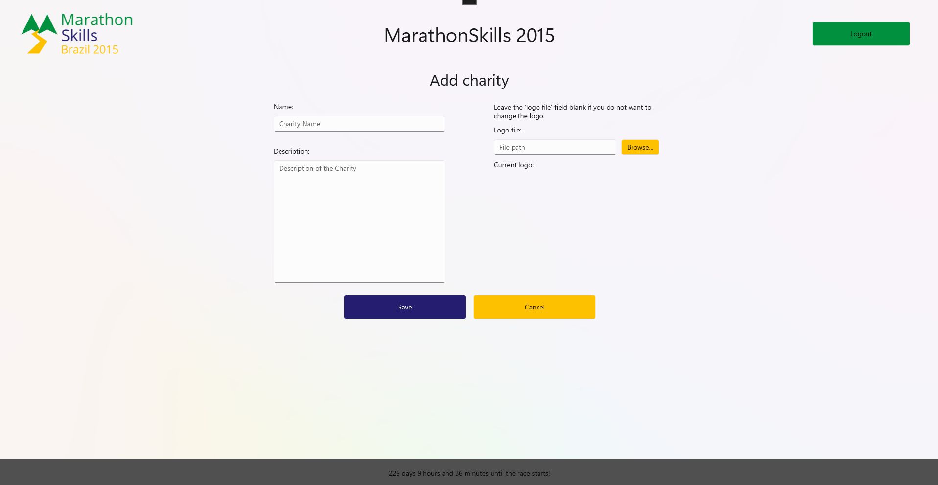
Add New Charity Page
Adding a new charity
All fields blank
Logo has to be selected with file picker

Slide 35
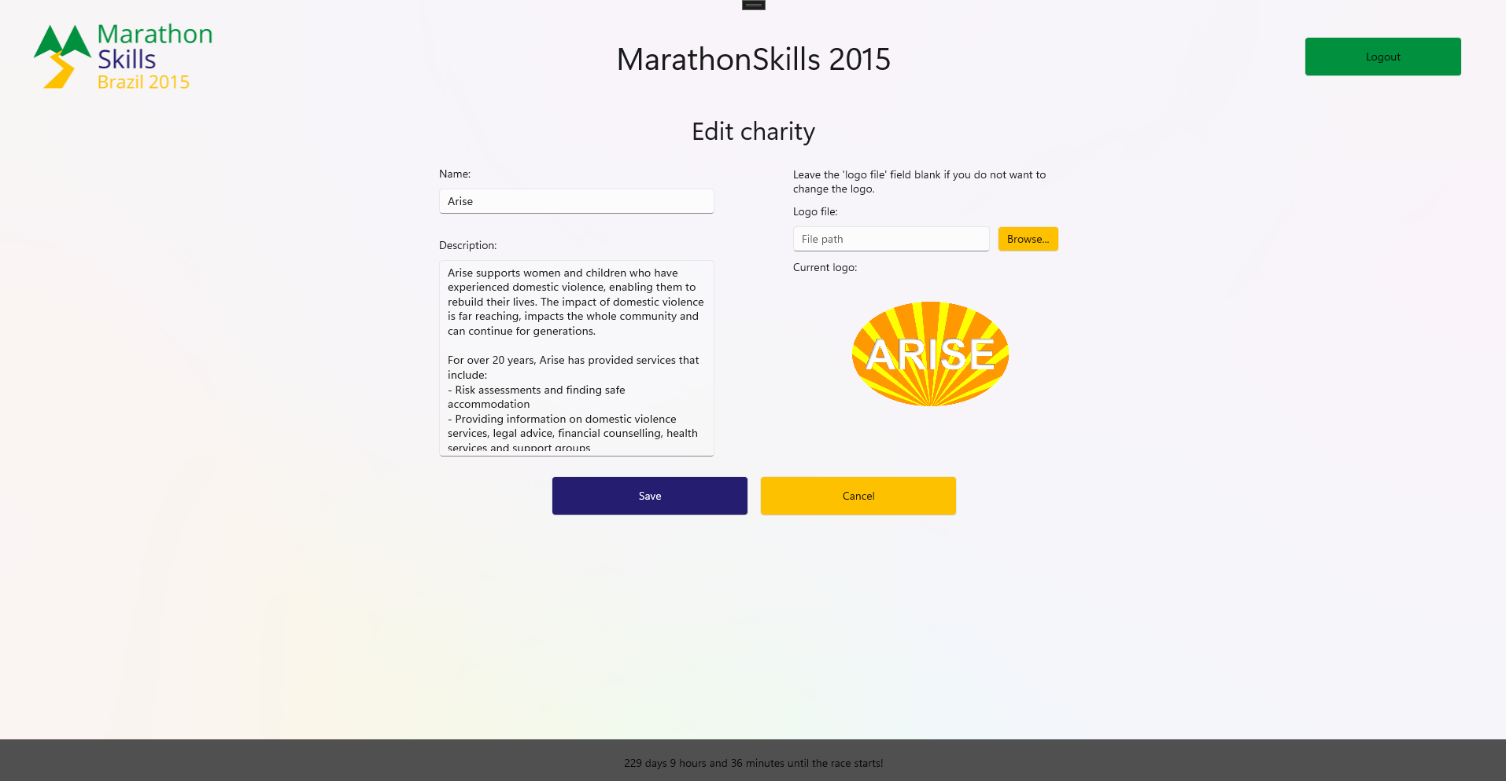
Edit Charity Page
Editing charity
Logo changes directly

Slide 36
Thank you for your attention.
We are looking forward to working with you.

