Slide 1

Fact Checking
SNLP Miniproject

Slide 2
“Angela Dorothea Merkel is a German politician.
She is the Chancellor of Germany.”

Slide 3
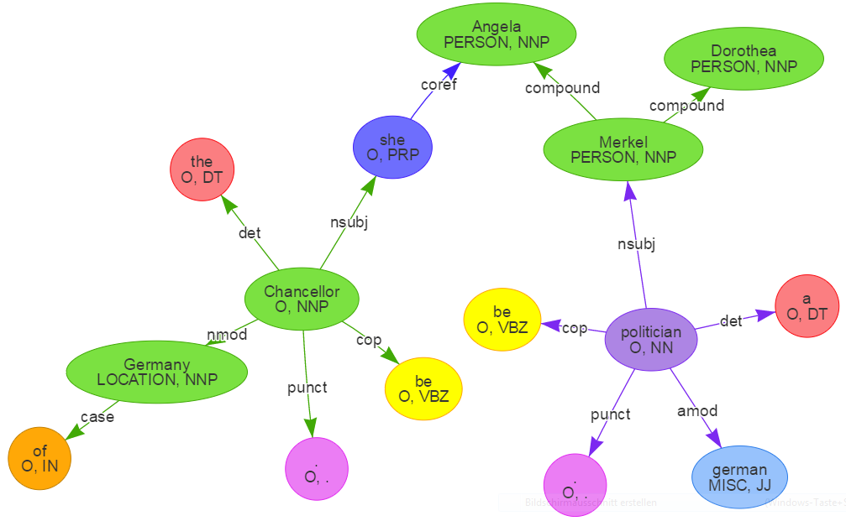
“Angela Dorothea Merkel is a German politician.
She is the Chancellor of Germany.”

Slide 4
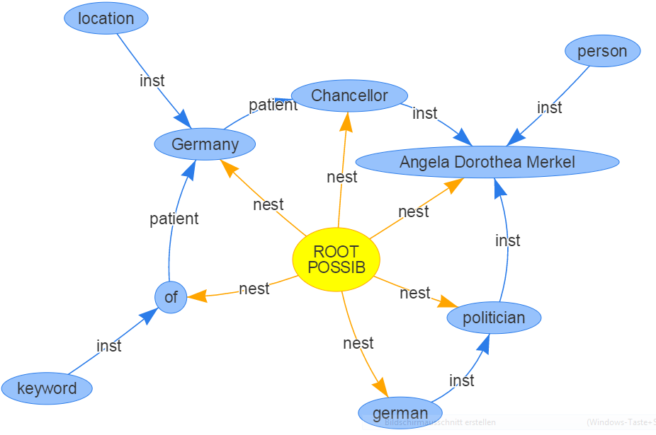
“Angela Dorothea Merkel is a German politician.
She is the Chancellor of Germany.”

Slide 5
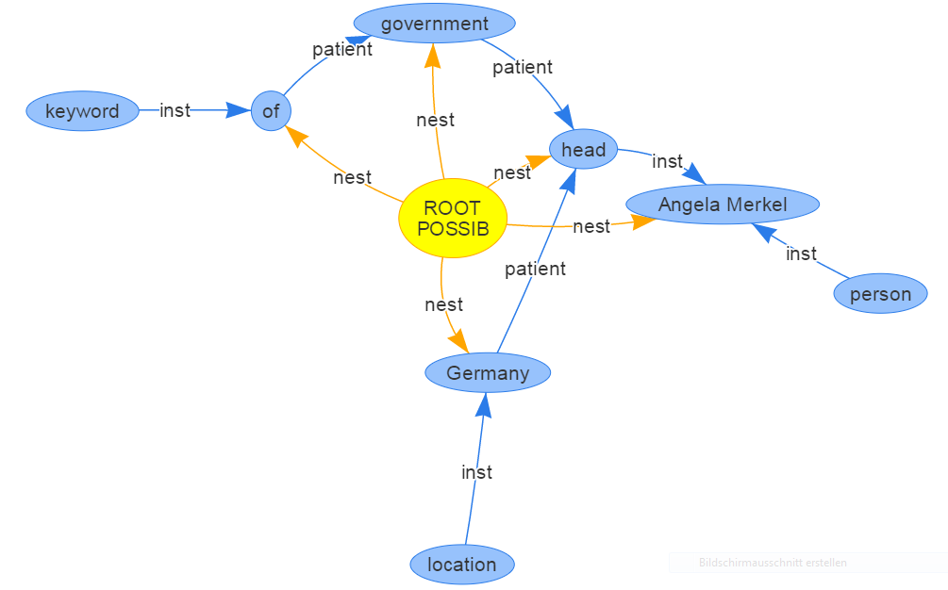
“Angela Merkel is Germany’s head of government.”

Slide 6
Angela Merkel |  | head |  | Germany
 |  |  | government
Angela Dorothea Merkel |  | Chancellor |  | Germany
Match entities via String/Label distance
Follow undirected paths between matches
Semantically match entities and edges via word2vec

Slide 7
Status Quo
TODO
Corpus Creation (Wikipedia)
CoreNLP integration
Concept graph construction
word2vec integration
Graph matching
+ 0.5
“Angela Merkel is Germany’s
head of government.”

