Slide 1

Fact Checking
SNLP Miniproject

Slide 2
“Angela Dorothea Merkel is a German politician.
She is the Chancellor of Germany.”

Slide 3
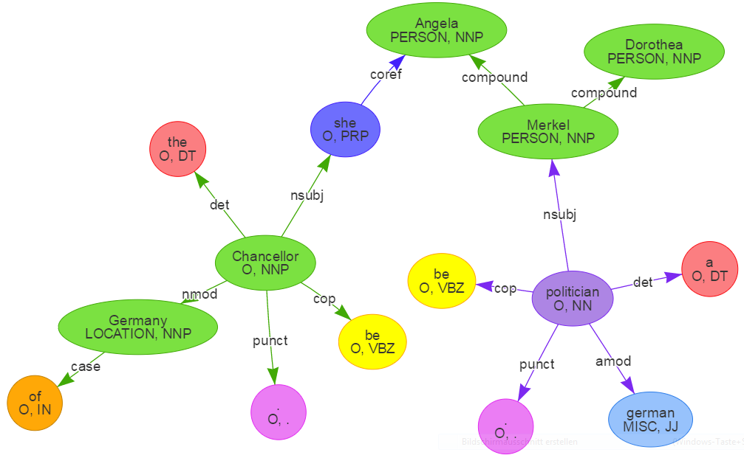
“Angela Dorothea Merkel is a German politician.
She is the Chancellor of Germany.”

Slide 4
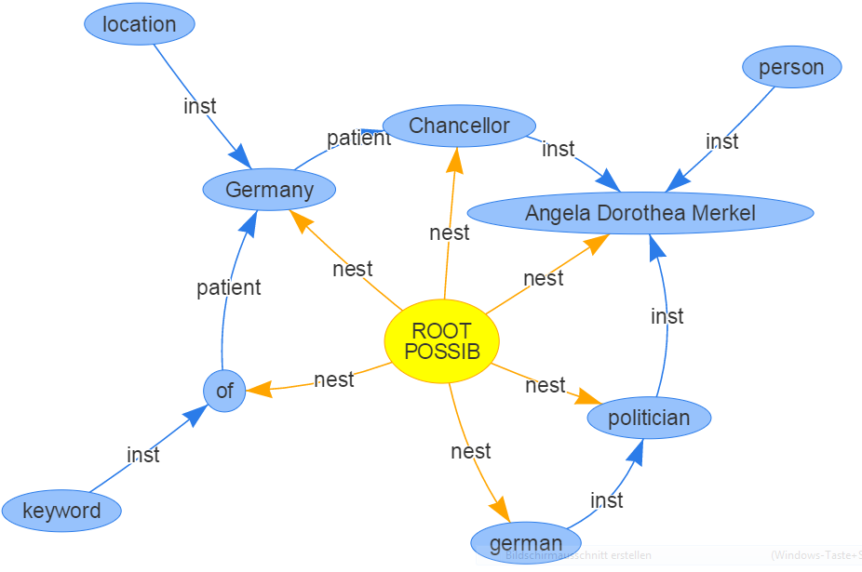
“Angela Dorothea Merkel is a German politician.
She is the Chancellor of Germany.”

Slide 5
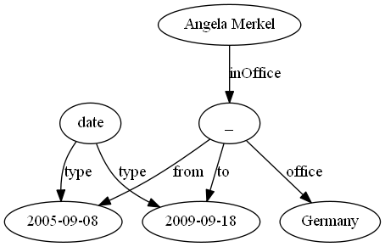
<http://dbpedia.org/resource/Angela_Merkel>
rdfs:label "Angela Merkel"@en ;
dbo:inOffice <http://dbpedia.org/resource/Angela_Merkel__1> ;
skos:altLabel "Angela Dorothea Merkel"@en .
<http://dbpedia.org/resource/Germany>
rdfs:label "Deutschland"@de , "Germany"@en .
<http://dbpedia.org/resource/Angela_Merkel__1>
dbo:from "2005-09-18"^^xsd:date ;
dbo:office <http://dbpedia.org/resource/Germany> ;
dbo:to "2009-09-27"^^xsd:date .

Slide 7
Angela Merkel | inOffice |  | office | Germany
Angela Dorothea Merkel |  | Chancellor |  | Germany
Match entities via String/Label distance
Follow undirected paths between matches
Semantically match entities and edges via word2vec

Slide 8
Status Quo
TODO
Corpus Creation (Wikipedia)
CoreNLP integration
Concept graph construction
Turtle-Parser for FactBench
word2vec integration
Graph matching
<http://dbpedia.org/resource/Angela_Merkel>
rdfs:label "Angela Merkel"@en ;
dbo:inOffice <http://dbpedia.org/resource/Angela_Merkel__1> ;
skos:altLabel "Angela Dorothea Merkel"@en .
<http://dbpedia.org/resource/Germany>
rdfs:label "Deutschland"@de , "Germany"@en .
<http://dbpedia.org/resource/Angela_Merkel__1>
dbo:from "2005-09-18"^^xsd:date ;
dbo:office <http://dbpedia.org/resource/Germany> ;
dbo:to "2009-09-27"^^xsd:date .
+ 0.8

