Slide 1
Autism Asperger’s Friendship Society
Website Usability Study
COMS 363
George Barnhardt, Geena Kim, Josephine Liang, and Kyle Derby MacInnis
Notes:
Hello members of the Autism Asperger’s Friendship Society board of directors. My name is [insert your name here] and these are my associates, [names of other members]. We are here today to present to you the usability study conducted for your website; aafscalgary.com. The purpose of our study was to examine the effectiveness of your website based on our evaluation criteria.

Slide 2
Agenda
AAFS Website Overview
Usability Testing
Criteria
Methods
Data
Survey Results and Usability
Recommendations
Notes:
Today we will be giving a brief overview of the AAFS Calgary website.
We will start with a brief overview of the AAFS website.
Following that we will examine the criteria we used as our metrics for our usability study, and the methods of data collection.
We will then go in depth into some of the key findings of the survey, followed by our proposed recommendations.
[Transition to AAFS Overview]
First, lets do a brief overview of the society’s website.

Slide 3
AAFS Website Overview
AAFS Organization Purpose
Promote and provide safe and fun programs for those affected by autism and Aspergers
Promote their mission of friendship
Website Purpose
Inform public about autism and Aspergers
Provide information about programs and resources available in Calgary
Notes:
The purpose of the AAFS website is to
Notify the public about Autism and Asperger’s, and
Promote the available programs, activities, and resources offered within the community.
This requires the website to
clearly and effectively provide such information to the public, and
accurately gauge the user’s experience.
[Transition to next slide]
In order to effectively measure the websites usability, we will use the following criteria.

Slide 4
Usability Testing: Criteria
Design
Identity
Accessibility
Navigation
Notes:
Our evaluation of the website was based on the following criteria; design, identity, accessibility, and navigation.
The design component concentrates on the aesthetic choices including; color choices and graphics.
For navigation we will look at the ease and effectiveness regarding moving about the website via the header navigation bar.
The accessibility regards communications technologies used on the website and the ease of access to website content.
The identity component addresses how the website identifies as the AAFS group and their goals as well briefly on contact information.
[Transition to Methods]
Before proceeding into the results we will outline our research methods as shown on the next slide.

Slide 5
Usability Testing: Methods
Primary Research: Usability Survey
Anonymous survey
20 questions
14 participants
Secondary Research:
Online resources and literature that back up our recommendations.
Notes:
In order to evaluate the current website we used both primary and secondary research.
To start, we will talk about the survey.
We decided to conduct an online survey because it allowed users to look at the website while completing it.
The survey had 14 participants and consisted of 20 questions.
We chose to conduct the survey on eSurv so that participants could keep their anonymity.
Based on the results, we then looked into secondary research in order to help us make recommendations for the areas needing improvement.
[Transition to Data]
Upon completion of our survey we found some interesting correlations.

Slide 6
Usability Testing: Data
Areas Requiring the most improvement:
Design
Navigation
Areas that had a mixed response:
Accessibility
Identity
Notes:
Based on survey results
The areas of our primary research which had the strongest correlation were in the areas:
Design
Navigation
The areas of our primary research which were weakly correlated or inconclusive were in:
Accessibility
Identity
[Transition to Design]
There was a general consensus that design and navigation were the areas that required the most improvement. Therefore we will first address these two criteria.

Slide 7
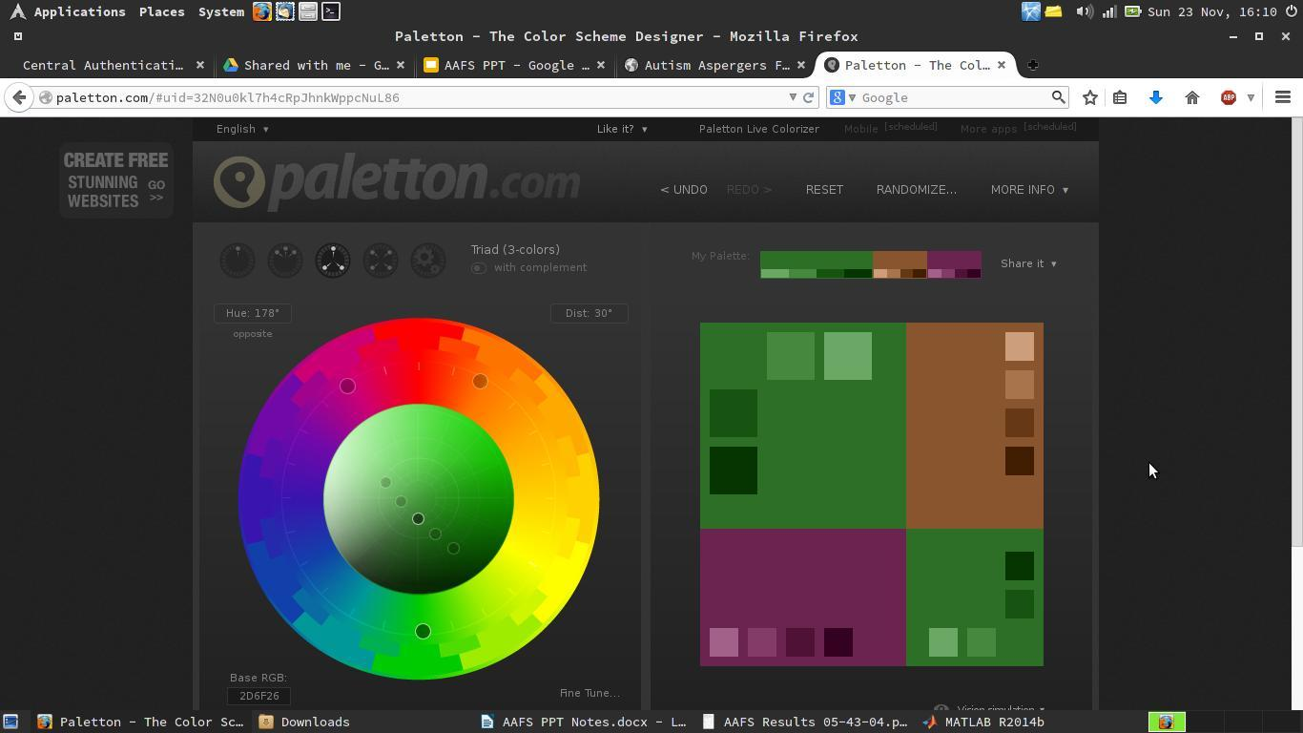
Design
Attractive website is crucial for promoting interest.
Participants identified aesthetics as needing improvement.
Colour Scheme received strong criticism
Special consideration for people with Autism and Aspergers
Notes:
The current design of the AAFS website was noted by participants as needing the most work.
As websites design is the first thing users’ note when visiting a website, an attractive webpage is crucial in leaving a strong first impression while maintaining user interest.
9 out of 14 (64.28%) participants agreed that the website was not visually appealing, and
7 (50.00%) of those participants thought the color scheme was the main cause.
The results show that the website is unappealing because the current color scheme of the AAFS Calgary website is bland.
According to the National Autistic Society (2014), many users find that black on white, for example, is too visually stimulating and makes text look as if it is moving on the screen, therefore, a lower contrast is often requested.
Although the current website is low in contrast, we feel that it could still be more aesthetically pleasing to maintain user interest.
As shown on the slide, we have compiled a possible colour scheme which maintains their current colours, but also promotes a stronger impression.
[Transition to Design Cont.]
Colour scheme is not the only important factor when considering the aesthetics, another area we identified as needing improvement was the header.

Slide 8
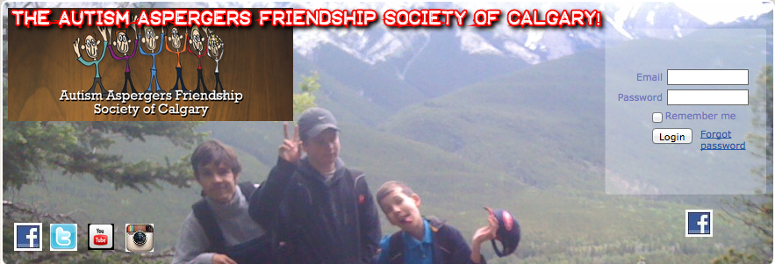
Design cont.
Maintain Graphic Consistency
Ensure Content Relevance
Photo courtesy of AAFSCalgary.com
Notes:
The website when loaded initially shows the header taking up almost a third of the page. This is a lot of exposure, and thus must be properly accounted for.
According to Webpage Mistakes (2013), maintaining consistent design improves the overall experience as well the professionalism of the website.
10 (71.42%) participants agreed that the graphics used on the website were not visually appealing.
8 (57.14%) participants believed those graphics did not enhance information provided on the AAFS Calgary website.
Redesigning the header and making it more consistent will improve the professionalism of the site, and will improve the user experience.
[Transition to Navigation]
We will now move onto the next area of our review, Navigation.

Slide 9
Navigation
Navigation Bar
Drop-down menus are user friendly,
Main tabs should be more general, with drop down specifics
Current Drop down menu is cluttered,
Contact information was difficult to locate.
Home Page
Available programs were easy to find.
Photo courtesy of AAFSCalgary.com
Notes:
Having a drop down menu is a concise way to organize navigation links without clogging up the website.
11 out of 14 (78.57%) participants agreed that the navigation tools were user friendly for locating information. This indicates that the existence of the navigation bar in itself is helpful.
However, 8 (57.14%) participants noted that the links under each drop-down were too cluttered.
According to The National Autistic Society (2014), “some people on the spectrum can get 'information overload' very easily.”
Miller (2014) suggests, it would be effective to reduce or limit the number of links on the navigation bar as it makes each remaining section more prominent.
Less is more because too many navigation buttons may leave users with too many choices.
By providing a well thought navigation bar consisting of
a few main categories users can quickly navigate to their intended destinations, whilst
ensuring that drop down menus remain uncluttered with as few links as necessary,
will also ensure effective navigation.
[Transition to Accessibility]
We will now focus our attention on to the remaining criteria of our study, Accessibility and Identity.

Slide 10
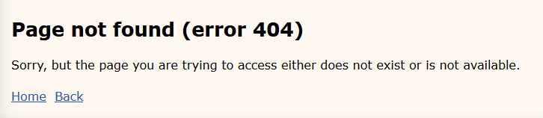
Accessibility
Readability
Majority of participants felt the font was adequate
Organization
Participants were in disagreement over effectiveness
Broken Links
404 error message found on the site
Photo courtesy of AAFSCalgary.com
Notes:
Font is an important aspect of website accessibility:
6 (42%) participants responded positively to the chosen font, while
5 (35%) felt the font was poorly chosen or difficult to read.
Maintaining an organized layout also promotes user accessibility.
The participants of the survey were in disagreement over the effectiveness of the website layout:
7 (50%) participants stated that the layout was well organized, however
7 (50%) participants also stated that the layout was poorly organized
Ensuring that the layout is similar on all pages would help to promote an accessible website by not requiring users to readjust themselves to a new layout.
Broken links can be detrimental to ensuring easily accessible information is available
10 (71.42%) participants found that contact information is easy to find however they agreed that the blog link in the ‘contact us’ drop-down should be removed or placed elsewhere as it takes away from the contact information.
It is misleading as some users could not find the contact info as they did not realize they had to click on ‘contact us’ versus hover over it.
Accessibility to the contact page is broken when users visit the frequently asked questions page.
The page tells users that if they cannot find the answer to their question, to please contact them, however that link leads to a 404 error message.
According to Stamoulis (2013), “broken links, whether internal or outbound, can hurt the usability of a website” and that 404 error pages lead to a poor user experience.
Other than these two points, everything else seems to be in order as the FAQ page is locatable and information regarding your programs and activities are concise, informative, and easy to find.

Slide 11
Identity
The participants easily recognized that the website was for the AAFS
The Society’s mission was distinguishable.
Contact information is vital information and it needs to be accessible via the main menu on every website.
Only 21% of our participants were able to locate the information of Dean Svoboda.
Notes:
A key feature of a website it to promote its identity and mission statement:
11 (77%) participants recognized the the website as the Autism Aspergers Friendship Society of Calgary.
7 (50%) participants felt the mission was difficult to read in the current format.
According to AGConsult (2009), contact information is vital information and it needs to be accessible via the main menu on every website.
It is important that the contact information of the executive director is easily identifiable and locatable. However,
only 3 (21.42%) of our participants were able to locate the information of Dean Svoboda.
Even we had difficulties to find his information when we first visited the AAFS website. With multiple clicks, we eventually found his contact information under the drop-down link ‘summer info’ under ‘info’ in the navigation bar.
The contact information of the executive director is something we believe should be included with the AAFS Calgary’s general contact information.

Slide 12
Conclusions?
AAFS’ website is necessary to promoting its purpose but it’s effectiveness is limited by parts of it’s design, navigation and accessibility.
Notes:
Based on our research and data collection, we have concluded that the content of the AAFS is concise and informative to users. However, areas of the current design, navigation, accessibility, and identity deter the users from experiencing optimal website usability. By following our recommendations, the AAFS website can be made a more efficient website for both the AAFS and the website users.
A more visually appealing website may be achieved by:
better use of graphics,
using a free online colour scheme generator,
fonts and colour schemes that work with their audience.
it is possible to improve navigability by:
Re-arranging the navigation bar to organize the site better,
reducing “information overloading” for those sensitive to it.
People using the website need better access to:
Contact information,
Event coordination.
Ways to create a better organization identity tie to the website:
Promote current membership better,
Allow access to figureheads and contacts easier to create a personal connection.
Thank you.

Slide 13
References
AAFS. (2014). AAFS Calgary. Retrieved November 20, 2014, from: http://www.aafscalgary.com/
AGConsult. (2009). Contact info: how, what and where?. Retrieved November 18, 2014, from http://webusability-blog.com/contact-info-how-what-and-where/
Miller, E. (2014). Five rules of effective website navigation. Retrieved October 21, 2014, from: http://graphicdesign.about.com/od/effectivewebsites/a/web_navigation.htm
National Autistic Society. (2014). Designing Websites Suitable for People with Autism Spectrum Disorders. Retrieved November 21, 2014, from: http://www.autism.org.uk/working-with/leisure-and-environments/designing-websites-suitable-for-people-with-autism-spectrum-disorders.aspx
Stamoulis, N. (2013). Fix broken links to maintain site usability for seo. Retrieved November 18, 2014, from: http://biznology.com/2013/08/fix-broken-links-to-maintain-site-usability-for-seo/
Web Page Mistakes. (2013). Retrieved November 18, 2014, from: http://www.webpagemistakes.ca
Notes:
References
AAFS. (2014). AAFS Calgary. Retrieved November 20, 2014, from: http://www.aafscalgary.com/
AGConsult. (2009). Contact info: how, what and where?. Retrieved November 18, 2014, from http://webusability-blog.com/contact-info-how-what-and-where/
Miller, E. (2014). Five rules of effective website navigation. Retrieved October 21, 2014, from: http://graphicdesign.about.com/od/effectivewebsites/a/web_navigation.htm
National Autistic Society. (2014). Designing Websites Suitable for People with Autism Spectrum Disorders. Retrieved November 21, 2014, from: http://www.autism.org.uk/working-with/leisure-and-environments/designing-websites-suitable-for-people-with-autism-spectrum-disorders.aspx
Stamoulis, N. (2013). Fix broken links to maintain site usability for seo. Retrieved November 18, 2014, from: http://biznology.com/2013/08/fix-broken-links-to-maintain-site-usability-for-seo/
Web Page Mistakes. (2013). Retrieved November 18, 2014, from: http://www.webpagemistakes.ca

